Slide 1
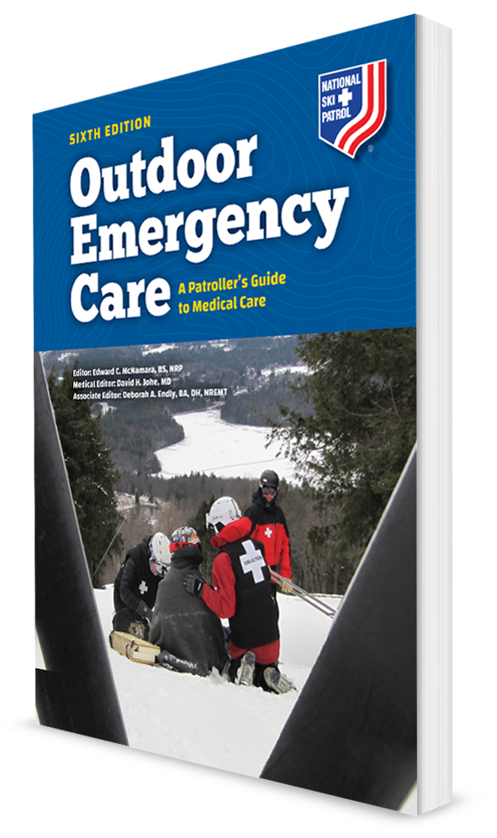
Musculoskeletal Injuries
CHAPTER 20

Slide 2
The following presentation will utilize two symbols to identify material necessary for an OEC Technician to comprehend:
key term
Meets a Chapter Objective.
This symbol will have the corresponding Objective Number denoted within.
Identifies a Key Term.
The Key Term will be underlined for easy identification.

Slide 3
Objectives: Section 1
20-1.1 Identify and define the functions of the following structures:
Bones
Cartilage
Joints
Muscles
Synovium
Tendons
Ligaments

Slide 4
Objectives: Section 1
20-1.2 Describe how musculoskeletal tissues heal.
20-1.3 Explain the difference between a sprain and strain.
20-1.4 Describe and demonstrate the general assessment of musculoskeletal injuries.
20-1.5 List the signs and symptoms of sprains, strains, ruptured tendons, dislocations, and fractures.

Slide 5
Objectives: Section 2
20-2.1 Describe and demonstrate how to assess injuries in the following parts of the body:
Shoulder and clavicle
Humerus
Elbow
Forearm
Wrist
Hand and finger
Pelvis
Hip
Femur
Knee
Tibia and fibula
Ankle
Foot and toe

Slide 6
Objectives: Section 3
20-3.1 Explain the general management of a patient with a musculoskeletal injury.
20-3.2 List and demonstrate the use of the following types of splints:
Sling and swath
Quick splint
Soft splint
Rigid splint (e.g., airplane, quick, wooden, SAM)
Traction splint (the one you use at your resort/area; e.g., Kendrick, Hare, Slishman, Sager)

Slide 7
Objectives: Section 3
20-3.3 Explain the difference between traction and tension.
20-3.4 Discuss the general principles of splinting.
20-3.5 Demonstrate how to care for an injured extremity when there is neurovascular compromise.
20-3.6 Demonstrate how to care for the following injuries:
Shoulder, clavicle, and scapula
Humerus fracture
Elbow
Forearm
Wrist
Hand and finger
Pelvis
Hip
Femur
Knee
Tibia and fibula
Ankle
Foot and toe

Slide 8
Objectives: Section 3
20-3.7 Define and demonstrate the proper care for an open (compound) fracture.
20-3.8 Demonstrate how to remove a ski boot, hiking boot, or snowboard boot when patient has an injury to that leg.

Slide 9
Key Terms
Acromioclavicular (A/C) joint
Angulation
Articular cartilage
Articulation
Bone crepitus
Cartilage
Cortex
Dislocation
Dorsal
Dorsiflex
False movement
Fracture
Guarding
Immobilization
Joints
Joint capsule
Ligaments

Slide 10
Key Terms
Meniscus
Popliteal fossa
Musculoskeletal system
Periosteum
Plantarflex
Skeletal muscle
Sling and swathe
Splint
Sprain
Strain
Subluxation
Synovium
Tendons
Traction
Traction splint
Zone of injury

Slide 11
Chapter Summary

Slide 12
Chapter Overview
The body’s musculoskeletal system allows the body to stand and walk upright and perform tasks.
Primary components are the muscles and the bony skeleton.
Also includes:
Joints
Cartilage on the ends of bones at joints
Synovial fluid that lubricates the joints
Ligaments
Tendons
The interface between the nervous system and the muscles

Slide 13
Chapter Overview
This chapter:
Provides a review of the anatomy and physiology of the various components of the musculoskeletal system including:
The major bones, muscles, and joints
How ligaments, tendons, and joints work
The physiology of movement
How the musculoskeletal system repairs itself
The assessment and management of common musculoskeletal injuries, including strains, sprains, dislocations, ruptures of tendons, and fractures are discussed.

Slide 14
Anatomy and Physiology

Slide 15
Anatomy and Physiology: The Skeleton
20.1-1
The various components of the skeleton are crucial to the makeup and function of the musculoskeletal system.
The skeleton functions as a rigid framework to:
Protect the internal organs
Provide the body form we recognize as human
Produce blood cells
The skeleton consists of bones, connective tissue, and cartilage.

Slide 16
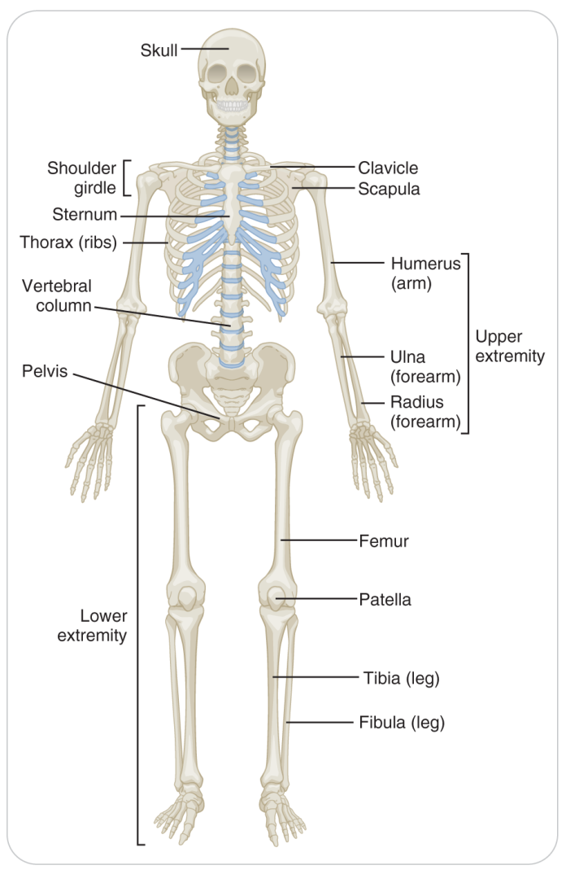
Anatomy and Physiology: The Skeleton
20.1-1
The skeleton has seven areas:
Head, skull, facial bones
Spine
Shoulder
Upper extremities (arms)
Rib cage (thorax)
Pelvis
Lower extremities (legs)

Slide 17
Anatomy and Physiology: Bones
20.1-1
Articular cartilage:
Covers bone ends
Provides a nearly friction-free surface
Allowing bone ends to move smoothly against one another
Children’s bones grow longer near the ends, along the growth plate.
Fractures in the growth plate can damage the cells needed for bone growth, creating abnormal bone growth and deformity.

Slide 18
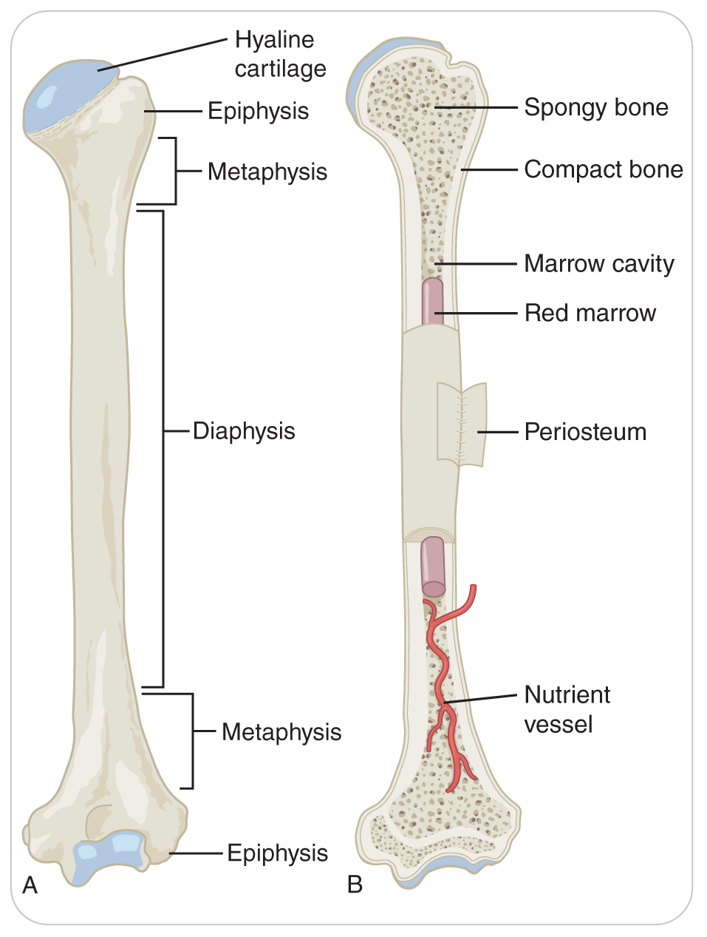
Anatomy and Physiology: Bones
20.1-1
The dense vascular layer on the outside of a bone is the periosteum.
Beneath the periosteum is the hard cortex.
Within is the bone marrow, a less-dense region where blood cells are made.
Bones are highly vascular and receive 10% to 20% of the blood pumped by the heart.
If the cortex of a bone breaks, can bleed severely

Slide 19
Anatomy and Physiology: Joints
20.1-1
Joints
The site at which two or more bones make contact is known as a joint.
Enables all body movements, including bending and straightening
Joint Capsule
Connective tissue that surrounds, stabilizes, and supports the joint
The synovium is the lining of the joint.
Creates a slippery lubricant, known as synovial fluid
Allows the bones to move freely within the joint capsule

Slide 20
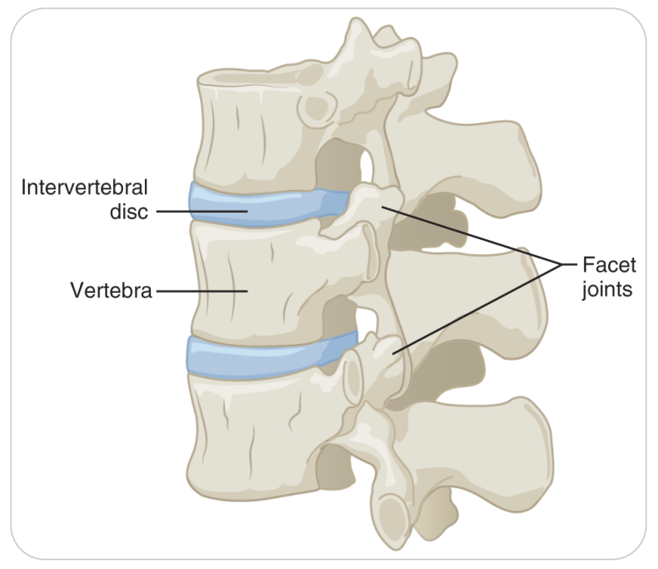
Anatomy and Physiology: Joints
20.1-1
Joints provide different degrees of movement.
Freely movable: Many joints, such as the knee, hip, elbow, and shoulder joints
Slightly movable: A few joints, such as those between vertebrae
Minimal movement: Other joints, such as the acromioclavicular joint of the shoulder, because thickened fibrous ligaments firmly stabilize the bone ends

Slide 21
Anatomy and Physiology: Ligaments
20.1-1
Ligaments
Thick bands of tissue that connect two bones together
Composed of strong connective tissue
Resist stretching, restricting joint movement to the range of normal motion.
Provide structure and stabilize the skeleton.

Slide 22
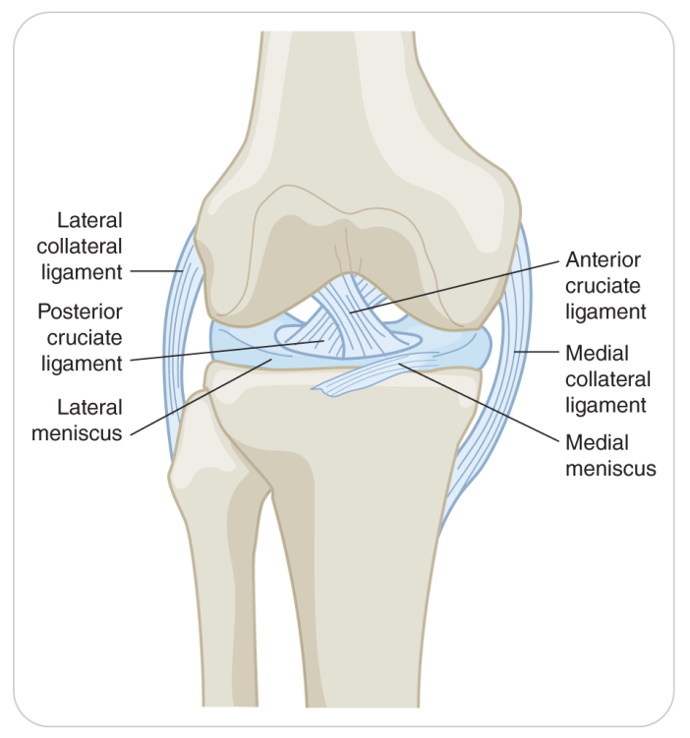
Anatomy and Physiology: Ligaments
20.1-1
The anterior and posterior cruciate ligaments are inside the knee, providing anterior/posterior stability.
This forms a stable hinge joint, allowing motion only in the anterior/posterior plane.
Conversely, the shoulder joint, with only a few restrictive ligaments, can move in almost any direction.

Slide 23
Anatomy and Physiology: Ligaments
20.1-1
The amount and type of motion differ from joint to joint, with all joints restricting motion to some degree.
Joint movement is determined by:
The degree of tightness or laxity of the ligaments and capsule that hold the bone ends together
The orientation of the bone ends to each other
When a joint is pushed beyond this limit, damage occurs and pain.
Can overstretch or tear, or the capsule can tear open

Slide 24
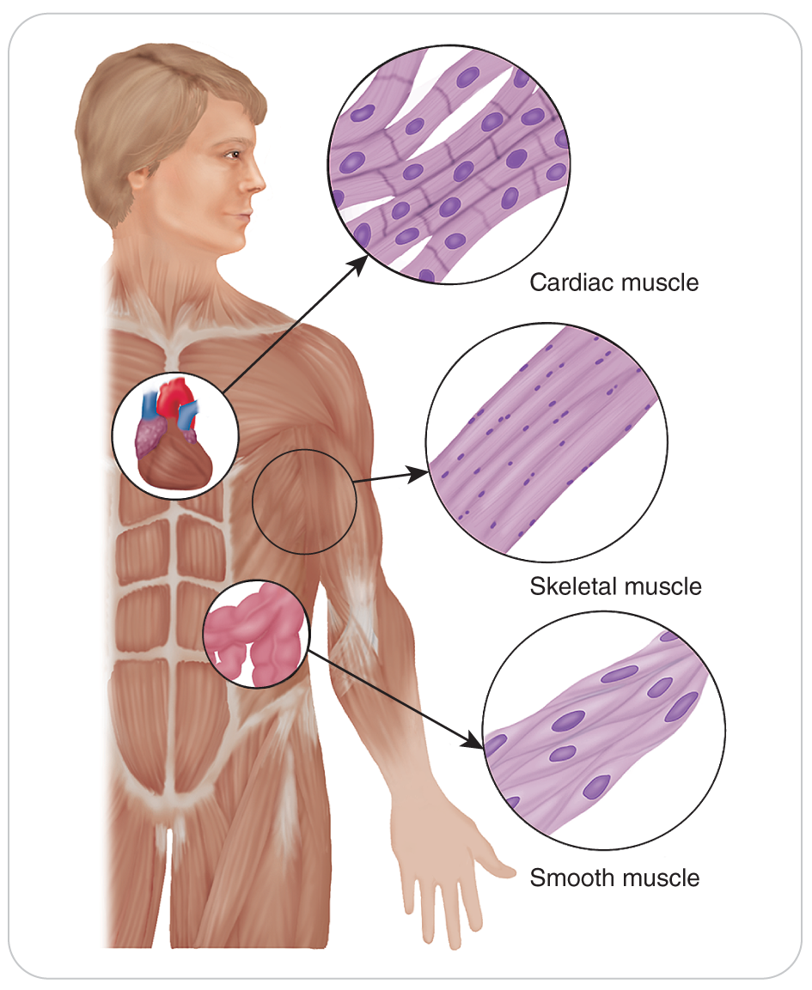
Anatomy and Physiology: Muscle
20.1-1
Muscle
Three types of muscle, each of which has a unique function.
Classified as skeletal, smooth, and cardiac.
The musculoskeletal system has ONLY skeletal muscle.
Skeletal muscle makes up the major visible muscle mass in the body and is named for its close association with the skeleton.

Slide 25
Anatomy and Physiology: Muscle
20.1-1
Muscle is a unique type of tissue that, when stimulated, can contract.
After a muscle has contracted, it passively returns to its original length during the relaxation phase.
The combination of contraction and relaxation enables the body to move the extremities, walk, and perform normal daily activities.
Muscles respond to chemical and electrical signals that travel from the brain through the spinal cord to peripheral nerves, causing the movement of a specific body part.

Slide 26
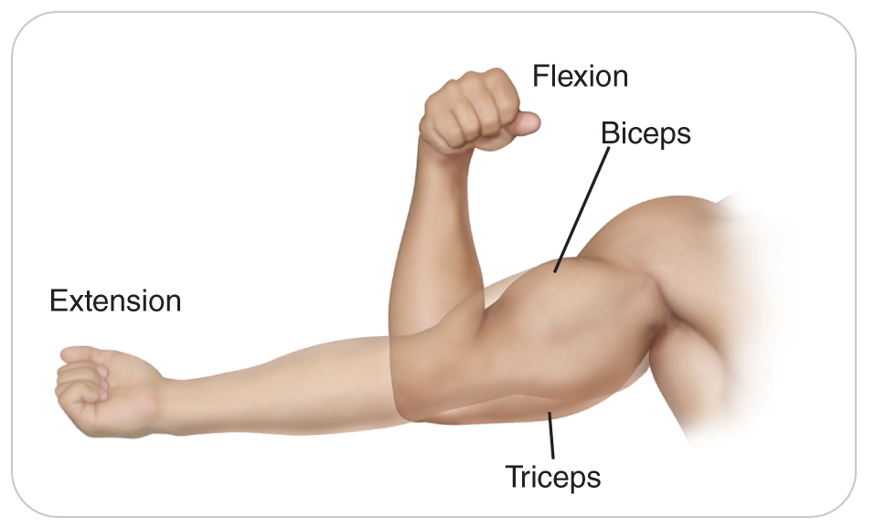
Anatomy and Physiology: Muscle
20.1-1
Most of the more than 600 muscles in the skeletal muscular system are divided into complementary pairings.
In the upper arm, the biceps and triceps are paired muscles.
Contraction of the biceps muscles enables us to bend (flex) the elbow.
Contraction of the triceps muscles enables us to straighten (extend) the elbow.
These complementary pairings are essential for effective movement and for the manipulation of objects.

Slide 27
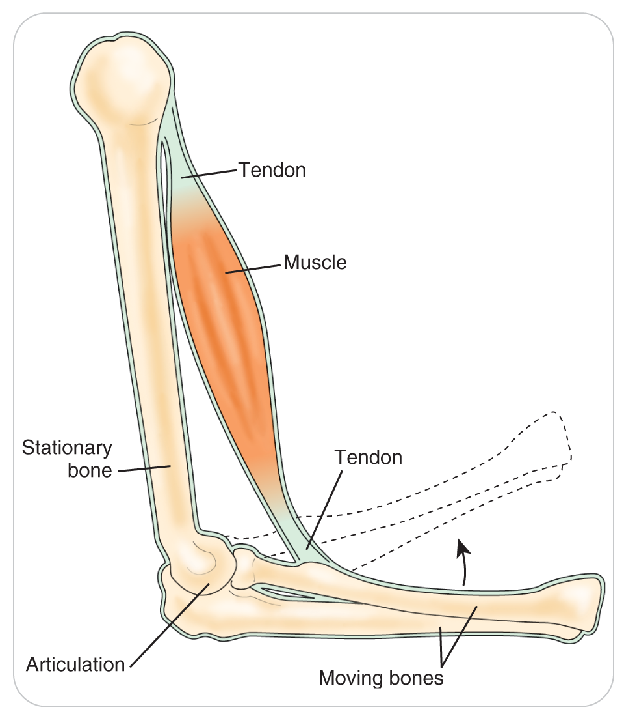
Anatomy and Physiology: Tendon
20.1-1
Tendons
Strap-like continuations of a muscle that connect a muscle to a bone across a joint
This tissue is very strong and transmits the force of a contracting muscle to the bone.
Like ligaments, tendons can be damaged through overstretching and tearing.
When a tendon is damaged, the effectiveness of a muscle is significantly reduced or can become nonfunctional.

Slide 28
The Healing Process
20.1-2
Bones and other musculoskeletal tissues can make new tissue.
Ability to heal depends on many factors, including the extent of damage and the person’s age, nutritional status, and overall health.
Sometimes tissue can heal almost completely, leaving no trace of the injury.
Some damaged tissue does not heal normally, leaving scar tissue.

Slide 29
The Healing Process: Fracture
20.1-2
Although bone tissue is strong, it can break.
The site of a break in bone is called a fracture.
Causes the bone to bleed, and a hematoma forms around the fracture site
This hematoma, or collection of blood, organizes into a substance called callus.
Calcium is deposited into the site, forming new bone.

Slide 30
The Healing Process: Fracture
20.1-2
Nutrients, including proteins, calcium, and vitamins, along with energy from glucose and oxygen, are essential elements for proper bone healing.
Oxygen is provided from arteries close to the fracture site.
Immobilization is the process of holding an object in place.
Important to promoting optimal bone healing
By implanted surgical hardware, a cast, or other restrictive device
Type depends on the location and severity of the fracture.

Slide 31
The Healing Process
20.1-2
Muscle also can heal, but it heals more slowly than bone.
Fibrous scar tissue makes up some of the new tissue.
Ligaments also heal slowly and with some scar tissue.
Like bones, the healing process for muscles and ligaments involves the formation of a hematoma that is later replaced by new fibrous tissue.
The difference: calcium is NOT deposited
This healing process can take 6 weeks or longer.

Slide 32
The Healing Process
20.1-2
Tendons need to be protected for several months then be increasingly stressed so they can take the stress on them when a muscle pulls hard.
Cartilage does not heal very well.
The blood supply to this tissue is poor.

Slide 33
Common Musculoskeletal Injuries

Slide 34
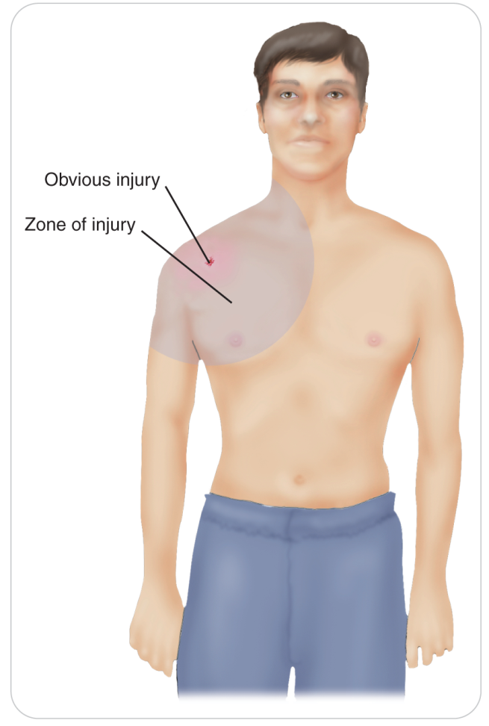
Common Musculoskeletal Injuries
20.1-3
The area of damage to the surrounding soft tissues, nerves, and blood vessels around a bone or joint injury is known as the zone of injury.
This zone can be large or small depending on the amount of force (kinetic energy) that caused the trauma.

Slide 35
Common Musculoskeletal Injuries: Sprain
20.1-3
A sprain is an injury involving the stretching or tearing of a ligament.
Occurs when a joint is forced beyond its normal range of motion
Sprains affect the ligaments on one side of a joint.
May occur with other musculoskeletal injuries
Most often involve the knee, shoulder, wrist, or ankle
Mild ligament sprains heal relatively quickly.
Usually in several weeks
Most completely torn ligaments need surgical repair.

Slide 36
Common Musculoskeletal Injuries: Strain
20.1-3
A strain is a stretched or torn muscle.
A “pulled muscle”
Often caused by overexertion and poor body mechanics
Strains affect muscle tissue only.
Do not result in bone, ligament, or joint damage
Commonly strained muscles include the hamstring muscles, the biceps, and the muscles of the back.
Mild = requiring only a few days to heal
Severe = requiring surgical repair and months of healing

Slide 37
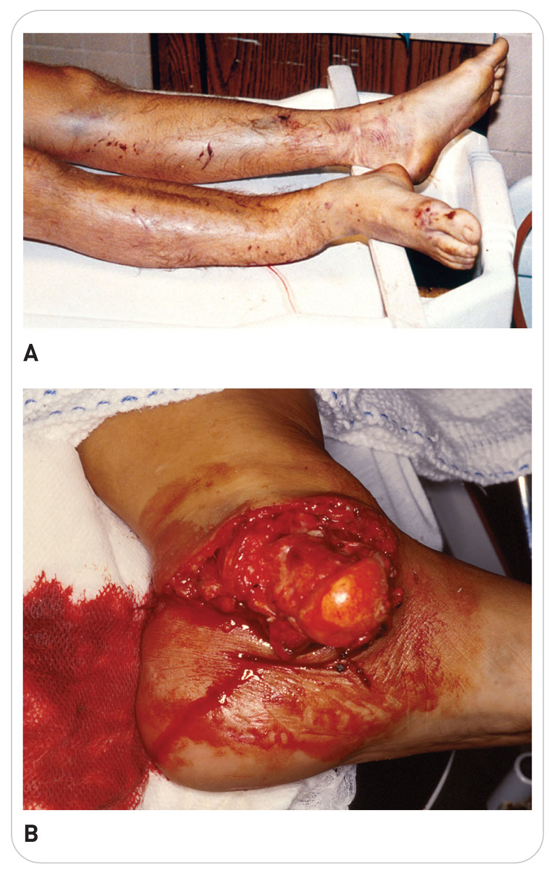
Common Musculoskeletal Injures: Fractures
20.1-5
Types of Fractures:
Closed
The overlying skin surface has not been disrupted.
Open
The overlying skin has been opened.
Also referred to as a Compound Fracture
Occurs when either:
External forces penetrate the skin and fractures the underlying bone
The sharp ends of the broken bone come through the surface of the skin
True emergency due to risk of infections

Slide 38
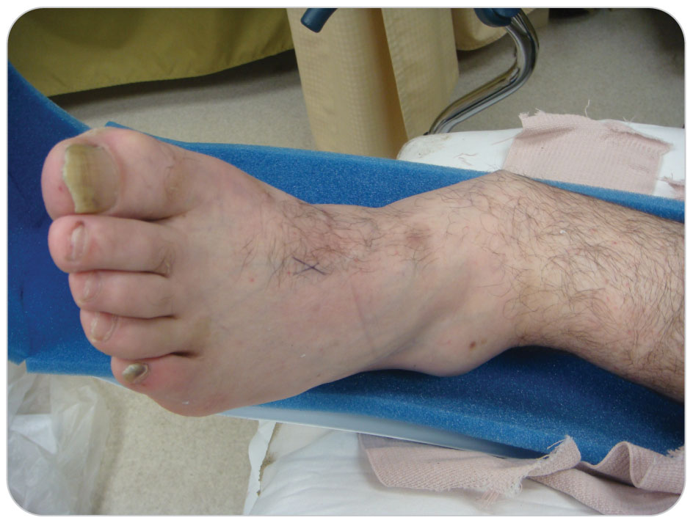
Common Musculoskeletal Injuries: Fractures
20.1-5
Classification of fractures based on whether broken bone remains in normal anatomic alignment
Nondisplaced: ends of fractured bone remain in alignment
Displaced: causes the affected extremity to appear bent, crooked, shortened, or rotated

Slide 39
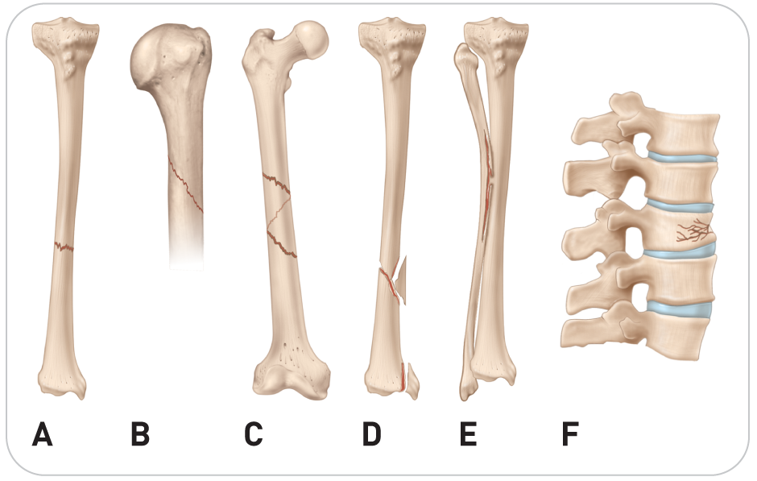
Common Musculoskeletal Injuries: Fractures
20.1-5
Fractures are named based on MOI or shape of fracture line.
Transverse
Oblique
Comminuted
Greenstick
Compression

Slide 40
Common Musculoskeletal Injuries: Dislocations
20.1-5
A dislocation is a separation or displacement of the bones of a joint.
Joint capsule and surrounding ligaments can stretch or tear.
Soft tissues, blood vessels, and nerves surrounding the joint are damaged.
Subluxation
A joint can partially dislocate and then return to normal anatomic position.
The most common joints to dislocate are shoulders, elbows, hips, knees, and ankles.

Slide 41
General Assessment of Musculoskeletal Injuries

Slide 42
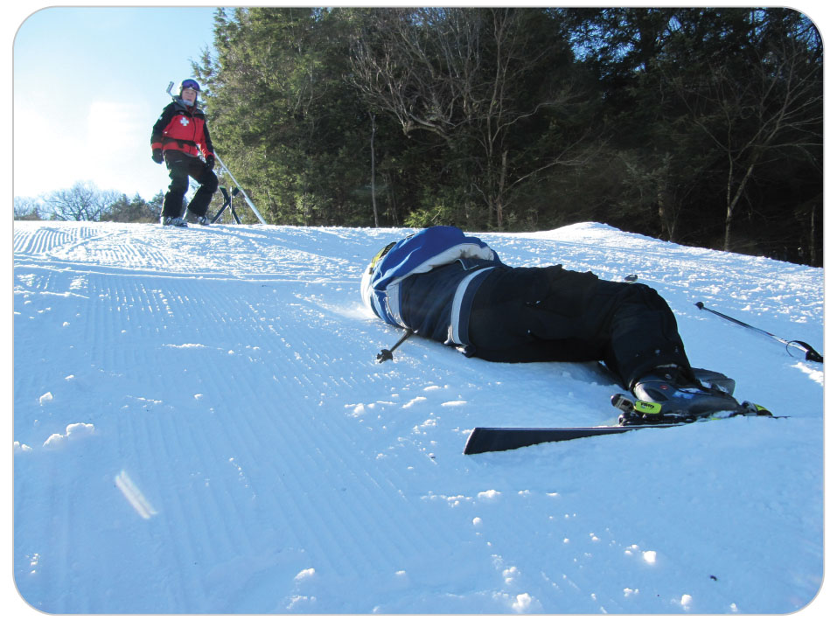
General Assessment: Scene Size-Up
20.1-4
Scene size-up:
First identify potential safety hazards.
Make sure patient and you are visible to others coming into the area.

Slide 43
General Assessment: Primary Assessment
20.1-4
Go through all the steps in the primary patient assessment process before focusing on the musculoskeletal injury.
External bleeding?
Difficult with bulky clothing or multiple layers
Control any excessive bleeding.
Assess responsiveness using the AVPU scale.
Unresponsive?
Immediately open the airway.
Simultaneously check for breathing and a pulse.
If there is no pulse, start CPR.

Slide 44
General Assessment: Primary Assessment
20.1-4
Neurologic injury?
After other rescuers arrive, manually stabilize the head and spine.
Be sure to assess the MOI.
May provide helpful clues to better understand possible injuries
High priority patients requiring immediate care and rapid transport:
Any patient who has a potential threat to life
Unstable
Unresponsive
Has suspected multiple fracture

Slide 45
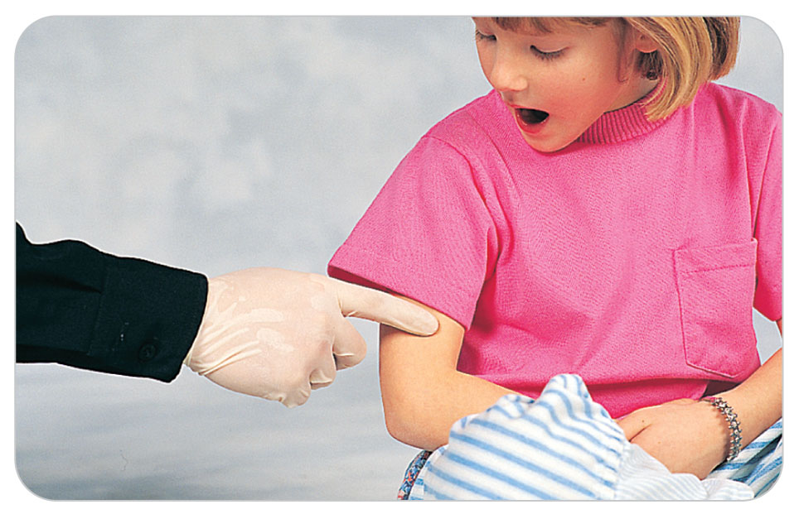
General Assessment: Secondary Assessment
20.1-4
Determine patient’s chief complaint.
Obtain a SAMPLE history.
Pain:
The most common symptom of a musculoskeletal injury
Ask the person to point with one finger to where it hurts.
Draw a circle around the site with a finger if large.
Assess the nature and quality of patient’s pain on a scale of 0 to 10.

Slide 46
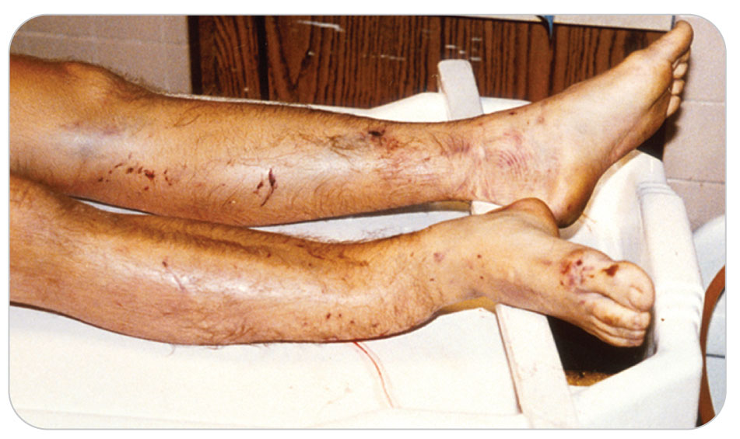
General Assessment: Deformity
20.1-4
Deformity is a common finding that generally indicates musculoskeletal injury.
Mild deformity:
Generally caused by swelling or internal bleeding
Can be caused by a fracture
Gross deformity:
Usually results from a fracture or a dislocation

Slide 47
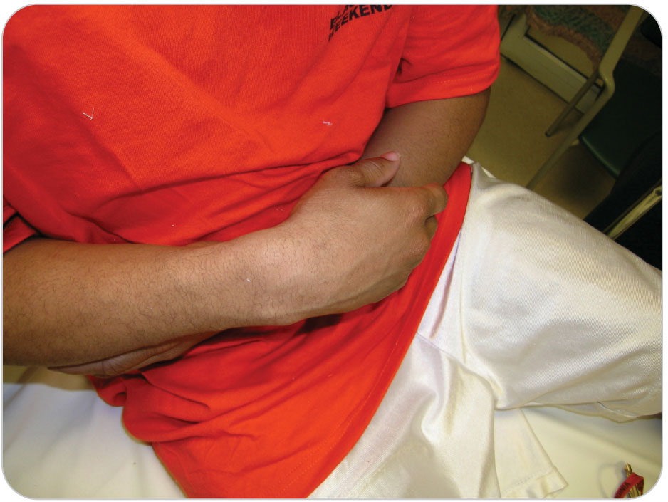
General Assessment: Guarding
20.1-4
Patients who suffer a musculoskeletal injury often try to protect the site from further injury.
A person with a sprained wrist or a broken radius bone will typically hold the forearm close to the body and be reluctant to move it.
This sign is known as guarding.

Slide 48
General Assessment: Physical Exam
20.1-4
Perform a physical exam using DCAP-BTLS.
Make sure you perform a full-body assessment.
Look for head, chest, and abdominopelvic injuries as well as extremity injuries.
Avoid focusing only on the obvious musculoskeletal injury.
May cause you to overlook a serious head or internal abdominal injury

Slide 49
General Assessment: Zone of Injury
20.1-4
Locate the zone of injury.
If major bleeding, control immediately.
Then, examine the REMAINDER of the extremity.
Do not palpate the zone of injury first.
Then patient is likely to pull away due to pain.
Especially true in young children

Slide 50
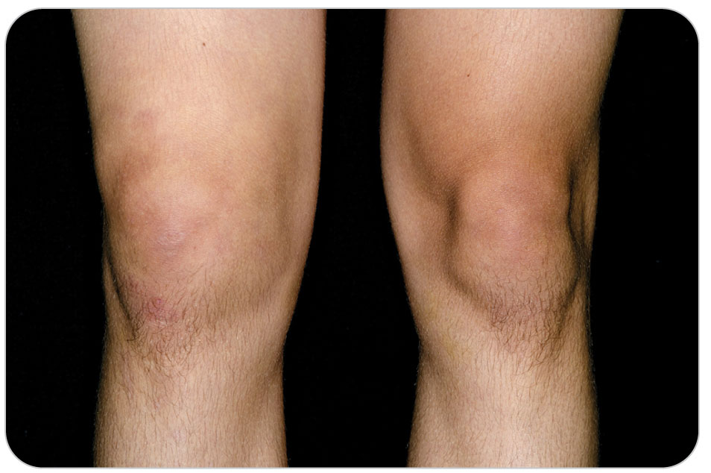
General Assessment: Exposure
20.1-4
Expose the injury site.
Look for bleeding or open skin.
Preserve patient’s modesty whenever possible.
In cold, rainy, or windy weather, cover all exposed skin immediately after examination.
It is not always wise to expose the zone of injury by cutting jacket or ski pants on scene.
In sunny weather, cover suspected musculoskeletal injuries.

Slide 51
General Assessment: Exposure
20.1-4
When unable to expose on scene, briefly look or feel with a gloved hand under patient’s clothing, assessing for pain, deformity, or blood.
Make sure external bleeding is controlled.
If transport time is minimal and there is no bleeding:
It may be better to stabilize the extremity without exposing.
Then move patient to a more controlled environment to expose.

Slide 52
General Assessment: CMS
20.1-4
Always assess the distal neurovascular status of a suspected musculoskeletal injury.
Commonly referred to as CMS.
A pulse (circulation)
Patient can move the fingers or toes (movement)
Patient can feel your touch distal to the injury site (sensation)
If the injury involves the spine, assess distal CMS in all limbs.
These findings should be documented.

Slide 53
General Assessment:
20.1-4
During the assessment, begin formulating a plan concerning:
What you will do to manage the injured body part(s)
Which mode of transport to use
Any special considerations
Equipment needs?
Splints
Transportation mode?
Toboggan, litter, ambulance, or other
Notify dispatch as soon as possible.
ALS?
Remember ALS can be very beneficial for pain control.
Reassess patient frequently, including the vital signs and distal CMS.
Document any changes.

Slide 54
Signs and Symptoms of Common Musculoskeletal Injuries

Slide 55
Signs and Symptoms: Sprains
20.1-5
Sprains:
Point tenderness over the injured ligament(s)
Swelling and bruising within the zone of injury
Joint instability
Characterized by abnormal motion of the affected joint
May be masked by major joint swelling, severe tenderness, and/or guarding
Decreased motion due to pain, swelling, and/or ligament instability
Difficulty bearing weight on the injured joint (in the lower extremities)

Slide 56
Signs and Symptoms: Strains
20.1-5
Strains:
Point tenderness over a muscle or a portion of a muscle
Pain when using the injured muscle to flex or extend an extremity
Bruising over a muscle
Swelling or hematoma over a muscle

Slide 57
Signs and Symptoms: Tendon Injuries
20.1-5
Tendon injuries:
A noticeable “gap” under the skin where the tendon has ruptured
This is a hallmark sign for this type of injury.
After initial severe pain, minimal pain due to minimal nerve involvement.
Little bruising or swelling (tendons contain few blood vessels)
Lack of joint movement
The tendon no longer connects the muscle to the bone.

Slide 58
Signs and Symptoms: Fractures
20.1-5
Fractures:
Pain at the fracture site that worsens upon movement of the affected bone
Tenderness to palpation
Swelling due to internal bleeding from the fracture site
Ecchymosis (bruising)
Decreased motion due to pain
Lack of bone continuity
Deformity due to bone misalignment
Tenting on the skin
Bone crepitus
A noise or palpable feeling of crackling when fractured bone ends rub together

Slide 59
Signs and Symptoms: Dislocations
20.1-5
Dislocations:
Pain
Swelling
Deformity
Reduced joint motion
Joint “locking” or “freezing”
A complete inability to move the joint
Numbness or tingling distal to injury

Slide 60
Section 2: Assessment of Specific Musculoskeletal Injuries

Slide 61
Upper Extremity Injuries

Slide 62
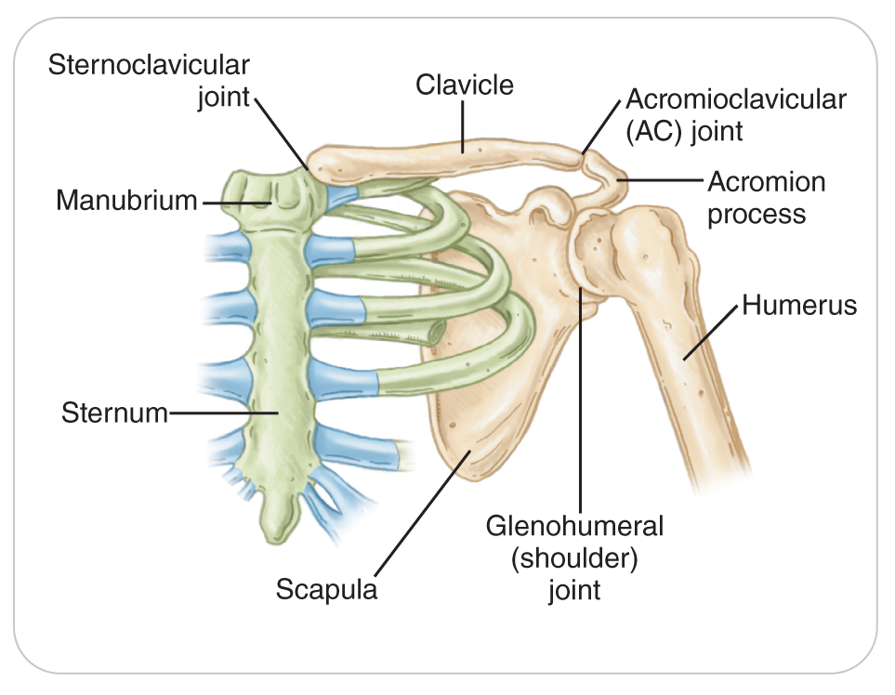
Clavicle and Shoulder Injuries
20.2-1
The clavicle, or collarbone, is located on the upper portion of the anterior chest wall.
The only bone of the arm to articulate (form a joint) with the chest wall
Has a joint on either end
The sternoclavicular joint attaches the clavicle to the sternum.
The acromioclavicular (A/C) joint attaches the clavicle to the acromion of the scapula.

Slide 63
Clavicle and Shoulder Injuries: Clavicle Fracture
20.2-1
The clavicle is the most frequently fractured bone in the body.
Commonly fractures in the middle or distal portions of the bone
This injury can be quite painful, and any movement of the arm hurts.
Young children may say that the entire arm hurts.
Patients will typically self-splint the arm to the chest wall as previously described.

Slide 64
Clavicle and Shoulder Injuries: Clavicle Fracture
20.2-1
The skin may “tent” over the fracture site due to a fractured end protruding up, resulting in deformity.
Hallmarks of a clavicle fracture:
Swelling
Tenting of the skin
Bruising
Point tenderness

Slide 65
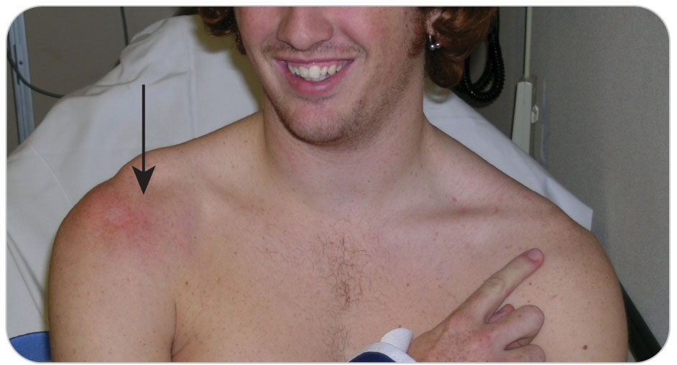
Clavicle and Shoulder Injuries: A/C Separation
20.2-1
The distal end of the clavicle articulates with the acromion process of the scapula.
Forms the acromioclavicular (A/C) joint
Frequently sprained or dislocated when a person falls on the “point” of the shoulder
This injury is referred to as an A/C separation, or sometimes a shoulder separation.
Some may confuse this injury with a fracture of the distal clavicle.

Slide 66
Clavicle and Shoulder Injuries: A/C Separation
20.2-1
Presentation:
Point tenderness is present over the A/C joint and just medial and inferior to the joint.
A mild deformity to the distal end of the clavicle may be present.
Rarely, the distal end of the clavicle will stick significantly upward.
An A/C separation is different from a true shoulder dislocation.
A skier who falls forward or a biker who goes over the handlebars may incur this injury by landing on the shoulder.

Slide 67
Clavicle and Shoulder Injuries: Shoulder Dislocation
20.2-1
The shoulder can easily dislocate, especially if forces are applied from certain directions.
The shoulder is a ball-and-socket joint
Called a glenohumeral joint
A very loose capsule
The ligaments that hold the shoulder in position are not very strong.
Over 95% of shoulder dislocations are anterior, where the humeral ball comes out in the front.
The mechanism of injury may help identify the direction in which the humeral head is dislocated.

Slide 68
Clavicle and Shoulder Injuries: Shoulder Dislocation
20.2-1
Anterior Shoulder Dislocation
Mechanism:
Forceful abduction and external rotation of the arm at the shoulder
Falling backwards on an outstretched arm that is away from the body.
The arm usually “locks” in this position.
Packaging of patient can be somewhat difficult.

Slide 69
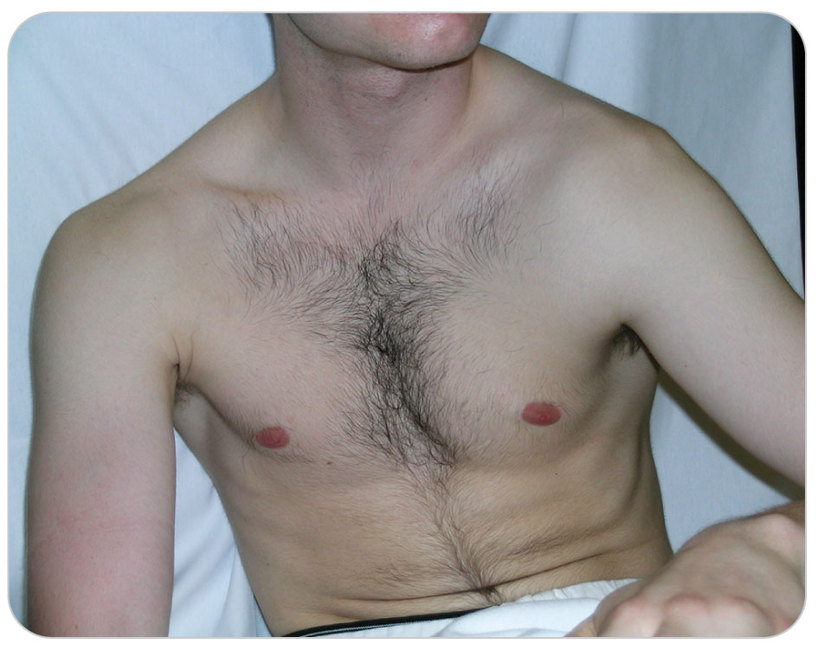
Clavicle and Shoulder Injuries: Shoulder Dislocation
20.2-1
Patient guard aggressively
Usually by sitting, holding the shoulder up and out with the other hand
Alternatively, holding their arm against their abdomen
Exam:
A skin “dent” under the acromion
The humeral head has dislocated down and anteriorly.
Any dislocated shoulder is very painful.
Occasionally, patient will complain of some numbness of the outside of the shoulder.

Slide 70
Clavicle and Shoulder Injuries: Shoulder Dislocation
20.2-1
Posterior Shoulder Dislocations
Rare
This is most commonly seen in vehicle collisions in which a person reaches out and puts a hand on the car’s dashboard just before impact, causing the humeral head to be forced directly posterior.
Also seen in patients who have had a seizure or an electric shock
The same mechanism of injury is seen when someone falling forward “breaks the fall” using an arm in which the elbow is locked, which pushes the humeral head out posteriorly.

Slide 71
Clavicle and Shoulder Injuries: Scapula Fracture
20.2-1
A fracture of the scapula on the posterior chest wall
Rare and usually indicates a severe mechanism of injury
Injuries to the chest wall (rib), internal chest, and spine are common when the scapula is fractured due to large forces.
The socket part of the shoulder that is part of the scapula
Known as a glenoid process
Can be fractured when significant force is applied to the outside of the shoulder, pushing the humeral head in and fracturing the underlying glenoid
Patients hold the arm very still and resist any movement of the limb.

Slide 72
Humerus Fracture
20.2-1
Humeral Head and Neck Fractures
At the top of the humerus, the ball can be broken.
The “neck” just below the ball is more frequently fractured.
Especially in children and older adults
Can break into several pieces
Patient complains of pain directly over the fracture site.
Deformity is uncommon.
The large muscles over the proximal humerus hide the fracture.

Slide 73
Clavicle and Shoulder Injuries: Humerus Fracture
20.2-1
Humeral Shaft Fractures
Common
Signs such as point tenderness, swelling, and angulation (deviation from straight) between the shoulder and the elbow suggest the presence of a midshaft humerus fracture.
Can be very unstable
Often result in movement of the bone at the fracture site
Humerus fractures can be significantly angulated.
The radial nerve spirals around the middle of the back of the humerus.
Bone fragments can damage this nerve, resulting in a wrist drop (inability to raise the back of the hand up).

Slide 74
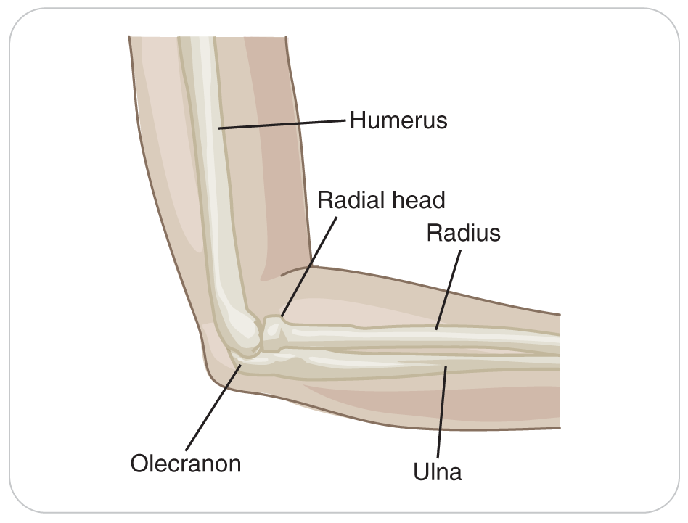
Elbow Injuries
20.2-1
The elbow joint is composed of the ends of three bones:
The radius
The ulna
The humerus
Signs and Symptoms:
Very painful
Can present with gross deformity at the elbow
Can have significant neurologic and/or vascular complications

Slide 75
Elbow Injuries
20.2-1
All elbow injuries should be examined by an advanced health care provider.
Many elbow injuries can result in permanent damage if not managed in a timely manner.
Especially involving young children
The soft tissue around the elbow contains:
Veins
Large nerves
The brachial artery
All can be injured.

Slide 76
Elbow Injuries: Distal Humerus Fracture
20.2-1
Distal Humerus Fracture
Fracture just above the elbow
Common because the bone is not very thick here
Called a supracondylar fracture of the elbow
Can have disastrous early and late complications in children, including nerve damage, arterial interruption, crooked healing, or muscle damage in the forearm from loss of blood supply
Signs and symptoms include:
Gross deformity
Severe pain
Swelling
Possible CMS deficits

Slide 77
Elbow Injuries: Olecranon Process Fracture
20.2-1
Olecranon Process Fracture
Signs include:
Swelling over the tip of the elbow
Possibly a gap between the fractured bone ends
Patient will not be able to extend the arm at the elbow.

Slide 78
Elbow Injuries: Radial Head Fracture
20.2-1
Radial Head Fracture
Occurs when the radius is forced up into the distal end of the humerus
Most common cause is falling on an outstretched hand
Pain on the lateral side of the elbow
Movement, especially turning the palm down or up (pronation/supination), is very painful.

Slide 79
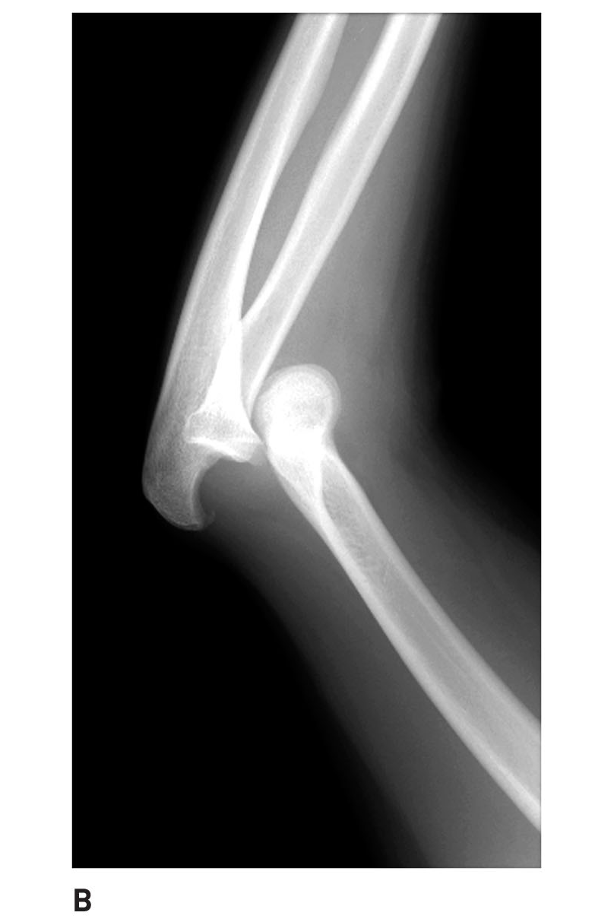
Elbow Injuries: Elbow Dislocation
20.2-1
Elbow Dislocation
May occur if a patient falls on an outstretched hand with the elbow in partial flexion
The joint becomes locked, usually at about 40 to 50 degrees of flexion.
Pain is severe and is aggravated by movement.
Swelling develops rapidly, and CMS function can be compromised.

Slide 80
Elbow Injuries: Nursemaid’s Elbow
20.2-1
Nursemaid’s Elbow
An injury seen in toddlers younger than 5 or 6 years old
Results when an adult, who is holding the child’s hand, jerks the child’s hand, dislocating the head of the radius in the elbow joint
Can also be caused by “swinging” a young child by the hands
Symptoms include self-splinting (holding the arm against the body), slight flexion of the arm, and pain.
Often, the child will cry if you touch or move the arm.

Slide 81
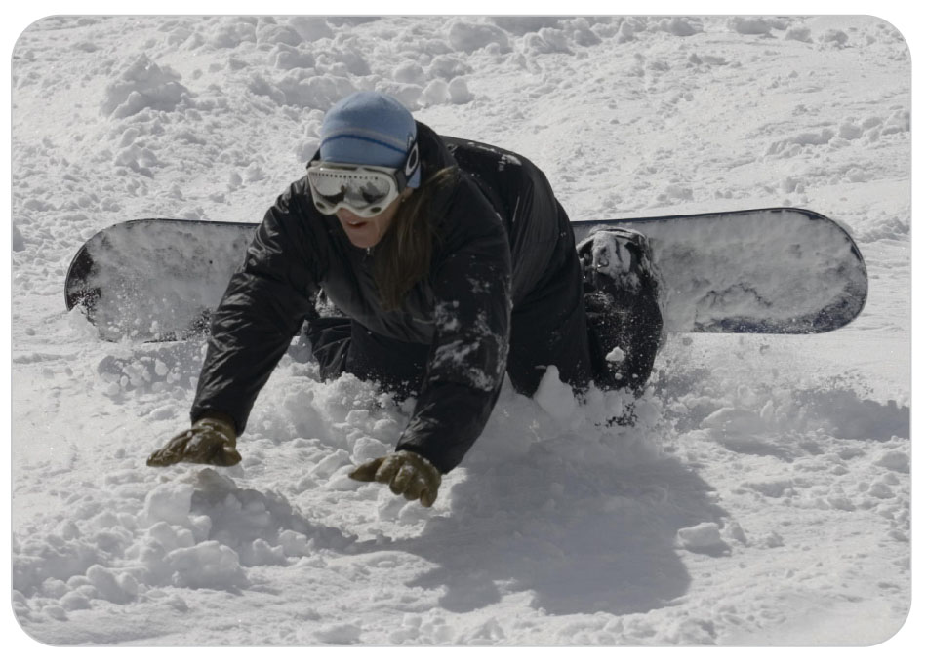
Forearm Injuries
20.2-1
Forearm Injuries
Direct or indirect trauma to the arm between the elbow and wrist can cause a variety of injuries, including fractures.
Fractures of the shaft of the radius and/or ulna can occur from direct trauma or when a person falls onto an outstretched hand.
Common among snowboarders and bicyclers who have fallen forward or backward.

Slide 82
Forearm Injuries: Fractures
20.2-1
If both bones are fractured, the limb may be angulated and exhibit false movement.
Signs and Symptoms:
Swelling
Point tenderness
Deformity
CMS may be compromised.
Distal Ulnar Fracture can result from falling on this bone.
Or from a direct blow

Slide 83
Wrist Injuries: Colles and Smith Fractures
20.2-1
Falling forward on the palm of the hand can result in fractures to the distal radius and ulna.
Known as a Colles fracture or “silver fork” fracture
Characteristic injury pattern resembling an overturned fork
The distal end of the fractured radius is pushed in the direction of the back of the hand.
Deformity, pain, swelling, and false movement are common.
Common snowboarding injury
Rarely, one can fall on the dorsum (back) of the hand, causing a Reverse Colles, or Smith, fracture.
The fractured end of the radius is displaced toward the palm.

Slide 84
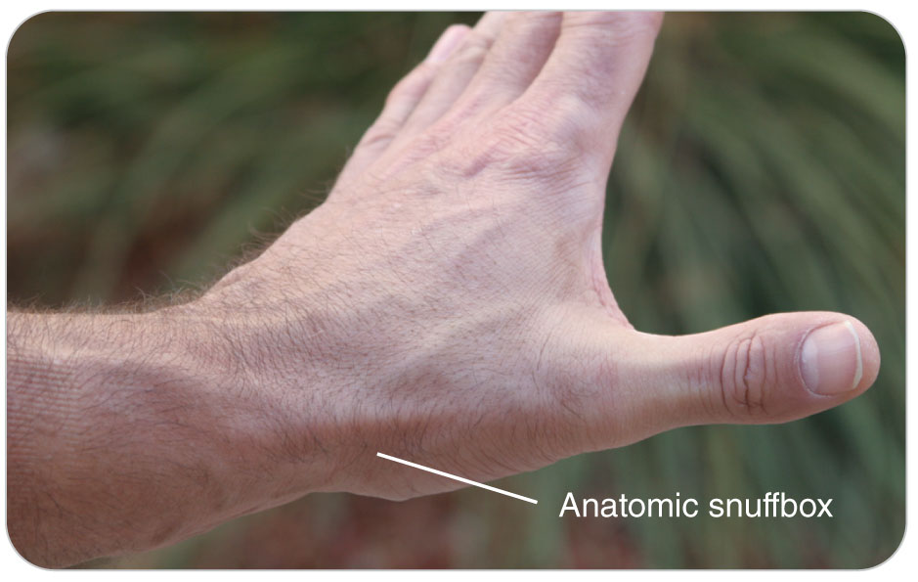
Wrist Injuries: Scaphoid Fracture
20.2-1
The most commonly fractured of the wrist’s eight carpal bones is the scaphoid.
Also known as the navicular bone
Caused by falling on an outstretched hand
Common injury among snowboarders who fall forward on the toe side of their board
A fall known as a “mousetrap”
Symptoms are:
Pain in the lateral side of the wrist joint in the “snuffbox”

Slide 85
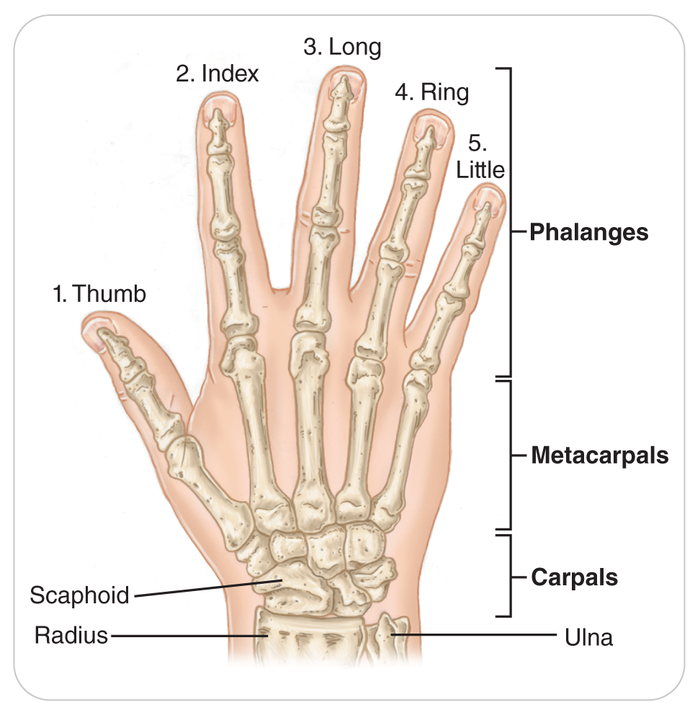
Wrist Injuries: Carpal Bone Injuries
20.2-1
Other carpal bones may also fracture.
Dislocation of the carpal bones results in a deformed wrist, severe pain, swelling, and reduced motion.
Patient is often found cradling the injured wrist in the opposite hand.

Slide 86
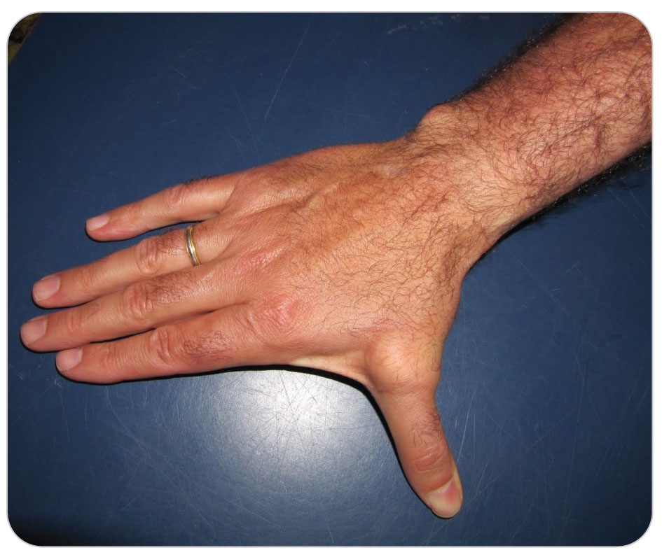
Hand and Finger Injuries: Skier’s Thumb
20.2-1
A Skier’s Thumb
A sprain of the ulnar collateral ligament of the thumb
Occurs when a ski pole catches on the snow and bends the thumb in a lateral and dorsal (backward) direction
Also occurs in hikers who fall while using walking poles

Slide 87
Hand and Finger Injuries
20.2-1
Any of the bones of the hand may be fractured or dislocated.
First metacarpal fracture
The bone at the base of the thumb
May appear dislocated where it attaches to the hand
“Boxer’s Fracture”
A fracture of the fifth metacarpal bone
Caused by punching a hard object or falling on the hand when it is clenched in a fist
Other hand and finger injuries can involve damaged tendons, creating severe disability.
Symptoms may include pain and swelling and always loss of motion.

Slide 88
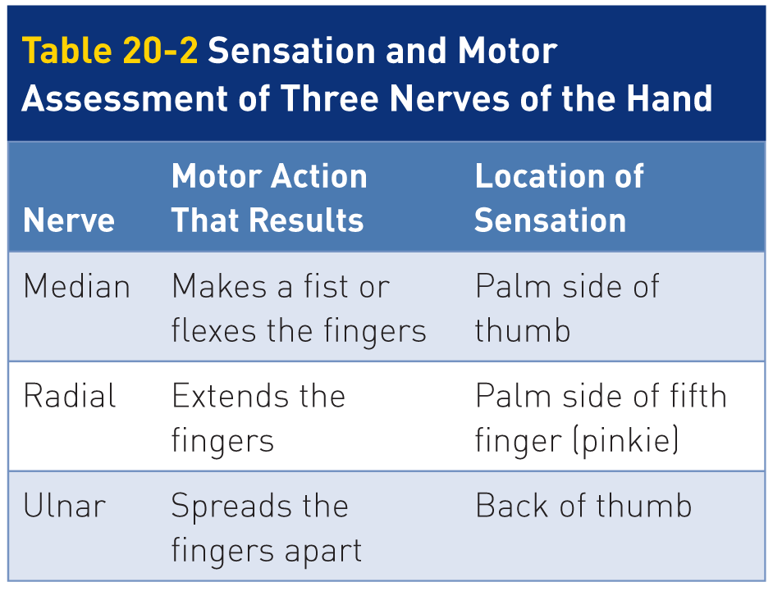
Hand and Finger Injuries
20.2-1
A good way to assess the neurologic function of the hand’s three nerves is shown in Table 20-2.

Slide 89
Hand and Finger Injuries: Amputations
20.2-1
Amputations involving the fingers may be:
Partial: the finger is still attached to the hand by a tendon or skin
Complete: the finger is entirely separated from the hand
One of the worst injuries to the hand can result from trying to remove a stuck object from a running snowblower.

Slide 90
Lower Extremity Injuries

Slide 91
Assessment of Lower Extremity Injuries
20.2-1
May not be possible to perform a complete neurovascular exam until the patient is moved indoors
In such cases:
Assess movement by having patients move their toes:
Move toes up (Dorsiflex)
Move toes down (Plantarflex)
Assess sensation by asking if the patient can feel the toes wiggling inside the boot.
Later, assess pulse (dorsal pedis pulse) as soon as possible after removing footwear.

Slide 92
Pelvic Fractures
20.2-1
Fractures usually require great force.
Should be suspected in:
High-speed collisions,
Falls from 20 feet or higher for adults
Falls from 10 feet or higher for children
Motor vehicle crashes
Pedestrian-vehicle collisions
Pelvic gunshot wounds
Any other type of direct blunt trauma

Slide 93
Pelvic Fractures
20.2-1
Forces great enough to fracture the pelvic bones may result in injuries to internal structures such as the urinary bladder and blood vessels.
The most significant complication of a pelvic fracture is acute internal bleeding.

Slide 94
Hip Fractures
20.2-1
Hip Fractures
Proximal femur fractures
The hip is a joint with a socket (acetabulum) and ball (top of the femur).
Older individuals experience these fractures much more commonly, often from simple falls.
Bones are more brittle.
Displaced proximal femur fractures present with the affected leg shortened and externally rotated.

Slide 95
Hip Fractures
20.2-1
Pain is extreme.
Generally located in the groin or inner aspect of the thigh
Occasionally pain is referred to the knee, even though the knee is not injured.
Movement makes the pain worse.
Patient will complain of pain with gentle, very slight movement of the leg by rolling the knee medially and laterally.
Always check CMS.

Slide 96
Hip Dislocations
20.2-1
The hip joint is a ball-and-socket joint.
Strong ligaments that hold the bones in position
Significant force is required to dislocate the hip, which can occur anteriorly or posteriorly.
Both injuries are extremely painful and are aggravated by movement of the affected leg.

Slide 97
Hip Dislocations: Anterior
20.2-1
Anterior Hip Dislocation:
Signs include abduction of the thigh and external rotation of the knee.

Slide 98
Hip Dislocations: Posterior
20.2-1
Posterior Hip Dislocation:
Over 90% of hip dislocations
The MOI is a significant force applied to the knee of a person who is sitting.
The flexed hip is pushed out the back of the socket (acetabulum).
Commonly seen in an unrestrained person in a car collision whose knee hits the dashboard
Signs include internal rotation of the knee and shortening of the affected leg.

Slide 99
Hip Dislocations
20.2-1
Fracture of either the acetabulum or the femoral head may occur as the hip dislocates.
The sciatic nerve can be injured in a dislocated hip.
Can result in temporary partial paralysis or complete paralysis of the ankle and foot
The major blood vessels supplying the hip joint can be compromised if the capsule is stretched or torn.
The longer the hip remains dislocated with lack of blood supply, the more damage can occur to the head of the femur.

Slide 100
Hip Dislocations
20.2-1
If blood does not reach the femoral head for some time (usually several hours), the bone cells in the femoral head dies.
Why a dislocated hip is considered a true orthopedic emergency
Once a hip has dislocated, the joint is usually “locked” out of position until it is put back into place by a physician.

Slide 101
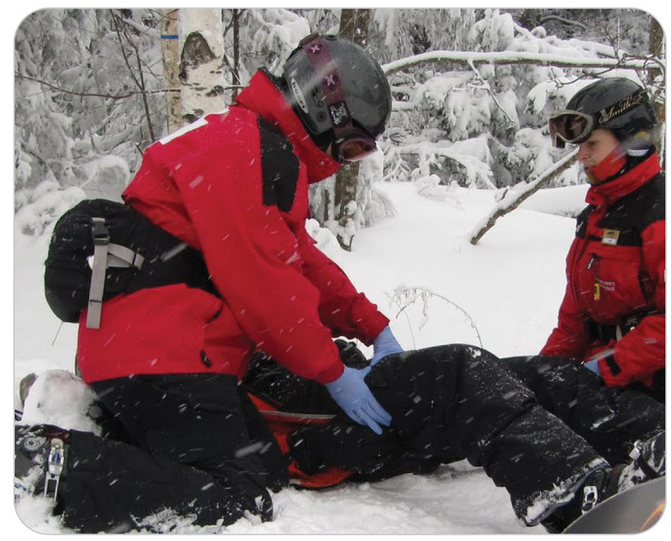
Femur Fractures
20.2-1
Femur fractures are usually seen only in high-energy trauma.
The femur is commonly divided into three sections:
The proximal femur (hip)
The shaft
The distal femur

Slide 102
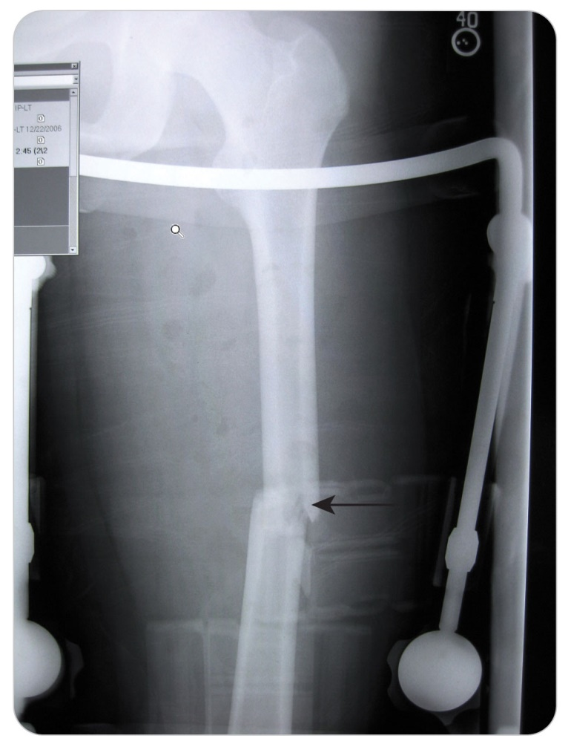
Midshaft Femur Fractures
20.2-1
Fractures of the middle third of the femur (known as the “shaft”)
Caused by direct and forceful trauma to the thigh, a fall, or intense twisting of the thigh
Assessment of the mechanism of injury generally provides clues concerning the forces involved.

Slide 103
Midshaft Femur Fractures
20.2-1
Direct trauma results in a transverse (straight across) fracture.
Twisting results in a spiral fracture or an oblique fracture.
Falls from a height often result in a comminuted (more than two parts) fracture.
Signs and symptoms of a femur fracture include:
Intense pain
Deformity
Angulation
Thigh swelling
False movement

Slide 104
Distal Femur Fractures
20.2-1
The distal end of the femur has two large flared ends known as the medial and lateral condyles.
A fracture occurring just above or between the two ends of the bone is called a supracondylar femur fracture.
Fractures involving this area are characterized by:
Severe pain and swelling just above the knee
Deformity
Inability to move the knee
Spasm of the thigh muscles

Slide 105
Distal Femur Fractures
20.2-1
Large popliteal artery and its branches, the popliteal veins, and the major nerves to the lower leg
All positioned behind the distal end of the femur
Distal CMS may be compromised, resulting in:
Poor blood perfusion
Decreased motor function
Decreased sensation in the lower leg

Slide 106
Knee Injuries
20.2-1
Knee injuries are a common occurrence in many other outdoor activities.
Especially those involving twisting of the knee during running and jumping
Assessment of a knee injury at the accident scene should be brief.
It is not necessary to diagnose the injury in the field.
Try to establish a mechanism of injury.
Attempt to isolate the part of the knee that is injured.
Assess injury severity, deformity, and CMS.
Plan immobilization and transport.

Slide 107
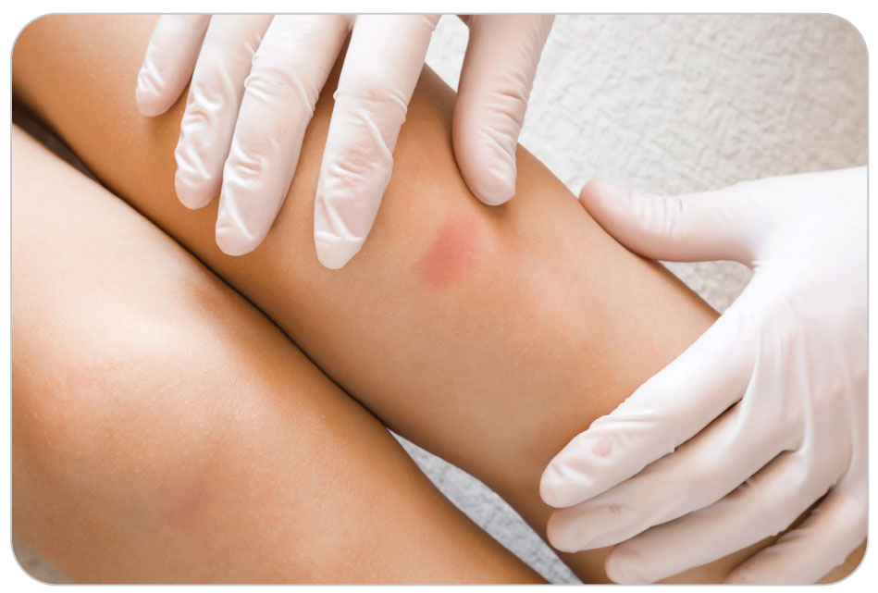
Knee Injuries
20.2-1
Further assessment of the knee is best performed in a controlled environment such as a warm aid room.
Expose the leg from mid-thigh to the toes.
Look for swelling, point tenderness, bruising, or deformity.

Slide 108
Knee Injuries
20.2-1
Ask patient to point with one finger to where it hurts the most.
On the outside or the inside of the joint
A ligament or cartilage injury
Over the distal femur, patella, or proximal tibia
A possible fracture

Slide 109
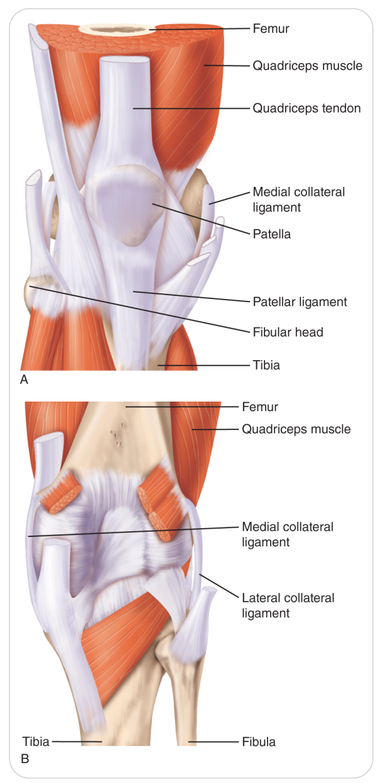
Knee Injuries
20.2-1
Most knee injuries are sprains involving the four main ligaments that support the knee joint.
The medial collateral and lateral collateral ligaments act as hinges on each side of the knee.
The anterior and posterior cruciate ligaments prevent forward and backward motion of the femur on the tibia.

Slide 110
Knee Injuries: Medial Collateral Ligament Sprains
20.2-1
A common ski injury is a medial collateral ligament sprain.
Occurs when the knee is stressed while in a valgus position
When the knee is forced medially
An extremely “knock-kneed” position
Symptoms of this injury include point tenderness above, below, or over the joint line on the inside of the knee.

Slide 111
Knee Injuries: Lateral Collateral Ligament Sprains
20.2-1
Much less frequent is an injury to the lateral collateral ligament.
Can occur if the knee is stressed in the varus position
The knee is forced laterally
As if the limb were suddenly made bow-legged
Pain is localized to the lateral part of the knee.

Slide 112
Knee Injuries: Anterior Cruciate Ligament
20.2-1
The anterior cruciate ligament can be torn when a skier “sits back” and falls or when someone is running and stops abruptly.
Typically feel or hear a “pop”
Then, immediate pain in the knee
It may require surgical reconstruction and lengthy rehabilitation.

Slide 113
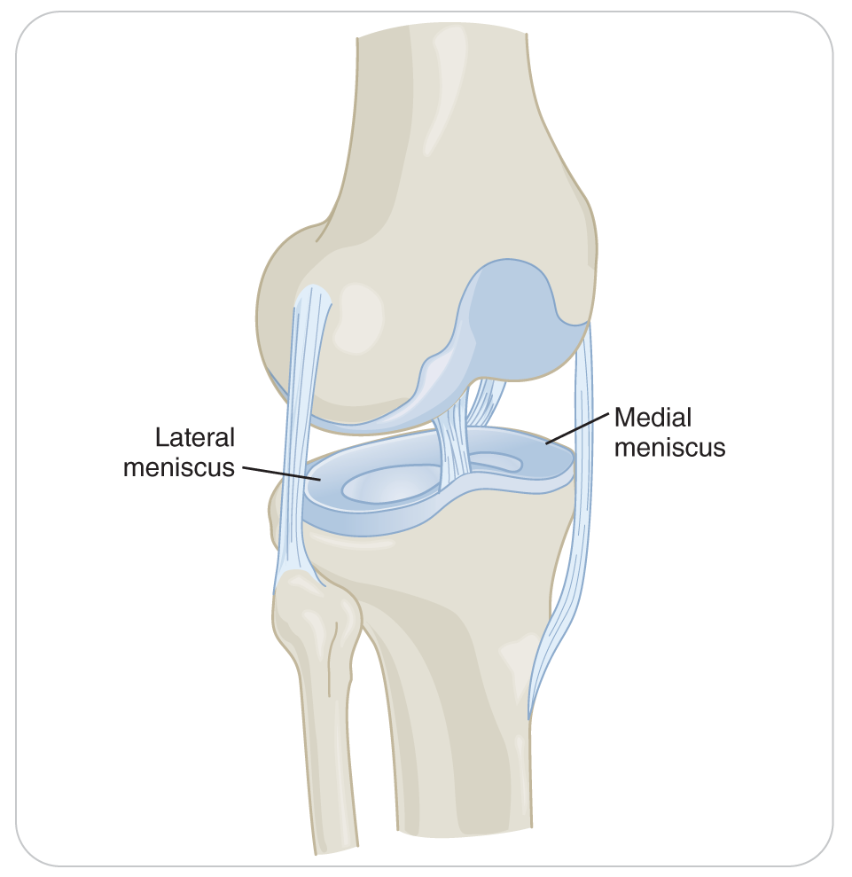
Knee Injuries: Cartilage Injuries
20.2-1
Articular cartilage is firm tissue that acts like a cushion attached on the end of a bone where it forms a joint.
The cartilage on the ends of the femur and tibia where they come together to form the knee joint
Can be damaged when the knee is injured
On the medial side of the knee is a C-shaped cartilage, known as the medial meniscus.
On the lateral side of the knee is an O-shaped cartilage, known as the lateral meniscus.

Slide 114
Knee Injuries: Cartilage Injuries
20.2-1
These menisci cushion the knee.
Help stabilize the joint
The menisci can be damaged or torn when the knee joint is compressed or twisted.
Causing pain, swelling or fluid in the knee joint, and reduced mobility
When a piece of meniscus gets “stuck” in the joint space, the knee can become locked.

Slide 115
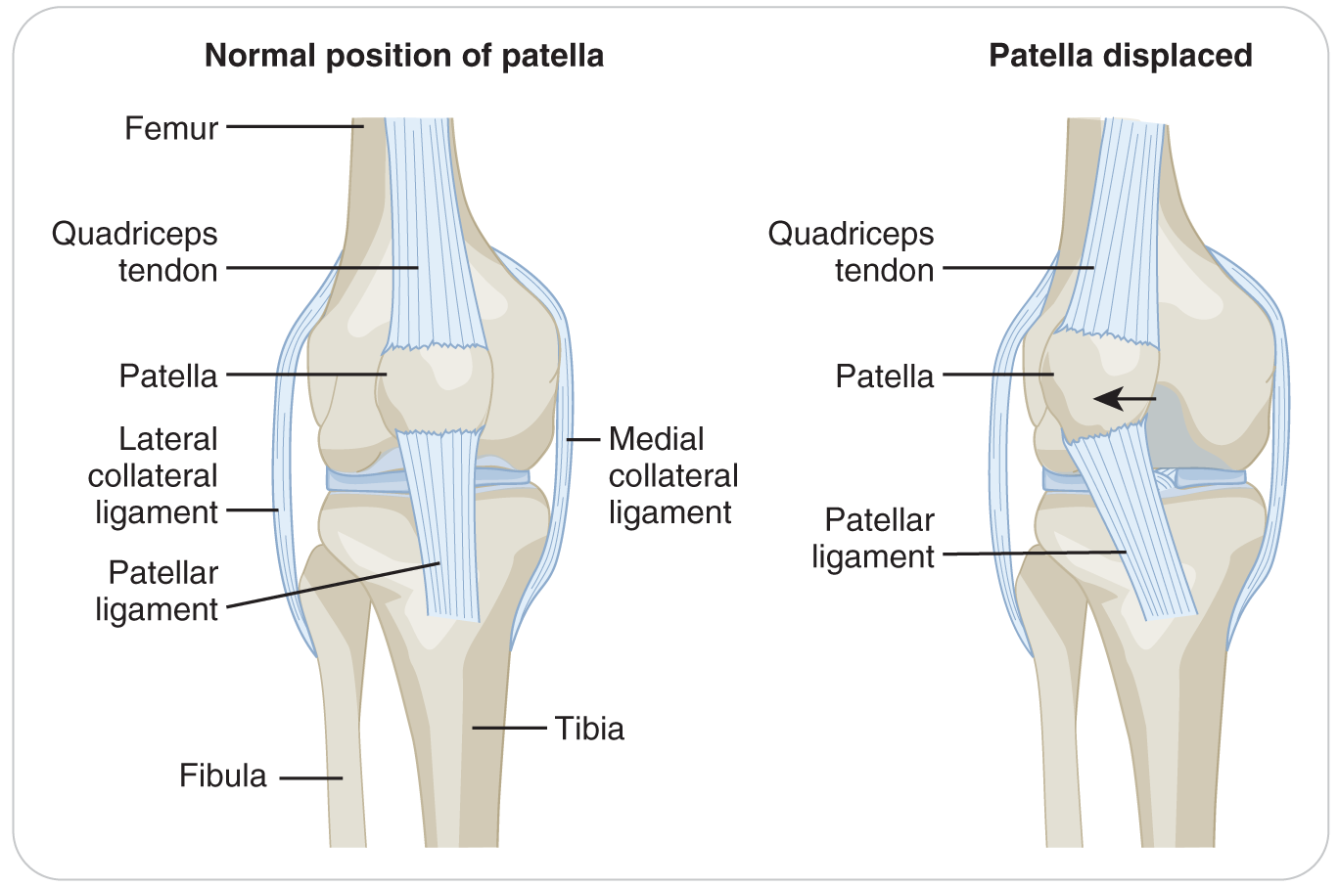
Knee Injuries: Patella Fracture
20.2-1
The patella, or “kneecap,” is a large bone on the anterior portion of the knee.
Superiorly connected to the quadriceps muscle’s tendon
Inferiorly connected to the top front of the tibia
Caused by either falling directly on the front of the knee or localized to the lateral part of the knee
The amount of force necessary to fracture the patella is great, as it is a dense bone.
Patella fractures may be open, so expose the zone of injury to assess for bleeding.

Slide 116
Knee Injuries: Patella Dislocation
20.2-1
Common
Occurs more frequently in teens and in women
Because the knees are in a valgus position (knock-kneed)
MOI involves twisting the knee in a slightly flexed position while forcefully contracting the quadriceps muscle.
Excessive direct force to one side of the patella or the other can also dislocate it.

Slide 117
Knee Injuries: Patella Dislocation
20.2-1
Once a patella dislocates, the risk for future dislocations is great.
Nearly all patella dislocations are lateral (to the outside).
The tissue holding the patella in place is disrupted on the medial side of the knee.
Presents as a knee that is flexed and has a large firm bulge (the patella) on the lateral side of the knee
The isolated deformity is significant and characteristic, but it is not limb threatening.

Slide 118
Knee Injuries: Patella Dislocation
20.2-1
Often, the patella will “pop” back into place spontaneously if the leg (knee) is straightened.
After, the medial aspect of the knee will be tender to the touch.
Both ecchymosis and swelling may be present.
A patella dislocation should not be confused with a dislocated knee, which is a much more serious problem.

Slide 119
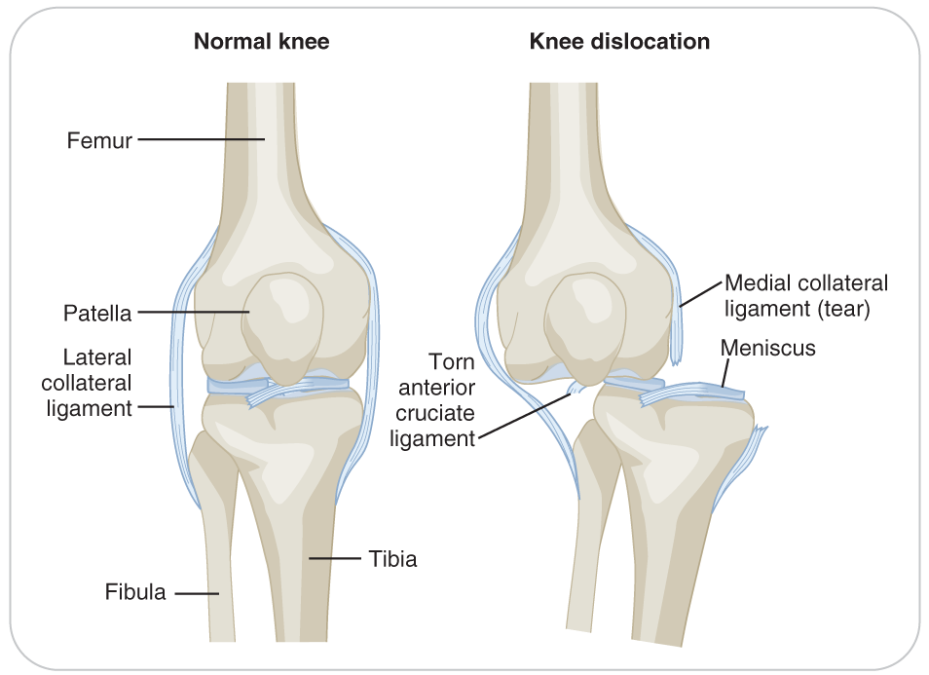
Knee Injuries: Knee Dislocation
20.2-1
A knee dislocation is a true orthopedic emergency.
It occurs rarely.
Associated with massive trauma in which at least three (if not all four) of the ligaments of the knee are completely torn

Slide 120
Knee Injuries: Knee Dislocation
20.2-1
The actual knee joint, not just the patella, moves into an abnormal anatomic position.
There is gross deformity.
The proximal tibia is in front of or behind the femur.
Severe angulation at the knee joint
The pain with this injury is severe.

Slide 121
Knee Injuries: Knee Dislocation
20.2-1
Severe neurovascular compromise:
No longer any true articulation in this portion of the leg
Important neurovascular structures in the popliteal fossa are frequently damaged.
The popliteal artery can be lacerated or compressed.
Causing a pulseless, pale, and cold foot
Since the mechanism of injury is severe:
A complete patient assessment is needed.
Ensure that no potential threats to life are present.

Slide 122
Knee Injuries: Rupture of Tendons/Ligaments
20.2-1
Rupture of the Quadriceps Tendon or Patellar Ligament
Injuries by an excessively forceful contraction of the quadriceps
Quadriceps Tendon: muscle rips the quadriceps tendon off the top of the patella
Patellar Ligament: rips below or off the bottom of the patella
Likely report hearing a “pop”
A palpable “gap” is present above or below the kneecap.
Unable to straighten the affected leg at the knee.

Slide 123
Tibia and Fibula Injuries
20.2-1
The two bones of the lower leg are:
The larger, weight-bearing tibia
The smaller, non-weight-bearing fibula
Are connected to the femur and the ankle/foot by muscles and ligaments
Both the knee and ankle are hinge joints.
The tibia and the femur come together to form the knee joint.
The ankle joint is a “mortise” joint formed where the talus bone fits into the space created by the tibia and fibula.

Slide 124
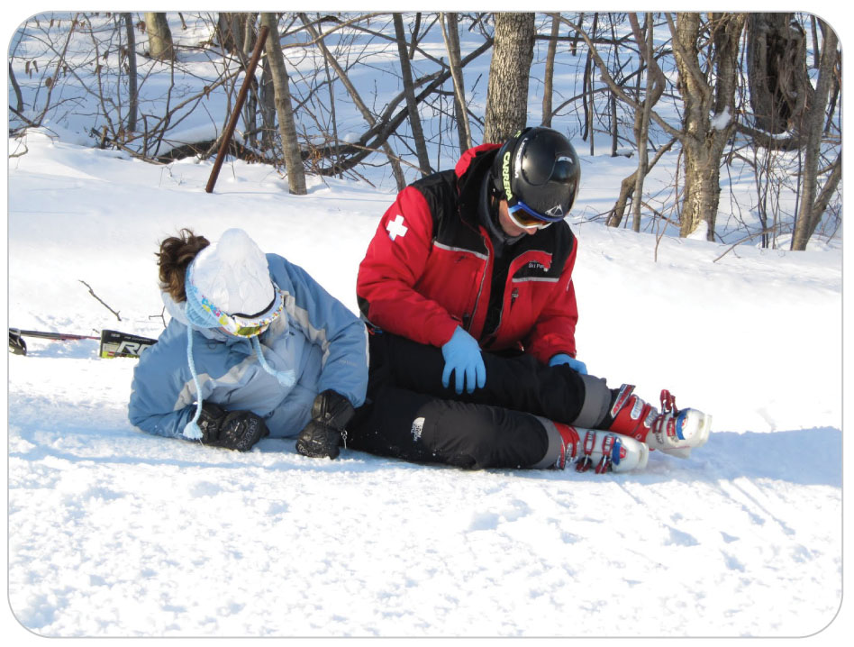
Tibia and Fibula Injuries: Proximal Tibia Fracture
20.2-1
Extremely painful
MOI:
Fall from a height
Lands flat when performing a jump in a terrain park
The bottom of the femur is forced into the top of the tibia, compressing the tibia and causing a compression fracture of the top of the bone just below the joint line.
Increasingly frequent in older skiers

Slide 125
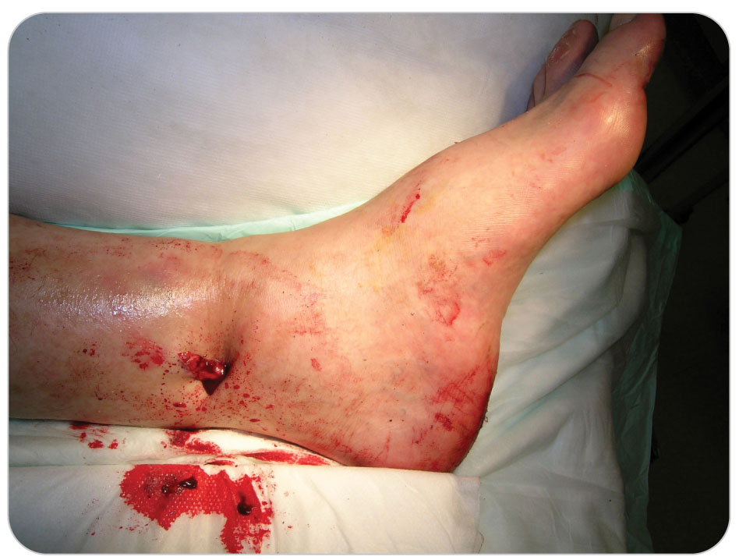
Tibia and Fibula Injuries: Tib-Fib Fractures
20.2-1
“Tib-Fib” Fracture:
Both lower bone shafts in the same leg break at the same time.
Tibia and fibula fractures are often seen in skiers.
Especially those that do not have release bindings
Lower incidence in snowboarders
Less often, direct trauma or other infrequent mechanisms of injury can break the shaft of one bone only.
Open fractures involving the tibia can easily occur because the entire anterior bone is just under the skin.

Slide 126
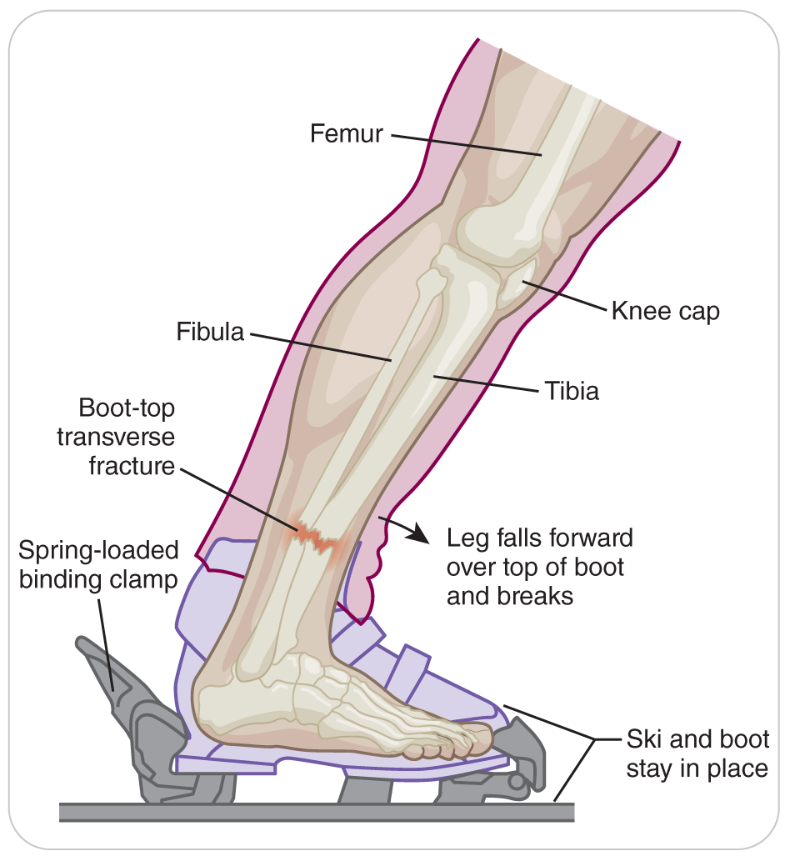
Tibia and Fibula Injuries: Common Fractures
20.2-1
Injuries that occur while skiing include:
A boot top fracture
The fibula or the tibia and fibula can undergo a transverse fracture.
A spiral fracture
The tibia is broken in the middle, and the fibular shaft is broken above or below the tibial fracture.
Direct blow fracture
Either bone is broken crosswise.

Slide 127
Tibia and Fibula Injuries: Compartment Syndrome
20.2-1
Compartment syndrome is a condition in which a muscle swells but is constricted by the connective tissue around it, which cuts off the blood supply to the muscle.
Seen with tibia and fibula fractures
It is a true emergency that can happen rapidly following an injury to an extremity.
Requires rapid transport

Slide 128
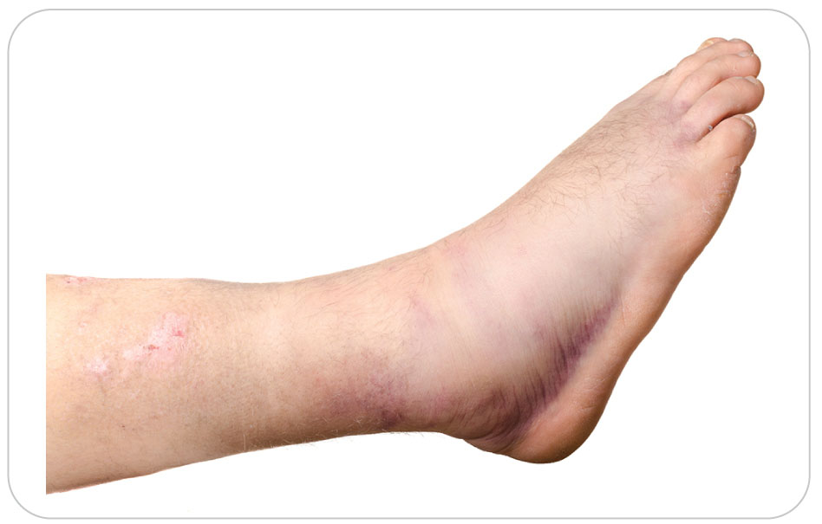
Ankle Injuries
20.2-1
Ankle injuries are common among outdoor enthusiasts.
Uneven terrain
Some footwear gives little support to the ankle, allowing it to twist or bend sideways.
Sneakers, soft snowboard boots, soft alpine boots, and low top cross-country ski boots

Slide 129
Ankle Injuries: Mechanism of Injury
20.2-1
Most are due to “rolling” the joint.
Inversion: stepping on the outside of the foot and turning the arch up
More common
Results in sprain or fracture to the OUTSIDE of the ankle
Eversion: coming down on the inside of the foot and flattening the arch
High lace-up hiking boots and plastic-shelled alpine ski boots hold the ankle in a more rigid position, reducing both the incidence and the severity of ankle injuries.
However, the likelihood of tibial shaft fractures and knee injuries increases with stiffer or higher boots.

Slide 130
Ankle Injuries: Lateral Malleolus Sprain/Fracture
20.2-1
Three ligaments on the lateral side of the ankle may be injured by inversion.
Tenderness below the lateral malleolus of the fibula, lateral ankle bone, indicates injury to the ligaments.
By palpating the lateral (outside) ankle bone, you can determine if it is a possible ankle fracture.
If the bone is tender, a fracture is more likely than a sprain.
Pain over the bone usually means a fracture, but only X-ray imaging can determine if it is broken.

Slide 131
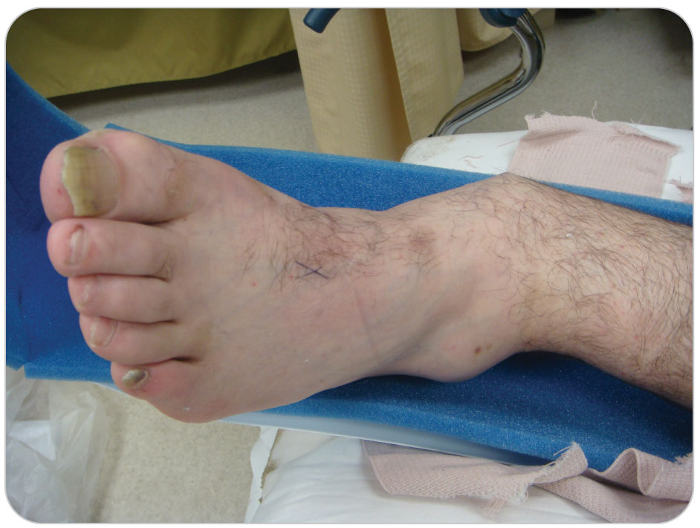
Ankle Injuries: Medial Malleolus Fracture
20.2-1
The medial malleolus is the large bulge located at the distal end of the tibia on the medial (inside) side of the ankle.
One large wide ligament located there may be injured when the ankle everts (turns outward).
Tenderness above this ligament suggests the presence of a medial malleolus fracture.

Slide 132
Ankle Injuries: Talus Fracture
20.2-1
The talus, a bone in the middle of the ankle, is broken beneath the lateral ankle ligaments.
A unique ankle injury of snowboarder
Snowboarder jumps and lands on a “flat”
Severely dorsiflexing the ankle (shoving the foot up toward the shin)
Often appears to be a sprain but is a fracture
Left untreated, can result in serious disability

Slide 133
Ankle Injuries
20.2-1
Ankle injuries can range in severity from mild to severe.
When combinations of forces are involved, more severe injuries result.
One side of the ankle could be fractured, the other side sprained, or both sides could be broken.
Most ankle injuries present with:
Point tenderness
Swelling
Ecchymosis
Reduced motion of the joint

Slide 134
Foot and Toe Injuries
20.2-1
In snow sports, the foot is usually held to a flat surface (e.g., ski, snowboard, snowshoe), and the type of boots worn generally holds the foot immobile.
Thus, fractures involving the foot and toes are uncommon.
Foot injuries occur more frequently in recreational activities and sports like cycling where the shoes worn are soft and the foot can twist.

Slide 135
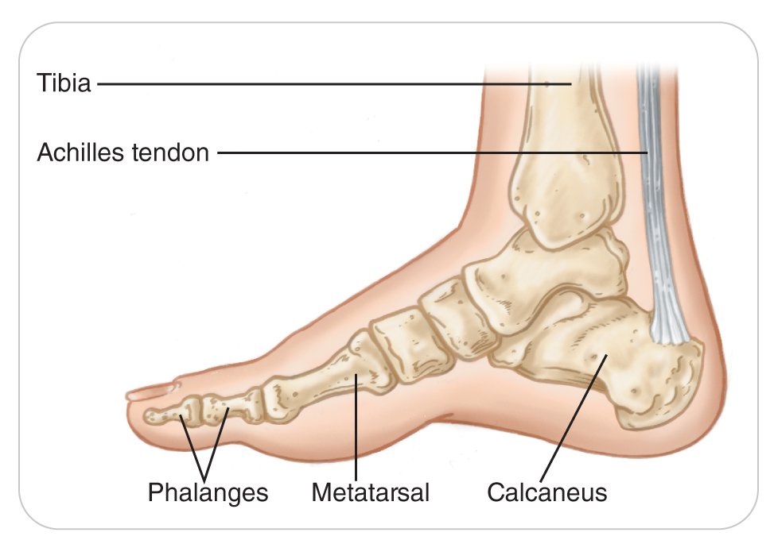
Foot and Toe Injuries
20.2-1
Toe and metatarsal fractures are common, as are sprains of the midfoot and great toe joint.
Toe injuries most commonly occur when a person kicks a fixed object.
The calcaneus (heel bone) is broken more often than any other tarsal bone.
Landing on the heel during a jump or fall from height is the most common mechanism of injury for a calcaneal fracture

Slide 136
Foot and Toe Injuries: Fifth Metatarsal
20.2-1
Metatarsal fractures occur frequently in jumping sports such as basketball or volleyball.
The fifth metatarsal on the lateral side of the foot is most likely to be fractured.
Common in marching, running, or other activities that continually load the bottom of the foot
Subject to stress or fatigue fractures
Repetitive, slight bending (or repetitive stress) of the bone eventually causes it to crack or break.

Slide 137
Section 3: Management of Musculoskeletal Injuries

Slide 138
Overview of Musculoskeletal Injury Management
20.3-1
Begin with a scene size-up.
Eliminate any hazards that may be present.
Manage any life-threatening problems and assess ABCDs in a primary patient assessment.
Bleeding is common with musculoskeletal injuries and can be severe, especially with open fractures.

Slide 139
Overview of Musculoskeletal Injury Management
20.3-1
Standard precautions
Control external bleeding.
Bandage wounds appropriately, using sterile dressings that completely cover the wound.
Cover exposed bone ends to keep them from becoming contaminated.
When appropriate, call for ALS personnel, especially for open fractures and severely angulated extremities.

Slide 140
Overview of Musculoskeletal Injury Management
20.3-1
High-flow oxygen:
Titrate with a pulse oximeter, keeping the oxygen saturation between 94 and 99%.
Generally, patients with fractures that can bleed a lot—femoral, pelvic, and open fractures—may need high-flow oxygen.
Rarely does a person need oxygen for an isolated broken ankle or wrist.

Slide 141
Overview of Musculoskeletal Injury Management
20.3-1
Differentiating one musculoskeletal injury from another can be difficult in the field.
The general care of sprains, dislocations, and fractures is essentially the same and involves the following actions:
Use standard precautions to avoid contaminating yourself or others.
Formulate a plan of action early.
Get the right equipment for patient’s injuries.
Summon EMS transport if needed.
Request ALS if there are threats to life or if pain medication may be needed.

Slide 142
Overview of Musculoskeletal Injury Management
20.3-1
Expose the zone of injury to look for bleeding, abrasions, lacerations, contusions, punctures, swelling, or deformity.
Bandage any wound appropriately:
Apply a pressure bandage if there is active bleeding.
Use sterile dressings and completely cover the wound.
Make sure bleeding is controlled and check the wound frequently for additional bleeding.
When needed, use a tourniquet.

Slide 143
Overview of Musculoskeletal Injury Management
20.3-1
Use the correct splint or other immobilization device for the injury.
When a fracture is immobilized, there is usually less pain.
Avoid letting an injured extremity move uncontrollably, as this may cause more tissue damage and pain.
Always immobilize the joint above and below the injury.
Check CMS before and after splinting.
If normal CMS becomes compromised after the splint is applied, readjust the splint and/or bandage once.
Rapid transport to advanced care is needed if CMS has been compromised, even if it returns.

Slide 144
Overview of Musculoskeletal Injury Management
20.3-1
Use some cooling method (e.g., ice or snow in a plastic bag) early to treat pain.
Do not keep ice on for longer than 15 minutes.
Cover the skin with a cloth or a bandage and place the ice on the cloth.
Provide oxygen if appropriate.
The majority of musculoskeletal injuries do not require oxygen.
Transport as soon as is practical to a higher level of care.

Slide 145
Types of Splints

Slide 146
Management: Types of Splints
20.3-2
Splints are mechanical devices used to prevent a part or parts of the body from moving, protecting it from further injury.
There are four main types of splints:
Soft
Rigid or semi-rigid
Traction
Improvised

Slide 147
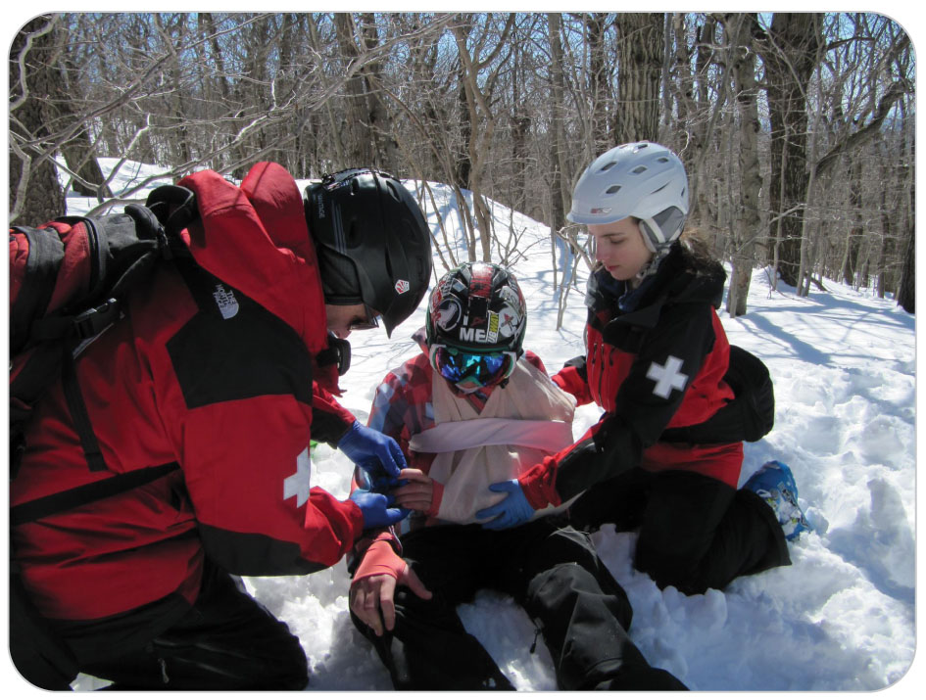
Management: Soft Splints
20.3-2
Soft Splints: Sling and Swathe Splints
Made from two triangle-shaped cravats
Used to immobilize upper extremity injuries
Clavicle fractures
Shoulder separations
Humerus and elbow injuries
Wrist injuries

Slide 148
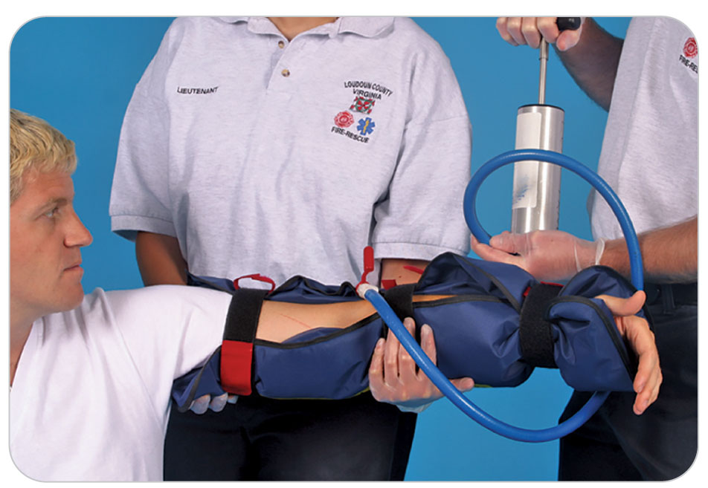
Management: Soft Splints
20.3-2
Other soft splints include:
Air Splints
Inflated with air to form a rigid splint
Vacuum Splints
Air is sucked out of the splint after application to an injured extremity forming a rigid enclosure around the body part.
Blanket Roll/Pillow Splint
Pelvic Binders

Slide 149
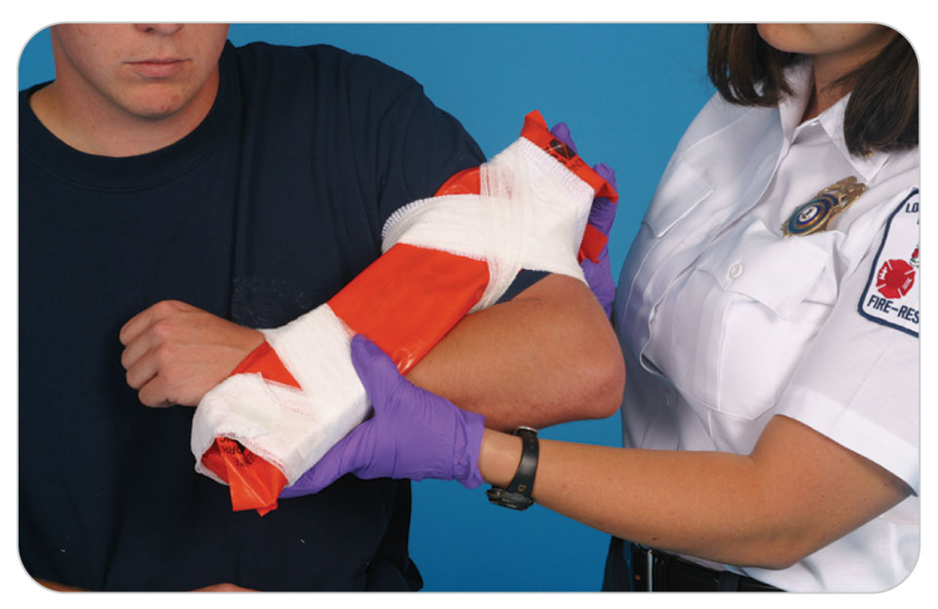
Management: Rigid or Semi-Rigid Splints
20.3-2
Rigid or Semi-rigid Splints: Cardboard, Wood, or Metal Splints
Constructed of stiff materials such as heavy cardboard, wood, or metal
Reliable, low cost, effectiveness in all weather and altitude conditions, and ease of use
Applied to the sides, front, and/or back of an injured limb
Generally held in place by roller gauze (bandage) or cravats
Do not use Ace bandages due to circulation problems distally.

Slide 150
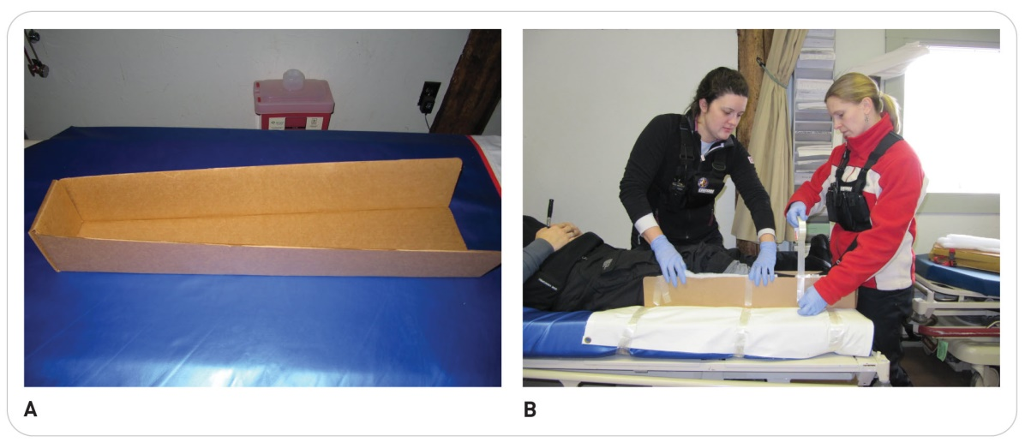
Management: Rigid or Semi-Rigid Splints
20.3-2
Cardboard splints:
Primarily to splint an arm or leg
Best used in dry environments
Unless treated with a water-resistant coating
Commercially available but easy to make using corrugated cardboard
For an elbow or a forearm, a double thickness of cardboard 3 inches by 12 to 15 inches is effective.

Slide 151
Management: Rigid or Semi-Rigid Splints
20.3-2
Wood splints:
More rigid than cardboard
Provide very effective immobilization
Commonly used to immobilize long bones (radius, ulna, humerus, tibia, and fibula) and joints (elbow, knee, and wrist)

Slide 152
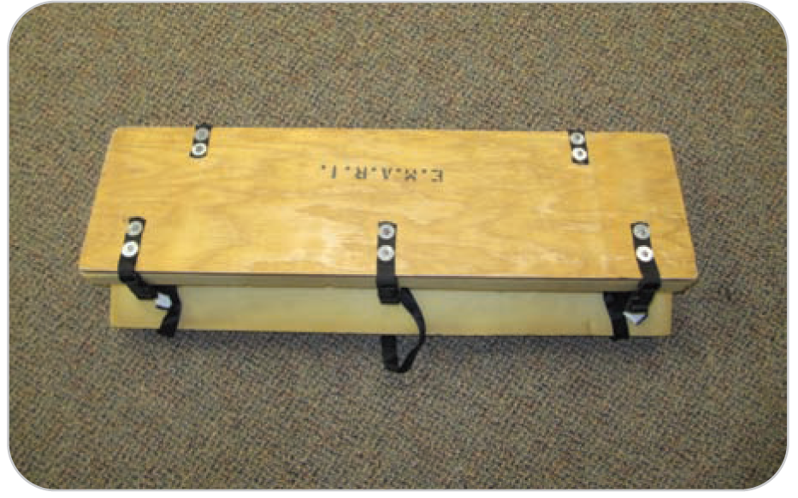
Management: Quick Splint
20.3-2
The Quick Splint has been used by ski patrols for many years.
Mainstay of care for lower leg injuries
Made of lightweight plastic or plywood
Effective for knee, tibia, or fibula injuries
Easy to use and may be applied rapidly by one or two people
Its compact design allows it to easily fit on a fully loaded toboggan.

Slide 153
Management: Traction Splint
20.3-2
Traction Splints
A device that applies longitudinal traction to a fractured femur
A safe mechanism for immobilizing a broken bone
Traction is the placement of an in-line force to a fractured long bone in the direction of its normal alignment for the purpose of regaining bone length and reducing pain.
Aligns the limb in a more anatomically neutral position, preventing further soft-tissue damage
A traction splint does not reduce a fracture, but it does align the fractured bone in a more anatomically favorable position, allowing transportation to be easier.

Slide 154
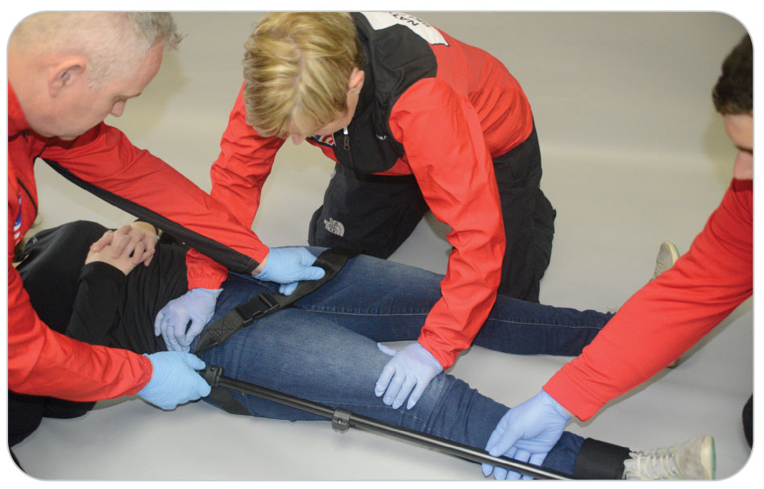
Management: Types of Traction Splints
20.3-2
Many different types of femoral traction splints are commercially available, including splints made by:
Sager
Slishman
Kendrick

Slide 155
Management: Traction Splints
20.3-2
Traction splints are used primarily for fractures involving the middle third of the femur.
Some EMS programs and traction splint manufacturers (Sager) have advocated the use of these devices, using tension, for proximal femur fractures, including classical hip fractures.
Generally, hip fractures can be immobilized well with the use of a backboard and straps used as a litter.

Slide 156
Management: Traction vs. Tension
20.3-3
Traction is required for Midshaft Femur Fractures.
Requires pulling on the foot with about 15 pounds of force.
The force of traction should be no more than 10% of the total body weight.
Tension is used to align other long-bone fractures when necessary.
Involves pulling with less force, generally 7-8 pounds
Pulling with only enough force to align the bone
After proper application of traction or tension, generally the injured limb feels “better.”

Slide 157
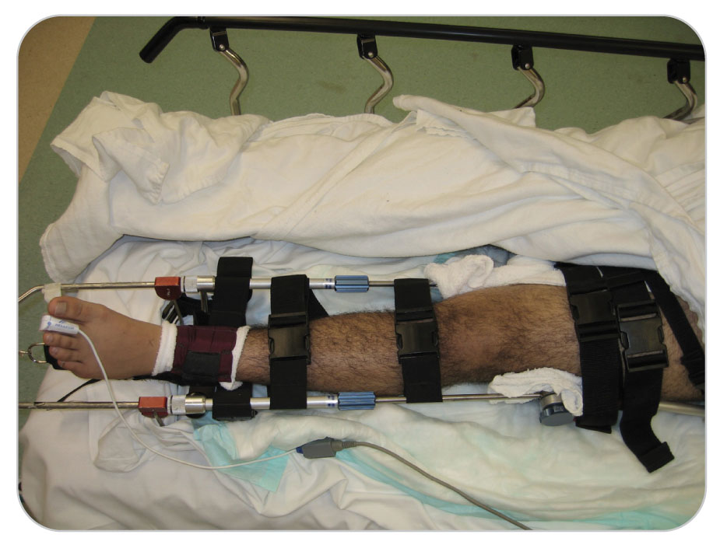
Management: Traction Splints
20.3-2
Traction splints are contraindicated in fractures of the:
Distal third of the femur
Any upper extremity fracture

Slide 158
Principles of Splinting

Slide 159
Management: Principles of Splinting
20.3-4
Splint an injured extremity before moving patient.
Exceptions:
An immediate hazard to patient or rescuer
Patient’s general condition demands immediate care and/or rapid transport for a life-threatening condition

Slide 160
Management: Principles of Splinting
20.3-4
If hypovolemic shock:
First control bleeding.
Carefully attempt to align the injured limb(s) as close to normal anatomic position as possible (for ease of transport).
Place an injured arm to the chest and splint it anatomically.
Place an injured leg to the other leg.
Put patient on transport device such as a toboggan.
Then treat for shock and provide rapid transport.

Slide 161
Management: Key Principles of Splinting
20.3-4
The key principles of splinting:
Check distal CMS before splinting.
Document.
Manually stabilize the injury in the position it was found until a splint can be applied.
Gently hold the bones above and below the suspected injury site.
“Proximal to and distal to”
Select an appropriate splint.

Slide 162
Management: Key Principles of Splinting
20.3-4
Properly size the splint.
Should span the joint above and the joint below the injury
If involves a long bone, size the splint using the uninjured extremity as a guide.
Malleable splints should be shaped to match the injured extremity.
Make all adjustments away from the injury so as not to accidently move the injured area.
Pad the splint (if needed) to maximize patient’s comfort.
Important if transporting over rough or uneven terrain

Slide 163
Management: Key Principles of Splinting
20.3-4
Check distal CMS after splinting.
Document.
Position the splint.
Place next to the injured area or slide under or around the extremity.

Slide 164
Management: Key Principles of Splinting
20.3-4
Secure the splint.
Use roller gauze, or cravats, to secure the injured body part(s) to the splint.
Not too tight or may affect distal neurovascular status
Reassess CMS.
Adjust the splint if now compromised.
Record your findings.

Slide 165
Management: Difficult Splinting Positions
20.3-4
Placing an injured extremity into anatomic position before splinting may be difficult or impossible.
Open fractures
Severely angulated fractures
Dislocations
Fracture–dislocations close to a joint (elbow, shoulder, hip, knee)
Patients or children who will not let you move the injured limb
Patients with an impaled object in the injured extremity
Place the limb in the most comfortable, best immobilized position possible.
Check CMS before and after splinting, and transport patient.

Slide 166
Management
20.3-1
Do not attempt to set (reduce) a fracture nor force exposed bone fragments of an open fracture back into their normal anatomic alignment, especially when the injury involves the femur.
Often, bone ends will go back into the wound below the skin with the proper application of a traction splint.
Leave the bones where they are, bandage the wound, and communicate to the EMS personnel that the fracture was open.

Slide 167
Management
20.3-1
If significant pain:
Apply cold packs or ice or snow in a plastic bag.
Be sure to place a cloth or bandage between the ice and skin to avoid local cold injury.
Make patient as comfortable as possible during transport, especially when an immobilized extremity is in an unusual position.
Reassess neurovascular status of the limb frequently.
If it worsens, readjust bandages, splints, or other dressings as needed.

Slide 168
Management of Upper Extremity Injuries

Slide 169
Management: Shoulder, Clavicle, and Scapula Injuries
20.3-6
Nearly all can be treated with a sling and swathe.
During transport, patients may wish to remain partially sitting or may prefer lying on the unaffected side.

Slide 170
Management: Alternative Sling and Swathe
20.3-6
Alternative method avoids placing any pressure on the injured shoulder or a fractured clavicle.
Support patient’s elbow while it is bent to just under a 90-degree angle.
Lay the long corner of the triangle bandage across patient’s chest and over the uninjured shoulder in the midclavicular line, as before.
Bring the other corner of the sling up and around the forearm and under the near axilla (i.e., armpit of the injured side).

Slide 171
Management: Alternative Sling and Swathe
20.3-6
Tie this corner to the opposite upper corner behind patient’s back to keep pressure off the injured clavicle.
Tie the swathe around patient’s chest and forearm rather than around the injured part of the upper arm.

Slide 172
Management: Anterior Dislocated Shoulder
20.3-6
Anterior dislocated shoulder requires creativity due to the position of comfort being away from the body.
Do NOT attempt to reduce a dislocated shoulder.
Immobilize:
In a position of comfort
Use a blanket roll or airplane splint.
Encourage the person to seek medical attention for reduction.
Rarely, the arm is unable to be brought down onto the blanket roll.
Stabilize the injured arm with cravats to avoid movement.
Transfer in a transportation device with patient in a semi-sitting position.

Slide 173
Management: Humerus Fracture
20.3-6
Fractures of the humerus shaft often require gentle longitudinal tension before splinting.
If patient resists or if too painful, splint in position found.
Ideally, place patient in a high-Fowler position or lying on uninjured side during transport.

Slide 174
Management: Elbow Injuries
20.3-6
Due to the abundance of blood vessels and nerves in the area, it is best to splint in the position found.
If distal CMS is worsened with the splint, loosen and reapply with less pressure or extending the elbow slightly.
If injury has a CMS deficit, attempt to align once (if final definitive care is greater than 2 hours away).
Splint in position pulse restored.
Often, just past 90-degree extension.
Rapidly transport the patient to definitive care.

Slide 175
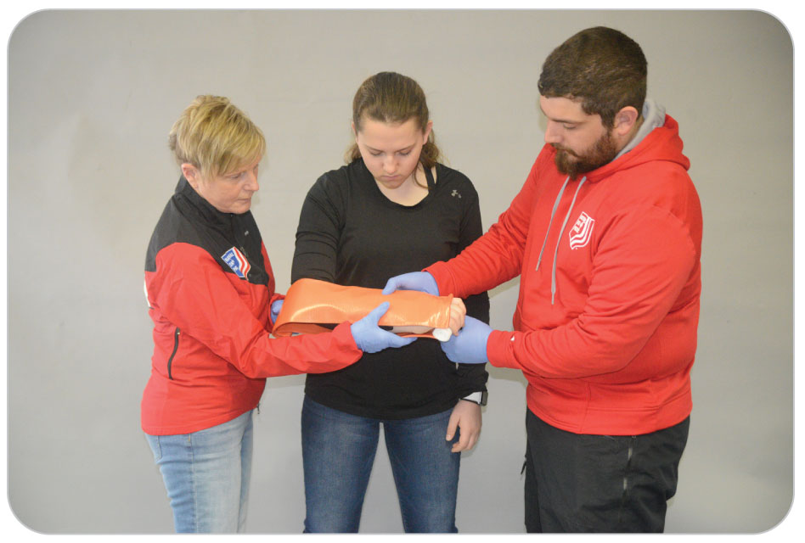
Management: Forearm Injuries
Sugar tong splint or long arm splint is one of the best ways to care for this fracture.
Prevents rotation of the forearm at the elbow
Allows less movement at the fracture site and less pain
Sugar tong splint is made with a malleable splint wrapped around a joint and covering both sides of the extremity.

Slide 176
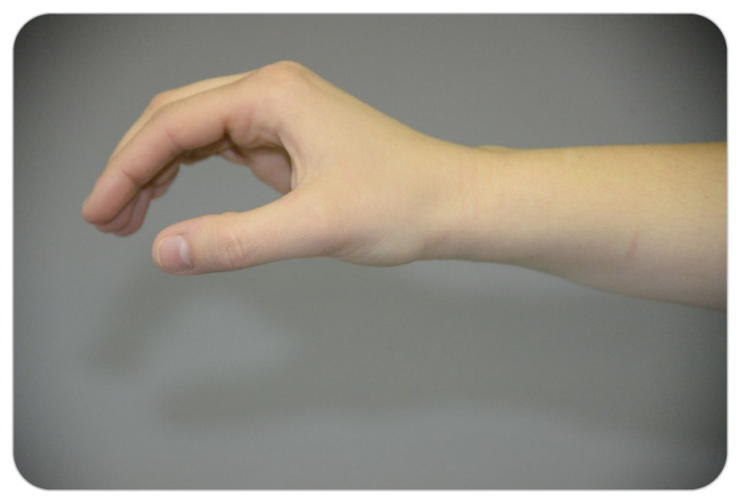
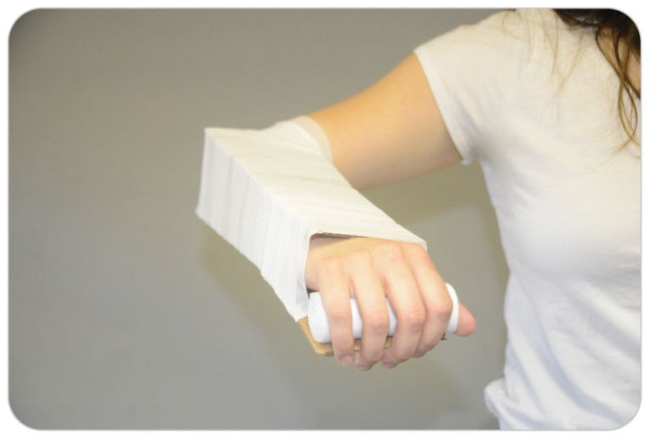
Management: Wrist Injuries
Patients are most comfortable when an injured wrist and hand are placed in the “position of function.”
Wrist is slightly dorsiflexed (positioned upward) with the fingers slightly curled down.
Often achieved best by placing a soft roller bandage in the patient’s palm

Slide 177
Management: Hand and Finger Injuries
20.3-6
Skier’s thumb:
Splint thumb from tip to base with a tongue blade and secure with roller gauze to prevent movement.
Finger fractures:
Splint using a tongue blade and tape.
Alternatively, tape the two fingers together with gauze in between.
Do not attempt to reduce dislocated fingers.

Slide 178
Management of Lower
Extremity Injuries

Slide 179
Management: Pelvis Fractures
20.3-6
Do NOT logroll a patient with a suspected pelvic fracture.
Use a bridge lift or another technique not involving rolling the patient.
Splint pelvic fractures using a pelvic binder, a sheet splint, or a SAM pelvic splint.
Patient should then be immobilized using a long spine board or full-body vacuum splint.
High-flow oxygen is needed in the field.
Due to potential significant blood loss
Later titrated to an oxygen saturation of greater than or equal to 94%

Slide 180
Management: Pelvis Fractures
20.3-6
All patients with pelvic injuries should be transported to a hospital.
Highly vascular nature of the pelvis
Potential life-threatening bleeding
Be highly suspicious of possible spinal injuries.
Spinal Motion Restriction with a cervical collar is recommended with this injury.
Is a very painful distracting injury.

Slide 181
Management: Hip Fractures
20.3-6
High-flow oxygen is needed.
Potential significant blood loss
Immobilize hip injuries (proximal femur fractures) using:
A long spine board
A full-body vacuum splint
A double-pole splint (hare)
A single-pole splint approved for hip fractures (Sager)
Most common: place patient gently on a long spine board, padding voids (especially the one under the knee) and strapping patient to the board.

Slide 182
Management: Hip Fracture
20.3-6
Alternatives:
Place a full-body vacuum splint under patient, wrap it around the torso, pelvis, and legs, and remove the air to form a rigid structure.
A single or double-pole femur splint approved for hip immobilization may be used for a hip fracture.
Hare and Sager
Applying approximately 7 to 10 pounds of longitudinal tension
Less than is used for a midshaft femur fracture
Place patient on a long spine board for lifting and transport.
Recheck CMS.

Slide 183
Management: Hip Fracture
20.3-6
Ideally, logroll patient onto the board with the possible fractured hip side up.
Have several people available.
Minimize movement of the fracture site.
Rolling a prone patient with a fractured hip can be very difficult and takes some ingenuity.
Full spinal motion restriction for an isolated hip fracture is not needed.
Unless it is a distracting injury
Transport with EMS is always needed for a possible hip fracture.

Slide 184
Management: Hip Dislocation
20.3-6
Focus on stabilizing the affected leg, gently lifting or rolling and transferring patient to a long spine board.
Splint the hip in the position found by stabilizing the affected hip (and leg) with rolled blankets, pillows, etc.
Do not try to reduce the hip; most patients will not let you move it.
Secure patient to the long spine board.
Recheck CMS.
*Hip dislocations can occur more commonly in people with an artificial hip joint.*

Slide 185
Management: Midshaft Femur Fracture
20.3-6
Immobilize midshaft femur fractures with a traction splint unless patient is rapidly deteriorating.
If a Load-and-Go situation:
Place a Quick Splint reversed between the legs, and tie the legs together using several cravats.
Place the patient on a long board.
Consider transport the top priority.
Anticipate shock.
Large amount of blood can bleed into the thigh (1,000 to 1,500 mL).
Provide High-Flow Oxygen.

Slide 186
Management: Midshaft Femur Fracture Manual Traction
20.3-6
Application of in-line traction is very tiring; it should be performed for as short a time as possible.
Leave ski/board in place until ready.
Have adequate personnel.
Ideally, two or more rescuers should be used to apply traction.
If on a slope, may need additional rescuers to stabilize the patient by grasping beneath both armpits.
Expose site.
Have equipment out, measured and ready to apply.
Apply the appropriate hitch first, then manual traction.

Slide 187
Management: Midshaft Femur Fracture
20.3-6
Apply the traction splint according to manufacturer’s directions.
Logroll the patient onto the uninjured side or gently lift the patient onto the long board.
This step immobilizes the hip.
Do NOT let the patient sit up after applying the traction splint as it will become ineffective.
Place a folded blanket under the knee of the uninjured leg to keep it slightly flexed to relieve muscle tension on the injured side of the body.

Slide 188
Management: Bilateral Midshaft Femur Fractures
20.3-6
If a patient has both femurs broken in the mid-shaft, do not take the time to put on two traction splints.
Blood loss can be life threatening.
If significant shock:
Place inside-out Quick Splint high between legs.
Tie both legs together.
Secure the patient to a long spine board.
Rapidly transport.

Slide 189
Management: Knee Injuries
20.3-6
Knee injuries are usually splinted in the position found.
Patient will usually not want to straighten the knee.
If patient will straighten the knee out some, allow patient to do so.
This makes immobilization easier.
Splint the knee using either:
A Quick Splint (with or without a properly angled airplane splint or rolled blanket under the knee)
Two rigid board splints placed on each side of the knee with cravats
A wire/ladder splint
If severe angulation is present, may need to use various types of padding and straps or cravats to immobilize the leg on a long spine board.
Angulated knee injuries may also be immobilized using a vacuum splint or blanket roll.

Slide 190
Management: Patella Dislocation
20.3-6
Splint patella dislocations in the position found.
Some patients may straighten out the knee themselves, reducing the dislocation.
Even if the patella spontaneously reduces itself, splint the extremity and encourage patient to go to the hospital for follow-up care.
Inform receiving emergency personnel that the patella reduced spontaneously.
Apply intermittent cold packs to this injury because significant pain can occur.

Slide 191
Management: Dislocated Knee
20.3-6
A dislocated knee that has a distal pulse should also be splinted in the position in which it was found.
Moving the joint could cause sudden distal neurovascular compromise.
Most notably, interruption of the blood supply to the foot
If no distal pulse and gross deformity, perform one attempt to axially align the knee joint.
If transport time to an aid room is short:
Spend a brief time splinting the leg outdoors.
Then attempt alignment indoors with two OEC technicians.

Slide 192
Management: Axially Align a Knee Joint
20.3-6
To axially align a knee joint:
One individual should apply manual stabilization above the knee.
Second individual moves the limb slowly with gentle traction, extending the knee.
Assess the pulse on a bare foot as you move the leg.
Stop as soon as you palpate a pulse in the foot and splint the leg in that position.
Usually straight in the frontal plane, with slight knee flexion
If the foot remains pulseless after alignment, splint the extremity and transport.

Slide 193
Management: Dislocated Knee
20.3-6
Splinting a bent knee in a Quick Splint without straightening it:
Put the airplane splint behind the knee.
Attach it to the leg with cravats.
Place both in a Quick Splint.
Alternative to using a Quick Splint: tie the two legs together after applying the airplane splint.
All dislocated knees require immediate evaluation at a hospital.
Even if they spontaneously reduce and have normal neurovascular findings
The popliteal artery can occlude several hours after the initial injury.
Air transport may be appropriate for this injury in cases that involve prolonged land transport.

Slide 194
Management: Knee
20.3-6
A disposable cardboard splint often replaces a Quick Splint before sending patient to the hospital.
Use caution when considering the removal of a Quick Splint.
Serious multiple injuries
A very unstable fracture
A bandaged open fracture
A fracture that is accompanied by advancing hypovolemic shock
Rapid transport then takes precedence, leaving on the Quick Splint.
Any patient with a suspected knee injury should be advised to seek further medical care by a physician or orthopedist.

Slide 195
Management: Tibia and Fibula Injuries
20.3-6
All suspected tib-fib fractures should be immobilized to prevent further injury.
Expose the zone of injury if above the boot.
Control bleeding.
Cover the skin to prevent cold injury and open wounds (sterile dressing) to prevent contamination.
Generally, the boot is left on until patient is moved inside.
CMS can be assessed by:
Tapping on the boot and asking patients if they can feel you tapping
Having them move their toes

Slide 196
Management: Tibia and Fibula Injuries
20.3-6
Once inside, the pulses, skin color, sensation, and movement of the foot and toes can be assessed.
If the leg is angulated, it may need to be realigned before placement into a splint.
Procedure is best done with two rescuers.
If patient will not allow you to move the injured leg, splint the angulated extremity in the position found.
Use blankets or pillows.

Slide 197
Management: Tibia and Fibula
20.3-6
Tib-fib fractures are best managed using:
A long ladder splint
Two rigid splints
A vacuum splint
A Quick Splint (the most widely used device for this type of fracture)

Slide 198
Management: Tibia and Fibula
20.3-6
As a last resort, a Hare or other double-pole traction splint may be used to cradle the fractured tibia.
Only when more appropriate splints are unavailable
Support the fractures with Velcro straps and apply tension to the bones using the ankle hitch.
Do not place straps over the zone of injury.

Slide 199
Management: Femur/Tibia Fractures
20.3-6
Femur/Tibia Fracture in the Same Leg
Disrupts the stability of the bones between the fractures
Causes the knee to “float” between the two fractures
Patients with this type of injury often have other ABCD-related injuries that require attention first.
During which try to keep the affected leg axially aligned.

Slide 200
Management: Femur/Tibia Fractures
20.3-6
Femur/Tibia Fracture in the Same Leg
Immobilize a “floating knee” injury by applying a Quick Splint over the entire length of the leg.
During the application, another rescuer should provide tension and alignment.
Splint the injured leg by tying it to the good leg after applying the Quick Splint.
Alternative:
Apply a traction splint using only tension.
A double-pole traction device such as a Thomas splint or a Hare traction device (with tension, not traction)

Slide 201
Management: Ankle Injuries
20.3-6
Ankle sprains:
Treated with immobilization using a splint, usually Quick Splint, and/or cardboard
Elevation
Intermittent ice if painful
Ankle deformity generally indicates either a dislocation or (more frequently) a fracture–dislocation.
Only an X-ray image can tell if an ankle is broken.
Do NOT attempt to align or reduce ankle deformities when CMS is intact.
Doing so is extremely painful.

Slide 202
Management: Ankle Injuries
20.3-6
If distal CMS is compromised or if the bone appears ready to come through the skin, one attempt to reduce the ankle may be tried.
Apply gentle but firm tension by pulling on the heel (and the top of the foot).
Put the ankle back into normal anatomic position.
Be Prepared: If the ankle becomes realigned but is not immobilized, it could dislocate again.
Ankle sprains may be difficult to differentiate from ankle fractures.
Management of potential ankle fractures should include:
Immobilization
Splinting
Follow-up evaluation by a physician

Slide 203
Management: Ankle Injury Splints
20.3-6
Splinting an Ankle Injury:
A blanket roll or a pillow splint wrapped around the ankle is often best.
Other splints may also be used.
Quick Splint, cardboard box splint, air splint, or a malleable splint
May be difficult to apply if the ankle is dislocated

Slide 204
Management: Pillow Splint for Ankle Injuries
20.3-6
Applying a pillow splint:
Stabilize the ankle above and below by holding the foot and the tibia at midshaft.
Position a soft pillow under the ankle such that the foot rests in the middle of the pillow.
Gently bring the corner of the pillow over the dorsum (top) of the foot, molding the pillow to the shape of the foot. Leave the tip of the toes exposed to facilitate CMS reassessment.
Secure the pillow in place with roller gauze or tape.
Reassess CMS.

Slide 205
Management: Ankle Injuries in the Wilderness
20.3-6
In wilderness settings, people with mild ankle injuries may need to self-evacuate.
In this instance, it is important to firmly stabilize the zone of injury.
Help patients walk by applying either cloth bandages, cravats, or tape wrapped in a figure eight pattern.
Check CMS to the toes frequently because cravats or tape may become too tight as the foot swells.
Using the “human crutch” may be helpful.

Slide 206
Management: Toe and Foot Injuries
20.3-6
Splint these injuries using:
A blanket roll
A pillow splint
A rigid, well-padded splint
Be sure to leave toes slightly exposed so that distal CMS may be assessed.
Foot and toe injuries, especially open injuries and puncture wounds, have a high rate of infection.

Slide 207
Management of Open Fractures
20.3-5
20.3-7
Open fractures require special care.
When a bone is exposed to the outside environment, serious consequences can occur.
By a jagged edge of a broken bone puncturing from the inside through the skin
From an object such as a stick puncturing through the skin, damaging a bone

Slide 208
Management of Open Fractures
20.3-5
20.3-7
Foreign contaminants such as dirt and bacteria can become attached to the end of the bone.
The end of the bone sticking out has compromised blood supply.
Any penetrating wound over a suspected fracture should be cared for as an open fracture.
The bone may have penetrated the skin and gone back in.
The penetrating object may no longer be present.

Slide 209
Management of Open Fractures
20.3-5
20.3-7
If an open fracture is not cared for promptly at a hospital, serious infection can occur.
Broken bone penetrates the skin and remains outside the body.
Control bleeding.
Cover the exposed bone with sterile dressings.
The injury should be immobilized in the position found.
With the bone outside
If the bone end goes back into the wound as you apply the splint, leave it inside the body.

Slide 210
Management of Open Fractures
20.3-5
20.3-7
A midshaft femur fracture with a traction splint usually allows the bone sticking out to go back inside the body.
This is preferred in this case.
If (1) neurovascular compromise to an extremity with an open fracture (where the bone is outside the body) and (2) definitive care is more than 2 hours away:
Make one attempt to realign the bone, allowing it to go back inside the body so neurovascular compromise is corrected.

Slide 211
Management of Open Fractures
20.3-5
20.3-7
If there is no blood flow (pulseless, white extremity) to the distal part of the arm or leg, repositioning the fracture site once to obtain blood flow is appropriate.
Before repositioning, if there is gross contamination (dirt or mud on the exposed bone end), pour sterile water over the bone end to clean it.
Do NOT try to scrub it.
If sterile water is not available, tap water may be used.
It would be appropriate to clean and realign the extremity inside the aid room if this care is needed.

Slide 212
Management of Open Fractures: Wilderness
20.3-5
20.3-7
In a wilderness situation where definitive care is not available for a long time (4 hrs+):
Bone is protruding but neurovascular status is intact.
Follow the same care for an open fracture with neurovascular compromise.
Use potable (drinking) water to clean the exposed bone and reposition the bone inside the body.
Do not use creek or pond water.

Slide 213
Management of Open Fractures: Definitive Care
20.3-5
20.3-7
All open fractures require transport to a hospital for appropriate care.
Always tell the transporting EMS personnel details about the injury and your care, including whether the bone was outside and went back into the body.
Open fractures always need emergent transport and early definitive surgical care at a hospital.

Slide 214
Management: Boot Removal
20.3-8
Removing a boot on the hill or in the aid room remains a subject of considerable discussion.
Current recommendation is to leave on in an outdoor environment, unless local protocols dictate otherwise.
If the boot is unfamiliar to you, ask the patient how to remove it or remove the uninjured boot first.
If during the procedure resistance is met, stop and attempt to further loosen the boot.
If necessary, stop and splint the ankle with the boot in place.

Slide 215
Case Study

Slide 216
CASE PRESENTATION
On a great day for spring skiing, a call comes over the radio for someone to respond to Fiddler’s Elbow for a possible leg injury. Getting off the top of the lift, you find a helmeted teenager on twin-tipped skis, just below a rail sitting on the ground. He is in severe pain, complaining that his left knee hurts and “feels funny.” You notice his left shoulder seems lower than the right one. One of his buddies standing nearby says, “Wow, that was awesome.”
What should you do?

Slide 217
CASE UPDATE 1
After making sure the scene is safe, placing crossed skis above the site, and taking standard precautions, you perform a primary patient assessment, also looking for severe bleeding.
Patient states that he caught “way too much air and crashed.” Airway, breathing, and circulation are normal. There is no bleeding. Both his knee and shoulder do not look normal. You immediately call for assistance.
What should you do next?

Slide 218
CASE UPDATE 2
You perform a secondary assessment. Patient’s shoulder shows tenderness at the end of the clavicle where it attaches to the shoulder. Because of the extreme pain in the teen’s knee, you cut the ski pants. You find a grossly deformed knee, with the tibia shifted laterally from under the femur. No other injuries or problems are seen. You call base and request EMS transport.
What do you do now?

Slide 219
CASE UPDATE 3
You are concerned the teen has a dislocated knee. Since you are on the slope and it is cold, when help arrives, you splint the leg as it lies using a Quick Splint. A sling and swathe is placed on the injured shoulder. There is no other injury apparent, including no evidence of spinal injury by your evaluation. After immobilizing the shoulder and leg, you use a backboard as a litter and place him head downhill in the sled. Upon reaching the aid room, a paramedic has arrived. You explain to the paramedic what is wrong with patient.
What do you do next?

Slide 220
CASE UPDATE 4
The paramedic says he needs to examine the distal CMS in the injured leg. After the paramedic has started an IV and administered pain medication, you help remove the boot. The dorsalis pedis pulse is absent, and patient cannot feel part of his foot. With your assistance holding the leg above the knee, the paramedic pulls axial traction on the foot and the knee “pops” back into place. The paramedic continues to gently provide traction while you place the Quick Splint back on. The dorsalis pedis pulse is now present, but the foot is still partially numb. Vital signs remain stable. The sling and swathe remain in place. You help the EMS personnel load patient onto the ambulance stretcher, and he is transferred to the waiting helicopter.
What do you do next?

Slide 221
CASE OUTCOME
Three weeks later, the teen, in a wheelchair, and his father return to thank you for saving the boy’s leg. He had a complete dislocation of his knee, with three torn ligaments, and a proximal tibia fracture. His popliteal artery was compromised. After 4 hours of surgery, his leg’s circulation and stability were restored. He said he faces a long rehab, but still has his leg. His shoulder has an A/C separation but should heal in a sling without surgery.

Slide 222
OEC Skill Activities

Slide 223
OEC Skill 20-1: Applying a Sling and Swathe
Assess CMS.
1. Rescuer 1: Support patient’s elbow while it is bent to about a 90-degree angle.

Slide 224
OEC Skill 20-1: Applying a Sling and Swathe
2. Rescuer 2
Place a triangle bandage on patient’s chest, under the injured arm.
Position the long edge of the bandage so that it lies opposite the midclavicular line and just medial to the fingertips of the injured arm. The upper corner should pass over the opposite shoulder, and the apex of the triangle should be just beyond the elbow of the injured arm.
Fold the lower corner of the bandage anteriorly around the forearm, and then up and over the shoulder on the injured side.
Raise or lower the arm to an appropriate level at which it will remain.
Tie the two long ends of the sling together at the side of the neck (to prevent pressure on the back of the neck); if the knot is placed over the midline of the neck, pad it for patient’s comfort.
Bring the apex forward and pin it to the front of the sling or tie a knot in the apex.
Reassess CMS.

Slide 225
OEC Skill 20-1: Applying a Sling and Swathe
3. Make sure the tips of the fingers are visible to allow for CMS checks. Properly applied, the forearm should be cradled in the sling, with its weight evenly distributed.
To make the swathe:
Fold a second triangular bandage to form a cravat that is 4 inches wide (or 6 inches, for humerus fractures).
Wrap the cravat around patient’s chest, with the middle of the swathe over the injured arm that is resting on the side of the chest. Place the two ends of the swathe under the opposite arm.
Tie the two ends snugly with a square knot.

Slide 226
OEC Skill 20-2: Applying a Blanket Roll Splint to a Shoulder
1. Rescuer1: Place an open blanket on a flat surface. Fold it longitudinally in thirds or fourths lengthwise according to how large a splint you need based on the deformity of the injured shoulder.

Slide 227
OEC Skill 20-2: Applying a Blanket Roll Splint to a Shoulder
2. Place four cravats crosswise on one end of the folded blanket, then roll it up. For identification purposes later, you may tie knots in the ends of cravats (i.e., one in cravat 1, two in cravat 2, etc.) so that you will be able to identify the corresponding ends of the cravats when you go to tighten and then tie them.

Slide 228
OEC Skill 20-2: Applying a Blanket Roll Splint to a Shoulder
3. Roll the blanket firmly, including the cravats. Check CMS.

Slide 229
OEC Skill 20-2: Applying a Blanket Roll Splint to a Shoulder
4. Position/place the roll snugly up in the axilla of the dislocated shoulder. Hold the roll in place. Rescuer 2: Tie one of the cravats over the opposite shoulder and around the neck.

Slide 230
OEC Skill 20-2: Applying a Blanket Roll Splint to a Shoulder
5. Tie the other cravat around patient’s waist.

Slide 231
OEC Skill 20-2: Applying a Blanket Roll Splint to a Shoulder
6. Stabilize the hand and forearm on the blanket with the other two cravats.
Reassess CMS.

Slide 232
OEC Skill 20-3: Splinting a Humerus Fracture
1. Select an appropriate splint (a wire, ladder, or malleable splint). Measure and form the splint using the opposite arm as a guide. The splint should be bent to hold the elbow at approximately a 90-degree angle and should be long enough to continue down the forearm to the distal palm crease, thereby immobilizing the wrist. Assess CMS.

Slide 233
OEC Skill 20-3: Splinting a Humerus Fracture
2. Gently place the splint under the arm.

Slide 234
OEC Skill 20-3: Splinting a Humerus Fracture
3. Secure the arm to the splint with roller gauze or cravats. The wrap should be “snug” but not tight. Never use elastic material, which can constrict blood flow. Gently place the upper arm against patient’s chest and the forearm on patient’s abdomen, and then apply a sling and a wide swathe, as previously described. Reassess CMS. Another option is to use a sugar tong SAM Splint: Use a sugar tong SAM Splint from the armpit around the elbow and back up the outside of the humerus to the top of the shoulder. Use a sling and swathe with this method. If patient will not let you bend the elbow, a long rigid splint from the shoulder to the wrist can be applied. The arm is then strapped to the body.

Slide 235
OEC Skill 20-4: Alternate Method of Applying a Rigid Splint to an Injured Elbow
1. Rescuer 1: Stabilize the injured arm.

Slide 236
OEC Skill 20-4: Alternate Method of Applying a Rigid Splint to an Injured Elbow
2. Rescuer 2:
Assess CMS.
Apply wooden splints to the medial and lateral aspects of the arm, extending past the wrist and past the upper third of the humerus.
Secure splints in place using three roller bandages or cravats:
Cravat 1 is applied around the splints and the upper arm.
Cravat 2 is applied around the splints and the forearm.
Cravat 3 is applied around both splints (but not the arm) in the hollow of the elbow.
Apply a sling and swathe.
Reassess CMS.

Slide 237
OEC Skill 20-5: Splinting a Forearm or Wrist Injury
1. Rescuer 1: Stabilize the injury. Rescuer 2: Assess CMS. Select the appropriate splint (malleable, wire, or ladder splint). Form the splint into the shape of a sugar tong. Place a piece of padding into the palm of the hand so that it is in the “position of function.” Gently move the splint into position. Apply the splint from where the fingers attach to the palm, then along the volar (palm-side) forearm, around the elbow so that rotation of the forearm is limited, and then on the dorsum of the forearm back to where the fingers attach to the back of the hand.

Slide 238
OEC Skill 20-5: Splinting a Forearm or Wrist Injury
2. Secure the forearm to the splint using roller gauze or cravats.

Slide 239
OEC Skill 20-5: Splinting a Forearm or Wrist Injury
3. Apply a sling and swathe. Reassess CMS.

Slide 240
OEC Skill 20-6: Splinting to Immobilize the Hand
1. Rescuer 1 stabilizes the bones above and below the injury. At the same time, Rescuer 2 does the following:
Assess CMS.
Select an appropriate splint.
Size the splint.
Gently place the hand and fingers in a position of function.
Place an unrolled roller gauze in the palm of the hand to maintain the position of function.

Slide 241
OEC Skill 20-6: Splinting to Immobilize the Hand
2. Place the palm side of the forearm, wrist, and hand on a cardboard, wooden, or SAM splint (the wrist should be slightly dorsiflexed).

Slide 242
OEC Skill 20-6: Splinting to Immobilize the Hand
3. Secure the wrist and hand to the splint using soft roller gauze or cravats. Do not use elastic wrap. Leave the fingertips exposed. Apply a sling and swathe.

Slide 243
OEC Skill 20-7: Applying a Traction Splint to a Femur
1. Rescuer 1: Use standard precautions.
Assess the injury to determine its proximity to the hip or knee joint. Check for bleeding and treat it if present. If bleeding is present, remove overlying clothing by cutting or ripping along a seam. (Many ski pants have zippers that run the length of each leg.) Manually stabilize the fracture site both above and below the injury.

Slide 244
OEC Skill 20-7: Applying a Traction Splint to a Femur
2. Rescuer 2: Use standard precautions. Check on distal CMS on the injured leg indirectly (e.g., tap on boot, ask patient to wiggle the toes); remove the boot only when environmental conditions do not present additional hazards to patient and your local protocols say you should do this.
Prepare a traction splint and adjust it to the proper size according to the manufacturer’s instructions; use the uninjured leg to measure the splint.
Remove the ski or snowboard if present and then apply the ankle hitch while Rescuer 1 continues to manually stabilize the fracture site.

Slide 245
OEC Skill 20-7: Applying a Traction Splint to a Femur
3. Rescuer 2: Firmly grasp the ankle hitch with one hand; place the other hand under the calf and cooperate with Rescuer 1 in using manual traction to straighten the leg into anatomic alignment. Maintain traction while Rescuer 1 releases the manual stabilization of the fracture site.

Slide 246
OEC Skill 20-7: Applying a Traction Splint to a Femur
4. Rescuer 1: Position the splint snugly against patient’s ischial tuberosity. Secure the groin strap around patient’s upper thigh.

Slide 247
OEC Skill 20-7: Applying a Traction Splint to a Femur
5. Connect the ankle strap of the hitch to the end of the splint and turn the crank/ knob gradually to replace the manual traction of the splint with mechanical traction; as the mechanical traction is being applied, Rescuer 2 releases the manual traction. It may take some time for muscle spasms to ease off before patient feels relief. Rescuers secure Velcro support straps per the manufacturer’s instructions. (If needed, cravats can be used in place of Velcro straps.) Ensure that the limb is securely held in the splint. Reassess CMS in the injured leg. Treat for shock by keeping patient warm and by providing high-flow oxygen.

Slide 248
OEC Skill 20-7: Applying a Traction Splint to a Femur
6. Strap patient to a long spine board.

Slide 249
OEC Skill 20-8: Applying an Airplane Splint
1. Rescuer 1: Manually stabilize the extremity. Rescuer 2: Check CMS.

Slide 250
OEC Skill 20-8: Applying an Airplane Splint
2. Adjust the splint to the approximate correct angle. Turn the knob to lock the splint at the appropriate angle. Apply the splint to the extremity, and readjust the angle, if necessary.

Slide 251
OEC Skill 20-8: Applying an Airplane Splint
3. Rescuer 1: Hold the splint and leg in place. Rescuer 2: Use cravats to attach the splint to the extremity—two above and two below the knee (not over the zone of injury).

Slide 252
OEC Skill 20-8: Applying an Airplane Splint
4. Reassess CMS after securing splint to leg.

Slide 253
OEC Skill 20-8: Applying an Airplane Splint
5. Secure the leg and airplane splint by applying a quick splint and reassess CMS.

Slide 254
OEC Skill 20-9: Applying a Quick Splint
1. Rescuer 1: Open the splint flat, either parallel to patient’s injured extremity or in line with/distal to the foot. Rescuer 2: Take a position opposite Rescuer 1 if the splint is at the side of patient’s leg, or on either side of the leg if the splint is distal to the foot. Grasp patient’s foot with one hand and place the other hand just below the knee or under the lower thigh to support the extremity. (The “pant leg pinch lift” is another useful method for lifting and supporting the injured extremity into a Quick Splint.) On the count of three, lift the extremity. Rescuer 1: Slide the splint underneath the leg from the bottom to the top or from the side. Rescuer 2: Gently lower the extremity into the center of the splint.

Slide 255
OEC Skill 20-9: Applying a Quick Splint
2. Rescuer 1: Close the sides of the Quick Splint like a clamshell, thereby holding the leg snuggly with the splint. Rescuer 2: Firmly secure the splint straps, rope, or webbing.

Slide 256
OEC Skill 20-9: Applying a Quick Splint
3. Reassess CMS.

Slide 257
OEC Skill 20-10: Replacing a Quick Splint with a Rigid Splint
1. First, manually stabilize the injury site.

Slide 258
OEC Skill 20-10: Replacing a Quick Splint with a Rigid Splint
2. Detach and remove the Quick Splint.

Slide 259
OEC Skill 20-10: Replacing a Quick Splint with a Rigid Splint
3. Remove patient’s boot in your emergency facility if appropriate and required by local protocol.

Slide 260
OEC Skill 20-10: Replacing a Quick Splint with a Rigid Splint
4. Carefully support and lift the injured extremity and then slide a preformed cardboard splint into position under the leg, in the same manner as you did when applying the Quick Splint.

Slide 261
OEC Skill 20-10: Replacing a Quick Splint with a Rigid Splint
5. Lower the leg into the splint and pad all voids between the extremity and the cardboard. Pad under the knee to keep it slightly flexed. Tape the top of the pre-bent sides to hold the leg in place. Check CMS. Cardboard splints do not replace traction splints either at the scene or in the aid room.

Slide 262
OEC Skill 20-11: Immobilizing a Tib-Fib Fracture with Two Rigid Splints
1. Rescuer 1: Stabilize the bones above and below the injury.

Slide 263
OEC Skill 20-11: Immobilizing a Tib-Fib Fracture with Two Rigid Splints
2. Rescuer 2: Place one long padded splint on the medial aspect of patient’s leg such that it is above the knee and below the ankle.
Place a second long padded splint on the lateral aspect of patient’s leg in the same relationship to the knee and the ankle.
Thread a cravat near the top of the splints and tie the two splints together. (Roller gauze may be used if cravats are not available.)
Thread a second cravat just above the knee (above the injury) and tie the two splints together.

Slide 264
OEC Skill 20-11: Immobilizing a Tib-Fib Fracture with Two Rigid Splints
3. Both rescuers:
Thread a third cravat below the injury and tie the two splints together.
Reassess CMS.
Help patient onto the stretcher or toboggan; use a long spine board as a lifting device, if needed.
Alternatively, perform the following steps to splint a tib-fib fracture using a vacuum splint. (This procedure is best accomplished with two rescuers):
1. Rescuer 1: Stabilize the bones above and below the injury.
2. Rescuer 2:
Prepare the vacuum splint according to the manufacturer’s instructions.
Place the splint next to patient’s leg.

Slide 265
OEC Skill 20-11: Immobilizing a Tib-Fib Fracture with Two Rigid Splints
3. Rescuer 1: Gently lift patient’s leg.

Slide 266
OEC Skill 20-11: Immobilizing a Tib-Fib Fracture with Two Rigid Splints
4. Rescuer 2: Slide the vacuum splint under patient’s lower leg.

Slide 267
OEC Skill 20-11: Immobilizing a Tib-Fib Fracture with Two Rigid Splints
5. Rescuer 1: Gently lower patient’s leg onto the vacuum splint.

Slide 268
OEC Skill 20-11: Immobilizing a Tib-Fib Fracture with Two Rigid Splints
6. Rescuer 2: Remove air from the splint following the manufacturer’s instructions.

Slide 269
OEC Skill 20-11: Immobilizing a Tib-Fib Fracture with Two Rigid Splints
7. Reassess CMS.

Slide 270
OEC Skill 20-11: Immobilizing a Tib-Fib Fracture with Two Rigid Splints
8. Both rescuers: Gently lift and place patient on a long spine board. Secure patient’s leg to the board.

Slide 271
OEC Skill 20-12: Removing a Boot
1. Rescuer 1: Stabilize the boot that is to be removed.

Slide 272
OEC Skill 20-12: Removing a Boot
2. Rescuer 2:
Unbuckle or unlace the boot completely.
Spread the boot shell, pulling the tongue forward as far as it can go, or open a rear entry boot’s back as far as it can go.

Slide 273
OEC Skill 20-12: Removing a Boot
3. Rescuer 1: Stabilize the leg/ankle either by placing one hand on the front of the ankle and one hand on the back of the ankle, or by holding both sides of the ankle. Hold this position firmly as the boot is removed.

Slide 274
OEC Skill 20-12: Removing a Boot
4. Rescuer 2:
Gently remove the boot by sliding its heel away from the foot, followed by the toe.
Assess distal CMS.
Prepare and apply a splint.
Reassess distal CMS.

Slide 275
OEC Skill 20-12: Removing a Boot
5. Assess distal CMS.
Prepare and apply a cardboard splint as described previously.
Reassess distal CMS.

