Slide 1
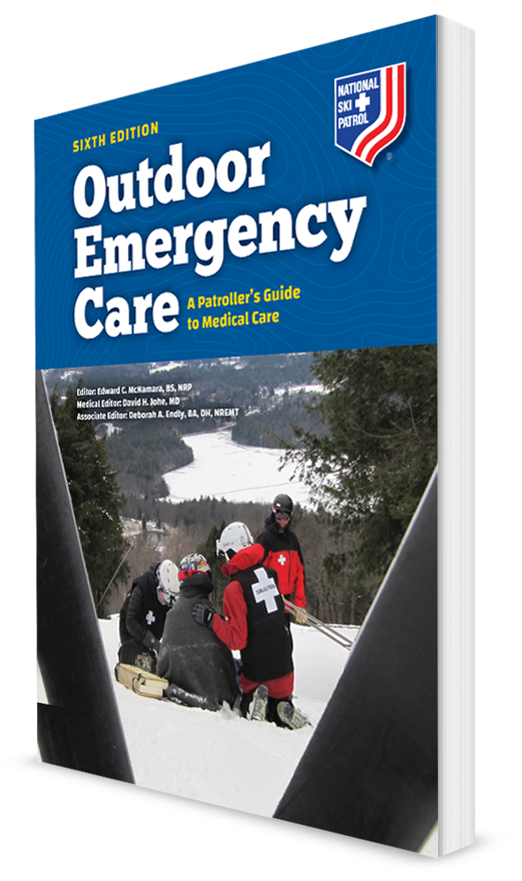
Shock
CHAPTER 10

Slide 2
The following presentation will utilize two symbols to identify material necessary for an OEC Technician to comprehend:
key term
Meets a Chapter Objective.
This symbol will have the corresponding Objective Number denoted within.
Identifies a Key Term.
The Key Term will be underlined for easy identification.

Slide 3
Objectives
10-1 Define shock.
10-2 Describe the three primary causes of shock.
10-3 Describe how the body compensates for shock.
10-4 Define the two stages of shock.
10-5 List the four major types of shock.
10-6 List the classic signs and symptoms of shock.
10-7 Describe and demonstrate the management of shock.

Slide 4
Key Terms
Anaphylactic shock
Anticoagulants
Cardiogenic shock
Distributive shock
Fainting
Hypovolemic shock
Neurogenic shock
Obstructive shock
Perfusion
Peripheral vascular resistance
Pulmonary embolism
Sepsis
Septic shock
Shock
Stroke volume
Tachycardia
Tachypnea

Slide 5
Chapter Overview

Slide 6
Chapter Overview
10-1
One of the most serious threats to life is the condition known as shock.
Shock is defined as inadequate perfusion or flow of blood to the cells, causing cellular and tissue hypoxia due to reduced oxygen delivery.
Perfusion is the circulation of blood within an organ or tissue in adequate amounts to meet the cells’ current needs for oxygen, nutrients, and waste removal.

Slide 7
Chapter Overview
The potential causes of shock are numerous.
Shock occurs when one or more components of the cardiovascular system fail.
This sets into motion a series of events that, unless corrected, may cause other body systems to fail and death to ensue.
Shock is initially reversible but must be recognized and treated immediately to prevent progression to irreversible organ dysfunction.

Slide 8
Chapter Overview
Shock is one of the most serious problems that OEC technicians will encounter.
Caused by various medical and traumatic conditions
Signs and symptoms of shock may not be apparent initially because the body compensates, maintaining normal vital signs.
Patient’s overall health, age, and medications taken may make shock more difficult to recognize at first.

Slide 9
Anatomy and Physiology

Slide 10
Causes of Shock
10-2
There are different types of shock, resulting from three basic causes.
Pump failure
If the heart cannot pump correctly (i.e., the heart fails)
Cardiac output decreases and blood is not pumped to the body adequately to sustain life.
Failure of blood vessels to respond properly
The veins and arteries expand too much, pooling blood in them.
Smooth muscle in the arteries and veins do not constrict these tubes.

Slide 11
Causes of Shock
10-2
Low fluid volume
Not enough blood to pump through the system
Body fluids can be lost due to:
Internal or external bleeding
Medical condition that decreases the amount of healthy blood
Dehydration from causes such as diarrhea or vomiting, burns, or excessive intake of diuretics (fluid pills)
Any one of these three conditions results in decreased perfusion, with insufficient oxygen or nutrients reaching vital organ tissue.
When two or more of these conditions occur together, shock develops rapidly.

Slide 12
Stages of Shock

Slide 13
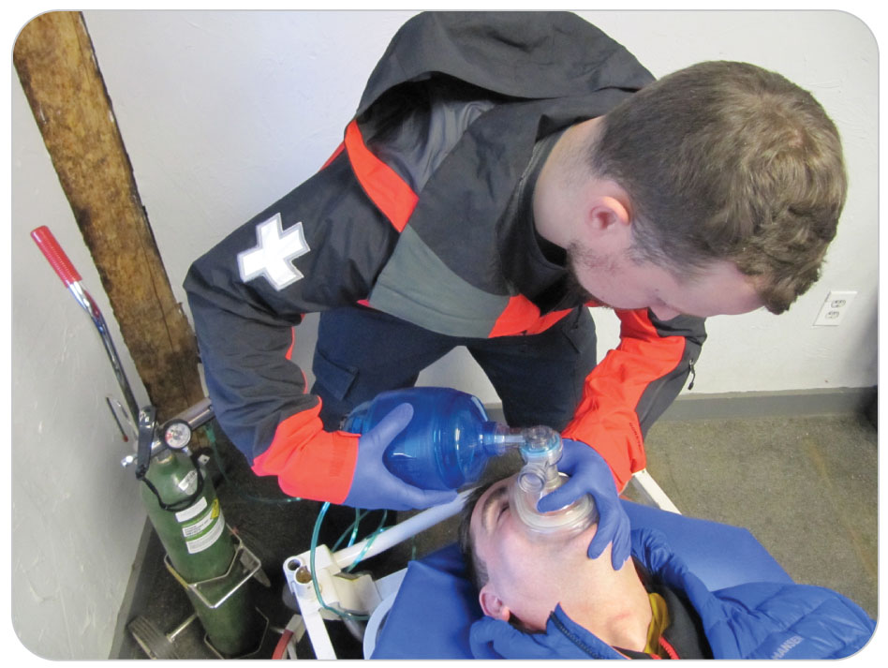
Stages of Shock
10-3
Shock is a progressive disorder that can be divided into two stages:
Compensated shock
Decompensated shock

Slide 14
Stages of Shock: Compensated
10-3
10-4
Compensated Shock
The human body can compensate to maintain homeostasis even during times of stress or harm.
Body’s systems have built-in redundancy and flexibility that correct adverse conditions.
In times of increased metabolic demand:
The body activates various compensatory mechanisms that help restore homeostasis.
Only for a while unless the problem is corrected

Slide 15
Stages of Shock: Compensated
10-3
10-4
Shock begins when the body detects:
A decrease in the amount of blood being circulated
A sudden decrease in the amount of oxygen reaching the cells

Slide 16
Compensated Shock: Increased Stroke Volume
10-3
10-4
The brain sends signals that stimulate the release of epinephrine, a hormone that causes:
Tachycardia (the heart to beat faster)
The ventricles to contract more forcefully
Both changes increase the stroke volume.
The amount of blood pumped out of the left ventricle into the aorta during one heartbeat
Enables more blood, oxygen, and nutrients to reach the body’s tissues and organs

Slide 17
Stages of Shock: Blood Vessel Constriction
10-4
Increasing resistance of blood flow to the extremities
Thus, increases blood flow to the vital organs
A key compensation in the early phases of shock
The central nervous system controls smooth muscles in the blood vessels, contracting the vessels or dilating them.
Peripheral vascular resistance refers to the tightening of the smaller-diameter blood vessels in the extremities.

Slide 18
Stages of Shock: Increased Respirations
10-4
The brain sends signals to increase the rate and depth of respirations.
Bring more oxygen into the body
Expel more carbon dioxide

Slide 19
Stages of Shock: Compensated
10-4
A combination of responses helps to stabilize the internal environment, at least temporarily:
Tachycardia
Increased stroke volume by the heart
Increased peripheral vascular resistance
Increased oxygen, by faster breathing
Compensated shock, therefore, is the body’s ability to maintain blood perfusion and oxygenation to vital tissues under adverse conditions.
Uncorrected, shock would inevitably lead to death.

Slide 20
Stages of Shock: Compensated
10-4
The body’s ability to compensate for shock early can mask a gravely serious uncorrected condition.
Gives you the false impression that the patient is less sick or less injured than is in fact the case
First signs of shock are:
Tachycardia
Tachypnea (respiratory rate greater than 20 breaths per minute)
Delayed capillary refill (greater than 2 seconds)
Cool skin
Anxiety or restlessness
A normal blood pressure

Slide 21
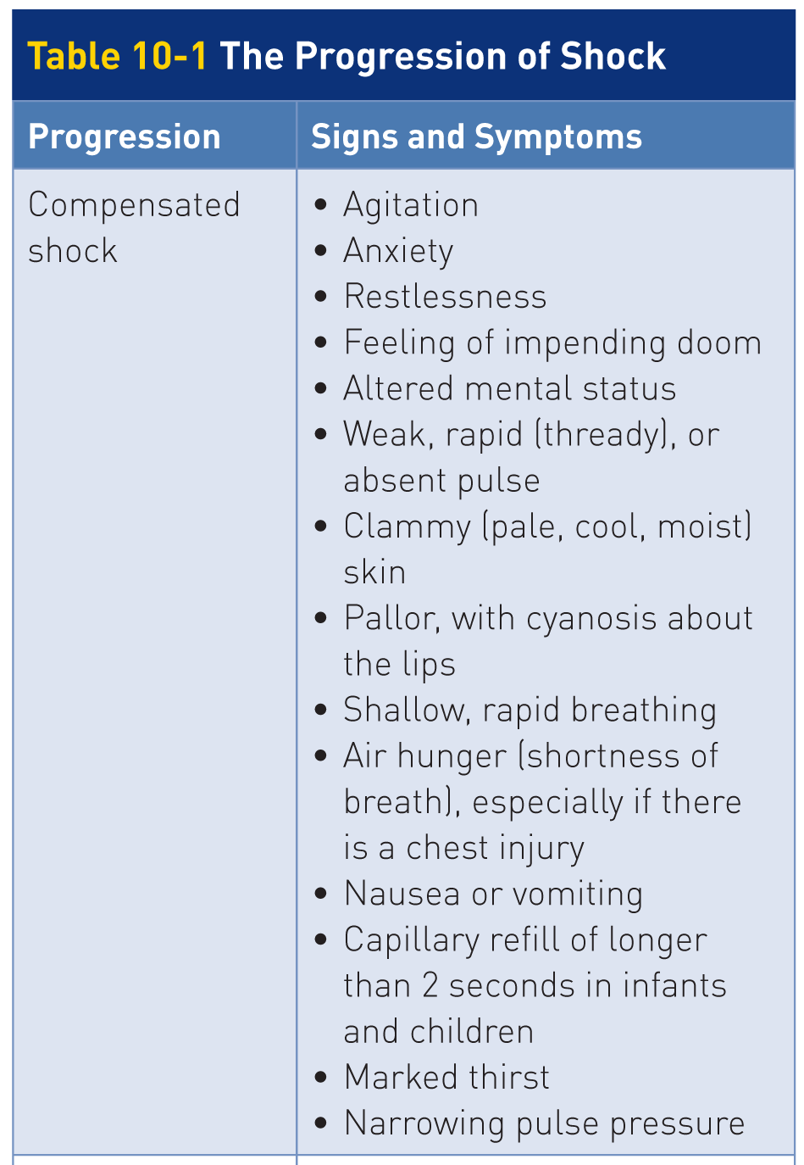
Stages of Shock: Compensated
10-4

Slide 22
Stages of Shock: Compensated
10-4
If shock is treated early:
Correctable and generally has no long-term adverse effects
If untreated:
Will progress until the body is no longer able to compensate

Slide 23
Stages of Shock: Decompensated
10-4
Decompensated Shock
When body’s compensatory mechanisms are unable to restore blood perfusion to the tissues:
Cellular hypoxia will worsen.
The body’s organs and systems will fail.
Heart rate will continue to rise, systolic blood pressure will now begin to fall (to below 90 mm Hg), and respirations may become shallow.
Skin will become grossly pale or cyanotic and will be cool and moist to the touch.
Due to severe constriction of the blood vessels in the extremities, capillary refill will be significantly delayed and may become undetectable.

Slide 24
Stages of Shock: Decompensated
10-4
Heart rate will continue to rise.
Systolic blood pressure will now begin to fall (to below 90 mm Hg).
Respirations may become shallow.
Skin will become grossly pale or cyanotic.
Will be cool and moist to the touch
Capillary refill will be significantly delayed and may become undetectable.
Due to severe constriction of the blood vessels in the extremities
Patient’s level of responsiveness will decrease (less than A on the AVPU scale).
Due to decreased oxygen in the brain

Slide 25
Stages of Shock: Decompensated
10-4

Slide 26
Stages of Shock: Decompensated
10-4
Treated early, decompensated shock may be corrected.
But serious complications can result.
Once the body’s compensating mechanisms fail, vital signs deteriorate very rapidly as cells begin to die.
Sets into motion a cascading effect that cannot be reversed
As more cells die, the tissues of various organs die, resulting in organ system failure and eventually death.
Despite even aggressive treatment, this form of shock is not reversible and is fatal.

Slide 27
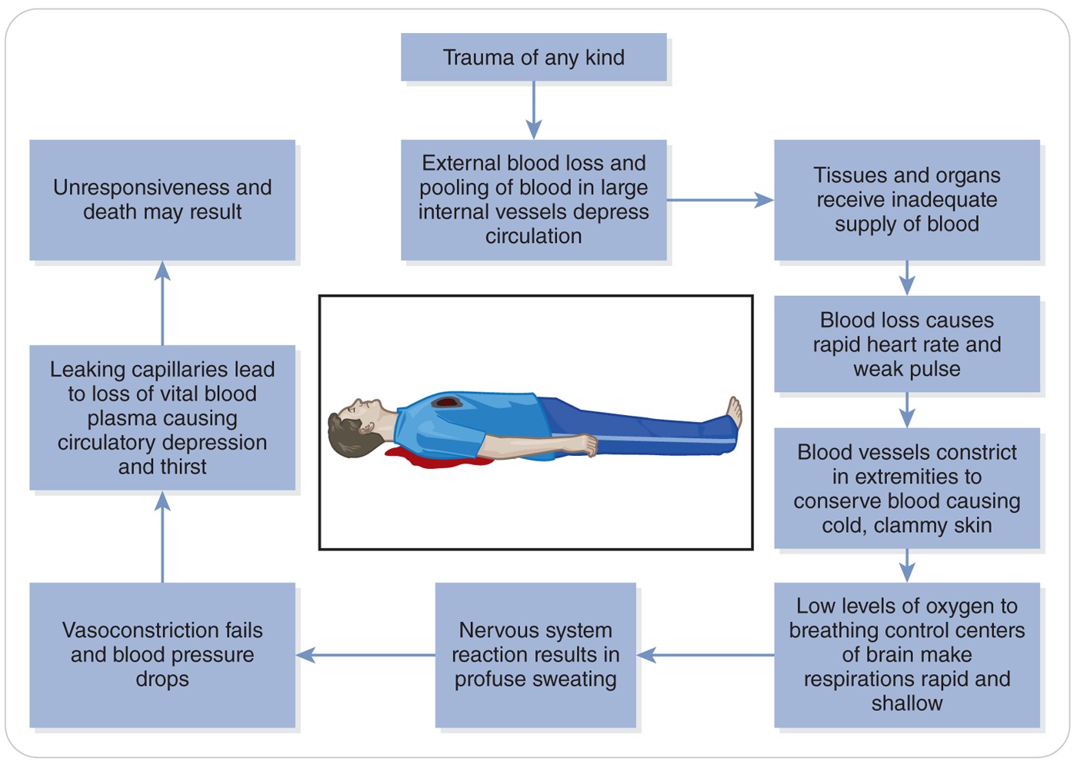
Stages of Shock
10-4

Slide 28
Types of Shock

Slide 29
Types of Shock
10-5
Four major types of shock:
Hypovolemic shock
Caused by loss of circulating blood volume or body fluids
Cardiogenic shock
Caused by the heart not pumping correctly
Distributive shock
A result of poor vessel function, resulting in the circulating blood pooling in the blood vessels
Obstructive shock
Caused by a blockage in the cardiovascular system preventing blood flow

Slide 30
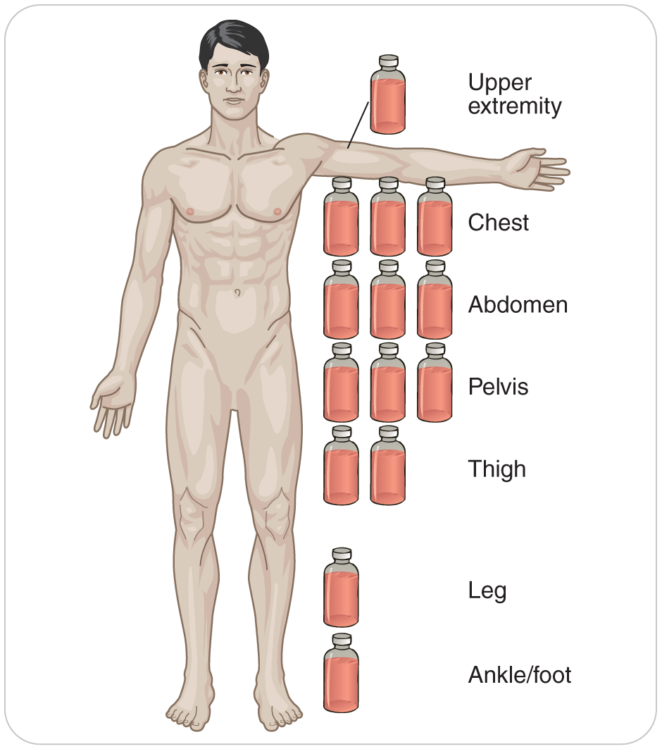
Types of Shock: Hypovolemic
10-5
Hypovolemic Shock
Results from a critical decrease in circulating fluid volume from:
Bleeding
A loss of internal body fluid
Causes:
Hemorrhagic
Nonhemorrhagic
Hemorrhagic shock is the more common type and has more far-reaching effects.

Slide 31
Types of Shock: Hemorrhagic Shock
10-5
Most common type of shock, a patient who has excessive bleeding.
Blood loss that results in hemorrhagic shock can be caused by a variety of problems, including:
Trauma
Gastrointestinal bleeding
Vascular disruption
Vaginal bleeding
Bleeding that is a complication of pregnancy
Bleeding disorders and certain medications may increase the severity of bleeding by preventing blood from clotting normally.
Anticoagulants, which inhibit the body’s ability to clot, can prolong bleeding; this can worsen hemorrhagic shock.

Slide 32
Types of Shock: Hemorrhagic Shock
10-5
Blood loss can be:
External and obvious
Internal and hidden
Blood loss due to hemorrhage can be divided into four classes, ranging from:
Class I, mild blood loss (less than 15% of total blood volume, or the equivalent of donating 1.5 units of blood)
to
Class IV, extremely life threatening (blood loss of 40% of total blood volume or greater)
A decrease in blood pressure may not be noted until more than 20% to 30% of total blood volume is lost.

Slide 33
Types of Shock: Hemorrhagic Shock
10-5
Early indicator of hemorrhage is a relative tachycardia.
Difficult to attribute increased heart rate to shock
Example: Someone who may be experiencing anxiety due to pain from an injury could also have tachycardia.

Slide 34
Types of Shock: Nonhemorrhagic Shock
10-5
Severe dehydration from vomiting and diarrhea may result in nonhemorrhagic shock.
Hypovolemia due to excessive water or fluid loss can occur with:
Severe burns
Dehydration
Excessive vomiting
Diarrhea
Sweating
The use of diuretic medications such as furosemide (Lasix)

Slide 35
Types of Shock: Nonhemorrhagic Shock
10-5
As water is lost from the body, compensatory mechanisms draw water away from the plasma.
Direct it to the spaces between the cells
Shift in fluid removes water from the bloodstream.
Thereby decreasing the circulating blood volume
Lowering blood pressure
Occurs over a much longer period of time than hemorrhagic

Slide 36
Types of Shock: Cardiogenic Shock
10-5
Cardiogenic Shock
Cardiogenic shock is a condition in which the heart cannot adequately pump blood.
Resulting in poor cardiac output
May fail for a variety of reasons, including:
Valve problems, which prevent the heart from filling or emptying properly
Heart attack, which results from heart muscle damage
Slow or fast heart rates, which decrease cardiac output
Legal and illegal medications
Trauma to the heart

Slide 37
Types of Shock: Distributive Shock
10-5
Distributive Shock
Distributive shock occurs when blood vessels lose their ability to constrict appropriately.
The resulting decrease in arterial vascular resistance causes blood to pool within the capillary beds.
Produces a sudden drop in blood pressure and cellular hypoxia
Distributive shock is a “container-related problem.”

Slide 38
Types of Shock
10-5
Under normal conditions, arterial resistance is regulated by:
Certain body chemicals
The nervous system
Local nerve receptors that help to ensure blood is delivered to where it is needed
Three subcategories of distributive shock include:
Anaphylactic shock
Septic shock
Neurogenic shock

Slide 39
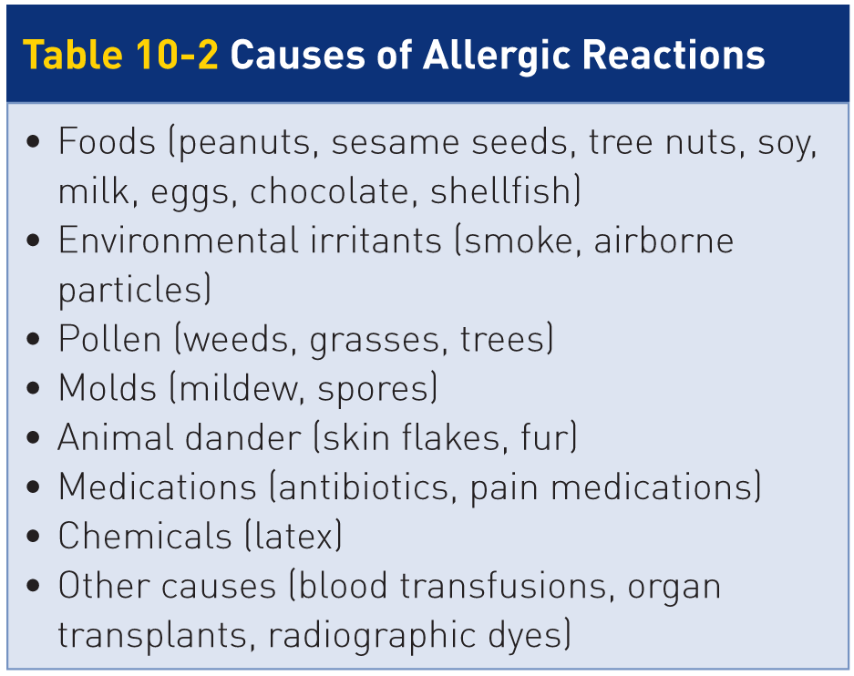
Types of Shock: Anaphylactic Shock
10-5
Anaphylactic shock
Anaphylactic shock is caused by a severe allergic reaction to a substance.
Common causes include:
Insect bites or stings
Consumption of shellfish, nuts, or other foods
Use of certain medications

Slide 40
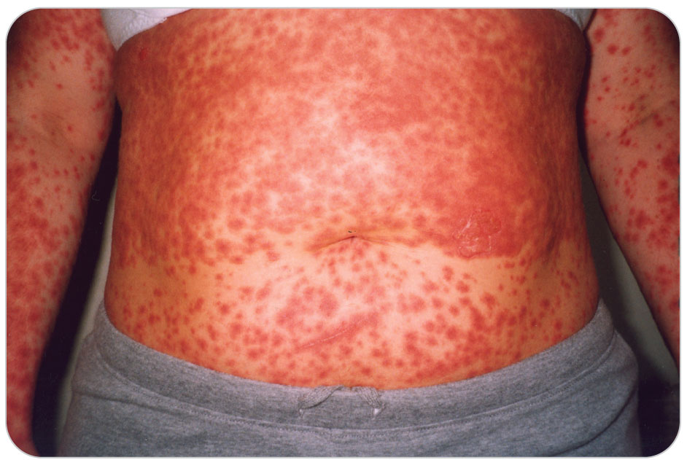
Types of Shock: Anaphylactic Shock
10-5
Normally, the immune system responds by releasing chemicals that aid the immune response to neutralize the foreign substance.
In a susceptible person, these chemicals cause:
Generalized dilation of the blood vessels
A host of other pathological problems
Without intervention, anaphylactic shock can quickly lead to respiratory arrest and death.

Slide 41
Types of Shock: Septic Shock
10-5
Septic Shock
Septic shock is caused by a severe systemic infection known as sepsis.
Is the most common cause of distributive shock
Sepsis is a serious medical condition caused by the presence of pathogenic organisms or their toxins in the blood, leading to a systemic inflammatory response.

Slide 42
Types of Shock: Septic Shock
10-5
Immune system’s white blood cells are released from the capillaries.
Attack and destroy pathogens such as invasive bacteria
If the pathogens or their toxins overwhelm the body and get into the bloodstream, sepsis occurs.
Results in a potentially life-threatening illness that involves severe fever, shaking “chills,” and shock
Unless sepsis is corrected, the pathogens will multiply beyond control, causing profound vasodilation, cellular hypoxia, and death.

Slide 43
Types of Shock: Neurogenic Shock
10-5
Neurogenic Shock
Neurogenic shock, is caused by a marked drop in blood pressure resulting from disruptions of the central nervous system, most often from a spinal cord injury.
Sometimes called spinal shock
When the spinal cord is damaged, normal neurologic input to the blood vessels is disrupted, causing the vessels to dilate.
Not generally seen immediately after a spinal cord injury
Usually occurring hours or possibly days later

Slide 44
Types of Shock: Obstructive Shock
10-5
Obstructive Shock
Obstructive shock results when a blockage prevents oxygenated blood from reaching vital organs.
Cause can be either external pressure being placed on the heart or a blockage within the body’s vascular system
Problem can be pump-related or container-related
Most common causes of obstructive shock are:
Tension pneumothorax
Pericardial tamponade
Pulmonary embolism

Slide 45
Types of Shock: Tension Pneumothorax
10-5
Tension Pneumothorax
Pleural Space: the potential space between the membrane on the outside of each lung and the membrane on the inside of the chest
Filled with a very small amount of pleural fluid
The lubricating properties of which allow the lungs to move freely while expanding and contracting during inhalation and expiration

Slide 46
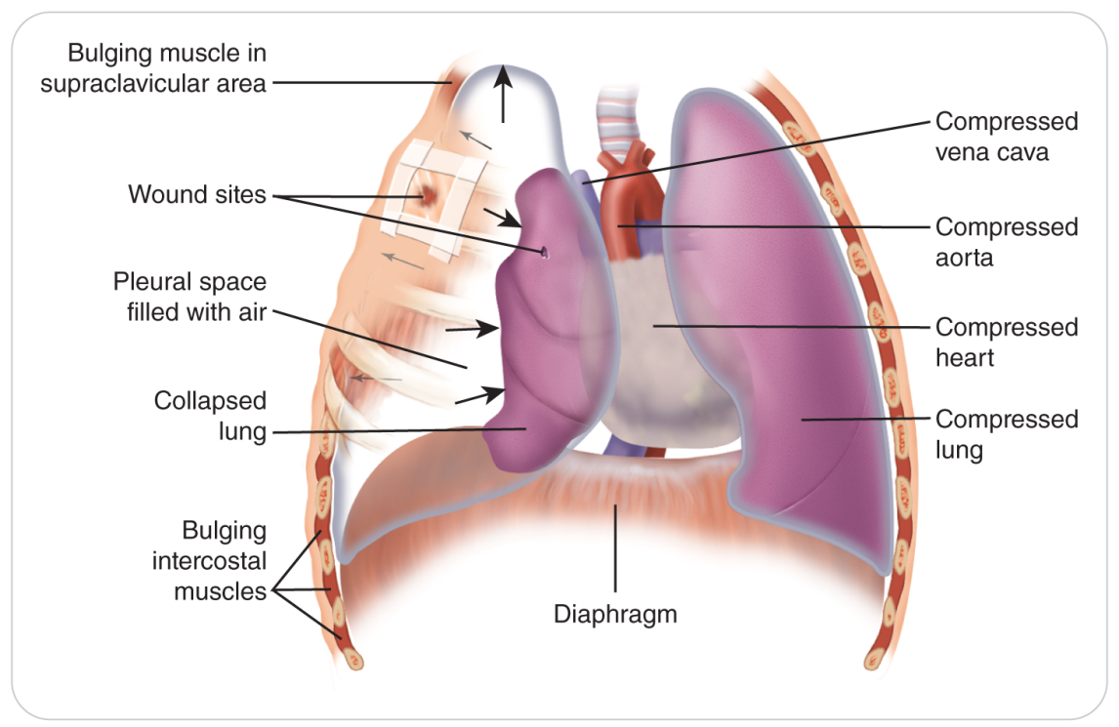
Types of Shock: Tension Pneumothorax
10-5
If the integrity of the chest wall or lung is compromised, air can seep into the pleural space causing a tension pneumothorax.
Pressure within the chest cavity can rise.
The lung can collapse.
Results in obstruction of venous blood returning to the heart
Thus impeding the heart’s ability to pump effectively

Slide 47
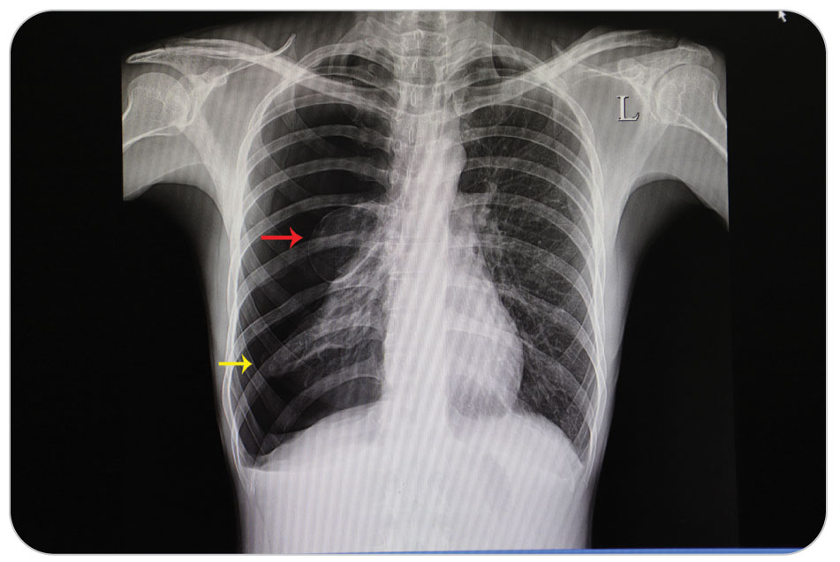
Types of Shock: Obstructive Shock
10-5
Obstruction can significantly reduce the amount of blood that enters and exits the heart.
Causes a drop in blood pressure and shock
Tension pneumothorax is a pump-related disorder caused by obstruction of blood flow.

Slide 48
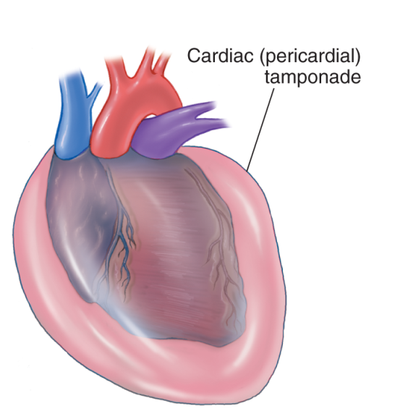
Types of Shock: Obstructive Shock
10-5
Pericardial Tamponade
Fluid accumulates within the pericardium, the sac surrounding the heart.
Fluid accumulation is called pericardial tamponade.
Right side of the heart cannot expand from the pressure of the fluid.
Decreasing cardiac output and causing shock
Pericardial tamponade is thus a pump-related problem.

Slide 49
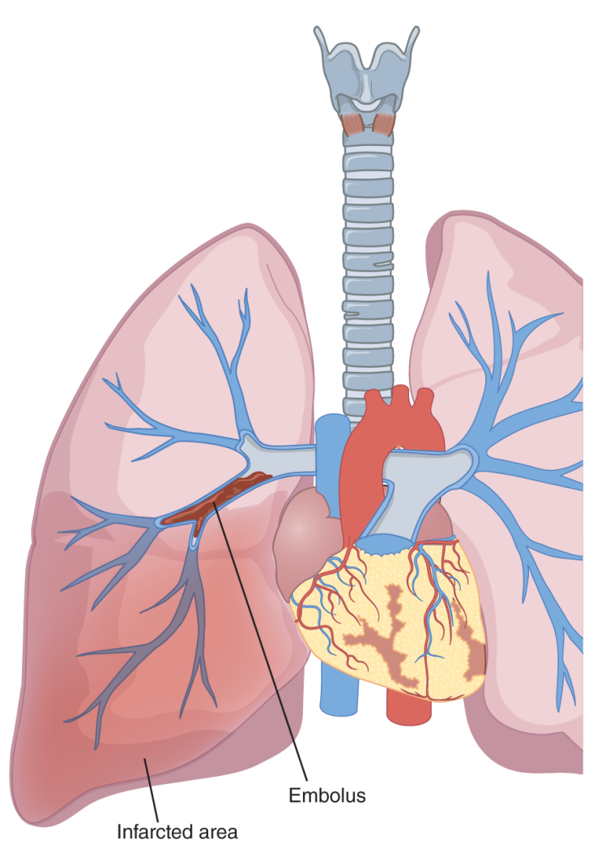
Types of Shock: Obstructive Shock
10-5
Pulmonary Embolism
A pulmonary embolism, or thromboembolism, is a condition where a blood clot becomes stuck in and blocks a pulmonary artery.
A blood clot breaks loose at a distant location.
Travels as an embolism through the right side of the heart
Lodges in the pulmonary artery
The blockage disrupts the flow of blood through the lungs and back to the heart.
Prevents gas exchange in the lungs
Pulmonary embolism can be rapidly fatal.

Slide 50
Fainting: NOT a form of Shock
Fainting, or syncope, is a loss of consciousness that results from a lack of blood flow to the brain.
This condition may occur suddenly.
Resulting from the temporary dilation of the body’s veins and pooling blood in those vessels
Hypotension of brief duration occurs.
Caused by fear, bad news, or an upsetting stimulus
Resolves by placing the patient in a supine position with feet raised 12 inches

Slide 51
Patient Assessment for Shock

Slide 52
“Classic” Signs and Symptoms of Shock
10-6
Tachycardia (fast heart rate)
Tachypnea (shortness of breath)
Thirst
Weakness
Nausea
Pale, cool, diaphoretic skin
Restless or combativeness
Occurs Later
Hypotension (low blood pressure)
Alter mental status

Slide 53
Management of Shock

Slide 54
Management of Shock
10-7
Management of a patient in shock centers on returning the patient to a state of homeostasis.
Given that shock is caused by inadequate tissue perfusion and oxygenation, initial treatment is focused on correcting any problems causing shock.

Slide 55
Case Study

Slide 56
CASE PRESENTATION
On a gentle slope, you find an approximately 55-year-old man holding his left side. You identify yourself and ask if you can examine him. While talking to him, you find he fell about 10 minutes ago on his left side. As you begin your assessment, the man says he’s fine and really doesn’t think any examination is necessary. Although he appears a little pale, his radial pulse seems normal, perhaps a little slow. As you gently touch his left upper abdomen and lower chest, he winces slightly.
What should you do?

Slide 57
CASE UPDATE
You suspect the man may be injured and secure the area by placing both your skis and his in an “X” several yards above your location. When you return, you obtain a more complete history. He tells you that his doctor recently put him on a blood thinner to prevent clots. He also tells you that he is taking a beta-blocker for high blood pressure. As you are talking with him, the man appears slightly confused and says, “I don’t feel very well.” You radio for help, oxygen, and ALS transport.
What do you think the problem is? What should you do next?

Slide 58
CASE OUTCOME
Two other patrollers arrive on scene. You inform them you believe the patient is suffering from shock due to internal injuries from the fall. The situation has been made worse because he takes a beta-blocker and an anticoagulant. Working with the other patrollers, you quickly put the man on high-flow oxygen and place him into a toboggan. You ski down with the toboggan team and help them move the patient into the first-aid hut. Soon after, a helicopter arrives and transports the patient to a local trauma center.
Several months later, you are in the ski area’s cafeteria when someone taps you on the shoulder. It’s the man and he thanks you for “saving my life” and informs you that your suspicions were confirmed. Lifting his sweater, he shows you an abdominal scar. He tells you that the impact of the crash ruptured his spleen and that had you not stopped and insisted that he be treated, he likely would have died of shock.

Slide 59
OEC Skill Activities

Slide 60
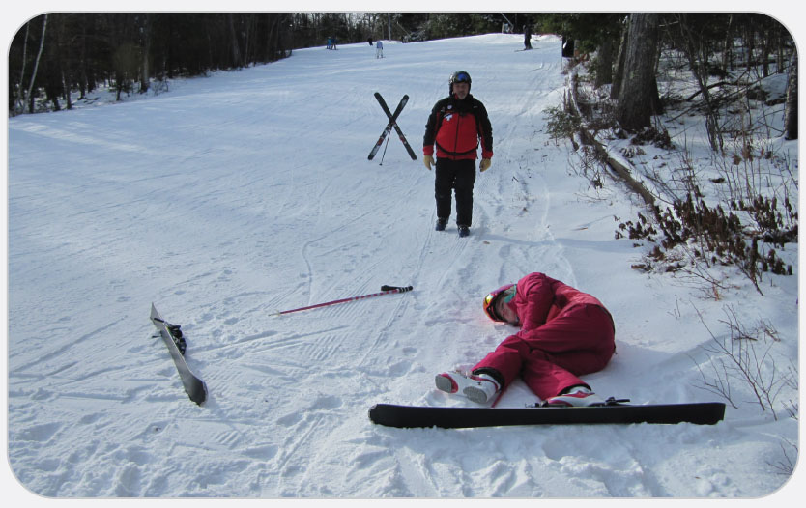
OEC Skill 10-1: Managing Shock
1. Assess scene safety and follow standard precautions.

Slide 61
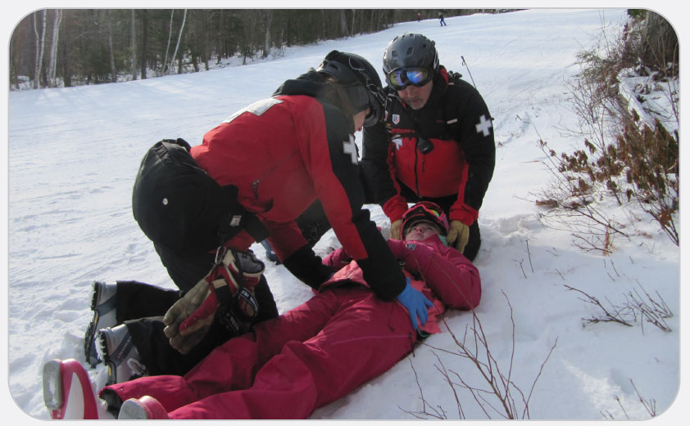
OEC Skill 10-1: Managing Shock
2. Perform a primary patient assessment. Control major bleeding and assess ABCDs. Correct any problems found. If the patient has no pulse, begin CPR.

Slide 62
OEC Skill 10-1: Managing Shock
3. Call for help and arrange for transport that includes ALS.

Slide 63
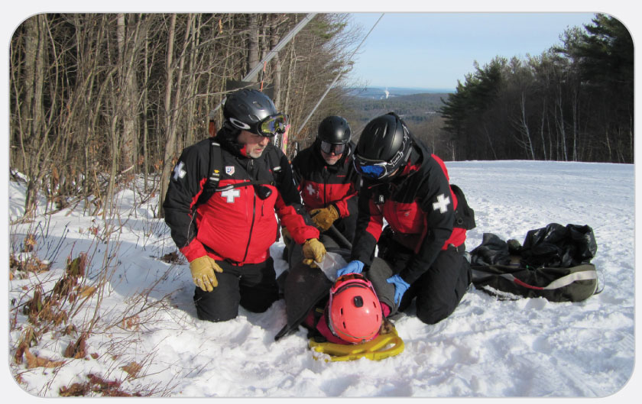
OEC Skill 10-1: Managing Shock
4. Monitor the airway and administer high-flow oxygen.

Slide 64
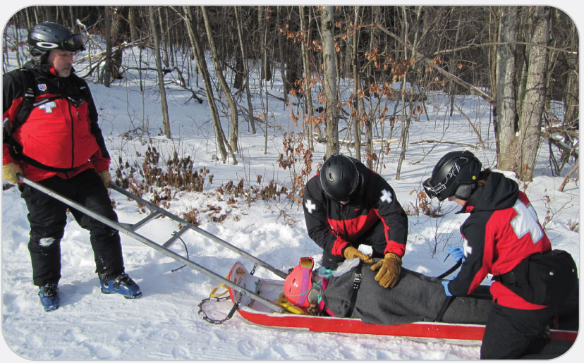
OEC Skill 10-1: Managing Shock
5. To prevent heat loss, keep the patient warm and dry. Provide rapid transport.

