Slide 1
Altered Mental Status
CHAPTER 11

Slide 2
The following presentation will utilize two symbols to identify material necessary for an OEC Technician to comprehend:
key term
Meets a Chapter Objective.
This symbol will have the corresponding Objective Number denoted within.
Identifies a Key Term.
The Key Term will be underlined for easy identification.

Slide 3
Objectives
OBJ
11-1 Define altered mental status.
11-2 List causes of altered mental status using the mnemonic AEIOU-TIPS.
11-3 Describe and demonstrate the management of a transient ischemic attack.
11-4 List the signs and symptoms of the following medical conditions:
Focal (partial) seizure
Generalized seizure
Hypoglycemia
Hyperglycemia

Slide 4
Objectives
OBJ
11-5 Describe how to assess a patient with altered mental status.
11-6 Define FAST-ED and explain how this can be used to identify someone who is having a stroke.
11-7 Describe and demonstrate the management of the two types of stroke:
Hemorrhagic stroke
Ischemic stroke

Slide 5
Key Terms
Absence seizure
Altered mental status
Aura
Clonic activity
Coma
Delirium
Dementia
Diabetes mellitus
Epilepsy
Generalized seizure
Glucose
Hyperglycemia
Hypoglycemia
Insulin
Polydipsia
Polyuria
Seizure
Stroke
Tonic activity

Slide 6
Chapter Overview

Slide 7
Chapter Overview
The body constantly monitors its internal and external environment and rapidly adapts to changes.
This process is controlled by the central nervous system (CNS), which regulates the functions of the other body systems.
The CNS consists of the brain and spinal cord.

Slide 8
Chapter Overview
11-1
To function properly, the CNS requires a steady stream of data from all parts of the body.
To preserve homeostasis, the CNS requires a constant supply of oxygen, glucose, and other nutrients.
Should the data stream or the body’s internal equilibrium be disrupted, the brain will lose its ability to respond appropriately.
Altered mental status is an abnormal change in a person’s level of responsiveness.

Slide 9
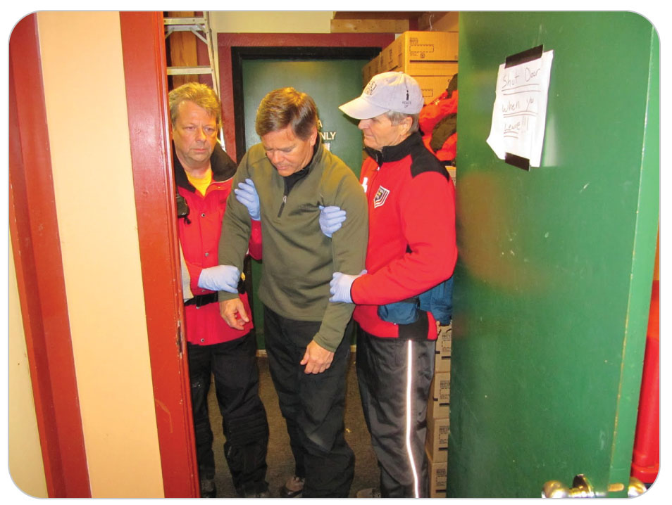
Chapter Overview
11-1
Altered mental status is a potentially serious problem that indicates that something is wrong within the brain.
There are many causes of altered mental status; some are life-threatening.
Symptoms may vary widely and be subtle.

Slide 10
Anatomy and Physiology

Slide 11
Anatomy and Physiology: Nervous System
One of the basic purposes of the nervous system is to sense the environment and to react to it.
Helps us avoid extremes in temperature, seek oxygen or water, or find nutrients to sustain life
Capable of such highly evolved functions as speech, locomotion, and intellect
Known as higher cortical functions
When the brain loses its ability to respond appropriately, this results in a condition known as altered mental status.

Slide 12
Anatomy and Physiology: Brain
The brain acts as a central processor that controls the rest of the body.
It consists of three major parts:
The brainstem
Controls functions necessary for life such as breathing, swallowing, responsiveness, heart function, and blood pressure
The cerebellum
Controls balance and coordination
The cerebrum
Controls emotion, thought, speech, integration, and memory as well as sensation and motor function

Slide 13
Altered Mental Status

Slide 14
Altered Mental Status
Most typically presents as decreased levels of responsiveness
Can also include abnormalities such as:
Delirium
A state of mental confusion and/or excitement characterized by disorientation with respect to time and place
Combativeness
Hallucinations
Delusions
Motor weakness
Balance problems
Vision loss
Speech abnormalities

Slide 15
Altered Mental Status
11-2
Altered mental status is not a diagnosis, instead a term indicating a general malfunction of the nervous system.
Causes of altered mental status
Include metabolic disorders such as:
Insufficient oxygen levels and low blood sugar
Infections
Nutrient imbalances
Structural brain abnormalities such as trauma, tumors, and cerebral blood clots
Toxic substances
Even behavioral problems

Slide 16
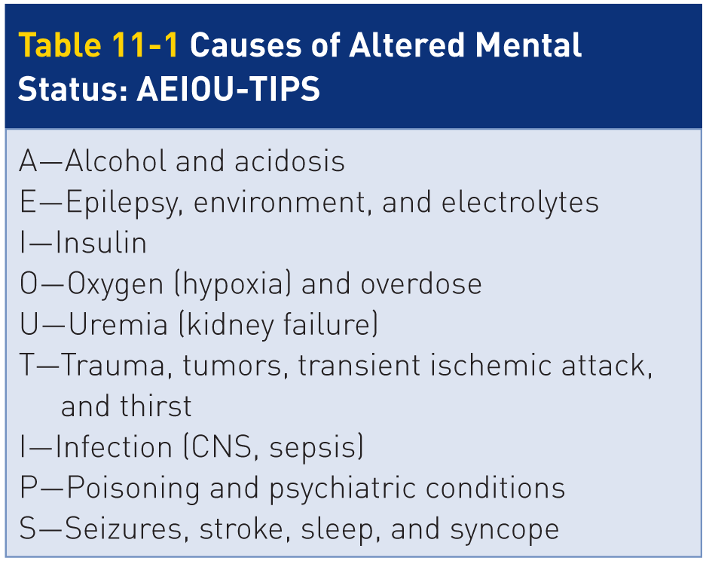
Altered Mental Status: AEIOU-TIPS
11-2
Regardless of the source, the exact cause may not be clear.
Be aware of the most common causes of altered mental status.
Can easily be remembered using the acronym AEIOU-TIPS

Slide 17
Altered Mental Status: A in AEIOU-TIPS
11-2
The A in AEIOU-TIPS stands for alcohol and acidosis.
Alcohol
Depresses CNS function
Acidosis
Body’s pH falls below normal levels
The resulting reduced effectiveness of various body systems threatens homeostasis.

Slide 18
Altered Mental Status: E in AEIOU-TIPS
11-2
The E in AEIOU-TIPS stands for epilepsy, environment, and electrolytes.
Epilepsy
Potentially serious medical disorder results in sudden, recurrent seizures
Environment
Changes in body temperature may also lead to altered mental status.
Electrolytes
To maintain homeostasis, the body always requires that a careful balance of electrolytes be maintained.
Imbalance can affect cellular function, resulting in altered mental status.
Factors such as excessive sweating, vomiting, or diarrhea can rapidly deplete electrolytes.

Slide 19
Altered Mental Status: I in AEIOU-TIPS
The first I in AEIOU-TIPS stands for insulin.
Insulin
Insulin is a hormone produced by the pancreas that regulates blood sugar levels.
Any condition that adversely affects the production and use of insulin or the regulation of blood glucose levels can produce altered mental status.
Glucose is a simple sugar that is the product of carbohydrate digestion in the body and the chief source of energy for most cells, especially neurons.

Slide 20
Altered Mental Status: O in AEIOU-TIPS
The O in AEIOU-TIPS stands for oxygen and overdose.
Oxygen
The brain requires an uninterrupted supply of oxygen to operate properly.
Even minor decreases or short interruptions in oxygen levels result in an immediate decrease in CNS functioning and overall responsiveness.
Hypoxia is the MOST common cause of altered mental status.
Overdose
Overuse of drugs, whether prescription or illicit
Overdoses involving opiates and depressant agents depress CNS function and respiration, resulting in decreased oxygenation and altered levels of responsiveness.
Heroin and fentanyl overdoses are common.

Slide 21
Altered Mental Status: U in AEIOU-TIPS
The U in AEIOU-TIPS stands for uremia.
Uremia
The kidneys are unable to effectively remove waste products from the body.
Uremia causes lethargy, coma, and ultimately death unless the toxins are removed from the blood.
Coma is an abnormal loss of responsiveness during which the patient cannot be aroused by external stimuli.

Slide 22
Altered Mental Status: T in AEIOU-TIPS
The T in AEIOU-TIPS stands for trauma, tumors, transient ischemic attack, and thirst.
Trauma
Injury to the brain is an especially common cause of altered mental status.
Tumors
Abnormal growth of cells that can be cancerous or malignant, or noncancerous or benign
Within the brain or skull can impair normal brain function, causing both global and focal changes

Slide 23
Altered Mental Status
Transient ischemic attack (TIA)
Reversible neurologic deficit that is caused by a temporary interruption of blood flow to an area of the brain
Typically caused by a small embolus that only temporarily blocks a small artery within the brain
No permanent brain injury results.
The signs and symptoms resolve completely within 24 hours.
Once the embolus dissolves or no longer blocks the artery
TIA serves as an early warning that a more serious stroke is likely to occur soon.
Thirst
Dehydration, when significant, can also cause altered mental status.

Slide 24
Altered Mental Status: I in AEIOU-TIPS
The second I in AEIOU-TIPS stands for infection.
Infection
An infection anywhere in the body can spread through the bloodstream, a condition known as sepsis.
Septic shock can affect mental status.
Involving the brain and/or spinal cord (e.g., meningitis) also affect mental status

Slide 25
Altered Mental Status: P in AEIOU-TIPS
The P in AEIOU-TIPS stands for poisonings and psychiatric conditions.
Poisoning
Can cause altered mental status and injury or death
Psychiatric conditions
A small percentage of patients with altered mental status may have a behavioral or underlying psychiatric disorder such as schizophrenia or manic-depressive disorder.
Other common behavior-related disorders that can cause altered mental status are depression, Alzheimer disease, or dementia.
Dementia is a broad impairment of intellectual function (cognition) that usually is progressive and that interferes with normal social and occupational activities.

Slide 26
Altered Mental Status: S in AEIOU-TIPS
The S in AEIOU-TIPS stands for seizure, stroke, syncope, and sleep.
Seizure
An electrical disturbance within the brain that causes alterations in awareness, attentiveness, responsiveness, behavior, or body movement
Stroke
Neurologic brain impairment resulting from low blood flow or a lack of blood flow to areas of the brain
Depending on what part of the brain is affected, different neurologic findings are present.

Slide 27
Altered Mental Status
Syncope (fainting)
This temporary loss of responsiveness is due to a disruption in blood flow to the brain.
Sleep
Patients who suffer from even minor sleep deprivation may have altered mental status, decreased reaction times, poor memory, and irritability.

Slide 28
Conditions Associated with Altered Mental Status

Slide 29
Conditions: Epilepsy
11-4
Epilepsy
Epilepsy is a chronic medical condition that causes recurrent seizures in an otherwise healthy individual.

Slide 30
Conditions: Seizures
11-4
Seizures
A seizure is an electrical disturbance within the brain that causes alterations in awareness, attentiveness, responsiveness, behavior, and body movement.
Signs and symptoms of seizures can be mild or severe depending on the part of the brain affected.
In its most dramatic form, a seizure results in violent, spasmodic movement of one or more opposing muscle groups.
Can cause a temporary loss of responsiveness
Seizures can last anywhere from seconds to hours, although most last 1 to 3 minutes.
Usually end on their own and generally do not cause any long-term problems

Slide 31
Conditions: Focal Seizures
Focal (partial) seizures
Can be:
Simple (responsiveness is not altered)
Complex (responsiveness is altered)
May involve:
Sensory changes
Involuntary skeletal muscle activity
Any combination of the two

Slide 32
Conditions: Focal Seizures
A simple focal motor seizure may present as an involuntary jerking motion of a specific muscle group.
Other signs:
Grunting or incomprehensible vocalizations
Tensing of the torso muscles
Facial twitching, usually on one side only
A simple focal sensory seizure may have blurred vision, see spots or flashing lights, abnormal smells, buzzing noises, hot or cold sensations, tingling, numbness, or abnormal metallic tastes.
These types of seizures generally do not result in a loss of responsiveness.

Slide 33
Conditions: Generalized Seizures
Generalized Seizures
Seizures that typically affect both sides of the body equally and result in a decreased level of responsiveness are considered generalized seizures.
Mildest form, affecting mostly children and young adults, is called an absence seizure.
Also called a petit mal seizure
Characterized by a vacant stare (i.e., “staring spells”), upward rolling of the eyes, or eyelid fluttering
An episode usually lasts less than 15 seconds and may not be noticed by others.
Patient exhibits normal behavior immediately after and between episodes.

Slide 34
Conditions: Generalized Seizures
The most common type is a grand mal seizure.
May occur without warning and is characterized by muscle tensing and contraction, better known as tonic-clonic activity
Tonic activity: the muscles of the body tightly contract, causing patient to forcefully stiffen
Clonic activity: the muscle groups spasm violently

Slide 35
Generalized Seizures: The Pre-Ictal Phase
A generalized seizure has three distinct phases: the pre-ictal, ictal, and post-ictal phases.
The pre-ictal phase occurs before the seizure.
Sometimes preceded by a premonition of the impending seizure called an aura
A distinctive feeling or sensation that signals patient a seizure is about to occur
Vary greatly among patients and are usually sensory in origin
May present as a cognitive state such as déjà vu, a unique taste or smell, an auditory sensation or visual hallucinations
Usually lasts for only a few seconds but can last several minutes

Slide 36
Generalized Seizures: The Ictal Phase
The ictal phase
Begins with tonic (rigid, stiff) muscle activity
Patient may cry out and/or fall stiffly to the ground.
Clonic (jerking) activity soon follows and may last for several minutes.

Slide 37
Generalized Seizures: The Ictal Phase
Patient is unresponsive and may make grunting or gasping sounds.
Jaw is usually clenched tightly, which can affect patient’s ability to breathe.
In extreme cases, patient may become slightly cyanotic, especially around the lips.
Ictal phase typically lasts a very short time, usually 1 to 3 minutes.
If the seizure lasts longer than 3 minutes, the cyanosis may become more pronounced.

Slide 38
Generalized Seizures: The Post-Ictal Phase
Post-ictal phase.
Once tonic-clonic muscle activity stops, the post-ictal phase begins.
Patient is minimally responsive to voices or painful stimuli.
Patient becomes limp.

Slide 39
Generalized Seizures: The Post-Ictal Phase
May unconsciously urinate or defecate due to relaxation of the urinary and anal sphincter muscles
Patient may exhibit snoring respirations or appear disoriented.
With time, patient becomes increasingly aware of the surroundings while becoming fully responsive and completely oriented.

Slide 40
Altered Mental Status: Status Epilepticus
Characterized by a seizure lasting longer than 10 minutes, a prolonged post-ictal unresponsive state, or three or more seizures without regaining consciousness or becoming responsive
This is a medical emergency.
Can cause permanent brain injury
The tremendous amount of energy expended during a prolonged seizure quickly depletes the brain of important energy substrates, thereby destroying delicate brain neurons.

Slide 41
Altered Mental Status: Diabetes Mellitus
The body is very effective in maintaining a constant and appropriate supply of glucose in the blood.
Normal blood sugar levels are between 80 and 140 mg/dl. May vary slightly depending on:
The individual’s physiology
Whether the person has recently eaten
Diabetes mellitus
Commonly referred to as “diabetes”
Body is no longer able to regulate the blood sugar level effectively and too much glucose is present in the blood.

Slide 42
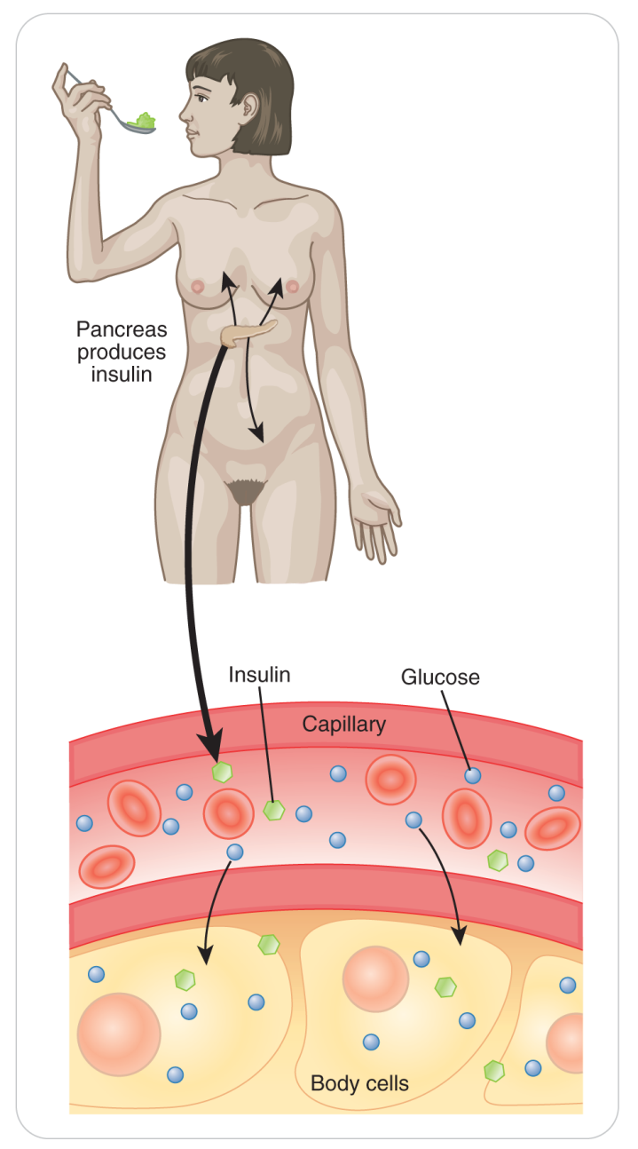
Altered Mental Status: Diabetes Mellitus
A chronic disease in which either:
The pancreas cannot produce enough insulin to meet metabolic needs OR
The body’s cells do not respond appropriately to insulin
Or both
When a person eats a meal, glucose is absorbed from the small intestine into the bloodstream.
Pancreas secretes insulin that allows glucose to move out of the bloodstream and into the cells for energy.
Excess glucose is stored in the cells of the liver, muscles, or fat.

Slide 43
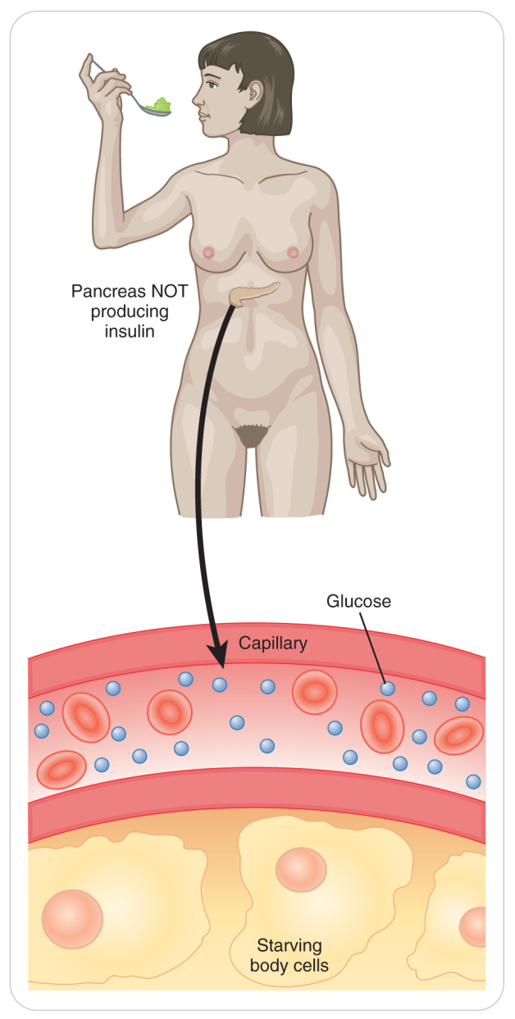
Altered Mental Status: Diabetes Mellitus
If not enough insulin is present, glucose cannot enter cells or be stored.
It accumulates in the bloodstream.
Raises circulating blood sugar levels
Long-term consequences of diabetes: damage or failure of the eyes, kidneys, heart, blood vessels, and nerves

Slide 44
Altered Mental Status: Diabetes Mellitus Type 1
There are two main types of diabetes mellitus, called type 1 and type 2.
Another type can occur in a pregnant woman temporarily, called gestational diabetes.
Type 1 diabetes
Previously called insulin dependent or juvenile diabetes
Usually diagnosed in children, teens, and young adults, but it can develop at any age.
Cause: the pancreas does not make insulin or is making very little
Far less common than type 2 diabetes
Usually treated with insulin injections

Slide 45
Altered Mental Status: Diabetes Mellitus Type 2
Type 2 diabetes
Previously referred to as adult-onset diabetes or non-insulin-dependent diabetes mellitus
Accounts for approximately 95% of all diabetes cases
Thought to affect only older individuals but is increasingly being diagnosed in young obese children
Causes:
The body either resists the effects of insulin or, after diabetes is present for some time, does not produce enough insulin to maintain a normal glucose level.
People make insulin, but their cells do not use it as well as they should.
Doctors call this insulin resistance.
There may be a genetic predisposition to the disease.

Slide 46
Altered Mental Status: Diabetes Mellitus Type 2
Type 2 diabetes
Most are treated through a regimen of weight loss, exercise, and hypoglycemia medications that lower blood glucose levels.
Do not initially require insulin injections
Occasionally, as patient gets older, low doses of insulin may be needed to regulate blood glucose levels.
Diabetic emergencies occur when patient’s circulating blood sugar level is either:
Too low (hypoglycemia)
Too high (hyperglycemia)

Slide 47
Altered Mental Status: Hypoglycemia
Hypoglycemia
When a blood sugar gets too low, hypoglycemia results.

Slide 48
Altered Mental Status: Hypoglycemia
Signs and symptoms of severe hypoglycemia:
Marked confusion
Disorientation
Lethargy and loss of responsiveness
Slurred speech
Seizures
Unilateral extremity weakness resembling a stroke
Irrational or combative behavior

Slide 49
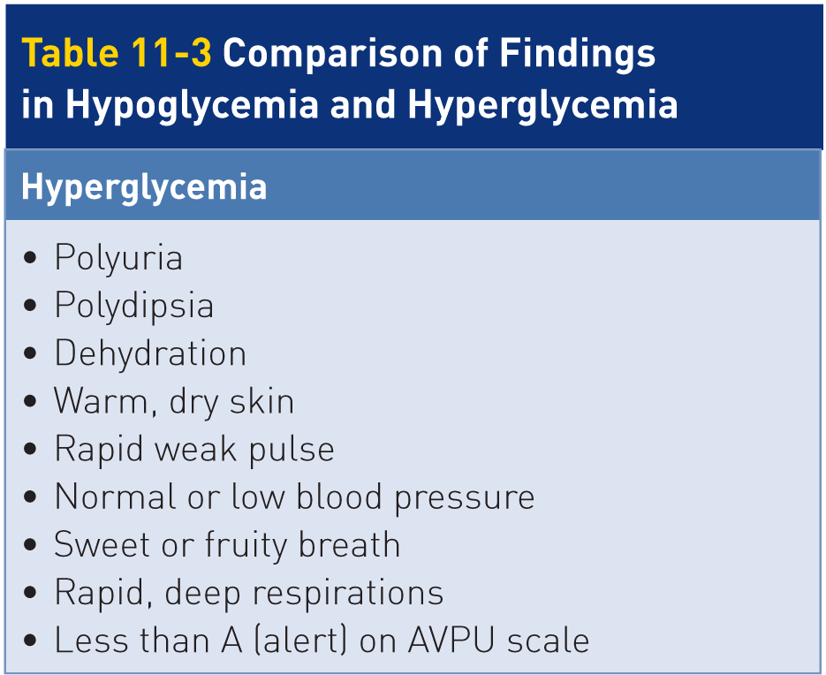
Altered Mental Status: Hyperglycemia
Hyperglycemia
High blood sugar, or hyperglycemia
The primary cause of hyperglycemia in diabetics is failure to take diabetes medications.
Leads to:
A very high blood sugar level
Polyuria (urinating a lot)
Polydipsia (thirsty all the time)
Dry mouth
Fatigue

Slide 50
Altered Mental Status: Hyperglycemia
Escalating blood glucose levels build up acids (ketones) within the blood.
Associated nausea, vomiting, abdominal pain, and varying degrees of altered mental status
Unless treated, the combination of high blood sugar and acidosis can result in coma, brain damage, or death.
Occurs much less than hypoglycemia and typically comes on slowly over days to even months.

Slide 51
Altered Mental Status: Hyperglycemia
Many children and adults who are undiagnosed diabetics commonly present with signs and symptoms of hyperglycemia.
Consider undiagnosed diabetes with someone who presents with altered mental status not from trauma and no history of diabetes.

Slide 52
Altered Mental Status: Stroke
Stroke
Stroke is a general term that describes neurologic brain impairment resulting from low blood flow or a lack of blood flow to areas of the brain.
Be familiar with the two basic types of stroke:
Ischemic Stroke
Hemorrhagic Stroke

Slide 53
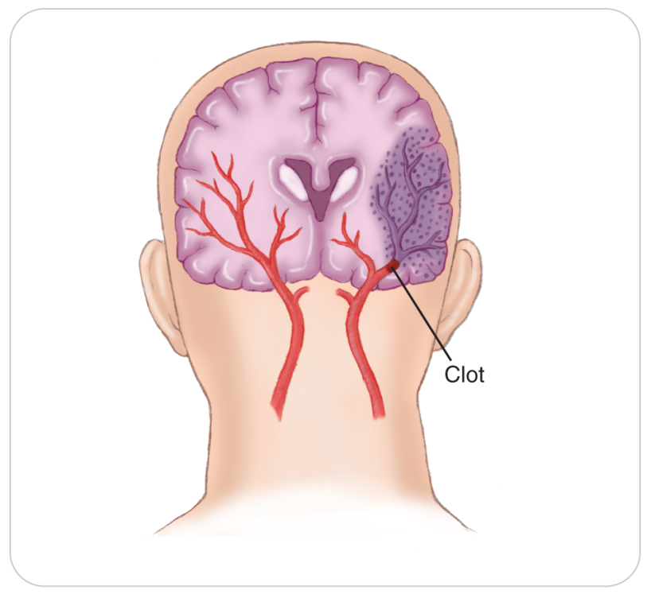
Altered Mental Status: Ischemic Stroke
Also known as a “dry stroke” or “white stroke”
The brain’s blood vessels, although blocked, remain intact and do not bleed.
Caused by a disruption of blood flow to a portion of the brain
Eighty percent of strokes are ischemic.
Primary cause is foreign material (an embolus) lodged in an artery in the brain.

Slide 54
Altered Mental Status: Ischemic Stroke
Most emboli originate outside the brain.
Blood clots
Fat from bone marrow after a recent long-bone fracture
Cholesterol plaques that break loose from the heart chambers or carotid arteries
Once lodged, blood flow to part of the brain may be reduced or completely stopped.
Portions of the brain may cease to function properly.
Results in a variety of signs and symptoms.

Slide 55
Altered Mental Status: Hemorrhagic Stroke
The second type of stroke is a hemorrhagic stroke.
Also known as an intracerebral hemorrhage, “wet stroke,” or “red stroke”
Occurs when a blood vessel within the brain suddenly ruptures
Releasing blood into the surrounding brain tissue
Reduces the amount of oxygen and nutrients available to the brain
The resulting hematoma also places direct pressure on the delicate brain tissue confined within the skull.

Slide 56
Altered Mental Status: Hemorrhagic Stroke
The most common cause is a structural weakness within the wall of a blood vessel within the brain.
Constant force of blood pressing against the wall of the vessel can cause it to burst.
A bulge, or aneurysm, present in an artery can burst open.
Small, fragile “end arteries” located at the base of the brain are especially vulnerable to developing a weakness and rupturing.
Depending on the size of the ruptured vessel and the extent of the brain affected, a hemorrhagic stroke can result in permanent neurologic problems or death.
People with high blood pressure are at risk for this type of stroke.

Slide 57
Patient Assessment for Altered Mental Status

Slide 58
Patient Assessment for Altered Mental Status
11-5
11-6
Determining the underlying cause of altered mental status can be challenging.
In many instances, patient cannot communicate.
May need to rely on circumstantial evidence:
Interviews with family members or bystanders
Medical alert tags that list patient’s medications or illnesses
Younger individuals more likely caused by a toxic overdose or trauma
Older individuals more likely complicated such as a heart problem or stroke
Any age group: diabetic, trauma-related, and epilepsy-related

Slide 59
Patient Assessment: Scene Size Up
Scene size-up:
Remove and identify potential hazards.
Attempt to determine cause:
Traumatic
Medical
Remember that the two can occur together.
If trauma is suspected, give careful consideration of spinal motion restriction when opening and maintaining the airway.

Slide 60
Patient Assessment: Primary Assessment
Carefully assess the ABCDs to ensure intact.
Evaluate LOR using the AVPU scale.
Make sure the airway is open.
Unresponsive:
Open the airway and simultaneously check for breathing and a carotid pulse.
No pulse:
Begin CPR.
Activate ALS when needed for more complex causes.

Slide 61
Patient Assessment: Secondary Assessment
First obtain a complete SAMPLE history (if possible) and vital signs.
SAMPLE:
A relative may help you with the history.
Look for a medical identification to identify a medical condition, allergy, or medications patient is taking:
Tag on a bracelet or necklace
Card in patient’s pocket/wallet
Some cell phones now have patient’s medical information in them.
Ask responsive patients if they have taken their medications as prescribed.
Remember to use AEIOU-TIPS when assessing for altered mental status.

Slide 62
Patient Assessment: History
Attempt to determine the exact time when the symptoms began or where first noticed.
Note whether the symptoms came on suddenly or more slowly.
Noting the onset time is very important for a stroke.
If patient had a seizure:
Did the seizure begin in one part of the body?
How long did the convulsions last?

Slide 63
Patient Assessment: History
Does patient’s speech appear impaired?
Slurring of words
Misuse of words
Incomprehensible speech
May result from alcohol or drug intoxication, hypoglycemia, stroke, or a behavioral condition
Does the patient repeatedly ask the same question? Says the same phrase over and over?
This disoriented behavior may be a clue to an underlying brain injury or a diabetes-related problem.

Slide 64
Patient Assessment: Physical Exam
Look closely at the pupils and inside patient’s mouth.
Note pupil size and response.
Pinpoint pupils are often associated with a narcotics overdose.
Unequal pupils can indicate a buildup of pressure within the brain.
Often due to trauma or stroke
An ominous sign

Slide 65
Patient Assessment: Physical Exam
Examine the mouth:
Cuts on the tongue or inside the cheeks
Commonly result from inadvertent biting that occurs during a seizure
Check patient’s skin:
Note temperature and overall condition.
Pale, moist skin may be due to shock or hypoglycemia.
Hot, dry skin may result from hyperglycemia or hyperthermia.
Hot and moist skin may also be caused by an infection.
Check to see if patient is incontinent of urine or feces.
May indicate that patient had a seizure

Slide 66
Patient Assessment: Physical Exam
Check higher cortical function by having patient perform a task consisting of multiple steps:
“Hold up two fingers on the right hand.”
Requires the brain to accurately process the request and to send the proper signal to the hand
A brain unable to perform the task accurately and quickly is not functioning properly.
Vocal-speech portion:
Repeat a phrase such as “Bananas are yellow, apples are red.”
Not functioning brain cannot accurately repeat the phrase or without slurring.

Slide 67
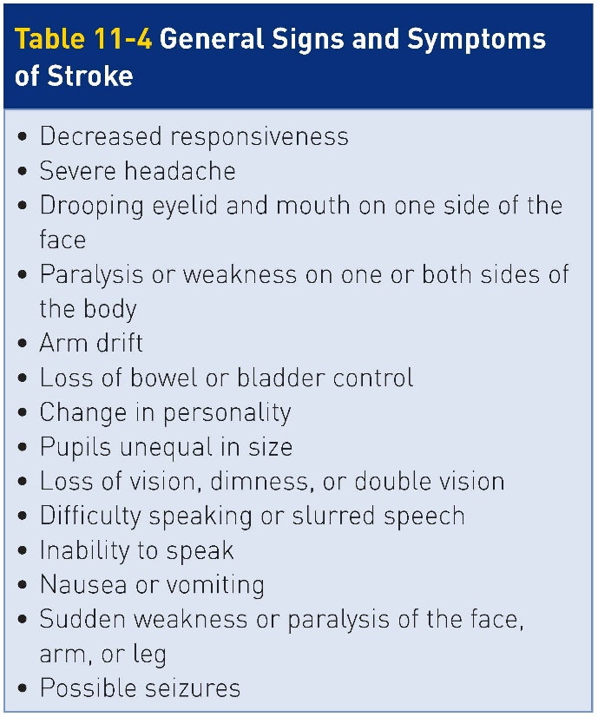
Patient Assessment: Recognizing a Stroke
Must recognize the signs and symptoms of a stroke as needs immediate evaluation at hospital
Watch for numbness and weakness or paralysis on one side of the body.
May involve only the leg, the arm, or the face, or all of them
Speech and language may be affected as well.

Slide 68
Patient Assessment: Recognizing a Stroke
Additional signs of a stroke:
Sudden disorientation
Inability to perform tasks such as buttoning a shirt, putting on a hat, or zipping a coat
Visual problems such as blurry vision or loss of vision for part of the visual field
Patients may walk into objects.
Sudden inability to walk, dizziness, or clumsiness
Sudden and unusually severe headache
If signs and symptoms have resolved or if subtle, may be a TIA.

Slide 69
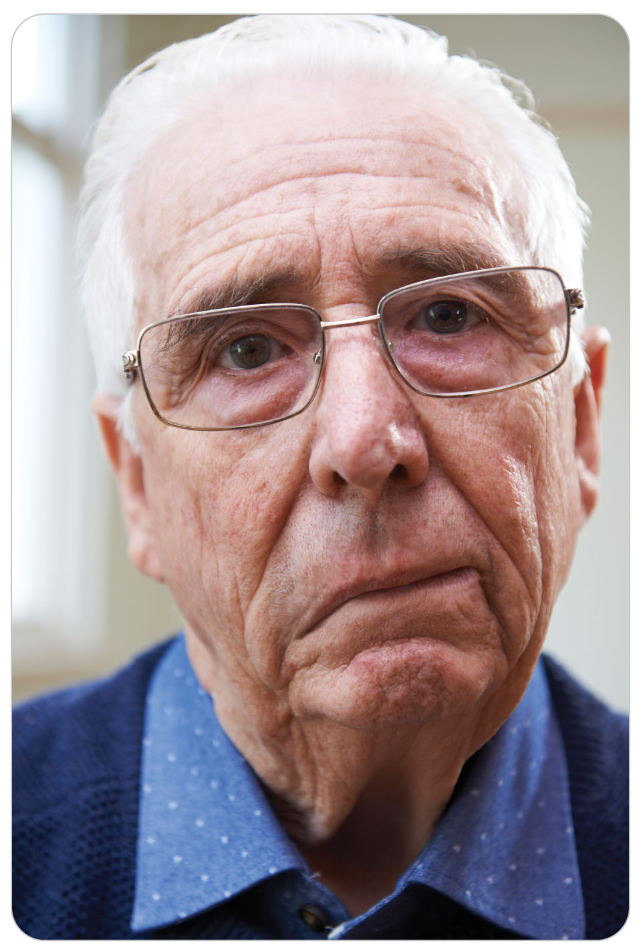
Patient Assessment: FAST-ED for Stroke
To aid in assessment, use the Field Assessment Stroke Triage for Emergency Destination (FAST-ED) scale.
F Face Drooping
Look for paralysis of one side of the face.
Drooping of the corner of the mouth
Sagging of facial skin

Slide 70
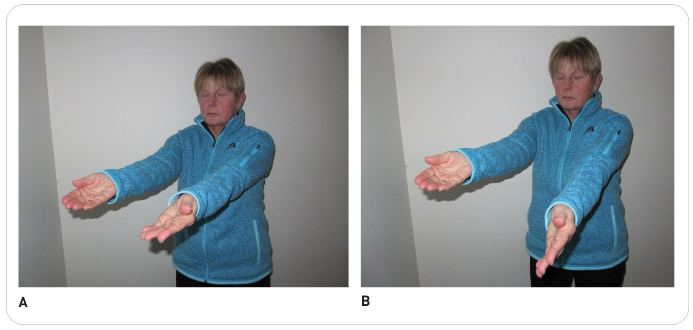
Patient Assessment: FAST-ED for Stroke
A Arm weakness:
Have patient raise both extended arms to shoulder level in front of them with eyes closed to see if one drifts down.
The arm droop test is easy to perform in the field.
Check if grip strength is equal in each hand.

Slide 71
Patient Assessment: FAST-ED for Stroke
S Speech difficulty: Are words garbled or cannot express themselves when you ask them to repeat a simple phrase?
T Time to call: If you see any of these signs, call 9-1-1 immediately.
If available, record the last know time patient responded normally.
E Eye deviation: Check extraocular eye motion.
D Denial/neglect: A positive finding is when patient is in denial of the problem.

Slide 72
Patient Assessment: Stroke
Estimating an accurate time of onset needed
Determines effectiveness of therapy with medications at hospital
If cannot be determined, the time of onset is the last time patient was known to be normal.
Any patient presenting with altered mental status should be evaluated at a clinic or hospital.
Even if signs are improving
Early detection and rapid transport are the keys for improving patient’s survival after a stroke.

Slide 73
Management of Altered Mental Status

Slide 74
Management of Altered Mental Status
Check patient’s airway frequently.
Suction as needed to ensure patent.
No spinal injury: recovery position
Unresponsive: nasal or oral airway
Spinal precautions should be taken when the cause is unknown.
Trauma may have produced a spine or other neurologic injury.

Slide 75
Management: Hypoglycemia
Insulin
Provide oral sugar to any diabetic with altered mental status.
Only if can swallow!
Regardless if on insulin or not
Always assume patient is hypoglycemic.
Because can quickly cause irreparable brain damage
If hyperglycemic, you will not cause further harm.
The small amount of sugar that is administered will not make patient worse.

Slide 76
Management: Hypoglycemia
Before administering oral glucose, be sure patient can swallow.
If unresponsive, never place oral glucose into the mouth.
Can result in aspiration and serious pulmonary problems
An unresponsive diabetic patient requires IV glucose or subcutaneous glucagon.
Can be provided only by ALS
Check to see whether any family member present might be carrying an emergency glucagon kit and be trained in its use.

Slide 77
Management: Hypoglycemia
Oral glucose includes prepackaged chewable sucrose tablets, sugar packs, or prepackaged tubes of cake frosting.
Sugar can be dissolved in water or the person can drink water after eating the sugar.
Orange juice has been found to be less effective than any of these forms for raising blood sugar levels.

Slide 78
Management: Hypoglycemia
If symptoms resolve:
Patient should consume a small meal to prevent recurrent hypoglycemia.
If symptoms do not resolve:
There may be another cause for patient’s altered mental status.

Slide 79
Management: Hypoglycemia
Patients often refuse further treatment or transport to a hospital once their level of responsiveness improves.
Especially common among patients who have had diabetes for a long time
Strongly recommend that such patients be evaluated further by a physician and document if the person refuses.
If patient has a hypoglycemic episode, their blood sugar is not well controlled.

Slide 80
Management: Stroke
Stroke
Can greatly improve chances of survival by providing:
High-flow oxygen
Protecting the airway
Rapid transport to a definitive-care facility, preferably a stroke center
Stroke is a time-sensitive condition because new therapies may reverse the effects if administered soon after symptoms develop.
New “clot-busting” medications may reverse an ischemic stroke if given within several hours of onset.

Slide 81
Management: Stroke
Do not delay transport unless spine trauma is highly suspected.
If possible, notify the receiving clinic or hospital that a potential stroke patient is coming to their location.
Document the TLKW (time last known well), as this helps the doctor know if clot-dissolving medication can be given.

Slide 82
Case Study

Slide 83
CASE PRESENTATION
In the bathroom at a ski resort, you find a woman on the floor. This middle-aged woman appears to be very confused and responds to verbal stimuli. Her radial pulse is fast and strong. Her skin is pale and cool to the touch, and she appears dyspneic (short of breath).
What should you do?

Slide 84
CASE UPDATE
An acquaintance states that she is unaware of the individual’s past medical history. They were partying last night and drinking too much. The woman skipped breakfast. Her friend says recently the woman has been drinking a lot of water and frequently goes to the bathroom.
The friend says she has not fallen or been injured. At first you suspect she has hypoglycemia and you ask her to swallow. She can swallow, so you give her three packs of sugar dissolved in water. Her condition does not improve.
What should you do now?

Slide 85
CASE OUTCOME
You realize the woman probably is not hypoglycemic, and you are unsure why she has altered mental status. You immediately call for ALS and transport. Several other patrollers arrive. Vital signs are stable. Following a secondary patient assessment, which reveals nothing, you get her to the waiting ambulance. Later you learn that she was admitted to the intensive care unit with hyperglycemia. She did not know she was a diabetic and had a blood sugar of 570 mg/dL on admission. Following the regulation of her blood sugar and starting insulin, she returns several weeks later to thank you.

