Slide 1
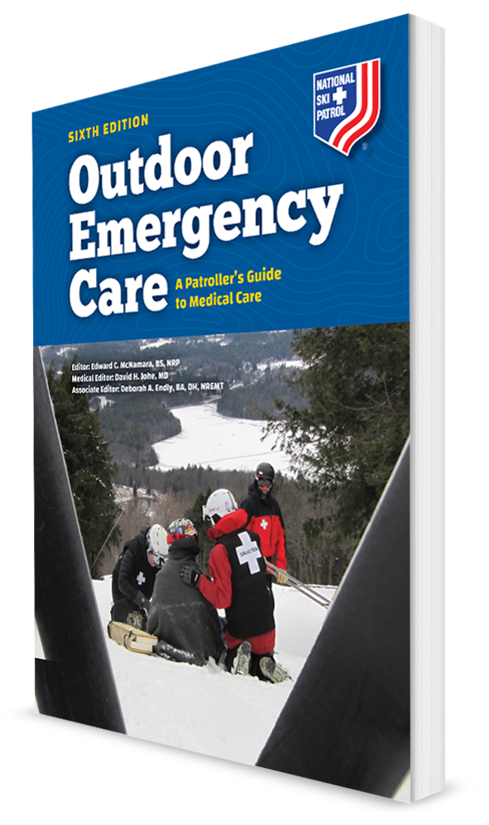
Allergies and Anaphylaxis
CHAPTER 14

Slide 2
The following presentation will utilize two symbols to identify material necessary for an OEC Technician to comprehend:
key term
Meets a Chapter Objective.
This symbol will have the corresponding Objective Number denoted within.
Identifies a Key Term.
The Key Term will be underlined for easy identification.

Slide 3
Objectives
14-1 List four routes by which an allergen may enter the body.
14-2 List four potential allergy causes.
14-3 List the signs and symptoms of an allergic reaction.
14-4 Demonstrate the steps for properly using portable epinephrine auto-injectors.

Slide 4
Key Terms
Allergen
Allergic reaction
Anaphylaxis
Angioedema
Antibody
Histamine
Hypersensitivity
Pruritus
Urticaria

Slide 5
Chapter Overview

Slide 6
Chapter Overview
Many people have medical problems caused by allergies.
Substances causing allergies are everywhere.
These substances can be:
In the air such as pollen
From common foods such as peanuts or shellfish
Due to medications

Slide 7
Chapter Overview
Allergies can be more than a simple nuisance.
In their most severe form, they can be deadly.
Allergies affect (in the United States):
30% of the adults, 4% having food allergies
40% of children, 5% having food allergies
OEC technicians are increasingly likely to encounter patients who are experiencing an allergic reaction.

Slide 8
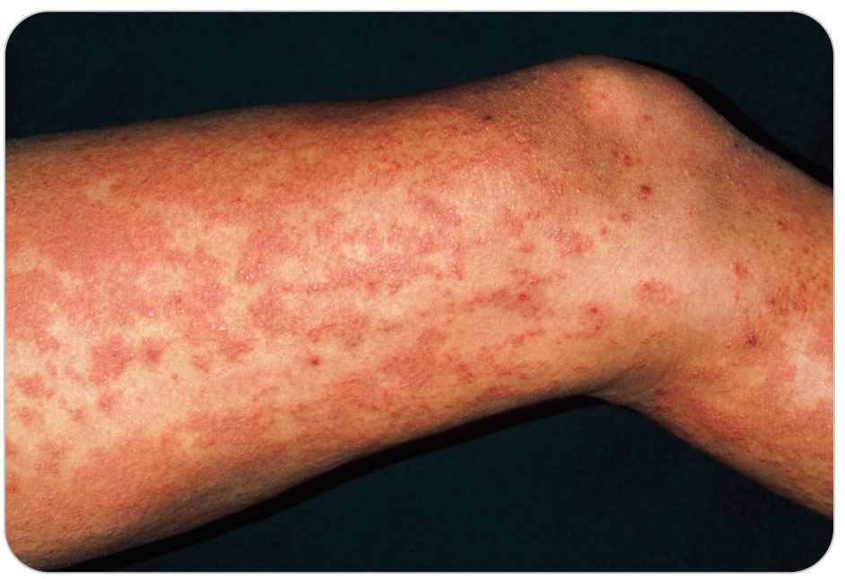
Chapter Overview
Allergy-related signs and symptoms can vary widely:
A simple runny nose
Shortness of breath
Life-threatening shock
An OEC technician needs to:
Have a basic understanding of the causes of allergies
Their effects on the body
Recognize the signs and symptoms of an allergic reaction
Be ready to help at a moment’s notice

Slide 9
Chapter Overview
Severe allergic reactions, known as anaphylaxis, can cause death within minutes.
The correct and timely responses to the situation may lessen the overall effects of an allergic reaction.
May save patient’s life by assisting them with their emergency allergy medications in the event of a severe allergic reaction

Slide 10
Anatomy and Physiology

Slide 11
Anatomy and Physiology
14-1
The immune system is a complex collection of the body’s cells, proteins, and organs that protect the body from foreign substances, including:
Viruses
Bacteria
Other microorganisms
Chief among the immune system’s primary components are:
White blood cells
Hormones
Lymph nodes
Bone marrow
The thymus
The spleen

Slide 12
Anatomy and Physiology: Antigen
14-1
Without the immune system, your body would be constantly invaded by pathogens that could easily harm or even kill you.
The immune system is highly specialized.
Can distinguish between the body’s normal cells and millions of foreign substances, known as antigens
Could be:
Allergens
Toxins
Bacteria
Foreign blood cells
The cells of transplanted organs

Slide 13
Anatomy and Physiology: Antibody
When antigens get into the body, this stimulates the production of an antibody.
An antibody is produced by the body to neutralize or destroy specific antigens.
When mobilized, they target the offending antigen.
Triggers a chain of events, known as antigen–antibody reaction
Results in the immune system attacking and destroying the antigen without harming normal body cells.
The antibodies produced from an initial exposure are specific to that antigen.
Those antibodies continue to be present in the body.
The next time that antigen enters the body, the immune system is ready.

Slide 14
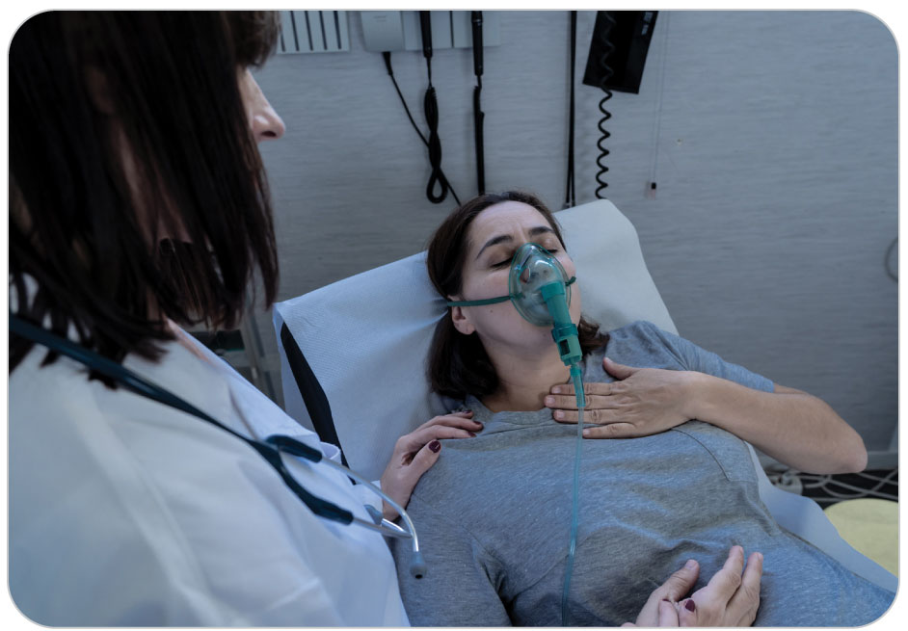
Anatomy and Physiology: Allergic Reaction
An exaggerated immune response to an allergen, drug, or other foreign substance is referred to as hypersensitivity.
Subsequent exposures cause the immune system to produce excessive amounts of antibodies.
Hypersensitivity known as an allergy
The exaggerated response is better known as an allergic reaction.
A severe allergic reaction, known as anaphylaxis
Can result in life-threatening shock (anaphylactic shock)

Slide 15
Anatomy and Physiology: Allergen
14-1
Any antigen that triggers an allergic response is known as an allergen.
Allergens can enter the body via four routes.
Inhaled
Ingested
Injected
Touch the skin (topical)

Slide 16
Anatomy and Physiology: Allergic Reaction
14-3
Once a person develops an allergy to a specific allergen, repeated exposure will again produce an allergic reaction.
How the body responds to an allergen and how long the effects last depend on the body’s sensitivity to the substance.
A mild reaction:
Skin-related effects, such as a rash or itching
A severe reaction:
Stimulates a massive inflammatory response due to the release of a chemical called histamine into the bloodstream
An event that can result in cardiovascular collapse and death

Slide 17
Anatomy and Physiology: Histamine
14-3
Histamine is a chemical that is released in the body because of an allergic reaction.
Causes local and peripheral edema, bronchoconstriction, vasodilation, hives, itching, and pain
Primary culprit in the production of an allergic reaction
Most allergic reactions occur within minutes to hours following the subsequent exposure to the allergen.
Some can occur much later.

Slide 18
Common Causes of Allergies

Slide 19
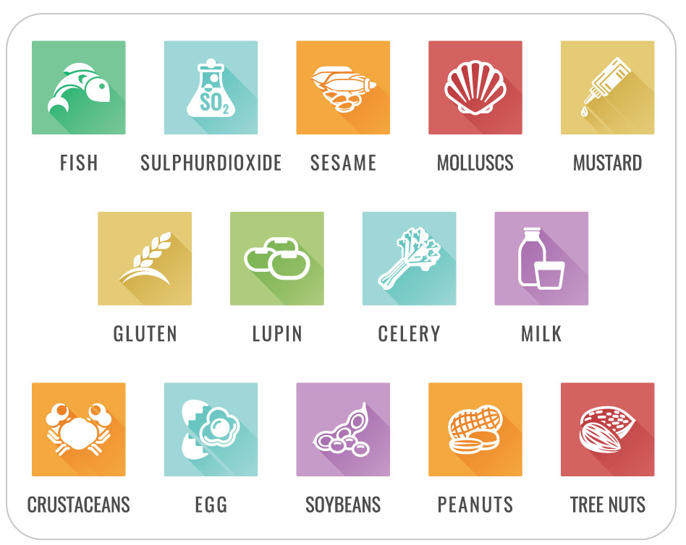
Common Causes of Allergies
14-2
Allergies can:
Be chronic, occurring throughout the year
Be seasonal, affecting an individual only during certain times
Allergies have a variety of causes:
Foods
Peanuts
Sesame seeds
Shellfish
Nuts
Soy
Milk
Eggs
Chocolate

Slide 20
Common Causes of Allergies
14-2
Insect bites and stings
Environmental irritants
Smoke
Airborne particles
Pollen and plants parts
Weeds
Grasses
Trees
Molds
Mildew
Spores

Slide 21
Common Causes of Allergies
14-2
Animal dander
Skin flakes
Fur
Medications
Antibiotics
Pain medications
Chemicals
Latex
Other causes
Blood transfusions
Organ transplants
Radiographic dyes

Slide 22
Common Causes of Allergies: Leading Allergies
14-2
Peanuts are the number one cause of allergic reactions to food in the world.
The exact reason for this is unknown.
Children are more prone to peanut allergies than are adults.
Dust mites are another leading allergen.
Chemicals such as natural rubber and latex are known to induce allergic reactions.
Medical personnel are strongly encouraged to use latex-free medical supplies and equipment.
Even severe stress can evoke an allergic reaction in susceptible individuals.
Allergies may also have a genetic component.

Slide 23
Categories of Allergic Reaction

Slide 24
Categories of Allergic Reactions: Mild
14-3
Mild Allergic Reactions
Skin reactions such as a rash or hives, known as urticaria
Rash may appear anywhere on the body.
Flushed and/or severe itchy skin, known as pruritus
Tingling in or around the mouth
Swelling of the nasal mucosa, a runny nose, and nasal congestion
Sneezing
Watery reddened eyes
A general feeling of being tired or “run down”

Slide 25
Categories of Allergic Reactions: Mild
14-3
Signs and symptoms may take minutes, hours, or even days to develop.
Effects usually disappear over time or with treatment.

Slide 26
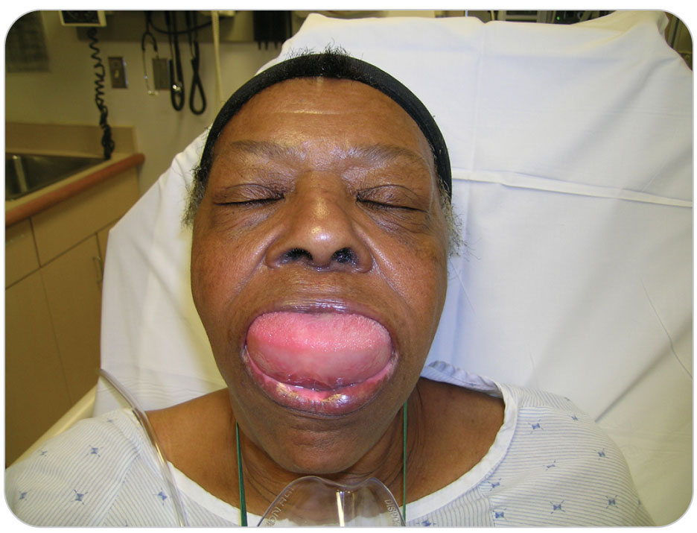
Categories of Allergic Reactions: Moderate
14-3
Moderate Allergic Reactions
The effects of moderate allergic reactions include all those that occur in mild reactions, but they are more pronounced.
Hives can appear on the chest and arms.
Itching is worse.
Skin can become flushed or pale.
Angioedema
The swelling or “puffiness” of the tissues beneath the skin
Common around the eyes, mouth, and hands

Slide 27
Categories of Allergic Reactions: Moderate
14-3
Moderate allergic reactions also affect the respiratory system.
Breathing may become mildly compromised.
The bronchioles constrict and secretions within them thicken.
Wheezing is often present and may be pronounced.
Swelling can become more pronounced in and around the face and lips.
The tongue may also swell, which can further hinder breathing.
As breathing becomes compromised, the amount of oxygen reaching the brain may be reduced.

Slide 28
Categories of Allergic Reactions: Moderate
14-3
Gastrointestinal distress is common in moderate allergic reactions.
Includes:
Heartburn, due to release of hydrochloric acid by the stomach’s lining
Diarrhea, due to contraction of intestinal wall smooth muscle
Intestinal cramping, nausea, and vomiting

Slide 29
Categories of Allergic Reactions: Moderate
14-3
All these effects may:
Appear within a few minutes after exposure OR
Take several hours to become apparent
These effects may dissipate on their own or increase in severity to a life-threatening problem.

Slide 30
Categories of Allergic Reactions: Severe
14-3
Severe Allergic Reactions
Anaphylaxis
The most severe type of allergic reaction
Results in collapse of the respiratory and circulatory systems
Cause major changes due to the release of massive amounts of histamine:
Respiratory systems
Integumentary systems
Circulatory systems
Gastrointestinal systems

Slide 31
Categories of Allergic Reactions: Severe
14-3
Within the respiratory system, the smooth muscles of the bronchioles tightly constrict.
Making wheezing severe and frequently audible
Ventilations, if any, may be minimal.
Result in virtually no gas exchange within the alveoli
The airways become occluded due to the combination of tight bronchoconstriction and edema.

Slide 32
Categories of Allergic Reactions: Severe
14-3
Angioedema:
The tongue and lips may completely block the upper airway.
The eyes and upper airway swell completely shut.
Hives may cover the entire upper body.
Skin can become increasingly flushed or profoundly pale.
Blood vessels dilate, causing a fall in blood pressure.

Slide 33
Categories of Allergic Reactions: Severe
14-3
Effects are usually obvious within a few seconds to minutes following exposure.
If patients are not treated quickly, anaphylaxis can lead to shock.
Blood pressure falls to dangerously low levels.
Tissue hypoxia becomes critical.
Anaphylactic shock is a serious medical disorder.
Almost always leads to death if it is not quickly recognized and properly treated

Slide 34
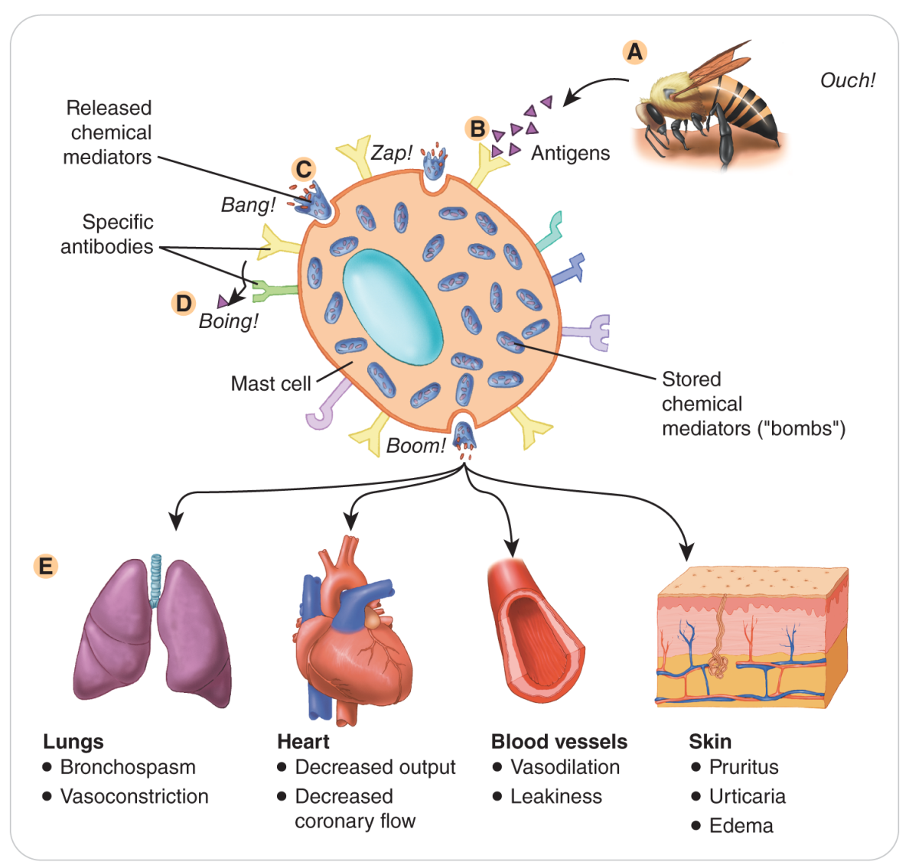
Categories of Allergic Reactions: Severe
14-3

Slide 35
Patient Assessment for Allergic Reactions

Slide 36
Patient Assessment: Scene Safety
Assessment starts with scene safety considerations.
Important if rescuers will be exposed to the suspected allergen
Especially for those who have the same allergy
Any rescuer who has the same allergy as patient should NOT risk exposure.

Slide 37
Patient Assessment: Primary Assessment
Treat any immediate threats to life:
Depending on the severity of patient’s distress, may need to JUST care for life threats
Not perform a secondary patient assessment until additional rescuers arrive
No immediate threats to life:
Proceed with obtaining a medical history.
Perform the secondary patient assessment.
Continue to monitor patient’s ABCDs carefully.

Slide 38
Patient Assessment: Secondary Assessment
14-3
Signs and symptoms of an allergic reaction are often evolving.
May not be immediately apparent
Can change over time
As a rule, those associated with respiratory impairment are especially ominous.
Indicate a potentially serious reaction

Slide 39
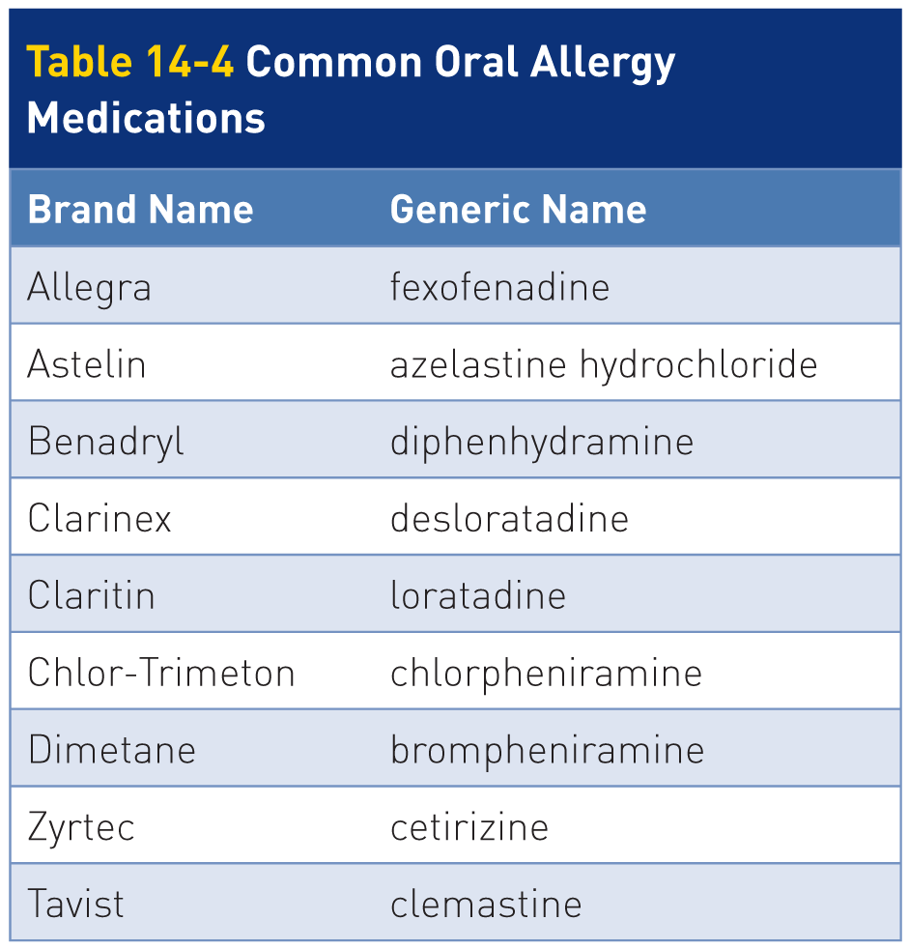
Patient Assessment: SAMPLE
14-3
Obtain a SAMPLE history.
Pay close attention to any known allergies.
Including medications
Ask for details of previous allergic reactions.
For patients with known allergies:
“Ever had a severe allergic reaction or an anaphylactic reaction?”
Ask patients whether they have taken any medications to self-treat this current allergic reaction.

Slide 40
Patient Assessment: Anaphylactic Shock
14-3
Anaphylactic Shock
Identified by the simultaneous presence of the:
Signs of a severe allergic reaction
Shock (nonhemorrhagic hypovolemic shock)
Symptoms/signs include the following:
Systolic blood pressure below 90 mm Hg
Respirations greater than 20 breaths/min
Heart rate greater than 110 beats per minute
In some cases, pulse rate less than 60 beats per minute
Level of responsiveness decreased
AVPU scale less than A (alert)
Pulse oxygen saturation levels less than 90%
May be less than 80%

Slide 41
Management of Allergic Reactions

Slide 42
Management: Moderate and Severe Reactions
14-4
Moderate and Severe (Anaphylactic) Allergic Reactions
Constitute a true emergency that must be treated immediately to prevent life-threatening shock
Begin treatment by correcting any ABCD-related problems.
Open the airway.
If patient has an EpiPen, assist patient as soon as possible by delivering the shot of epinephrine.
Oxygen should be given using a nonrebreather mask at 15 LPM.
If necessary, assist patient’s ventilations with a bag-valve mask or begin CPR.
Arrange transport and notify advanced life support immediately.

Slide 43
Management of Allergic Reactions
14-4
Remove any:
Tight-fitting necklaces, scarves, or bandanas from around the neck
Tight-fitting watches, rings, and bracelets, all of which can restrict or occlude blood flow through swollen distal structures
Place patient into a position of comfort.
Typically seated and slightly forward position
If exhibits signs of shock or a decreased level of responsiveness, place patient in a supine position.
If an allergic reaction is suspected, determine whether patient has an epinephrine auto-injector.
Do not use anyone else’s epinephrine auto-injector.

Slide 44
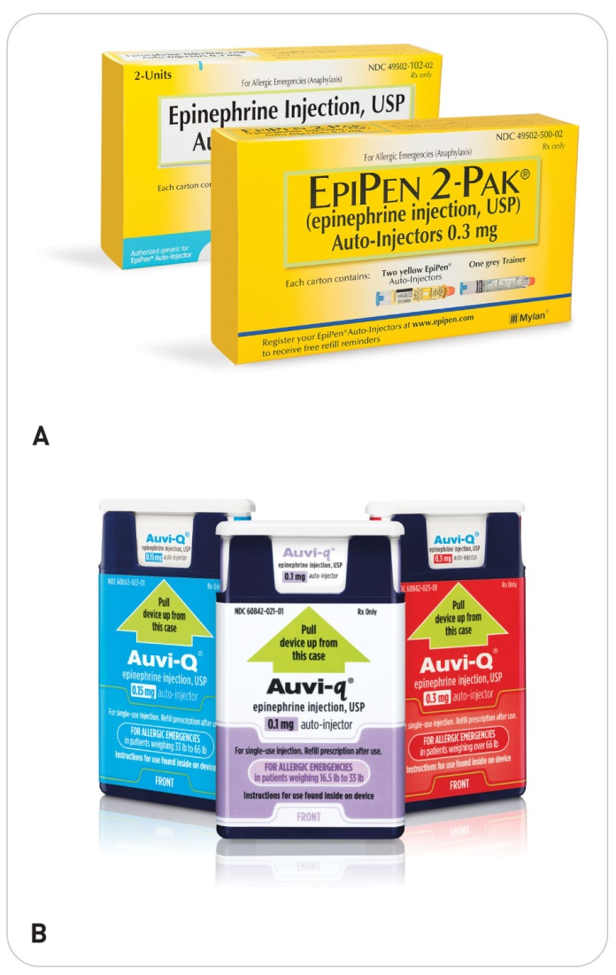
Management of Allergic Reactions
14-4
Epinephrine Auto-injector
Contains epinephrine, the drug of choice for managing severe allergic reactions
Promotes bronchodilation and vasoconstriction, thereby relieving dyspnea and hypotension
Come prepackaged as a single-dose or dual-dose portable auto-injector
Sold under brand names such as:
Epi E-Z Pen
EpiPen
Auvi-Q

Slide 45
Management of Allergic Reactions
14-4
The Auto-Injectors administer the proper dose of epinephrine using an automatic needle-injection system.
Injectors come in:
Adult and pediatric doses
Epinephrine is a fast-acting drug.
In most cases, a single dose will relieve symptoms within a few minutes.
Severe cases may require additional doses of epinephrine.
Especially true for prolonged transport situations
Second dose indicated if symptoms have not resolved within 10 minutes, or if they reoccur
Several epinephrine auto-injectors now have two doses of epinephrine in them, and thus can be used twice.

Slide 46
Management of Allergic Reactions
14-4
Every 5 minutes, monitor:
Breathing
Lung sounds
Vital signs
Patient’s condition should rapidly improve following the administration of epinephrine.
Able to breathe more easily
Normal vital signs
Signs of shock also should quickly diminish.
Administration of a person’s auto-injector is a lifesaving measure.

Slide 47
Management of Allergic Reactions
14-4
After usage of epinephrine, adverse reactions may occur.
These side effects are usually benign.
They include:
Anxiety
Restlessness
Tremor
Weakness
Dizziness
Sweating
Palpitations
Pallor
Nausea
Vomiting
Headache
Rarely heart rhythm irregularities

Slide 48
Management of Allergic Reactions
14-4
Moderate to severe allergic reaction:
Always call for ALS and transport early.
They need to go to the hospital.
Even if their condition improved using the auto-injector
Anyone who accidentally injects epinephrine into a thumb or finger also should be transported to the hospital for a follow-up evaluation.

Slide 49
Case Study

Slide 50
CASE PRESENTATION
You arrive on scene to assist a 16-year-old girl who is complaining of shortness of breath in the resort’s picnic area. In very short phrases, she states, “I have . . . a hard time . . . breathing.” She appears to be very anxious and says, “My tongue feels fat.” She denies any preexisting medical problems but states, “I am deathly . . . allergic to peanuts.” Her mother says she had a reaction to peanuts twice before. The last time required hospitalization. She appears to be very afraid. Just then you notice only a few feet away a small girl eating a peanut butter and jelly sandwich.
What should you do?

Slide 51
CASE UPDATE
You move patient to a safe area and begin to assess her condition. She looks pale and appears to be in moderate respiratory distress, and she has a wheeze. Once you determine that the ABCDs are intact, you notify dispatch to send additional personnel with oxygen and an airway kit. You also request that an ALS provider respond. Secondary patient assessment reveals no extremity, spinal, or abdominal problems. Respirations are 38 breaths per minute and labored. Patient’s face appears swollen. You then ask her if she has an epinephrine auto-injector. The mother says she has the girl’s EpiPen in the car. You reassure the mother that you will watch the girl while she goes to get the injector.
What should you do now?

Slide 52
CASE OUTCOME
Another OEC technician arrives with oxygen. You place patient on a nonrebreather mask at 15 LPM. Her mother arrives with the girl’s EpiPen and assists her in administering the medication in the lateral side of her thigh. Within a few minutes, she is breathing more easily, and her facial swelling begins to diminish. Shortly thereafter, an ALS provider arrives on scene. Together, you transport the girl to the parking lot, where an ambulance takes her to a nearby hospital. She makes a full recovery, thanks to your quick action.

Slide 53
OEC Skill Activities

Slide 54
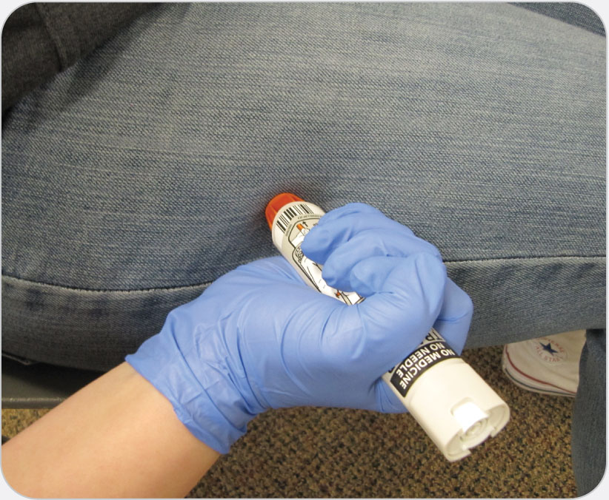
OEC Skill 14-1: Administration with an Auto-Injector (EpiPen)
1. Ensure that the medication is prescribed for patient by checking the name on the medication. Remove the medication from its protective package. Do not use if expired or discolored. Remove the safety cap from the auto-injector. Use your dominant hand to grasp the auto-injector firmly.

Slide 55
OEC Skill 14-1: Administration with an Auto-Injector (EpiPen)
2. Do not place your thumb over either end of the auto-injector, because doing so could result in the accidental injection of the medication into your thumb. Place the tip of the auto-injector against patient’s outer thigh muscle (halfway between the hip and knee). If possible, wipe the skin with an alcohol wipe first. In an extreme emergency, the auto-injector may be administered through clothing. Firmly push the tip against the thigh until the needle deploys. (You should hear an audible “click” as the medication is being injected into the thigh muscle.) Maintain firm pressure for 10 seconds so that needle does not come out of skin. Remove the auto-injector, and dispose of it in a suitable container. Massage the injection site for 10 to 20 seconds. Note the time and dose at which the drug was administered, and document.

