Slide 1
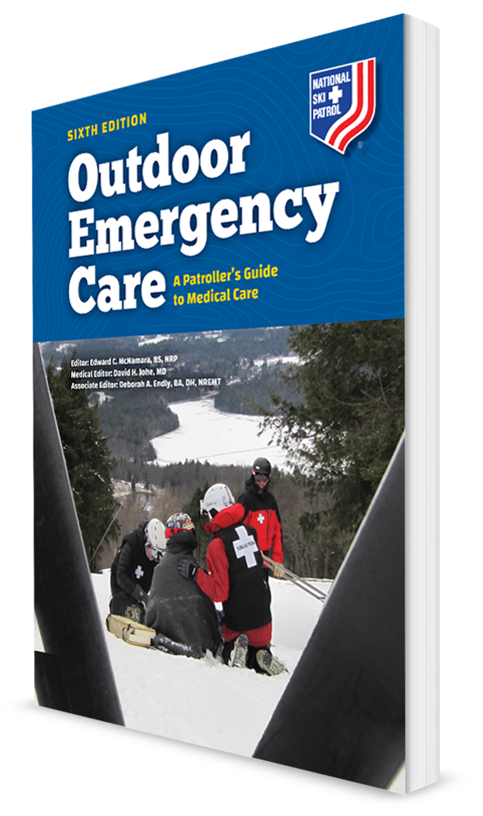
Childbirth, Obstetric Emergencies, and Sexual Assault
CHAPTER 17

Slide 2
The following presentation will utilize two symbols to identify material necessary for an OEC Technician to comprehend:
key term
Meets a Chapter Objective.
This symbol will have the corresponding Objective Number denoted within.
Identifies a Key Term.
The Key Term will be underlined for easy identification.

Slide 3
Objectives
17-1 Explain the normal reproductive cycle of a woman.
17-2 List the normal changes in vital signs a woman experiences during pregnancy.
17-3 Explain how to take a blood pressure in a pregnant woman.
17-4 Describe what happens to the mother and fetus during shock.

Slide 4
Objectives
17-5 Describe the three trimesters of a normal pregnancy.
17-6 Describe possible complications of pregnancy.
17-7 Demonstrate how to examine a female patient with abdominal or pelvic pain.
17-8 Describe the special considerations that are needed when using spinal motion restriction for a pregnant woman.

Slide 5
Objectives
17-9 Describe the management of a pregnant patient with abdominal trauma.
17-10 Describe and demonstrate the process of assisting a woman during a delivery.
17-11 Explain what to do when there is a possible sexual assault of a woman.
17-12 Describe the basic care for a newborn.

Slide 6
Key Terms
Abruptio placentae
Eclampsia
Ectopic Pregnancy
Gestational period
Meconium
Menstruation
Miscarriage
Placenta previa
Preeclampsia
Reproductive age

Slide 7
Chapter Overview

Slide 8
Chapter Overview
A woman’s anatomy enables reproduction and the continuation of humanity.
Fertilization of an egg inside a woman results in pregnancy.
Following fertilization, a fetus grows inside a woman’s uterus for approximately 9 months.
When delivery of a newborn baby occurs
During pregnancy, many changes happen to a woman’s body that a ski or bike patroller must understand when caring for the pregnant woman.

Slide 9
Chapter Overview
Many athletic women continue to exercise and enjoy outdoor activities during the first several months of pregnancy.
Some women participating in sports may not even know they are pregnant.
Pregnant women nearing childbirth may stay in the lodge.
As an OEC technician, you may be called upon to care for a pregnant woman in a wide range of scenarios, from a medical or traumatic emergency to delivery of a baby.

Slide 10
Chapter Overview
For thousands of years, women have been delivering babies without the assistance of medical personnel.
Women who have a normal, uncomplicated childbirth need very little help.
Even in an uncomplicated childbirth, the right assistance can enhance safety and comfort for the mother and child.
Helping the mother when complications arise can prove lifesaving for the woman, the newborn, or both.
It is important for OEC technicians to understand key concepts relating to pregnancy, labor, and delivery.

Slide 11
Chapter Overview
Some women have medical conditions while pregnant such as high blood pressure or gestational diabetes.
Trauma can potentially result in the injury or death of two patients—the mother and the fetus.
Goals for management of obstetric emergencies and pregnancy complications are the rapid identification of a potentially serious or life-threatening condition followed by immediate prehospital care and evacuation to a medical center.

Slide 12
Anatomy and Physiology

Slide 13
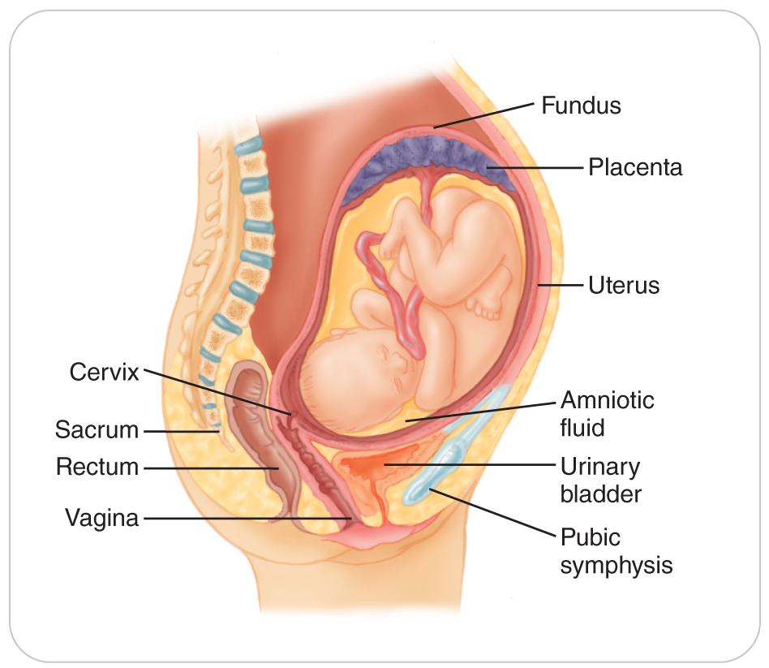
The Reproductive Cycle
17-1
This cycle occurs about once every 28 days during a woman’s reproductive years.
Begins with ovulation, when an ovum or egg is released from an ovary.
Ovum travels through a fallopian tube to the uterus.
For pregnancy to occur, the ovum must be fertilized by a sperm while in the fallopian tube.

Slide 14
The Reproductive Cycle
17-1
Fertilized ovum then continues into the uterus, which has become thicker and richer in blood vessels because of hormones.
Fertilized egg implants and grows in the lining of the uterus.
If not fertilized, the ovum dies, and the lining of the uterus breaks down and is expelled through the vagina in the form of menstruation, or a menstrual period, which normally lasts for 5 to 7 days.
Reproductive age is approximately ages 12 to 49 years.

Slide 15
The Reproductive Cycle: Pregnancy
17-1
Following fertilization by a sperm, an embryo is formed.
Embryo becomes a fetus from the beginning of the 9th week of pregnancy until delivery.
In humans, birth normally occurs between 37 to 42 weeks of pregnancy.
The average gestational period in humans is 280 days, or 40 weeks.
Gestational period begins on the first day of the woman’s last menstrual period.
Gestational period is divided into three trimesters of 12 weeks each.
Delivery before 37 weeks is considered “preterm” or premature and can result in a wide spectrum of problems for the infant.
Most of which result from immature lungs that cannot absorb oxygen
Infants born before the third trimester of pregnancy have a very low chance of survival.

Slide 16
The Reproductive Cycle: 1st Trimester
17-1
17-5
As the fetus develops, a woman’s body changes during pregnancy.
During the first trimester, a pregnant woman may notice swelling of her breasts, fatigue, nausea, and the need to urinate frequently.
Vomiting is common, especially in the morning, and when severe or protracted it may prompt the woman to seek medical attention.
The fetus develops within the mother’s uterus inside a bag-like amniotic sac filled with up to a liter of clear amniotic fluid.
Fluid helps to insulate, cushion, and protect the developing baby.
Nourishment is provided from the mother by way of a vascular placenta, which is attached to the uterine wall and connected to the baby by the umbilical cord.

Slide 17
The Reproductive Cycle: 2nd Trimester
17-1
17-5
By the end of the 12th week:
The baby’s vital organs have developed.
Its bones start developing.
The limbs become more pronounced.
At this point, the fetus is about 4 inches long.

Slide 18
The Reproductive Cycle: 2nd Trimester
17-1
17-5
By the second trimester:
Mother:
Nausea usually resolves.
Mother’s breasts continue to enlarge.
The uterus begins to expand out of the pelvis.
Women may find it more difficult to sleep on their backs during this stage.
They may experience backache, gas, or constipation.
Fetus:
The fetus continues to grow.
Facial features become more distinguishable.
Brain and spinal cord continue to grow, and the kidneys and liver begin functioning.
Woman will now feel the baby’s movement.
By the end of this trimester, hair, nails, and eyelids begin to form.

Slide 19
The Reproductive Cycle: 3rd Trimester
17-1
17-5
During the third trimester:
Fetus:
Maintains steady growth
Brain continues to develop, eyelashes form, and the eyes open.
By week 30, the fetus weighs about 3 pounds.
Mother:
Additional weight gain can make a pregnant woman feel off balance, creating a risk for falls, especially during outdoor recreational activities.
Some swelling of the feet and hands is common, as are indigestion, fatigue, difficulty sleeping, and difficulty breathing (due to the growing uterus expanding high into the abdomen).
By the end of the third trimester, the fetus usually rotates within the uterus to a head-down position in preparation for delivery.

Slide 20
Anatomy of the Pregnancy
17-1
17-5
Early in pregnancy: the uterus and developing fetus are protected by the pelvic bones and are not palpable.
After 12 to 13 weeks: the uterus emerges from this protective bony enclosure, making it vulnerable to direct trauma.
By 20 weeks: the uterus rises to the level of the umbilicus.
Toward the end of pregnancy: the uterus can extend as high as the diaphragm.
Full-term pregnancy: the uterus may be found in all four quadrants of the abdomen as well as the pelvis.

Slide 21
Vitals during Pregnancy
17-2
Changes to the maternal vital signs are normal during pregnancy.
Heart rate increases by 15 to 20 beats per minute by the third trimester.
Respiratory system is also subject to changes during pregnancy.
As the uterus expands, the diaphragm is pushed upward into the thorax, and the ribs compensate by flaring out.
Mother’s need for oxygen increases as the fetus and uterus grow and as blood volume increases.
Respiratory systems adapt resulting in an increase in respiratory rate.

Slide 22
Blood Pressure During Pregnancy
17-3
Accurate blood pressures are obtained with the patient lying on her left side.
Take pressure from the right arm.
The pregnant woman’s normal blood pressure also changes.
Systolic decreases by 4 to 6 mm Hg.
Diastolic blood pressures decrease by 8 to 15 mm Hg.
Reaching their lowest point in mid-pregnancy before returning to normal levels by full term

Slide 23
Common Obstetric Emergencies

Slide 24
Ectopic Pregnancy
17-6
Ectopic Pregnancy is a serious and potentially life-threatening condition.
Fertilized egg implants outside of the uterus.
95% are within a fallopian tube
During first months of pregnancy, light vaginal bleeding or “spotting” occurs due to the fallopian tube stretching.
Many women misinterpret as menstrual period.
The tube eventually ruptures, resulting in:
Major internal bleeding
Severe pain
Hemorrhagic shock
Even death
Blood in the abdomen can cause referred pain in the left shoulder.

Slide 25
Miscarriage
17-6
Miscarriage is the loss of pregnancy prior to 20 weeks gestation.
Also referred to as a Spontaneous Abortion
Any fetus less than 24 weeks will have little chance of survival.
Symptoms:
Spotting or bleeding is primary symptom.
Lower abdominal cramping
Roughly a fourth of all pregnant women will have a miscarriage.

Slide 26
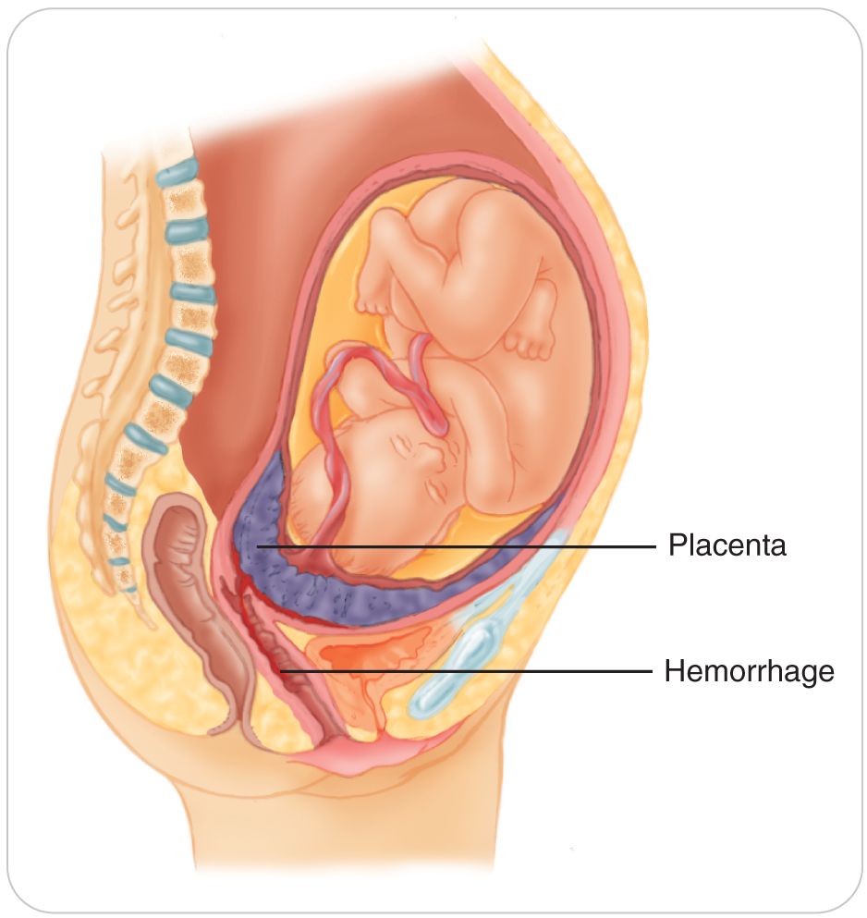
Placenta Previa
17-6
Placenta Previa is a condition in which the placenta implanted abnormally low, covering the opening of the cervix.
Initially presents with painless, dark-red vaginal bleeding
Can result in termination of the pregnancy and severe maternal bleeding

Slide 27
Uterine Rupture
17-6
Trauma to the abdomen during pregnancy can result in rupture of the uterus.
Muscular wall of the uterus tears.
Massive bleeding results.
The fetus usually dies.
The mother’s life is in jeopardy.
True emergency with shock to both mother and fetus occurring rapidly

Slide 28
Abruptio Placentae
17-6
Abruptio Placentae is the most common cause of fetal death.
After the death of the mother during pregnancy
Typically result of a shearing force produced when the body stops moving before the internal organs (uterus) stop.
Classic signs and symptoms include:
Vaginal bleeding
Abdominal pain
Constant uterine contractions
Expanding uterine height from bleeding inside the uterus

Slide 29
Rupture of the Amniotic Sac
17-6
Also referred to as “Ruptured Membrane.”
Normally the sac ruptures spontaneously just before birth at full term.
Premature rupture of the amniotic sac:
Occurs before full term
Causes leakage of clear or blood-tinged fluid from the vagina
Can occur spontaneously but usually occurs following trauma
Early labor usually occurs once the sac is torn.
Fluid, sometimes blood-tinged, will leak out of the vagina.

Slide 30
Preeclampsia
17-6
Preeclampsia is pregnancy-induced hypertension, or “toxemia,” a form of high blood pressure that develops during pregnancy.
Develops after the 20th week of gestation
Is more common in a first-time pregnancy, twin pregnancies, and women with preexisting diabetes
Place a pregnant woman on her left side to take the pressure off the vena cava.
OEC technicians may observe the following two characteristics of this condition:
Blood pressure greater than 140/90 mm Hg (or a significant rise in one or both pressures)
Edema of the face and/or hands

Slide 31
Eclampsia
17-6
Eclampsia is when pregnancy-induced hypertension is complicated by seizures.
Severe form of pregnancy-induced hypertension usually develops late in pregnancy, close to the time of delivery.

Slide 32
Diabetes of Pregnancy
17-6
Known as gestational diabetes
Always be concerned that a woman could have new-onset diabetes when pregnant.
Symptoms of hyperglycemia
First responder care is the same for anyone with diabetes, but the patient needs referral to a qualified medical professional for definitive care.
Following delivery, most women’s blood sugar levels will return to normal.

Slide 33
Patient Assessment

Slide 34
Exam of a Woman
17-7
Always be mindful of a woman’s need for privacy.
Although a gynecologic or obstetric history is crucial, try to ask the necessary questions in a way and in a place where others cannot overhear your conversation.
In general, undressing a woman in an outdoor environment to perform an examination is not necessary.
Wait until she has reached a patrol facility or other first-aid facility where a female assistant can help with the inspection of the affected areas in privacy.
If evacuation will take a long time and the woman is in labor, inspect for crowning.
Improvise some screening using clothing, sheets, towels, or sleeping bags.

Slide 35
Exam of a Non-Pregnant Woman
17-7
When examining a nonpregnant woman who has abdominal pain or vaginal bleeding, place her in a position of comfort.
Look at the abdomen, noting any distention or discoloration.
Have the patient use one finger to point to where her pain is most intense.
If abdominal pain is present, determine the quality, location, and timing, and whether any back pain is present.
Conditions other than pregnancy may be the cause of the pain.
Gently palpate the four quadrants of the abdomen and the suprapubic region.
Note tenderness or if shows guarding

Slide 36
Exam of a Woman’s Genital Region
17-7
OEC technicians should not examine a non-pregnant woman’s genital region unless she has a history of trauma and ongoing hemorrhage.
If the responder is male, and a female responder is immediately available, consider having the woman conduct the exam.
Patrollers should only visually inspect the female genitalia.

Slide 37
Exam of a Pregnant Woman
17-7
Note whether the uterus feels tight, as during a uterine contraction, or if there is tenderness upon palpation.
If the uterus is easily palpable, attempt to detect any fetal movement.
Look for a bloody show or amniotic fluid leaking from ruptured membranes.

Slide 38
Management

Slide 39
Management: Vaginal Bleeding
17-9
Vaginal bleeding cannot be stopped using dressings or bandages or by packing the vagina.
Use an external pad to absorb the blood, but this will not control it.
May lose 30% to 35% of their blood volume before showing signs of shock

Slide 40
Management: Pregnancy and Shock
17-4
17-9
While the woman’s vital signs may appear stable during significant blood loss, the fetus will be in shock due to:
Decreased blood flow from the uterus to the placenta
The shunting of blood
Always anticipate the development of shock in a pregnant trauma patient and her fetus, even when vital signs are normal.
Provide:
Oxygen when needed to keep the oxygen saturation between 94 and 99%
Rapid evacuation
Immediate transport using an ALS provider to a definitive-care facility

Slide 41
Management: Postpartum Bleeding
17-9
Postpartum (following childbirth) hemorrhage is bleeding in excess of 500 mL following a vaginal delivery.
Firm, downward massage of the woman’s lower abdomen after delivery stimulates the uterus to contract and can promptly resolve this form of bleeding.
If possible, position the woman on her left side.
If her injuries prevent this, elevate her right hip, displacing the uterus to avoid possible supine hypotension from pressure on the vena cava.

Slide 42
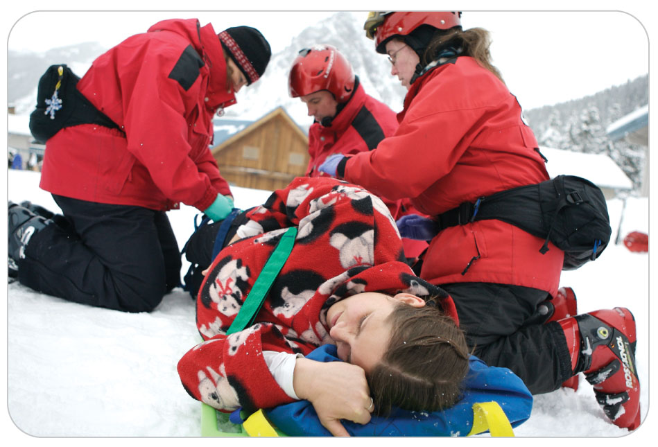
Management: Spinal Motion Restriction and Pregnancy
17-8
Avoid placing any straps directly over her abdomen.
After securing her to the backboard, tilt the backboard approximately 4 to 6 inches to the patient’s left by placing a patrol pack or a folded blanket under the right side of the backboard.
Abdominal pain may be associated with nausea or vomiting, so anticipate this.
Suction as needed to clear the patient’s airway.

Slide 43
Management: Childbirth
First stage of labor:
Begins with irregular lower abdominal contractions and is often accompanied by lower back pain
Contractions eventually recur at 3- to 4-minute intervals and last 50-60 seconds.
The cervix gradually dilates.
Second stage of labor:
Fetus descends through the birth canal, and the baby is delivered.
Third stage of labor:
The delivery of the placenta

Slide 44
Management: Childbirth
17-10
Signs of imminent delivery:
Bloody show
Rupture of the amniotic sac
Usually clear
Tea-stained or pea-colored is due to meconium, or fetal stool
The urge to push or defecate

Slide 45
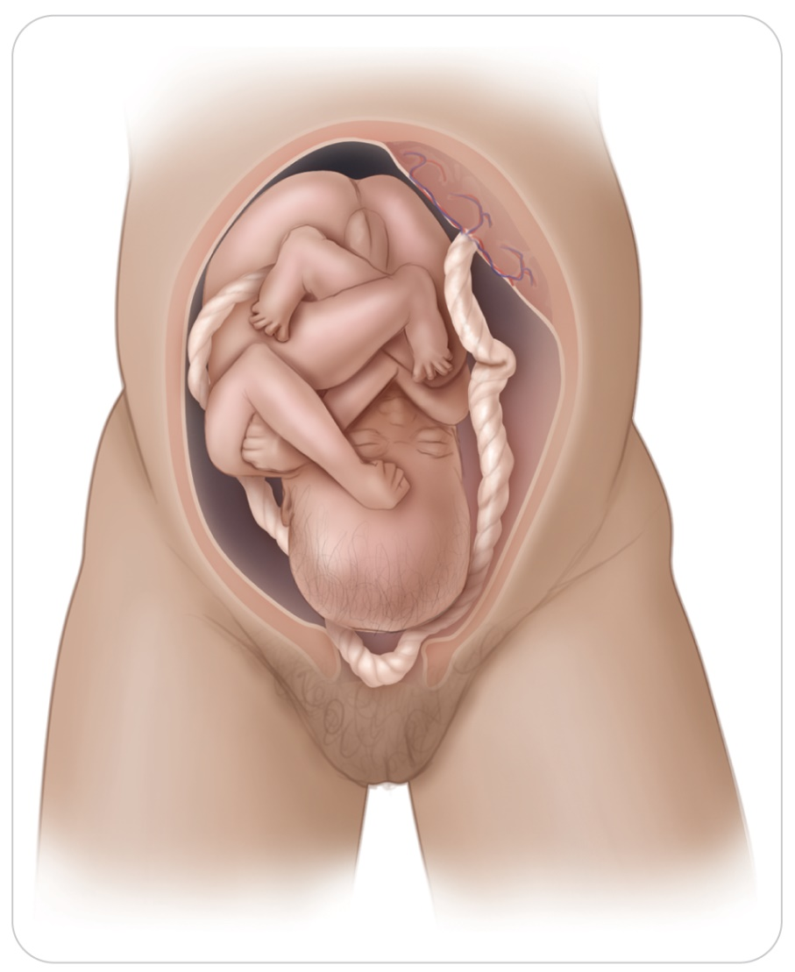
Management: Prolapsed Umbilical Cord
17-6
17-10
If the umbilical cord or any part of the baby besides the head is visible at the vaginal opening:
Instruct the woman to stop pushing
Assist her into a knees-to-chest position.
Apply supplemental oxygen if her oxygen saturation is less than 94%.
Arrange emergent transfer to advanced medical care.

Slide 46
Management: Delivery
17-10
Any signs of an imminent delivery require OEC technicians must be prepared to assist with immediate delivery.
Time the woman’s contractions from the start of one contraction to the start of the next.
Then, while feeling the abdomen, note the duration of a single contraction by recording the time between the onset of a contraction and its completion.
Encourage the woman to rest (and pant) between contractions.
If the baby is crowning (top of the infant's skull is showing), assist the woman with an emergency delivery.

Slide 47
Management: Delivery
17-10
After birth, put a sanitary pad over the mother’s vagina and have her lie on her back with her legs straight.
Vaginal bleeding slows after the placenta is out and the uterus starts to shrink.
Massage the mother’s lower abdomen in a circular motion where the uterus is located to help her uterus shrink and to aid in the production of oxytocin, a hormone that makes the uterine muscles contract.
Always have the mother, baby, and placenta transported to the hospital.

Slide 48
Management: Delivery
17-10
If there is excessive bleeding:
Keep the mother in the supine position
Provide supplemental oxygen
Monitor her vital signs
Apply sanitary napkins to the perineum, as needed.
Do not place a tampon or any dressings inside the vagina.

Slide 49
Management: Care of Newborns
17-12
Once an infant is delivered, vigorously dry it off and wrap it in a blanket or towel, covering the entire baby except for its face.
Begin your evaluation of a newborn with the ABCDs.
Airway/Breathing:
Obvious obstruction:
Suction after the head is delivered.
Suction again after the baby is delivered.
When using a bulb syringe, always blow the air out before suctioning the airway (do not blow air into the airway).

Slide 50
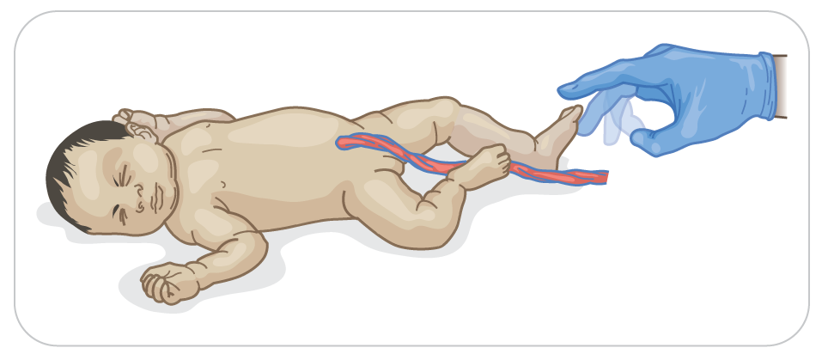
Management: Care of Newborns
17-12
Usually an infant begins crying vigorously within 15 to 20 seconds after delivery, often while being dried.
If the baby does not begin crying, use your fingers to either flick the soles of the infant’s feet or rub the infant’s back.
Do not spank the baby.
If the infant does not begin to breathe after 10 to 15 seconds, begin resuscitation.

Slide 51
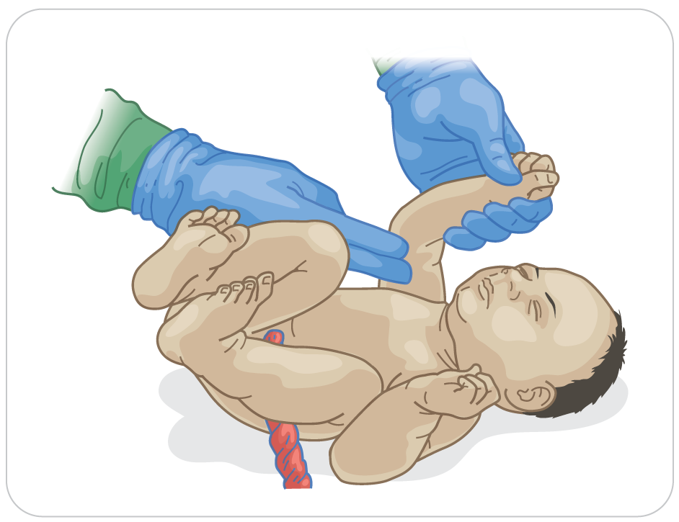
Management: Care of Newborns
17-12
Circulation:
If the infant appears to be breathing well, determine its pulse rate by palpating the brachial pulse.
A newborn’s pulse rate should be between 90 and 180 beats/min.

Slide 52
Management: Care of Newborns
17-12
If it is less than 90 beats per minutes:
Begin gentle positive-pressure ventilations with supplemental oxygen using an infant bag-valve mask (BVM) placed over the baby’s nose and mouth at a rate of 40 to 60 breaths/min.
When using the BVM, use just enough pressure to observe the chest rising.
Do not overinflate the lungs.

Slide 53
Management: Care of Newborns
17-12
Reassess the pulse rate after 90 seconds:
If less than 60 beats/min, give oxygen at low concentrations, increasing it as needed until the heart rate is at least 100 beats/min.
Assisted ventilation is the most effective action in neonatal resuscitation and usually brings the heart rate up to 100 beats/min.
Once the pulse rate reaches 100, gradually reduce the rate and pressure of the BVM ventilations until it is apparent the infant is breathing well on its own and is maintaining good color.

Slide 54
Management: Care of Newborns
17-12
An infant’s skin color is another indicator of its well-being.
Lack of oxygen in the infant’s bloodstream causes cyanosis of the face and trunk, normally for up to several minutes after delivery as the hemoglobin becomes saturated with oxygen.
Full oxygen saturation takes up to 10 minutes.

Slide 55
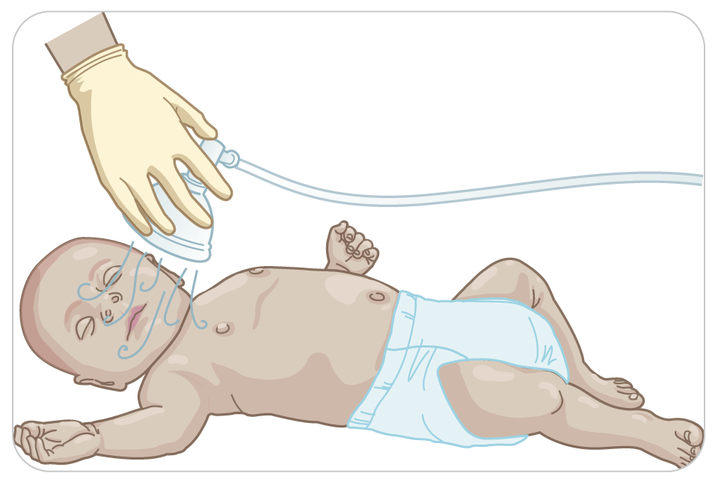
Management: Care of Newborns
17-12
Newer evidence has shown clinical assessment of skin color is a very poor indicator of the newborn’s oxygen saturation of hemoglobin during the period immediately after birth.
For infants with strong, regular respirations and cyanosis, administer high-flow oxygen using “blow-by oxygen,” in which the end of the tubing is placed close to the infant’s nostrils.

Slide 56
Management: Care of Newborns
17-12
If the newborn is not breathing, begin ventilation with room air first and increase the oxygen percentage in the ventilations slowly.
Growing evidence that brief hypoxia of the newborn can result in an adverse outcome
Begin chest compressions (CPR) IF:
Pulse rate lower than 60 beats/min
Pulse rate remaining between 60 and 100 beats/min despite adequate ventilation with supplementary oxygen for 30 seconds
Even though a pulse may be palpable, the slow heart rate and cardiac output are inadequate for supporting the infant’s life.

Slide 57
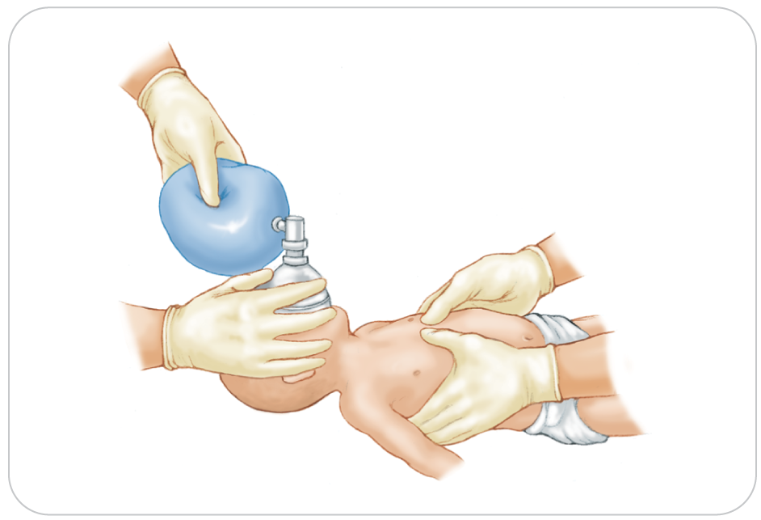
Management: Care of Newborns
17-12
Perform the chest compression technique and compression rates specified by current standards for health professionals.
CPR should be continued until the infant responds with adequate respirations and a heart rate greater than 60 beats/min, or until pronounced dead by a physician.
Remember that infants are quite resilient and can survive prolonged effective CPR without brain damage.

Slide 58
Management: Care of Newborns
17-12
If the baby is doing well, place the baby in an improvised crib so you don’t drop it.
Crib could be a basket or a cardboard box padded with blankets.
Keep the baby warm, as a baby’s body temperature can drop very quickly.
Neonatal hypothermia is reported in about half of all prehospital deliveries.

Slide 59
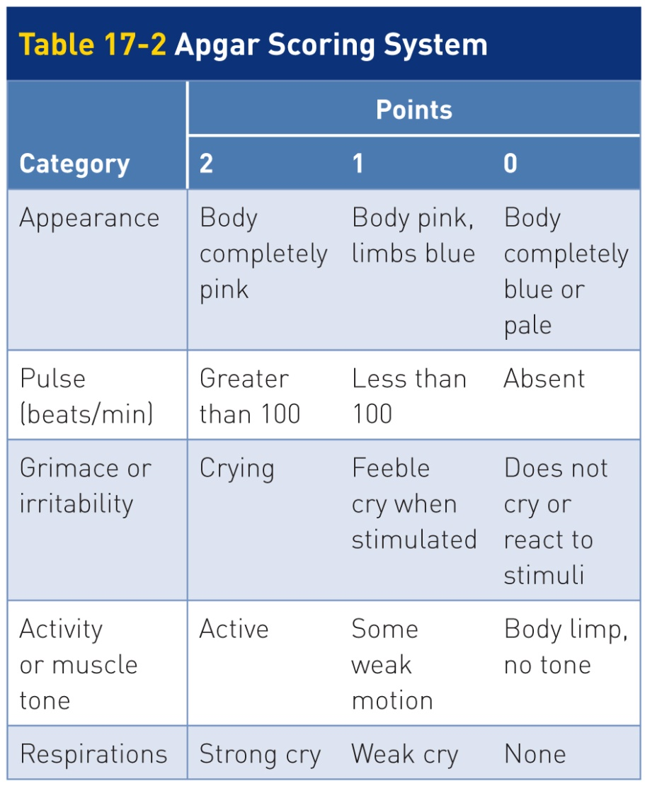
Management: Care of Newborns
17-12
Assess the Apgar score.
0, 1, or 2 points are assigned at 1, 5, and 10 minutes after birth for each of the five categories.

Slide 60
Management: Care of Newborns
17-12
Apgar score is helpful in determining if the baby is doing well outside the uterus or if it needs resuscitation.
If the infant needs resuscitation before the 1-minute score, do not wait.
Begin resuscitation efforts.
Should the 5-minute score be less than 7, continue obtaining scores every 5 minutes up to 20 minutes.

Slide 61
Management: Gynecologic Sexual Assault
17-11
Sexual assault
A form of trauma defined as any physical contact of a sexual nature without voluntary consent
Forms of sexual assault include:
Inappropriate touching
Child molestation
Vaginal, anal, or oral penetration
Perpetrator may be of either sex but is typically:
Male
Someone known to the victim or a member of the victim’s family, rather than a total stranger

Slide 62
Management: Gynecologic Sexual Assault
17-11
Sexual assault may occur with enough force to cause physical trauma, both internal and external.
Other health problems resulting from rape include:
Sexually transmitted infections
Chronic abdominal pain
Headaches
Psychological trauma is often more severe than the physical trauma and is potentially long lasting.
Victims of sexual assault often suffer from anxiety, fearfulness, eating disorders, and chronic depression that may even lead to suicide.

Slide 63
Management: Gynecologic Sexual Assault
17-11
In most states, OEC technicians are mandated by law to report suspected sexual assault to law enforcement officials.
Sexual assault is a serious problem.
Reassure the patient and contact the proper authorities, usually law enforcement, immediately.
If there is bleeding, control it.
Except for controlling bleeding, an exam of a sexual assault victim is best left to higher-level medical personnel.
Transport to a definitive-care facility for evaluation and care is a priority.

Slide 64
Management: Gynecologic Sexual Assault
17-11
Be careful, compassionate, and respectful in your interaction with the patient.
Reassure the patient, provide patient privacy, and ensure confidentiality.
Attempt to minimize the number of people around the patient.
When possible, use a female patroller for the interview and assessment.

Slide 65
Case Study

Slide 66
CASE PRESENTATION
Late one afternoon, you are called to assist a woman who is having medical problems in a second-floor condo just off a ski slope. Upon arrival, you knock on the door and a frantic woman’s voice inside says come in. In the bathroom, you find a 29-year-old woman who is standing in front of the sink, half-dressed, and a lot of blood on the floor. She is screaming, complaining of severe abdominal pain, and saying she has never bled this much in her life. She is alone and says her husband and two children went skiing while she stayed behind to fix dinner. The toilet bowel is full of blood clots. As you assess the patient, you notice her radial pulse is quite weak and seems faster than normal.
What should you do?

Slide 67
CASE UPDATE
Realizing the woman has severe vaginal bleeding, you ask for permission to help her. Somewhat embarrassed, she says, “Please help me.” You rapidly place her supine, putting several blankets on her to keep her warm. Soon two other patrollers arrive, one a woman. Vital signs are obtained, with a carotid pulse of 112 beats/min and respirations of 20 breaths/min.

Slide 68
CASE UPDATE
Her radial pulse is absent. You instruct the female patroller to help you, since hypovolemic shock is present. You instruct the other patroller to tell dispatch to send the ambulance directly to the condo parking lot. The female patroller calms the patient. The patient’s history reveals she is healthy with no medical problems, but she missed her last two periods and could be pregnant. She takes no medications. Oxygen is placed on the woman by mask with rebreather.
What should you do next?

Slide 69
CASE OUTCOME
The patient continues to complain of severe abdominal pain, and reassessment shows more vaginal bleeding with clots. A paramedic arrives with the ambulance crew. You explain what you have done to the crew. An IV line is started on scene, and transport is rapidly carried out. Just before transport, the woman’s husband and children arrive. The female patroller takes the children to the side and comforts them, while the husband accompanies his wife to the hospital. You tell the husband his children will be taken to and cared for in the patrol family room until another relative can pick them up. Later that day, a sister of the patient retrieves the children. Two days later, the husband returns and says his wife was nearly 3 months pregnant and had a miscarriage. She was in shock when arriving at the hospital and received three units of blood. She is improving and should be OK. He tearfully notes that without your prompt care he could have lost his wife.

Slide 70
OEC Skill Activities

Slide 71
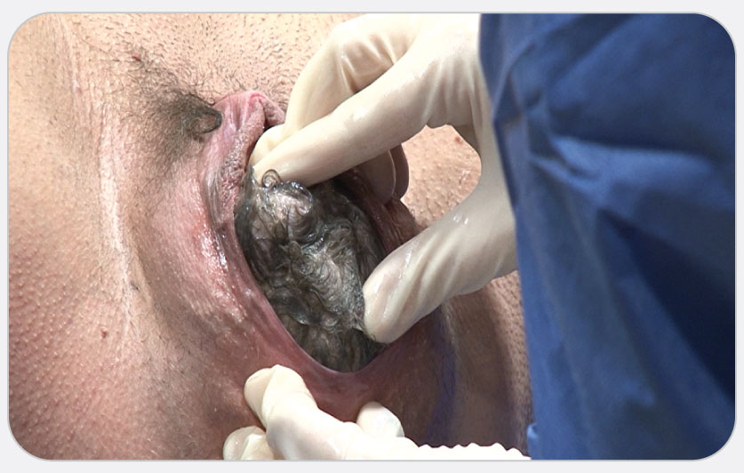
OEC Skill 17-1: Assisting with Childbirth
1. Once the baby is crowning, allow the woman to push the baby’s head out; support its head with your gloved hand as it emerges. Applying gentle pressure to the top of the baby’s head with your hand will allow the head to come out in a controlled fashion and help prevent the baby’s head and body from suddenly popping out. Applying this gentle pressure can markedly reduce the severity of tearing to the woman’s perineal tissues. The head usually emerges facedown. Once the head has emerged, it will rotate slightly, allowing easier access to the baby’s face and airway. Do not twist the baby’s neck. Next, feel for the umbilical cord around the baby’s neck. If present, gently lift the cord over the baby’s head. If unable to lift the cord over the baby’s head, immediately place two clamps or umbilical ties around the cord 2 to 4 inches apart and at least 6 inches from the child, then cut the cord between the clamps.

Slide 72
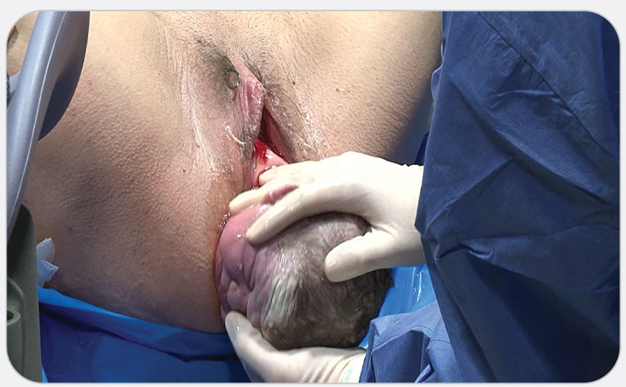
OEC Skill 17-1: Assisting with Childbirth
2. After delivering the head, you should see the baby’s upper shoulder. With one hand on either side of the baby’s head, gently guide the head down slightly to help deliver the upper shoulder as the woman pushes. After the upper shoulder is delivered, you may need to guide the head up slightly to deliver the lower shoulder. Support the baby’s head with one hand and its upper body with your other hand as the shoulders are delivered. Never pull the baby from the birth canal.

Slide 73
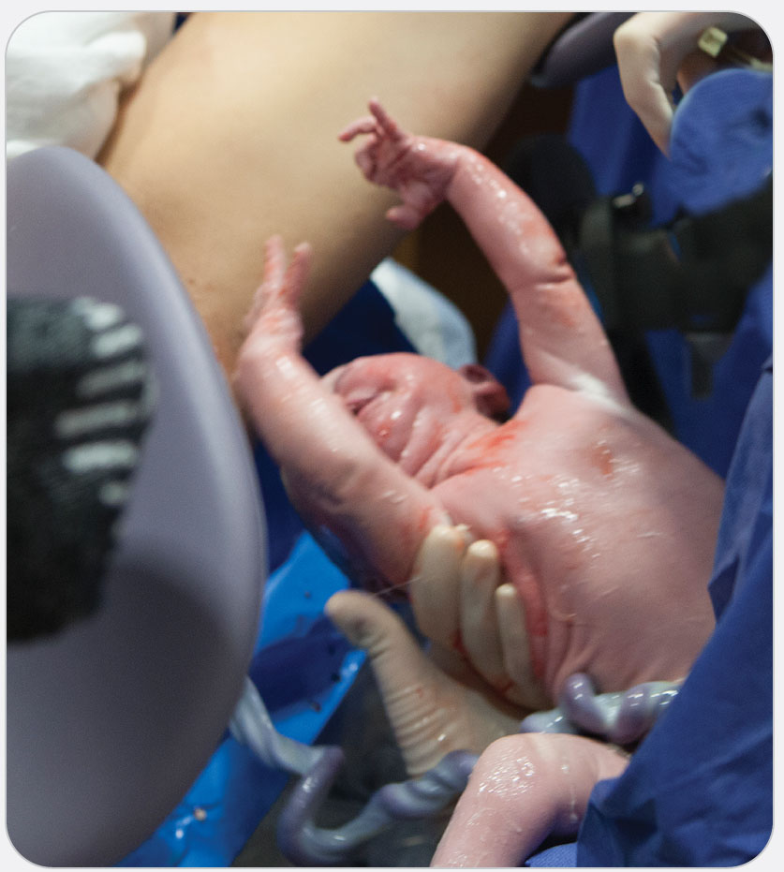
OEC Skill 17-1: Assisting with Childbirth
3. Once the head and shoulders are delivered, the rest of the baby slips out quickly because its body is covered with a white, cheesy substance (vernix caseosa). Be prepared to catch the baby! Once the baby emerges, rotate it 180 degrees so the supine newborn is against your body, with one hand holding the head and neck, and the torso resting on the same hand’s forearm. Hold the newborn with the head slightly lower than the body to facilitate drainage of secretions. Always hold the baby’s head and neck in a neutral position to maintain an open airway. Have an assistant record the time and location of the birth for later entry on a birth certificate.

Slide 74
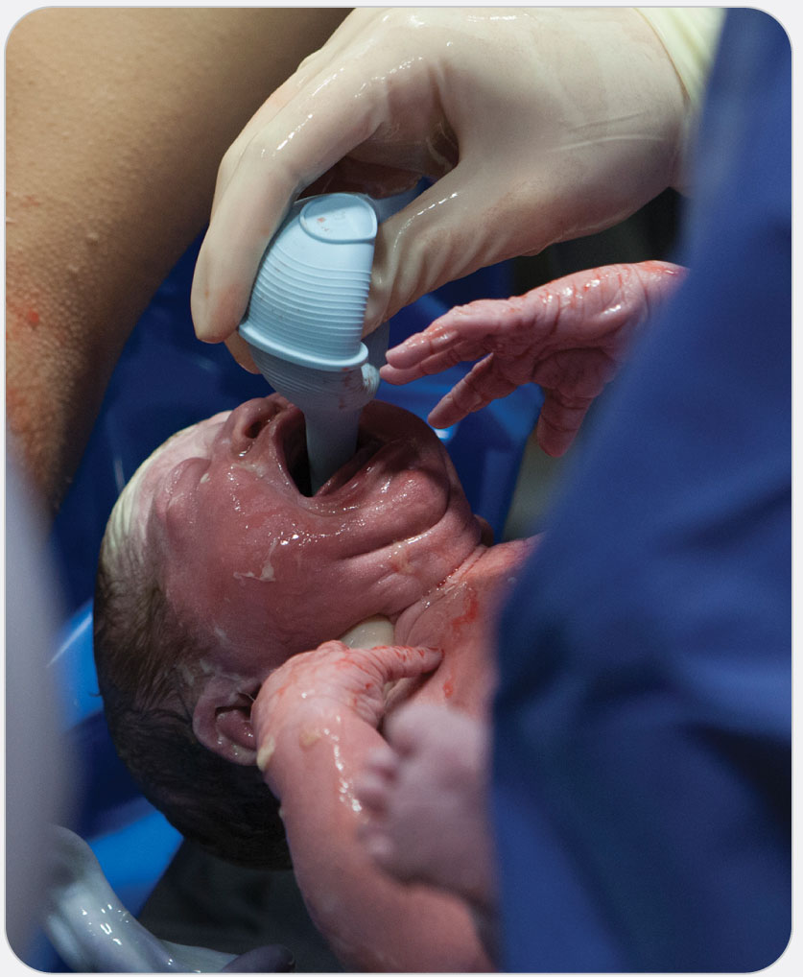
OEC Skill 17-1: Assisting with Childbirth
4. If there is obvious obstruction to the baby’s spontaneous breathing, immediately suction the baby’s mouth and then the nostrils, using a soft rubber bulb syringe. Squeeze the bulb before inserting it into the baby’s mouth and let the bulb suck once in the mouth. Suctioning the nostrils before the mouth may stimulate the baby to gasp and thereby aspirate any fluid in the nose or pharynx. Note if the fluid in the baby’s mouth and nose does not appear clear, a sign of meconium (stool) in the amniotic fluid. This condition is called meconium aspiration and causes inflammation in the baby’s lungs after birth. If you believe that you have seen this condition, make sure you tell the EMS personnel.

Slide 75
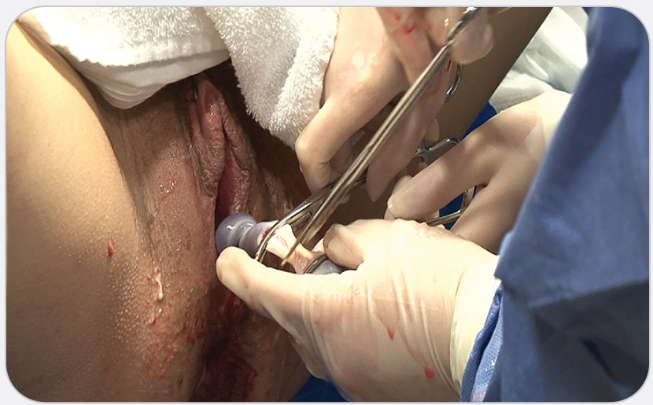
OEC Skill 17-1: Assisting with Childbirth
5. You will need to cut the umbilical cord. Place two clamps or tie two cloth shoelaces about 6 inches from the baby and about 2 to 4 inches apart, then cut the cord between the clamps or laces.

Slide 76
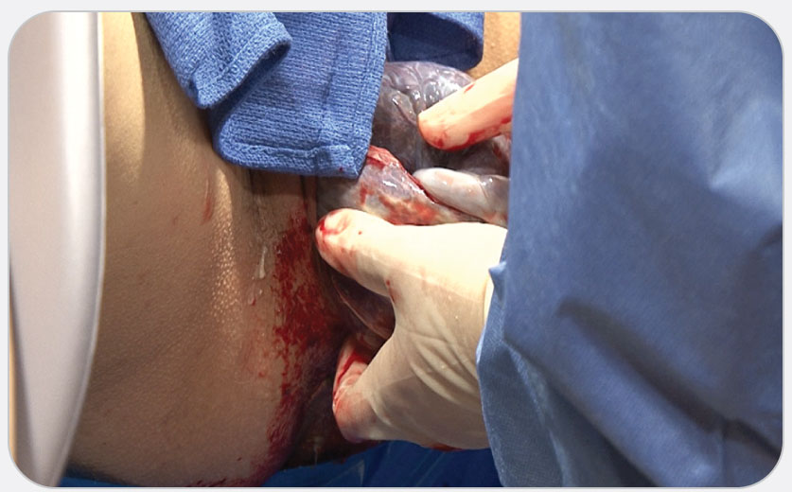
OEC Skill 17-1: Assisting with Childbirth
6. The delivery of the placenta is the third stage of labor. Allow the placenta to come out of the vagina by itself. Pulling on the umbilical cord that is still attached to the placenta can be harmful. The placenta should separate from the inside wall of the uterus about 20 to 30 minutes after the baby is delivered. If transport is available once the baby is born, do not wait on the delivery of the placenta. However, if the placenta does come out of the vagina, put it in a plastic bag and send it to the hospital with the mother and her baby. It will need to be inspected by the receiving physician.

