Slide 1
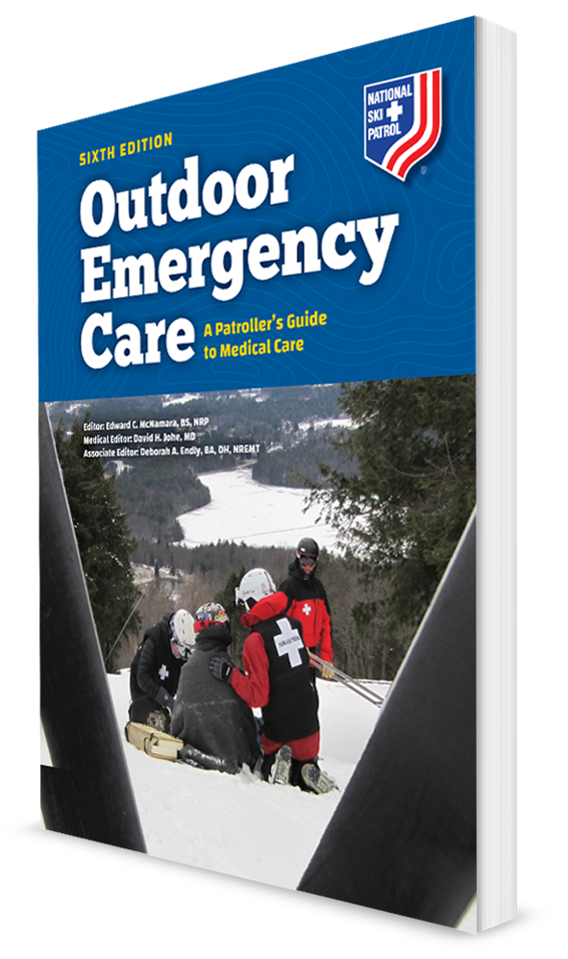
Soft-Tissue Injuries and Burns
CHAPTER 19

Slide 2
The following presentation will utilize two symbols to identify material necessary for an OEC Technician to comprehend:
key term
Meets a Chapter Objective.
This symbol will have the corresponding Objective Number denoted within.
Identifies a Key Term.
The Key Term will be underlined for easy identification.

Slide 3
Objectives
Upon completion of this chapter, the OEC Technician will be able to:
19-1 List the four functions of the skin.
19-2 List the layers of the skin.
19-3 Explain the difference between arterial and venous bleeding.
19-4 Explain how to assess a soft-tissue injury.

Slide 4
Objectives
19-5 Describe and demonstrate care for the following closed soft-tissue injuries:
Contusion
Hematoma
Crush injury
Compartment syndrome

Slide 5
Objectives
19-6 Describe and demonstrate care for the following open soft-tissue injuries:
Abrasion
Amputation
Avulsion
High-pressure injection injury
Incision
Laceration
Mechanical tattooing
Open crush injury
Puncture, including impaled object

Slide 6
Objectives
19-7 Explain the difference between thermal, chemical, electrical, lightning, and radiation burns, and the treatment for each.
19-8 Explain how to assess and care for sunburn, and what SPF means for sun creams.
19-9 Explain how to assess and care for a burn.
19-10 Explain and describe how to classify burns by depth of injury.

Slide 7
Key Terms
Amputation
Avulsion
Bandage
Burn
Compartment syndrome
Compression (pressure) dressing
Crush injury
Dressing
Ecchymosis
Exsanguination
Hematoma
Hemorrhage
Hemostatic dressing
Impaled object
Incision
Laceration
Mucous membranes
Occlusive dressing
Puncture
RISE
Scald
Subungual hematoma
Tourniquet
Universal dressing

Slide 8
Chapter Overview

Slide 9
Chapter Overview
Soft-tissue injuries are common occurrences in outdoor recreation and are an inherent risk of nearly every outdoor sport and activity.
These injuries are among the most common emergencies that OEC technicians will encounter.
Identifying various soft-tissue wounds, controlling external bleeding, and caring for these injuries are essential skills.

Slide 10
Chapter Overview
Soft-tissue injuries encompass wounds of the skin and all soft tissues, down to and including muscle.
Everything from abrasions, simple lacerations, and bruises to life-threatening bleeding and major amputations.
Can be devastating injuries, especially if much of the surface of the body is involved

Slide 11
Chapter Overview
The skin has several functions; the most important of which is to serve as a protective barrier to external contaminants.
Contains millions of tiny nerves that continually send sensory information to the brain
Not impervious to injury and is easily damaged when exposed to abrasive or sharp objects or to heat, cold, or caustic substances
When penetrated, the skin’s underlying structures and organs may be exposed to a variety of bacteria that can establish infections.

Slide 12
Anatomy and Physiology

Slide 13
Skin
19-1
The skin is the body’s largest organ and covers its entire external surface.
It serves many purposes, including:
acting as a protective barrier
regulating body temperature
maintaining water balance
synthesizing vitamin D

Slide 14
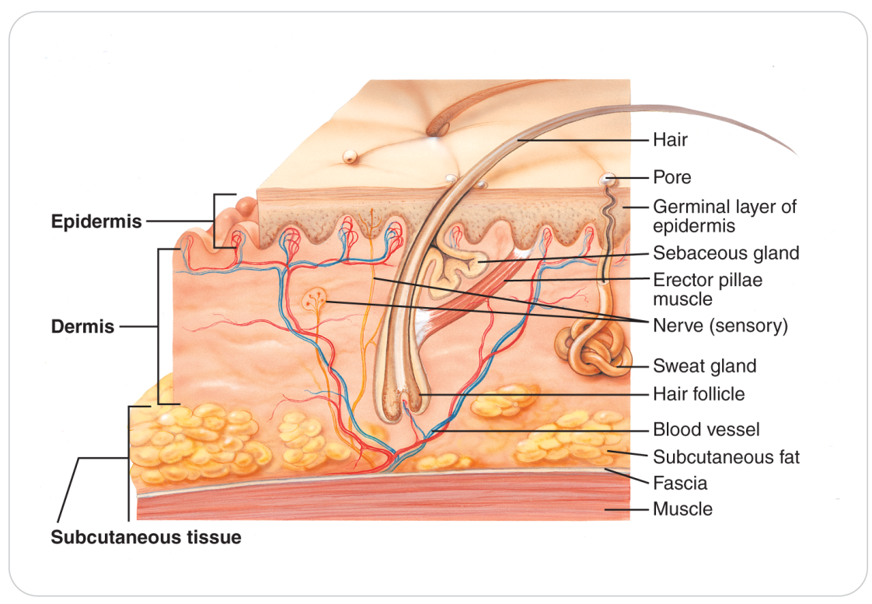
Skin Anatomy
19-2
Consists of two layers:
The epidermis, which lies on the surface and is several layers thick
The dermis, which lies beneath the epidermis and contains several unique structures
Beneath the dermis are the subcutaneous tissue, muscles, bones, and other underlying structures.

Slide 15
Skin Anatomy
19-2
Epidermis
Continuously produces new skin cells that steadily migrate toward the surface
Protective layer that helps the body retain water and prevents bacteria and other organism from entering the body
Very thick on the soles of the feet, the palms of the hands, the back, and the scalp, but very thin in other areas of the body, such as the back of the hand
Dermis
Layer of the skin deep to the epidermis
Contains several important structures, including hair follicles, sebaceous (oil) glands, sweat glands, blood vessels, and specialized nerve endings

Slide 16
Skin Anatomy
19-2
Sweat glands
Secrete a liquid that helps cool the body
Sweat is released from the dermis onto the surface of the skin through small pores, or ducts, that pass through the epidermis.
Blood vessels that provide nutrients and oxygen to the skin are found in the dermis and send small branches up to the bottom layer of the epidermis.

Slide 17
Skin Anatomy
19-2
Nerve Endings
Found within the dermis
Detect and then transmit to the brain data concerning:
Heat
Cold
Body position
External pressure
Painful and pleasurable stimuli

Slide 18
Skin Anatomy
19-2
Subcutaneous Tissue
Lies beneath the dermis
Is composed almost entirely of fat, which insulates the body and stores energy
Amount, thickness, and composition of subcutaneous tissue vary greatly from one area of the body to another and from one individual to another.
Musculature and the bony skeleton are found directly beneath the subcutaneous tissue and are discussed in more detail in other chapters.

Slide 19
Skin Physiology
19-2
In addition to its function as a protective barrier, the skin participates in the regulation of body temperature.
Cold environment
Hair follicles become erect to trap warm air near the skin’s surface.
Blood vessels within the dermis and subcutaneous tissue constrict to shunt blood away from these areas, which helps to slow heat loss.
Hot environment
Dermal blood vessels dilate, causing the skin to become warm and flushed, which allows heat to radiate away from the body and into the environment.
Sweat glands secrete sweat onto the surface of the skin, where it evaporates and thus cools the skin (and body temperature).
Evaporation

Slide 20
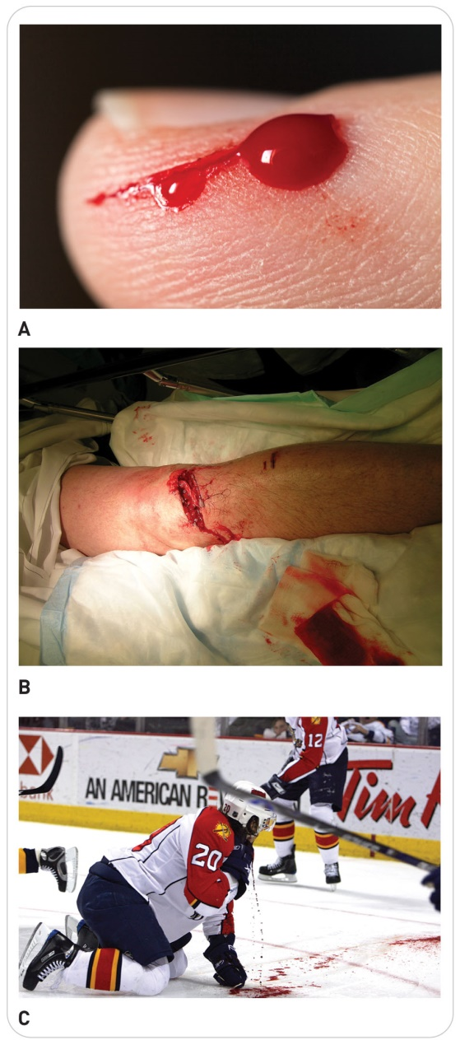
Physiology of Bleeding
19-3
Bleeding results from a leak or breakage in an artery, a vein, and/or tissue capillaries.
Artery Bleeding:
Pulsating spurts of blood (high arterial pressure)
Bright red blood (higher oxygen content)
Vein Bleeding:
Blood flows freely and evenly (less pressure)
Slightly darker red (lower oxygen content)
Capillary bleeding:
Ooze slowly because of the small size of these vessels and the low pressure of blood within them

Slide 21
Physiology of Clotting
19-3
Small veins and capillaries: bleeding will continue until a process known as clotting, or coagulation, seals off the damaged blood vessel.
Large veins or arteries: without outside intervention, bleeding may continue, with shock occurring from excessive blood loss.

Slide 22
Types of Soft Tissue Injuries

Slide 23
Types of Soft Tissue Injuries
19-5
The soft tissues are commonly injured because they are in the more superficial layers of the body.
OEC technicians should be familiar with three types of soft-tissue injuries:
Closed injuries
Open injuries
Burns

Slide 24
Closed Injuries
19-4
19-5
Closed soft-tissue injuries result in damage to structures beneath the skin or mucous membranes while the overlying skin surface remains intact.
They can run the gamut from mild to severe, depending on the mechanism of injury.
OEC technicians most commonly encounter the following four types of closed soft-tissue injuries:
Contusions
Hematomas
Crush injuries
Compartment syndrome

Slide 25
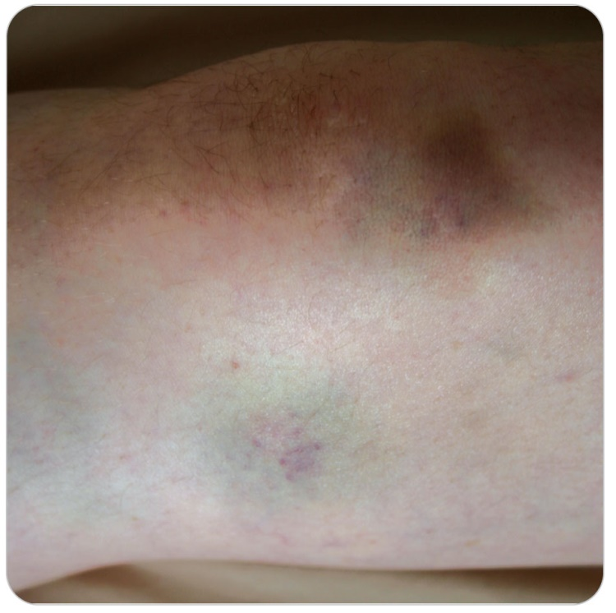
Closed Injury: Contusions
19-5
The epidermis, or outer layer of skin, is not disrupted, but cells within the dermis are injured, and the smallest blood vessels are torn.
Typically produced when a blunt force strikes the body or when the body strikes an immovable surface
Extent and severity of the injury depend on the amount of energy absorbed by the soft tissue.

Slide 26
Closed Injury: Contusions
19-5
Physiology:
Cellular fluid and blood leak into the injured area, causing tenderness, pain, and localized swelling.
Breakdown of blood cells that leak out of capillaries beneath the dermis eventually produces a characteristic blue or black skin discoloration known as a bruise, or ecchymosis.
As the injury heals, the bruise will change in color from black or purple to yellow or green.

Slide 27
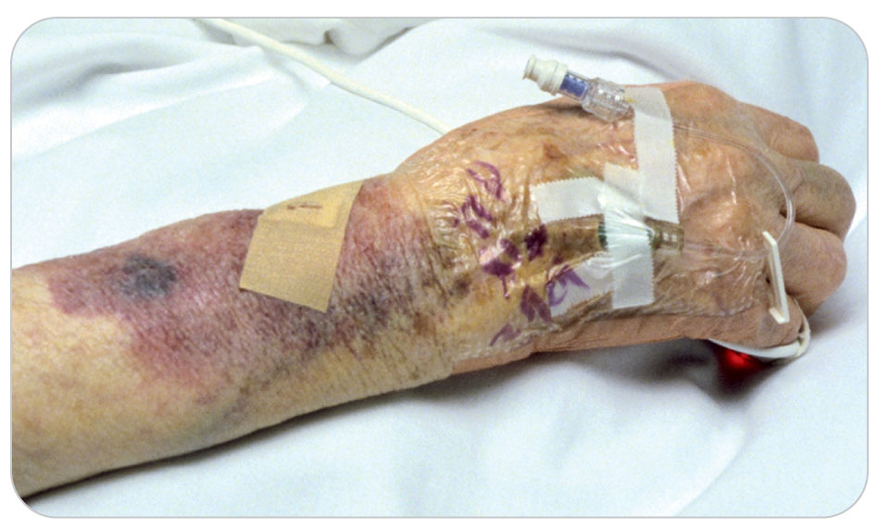
Closed Injury: Hematomas
19-5
A hematoma is a collection of blood that has leaked from a blood vessel and is confined to a localized area inside the body.
Usually presents as the result of a blunt soft-tissue injury collection (mass) of blood between the tissues
Produced when an injured blood vessel bleeds, bone marrow leaks out of a broken bone, or a highly vascularized solid organ is damaged
Severe cases can contain enough blood to cause hemorrhagic shock.

Slide 28
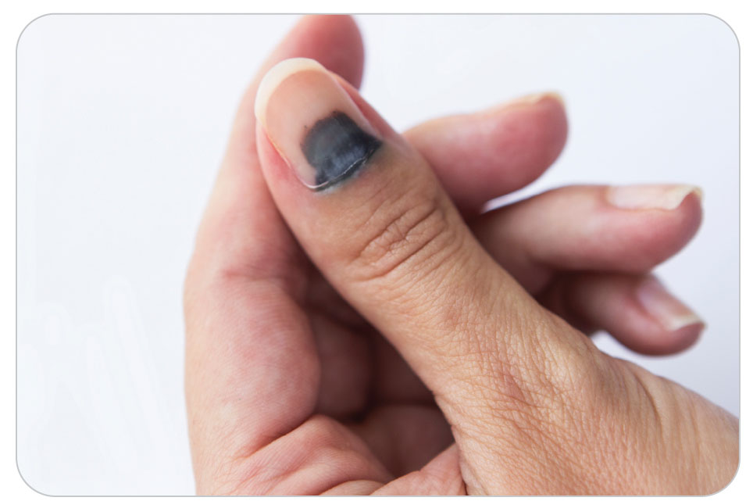
Closed Injury: Subungual Hematomas
19-5
Subungual Hematoma is a special type of hematoma that occurs beneath a nail bed.
Caused by blunt trauma
Can be very painful due to the buildup of pressure within the affected area.

Slide 29
Closed Injury: Crushing Injuries
19-5
A crush injury is produced when an excessive force strikes the body suddenly or when a force is continuously applied to the body over an extended period.
Resulting degree of tissue damage depends on several factors:
The amount of force involved
The severity of the crushing
The duration of the force applied
Eventually interrupts circulation within the tissues, thereby producing further cell damage and/or tissue death

Slide 30
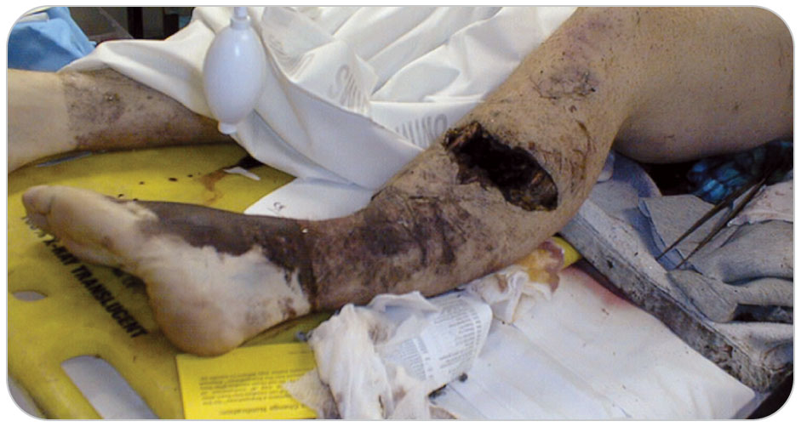
Closed Injury: Crushing Injuries
19-5
Example:
Tree trunk has fallen on and trapped a patient’s legs.
The sustained damage to leg tissues due to crushing will continue until the weight of the tree is removed.

Slide 31
Closed Injury: Compartment Syndrome
19-5
Compartment Syndrome is an injury resulting from significant trauma to the tissues of an extremity, usually from compression.
Damaged cell walls begin to leak fluid into the potential space that lies between them.
If this resultant swelling, or edema, continues to expand within a large muscle’s connective tissue covering, pressure within the tissues may increase to dangerous levels.

Slide 32
Closed Injury: Compartment Syndrome
19-5
Important to note that the connective tissue forms a compartment around the muscle that will not allow the edematous muscle to expand.
Eventually blood vessels in the edematous area become compressed.
Diminishes or even interrupts blood flow to the injured soft tissue
Results in tissue death
Compartment syndrome is a true emergency that requires rapid transport to a trauma center to prevent the loss of the limb.

Slide 33
Open Injuries
19-4
19-6
Soft-tissue injuries involve disruption of the skin and possibly damage to the soft tissue underneath.
Can result in extensive external bleeding
Wound may be exposed to microorganisms or become contaminated by foreign bodies such as dirt, rocks, or other debris.

Slide 34
Open Injuries
19-4
19-6
There are nine types of open soft-tissue wounds:
Abrasion
Incision
Laceration
Avulsion
Amputation
Puncture
Open crush injury
High-pressure injection
Mechanical tattooing

Slide 35
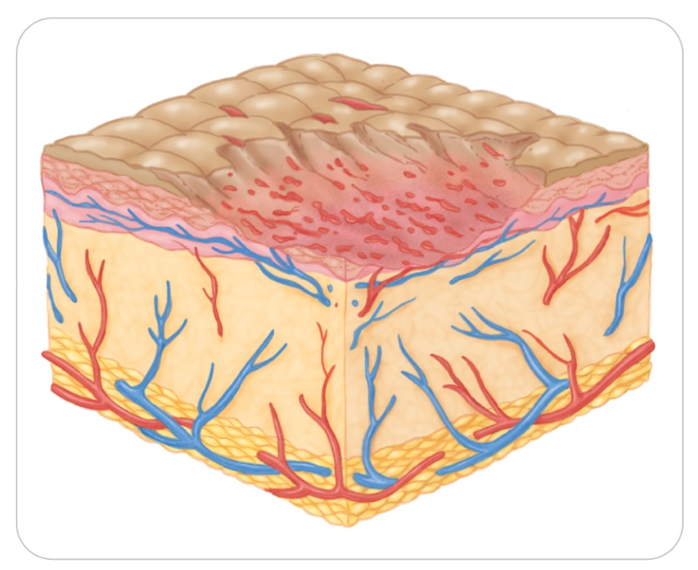
Open Injury: Abrasion
19-4
19-6
Involves the outermost layer of skin
Caused when a body part scuffs or grates across a rough, abrasive surface
Usually does not extend through the dermis
These injuries are called a variety of slang names such as a strawberry, road rash, and road burn and may be extremely painful.

Slide 36
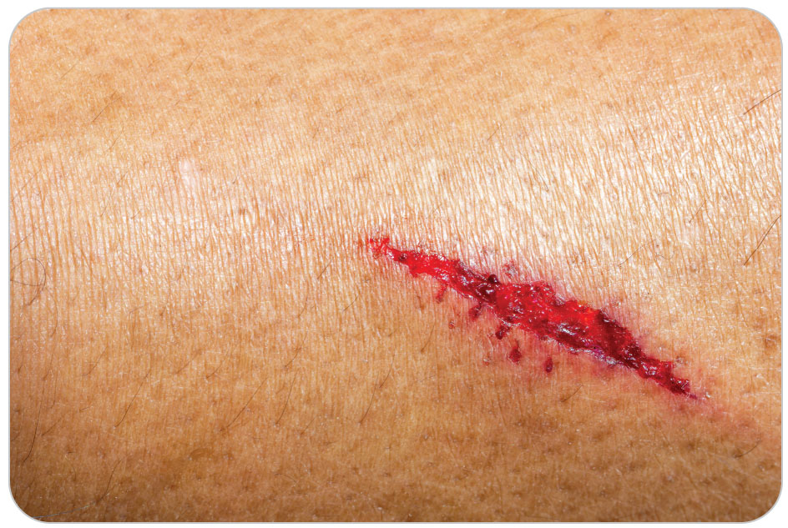
Open Injury: Incision
19-4
19-6
An incision is a cut caused by a sharp object and has clean, smooth edges.
Can be superficial or deep
A knife or other sharp object causes incisions.

Slide 37
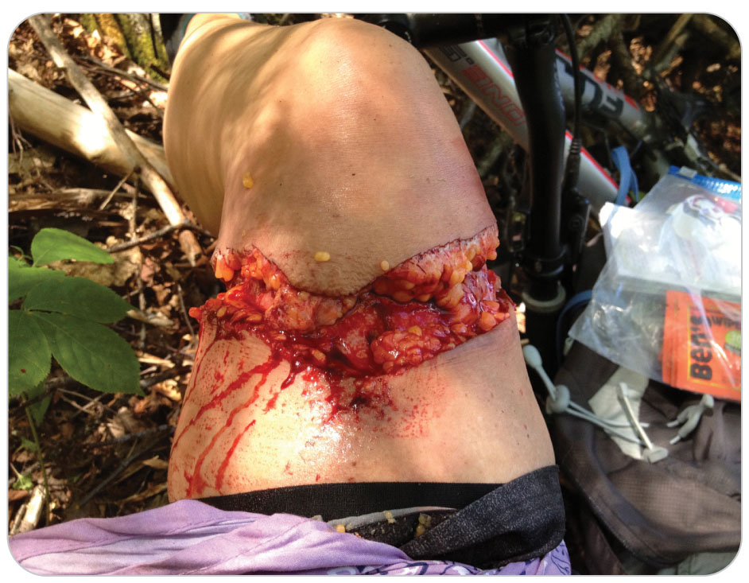
Open Injury: Laceration
19-4
19-6
A laceration is a cut caused by forces that tear or crush the skin.
Tends to have jagged edges
Can be superficial or deep
Irregular is called stellate.
Severe arteries typically result in severe bleeding.

Slide 38
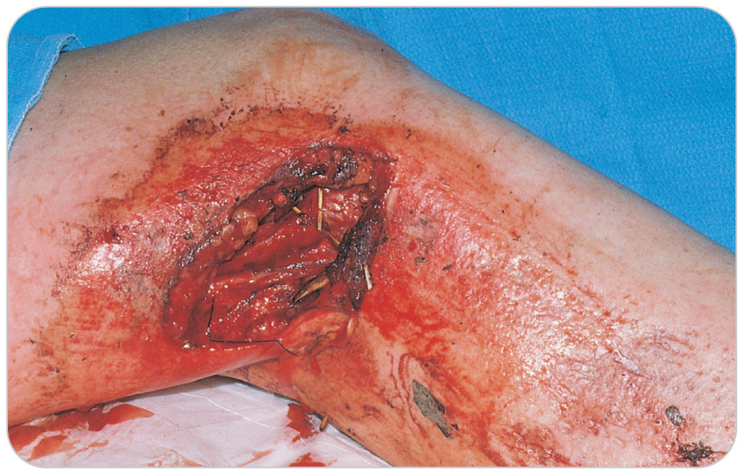
Open Injury: Avulsion
19-4
19-6
An avulsion is an incomplete or complete separation of the soft-tissue layers where the injured tissue is left dangling as a flap.
Flap also may no longer be connected to the body.
Resultant skin edges are irregular.
Significant bleeding usually accompanies this type of injury.
If hanging by only a small bridge of skin, circulation in the avulsed segment may be lost.

Slide 39
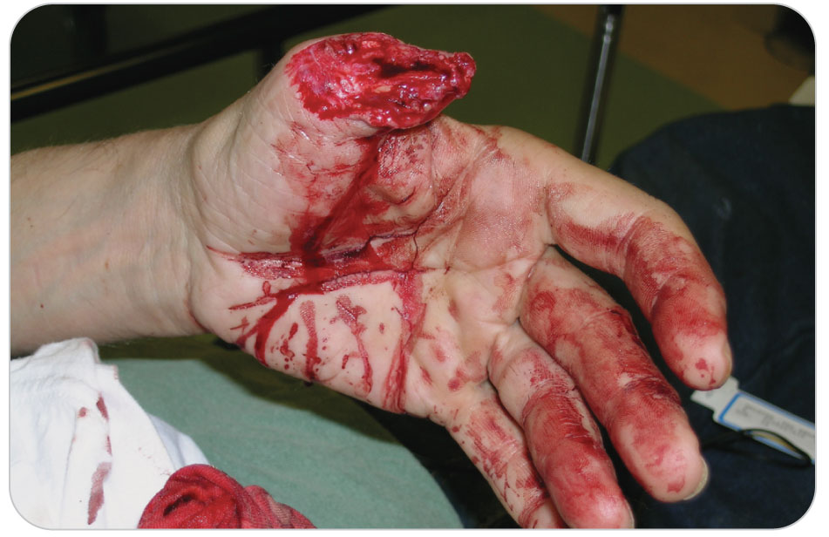
Open Injury: Amputation
19-4
19-6
An amputation is the complete or nearly complete separation of a body part or limb.
Serious injuries that may involve an entire extremity, an appendage, or some other anatomic part
Bleeding can be severe, even life threatening.

Slide 40
Open Injury: Puncture
19-4
19-6
A puncture is an injury involving the penetration of skin.
Pointed objects, such as sticks, nails, tree limbs, ski poles, tent stakes, or ice tools, are common causes of this type of injury.
Bullets or knives may also cause puncture wounds.
Accidental stick from a hypodermic needle causes a puncture.
Even though the entrance wound may be small, serious damage to underlying structures can occur.
If it penetrates the chest, abdomen, or a major artery, it can cause severe, potentially fatal bleeding.

Slide 41
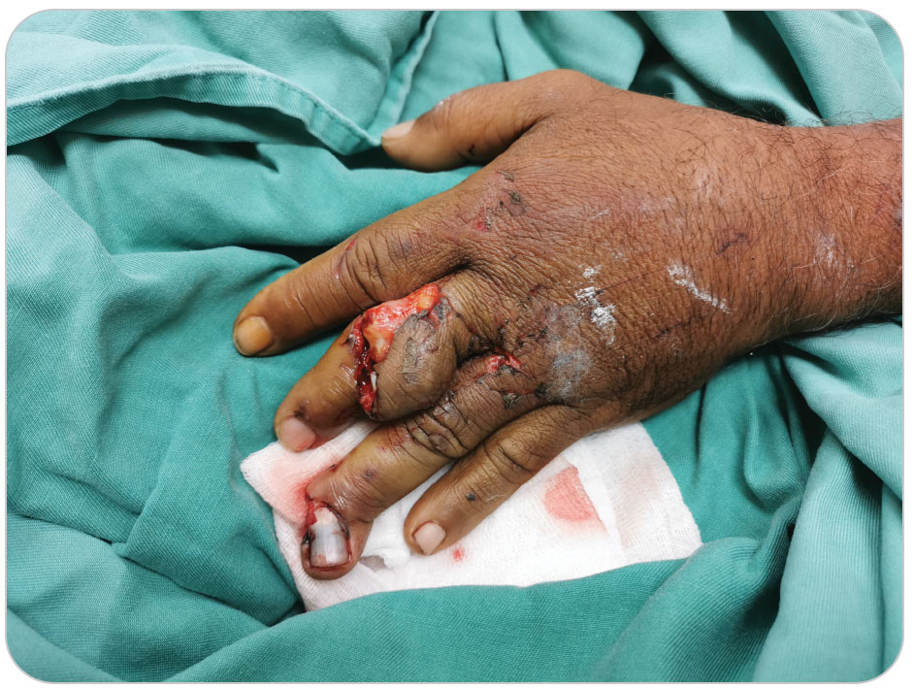
Open Injury: Open Crush Injury
19-4
19-6
As with closed crush injuries, may damage underlying internal organs, fracture adjacent bones, and/or generate widespread soft-tissue damage
Internal bleeding may be extensive and can produce life-threatening hypovolemic shock.
If the patient survives a massive crush injury, result is often a permanently painful and deformed area of the body.

Slide 42
Open Injury: High-Pressure Injection
19-4
19-6
Involves the introduction of a liquid or gas into the body from a pressurized source
In many instances, the presenting wound is very small and may initially be thought of as minor.
Can cause severe damage to underlying tissues, blood vessels, and nerves
Because the substance is injected into the tissues with great force, high-pressure injection injuries must be considered serious until proven otherwise.
Injuries may result in surgical amputation of the affected part.
Common sources of high-pressure injection injuries include high-pressure water sprayers, grease guns, paint sprayers, and pneumatic tools.

Slide 43
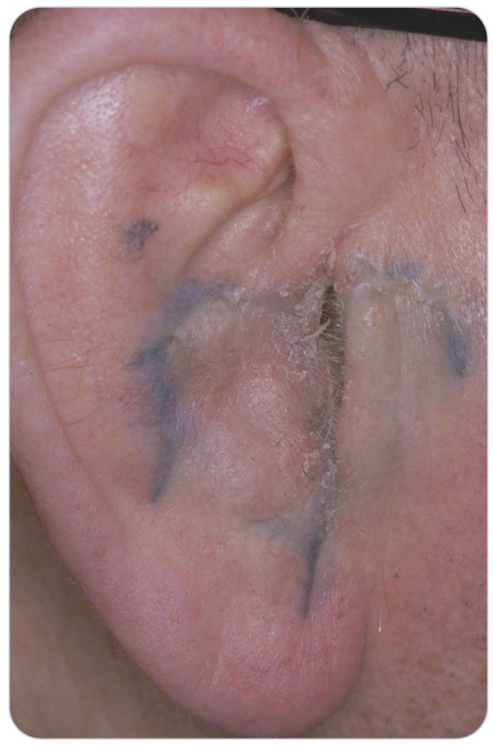
Open Injury: Mechanical Tattooing
19-4
19-6
A form of open soft-tissue injury that occurs when foreign debris such as dirt, rocks, or tar is ground into a wound or the adjacent skin
Can leave indelible marks on the skin
Powder residue from a gunshot wound at close range can result in mechanical tattooing.
Cosmetic tattooing: the person deliberately etches ink into the skin

Slide 44
Burns
19-4, 19-7,
19-8, 9-15
A burn is a unique type of soft-tissue injury.
Caused by exposure to excessive:
Ultraviolet light (sunburn)
Thermal heat
Heat resulting from friction
Chemicals
Electricity
Lightning
Nuclear radiation

Slide 45
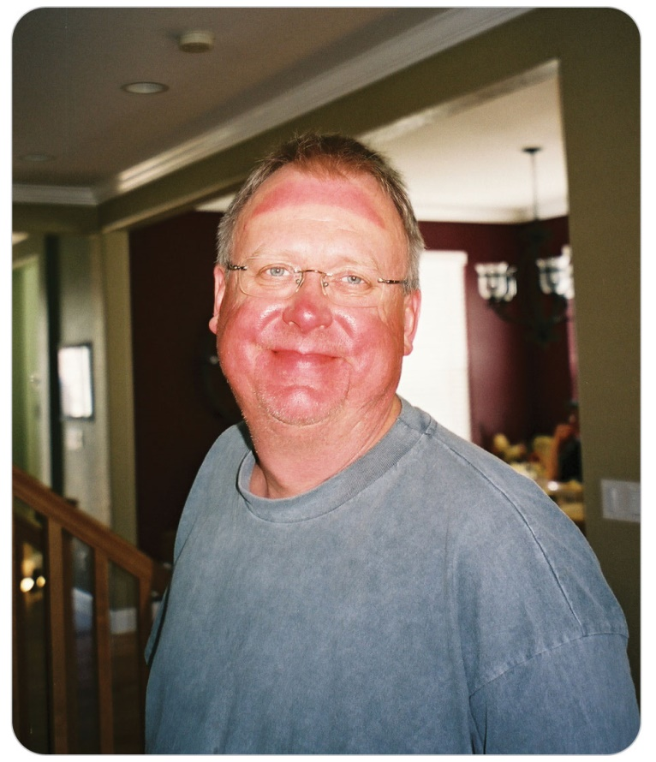
Burns: Sunburn
19-7
19-8
Sunburn is a superficial burn of the skin caused by medium-wavelength ultraviolet (UV) light in sunlight.
Repeated excessive sun exposure over many years may lead to chronic degenerative skin changes, such as excessive wrinkling, darkening, and thickening.
Repeated sunburns are associated with an increased incidence of cancerous lesions.
Avoiding excessive sun exposure and using proper skin protection is the best protection for skin damage.

Slide 46
Burns: Sunburn
19-7
19-8
Environments in which sunlight is more intense, such as at high altitude, or where sun is reflected, such as on snow or water, increase the risk of sunburn.
At higher altitudes, sunburn occurs upon shorter exposure to sunlight.
The less-dense atmosphere at greater elevations provides less protection against UV rays.
Even on cloudy days, significant sunburn can occur to the skin or eyes.

Slide 47
Burns: Sunburn
19-7
19-8
Individuals with fair skin, light-colored hair, or a prior history of sun burning easily should be more careful when at high altitude, on snow, or on water.
Sunscreen can protect the skin by providing a mechanical or chemical barrier to sunlight.
Zinc oxide and titanium dioxide are examples of mechanical (or physical) barriers that reflect the UV light in sunlight when applied to the lips and nose.
Chemical components of sunscreen absorb, rather than reflect, harmful UV rays.

Slide 48
Burns: Sunburn
19-7
19-8
Most manufacturers of sunscreen creams, lotions, and lip salves specify the sun protection factor (SPF) on the label.
Usually ranges from 4 to 100
Refers to how long the skin is protected before becoming red from exposure to the sun
“SPF 15” means that 1⁄15 of the burning radiation reaches the skin through the recommended thickness of sunscreen.
Sunscreen with an SPF of 50 or greater should be used in outdoor environments, especially at high altitude and on snow.
Probably no additional benefit to sunscreens with an SPF that is higher than 50
The key is to apply a thick coat of sunscreen on the skin before exposure to sunlight, and then to reapply it every few hours.

Slide 49
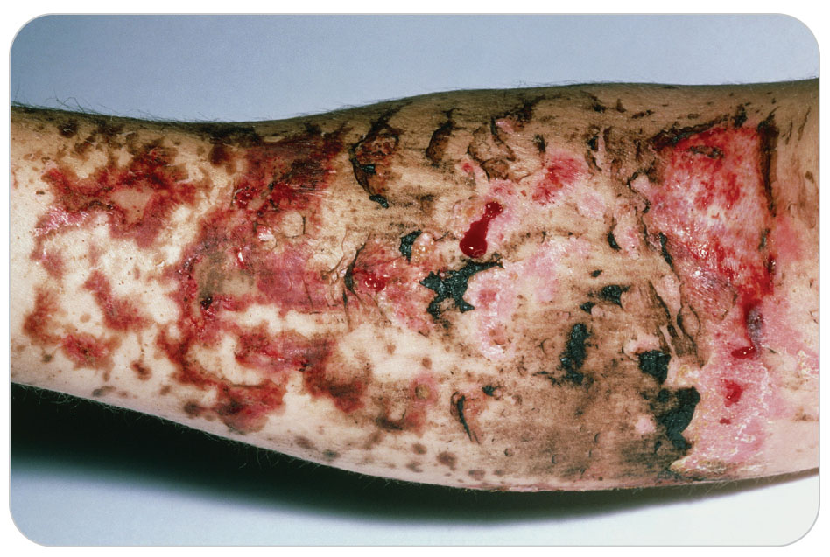
Burns: Thermal
19-7
The most common type of burn
Caused when heat comes directly into contact with the skin
Temperatures greater than 46°C (115°F) are enough to inflict a thermal burn.

Slide 50
Burns: Thermal
19-7
Common causes of thermal burns include:
Hot water
Hot steam
Superheated air, which cause a scald
Physical contact with a hot object such as an iron, a stove, molten tar, or a lightbulb
While most occur on the skin surface, they can also occur inside the body under certain circumstances.
Example: Patients who breathe heated air or hot steam into their lungs may receive an inhalation burn that causes extensive damage to delicate lung tissue.

Slide 51
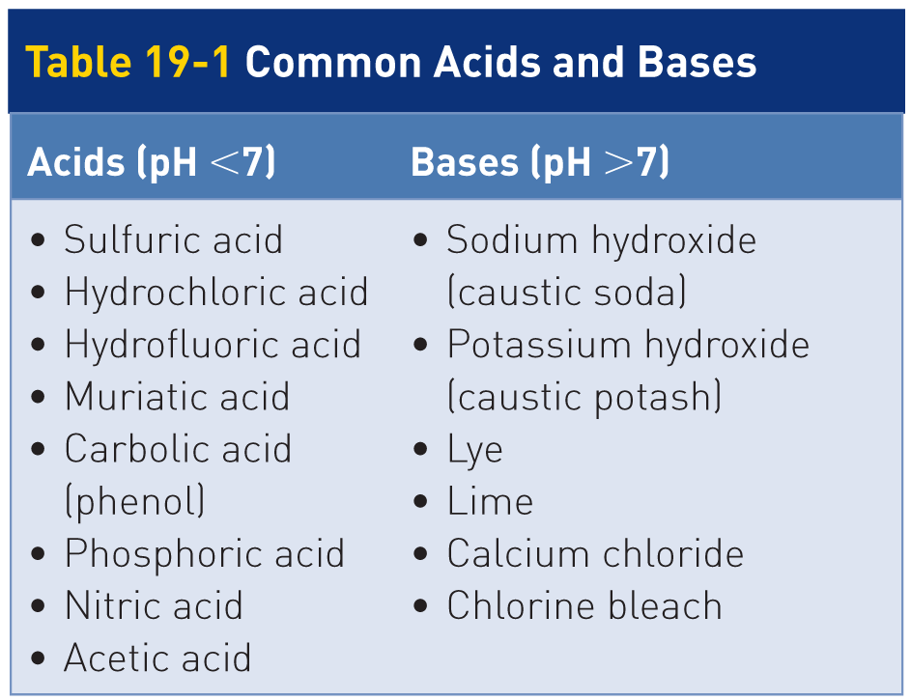
Burns: Chemical
19-7
Chemical burns result from exposure to acids or bases, depending on the substance’s potential of hydrogen (pH)—the concentration of hydrogen ions in solution.
pH scale ranges from 1 (strong acid) to 14 (strong base)
pH of 7 is considered neutral because it is neither acidic nor basic.

Slide 52
Burns: Chemical Burn
19-7
The extent of injury resulting from exposure to caustic substances varies with the concentration of the chemical, the amount of chemical involved, and the duration of contact.
Alkaline (or basic) chemicals tend to cause more extensive chemical burns than acids because they penetrate the skin more deeply.
Mucous membranes, especially in the mouth, can be burned if patient has ingested a caustic chemical.

Slide 53
Burns: Chemical Burn
19-7
Acidic and alkaline solutions are commonly found in commercial settings such as a mountain resort or backcountry lodge, often in cleaning solutions.
Unlike most household equivalents, commercial cleaners are typically in concentrated forms that require dilution before use.
In addition to acids and bases, chemical burns can be caused by substances such as mustard gas, a powerful vesicant (blister-producing agent).
Used as chemical weapons

Slide 54
Burns: Electrical
19-7
When the body encounters an electrical current, an electrical burn can occur.
Many factors determine severity of an electrical burn:
Amount and type of electricity contacted
Where the electricity enters and exits the body
Duration of contact
Under normal conditions, electricity flows from some electrical source to an electrical ground following the “path of least resistance.”
When skin becomes wet or oily, its conductivity increases, and its resistance markedly decreases, so electricity travels through the skin easier.

Slide 55
Burns: Electrical
19-7
Internal structures such as blood vessels and nerves are highly conductive and have low resistance.
This is why electrical injuries traveling through the body produce severe internal injuries.
OEC technicians should always consider internal injuries whenever a patient has been exposed to a significant electrical current, which can pass into and burn (essentially cook) any organ in the body.
Heart can be significantly damaged or can stop altogether when significant electrical current travels through it.

Slide 56
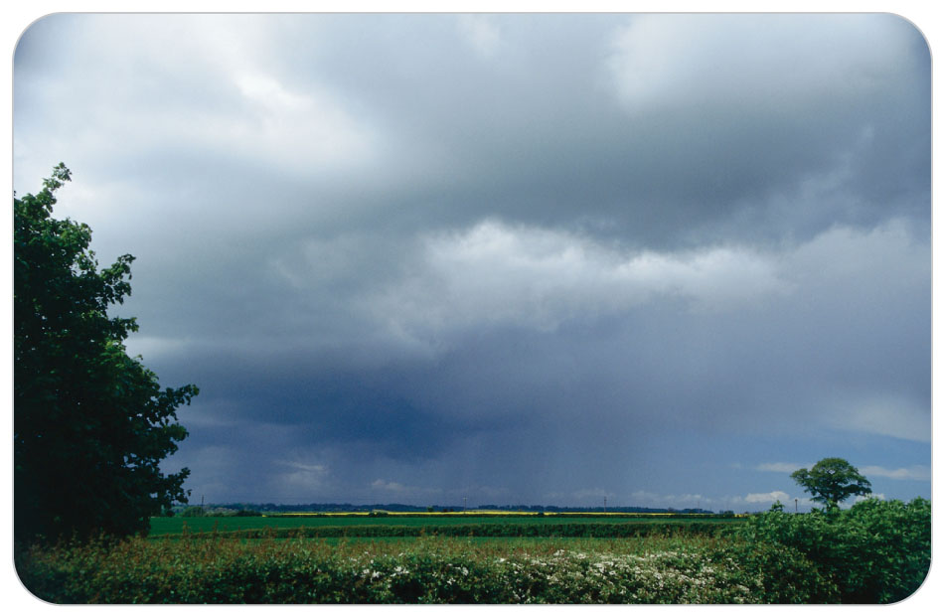
Burns: Lightning Injuries
19-7
A type of electrical burn
Presents unique considerations
An atmospheric discharge of electricity can generate 300,000 amps and 2 billion volts.
Only 500 milliamps of direct current to kill someone
Depends on the resistance of the human body

Slide 57
Burns: Lightning Injuries
19-7
Significant internal tissue damage may not be obvious from the external burns at the sites at which electricity entered or exited the body.
Respiratory arrest
From injury to the respiratory control center of the brainstem
Cardiac arrest
If the electrical current passes through the heart and disrupts its organized electrical activity
Severe tissue damage by an electrical current may lead to the breakdown of muscle and the release into the circulation of chemicals that injure the kidney.
Can cause neurologic effects such as pain, paralysis, blindness, numbness, weakness, loss of hearing or speech, and unresponsiveness

Slide 58
Burns: Lightning Injuries
19-7
Electrical current from lightning can cause muscular contractions that throw patient off balance and cause injurious falls.
Fatality rate from a direct lightning strike is 30%.
Cardiac arrest is the most common cause of death.
Characteristic lightning-induced skin injury is known as “feathering” or “ferning.”

Slide 59
Burns: Radiation
19-4
19-7
Following an exposure to an object, substance, or element that emits radiation
Depending on the source, exposure may be brief or prolonged.
Radiation is transmitted in the form of rays or particles.
May be transmitted by a variety of sources
Sun is another source of radiation; it transmits UV light.
Sunburn or burns associated with welding equipment are the radiation burns most likely to be encountered by OEC technicians.

Slide 60
Patient Assessment

Slide 61
Patient Assessment: Burns
19-9
SCENE SAFETY
The priority when assessing a burn patient is to ensure that the scene is safe to enter.
Put out any fires, turn off the electricity, and have any chemicals removed.
Call a fire department and request a hazardous materials (hazmat) team respond if the scene contains any chemicals or radiation that could harm you or others.
Touching a patient who is still in contact with a live electric wire can be dangerous.
Only after all potential dangers have been abated may you begin the assessment process.
Attempt to identify these dangers as part of the scene size-up.
Information may be useful both in performing the assessment and in making treatment decisions.

Slide 62
Patient Assessment: Burns
19-9
As soon as you are aware that a toxic substance or bodily fluids may be present, use standard precautions.
At a minimum, use eye, face, and hand protection.
For chemical burns, consider using chemical-resistant gloves and a protective gown or overgarment.
Do not overlook this critical step.
Some chemicals may not be readily apparent.
Failure to adequately protect yourself increases your risk of injury.
Some chemicals give off toxic gases that can cause damage to the eyes and lungs, and burns can expose structures beneath the skin to potential contaminants and pathogens.

Slide 63
Patient Assessment: Burns
19-9
PRIMARY SURVEY
Control serious bleeding and assess the ABCDs, beginning with evaluating the patency of the airway.
Patients who are exposed to thermal sources or caustic chemicals are at high risk for serious airway injuries.
Burn injuries to the upper airway may require prompt ALS airway evaluation for potential emergent intubation.
Lower airway can still suffer inhalation injuries.
Injuries may not be immediately apparent but can cause sudden respiratory compromise.
Complete the primary assessment by determining patient’s level of responsiveness and distal neurologic function.

Slide 64
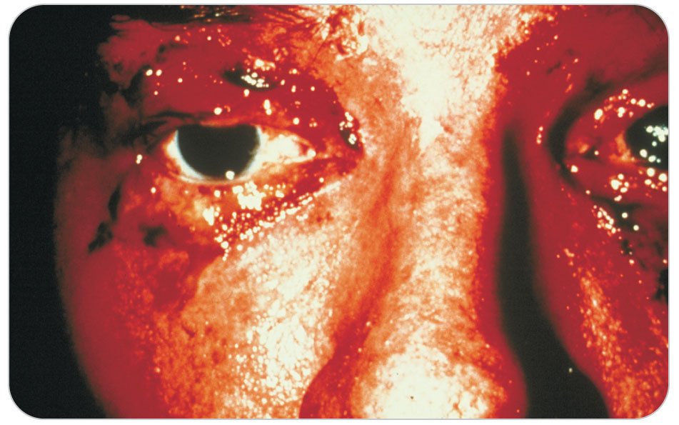
Patient Assessment: Burns
19-9
Signs and symptoms associated with an Inhalation Injury include:
Obvious burns involving the head, face, or neck
Singed hair, eyebrows, nose and facial hairs
Soot and combustion on the face, in the mouth, or around the nostrils
Hoarseness or voice changes
Airway swelling
Difficulty swallowing
Darkened oral or nasal discharge

Slide 65
Patient Assessment: Burns
19-9
SECONDARY ASSESSMENT
Perform a thorough secondary assessment.
Take vital signs.
SAMPLE
Obtain a medical history, which can reveal valuable clues regarding the mechanism of injury and may help to identify other possible injuries and preexisting medical conditions.
Obtain information regarding patient’s medications and tetanus immunization status.

Slide 66
Patient Assessment: Carbon Monoxide
19-9
If source of the burn involves flames that occurred in an enclosed area, assume that patient may have carbon monoxide poisoning.
Symptoms include headache, nausea, and altered mental status.
Even though cherry-red skin is often described as a feature of carbon monoxide poisoning, it is rarely observed in prehospital environments.
Occurs only after significant exposure
Probably the result of burns
If exposure to carbon monoxide is expected, give patient high-flow, high-concentration oxygen through a nonrebreather mask.
Note: Pulse oximetry (Sp O₂) is not effective when a patient has carbon monoxide poisoning.

Slide 67
Patient Assessment: Burns
19-9
DETERMINING THE SOURCE
Hot Liquid:
Attempt to determine how long the liquid was in contact with the skin.
Find out if the burn was irrigated with water or if a cream or lotion was applied to the burn.
Chemical:
Attempt to identify the chemicals involved by examining the container, paying attention to the identities and concentrations of the active ingredients.
Do not expose yourself or others to the chemical.

Slide 68
Patient Assessment: Burns
19-9
Electricity:
Attempt to determine:
Which body part was in direct contact
For how long
The source of the electricity
Burns are usually more extensive than first apparent.
Greatest injuries are often internal and involve deep tissues or organs.
At greater risk for cardiac-related injury or arrest when electricity is involved
Determining the path of the electrical current through patient’s body and applying your knowledge of human anatomy can help you identify which internal structures may have been affected.

Slide 69
Patient Assessment: Burns
19-9
Once the initial threats to life have been mitigated, the history obtained, and the secondary assessment completed, the next step is to evaluate the severity of the burns by classifying them using either the degree-based or the thickness-based method.

Slide 70
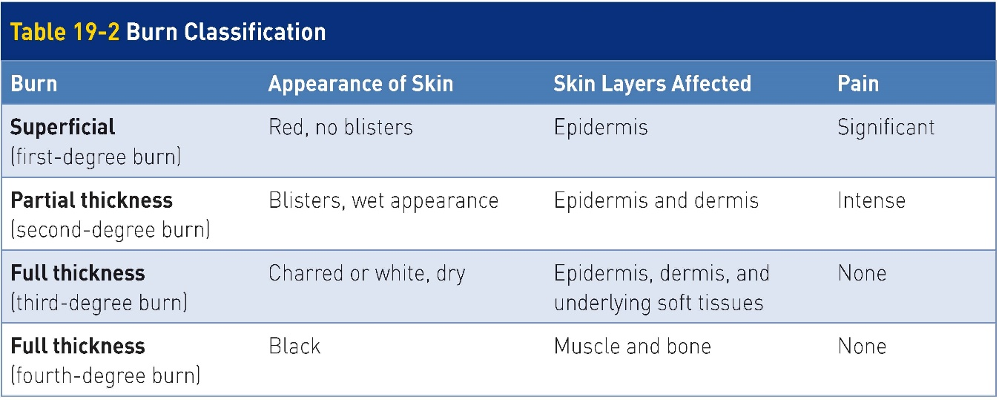
Classifications of Burns
19-10
Burns are classified according to the depth of skin damage using two methods:
Thickness-based: classifies burns as superficial burns, partial-thickness burns, or full-thickness burns
Degree-based: classifies burns as first-degree burns, second-degree burns, third-degree burns, and fourth-degree burns
Both methods are commonly used in emergency and burn medicine, often in conjunction with one another.

Slide 71
Classifications of Burns
19-10
Accurately classifying burn injuries
An important skill for OEC technicians to learn
This information is used to determine:
Initial treatment
Subsequent therapy
Whether hospitalization should occur in a specialized burn center

Slide 72
Classification of Burns: Superficial
19-10
Superficial Burns
Mildest form of burn
Affects the epidermis only
Epidermis remains intact.
Skin that is hot, dry, and reddened
Pain and tenderness are mild to moderate.

Slide 73
Classification of Burns: Superficial
19-10
Healing is usually spontaneous and occurs within a few days.
May be accompanied by superficial sloughing of the epidermal layer (“peeling”)
Too much exposure to the sun and remaining too long in a tanning bed are the most common sources of superficial burns.
Sunburns are usually first-degree burns.
Can blister and result in second-degree burns
Depending on the amount of UV radiation exposure

Slide 74
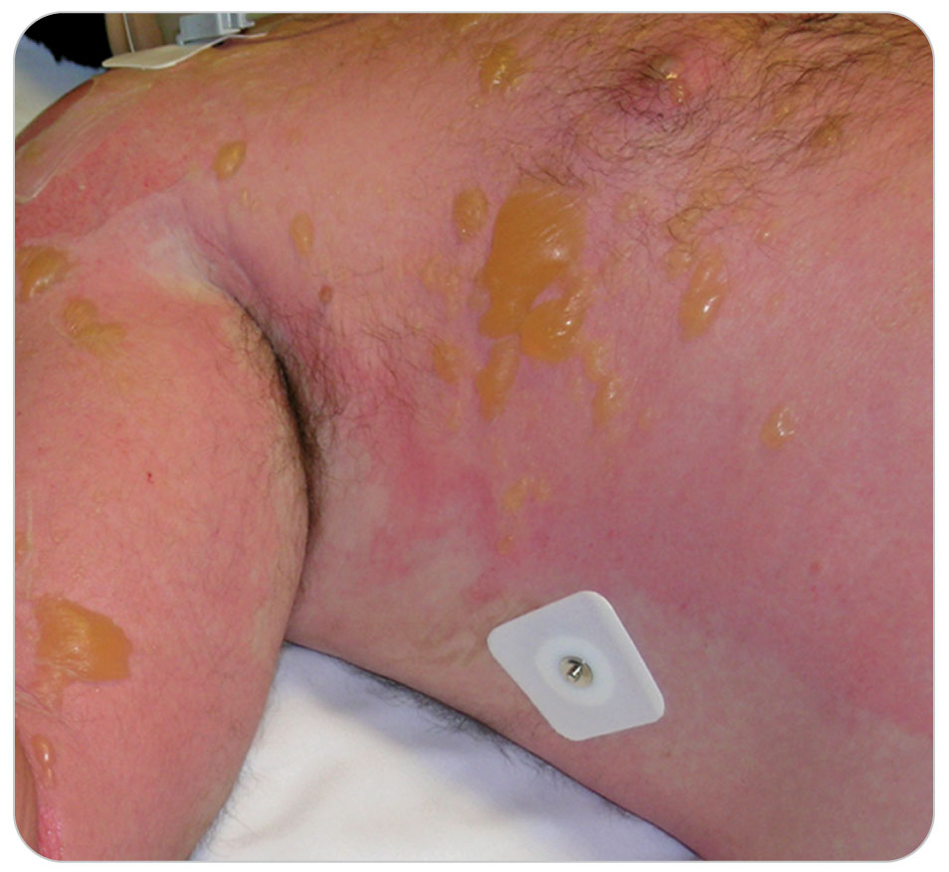
Classification of Burns: Partial-Thickness
19-10
A partial thickness burn (second-degree burn) affects both the epidermis and dermis.
Does not exceed the regenerative capabilities of the skin
Characterized by reddened skin and blisters that form from plasma leaking into the spaces surrounding epidermal cells
Unless the blisters break, the skin is dry and reddened.

Slide 75
Classification of Burns: Partial-Thickness
19-10
Nerve endings remain intact but are inflamed and irritated.
Skin is painful to the touch, with the pain described as moderate to severe.
Consider calling for ALS to provide intravenous pain medication for patients with extensive partial-thickness burns.

Slide 76
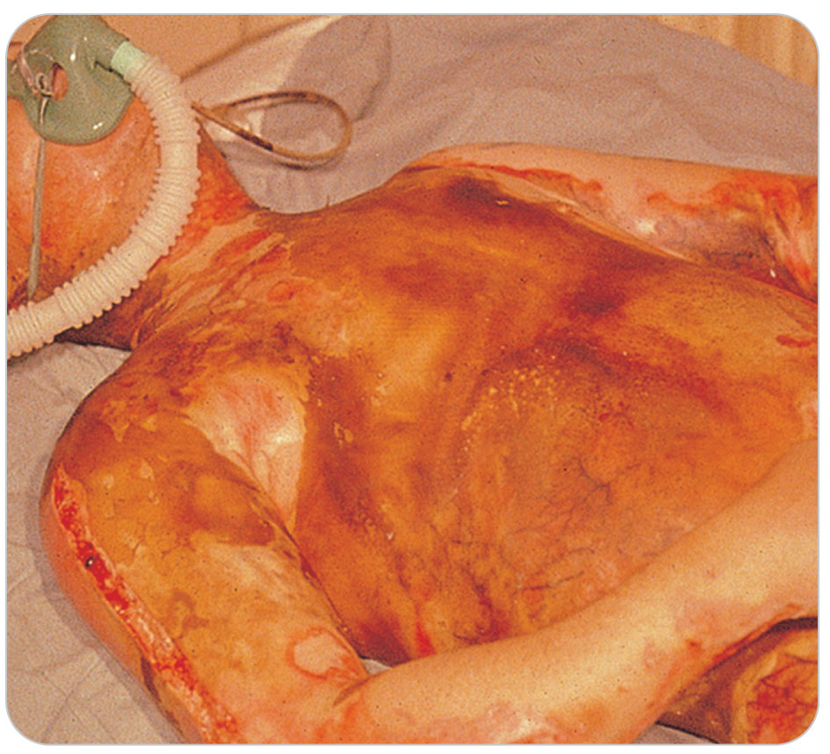
Classification of Burns: Full-Thickness
19-10
A full-thickness burn is a devastating injury.
Third-degree burns: all layers of the skin and possibly the underlying structures are destroyed.
Fourth-degree burns are even more extensive, affecting muscle and bone.
Mortality rate is high.

Slide 77
Classification of Burns: Full-Thickness
19-10
In a full-thickness burn, the skin takes on a white or charred “leathery” appearance and is usually dry.
Pain is usually absent in that specific area due to complete destruction of nerve endings.
Site may be surrounded by partial-thickness and superficial burns that are painful.
Skin does not grow back; the growing layer has been destroyed.
Skin grafts are needed.
Thermal burns, such as boiling water, scalds, or direct contact with an open flame, are the most common sources of full-thickness burns.
Such serious burns are more prone to infection than are superficial or partial-thickness burns.

Slide 78
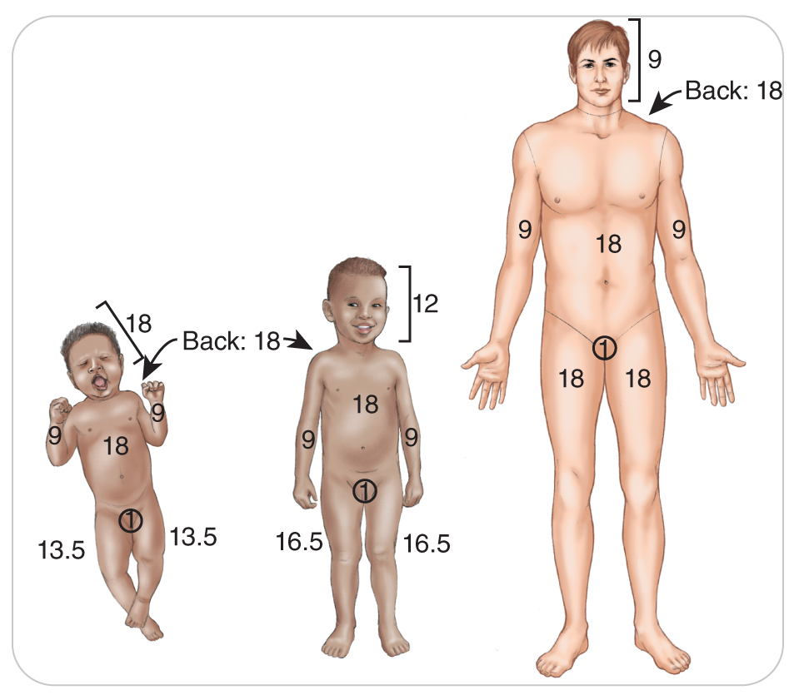
Classification of Burns: Calculation of Burn Area
19-9
Calculate the total area of skin for partial-thickness or full-thickness burns.
Superficial burns should not be included in this calculation.
The “Rule of Nines”
The surface area of the body is divided into 11 sections.
Each represents 9% of the total body surface area (TBSA).

Slide 79
Management

Slide 80
Management: Controlling Bleeding
19-11
When managing the ABCDs, control any severe bleeding first.
Determine immediately if the bleeding is a life-threatening problem.
Treatment for minor bleeding and major bleeding is different.
Bleeding from a minor cut can be treated with a small dressing or Band-Aid.
In most situations, more extensive external bleeding, whether arterial, venous, or capillary, can usually be controlled by applying direct pressure.
If needed, apply additional dressings or use a compression dressing.
When life threatening/more intense, other measures such as packing the wound, using hemostatic dressings, or using a tourniquet are needed.
More severe bleeding is called hemorrhage.
To control bleeding, follow the steps in OEC skill 19-1.

Slide 81
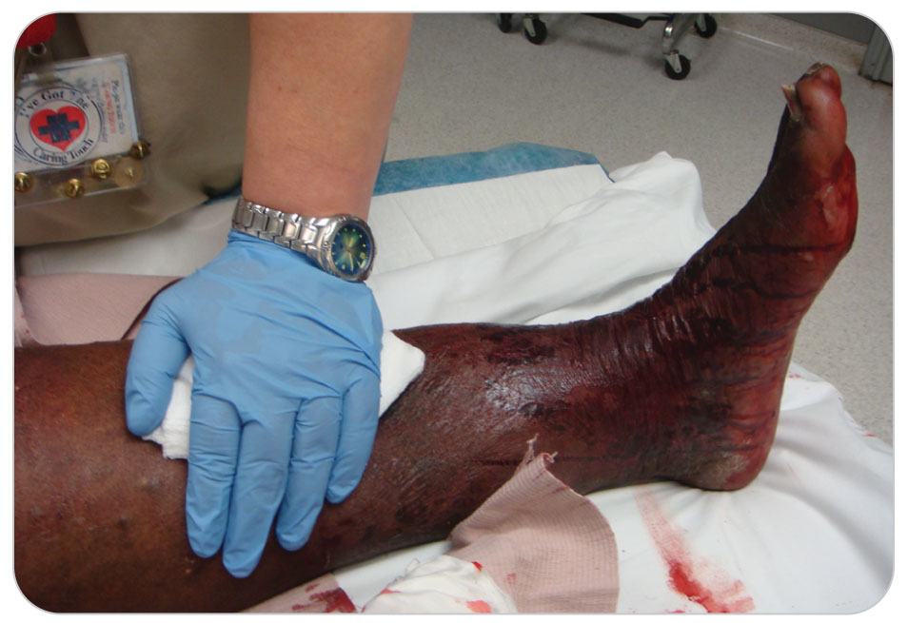
Management: Direct Pressure
19-11
The primary method used to control any external bleeding
Performed by applying firm direct pressure with a gloved hand, or both hands if bleeding is severe
Can even stop major arterial bleeding
If sterile is available, place on the wound and then apply and maintain continuous firm pressure.
Occludes underlying blood vessels until normal clotting mechanisms can seal them

Slide 82
Management: Direct Pressure
19-11
If the situation is urgent and a sterile dressing is not available, use any clean, soft material or even the palms of your gloved hands to apply direct pressure.
People on anticoagulants (“blood thinners”) will need to have pressure applied for a much longer time, sometimes 30 minutes.
If for some reason you do not have medical gloves, leave your ski gloves on.

Slide 83
Management: Application of Additional Dressing
19-11
For non-life-threatening bleeding not controlled by the initial application of a dressing, add additional sterile dressings over the initial dressing.
Once applied, do not remove the original dressing.
Instead, add to the base layer.
Removing the primary dressing will disrupt any clotting that has occurred and cause additional bleeding.
Continue to place pressure on the wound with both hands.
If bleeding continues, additional measures are needed.

Slide 84
Management: Compression Dressing
19-11
Compression Dressing
Also known as a Pressure Dressing
Once bleeding is controlled, maintain direct pressure on the wound.
Secured in place by a firmly applied roller bandage
When two OEC technicians are available, one should hold direct pressure with both hands over the wound while the second OEC technician applies the pressure dressing, removing the first person’s hand as it is positioned.

Slide 85
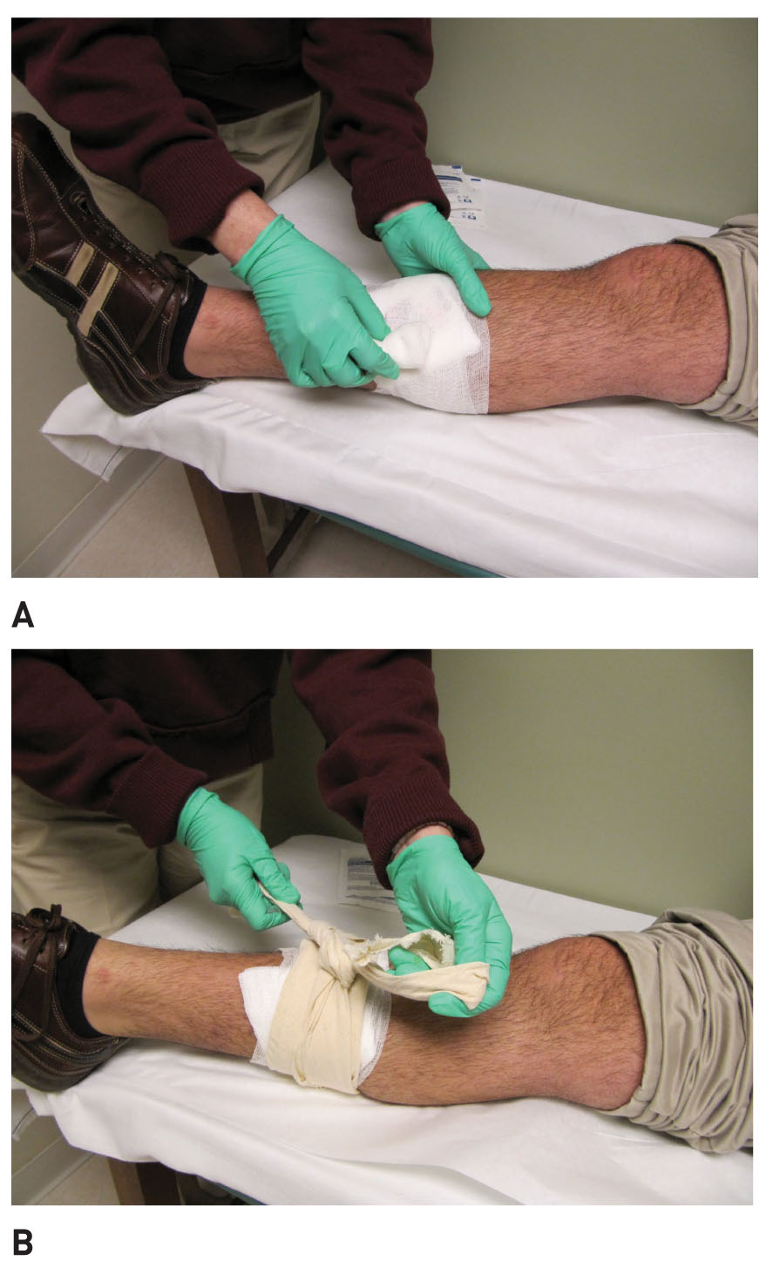
Management: Compression Dressing
19-11
To apply a compression (pressure) dressing, begin distal to the injury and wrap roller bandage over dressing, all the time moving proximally and tying the knot directly over the wound.
Cravat can be applied to add more pressure.
Cravat wrapped around the wound several times and then tied tightly over the wound will work.
Check CMS distally before and after applying the pressure dressing.

Slide 86
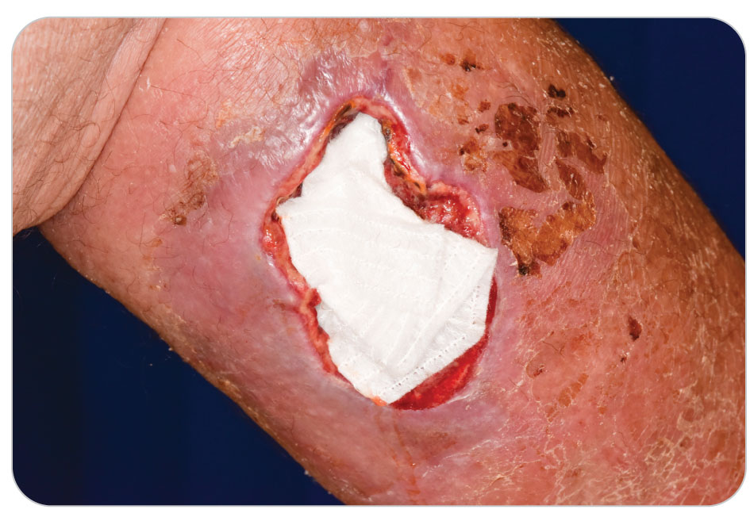
Management: Compression Dressing
19-11
A pressure dressing using a cravat can then replace your hands if the bleeding is controlled.
DO NOT USE on the neck, where you must continue to maintain pressure with your hands.

Slide 87
Management: Severe Life-Threatening Bleed
19-11
“Stop the Bleed” is an educational program created for prehospital providers.
Step-by-step approach for controlling life-threatening bleeding
Primary principles of the program include:
Notifying the EMS system of a patient with severe bleeding
Finding the source of the bleed
Applying pressure to stop the bleeding

Slide 88
Management: Severe Life-Threatening Bleed
19-11
Notify dispatch to call EMS.
To stop severe bleeding, first cover the wound with a sterile dressing or clean cloth and apply pressure with both gloved hands.
Tourniquet, or pack wound with gauze or a clean cloth and apply pressure with both hands.
Hemostatic dressings may also be used in treating severe bleeding.

Slide 89
Management: Packing the Wound
19-11
Fill the wound with gauze, hemostatic dressing, or a clean cloth, and then apply pressure with both hands.
Technique that is necessary for life-threatening bleeding from locations where a tourniquet cannot be used:
Can also be used on large or deep extremity wounds with severe bleeding when tourniquet is not available
Neck
Shoulder
Torso
Abdomen
Chest
Groin

Slide 90
Management: Hemostatic Dressings
19-11
Contains a topical hemostatic agent that promotes clotting
Originally used by the military successfully, then by EMS
Some ski patrols now have these dressings available.
A variety of sizes are sold individually wrapped in a vapor barrier.
Latex-free
Cost of these dressings and shelf life need to be considered when developing a local protocol for use of these products.
Dressings are not needed for small cuts and abrasions where bleeding can be controlled by simple means.

Slide 91
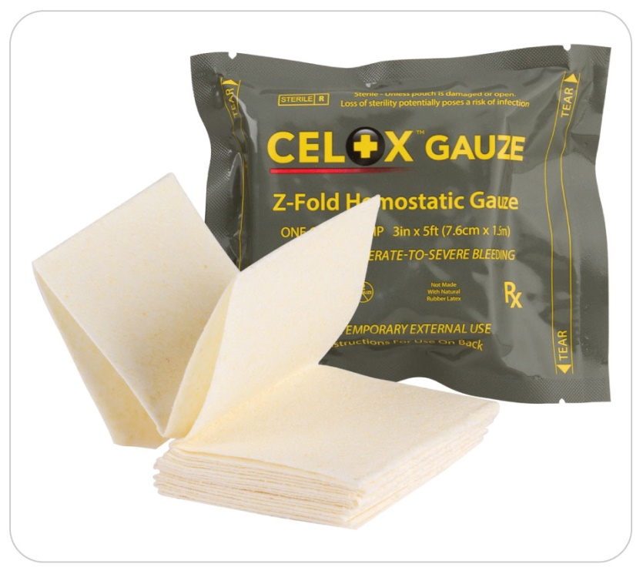
Management: Hemostatic Dressing
19-11
“Recommend the use of hemostatic gauze where direct pressure alone is ineffective or not practical, and in cases where tourniquet application is not possible due to anatomic limitations.” -- American College of Surgeons, 2014

Slide 92
Management: Hemostatic Dressing
19-11
Hemostatic dressings must be placed directly on the wound to be effective.
Apply direct pressure first to the wound to stop the bleeding; then apply the hemostatic dressing as the first layer and add more sterile gauze on top.
Make this into a pressure dressing.

Slide 93
Management: Tourniquets
19-11
The use of a tourniquet to control severe bleeding in an extremity is well accepted.
Use only on extremities.
If the bleeding is severe and places patient at great risk for bleeding to death (also knowns as exsanguination), a tourniquet can be lifesaving and needs to be applied.
Effective method to completely stop blood flow distal to the area of application
Applied only when hemorrhaging from an extremity cannot be controlled by other methods

Slide 94
Management: Tourniquets
19-11
Two situations that might warrant use of a tourniquet immediately are:
Unable to control severe bleeding with direct pressure
Significant bleeding from an extremity and simultaneously other major problems
Always make the tourniquet tight.
If completely tight and the bleeding does not stop, leave the first tourniquet on and apply a second tourniquet above (proximal to) the first one.
Place a tourniquet directly over clothing.
Must remove bulky items before placing a tourniquet
Tourniquet will hurt, a lot.
Do NOT loosen it if patient complains of pain.
Never remove a tourniquet in the prehospital setting once it is applied.

Slide 95
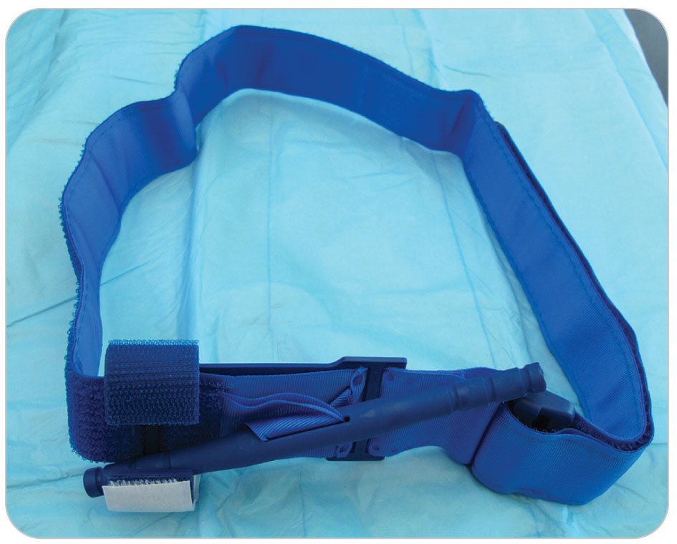
Management: Tourniquets
19-11
Use of a tourniquet always is accompanied by the risk of patient losing the limb.
No amputations have been caused by leaving tourniquets in place for fewer than 2 hours.
It is best to get patient to a trauma center as soon as possible so that bleeding can be completely stopped and the tourniquet removed.
Write the time at which the tourniquet was applied either directly on patient’s forehead or on a piece of tape applied to patient’s forehead.

Slide 96
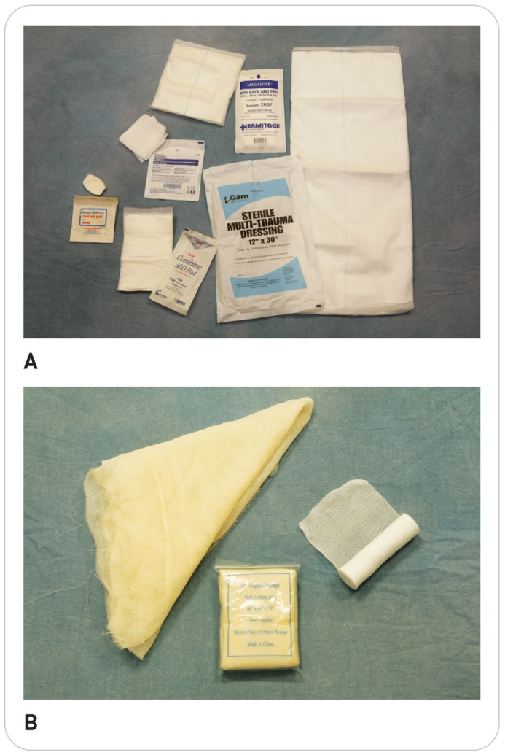
Management: Dressing
19-12
A dressing is a piece of material, usually cloth or a cloth-like fabric, that is placed directly on a wound.
Should be sterile, prepackaged
Large enough to extend at least 1 inch beyond all wound edges
Conventional sterile gauze pads:
4 inches by 4 inches (4×4)
4 inches by 8 inches (4×8)
Soft self-adherent roller dressings
Assorted small adhesive-type dressings

Slide 97
Management: Dressing
19-12
Universal dressing
Sometimes called the trauma dressing
Measures 9 inches by 36 inches
Made of a thick, absorbent cotton material
Well suited for covering large open wounds
Works well to pad rigid splints
Commercially available in compact, individually wrapped sterile packages
Occlusive dressings
Used in special situations in which the wound requires an occlusive dressing
e.g., Vaseline gauze, aluminum foil, plastic cling wrap

Slide 98
Management: Bandages
19-12
A bandage is a piece of material that is used to hold a dressing or splint in place.
The term bandaging usually refers to the process of applying both a dressing and a bandage.
Most wounds require dressings and bandages to prevent further contamination and to absorb blood and wound secretions.
Become familiar with the indications, functions, and proper application of each of the many types of bandages.

Slide 99
Management: Bandages
19-12
Examples of Bandages:
Self-adhering roller bandages (e.g., Kerlix)
Rolls of soft gauze (e.g., Kling)
Triangular bandages folded into 2- to 3-inch wide strips
Adhesive tape are used to secure dressings in place.
Kerlix is a commercial self-adherent roller bandage that is available in multiple widths and is considered by many to be the most effective because its elasticity makes it easy to apply.

Slide 100
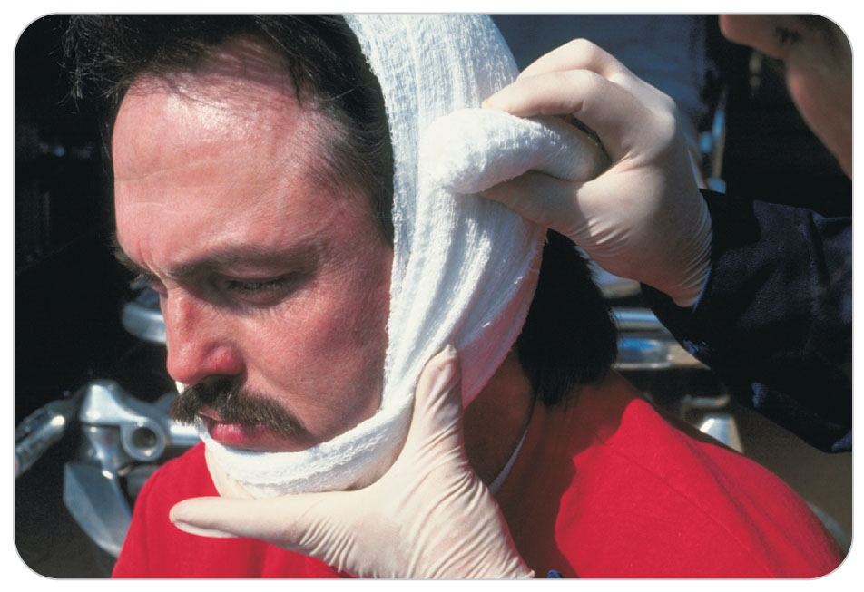
Management: Dressing and Bandages
19-12
Kling is a commercially available, tightly woven, light gauze wrap that also may be used to secure a dressing in place.
Less elastic than Kerlix
Triangular bandages can be used to secure dressings in place.

Slide 101
Management: Principles of Bandaging
19-13
Most bandages that are placed on an extremity are wrapped entirely around the body part.
Introduces the danger of restricting circulation if the bandage is too tight
Always leave fingers and toes exposed so that you can perform CMS checks distal to any bandage that has been applied.
Tourniquet for uncontrolled bleeding is not a bandage.

Slide 102
Management: Principles of Bandaging
19-13
Do NOT use elastic bandages, because they tend to tighten on the injured part.
Ace wrap may even function like a tourniquet and subsequently cause additional tissue damage or loss of limb.
Adhesive tape can be used to secure small dressings (4×4s) in place and is helpful in closing/securing larger dressings.
Allergies to adhesive tape (latex in adhesive) are common.
If you discover during your SAMPLE history that patient has this allergy, use latex-free tape.

Slide 103
Management: Knots
19-13
Knots
Necessary skill to tie a square knot
Essential for successful bandaging and splinting

Slide 104
Management: Occlusive Dressing
19-13
Occlusive Dressing:
An airtight layer of sterile Vaseline gauze, plastic cling wrap, or aluminum foil
Packaged individually wrapped
These dressings prevent air and liquids from entering (or exiting) the wound.
Chest Wound:
Seal only three sides to allow air to escape (sealing all four edges might worsen the problem).

Slide 105
Management: Occlusive Dressing
19-13
Abdominal Wounds:
Use a sterile universal dressing moistened with sterile saline to cover open abdominal wounds in which organs are exposed.
Secure with a dry universal dressing taped to the abdomen.
Puncture-type wounds to the head, neck, or abdomen:
Seal all four sides of the occlusive dressing to prevent wound contamination.

Slide 106
Management: Stabilizing Dressing
19-13
A stabilizing dressing is used to secure an impaled object in place.
Taking the object out could result in more damage to the tissues or cause significant bleeding.
The dressing consists of several layers of a thick sterile dressing that are wrapped around the object and held in place by tape or a self-adhering roller bandage.

Slide 107
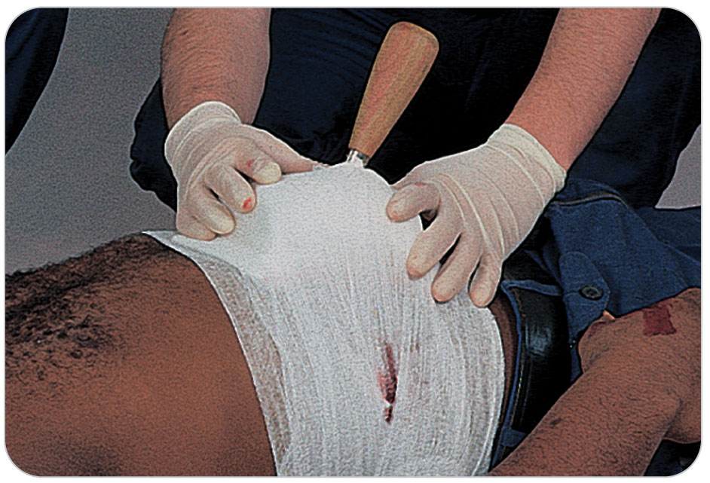
Management: Stabilizing Dressing
19-13
Fully stabilizing the object may require wrapping several layers of folded cravats around the object to form a doughnut.
If you do not have a stabilizing dressing, stabilize the object with several cravats and secure it with a square knot.

Slide 108
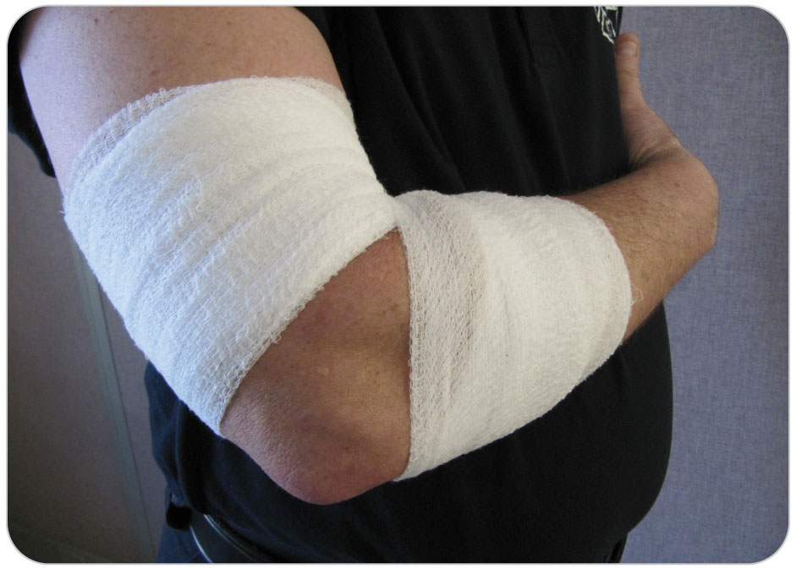
Management: Bandaging Problem Areas
19-13
Special bandaging techniques:
Moveable joints
Irregularly shaped areas of the body
Spherical and conical anatomic regions
Bandages tend to loosen when the joints beneath them move.
Choose a 3- to 6-inch self-adherent roller bandage to secure a sterile dressing applied to wounds near joints.

Slide 109
Management: Bandaging Problem Areas
19-13
Begin applying the bandage from below the joint and move diagonally in a figure-eight pattern to above the joint and then back down, overlapping the wrap as you go.
Either tuck in the free end or secure it with adhesive tape.
If roller bandage is not available, multiple 3- to 6-inch wide strips made from cravats may be used.

Slide 110
Management: Bandaging Problem Areas
19-13
Conical regions such the arm, forearm, thigh, and leg are also best bandaged using a self-adherent roller bandage.
Make several turns below the dressing, continue up, over, and above the dressing, overlapping the edges as you wrap.
Anchor loose end either under an edge of the bandage or with a strip of tape.

Slide 111
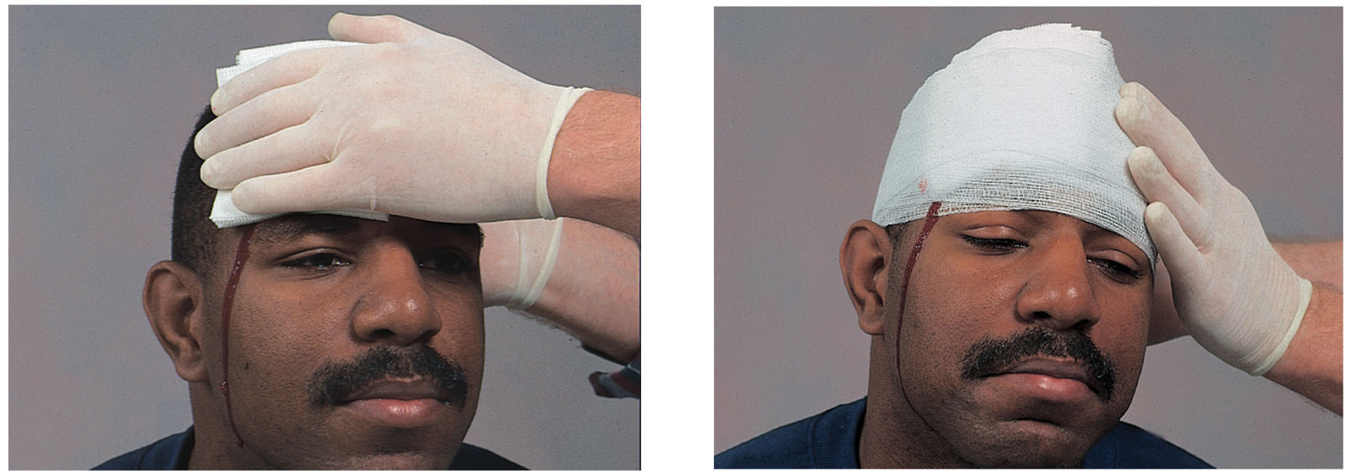
Management: Bandaging a Head
19-13
It is difficult to keep a dressing in place on the head.
Either secure the dressing using a 2- to 3-inch self-adherent roller bandage as a compression band or create a bandana wrap using a triangular bandage.

Slide 112
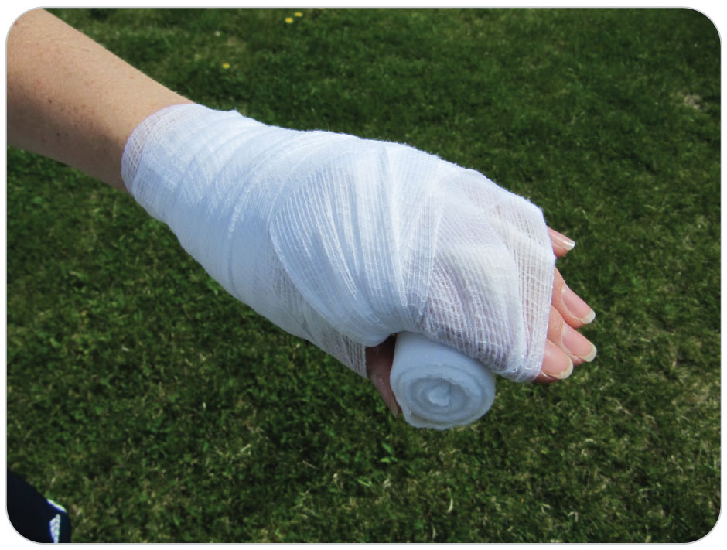
Management: Bandaging Problem Area
19-13
Because hands are always moving, even after being injured, bandages tend to work loose easily.
An effective technique for bandaging wounds involving the palm or the back of the hand is to immobilize the entire hand.
This is accomplished by placing small sterile pads (2×2) between the fingers and a roller gauze in the palm, putting the hand into the “position of function.”

Slide 113
Management: Bandaging Problem Area
19-13
Next, wrap the hand with non-elastic bandage, elevate it above heart level, and sling and swathe it into place.
Try to leave the thumb and the fingertips exposed to facilitate CMS checks.
When patient’s fingers must be left relatively free, use a suitable alternate bandaging technique for palm and dorsal hand wounds.
Employ a modified figure-eight bandage or apply a short splint to the hand and distal forearm.

Slide 114
Management: Bandaging a Finger
19-13
A finger is a difficult structure to bandage because of its cylindrical shape and ability to move in multiple directions.
If possible, use 1-inch roller gauze for smaller wounds, and a bulky hand bandage for large finger wounds.

Slide 115
Management: Bandaging a Finger
19-13
Alternative finger bandage is the modified figure-eight hand bandage, in which the finger is wrapped in an overlapping circular fashion with 1/2- or 1-inch roller gauze, which is then brought diagonally through the palm and around the wrist several turns.
Do not wrap bandages around a finger too tightly because doing so can compromise capillary refill.

Slide 116
Management: Splinting
19-12
Will help with bleeding
By immobilizing a fractured extremity, the bone ends are held still.
Allows a solid internal hematoma to form at the fracture
Movement of a fractured and bleeding arm or leg allows internal bleeding to continue from both the damaged soft tissue and the fracture site.
In severe pelvic fractures, the reason to use a pelvic sling is that it holds the bones still and together and slows bleeding.

Slide 117
Management: Closed Soft-Tissue Injuries
In 2019, the founder of RICE (Rest, Ice, Compression, and Elevation) recommended a modification known as RISE.
Ice is still recommended immediately after the injury.
Helps by the numbing effect
Ice the injury for 5 minutes at a time with at least 30 minutes off.
Always put a cloth between the ice and the skin so you do not freeze the tissue.

Slide 118
Management: Closed Soft-Tissue Injuries
Compression is no longer recommended.
Compression dressings, such as an ACE bandage, may cause an unwanted tourniquet effect on an extremity.
Can damage skin and soft tissue while decreasing blood flow that starts the healing process
Rather initial splinting is important.
Current recommendations are to use RISE, as explained in OEC Skill 19-7.

Slide 119
Management: Open Soft-Tissue Injuries
19-16
Control bleeding while observing standard precautions.
Once controlled, provide wound care.
Superficial – Irrigate with sterile water.
Deep – Only if definitive medical care is more than 90 miles away, irrigate gently with copious amount of sterile water or saline, ideally with a 20-30 mL syringe.
If sterile water or saline is not available, use tap water.
Do NOT try to clean out any material injected (via High-Pressure) out of the tissue.
Cover with a clean dressing (sterile if available).
If involves an avulsion, replace the flap in is original position first.
Secure the dressing with a bandage.
Splint and elevate above the level of the heart.

Slide 120
Management: Amputations
19-16
Incomplete:
Immobilize with a bulky dressing.
Splint above and below the injury site.
NEVER detach.
Complete:
Preserve all amputated parts, regardless of level of damage.
Follow local EMS regarding care.
Either wrap amputated part in a few layers of saline-moistened gauze or in dry gauze.
Seal in a plastic bag.
Place in a container with ice (but not directly on top of the ice).
Do NOT submerge in water as this will damage the tissue.
Replantation of an amputated part is ideally within 4-6 hours of injury.

Slide 121
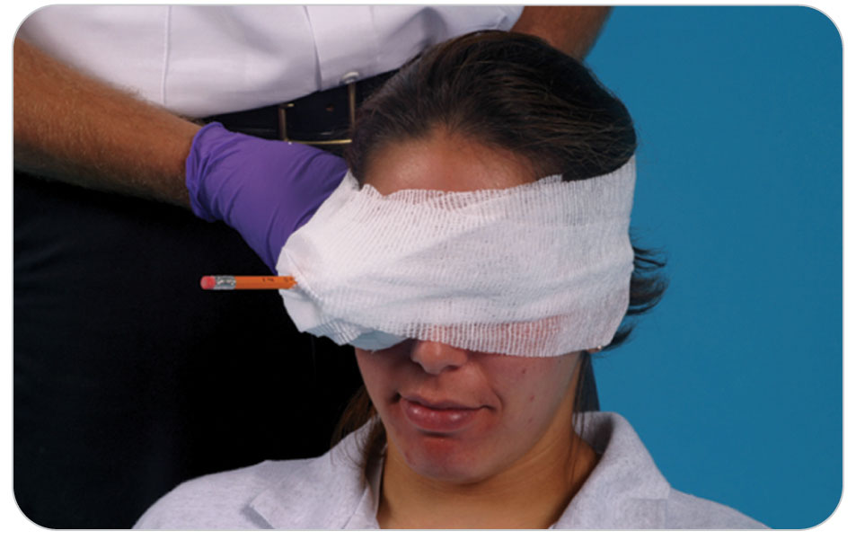
Management: Impaled Object
An impaled object
Causes a puncture wound and
Remains embedded in the patient’s body.
After controlling bleeding, the primary goal is to stabilize the object in the position found.
Rarely, objects are removed if they hinder rescue efforts or compromise airways.

Slide 122
Management: Burns
19-14
Although most burns are minor, severe burns can develop numerous complications, including shock, sepsis, respiratory distress, and cardiac arrest.
Patients who have extensive burns must be transported to a definitive-care facility, preferably a designated burn center, because of the likelihood of extensive tissue damage, underlying injuries, and the need for long-term care.
If a burn center is not available, transport patient to the nearest trauma center.

Slide 123
Management: Burns
19-14
The area of the body with partial-thickness and full-thickness burns (or second-degree and higher burns) is important in determining the care of a patient.
The more severe the burns and the greater the amount of TBSA involved, the more difficult it is to manage the injuries and the higher the mortality rates.
OEC technicians must be able to quickly identify burn patients whose injuries are considered critical and require immediate treatment and rapid transport.

Slide 124
Management: Criteria for Burn Center
19-14
According to the American Burn Association, patients who meet any of the following criteria are critical and should be taken to a burn center:
Burns to a child younger than 10 years or to an adult older than 65 years
Burns involving more than one body part
Burns involving the head, neck, hands, feet, genitals, or major joints
Inhalation injury or burns
Burns associated with difficulty breathing or hoarseness
Chemical or electrical burns
Partial-thickness burn greater than 10% of TBSA

Slide 125
Management: Criteria for Burn Center
19-14
Any full-thickness burn
Burns associated with trauma
Burns with a serious underlying medical disorder
Burns in a patient who has special social, emotional, or physical needs
Exposure to radioactive materials

Slide 126
Management: Further Care and Transport of Burn Patient
19-14
If possible, summon advanced care providers to transport patient.
They can administer pain medications and other advanced therapies that can make patient significantly more comfortable and lessen the incidence of shock.
However, do not delay transport if ALS is not readily available.
Transport burn patients on a clean, dry sheet to prevent the person from sticking to the backboard, toboggan, litter, or stretcher.
Provide the transporting crew or hospital staff a complete oral handoff report that includes the
source of the burn,
any pertinent history,
clinical findings and treatment administered, and
patient’s responses to the treatment.

Slide 127
Management: Lightning Strike
19-15
There is a high risk of cardiopulmonary arrest in lightning strike.
Be alert to possibility for Cardiac Arrest.
Secure that the scene is safe.
Perform an appropriate primary survey, secure resources, and activate ALS.
Assessment should be rapid including ABCDs.
Look for burns and other trauma from lightning strike.
Protect the spinal column using SMR.
Continue secondary survey; splint or bandage as needed.
Transport patient.

Slide 128
Case Study

Slide 129
CASE PRESENTATION
As a member of your area bike patrol, you are called to assist a participant in a summer bicycle race who apparently lost control on the curve of a steep gravel road. As you approach patient, you can see that his wrist and leg are covered with blood. He is responsive and alert but in obvious pain. After the scene is safe, you introduce yourself and ask him what happened. He says, “I lost it in the gravel.” Patient is wearing a helmet and denies striking his head.
He denies any neck or back pain. You note a deep, actively bleeding laceration over the cyclist’s left wrist and “road rash” on his left leg. Immediately, you put on protective medical gloves and notify dispatch that you will need EMS for significant bleeding.
What should you do?

Slide 130
CASE UPDATE
You instruct a race official to close the site to ensure that no other cyclists crash into the scene. Patient can speak to you normally, so he has an airway and is breathing, and his heart is pumping blood. Using standard precautions, you apply direct pressure to the “spurting” wrist laceration using a sterile dressing. The deep laceration over patient’s wrist continues to bleed. A large bruise over the superior-lateral aspect of patient’s left shoulder is tender to the touch, and multiple abrasions are apparent over the lateral aspect of patient’s lower leg.

Slide 131
CASE UPDATE
Many of the abrasions contain dirt and small stones that appear to be ground into the skin and are slowly oozing blood. The cyclist also has large abrasions on the palms of both hands. He can rotate his left arm in all directions without an increase in pain. SAMPLE is noncontributory. All extremities have normal motor and sensory function. Patient’s pulse is 100 beats per minute, and his respirations are 16 breaths per minute.
What should you do now?

Slide 132
CASE OUTCOME
You apply more dressings over the wrist, and bleeding continues. Thinking the man cut his radial artery, you pull your tourniquet out of your pack and place it on his arm above the cut and below the elbow, tightening it appropriately. The bleeding stops. You mark the time the tourniquet was applied on the arm bandage. Realizing you have a major bleed, you call base, requesting immediate transport, saying you have applied a tourniquet. While waiting on transport, you wrap the lower leg abrasions with a roller bandage. Next, you bandage patient’s hands to prevent further contamination. You then recheck the distal circulation, motor function, and sensation to ensure that the bandages are not too tight. A sling is placed on the arm with the shoulder injury. An ambulance arrives shortly thereafter and transfers patient to a trauma center that is 30 minutes away. Patient has surgery to repair the lacerated radial artery.

Slide 133
OEC Skill Activities

Slide 134
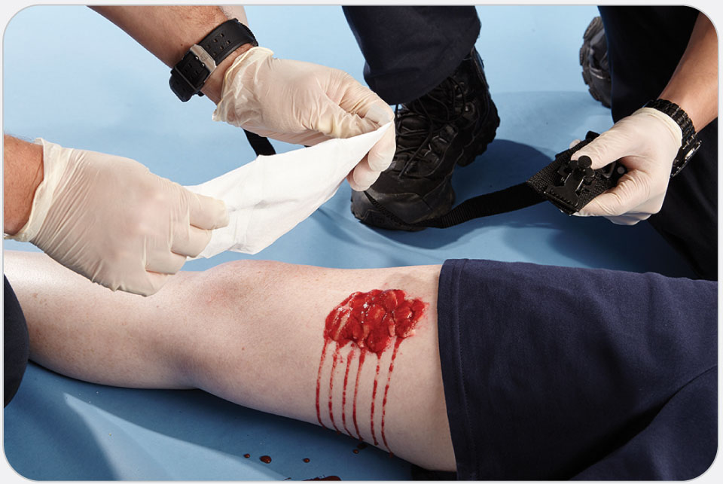
OEC Skill 19-1: Controlling Bleeding
1. Expose the area to see the wound. Open, cut, or remove clothing. Place a sterile dressing over the wound and apply direct pressure. If you find life-threatening bleeding, control this immediately.

Slide 135
OEC Skill 19-1: Controlling Bleeding
2. If the bleeding does not stop, add other sterile dressings over the first dressing and again apply direct pressure. When applying direct pressure to a wound, always observe standard precautions by wearing appropriate PPE.

Slide 136
OEC Skill 19-1: Controlling Bleeding
3. Bandage extremity.

Slide 137
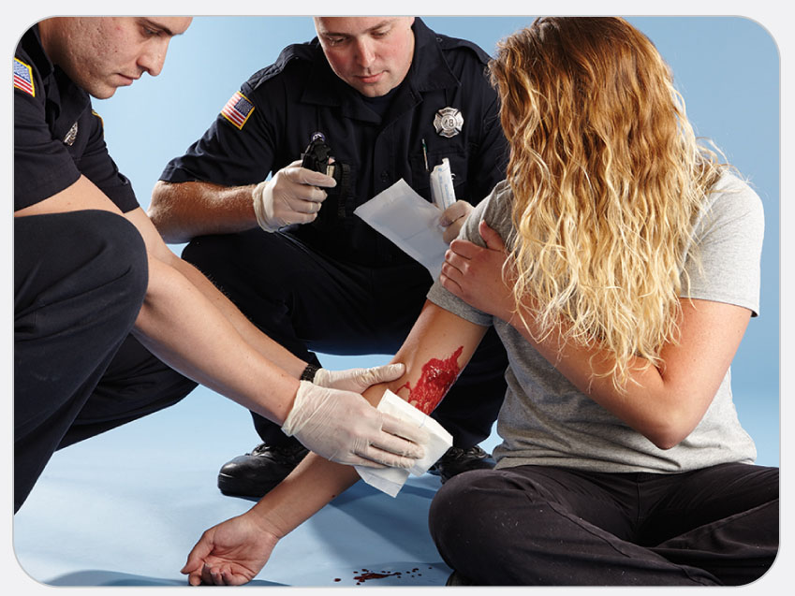
OEC Skill 19-2: Applying a Tourniquet
1. While preparing the tourniquet, apply direct pressure to a dressing placed over the wound.

Slide 138
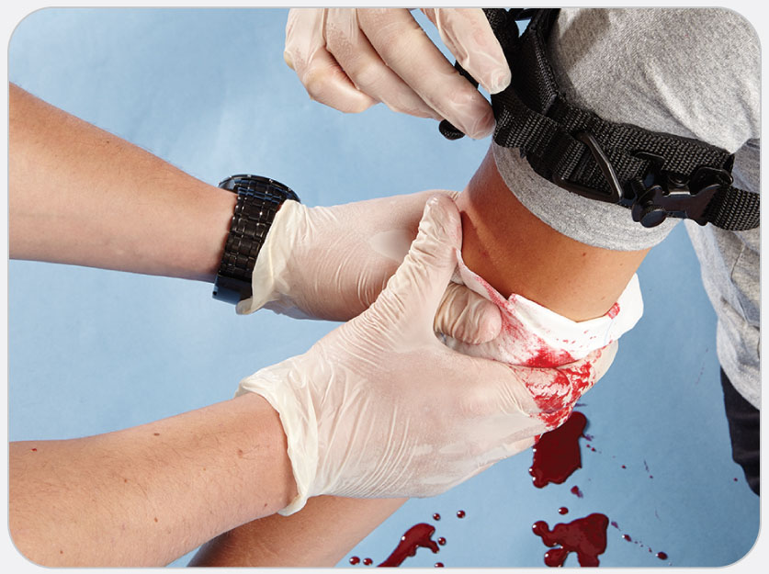
OEC Skill 19-2: Applying a Tourniquet
2. Place the tourniquet around the injured extremity several inches above (proximal to) the injury but not over a joint.

Slide 139
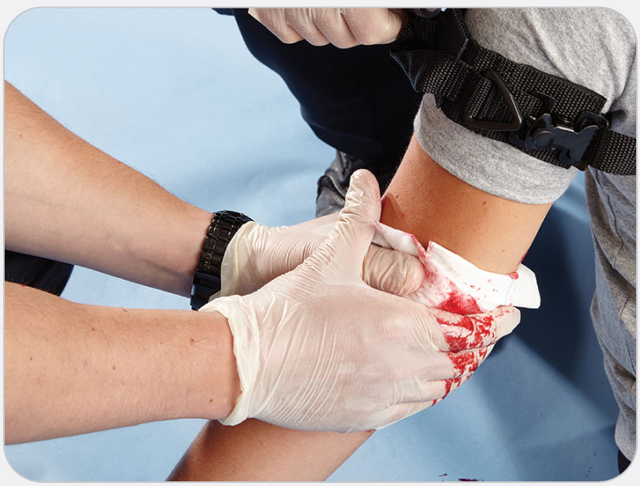
OEC Skill 19-2: Applying a Tourniquet
3. Pack large wounds with gauze. Twist the rod to tighten the tourniquet only to the extent needed to control the bleeding.

Slide 140
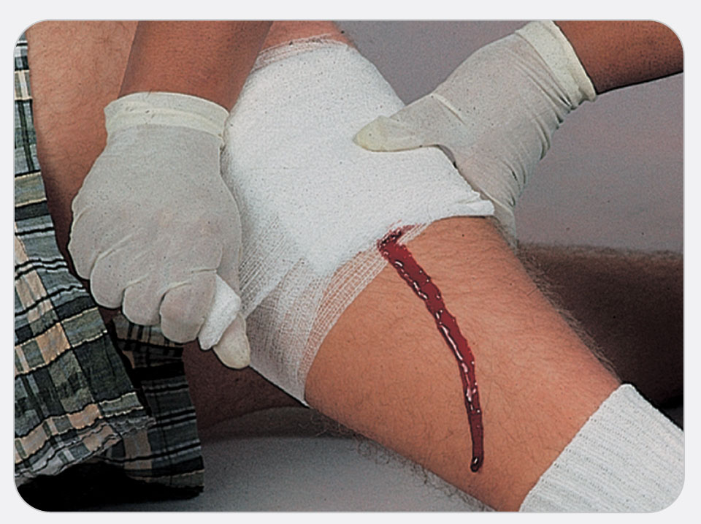
OEC Skill 19-3: Using a Self-Adhering Roller Bandage
1. Use your hand to hold the dressing in place and secure the roller bandage with several wraps around the wound.

Slide 141
OEC Skill 19-3: Using a Self-Adhering Roller Bandage
2. After the dressing and bandage are anchored, continue to wrap the bandage around the wound, overlapping it and keeping it snug.

Slide 142
OEC Skill 19-3: Using a Self-Adhering Roller Bandage
3. After covering an area larger than the wound, tie the bandage in place or secure it with tape.

Slide 143
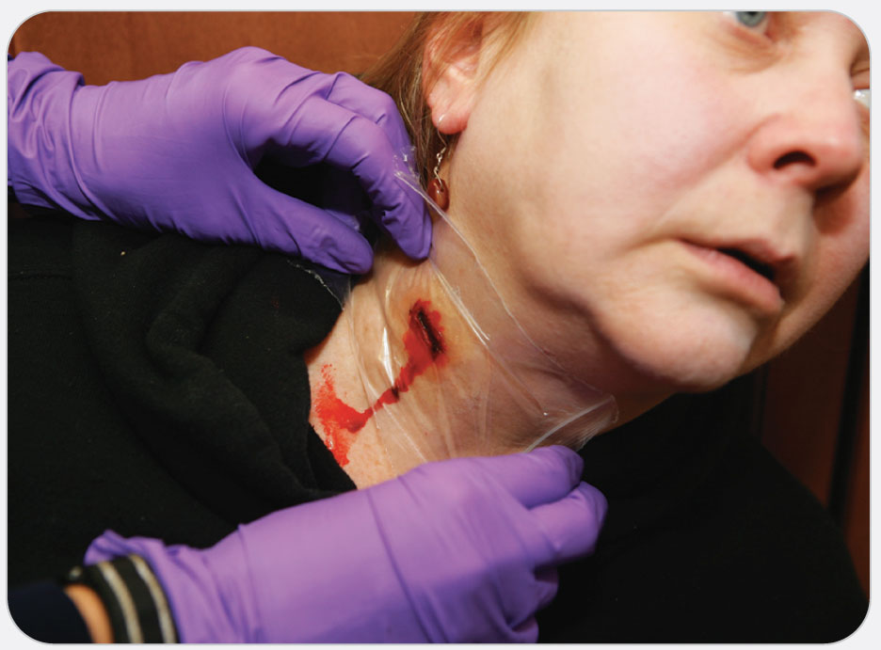
OEC Skill 19-4: Using an Occlusive Dressing
1. Cover neck wound with an airtight dressing and apply manual pressure. Do not compress both carotid arteries at the same time as this may impair circulation to the brain.
Note: In the case of an open chest wound, seal only 3 sides of the occlusive dressing to allow air to escape on expiration.

Slide 144
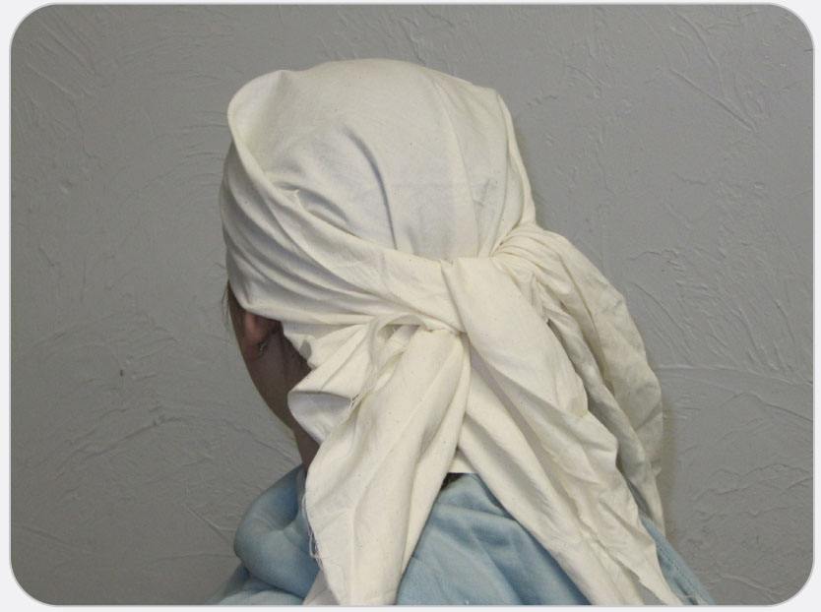
OEC Skill 19-5: Using a Triangular Bandage Bandana Wrap
1. Fold a triangular bandage making a 3” hem. Position over the head with the point hanging down the back of the neck.

Slide 145
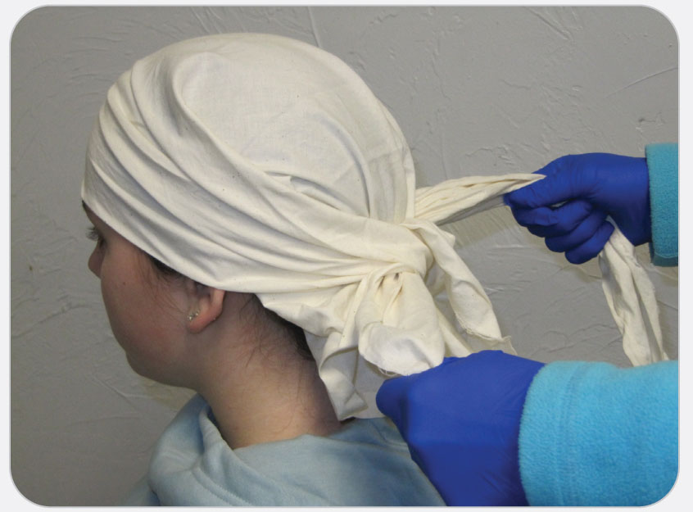
OEC Skill 19-5: Using a Triangular Bandage Bandana Wrap
2. Draw the ends together and tie at the back of the head.

Slide 146
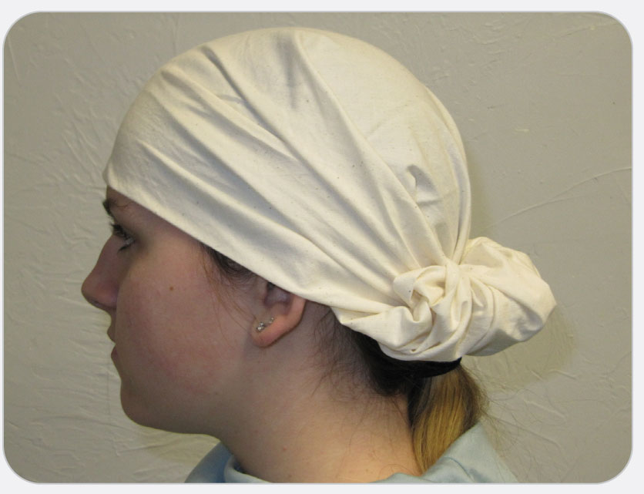
OEC Skill 19-5: Using a Triangular Bandage Bandana Wrap
3. Lift the point of the triangular bandage, fold it over, and tuck it behind the knot. Smooth the bandage.

Slide 147
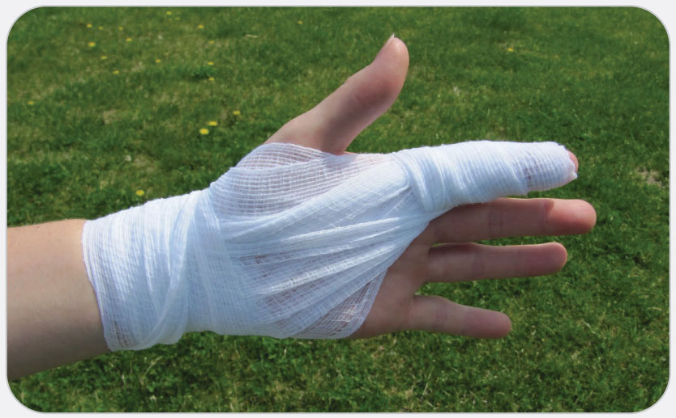
OEC Skill 19-6: Bandaging a Finger
1. While supporting the injured finger, secure the dressing and begin to wrap the finger with a roller bandage.

Slide 148
OEC Skill 19-6: Bandaging a Finger
2. Secure the bandage with adhesive tape.

Slide 149
OEC Skill 19-6: Bandaging a Finger
3. If appropriate, apply a splint to the finger.

Slide 150
OEC Skill 19-6: Bandaging a Finger
4. Secure the splint to the finger.
5. Use either a roller bandage or tape to secure the bandage to the hand.

Slide 151
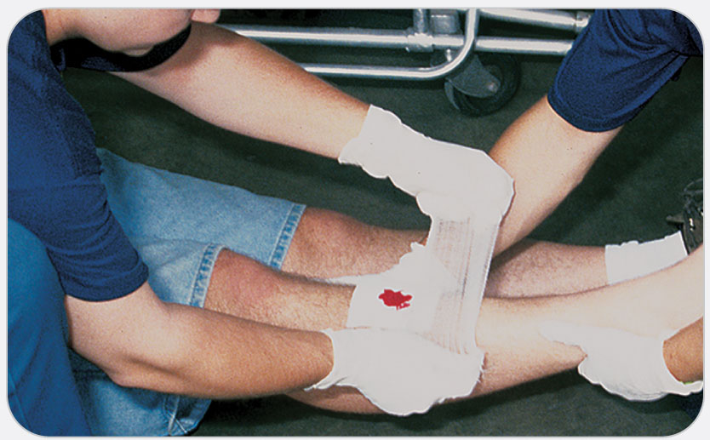
OEC Skill 19-7: Treating Closed Soft-Tissue Injuries
1. R—Rest: Cease activity or the use of the affected limb. Inactivity helps to reduce pain.

Slide 152
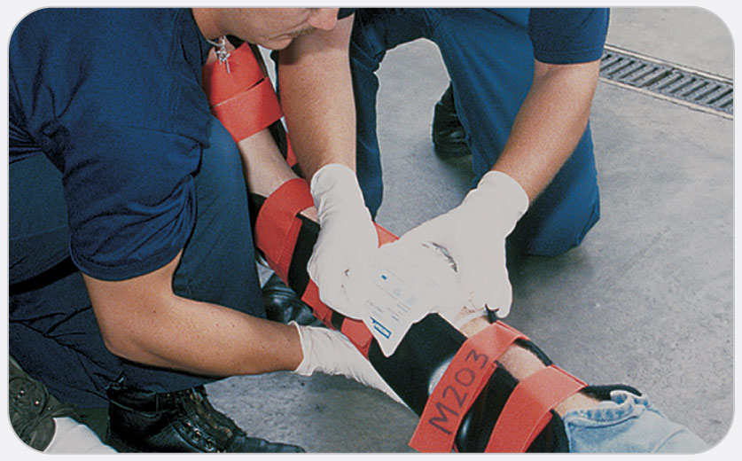
OEC Skill 19-7: Treating Closed Soft-Tissue Injuries
2. I—Ice: Apply cold packs or ice for pain control. Use only for short intervals.

Slide 153
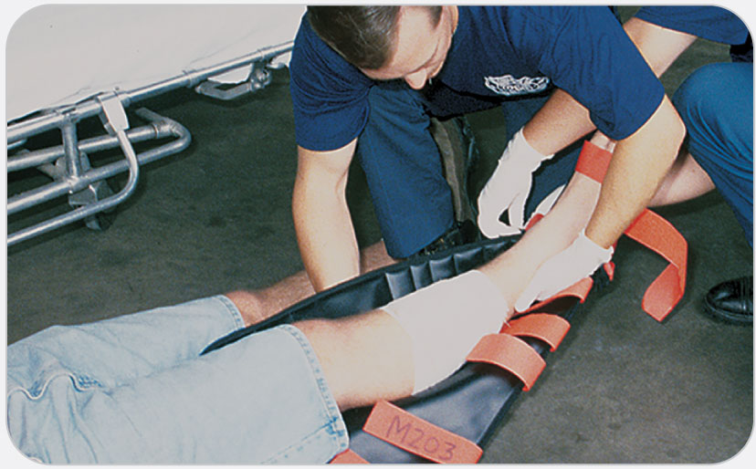
OEC Skill 19-7: Treating Closed Soft-Tissue Injuries
3. S—Splint: Immobilize the injured part using either a commercial splint or one fabricated from available materials. Splinting helps decrease pain.

Slide 154
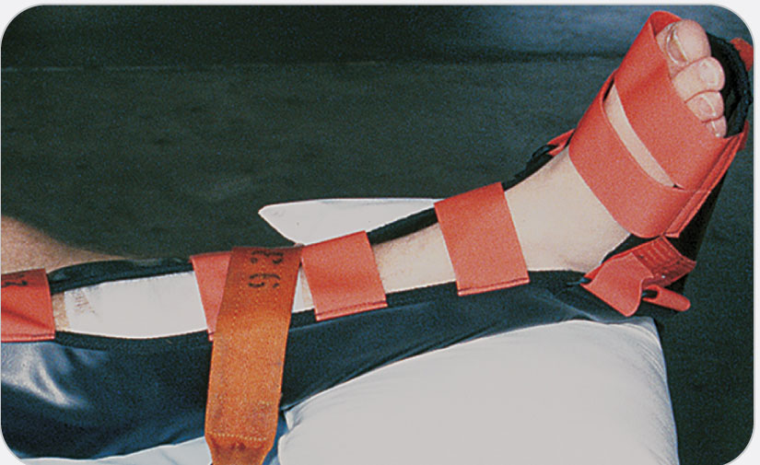
OEC Skill 19-7: Treating Closed Soft-Tissue Injuries
4. E—Elevate: Elevate the injured area above heart level to reduce pain.

Slide 155
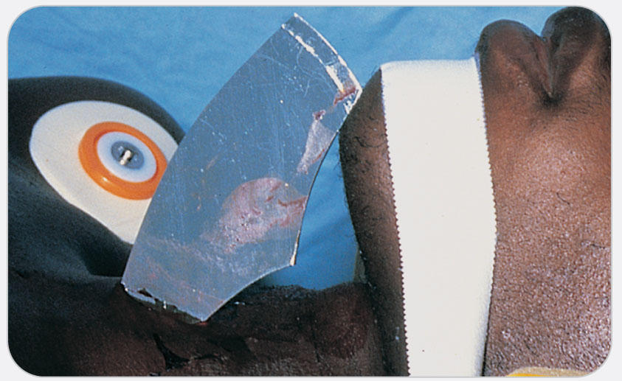
OEC Skill 19-8: Stabilizing an Impaled Object
1. Manually stabilize the object so that it cannot move and damage surrounding and underlying tissues while you perform the next steps in this procedure.

Slide 156
OEC Skill 19-8: Stabilizing an Impaled Object
2. Remove or cut away all clothing surrounding the impaled object. Control bleeding by direct pressure. Apply a donut dressing around the impaled object. Stabilize the impaled object against the body.

Slide 157
OEC Skill 19-8: Stabilizing an Impaled Object
3. Apply a bulky dressing around the object. If the object is long or unwieldy, it may be necessary to shorten it by cutting off some of the exposed portion. Keep the object from being nudged or moved during transport by stabilizing it with tape or bandages. If available, consider securing a plastic cup, a bowl, or half of a plastic water bottle over the object after it has been stabilized.

Slide 158
OEC Skill 19-9: Caring for Burns
1. Burns can happen unexpectedly.

Slide 159
OEC Skill 19-9: Caring for Burns
2. Remove any affected clothing, stop the burning process, and cool the burn.

Slide 160
OEC Skill 19-9: Caring for Burns
3. Apply a sterile gauze dressing to the wound. Wet the dressing only if the wound is less than 5 percent of TBSA.

Slide 161
OEC Skill 19-9: Caring for Burns
4. Bandage the wound to keep the dressing securely in place. Then prepare to assist the patient to find further medical treatment.

