Slide 1
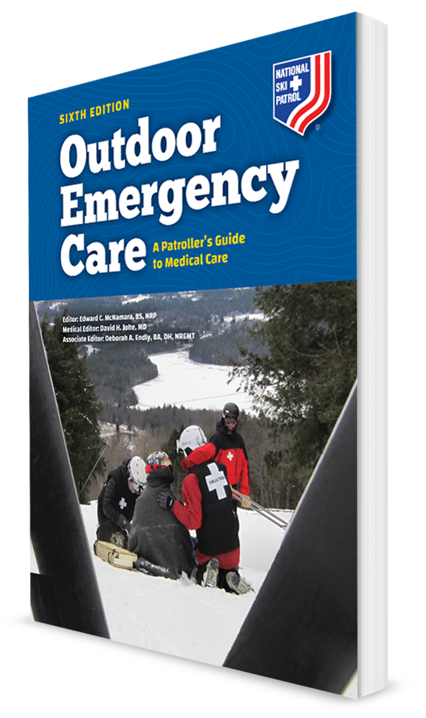
Chest Trauma
CHAPTER 23

Slide 2
The following presentation will utilize two symbols to identify material necessary for an OEC Technician to comprehend:
key term
Meets a Chapter Objective.
This symbol will have the corresponding Objective Number denoted within.
Identifies a Key Term.
The Key Term will be underlined for easy identification.

Slide 3
Objectives
23-1 List the major anatomic structures of the chest cavity.
23-2 Define and list the signs and symptoms of the following chest injuries:
Contusions
Fractures
Rib fractures
Flail chest
Sternum fracture
Aortic dissection and rupture

Slide 4
Objectives
Lower rib cage injury
Pneumothorax
Open pneumothorax (sucking chest wound)
Tension pneumothorax
Hemothorax
Pericardial tamponade
Commotio cordis
Traumatic asphyxia
23-3 Describe and demonstrate how to assess the chest for trauma, including using the LAP method.
23-4 Describe the management of chest injuries.

Slide 5
Key Terms
Aneurysm
Aortic rupture
Closed chest injury
Commotio cordis
Flail chest
Hemoptysis
Hemothorax
Myocardial contusion
Open chest injury (sucking chest wound)
Paradoxical motion
Pericardial tamponade
Pulmonary contusion
Tension pneumothorax
Traumatic asphyxia

Slide 6
Chapter Overview

Slide 7
Chapter Overview
Many activities that involve traveling at a high rate of speed can allow the participant to hit an object causing serious bodily injury, including chest (thoracic) trauma.
The chest (or thorax) contains such vital organs responsible for sustaining life as the heart, lungs, and great vessels.
Trauma can cause superficial injuries that affect only the chest wall, or it can cause internal injuries to the organs and structures within the chest.

Slide 8
Chapter Overview
Even seemingly minor chest injuries can present numerous challenges because they can create breathing problems, complicating other injuries or aggravate underlying medical conditions.
Chest trauma may appear to be stable at first.
The care for serious chest injuries includes:
Controlling excessive bleeding
Addressing the ABCDs
Caring for the specific condition
Proper positioning
Providing oxygen if appropriate
Transporting rapidly to a higher level of care

Slide 9
Anatomy and Physiology

Slide 10
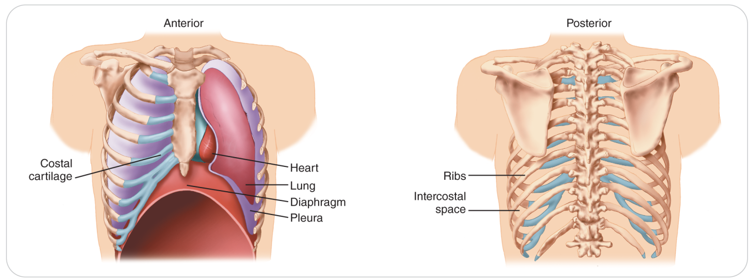
Anatomy and Physiology of The Chest
23-1
The chest (or thorax) extends from the base of the neck to the lower edge of the rib cage or costal margin.
The ribs:
Protect the thoracic organs
Provide structural support through their connections to the thoracic vertebrae in the back and to the sternum through flexible cartilages in front

Slide 11
Anatomy and Physiology: Chest Cavity
23-1
Chest cavity contains two major organs necessary for life:
The lungs, which take in oxygen and excrete gaseous waste products
The heart, which pumps the blood
The heart lies near the center of the chest beneath the sternum.
Between the lungs above the heart is the area known as the mediastinum.
Contains:
Heart
Aorta
Venae cavae
Trachea
Esophagus
Thymus gland
Several important nerves

Slide 12
Anatomy and Physiology: The Diaphragm
23-1
The diaphragm, the primary muscle of respiration, separates the chest and abdominal cavities.
This dome-shaped sheet of muscle attaches anteriorly at the xiphoid process, posteriorly at the lumbar vertebrae, and laterally at the lower ribs.
The diaphragm is controlled by the two “phrenic” nerves that connect to the spinal cord at levels C3, C4, and C5 in the neck and travel to the diaphragm.
Spinal cord injury at or above this level can impair respiration because the loss of signals through the phrenic nerves can affect diaphragmatic function (Insert Figure 23-2).

Slide 13
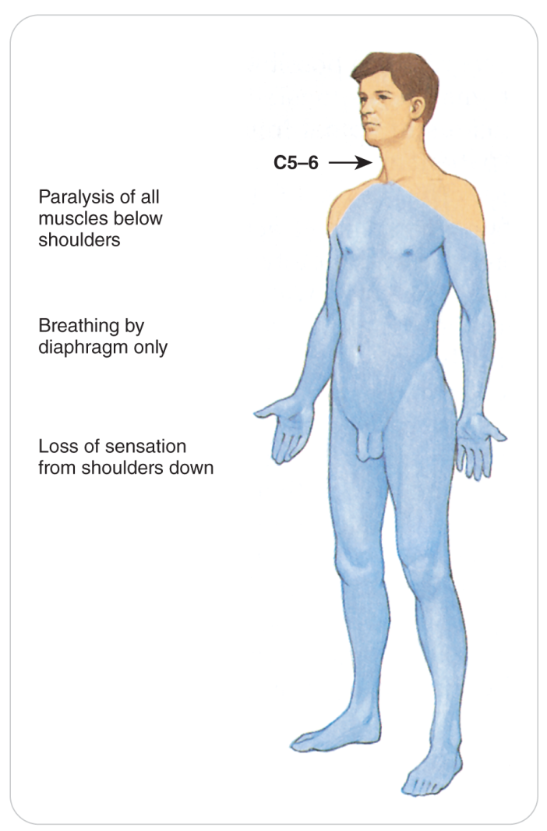
Anatomy and Physiology: Respiratory Arrest
23-1
A respiratory arrest will occur if the spinal cord is completely transected at or above C3.

Slide 14
Anatomy and Physiology: The Pleura
23-1
The chest cavity contains two adjacent membranes called pleura.
One membrane covers each lung, and one is on the inside wall of the chest.
Between these membranes is a small amount of clear (serous) fluid, which acts as a lubricant that allows the lungs to move freely while they expand and contract.
Trauma can cause air or fluid such as blood to fill this space, decreasing the volume of a lung, creating breathing problems.

Slide 15
Anatomy and Physiology: The Pericardium
23-1
The heart is contained within a fibrous sac called the pericardium.
A small amount of lubricating fluid within the pericardium allows the heart to move freely inside the pericardium with each beat.
Normally, little space exists between the sac and the heart.
Injuries or other conditions that allow fluid or blood to accumulate within the pericardial sac can compromise heart function and reduce cardiac output.
Known as pericardial tamponade

Slide 16
Anatomy and Physiology: Varying Chest Size
23-1
The chest cavity is unusual in that its overall size changes during each breath.
Can change due to the relative positions of the diaphragm or of the body as a whole
When a person is lying flat on their back, the diaphragm may rise as high as the level of the nipples.
What may appear to be a chest injury by the external location of a wound may be an abdominal injury and vice versa depending on the position of the person when injured.

Slide 17
Common Chest Injuries

Slide 18
Chest Injuries: Mechanism of Injury
23-2
A closed chest injury
Caused by blunt trauma
Frequently occurs as a result of a fall or collision with a large object, such as a tree
An open chest injury
Sucking chest wound
Caused by physical penetration of the chest cavity by an object such as a tree branch, ski pole, or knife
Compression is another common mechanism of injury for chest trauma.
Internal damage of thoracic structures can occur:
Directly due to applied force to the heart or lungs
Indirectly such as when a fractured rib internally lacerates a nearby structure
Sudden deceleration
A fall or a vehicular crash causes tissues such as the aorta to move violently, tearing it away from its attachment.

Slide 19
Chest Injuries: Contusions
23-2
The chest is susceptible to a variety of soft-tissue injuries.
Minor blunt trauma causing a contusion of the chest wall
Accompanied by localized swelling, bruising, and pain
More significant MOIs can cause internal organ contusions.
Can occur even when the skin over the rib cage has not been penetrated
Forcible compression of the chest wall during CPR causes damage to underlying structures.
Always consider whether organs in the chest are injured with a chest wall contusion.

Slide 20
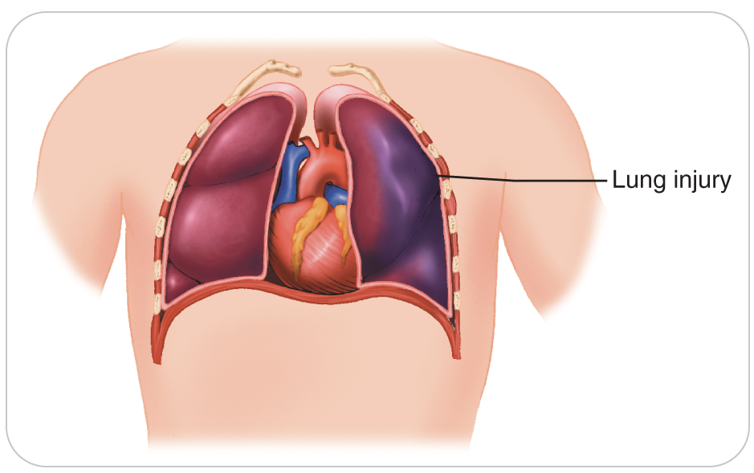
Chest Injuries: Pulmonary Contusion
23-2
A pulmonary contusion is a bruise of the lung tissue that causes the alveoli to become filled with fluid and blood.
Gas exchange is compromised, which can cause hypoxia, the severity of which is related to the size of the contusion.
A pulmonary contusion commonly occurs in patients who suffer rib fractures, even if the bones do not directly lacerate the lung tissue.
Hemoptysis, coughing up blood, can also occur depending on the severity of injury.

Slide 21
Chest Injuries: Myocardial Contusion
23-2
Myocardial contusion
A cardiac contusion
A bruise involving the heart that may cause heart contractions to become less effective
Severe bruising can result in:
An arrhythmia
Reduced cardiac output
Cardiogenic shock

Slide 22
Chest Injuries: Fractures
23-2
Impact-type injuries can cause fractures of the bones of the chest wall, including the:
Ribs
Clavicle
Sternum
Crushing injuries can also cause fractures.
The chest cavity is an anatomic marvel that can withstand relatively high amounts of energy while remaining intact.
OEC technicians must have a high index of suspicion for internal damage because energy that is great enough to fracture a bone may be transmitted to underlying structures.
Clavicle and rib fractures are among the most common chest injuries.

Slide 23
Chest Injuries: Rib Fractures
23-2
Can impair breathing due to intense pain that is usually right over the fracture site
Breathing is often shallow.
Deep respirations increase movements of the fractured bone, intensifying the pain.
Patients may “self-splint.”
Applying direct pressure over the injured site to keep the fractured bone ends from moving
In some instances, the sharp end of a displaced fractured rib can lacerate underlying lung tissue blood vessels, or both, causing additional problems.
High risk: elderly because their bones are more brittle
If multiple ribs are broken, a flail chest can occur.

Slide 24
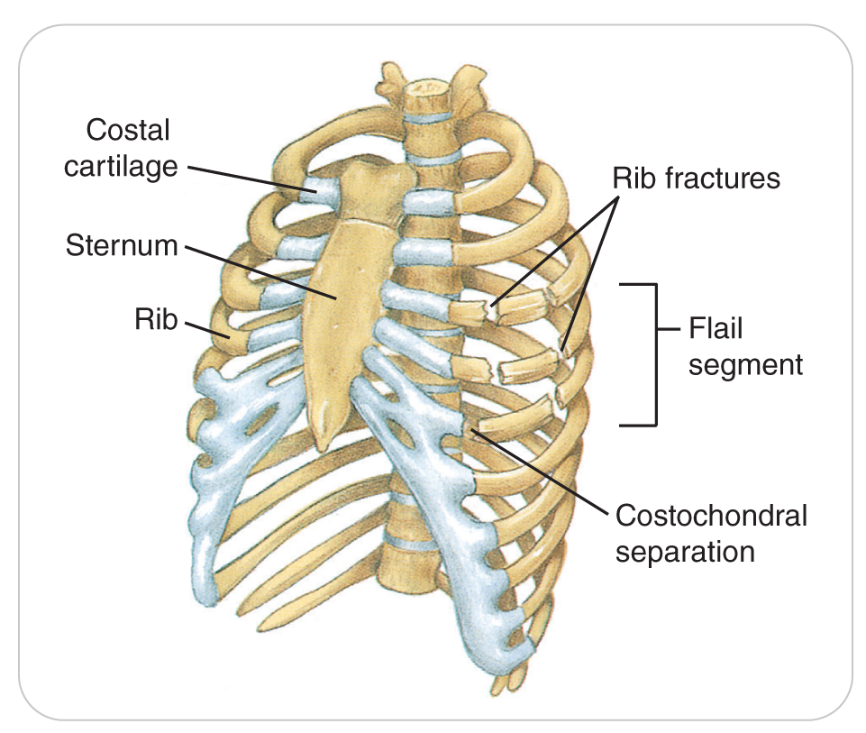
Chest Injuries Flail Chest
23-2
A flail chest is defined as fractures of two or more adjacent ribs, each of which is fractured in two or more places.
Two or more ribs could be separated off the spine posteriorly, or from the sternum anteriorly, and be broken in a separate place, and still be considered a flail chest.
Resulting thoracic instability causes the injured segment of the chest wall to move independently of the rest of the rib cage.

Slide 25
Chest Injuries: Flail Chest
23-2
Paradoxical Motion:
Isolated segment, or “flail” segment, moves inward upon inspiration and outward upon expiration, which is the opposite movement from that of the rest of the chest.
Patients with a flail chest usually complain of severe chest wall pain and shortness of breath.
May attempt to self-splint the injured area by firmly holding the flail segment in place as they breathe
The forces required to produce a flail chest may cause other serious internal injuries.
Lung tissue directly beneath the flail segment is often contused or damaged and may not expand properly.
Injury results in shallow breathing and can quickly result in patient becoming hypoxic.

Slide 26
Chest Injuries: Sternum Fracture
23-2
Sternum fractures can be associated with life-threatening injuries to underlying structures as well as other parts of the body.
Due to the force required to fracture the sternum, injuries to underlying organs, including the heart, lungs, aorta, and other large blood vessels as well as upper abdominal organs should be considered.
Rarely, the entire sternum can become a flail segment should the ribs on both sides become fractured or separated from the sternal cartilage.

Slide 27
Chest Injuries: Sternum Fracture
23-2
Most common cause:
Chest compressions applied during CPR
Even when performed properly
High-speed blunt chest trauma also can produce this type of injury.
Seat belts help prevent this injury by preventing drivers from hitting the center of the steering wheel.
If a patient has a sternal injury resulting from a very rapid deceleration, suspect an associated rupturing or tearing of the aorta, which is life threatening.

Slide 28
Chest Injuries: Aortic Rupture
23-2
Rapid deceleration injuries are common sources of injury.
Examples: hitting a tree while skiing or motor vehicle trauma
Aortic rupture is the most lethal of these hidden injuries.
The aorta is attached to tissue near the heart.
Rapid deceleration can cause the aorta to tear here, usually resulting in rapid death from massive internal bleeding.

Slide 29
Chest Injuries: Aortic Rupture
23-2
When the moving human body slows or stops rapidly and the chest hits a fixed object, the structures within the chest remain in motion for a short period of time.
Inertia and the sudden stop inflict a tremendous shearing force on the internal organs and on the tissues that hold them in place.
Upper aorta is especially vulnerable to deceleration injuries.
The resulting rupture or tearing is usually followed by rapid internal hemorrhage, hypovolemic shock, and death.
Example: a skier’s chest impacts a tree

Slide 30
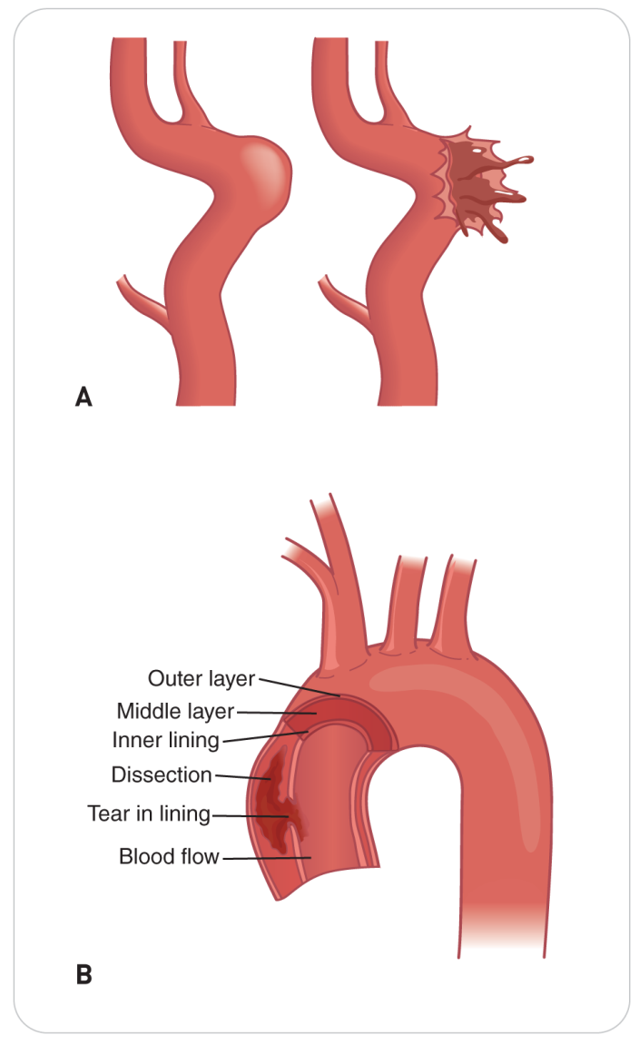
Chest Injuries: Aortic Dissection
23-2
If only part of the thickness of the aorta’s wall torn:
Not always immediately fatal
Causes other conditions:
An aneurysm, ballooning of the less dense outer layer of the wall of the aorta
An aortic dissection, in which blood leaks out between the layers of the wall of the aorta
If unrecognized and left untreated, can eventually cause the vessel to rupture.

Slide 31
Chest Injuries: Aortic Dissection
23-2
Usually present with:
Severe acute chest pain or back pain
A tearing or stabbing pain that radiates from the chest to the back between the shoulder blades
Such patients generally appear gravely ill.
If the aorta has ruptured, they exhibit signs of profound shock.
If the tear in the aorta is between the large arteries that go to each arm, the blood pressure can be different in the two arms.
Rapid transport to a definitive-care center is necessary.

Slide 32
Chest Injuries: Lower Rib Cage Injury
23-2
Cartilage along the bottom of the anterior rib cage can be torn, stretched, or separated from the bone, mimicking the signs and symptoms of rib fracture.
This condition is usually benign.
Can be quite painful
May hinder breathing
In the field, it is difficult to differentiate from a broken rib.

Slide 33
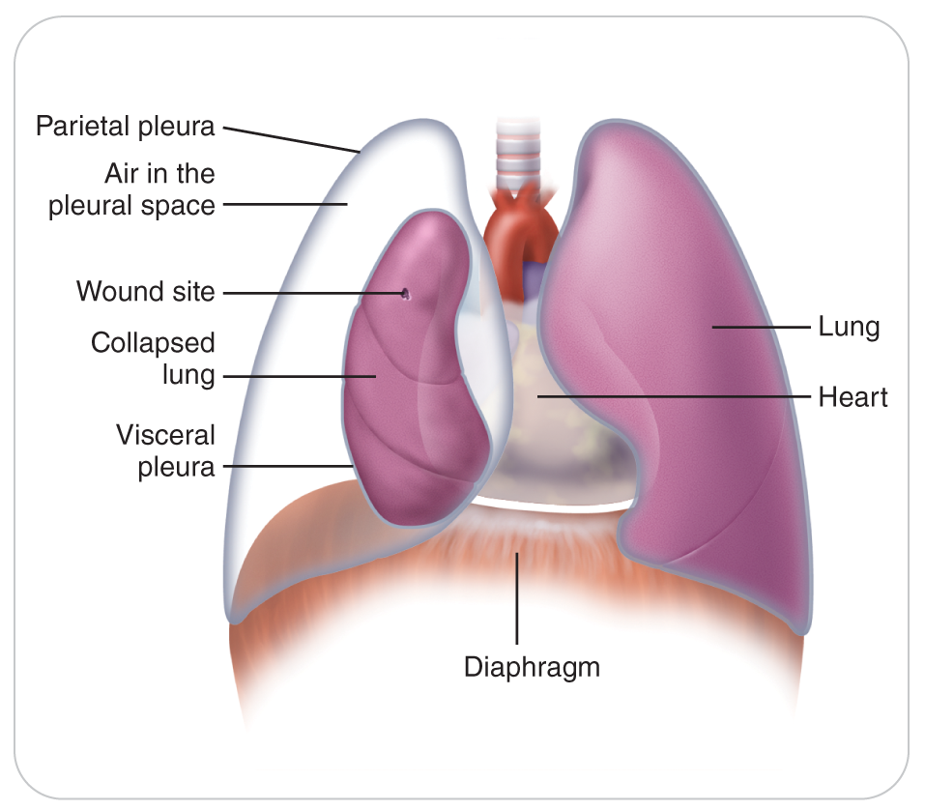
Chest Injuries: Pneumothorax
23-2
Trauma or a leak in the lung can cause air to collect in the pleural space, a condition known as a pneumothorax.
Condition is manifested by:
Shortness of breath
Hypoxia
Air in the pleura space prevents the lung from fully expanding.

Slide 34
Chest Injuries: Pneumothorax
23-2
Can be caused by either blunt or penetrating trauma
Can occur spontaneously due to underlying disease such as:
Asthma
Sudden changes in altitude
Compressive forces on the chest
Blast injuries
Other causes

Slide 35
Chest Injuries: Open Pneumothorax
23-2
An Open Pneumothorax (Sucking Chest Wound) results from a penetrating trauma where a hole in the chest wall allows external air to enter chest cavity.
With each inspiration, the difference between the pressure within the thorax and the pressure in the external environment causes air to be sucked into the pleural space.
If enough air enters the pleural space, the lung may partially or totally collapse, resulting in decreased gas exchange and hypoxia.

Slide 36
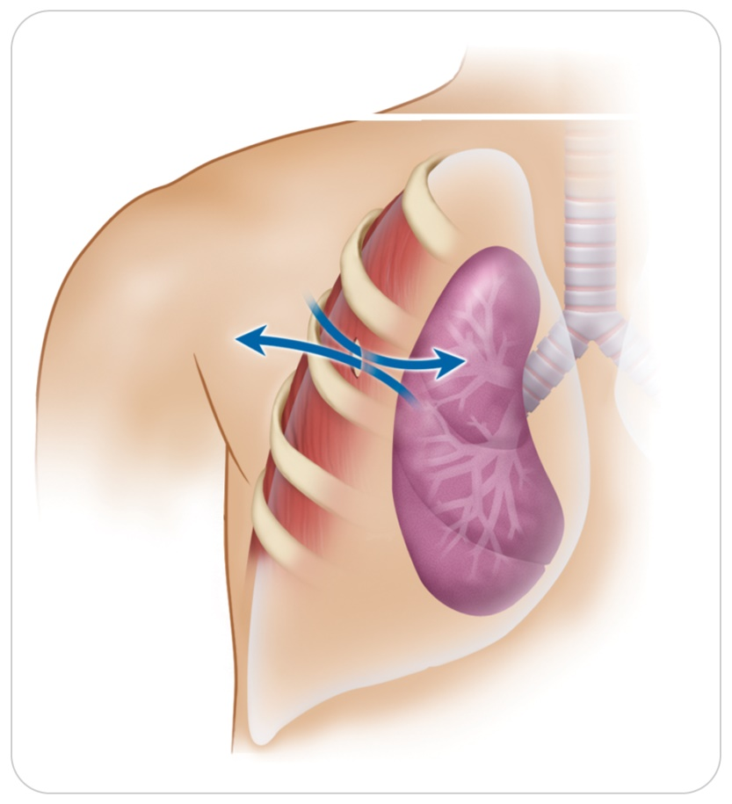
Chest Injuries: Open Pneumothorax
23-2
Sucking chest wound is when air gets sucked through the hole in chest wall into the chest cavity.
May hear a sucking noise each time patient breathes

Slide 37
Chest Injuries: Pneumothorax
23-2
Pneumothorax may occur as a result of blunt trauma.
Direct blow that covers a large area of the thoracic wall at the peak of the inspiratory cycle can cause one or both lungs to burst.
If air continues to accumulate within the pleural space, it can lead to an even more dangerous condition known as a tension pneumothorax.

Slide 38
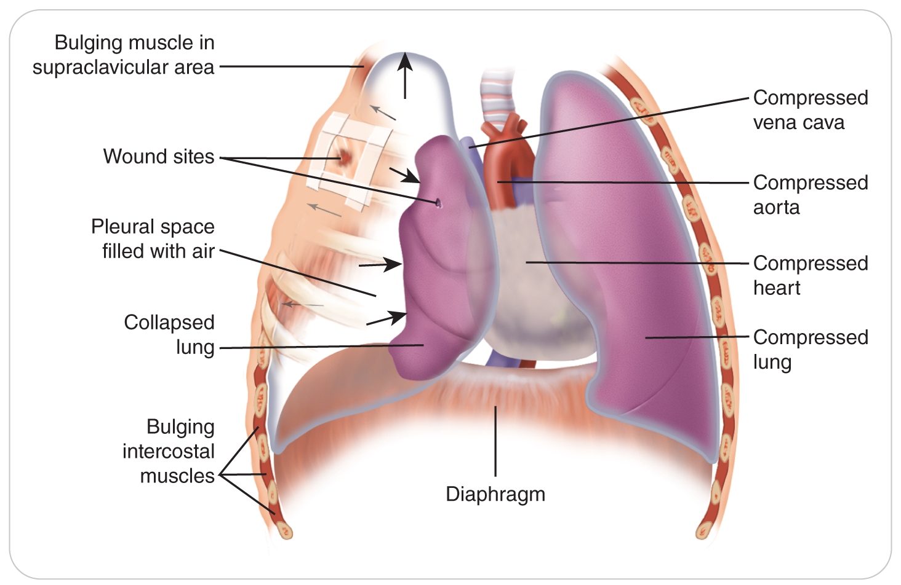
Chest Injuries: Tension Pneumothorax
23-2
Defined as an accumulation of pressurized air within the pleural space that compresses the lungs
No way for the air outside the lung to get out of the chest
Left untreated, this air will increase, causing the organs within the chest cavity to become compressed, resulting in:
Reduced lung capacity
Severe respiratory distress
Eventually decreased cardiac output

Slide 39
Chest Injuries: Tension Pneumothorax
23-2
With enough pressure, one lung will completely collapse.
As more pressure builds, the heart, great vessels, and trachea within the mediastinum are pushed into the opposite side of the chest, sometimes collapsing the other lung.
The vena cava collapses.
A rapid reduction in blood volume being pumped to the lungs occurs.
No blood is returned to the right side of the heart.
The collapse of both lungs from a tension pneumothorax is likely rapidly fatal.

Slide 40
Chest Injuries: Tension Pneumothorax
23-2
Can develop in closed chest trauma when a sharp bone fragment of a fractured rib punctures a lung or bronchus
Air leaks out of the hole in the lung or bronchus into the pleural space.
Pressure can build within minutes to a few hours, creating the same life-threatening situation.
A tension pneumothorax can develop, or be made worse, by the application of positive pressure such as occurs in rescue breathing using a bag-valve mask.
With each breath, more air passes through any internal airway hole into the pleural space, thereby changing a stable pneumothorax into an unstable tension pneumothorax.
When giving CPR with rescue breaths, you should not overinflate the lungs.

Slide 41
Chest Injuries: Tension Pneumothorax
23-2
The hallmarks are:
Shortness of breath
Distended (bulging) neck veins (known as jugular venous distention, or JVD)
Tachycardia
Low blood pressure
Cyanosis
May detect decreased lung sounds in the lung that has deflated
Tracheal deviation, in which the trachea shifts away from the side of the tension pneumothorax, may be observed, but this is a very late sign.

Slide 42
Chest Injuries: Subcutaneous Emphysema
23-2
Tension pneumothorax can lead to subcutaneous emphysema.
“Sub-Q air”
Pressurized air leaks out of the pleural cavity into the soft tissues.
Becomes trapped under the skin, causing a Rice-Krispies-like “crackling” sensation of the skin when pressed with the fingers
Because air rises, subcutaneous emphysema is typically found in the highest point of the chest cavity.
Generally exhibited in the neck first
Can spread to the shoulders, chest, or back, depending on patient’s position
Sub-Q air is usually benign, but the pneumothorax causing it can be life threatening.

Slide 43
Chest Injuries: Pneumothorax
23-2
Rarely, pneumothorax can occur spontaneously.
Typically in young adults or patients with chronic obstructive pulmonary disease
No trauma occurs.
A small defect, called a “bleb,” on the lung surface ruptures, allowing air to escape into the pleural space.
Signs and symptoms of this type of pneumothorax are the same.
Can advance to become a tension pneumothorax should enough air enter the space
Patients often experience sharp pain in the chest and back.

Slide 44
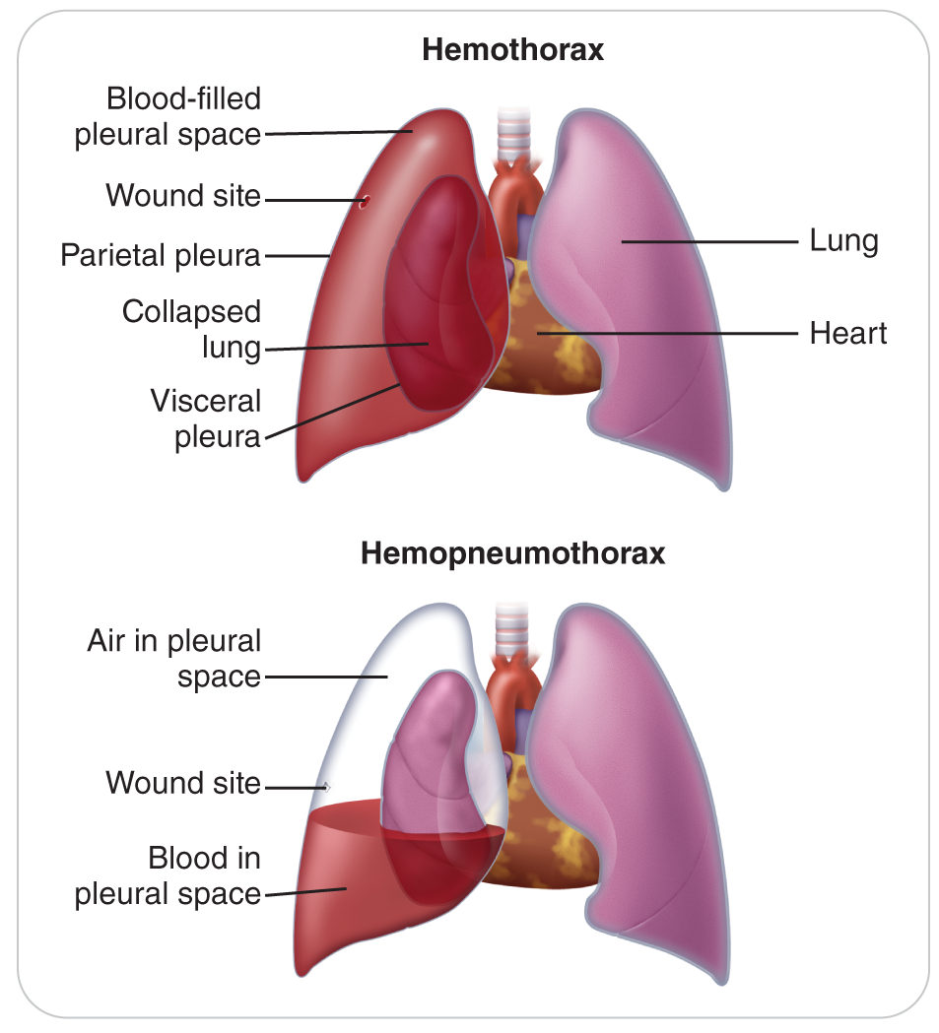
Chest Injuries: Hemothorax
23-2
Hemothorax is like a pneumothorax except that instead of air, blood accumulates within the pleural space.
Caused by disruption of one or more blood vessels inside the chest and can be due to either blunt or penetrating trauma

Slide 45
Chest Injuries: Hemothorax
23-2
Hemothorax due to arterial bleeding can be potentially lethal from hypovolemic shock.
The pleural space can hold 3 to 4 liters of blood.
Blood can also compress or collapse one or both lungs, resulting in hypoxia and shock.
Pain and shortness of breath are common complaints.
Both air and blood can leak into the pleural space simultaneously, producing a condition known as a hemopneumothorax.

Slide 46
Chest Injuries: Hemopneumothorax
23-2
Hemopneumothorax
When both air and blood can leak into the pleural space simultaneously
The mechanisms of injury that can produce hemopneumothorax are associated with multisystem trauma and have a high morbidity and mortality.

Slide 47
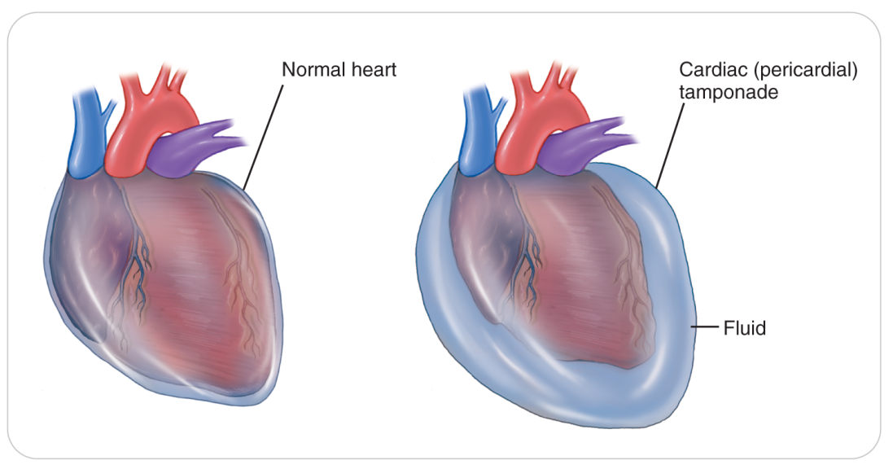
Chest Injuries: Pericardial Tamponade
23-2
Pericardial Tamponade is defined as a blunt or penetrating chest trauma causing internal bleeding into the pericardial sac from a hole in the heart’s muscular wall or the great vessels.
Rupture of a cardiac blood vessel on the heart’s wall can also cause this problem.

Slide 48
Chest Injuries: Pericardial Tamponade
23-2
Occasionally may be caused by various nontraumatic medical conditions
Bacterial sepsis: pus may be the source of the tamponade
Viral infections: creates serous fluid that compresses the heart

Slide 49
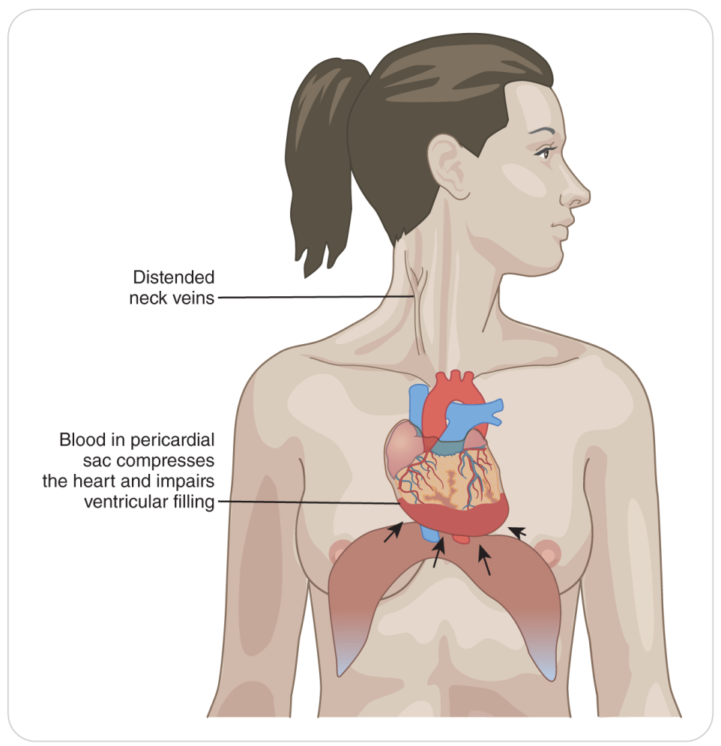
Chest Injuries: Pericardial Tamponade
23-2
As blood or other fluid accumulates within the fibrous pericardial sac around the heart, pressure constricts the heart from filling properly.

Slide 50
Chest Injuries: Pericardial Tamponade
23-2
Because the left ventricular wall is thicker than the right, the right ventricle becomes compressed first.
Prevents the walls of the right side of the heart from expanding
Impairs venous return of blood from the venae cavae
Blood backs up into the jugular veins in the neck causing them to bulge (JVD).
Cardiogenic shock and death occur rapidly.

Slide 51
Chest Injuries: Pericardial Tamponade
23-2
Early signs: Pain, shortness of breath, and distended neck veins
If not immediately resolved, muffled heart sounds and a decrease in the pulse pressure develop.
Pulse pressure is the difference between the systolic and diastolic blood pressure readings.
Systolic and diastolic readings become close together.
Beck Triad: combination of these findings
Distended neck veins
Muffled heart sounds
A pulsus paradoxus

Slide 52
Chest Injuries: Commotio Cordis
23-2
Defined as sudden cardiac death due to blunt chest trauma without any observable chest or cardiac damage
Most commonly, commotio cordis occurs following a direct blow to the chest that interrupts the heart’s electrical activity causing ventricular tachycardia or ventricular fibrillation.

Slide 53
Chest Injuries: Commotio Cordis
23-2
Condition most often affects young, healthy individuals.
More than 90% of cases occurring in children less than 16 years of age.
Of concern is snow terrain parks and BMX bicycle parks.
Although most reported cases involve direct anterior chest trauma from a baseball, a softball, or a lacrosse ball, one case involved a snowball, and in another case a child was hit in the chest by a snow sliding saucer.

Slide 54
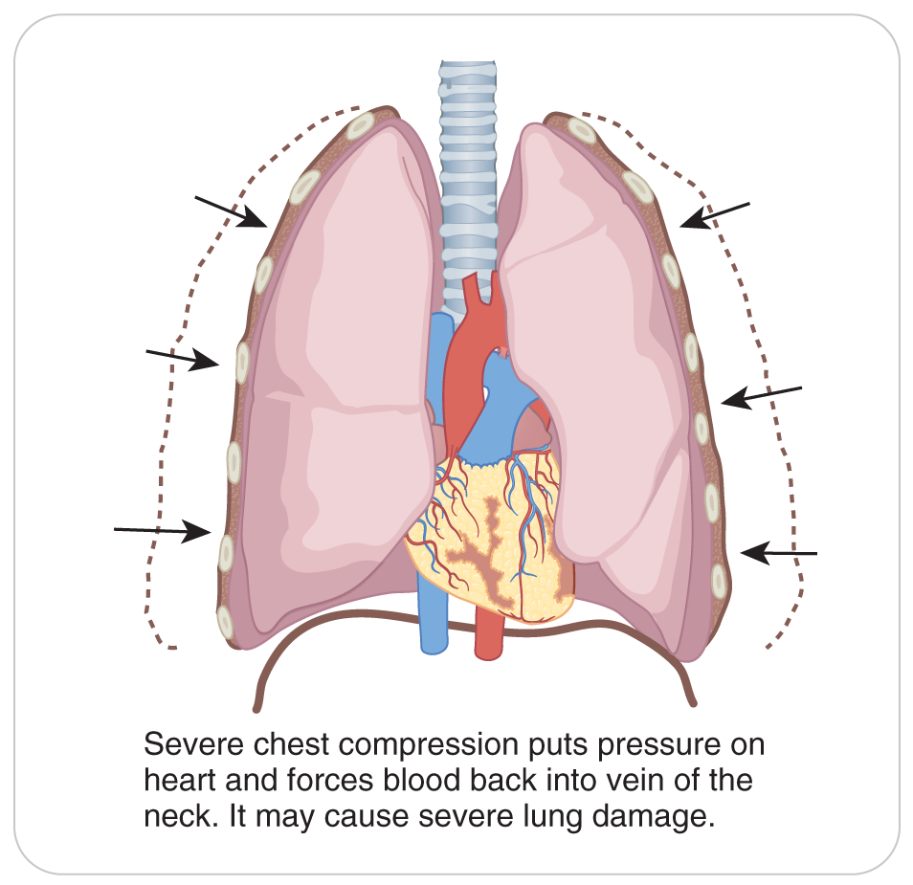
Chest Injuries: Traumatic Asphyxia
23-2
Traumatic Asphyxia is an injury in which external pressure on the chest wall prevents normal chest expansion for breathing.
Results in profound hypoxia or anoxia

Slide 55
Chest Injuries: Traumatic Asphyxia
23-2
This injury involves compression that is typically caused by entrapment under a heavy object, such as a vehicle or avalanche debris.
When buried in an avalanche, “concrete” snow packs around a victim’s chest, making it unable to expand.
Alternatively, snow can also be packed into the airway, leading to the inability to exchange gas. The person also dies of asphyxia.
Can result from massive thoracic cage fractures that render the chest wall unable to expand
Signs:
Ruptured blood vessels, particularly in the face and neck, which can cause bulging eyes
Ruptured blood vessels in the eyes
An overall purplish discoloration of the face

Slide 56
Chest Injuries: Environmental Factors
23-2
High altitude can complicate a chest injury due to:
The decreased partial pressure of available oxygen
Lower barometric pressure
Less oxygen is available per breath the higher you go.
Increased altitude may cause a pneumothorax to worsen.

Slide 57
Chest Injuries: Environmental Factors
23-2
When at a high altitude, descent in elevation may improve breathing and oxygenation for many chest injuries.
When you have a patient with a pneumothorax, take them to a lower altitude rapidly.
Consider the use of aeromedical evacuation of a patient with a suspected pneumothorax or other internal chest injury.

Slide 58
Patient Assessment

Slide 59
Patient Assessment for Chest Injuries
23-3
Assessment of patients with suspected chest injury is the same as for any other trauma patient.
Begin with a scene size-up.
Evaluate and mitigate any hazards that may be present.
Assess the mechanism of injury to determine the forces involved.
Take appropriate standard precautions and begin a primary assessment.

Slide 60
Patient Assessment: Primary Assessment
23-3
Carefully assess the ABCDs and correct life threats such as severe bleeding if needed.
Open and clear the airway as necessary.
Assess patient for adequate breathing and oxygenation, paying attention to the rate and quality of respirations.
A patient with a chest injury may exhibit rapid breathing or other signs of respiratory distress, including the use of accessory muscles.
Check pulse.
Assess mental status and neurologic condition.

Slide 61
Patient Assessment: Secondary Assessment
23-3
Note patient’s overall appearance and skin color.
Does the person appear anxious?
Is the patient pale or cyanotic?
Quickly check the head, face, and neck.
Do patient’s eyes appear bloodshot or bulge outward, which could indicate traumatic asphyxia?
Are the neck veins distended, which could suggest pericardial tamponade or tension pneumothorax?
Is the trachea deviated to one side?
Is there hemoptysis (coughing up blood)?

Slide 62
Patient Assessment: Secondary Assessment
23-3
Ask patient to take a deep breath and then exhale.
Observe for any signs of discomfort such as grimacing or self-splinting.
Observe the chest for equal and symmetrical movement.
If have a stethoscope, use it to listen to each lung to make sure breath sounds are present bilaterally.
If major chest injuries are present or suspected, do not waste precious time identifying each individual injury.
Prepare patient for rapid evacuation to a definitive-care facility.

Slide 63
Patient Assessment: LAP of Chest
23-3
One approach that is often used is the LAP method, which divides the chest examination process into three parts:
L—Look
A—Auscultate (listen)
P—Palpate

Slide 64
Patient Assessment: LAP of Chest
23-3
LOOK:
Inspect the chest, upper back, and axillae (armpits) for obvious trauma using the DCAP-BTLS acronym.
Look for contusions, deformity, and potentially serious injuries such as a sucking chest wound, an impaled object, or an obvious flail segment.
As patient breathes, see if both sides of the chest expand fully and symmetrically.
Look for paradoxical motion of the chest in which a portion of the chest wall moves inward during inspiration.
If present, suspect a flail chest and impending shock.

Slide 65
Patient Assessment: LAP of Chest
23-3
AUSCULTATE (listen) to the breath sounds:
May hear gurgling, gasping, wheezing, grunting, or other abnormal sounds, indicating breathing difficulty
Need not understand all the different pathological breath sounds
Become familiar with normal breath sounds and should be able to identify abnormalities.
Listen to the lungs with a stethoscope both anteriorly and posteriorly to ensure that breath sounds are present, equal, and clear bilaterally.

Slide 66
Patient Assessment: LAP
23-3
PALPATE the entire chest, axillary regions, and upper back for tenderness and deformity.
Be sure to “walk” patient’s clavicles with your fingertips because a displaced clavicle fracture may cause a pneumothorax.
Fractures involving the scapula are especially ominous because tremendous force is usually required to break this bone.
Many scapular and sternal fractures are associated with internal chest injuries.
Assess the integrity of the sternum, again using your fingertips and then the flat side of your hand.
As you palpate the chest, be alert for subcutaneous emphysema or any flail segments.

Slide 67
Patient Assessment: LAP
23-3
Two exam tests that help identify thoracic cage instability or rib fractures when not be readily apparent:
If you do not detect any obvious injuries, use both hands to apply moderate inward pressure on the lateral walls of the rib cage and ask patient to take a deep breath.
Apply moderate downward pressure on the sternum, again asking patient to take a deep breath.
If patient experiences pain with either of these tests, stop.

Slide 68
Patient Assessment: Vitals
23-3
Obtain a complete set of vital signs.
Reassess the patient frequently, including vital signs and breath sounds.
Document your findings on patient care report.
Serial vital signs are essential in suspected chest trauma.
Changes may be subtle.
Can indicate internal bleeding and decompensated shock
Pay close attention to the pulse pressure.
Narrowing of the pulse pressure may indicate the presence of a pericardial tamponade.

Slide 69
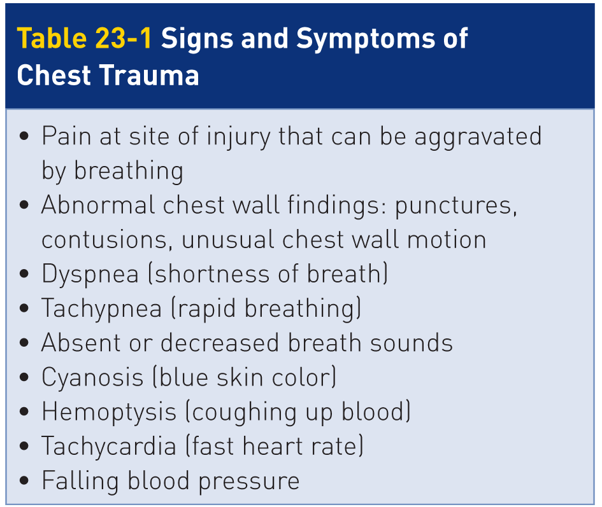
Patient Assessment: Signs and Symptoms
23-3
Table 23-1 summarizes the signs and symptoms of chest trauma.

Slide 70
Management

Slide 71
Management: Pneumothorax
23-4
Correct the ABCDs.
Provide high-flow oxygen.
Monitor the oxygen saturation level with a pulse oximeter if available.
Call for transport with ALS.
Consider transporting and caring for patient in a sitting position, which will provide ease of breathing.
May not be possible if there is a need for spinal motion restriction
Raise the head of the backboard.
Patient will demonstrate shortness of breath and need further care at a hospital.

Slide 72
Management: Soft Tissue Injuries
23-4
Treat other soft-tissue injuries of the chest in the usual manner using standard bandages and dressings.
Bulky pressure dressings may be needed to help control heavy bleeding.

Slide 73
Management: Rib Fractures
23-4
Rib fractures can be very painful, especially upon inspiration or movement.
Do not splint the chest as doing so will impair breathing.
Avoid placing a tightly constrictive bandage around the circumference of the chest.
It can inhibit chest wall expansion during inhalation.
This was once a standard of care. No longer recommended.
Always consider patient may have damaged internal organs when you suspect a rib fracture.
The broken rib may puncture a lung, causing a pneumothorax.

Slide 74
Management: Life Threatening
23-4
Chest injuries are often associated with multisystem trauma.
Can very quickly progress to a life-threatening condition
Any chest injury that is associated with respiratory distress or hypotension is considered a “load-and-go” situation.
Correct any life-threatening conditions.
Provide oxygen.
Immobilize the spine if necessary.
Rapidly evacuate patient to a definitive-care facility, preferably a designated trauma center.

Slide 75
Management: Commotio Cordis
23-4
Will present in cardiac arrest
Must be treated aggressively using current cardiopulmonary resuscitation techniques, including defibrillation

Slide 76
Management: Traumatic Asphyxia
23-4
Relieve external pressure from the thoracic cage quickly.
Then give aggressive ventilatory support.
If patient has been caught in an avalanche, quickly remove snow or other avalanche debris from around patient’s chest.
Ensure that the airway is open and clear and that breathing efforts are effective.
Use suction as necessary to ensure airway patency.
If you suspect serious problems such as traumatic asphyxia, tension pneumothorax, or cardiac tamponade, summon additional assistance immediately.
Call for transport and advanced care providers.

Slide 77
Management: Use of High-Flow Oxygen
23-4
If chest-injured patient’s breathing efforts are spontaneous and effective:
Apply high-flow oxygen via a nonrebreather mask.
Use a pulse oximeter and titrate oxygen keeping the oxygen saturation between 94 and 99%.
If necessary, assist ventilations using a bag-valve mask and supplemental oxygen.
If patient worsens while bagging, think of tension pneumothorax.

Slide 78
Management: Open Chest Injury
23-4
Any obvious sucking chest wound should be treated immediately.
Prevents the development or worsening of an underlying pneumothorax
Begin by covering the wound with a gloved hand to occlude the opening.
Then, cover the wound with an occlusive dressing.
Even if there is no obvious “sucking” sound, it is appropriate to cover ANY penetrating chest wound with an occlusive dressing.
Among the several commercial products available for this purpose are Vaseline gauze, a Bolin chest seal, and an Asherman chest seal.
If not available, improvise using plastic wrap, a plastic bag, aluminum foil, or other impermeable material.

Slide 79
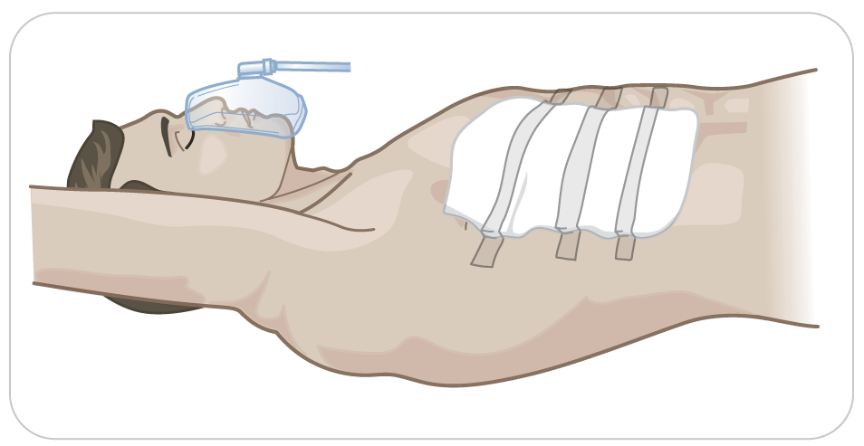
Management: Occlusive Dressing for Chest Injury
23-4
Tape the occlusive dressing in place on three sides.
Will prevent air intake through the wound upon inspiration
Will allow pressurized air within the chest cavity to escape
Monitor patient closely for signs of tension pneumothorax.
Readjust the dressing so that air can escape if there is evidence of air buildup.

Slide 80
Management of Chest Injuries
23-4
Remember that serious chest injuries are load-and-go situations.
If a spinal injury is suspected, apply manual cervical spine stabilization and rapidly immobilize the entire spine (spinal motion restriction) using conventional procedures and equipment.

Slide 81
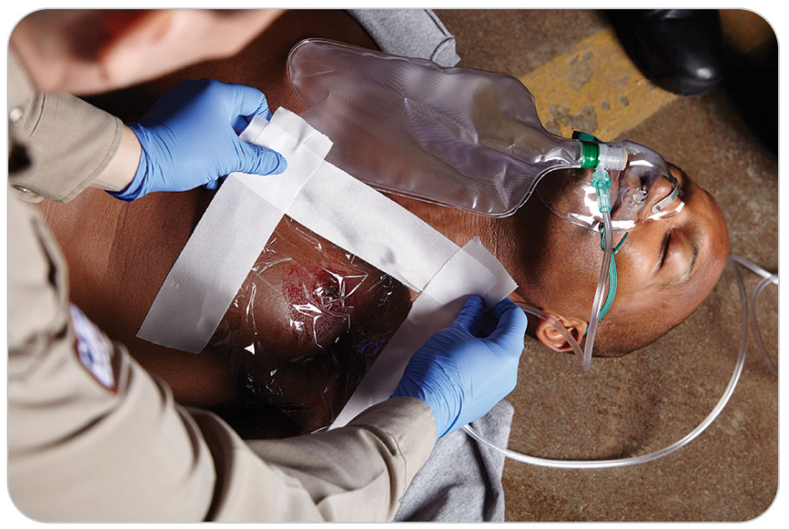
Management: Flail Chest
23-4
Splint flail segments above and below the fractured section in the same manner as for an isolated rib fracture.
Do not use a tight circumferential bandage.
If large, stabilize the bones using:
A large trauma dressing
Pillow
Folded clothing
Magazine
Other material

Slide 82
Management: Flail Chest
23-4
Patient can hold the splint in place.
Then secure the splint and dressing against the chest wall.
If causes severe pain or respiratory distress, assist patient’s respirations using a bag-valve mask and oxygen.
The positive pressure from the bag-valve mask will reduce the paradoxical motion of the flail segment.
If patient will not tolerate the bag-valve mask:
Use a high-flow nonrebreather mask
Allowing patient to sit quietly
Put patient in a position of comfort, which most likely will be sitting.

Slide 83
Management: Impaled Objects
23-4
Impaled objects should be left in place.
Transport to a trauma center immediately.
Objects such as a tree branch, ski pole, or knife should not be removed because the object may be preventing hemorrhage, pneumothorax, or exsanguination.
If the impaled object is large, you may need to shorten it (e.g., trimming a tree branch) to facilitate safe, efficient transport.

Slide 84
Management: Impaled Object
23-4
When shortening an impaled object, avoid causing further injury due to excessive movement of the object.
ONLY remove the impaled object if rapidly deteriorating conditions AND:
The object is fixed (immovable) or
If bringing in cutting equipment will take too long
Be ready to care for excessive bleeding, pneumothorax, or other threats to life once the object has been removed.
It is always best to leave an impaled object in patient if you can do so.

Slide 85
Management: Transport
23-4
Positioning patient for transport:
Place in a head-uphill position in a toboggan.
Reduce pressure on the diaphragm and thoracic organs
Make breathing easier
A patient with dyspnea in the absence of trauma will benefit by sitting.
Many cases of chest trauma are accompanied by spinal injury requiring spinal motion restriction, which precludes transporting patient in a seated position.
Consider elevating the head of the spinal immobilization device to ease breathing efforts.

Slide 86
Management: Shock
23-4
When patient is in shock and breathing is the primary concern:
Keep patient warm.
Oxygenate.
Position in a head-uphill position to assist with the breathing issue.
Shock is no longer a determining factor in the placement of a patient in the toboggan for transport.
Elevating the legs for shock is no longer recommended.
Consideration for placement of patient in the toboggan is based on their other injuries.

Slide 87
Management: Serious Chest Injuries
23-4
Table 23-2 summarizes the actions to take in managing serious chest injuries.

Slide 88
Case Study

Slide 89
CASE PRESENTATION
You are riding the chair lift when you observe a snowboarder entering the terrain park. He launches onto a rail and slams into the end of the rail. When he comes to a stop, you can see that he is lying on the snow and gasping for breath. You radio for someone to respond until you can get there. Upon reaching the summit, you hear another patroller at the scene requesting a trauma pack and an ambulance with advanced life support (ALS). Grabbing the trauma pack that includes oxygen from the summit hut, you proceed to the scene. Upon your arrival, patient is sitting up and is complaining of pain in the left chest and is having severe breathing difficulty.
What should the other patroller and you do?

Slide 90
CASE UPDATE
You calm patient and convince him to allow your partner to maintain manual cervical spine stabilization while you perform secondary assessment. Patient’s airway is open, there is no external bleeding, and circulation to all extremities is normal. Patient’s mental status is also normal. His spine exam and neurologic exam are normal. He appears to be having severe difficulty breathing and is holding his left upper chest and side with both hands. He has shallow respirations at 28 breaths per minute that are unrelieved with high-flow oxygen via a nonrebreather mask. His pulse is 102 beats per minute, and he is able to speak in only one- to two-word phrases. When you palpate patient’s left rib cage, he winces in pain. He states that his chest hurts “really bad” and that it is painful to breathe. Other patrollers arrive to assist.
What should you do now?

Slide 91
CASE OUTCOME
With the assistance of the other patrollers, you load him into a toboggan in a head-uphill position, place blankets behind the head and neck to assist with breathing and transport him to the first-aid room at the base lodge. Once inside, you take a full set of vital signs; the pulse has increased to 114 beats per minute, the blood pressure is 100/70 mm Hg, and the respiratory rate is 28 breaths per minute. On high-flow oxygen, the oxygen saturation level using a pulse oximeter is maintained at just above 90%. As you deliver your handoff report to the paramedic, you show them a large bruise on the left upper chest wall that extends beneath patient’s armpit. The paramedic uses his stethoscope and does not hear breath sounds suggesting a complete pneumothorax on the left side.

Slide 92
CASE OUTCOME
Several days later during a patrol meeting, your medical advisor informs you that patient was admitted to the hospital with a displaced rib fracture that had punctured the lung. Patient had a significant pneumothorax that required inserting a chest tube for several days. He compliments you on the care you and your team provided and states that patient is expected to recover fully.

