Slide 1
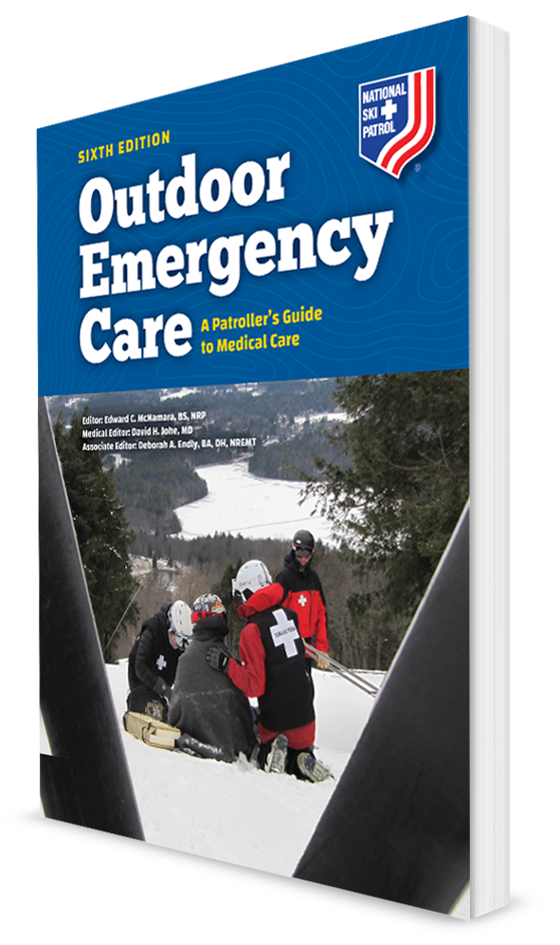
Plant and Animal Emergencies
CHAPTER 27

Slide 2
The following presentation will utilize two symbols to identify material necessary for an OEC Technician to comprehend:
key term
Meets a Chapter Objective.
This symbol will have the corresponding Objective Number denoted within.
Identifies a Key Term.
The Key Term will be underlined for easy identification.

Slide 3
Objectives
27-1 Describe how plants and fungi can be harmful to humans.
27-2 Describe how mushrooms can be harmful to humans.
27-3 Describe and demonstrate how to assess a patient who has been injured following an encounter with a toxic plant, an animal, or marine life.
27-4 Describe and demonstrate how to manage an exposure to topical (on the skin) toxins.
27-5 Describe how to manage someone who has been bitten by a poisonous snake.
27-6 Describe and demonstrate the proper management of wounds caused by animals, including reptiles, insects, and spiders.

Slide 4
Key Terms
Antivenom
Envenomation
Necrosis
Poison
Toxin
Venom

Slide 5
Chapter Overview

Slide 6
Chapter Overview
Anyone who has spent time in the outdoors should be aware of the risks posed by avalanches, lightning, or flash flooding.
Injuries stemming from these events, although dramatic, are rare.
Much more common are injuries and problems resulting from exposure to plants and animals.
With more ski resorts involved in summertime activities such as biking, a basic knowledge of these emergent medical problems is important.
Even though most encounters with plants and animals are benign, certain plants are highly toxic.
Most animal sightings are enjoyable events; however, both large and small animals can inflict great injury.

Slide 7
Poisons, Toxin, and Venom

Slide 8
Poisons, Toxin, and Venom
Poison:
Any substance that can cause severe organ damage or death if ingested, inhaled, injected into the body, or absorbed through the skin
Can come from a living creature or from chemicals or substances that do not come from living creatures
Toxin:
A poison made by a living creature, whether plant or animal
Venom:
A specific toxin or poisonous secretion of an animal, most commonly from a snake, spider, or scorpion, usually transmitted by a bite or sting

Slide 9
Common Emergencies

Slide 10
Toxins Ingested
27-1
While most toxic encounters from plants and fungi are topical in nature, outdoor enthusiasts may at times ingest vegetation or fruit that is harmful.
When eaten, some plants can cause life-threatening systemic reactions.
The most common presentations of ingestion include nausea and vomiting.
The body seems to know the substance that was eaten is toxic, so it tries to expel it.
May produce:
Cardiac effects, resulting in rhythm disturbances
Neurologic effects, producing hallucinations, confusion, or seizures
Onset of effects may occur within 15 to 30 minutes or over several hours.

Slide 11
Toxins Ingested
27-1
Some plants have toxins (chemicals) with medicinal purposes when administered in a small dose.
Examples:
Foxglove, giving us digitalis for the heart
Castor oil plant, giving castor oil as a laxative
Belladonna, which is used to treat diarrhea
When too much of the toxin in these plants is consumed, severe illness or death can occur.

Slide 12
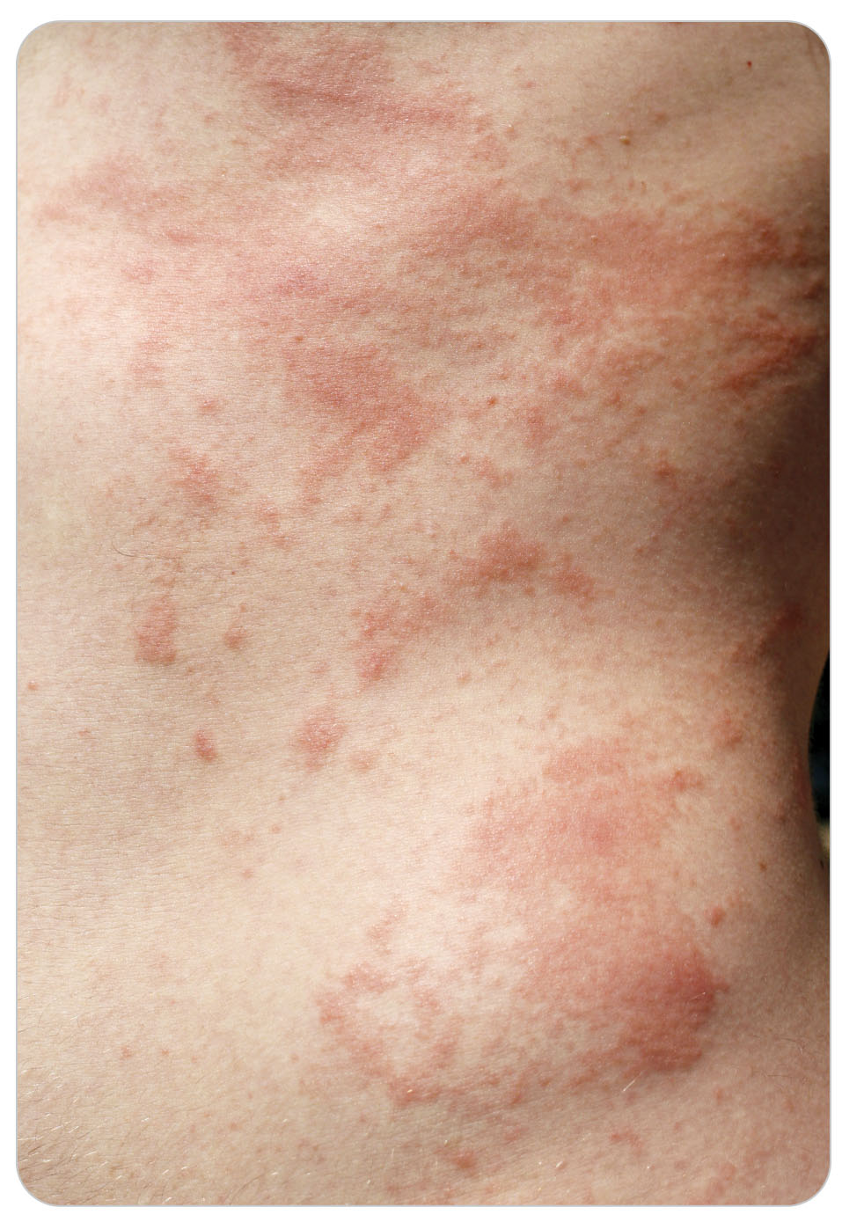
Toxins to the Skin
27-4
When plant toxins touch the skin (topical exposure), a localized skin reaction due to contact with plant material is common.
Reactions are typically a localized inflammatory response commonly called an allergic reaction.
May cause itching only, or blisters and pain that can be severe enough to require evaluation by a physician and treatment with medications
In severe cases, systemic effects may result in cardiovascular collapse or shock.

Slide 13
Poisonous Mushrooms: Most Dangerous
27-2
There are three main groups of mushrooms (fungi) that are dangerous to humans:
The Amanita genus
False Morels
“Little brown mushrooms,” a catch-all category
Mushrooms in these groups are responsible for the fatal mushroom poisonings in the United States, with Amanita mushrooms alone accounting for 90% of mushroom-related deaths.
Most victims are exposed by personal gathering and ingestion.
Unless you are very knowledgeable about mushrooms, the safest place to find mushrooms is in the supermarket.

Slide 14
Poisonous Mushrooms
27-2
Hundreds of other mushrooms also cause problems.
Can cause a mild stomachache to severe physical distress, including vomiting, diarrhea, cramps, and loss of coordination
Two common poisonous mushrooms of this type are the jack-o-lantern and the green-spored lepiota.
Effects usually pass in 24 hours or less with no lasting effects.

Slide 15
Poisonous Mushrooms
27-2
The onset of symptoms provides a general guide to the lethality of the mushroom.
More benign species can cause gastrointestinal upset within the first 2 to 3 hours.
More dangerous types have delayed symptoms up to 8 hours after ingestion.
In addition, some mushrooms, known as psilocybin, contain chemicals that can produce hallucinogenic effects in humans and animals.
Often be found in:
Intentional ingestion
Ceremonial events

Slide 16
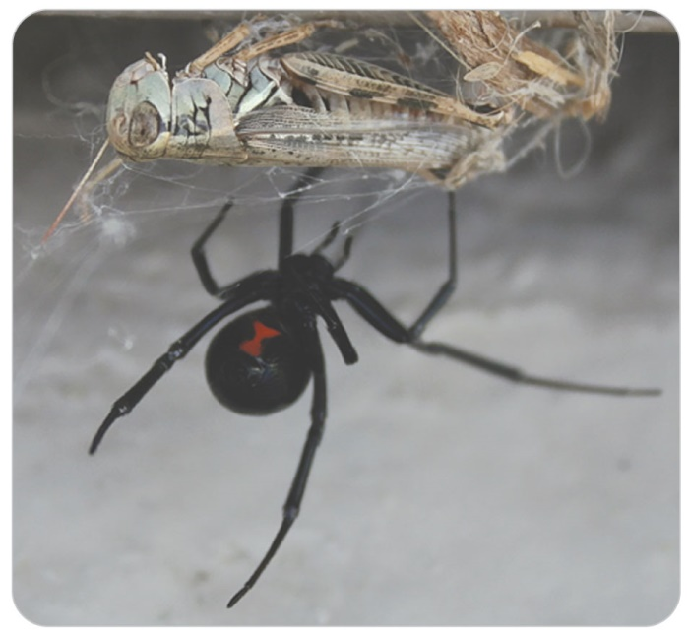
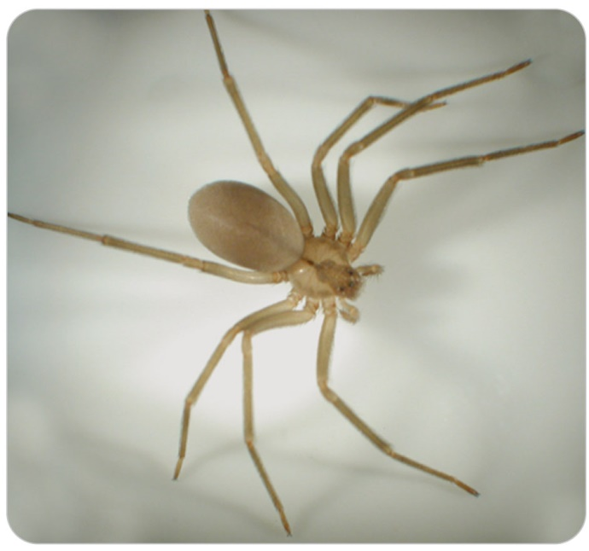
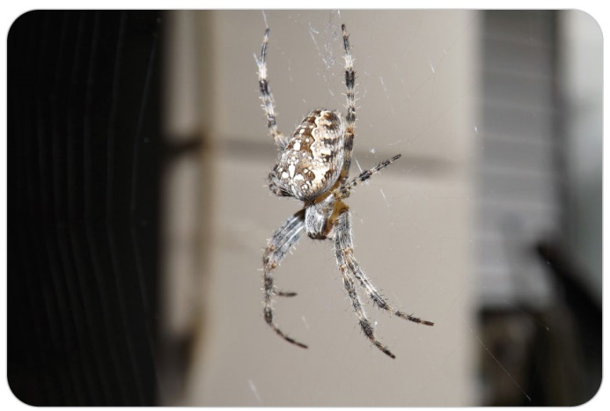
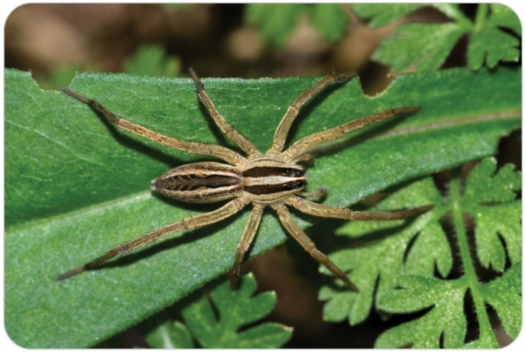
Spiders: Most Dangerous
Localized necrosis, infection at the bite site, and in some cases, serious systemic illness can occur.
The most harmful spiders in North America that bite are the black widow, brown recluse, hobo, and wolf spider.

Slide 17
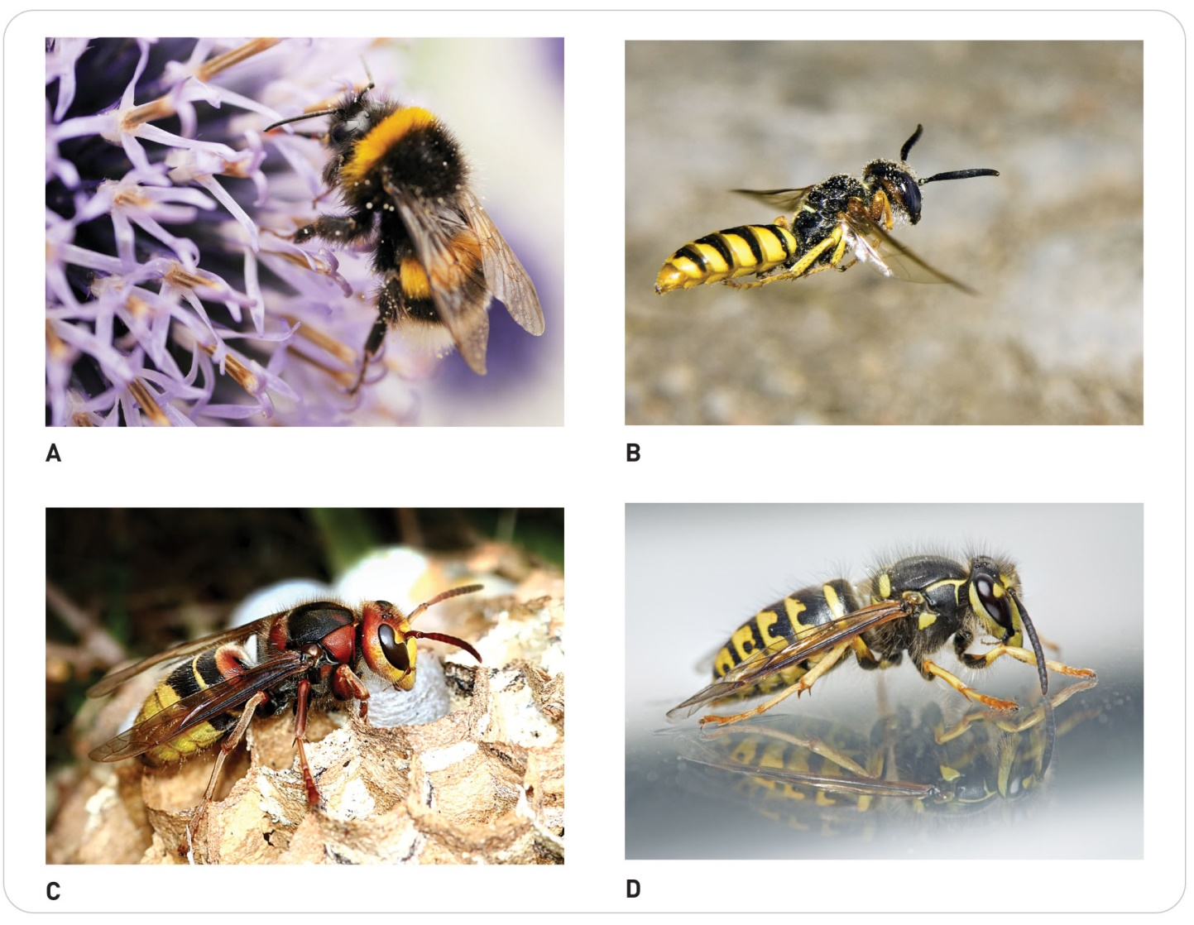
Bees, Wasps, Hornets, and Yellow Jackets
Cause the most instances of envenomation per year of any stinging creature
Most stings cause pain and swelling in the localized area of the skin and in the nearby joint.

Slide 18
Patient Assessment

Slide 19
Patient Assessment: Scene Safety
27-3
In any harmful exposure to a plant or animal, OEC technicians must first determine whether the scene is safe.
The same animal or plant can also harm the rescuer, creating a second patient.

Slide 20
Patient Assessment: Primary Assessment
27-3
If patient is not responsive, simultaneously open the airway and check for effective breathing while feeling for a carotid pulse.
If patient has no pulse and is not breathing, immediately initiate CPR.
If patient has a pulse but is not breathing, begin rescue breathing.
Control major bleeding and assess the ABCDs (airway, breathing, circulation, disability).
During your initial assessment, look for neurologic impairment, life-threatening external hemorrhage, signs of shock, and other serious trauma.

Slide 21
Patient Assessment: Secondary Assessment
27-3
Perform a secondary assessment using the SAMPLE acronym and the DCAP-BTLS mnemonic, paying close attention to any known allergies.
Begin by attempting to determine if the problem was a bite or sting, exposure to a plant, or trauma from a large animal.
Trying to identify the source of a plant or animal-related problem can be very challenging.
If patient has a known environmental allergy (e.g., an allergy to yellow jacket stings) and has signs of anaphylactic shock, find out whether patient has an epinephrine auto-injector.

Slide 22
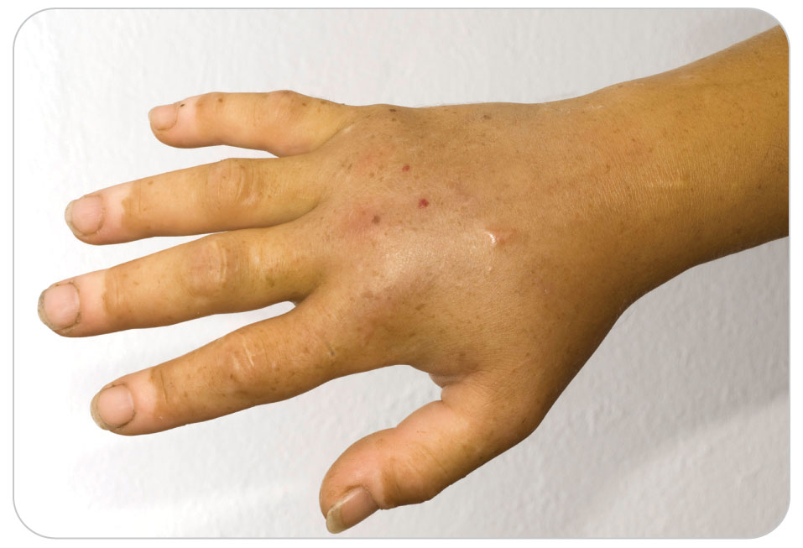
Patient Assessment: Inspection
27-3
For animal or insect injuries, expose and assess the affected area for findings such as rash, pale or discolored skin, and general swelling.
Closely examine the mouth and nose for evidence of swelling.
Look for bite or fang marks.
Assess patient for nausea and vomiting.
Carefully assess the cardiovascular, respiratory, and neurologic status.
Reevaluate patient frequently, because vital signs may deteriorate quickly, depending on the source of the problem.

Slide 23
Patient Assessment: Plant and Mushroom Poisoning
27-2
27-3
Skin contact with certain toxic plants can cause serious skin-related problems, allergic reactions, localized inflammation, or trauma from spines and needles.
Evaluate the skin for signs of rash or trauma.
Gastrointestinal upset, abdominal pain (sometimes severe), muscle aches, and generalized weakness are common with the ingestion of toxic plants and mushrooms.
Monitor patient’s vital signs frequently, and carefully evaluate for shock.

Slide 24
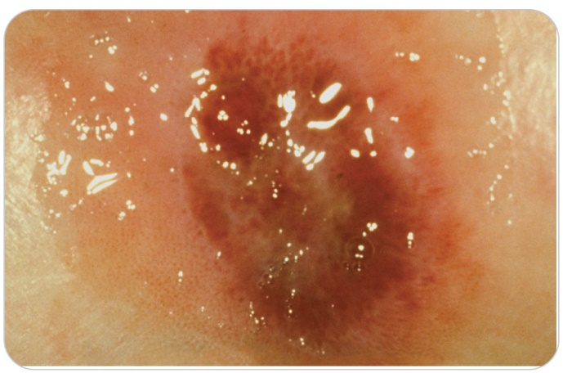
Patient Assessment: Insect Bites
27-3
Spider Bites and Scorpion Stings
The site of a spider bite or scorpion sting is usually very painful.
Severe localized soft-tissue injury and later, tissue necrosis occur.

Slide 25
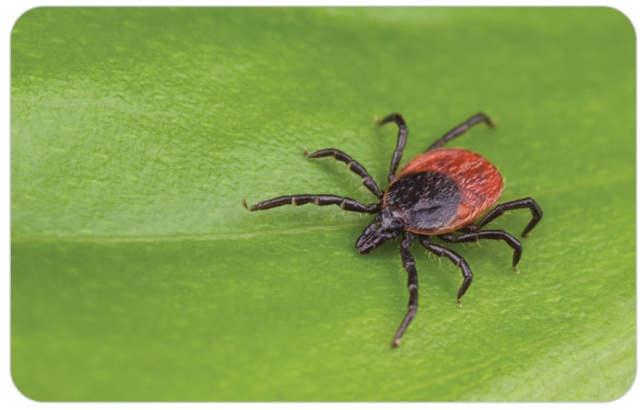
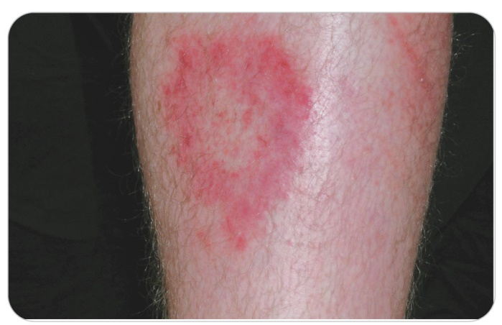
Patient Assessment: Insect Bites
27-3
Tick Bites takes several days to a few weeks for systemic illness to result from a tick bite, although a localized infection at the site may occur sooner.
Ticks usually remain on a host’s body for an hour or two before attaching, so it is important to look for them and remove them as soon as they are discovered.
Have patient monitor the attachment site for signs of a developing rash.

Slide 26
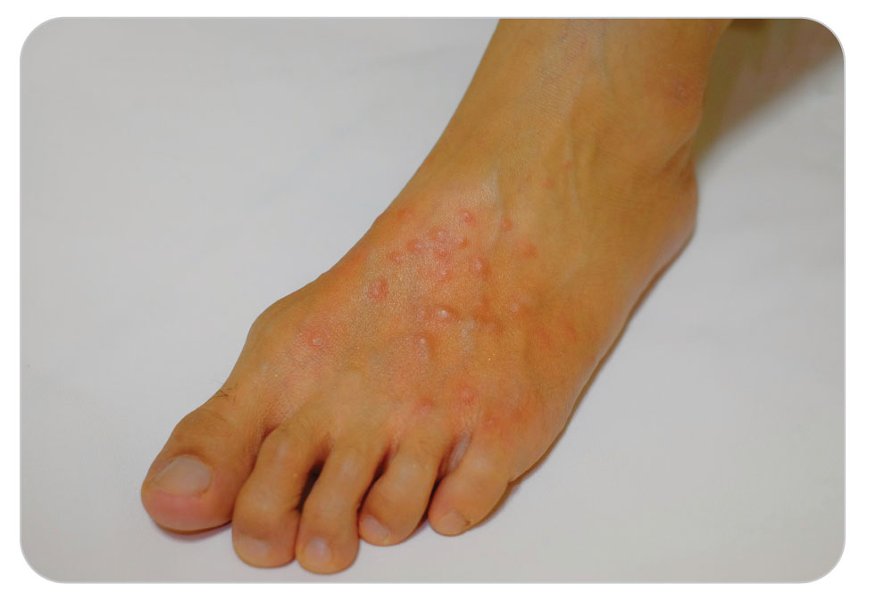
Patient Assessment: Insect Bites
27-3
Stings from Bees, Wasps, Hornets, Yellow Jackets, and Red Ants
Monitor site for localized inflammation and generalized signs of an allergic reaction.
Closely monitor patient’s vital signs, paying attention to swelling in and around the airway, change in voice, difficulty breathing, and instability of patient’s blood pressure.
Multiple stings are especially concerning and increase one’s risk for serious reactions.
Even if the person says they are not allergic to a bee sting, there is always a first time.

Slide 27
Assessment: Insect Bites
27-3
Injuries Caused by Mosquitos and Biting Flies
Assess the affected area(s) for localized inflammation, which, in most cases, should be minor.
Insect-transmitted diseases typically take several days to weeks to manifest themselves.
Given that mosquitoes can transmit serious diseases, advise patient to watch for signs of fever and systemic disease.

Slide 28
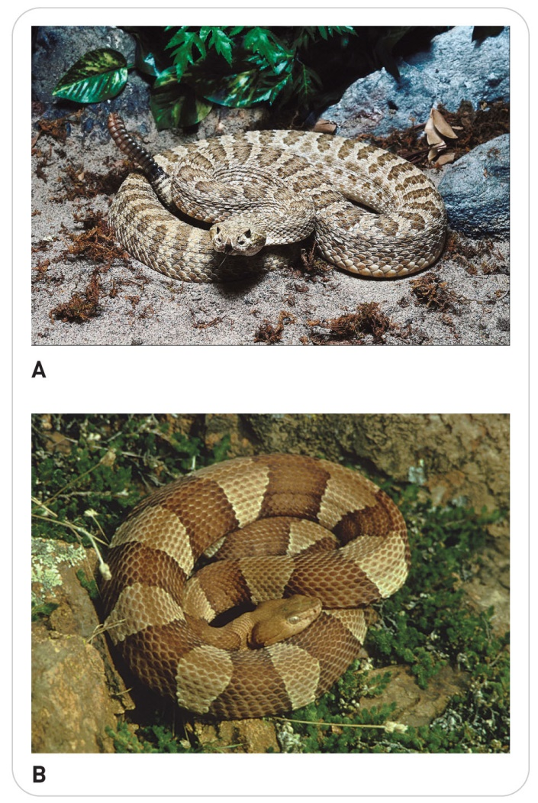
Patient Assessment: Reptile Bites
27-3
Snake bites can be life threatening.
Assess ABCDs and continue to monitor patient.
Snake venom can cause:
Severe systemic bleeding
Neurologic paralysis
Hypotension
Delayed necrosis at the bite site
Monitor patient’s vital signs, paying close attention to any signs of shock.
Large reptiles such as alligators and crocodiles generally cause major tissue damage, fractures, and amputations.

Slide 29
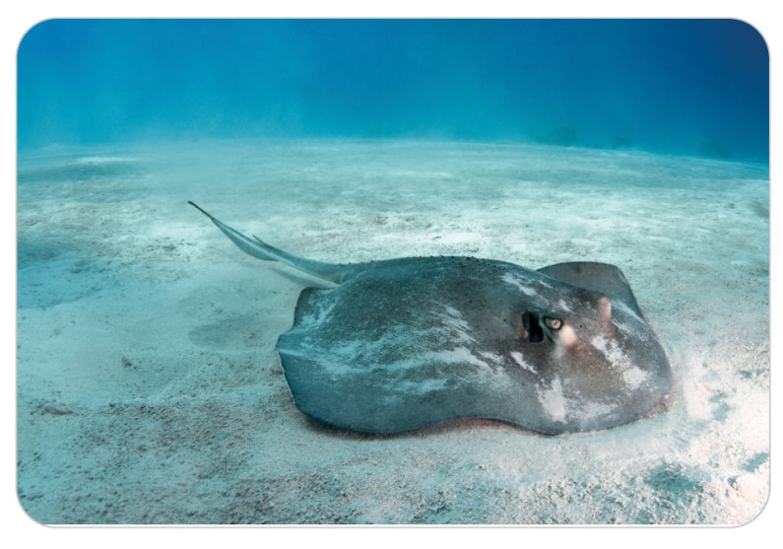
Patient Assessment: Injuries from Marine Animal
27-2
Most injuries from marine animals cause local soft-tissue damage, but some injuries can cause cardiovascular or neurologic instability.
Evaluate the severity of any soft-tissue injuries and monitor the vital signs.

Slide 30
Patient Assessment: Injuries from Mammals
27-3
For injuries caused by large animals:
Pay close attention to excessive bleeding and the ABCDs.
Perform a complete secondary patient assessment.
Assess all soft-tissue injuries for the degree of external bleeding.
Carefully evaluate patient for evidence of internal injuries and head or spine injuries.
Evaluate each soft-tissue injury for redness and swelling that may indicate a developing infection.

Slide 31
Management

Slide 32
Management: Scene Safety
27-5
27-6
As for any incident, ensure that the scene is safe with no plants or animal life that could further harm patients or rescuers.
Observe standard precautions to prevent contact with plant toxins or animal-transmitted diseases.

Slide 33
Management: Primary Survey
27-5
27-6
Control excessive bleeding and manage the ABCD-related problems.
If patient is unresponsive, immediately open the airway and simultaneously check for breathing and for a carotid pulse.
If no pulse, immediately begin CPR using the latest guidelines.
Request EMS assistance as needed.
Patient Position:
In the absence of significant trauma, place patient in a position of comfort.
Place patients who are in shock in a supine position and keep them warm.
For breathing difficulties:
Apply high-flow oxygen by nonrebreather mask.
Titrate the oxygen saturation level with a pulse oximeter to between 94 and 99%.

Slide 34
Management: Transportation Considerations
27-5
27-6
Further management of almost any serious animal-related injury, envenomation, or toxic ingestion should include urgent evacuation and transport to a definitive-care facility.
Base your choice of transport (i.e., by ground or by air) on:
The length of transport
The severity of the injury
Local protocols
Given that the effects of many toxins take time to become evident, assume that patients have a life-threatening condition and plan accordingly.

Slide 35
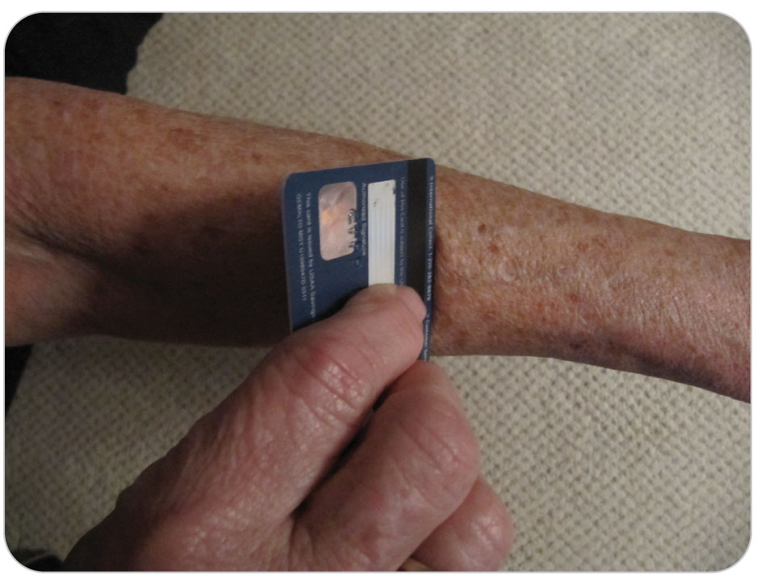
Management: Biting and Stinging Creatures
27-5
27-6
If a stinger is present, scrape the stinger off the skin using the edge of a firm flat object such as a credit card.
Clean the bite area using soap and water.
For spider bites or scorpion stings, immobilize (splint) the area to slow the spread of venom.
Do not use a tourniquet unless there is severe bleeding.
Continue to provide supportive care and arrange for transport.

Slide 36
Management: Epinephrine Auto-Injector
27-5
27-6
If patient has a known allergy to certain insects, such as bees, they may have an epinephrine auto-injector.
If indicated and authorized by your medical director and local protocols, you may need to assist patient in administering an injection of epinephrine.
Use patient’s own medication only.

Slide 37
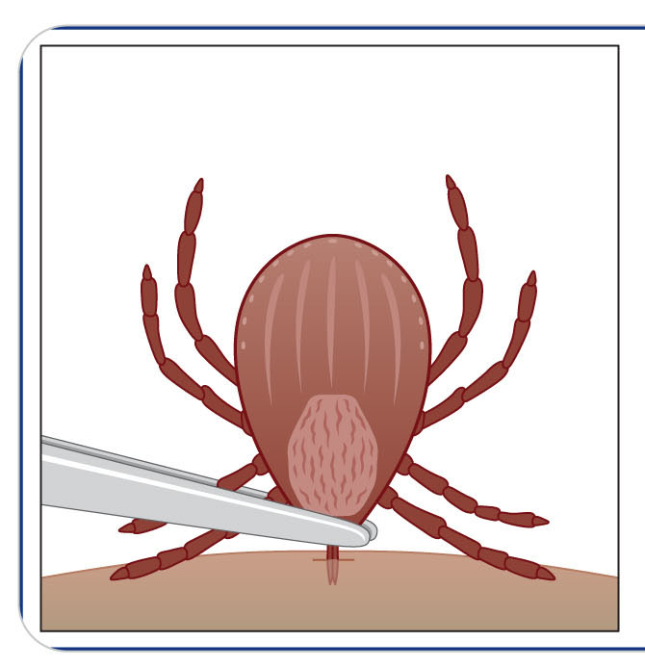
Management: Tick Bites
27-5
27-6
To properly remove an attached tick, perform the following steps:
Grasp the tick as close to the surface of patient’s skin as possible, preferably with fine-tipped tweezers while using medical gloves.
Do not apply fingernail polish, isopropyl alcohol, or a hot match head to the tick, because doing so can cause the release of toxins into the bite wound.

Slide 38
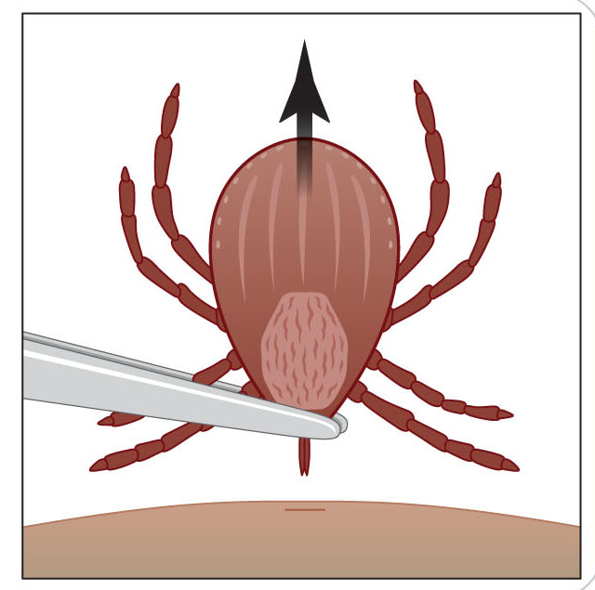
Management: Tick Bites
27-5
27-6
Pull the tick out with gentle, steady pressure, taking care not to crush the tick’s body. The tick may release infected saliva into the skin when crushed.
After the tick is removed, disinfect the skin with isopropyl alcohol or another disinfectant.

Slide 39
Management: Nonpoisonous Snake Bites
27-5
27-6
Nonpoisonous snake bites initially need only local care.
Follow-up medical evaluation is advised because delayed infection or skin necrosis can occur.
Make sure the snake was not a poisonous type.

Slide 40
Management: Poisonous Snake Bites
27-5
27-6
For all poisonous or non-identified snakes, make the scene safe by removing the person beyond striking distance of the snake.
Call for immediate transport with ALS.
Prompt evacuation and evaluation in a definitive-care facility in 30 minutes if possible are the primary focuses for a poisonous snake bite.
Have the person lie down, keep the person calm, and place a limb below the level of the heart to slow the spread of the venom.
Remove any jewelry from the area that was bitten.
Remove shoes if the leg or foot was bitten.

Slide 41
Management: Poisonous Snake Bites
27-5
27-6
Allow the wound to bleed if its oozing and not arterial.
Cover the wound with loose, sterile bandage.
Apply a splint to avoid motion of an extremity.
Because physical exertion should be avoided, do not allow patient to hike over a great distance because doing so will enhance the spread of the poison.

Slide 42
Management: Poisonous Snake Bites
27-5
27-6
Outdated Recommendations:
“Suck the poison out.”
Cut the wound to make it bleed.
Not only do these methods not work, they can worsen the envenomation.
Also, do not apply a tourniquet, ice, or water to a snake bite.
Do not give patient alcohol, caffeinated beverages, or other medications.
Antivenom may be indicated but should be administered by a physician or qualified person only.

Slide 43
Management: Alligator and Crocodile Bites
27-5
27-6
Treat for excessive bleeding and ABCD problems immediately.
Large reptiles such as alligators and crocodiles generally cause crush injuries resulting in major tissue damage, fractures, and amputations.
Treat massive bleeding with compressive dressings, tourniquets, or hemostatic dressings and splint fractures using standard precautions.
Monitor patient’s vital signs and treat for shock if needed.

Slide 44
Management: Injuries by Marine Creatures
27-5
27-6
For marine animal bites, control bleeding and transport patient.
Irrigate all wounds with fresh water and apply appropriate dressings.
If life-threatening hemorrhage is present, a tourniquet or hemostatic dressing is recommended.
If present, remove the spines and decontaminate the affected area.
X-ray imaging is usually done to look for retained foreign bodies.
Antibiotics are routinely administered at the hospital.

Slide 45
Management: Jellyfish Stings
27-5
27-6
Two important actions:
Preventing further nematocyst discharge
Pain relief
To inactivate the nematocyst venom, liberally wash off the nematocysts from the affected area of skin with vinegar as soon as possible for at least 30 seconds.
Check with local authorities; this has been shown to work for only certain types of jellyfish.
After the nematocysts are removed or inactivated with vinegar, the pain is treated by immersing the affected part in hot water for at least 20 minutes or longer if the pain persists.
Patient with a more systemic reaction should be emergently transported to a hospital.

Slide 46
Management: Sea Urchins
27-5
27-6
To remove the sea urchin spines from the skin, first immerse the affected area for 30 to 90 minutes in hot water or vinegar to help smoothen or dissolve the spines.
Next use tweezers to remove all spines stuck.
Apply shaving cream to the injured area and remove the pedicellaria (moveable stalked structures with jaws) by scraping with a razor.
Scrub the wound with soap and water. Rinse the injury with fresh water.

Slide 47
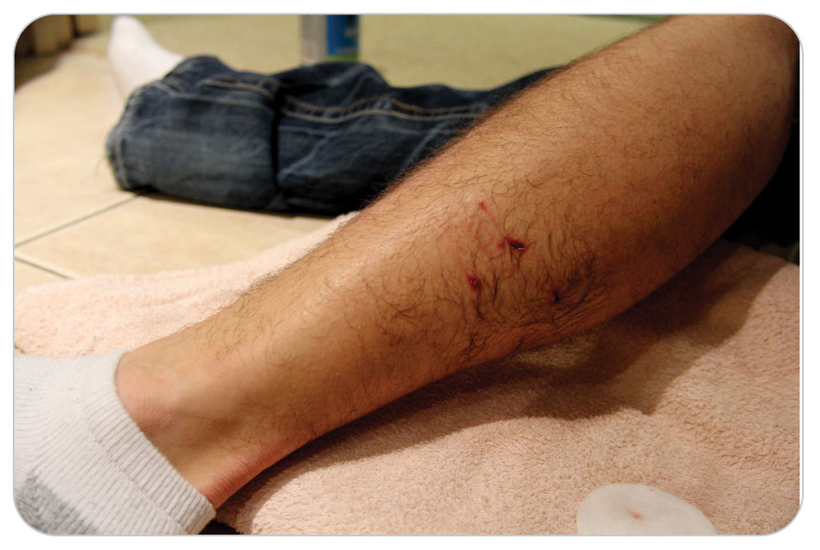
Management: Animal Bites
27-5
27-6
Care by an OEC technician for animal bites includes:
Bleeding control
Wound care
Shock management
The mouths of all animals contain multiple types of bacteria that can enter a victim’s tissues through a bite.
Wash bites with sterile or clean water, or a saline solution.
Apply a sterile dressing.
Immobilize suspected fractures in the usual manner.
Recommend further medical care.

Slide 48
Management: Animal Bites
27-5
27-6
Definitive Care of Wounds:
Larger wounds often require thorough cleaning and closure with sutures by a physician.
Smaller wounds (less than 2 cm) and punctures are typically left open to allow drainage.
Any wound debridement and repair, which may be extensive, should be performed by a physician.
Risk of Infection:
Because many rodents carry infectious diseases, a patient with a bite from these animals should be promptly transported to the hospital for treatment.
Dog and cat bites pose a high risk of infection, and prophylactic antibiotics are sometimes recommended.

Slide 49
Management: Injuries by Large Animals
27-6
Injuries caused by large animals are treated according to the signs and symptoms present.
A large bite or kick requires the same type of care as that indicated by similar trauma caused by any other mechanism.
Control external bleeding, splint possible fractures, and provide spinal motion restriction if indicated.
Bandage wounds as indicated to prevent further contamination.
Because an attack from these animals can result in massive injuries, monitor the vital signs carefully for signs of shock.
Treat massive bleeding with compressive dressings, tourniquets, or hemostatic dressings using standard precautions.

Slide 50
Case Study

Slide 51
CASE PRESENTATION
You are at the mid-station of an off-road bicycle competition at a national park. A cyclist comes into the station and says someone was attacked by a bear about a quarter mile back. You and another patroller grab your packs, get on an all-terrain vehicle (ATV) with oxygen, medical equipment, and a stretcher, and head up the trail. A ranger with a rifle accompanies you on another ATV. A small crowd has gathered near the trail. You find a middle-aged man lying alongside the trail, bleeding and confused. You scan your surroundings for wild animals and ask others if any are near. None can be found. The ranger stands guard and keeps the crowd away from you but stays close in case the bear returns. The race is stopped further up the trail. You ask the injured man his name, and he replies, “Mike.”

Slide 52
CASE PRESENTATION
You tell him you are here to help him. His right forearm has a large gash that is spurting bright red blood from severely damaged tissue. You control the bleeding with a pressure dressing. You notice he has a belt placed snugly around his upper right thigh, with a large amount of tissue missing from his lower right calf. You immediately radio for more help and EMS with air transport.
What should you do now?

Slide 53
CASE UPDATE
More patrollers arrive and put on personal protective equipment (PPE). You take out the commercial tourniquet and place it and snug it down about 4 inches below the knee above the wound. The very narrow belt is removed. Bleeding is controlled. The times both the tourniquet was placed is recorded. His pulse is 120 beats per minute, respirations are 18 breaths per minute, and blood pressure is 110/90 mm Hg. No other signs of trauma are evident. His mental status is now A in the AVPU (alert, verbal, pain, unresponsive) scale. He reports no medical problems, no medications, and no allergies. He has a normal spine exam. Sensing this is a load-and-go situation, you strap him onto the stretcher attached to the ATV.
What do you do now?

Slide 54
CASE OUTCOME
A landing zone has been set up near the administration building. As you approach the landing zone, a helicopter is about to land. After landing, a paramedic evaluates your patient, starts an IV line, provides medications, and then loads him into the helicopter. Later, you discover patient spent several hours in surgery, having his wounds cleaned and repaired. He received a blood transfusion for shock. A long road to recovery is needed, but his life was saved. The park ranger later finds a den 200 yards from the bicycle trail, with two bear cubs. The female bear was protecting her young.

