Slide 1
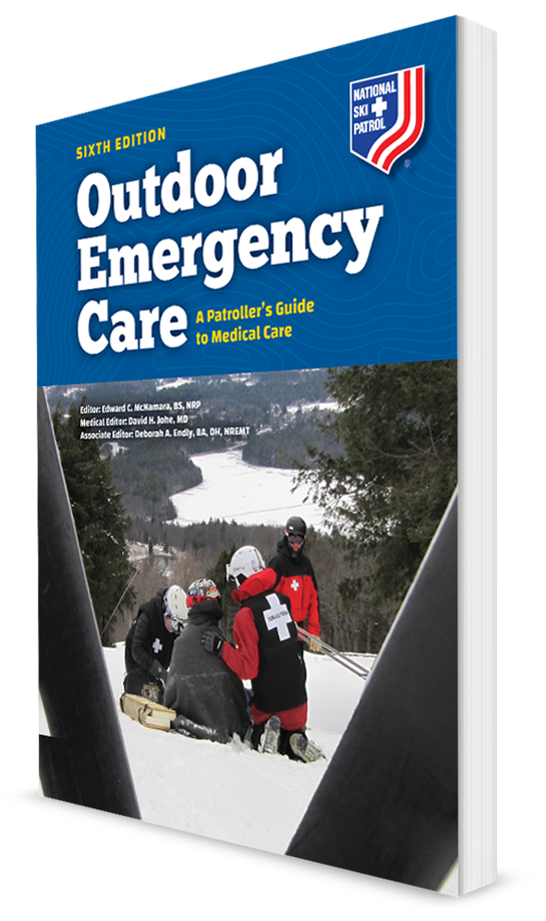
Altitude-Related Emergencies
CHAPTER 28

Slide 2
The following presentation will utilize two symbols to identify material necessary for an OEC Technician to comprehend:
key term
Meets a Chapter Objective.
This symbol will have the corresponding Objective Number denoted within.
Identifies a Key Term.
The Key Term will be underlined for easy identification.

Slide 3
Objectives
28-1 Define altitude.
28-2 Explain what happens to oxygen as altitude increases.
28-3 List risk factors for the development of altitude illnesses.
28-4 Describe strategies to prevent altitude illness.
28-5 List the signs and symptoms of the following altitude illnesses:
Acute mountain sickness (AMS)
High-altitude pulmonary edema (HAPE)
High-altitude cerebral edema (HACE)

Slide 4
Objectives
28-6 Describe how to assess a patient with altitude illness.
Acute mountain sickness (AMS)
High-altitude pulmonary edema (HAPE)
High-altitude cerebral edema (HACE)
28-7 Describe the treatment of a patient with altitude illness.
Acute mountain sickness (AMS)
High-altitude pulmonary edema (HAPE)
High-altitude cerebral edema (HACE)

Slide 5
Key Terms
Acclimatization
Acute mountain sickness (AMS)
Altitude illness
Ataxia
Gamow bag
High-altitude cerebral edema (HACE)
High-altitude pulmonary edema (HAPE)
Hypoxemia
Khumbu cough
Sleeping altitude

Slide 6
Chapter Overview

Slide 7
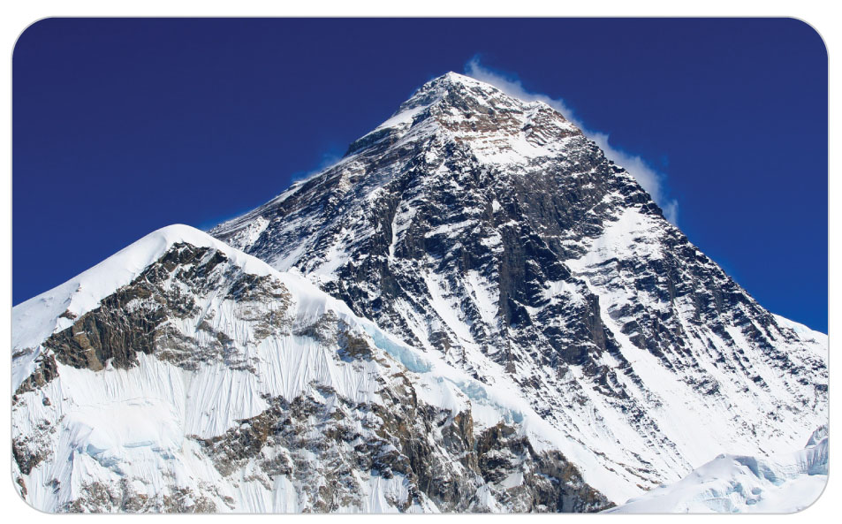
Chapter Overview
Snow sports enthusiasts, hikers, and sightseers have many opportunities to enjoy high-altitude activities.
Unsuspecting or unprepared people can quickly experience a miserable or even life-threatening event that includes intense headaches, breathing difficulty, coughing spells, pulmonary edema, coma-inducing brain swelling, or even death.
Even hardy recreationalists are at risk.

Slide 8
Chapter Overview
Altitude illness can affect up to 30% of visitors to the high-altitude resorts of the Rocky Mountains.
Fifty percent of all hikers and climbers in the Himalayas suffer from some form of altitude illness.
OEC technicians who work in high-altitude mountain resorts may encounter patients who are suffering from an altitude-related illness.
Need to learn to recognize the signs and symptoms of acute altitude illnesses and know how to provide prompt, appropriate treatment

Slide 9
Altitude Physiology

Slide 10
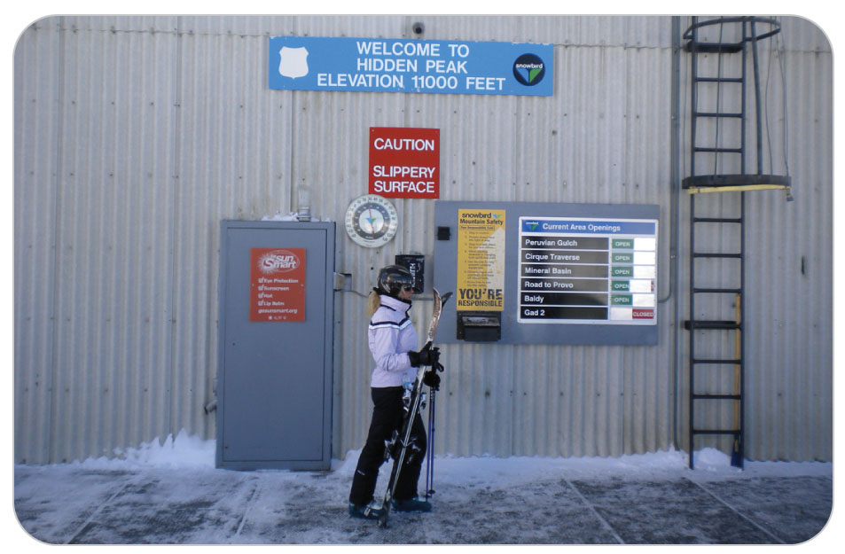
Altitude
28-1
The body’s ability to preserve homeostasis includes the ability to adapt to changes in altitude.
Altitude is the height or vertical elevation above sea level, which is “0 feet.”
Most altitude illness occurs at elevations higher than 8,000 feet above sea level.
But can occur at altitudes as low as 6,500 feet

Slide 11
Altitude Physiology
28-3
Rate of ascent is very important in determining the probability of developing altitude illness.
Rapid ascent is more likely to cause problems than a slower ascent.
Even though the deadliest forms of altitude illness occur more frequently at extreme elevations, they can occur at intermediate altitudes as well.
Scientific evidence suggests that the genetic makeup of some individuals helps them avoid altitude illness and acclimate to high altitudes more easily than other individuals.

Slide 12
Altitude Physiology
28-2
High altitude dramatically affects the amount of oxygen available to the body’s cells, which can have a profound effect on normal body function.
Low blood oxygen content is called hypoxemia.
As altitude increases, the atmosphere contains less air.
At a high altitude, oxygen remains at the same percentage, 21% of air.
Amount of oxygen contained in one cubic foot of air at a high altitude is less than in one cubic foot at sea level.
At 10,000 feet, oxygen taken in with each breath is only 69% of that taken in at sea level.

Slide 13
Altitude Acclimatization
28-4
Serious medical consequences of ascending to a high altitude can be prevented through acclimatization, which is the body’s process of gradual adjustment to changes in altitude.
The ability to adapt has allowed humans to travel to and inhabit some of the most inhospitable places on earth at high elevations.

Slide 14
Altitude Acclimatization
28-4
With less oxygen available, the body must adjust to improve the delivery of oxygen to the tissues and cells.
When traveling to high altitude too rapidly, altitude illness may occur because the body may not adjust fast enough to keep up with the body’s oxygen demand.
Keys to preventing altitude illness are knowing when to expect it, how to avoid it, how to identify it, and what to do if symptoms arise.

Slide 15
Altitude Acclimatization
26-2
During acclimatization, the body makes a series of physiological adjustments that increase the delivery of oxygen to the body’s cells.
Gradual adjustment to hypoxia allows a person to temporarily endure extreme altitudes.
Physiological adaptations that help preserve homeostasis include the following:
Increased rate and depth of respiration
Increased heart rate
Increased red blood cell production
Constriction of pulmonary blood vessels
Increased urine production

Slide 16
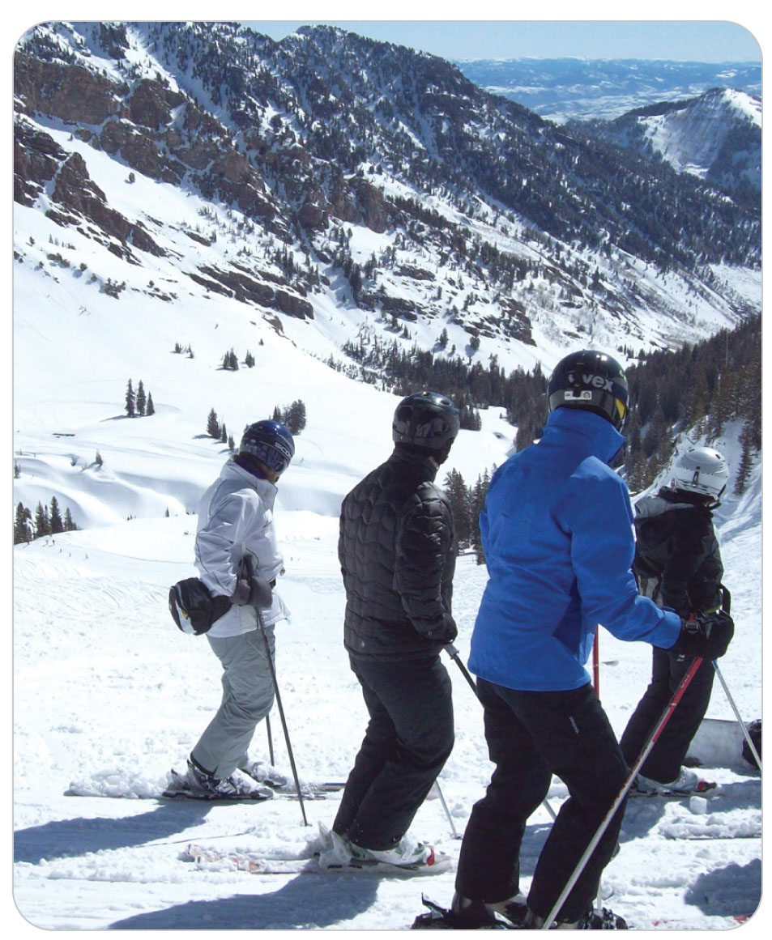
Altitude Acclimatization
26-4
The ability to acclimatize varies from person to person and has nothing to do with how physically fit someone is.
Some people can adapt quickly to altitude changes without any apparent discomfort, whereas others develop varying degrees of altitude illness.

Slide 17
Factors in the Severity of Altitude
The severity of altitude illness depends on:
Rate of altitude ascent
Ultimate elevation attainted
More importantly the sleeping altitude
Time spent at high altitudes
Level of exertion
Genetic susceptibility

Slide 18
Altitude-Related Problems

Slide 19
Acute Mountain Sickness (AMS)
28-5
Acute Mountain Sickness (AMS) is defined as a medical condition caused by exposure to high altitude.
Usually occurs within several hours to 1 day after ascending to a higher altitude
Occurs when the rate of ascent outpaces the body’s ability to adjust to the change in altitude
Rarely occurs at altitudes below 6,500 feet and is more often encountered at altitudes greater than 8,000 feet
Especially prevalent among individuals who rapidly ascend to high altitude from elevations below 2,000 feet
For example, AMS affects 25% of all visitors who sleep above 8,000 feet in Colorado.

Slide 20
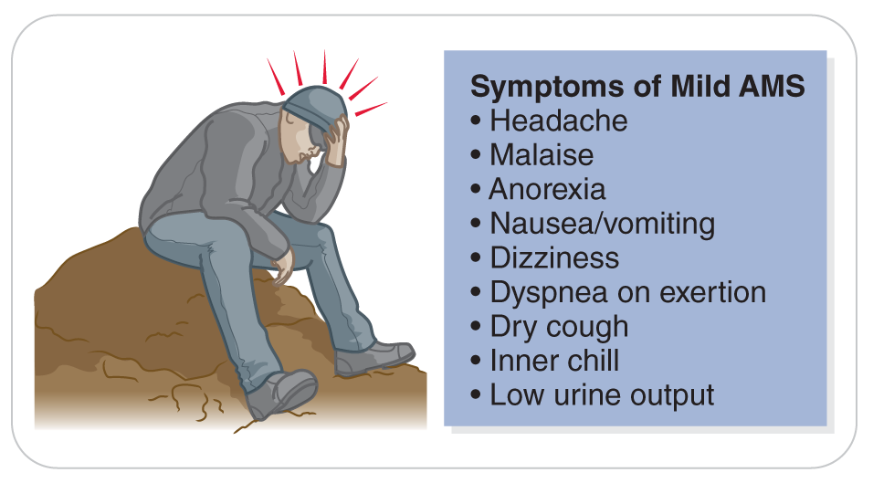
Acute Mountain Sickness
28-5
AMS is characterized by mild to moderate headache accompanied by one or more of the following symptoms:
Dizziness
Fatigue
Dyspnea on exertion
Loss of appetite
Nausea
A general feeling of malaise
Headache usually develops in 2 to 12 hours.

Slide 21
Acute Mountain Sickness
28-5
Other symptoms, which many patients compare to the feeling of an alcoholic hangover, commonly develop within 12 to 24 hours after arrival at a higher altitude but can appear in as few as 4 to 6 hours in susceptible individuals.
If the person can acclimatize successfully, the symptoms decrease in severity by about the third day.
Often misdiagnosed as a viral flu-like illness, a hangover, exhaustion, dehydration, or a drug-related effect.

Slide 22
High-Altitude Pulmonary Edema (HAPE)
28-5
High-altitude pulmonary edema (HAPE) is a condition in which fluid accumulates in the lungs of an individual at high altitude.
Not due to a preexisting cardiac disorder.
In cardiac pulmonary edema, fluid builds up in the lungs because the heart is not pumping correctly.
Fluid buildup is caused by excessive blood pressure in the pulmonary artery.
When at high altitude, it is thought that the body is stressed by cold, exertion, and anoxia, causing HAPE.

Slide 23
High-Altitude Pulmonary Edema
28-5
HAPE is the most common cause of altitude-related death and rarely occurs at elevations below 8,000 feet.
Like AMS, HAPE develops as a result of several factors, including individual susceptibility, ascent rate, altitude reached, physical exertion, and certain underlying medical conditions.
HAPE usually occurs within the first 2 to 4 days of ascent to altitudes above 8,200 feet and is heralded by the onset of marked fatigue during exercise.
Untreated, fatigue is soon accompanied by severe dyspnea upon exertion, such as walking uphill or upstairs.

Slide 24
High-Altitude Pulmonary Edema
28-5
About half of HAPE patients have symptoms of AMS first, but one can get HAPE without having AMS first.
Patients may also complain of a persistent dry cough during the early stages, and their nail beds and lips may become cyanotic.
Typically worsens at night
Labored breathing at rest and audible chest congestion herald the development of a serious, potentially life-threatening condition.

Slide 25
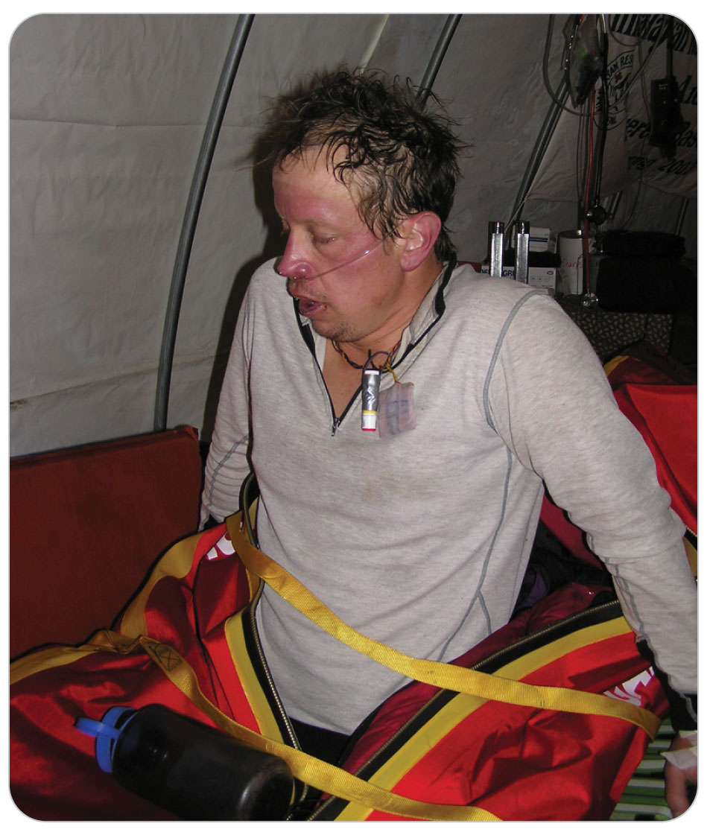
High-Altitude Pulmonary Edema
28-5
HAPE may strike abruptly.
Pink, frothy sputum is a very late finding and is accompanied by profound hypoxia.
Untreated, HAPE can be fatal within a few hours.
Fortunately, it can be completely and easily reversed if recognized early and treated properly.

Slide 26
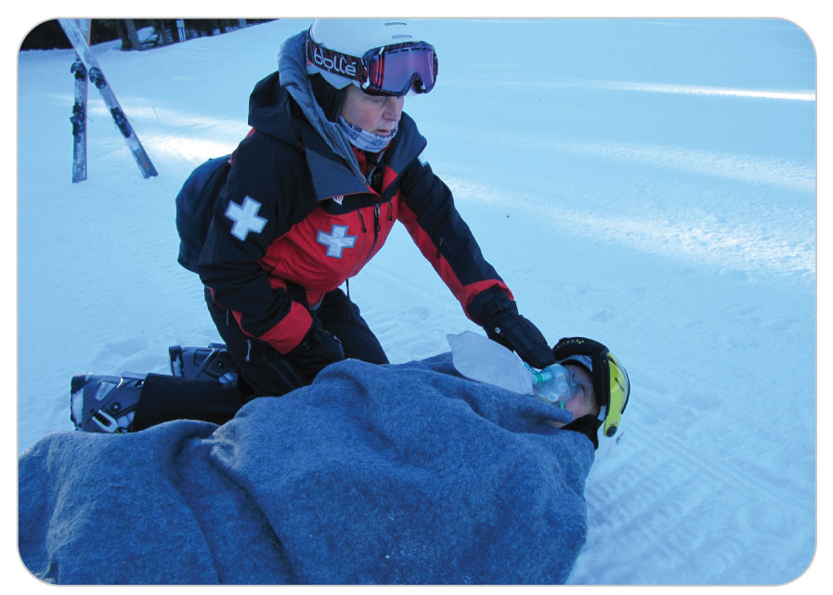
High-Altitude Cerebral Edema (HACE)
28-5
High-Altitude Cerebral Edema (HACE) is a potentially deadly condition in which the brain swells.
Most severe form of altitude illness and is most commonly encountered at elevations over 9,600 feet.
HACE or HAPE may be preceded by AMS.
About 3% of patients who develop AMS go on to develop HACE.
HACE is a true medical emergency that can rapidly lead to death if not recognized and quickly treated.

Slide 27
High-Altitude Cerebral Edema
28-5
Characterized by a progression of symptoms that usually begins with headache and nausea and progresses to ataxia plus any of the following signs and symptoms:
Altered mental status
Fatigue
Drowsiness
Difficulty speaking
Paralysis
Coma
Death
Hallucinations and psychotic behavior also are commonly observed.
Although uncommon, seizures can occur.

Slide 28
High-Altitude Cerebral Edema
28-5
Progression from AMS to HACE-induced coma may be as fast as 12 hours but usually requires 1 to 3 days.
Recovery can be very quick, especially if treated early, but recovery can also be very slow and result in long-term complications, including decreased brain or neurologic function.

Slide 29
Khumbu Cough
Khumbu Cough
Also known as high-altitude bronchitis
Dry, persistent cough that affects nearly all people who spend time at altitudes above 14,000 feet
Can become so severe that it can break ribs
The condition is named after Khumbu region of Nepal, near Mt. Everest, where it was first observed.

Slide 30
Prevention of Altitude Illnesses

Slide 31
Prevention of Altitude Illnesses
28-4
With proper precautions, the incidence of altitude illnesses can be significantly reduced.
Exceptional health or physical fitness does not render one immune to altitude illness.
Prevention of altitude illness depends on proper acclimatization.

Slide 32
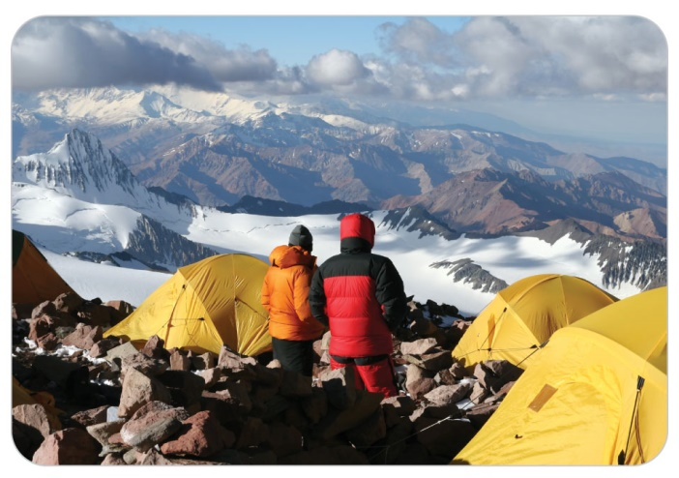
Prevention of Altitude Illnesses
28-4
Follow these guidelines to achieve proper altitude acclimatization:
Gradual ascent is the most effective way to prevent altitude illness, especially if you begin at sea level and continue above 10,000 feet.
Incorporate a layover of 2 to 3 days at an intermediate altitude—that is, between 8,000 feet and 10,000 feet. For individuals traveling from sea level, a 1-day layover at 6,000 feet can dramatically decrease the risk of becoming ill.
Once above 10,000 feet, limit increases in altitude to 1,000 feet per day. Then, for every 2,000 feet of elevation gained, take 1 or 2 extra rest days.
As you reach higher altitudes, more rest and a smaller altitude gain per day may be necessary.

Slide 33
Prevention of Altitude Illnesses
28-4
Avoid heavy physical exertion for the first 24 to 48 hours at high altitudes.
Stay hydrated.
Avoid alcohol and other depressant drugs (including most sleeping pills) because they decrease the respiratory drive during sleep, which can worsen symptoms and cause AMS.
If you begin to show symptoms of altitude illness, do not go higher until the symptoms resolve.
People acclimatize at different rates, so if you are traveling in a group, make sure everyone is properly acclimatized before going higher.
“Climb high and sleep low.”

Slide 34
Prevention of Altitude Illnesses: Medications
28-4
Several prescription and over-the-counter medications can reduce or even prevent altitude illness.
OEC technicians should specifically ask high-altitude patients during the SAMPLE history whether they have taken one of these medications.
Acetazolamide (Diamox) is a prescription medication that often is taken prophylactically to prevent AMS.
Effects may be delayed, so it is advisable to begin use 24 hours before ascent to altitude and to continue use for 48 to 72 hours at the maximum altitude attained.

Slide 35
Prevention of Altitude Illnesses: Medications
28-4
Dexamethasone is a prescription steroid that decreases swelling in the brain and in other structures and may reverse the symptoms of AMS.
Begin a few days before beginning the ascent.
Interestingly, sildenafil (Viagra) and tadalafil (Cialis) seem to prevent altitude illness.
These medications seem to help prevent HAPE by dilating the pulmonary arteries.
Nifedipine (Adalat) has also been used in the prevention of HAPE in people susceptible to high-altitude illness.

Slide 36
Patient Assessment

Slide 37
Patient Assessment
28-6
The role of OEC technicians is NOT to diagnose the underlying cause of a given problem, but instead to recognize patients who have signs and symptoms of an emergent condition and quickly initiate lifesaving treatment, if needed.
As with any patient, the assessment process begins with a careful examination of the ABCDs.
If a potentially emergent condition exists, initiate lifesaving treatment instead of performing a complete physical examination and refer patient to a higher level of care.

Slide 38
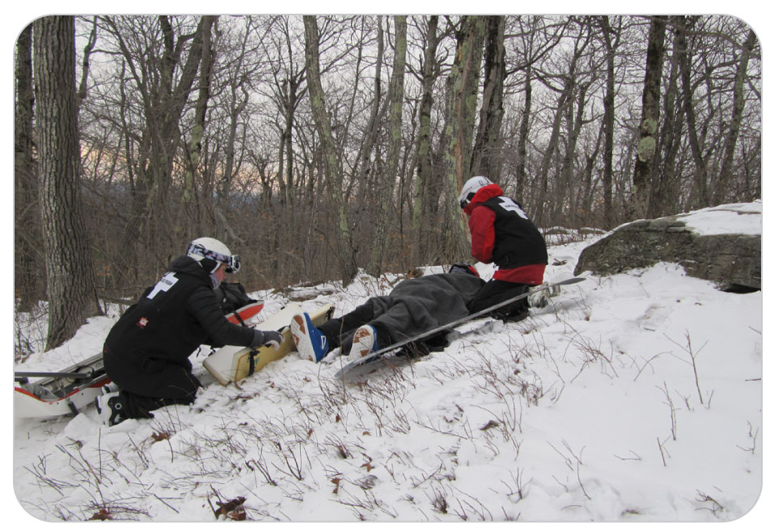
Patient Assessment
28-6
OEC technicians should ask patients about their medical history and symptoms using the SAMPLE acronym and the OPQRST mnemonic, respectively.

Slide 39
Patient Assessment
28-6
Note whether patients have any underlying cardiac or respiratory conditions that could be worsened by altitude.
Individuals with sleep apnea may become severely hypoxic at high altitudes.
Ask patients about this condition during your evaluation.
For patients who are experiencing shortness of breath, ask if it is associated with any pain or persists during rest.
Ask patients if they have ever had problems like this on previous visits to high altitude.
Also ask patients if they have any AMS-related symptoms such as a headache, difficulty sleeping, nausea, vomiting, or excessive fatigue.

Slide 40
Patient Assessment
28-6
Place patient into a position of comfort, which may well be an upright position that allows the person to breathe more easily.
Note whether patient appears short of breath at rest.
Inspect the conjunctivae, lips, and nail beds for discoloration or cyanosis, and the face, hands, ankles, and feet for edema.
Examine the inside of the mouth for any pink (blood-tinged) saliva or sputum.
If a stethoscope is available and you have been trained to do so, auscultate the lungs for any abnormal sounds that could indicate the presence of pulmonary edema.
See if there are any visual problems, especially a decrease in acuity.

Slide 41
Patient Assessment
28-6
Complete the physical exam by thoroughly palpating the body for areas of tenderness or swelling, and by assessing distal skin temperature, circulation, movement, and sensation.
For patients who are complaining of symptoms that suggest AMS or HACE, attempt to assess them for ataxia by asking them to walk a straight line, heel to toe.
Evidence of unsteadiness or an inability to maintain balance at high altitude suggests HACE, which requires immediate treatment.
Perform reassessments, including serial sets of vital signs, as needed.

Slide 42
Management

Slide 43
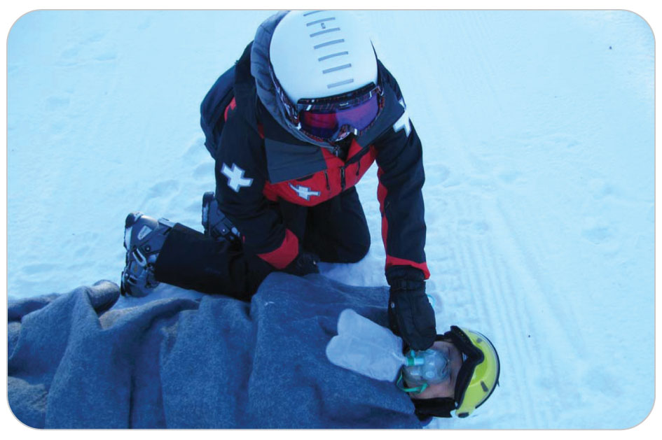
Management for Altitude-Related Emergencies
28-7
The treatment of patients who present with a suspected altitude-related disorder is generally supportive in nature, and early recognition is the key to a successful outcome.
The fundamental treatment for all cases of altitude illness is to descend to a lower elevation.
Depending on the severity of symptoms, descent may need to be done urgently.

Slide 44
Management: General
28-7
General Management:
Initial treatment for all altitude-related illnesses includes correcting any problems involving the ABCDs and placing patients into a position of comfort.
Immediate administration of high-flow oxygen via nonrebreather mask keeping the oxygen saturation between 94 and 99%, especially when combined with rapid descent to a lower elevation, can be lifesaving.
Keep patients warm by using jackets, blankets, reflective blankets, or sleeping bags as necessary because cold stress elevates pulmonary pressures, decreases peripheral blood flow, and can worsen shock.

Slide 45
Management: General
28-7
Anticipate vomiting and be ready to clear the airway by removing the oxygen mask and turning patients onto their sides.
Suction the airway as needed.
Continue to monitor vital signs and prepare for transport because all patients with serious altitude illness require further evaluation and treatment at a definitive-care facility.

Slide 46
Management: Acute Mountain Sickness
28-7
Treatment of AMS centers on treating symptoms, halting ascent, and waiting for altitude acclimatization to improve, which can take 12 hours to several days.
In all cases, minimize exertion to prevent the worsening of symptoms.
High-flow oxygen, keeping the oxygen saturation between 94 and 99%, is particularly effective and can ease other symptoms such as headache and nausea.
All other treatment is symptom based.
For headache, which is a tell-tale sign of AMS, patients may self-administer conventional analgesics such as acetaminophen or ibuprofen.
If symptoms do not resolve, descent is indicated.

Slide 47
Management: High-Altitude Pulmonary Edema
28-7
If oxygen is scarce or unavailable, the emergent treatment for HAPE is rapid descent to an elevation that is at least 1,500 to 3,000 feet lower than the elevation at which symptoms were first observed.
Unless there is no other way, avoid self-evacuation because it increases respiratory demands.
Patients should be transported in a sitting position to a lower elevation as rapidly as possible.
Rescue groups should make delivery of oxygen to patient a top priority.

Slide 48
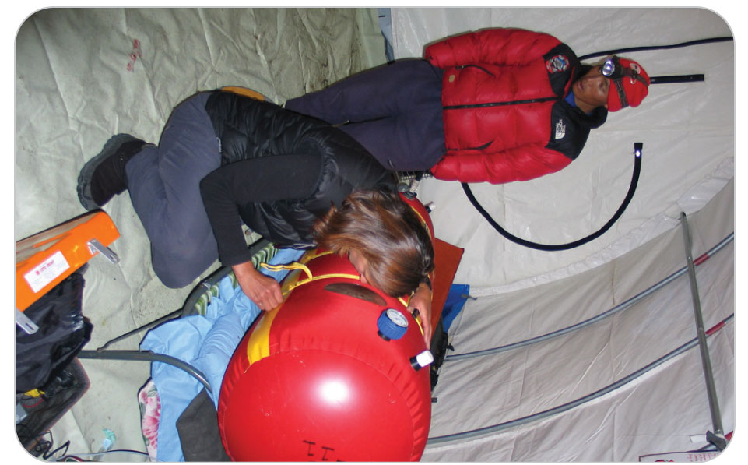
Management: High-Altitude Pulmonary Edema
28-7
If unlimited oxygen is available, descent may be delayed for rescuer safety because oxygen immediately reduces pulmonary arterial blood pressure.
In severe cases, the use of specialized devices such as a Gamow bag can be lifesaving.

Slide 49
Management: High-Altitude Pulmonary Edema
28-7
Following evacuation to a lower altitude, patients should be transported to a hospital for further evaluation and treatment, which typically consists of rest and supplemental oxygen.
In many cases, medications that reduce pulmonary blood pressure may be administered.
Upon release from the hospital, patients are advised to resume normal activities gradually and are warned that it can take up to 2 weeks to recover their strength completely.

Slide 50
Management: High-Altitude Cerebral Edema
28-7
At the first sign of ataxia or a change in responsiveness, patients should be transported to a lower altitude (decrease by at least 1,500 to 3,000 feet).
High-flow oxygen should be administered immediately, if available.
If descent is not logistically possible, devices such as a Gamow bag can “buy time” until descent is possible and can significantly decrease morbidity and mortality.
All other care is supportive in nature.
Patients should be transported immediately to a hospital for definitive evaluation and treatment, which often includes the administration of steroids to reduce cerebral swelling.

Slide 51
Case Study

Slide 52
CASE PRESENTATION
You are working first-aid duty in the patrol room at a resort that is at 11,000 feet above sea level when a 28-year-old woman slowly walks in complaining of shortness of breath. Noticing that she does not look well and is slightly cyanotic around her lips, you help her to the nearest stretcher. She tells you that she hasn’t felt great since arriving after her flight and driving up from sea level yesterday. She denies any chest pain but says she has a bad headache, is tired, becomes short of breath “just walking to the bathroom,” and has had a dry cough. She has no significant past medical history, has not suffered any recent trauma, and is not currently taking any prescribed medications. She appears very concerned and says, “I have never experienced anything like this in my life.”
What should you do?

Slide 53
CASE UPDATE
Upon examination of patient, you notice that her breathing is labored, even at rest. Patient appears physically fit, which she confirms by saying, “I run more than 50 miles a week.” Her heart rate is 116 beats per minute, blood pressure is 132/80 mm Hg, and respirations are 36 breaths per minute. A pulse oximeter measures patient’s oxygen saturation at 84%. The rest of the physical assessment is negative for any abnormal signs or signs of trauma.
What do you think is wrong with the patient? What should you do?

Slide 54
CASE OUTCOME
You are concerned that patient has early signs of HAPE. You place her on high-flow oxygen, keep her comfortable, and mobilize resources to transport her to a hospital that is approximately 1,500 feet lower than your present location. Her oxygen saturation remains at 98% by pulse oximeter. Two days later, patient’s husband stops by the patrol room and thanks you “for taking such great care of my wife.” He reports that her symptoms completely resolved within a day after descent and administration of supplemental oxygen. He further states that his wife was advised to either avoid going to a high altitude or to ascend more slowly on her next trip to a high elevation. She also was encouraged to speak with her private physician about using a prophylactic medication that can help prevent future episodes of HAPE.

