Slide 1
Emergency Medical Care Systems
CHAPTER 2

Slide 2
The following presentation will utilize two symbols to identify material necessary for an OEC Technician to comprehend:
key term
Meets a Chapter Objective.
This symbol will have the corresponding Objective Number denoted within.
Identifies a Key Term.
The Key Term will be underlined for easy identification.

Slide 3
Objectives
2-1 List several attributes of an emergency care system.
2-2 List four nationally recognized prehospital emergency care provider levels.
2-3 Compare and contrast direct medical oversight and indirect medical oversight.
2-4 Describe the purpose of quality improvement.

Slide 4
Key Terms
Advanced Emergency Medical Technician (AEMT)
Advanced life support (ALS)
Basic life support (BLS)
Emergency medical care system
Emergency medical dispatcher (EMD)
Emergency medical responder (EMR)
Emergency medical services (EMS)
Emergency medical technician (EMT)
Medical director
Medical oversight
National Highway Traffic Safety Administration (NHTSA)
Outdoor Emergency Care (OEC) Technician
Outdoor First Care (OFC) provider
Paramedic
Prehospital providers
Protocols
Scope of Practice

Slide 5
Chapter Overview

Slide 6
Chapter Overview
Each day, tens of thousands of people around the world are involved in an emergency medical situation.
Often, these individuals require treatment before reaching a medical facility.
Today, patient outcomes are significantly better thanks to the advent of modern emergency medical care systems.
Today’s coordinated response is part of an organized continuum of care that begins the moment the emergency care system is activated and continues long after the patient reaches the hospital.

Slide 7
Chapter Overview
An emergency care system is a formal, organized network of specially trained personnel, equipment, and facilities that responds to medical emergencies, regardless of cause, location, or the patient’s ability to pay.
In the United States, emergency care systems came from federal legislation enacted in the 1960s in response to the large number of highway fatalities.
Later, these systems were expanded to decrease the number of out-of-hospital cardiac arrest and stroke-related deaths.
All aspects of health care, including emergency medical care systems, are constantly changing to meet the needs of the communities they serve and to reflect changes in medical knowledge, procedures, and technology.

Slide 8
Chapter Overview
In many parts of the world, Outdoor First Care (OFC) providers and Outdoor Emergency Care (OEC) technicians interface with the local emergency system.
Provide emergency assistance and transportation services to patients located in outdoor nonurban settings typically not served by traditional 9-1-1 providers.
Having a basic understanding of what makes an emergency care system effective will help OEC technicians operate more effectively and better serve their patients.

Slide 9
The History of Emergency Care
2-1
EMS Agenda for 2050
In January 2019, the National Highway Traffic Safety Administration (NHTSA) enacted a new agenda.
NHTSA is the federal agency tasked with overseeing the development of emergency care system in the United States
Goal to develop a more cohesive and consistent EMS system across the country
To retain our place in the EMS system, NSP needs to determine how our role will develop moving forward.

Slide 10
The EMS Agenda 2050: Guiding Principles
EMS Agenda 2050’s Guiding Principles are:
Inherently safe and effective so the entire system from start to finish is designed to minimize exposure to injury, infections, illness, or stress
Integrated and seamless, where EMS is fully integrated with all other aspects of healthcare and is engaged with other emergency services and within the communities in which they operate
Reliable and prepared, ensuring EMS care is delivered consistently and compassionately and is guided by sound research at all times, by all EMS providers, at all levels, or form all agencies

Slide 11
The EMS Agenda 2050: Guiding Principles
Socially equitable, so that access to care and the quality of care are not determined by a patient’s age, socioeconomic status, gender, ethnicity, or where they live
Sustainable and efficient, meaning systems must be fiscally responsible, providing value to the community with a minimum of waste and a maximum of accountability
Adaptable and innovative, evolving to meet the changing needs of the people whom they serve by continuously evaluating new tools and techniques, education programs, and system designs

Slide 12
Levels of Emergency Personnel

Slide 13
Levels of Emergency Personnel
2-2
In the United States, emergency care systems utilize specially trained prehospital providers to deliver on-scene medical care.
These providers are divided into four nationally recognized categories:
Emergency medical responder (EMR)
Emergency medical technician (EMT)
Advanced emergency medical technician (AEMT)
Paramedic (EMT-P)

Slide 14
Emergency Medical Responder (EMR)
2-2
Emergency medical responder (EMR) is the first responder of an emergency care system.
Often the first formally trained health care provider to reach the patient
OEC technician training and qualifications meet or exceed the training requirements of NHTSA.
Trained to:
Provide immediate lifesaving treatment
Stabilize critically ill or injured patients
Wait for additional emergency response
Assist higher-level EMS providers, both at the scene and during transport
Examples: police officers, firefighters, lifeguards, and ski/bike patrollers

Slide 15
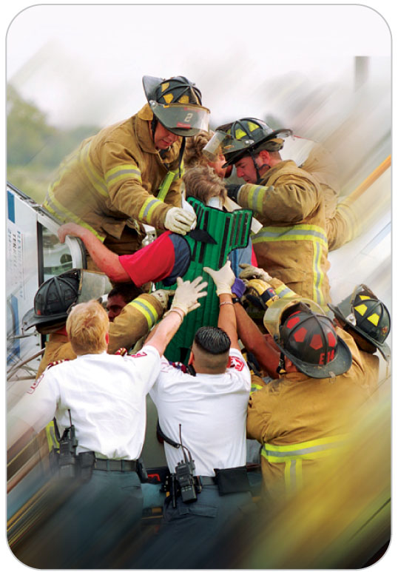
Emergency Medical Technician (EMT-B)
2-2
An Emergency Medical Technician (EMT-B) is an individual who has completed an NHTSA-approved EMT National Standard training course or its equivalent.
EMT courses must meet minimum national training standards.
Consist of a minimum number of hours of didactic and practical instruction as well as clinical experience in an acute care setting
Examples: an emergency department, an ambulance, an intensive care unit

Slide 16
Emergency Medical Technician (EMT-B)
2-2
EMTs function with medical oversight to provide basic life support (BLS) interventions, such as:
Assessing clinical status
Splinting fractures
Administering certain medications
Using an automatic external defibrillator
Performing CPR
Transporting patients to a medical facility

Slide 17
Advanced Emergency Medical Technician
2-2
An Advanced Emergency Medical Technician (AEMT) is a person who has completed an NHTSA-approved AEMT National Standard training course or its equivalent, which includes:
Didactic and practical instruction
Clinical internships in one or more acute care settings
AEMTs function under medical oversight and may perform all of the skills performed by EMTs, as well as other intermediate therapeutic interventions using basic and advanced equipment and medications typically found on an ambulance.
Equipment may vary by county, state, or province.

Slide 18
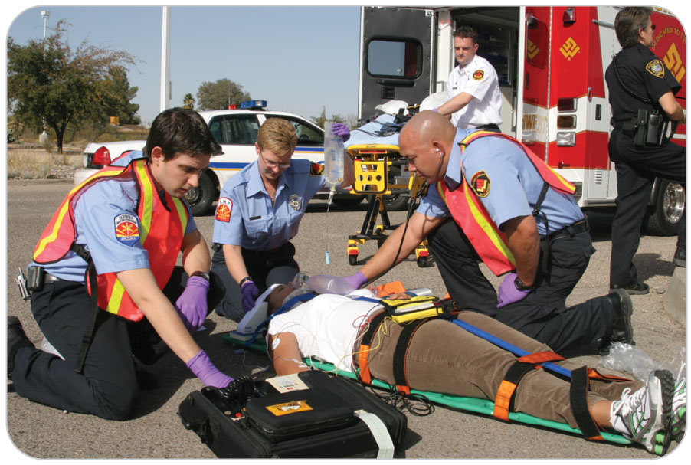
Paramedic (EMT-P)
2-2
A paramedic is an allied health care professional who has successfully completed a NHTSA-approved paramedic course, which includes extensive didactic, practical, and clinical training requirements.
Operates under medical oversight and provides a higher level of prehospital care than all EMTs using a variety of basic and advanced equipment and medications, including narcotics

Slide 19
Emergency Care Systems Tiered Deployment
Most emergency care systems deploy personnel to emergencies using a stratified, or tiered, approach based on the patient’s current condition or anticipated needs.
Tier 1
EMRs arrive quickly at the scene and initiate basic emergency care while awaiting the arrival of higher-level emergency providers.
EMRs (e.g., ski/bike patrols, search-and-rescue teams, wilderness first responders) may transport the patient to a location that is more accessible to rescue vehicles.
Tier 2
EMTs arrive shortly after EMRs and provide BLS measures.
If the situation warrants, EMTs may either await the arrival of advanced life support (ALS) providers or transport the patient to a definitive care facility.

Slide 20
Emergency Care Systems Tiered Deployment
Tier 3
AEMTs and/or paramedics arrive after EMRs/EMTs.
They provide ALS measures and transport the patient to a definitive care facility.
Tier 4
Critical care providers (e.g., critical care paramedics, nurses, physicians) bring to the scene additional ALS equipment, therapies, and interventions that are beyond the traditional paramedic scope of practice.
Transports the patient to a specialized hospital via helicopter, fixed-wing aircraft, critical care ambulance, or other means.

Slide 21
Continuity and Commonality of Emergency Care

Slide 22
Continuity of Care
Continuity of care is the seamless delivery of high-quality emergency medical care that occurs from a patient’s initial contact with an EMR through definitive treatment.
Ideally, from the moment a patient is initially contacted by ski patrollers to discharge from the hospital, the patient receives continuous care from trained medical professionals.
At each transition, the level of medical care provided to the patient increases.
If there is a break in the continuity of care or at any time if the care provided does not follow local practices, the outcome might not be favorable.
Team approach is one of the hallmarks of an effective emergency care system.

Slide 23
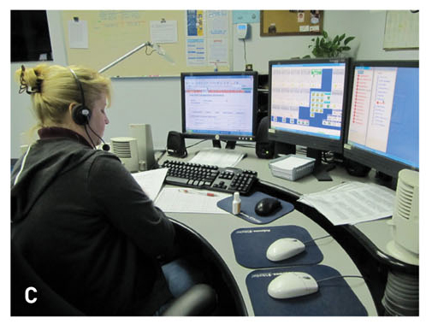
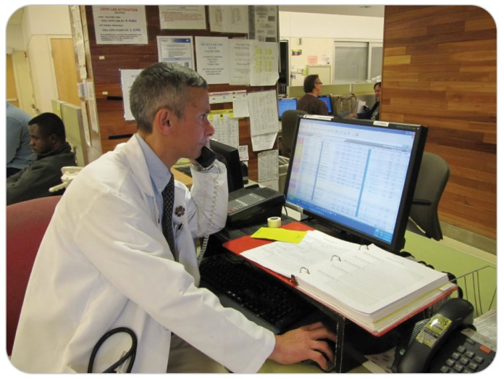
Continuity of Care: Important Roles
The emergency medical dispatcher (EMD) is the person who notifies patrollers and/or other emergency medical providers of possible medical injuries and conditions.
The medical director is a doctor who advises and provides oversight to EMS providers.

Slide 24
Commonality In Emergency Care Systems
Commonality enables rescuers within an emergency care system to:
Focus on the same priorities
Speak the same language
Perform rescue-related activities in a similar fashion, regardless of training level or clinical setting
This approach to teamwork enables rescuers to work together more effectively and to provide the best possible outcome for patients.

Slide 25
Communication Systems in Emergency Care Systems
Communication systems are the vital links that connect all the components of the emergency care system.
A typical EMS communication system consists of:
Hardware (telephones, cell phones, radio equipment, computers)
Software
Specialized professionals who manage these resources
Effective communications improve patient outcomes and are essential for successful rescue operations.

Slide 26
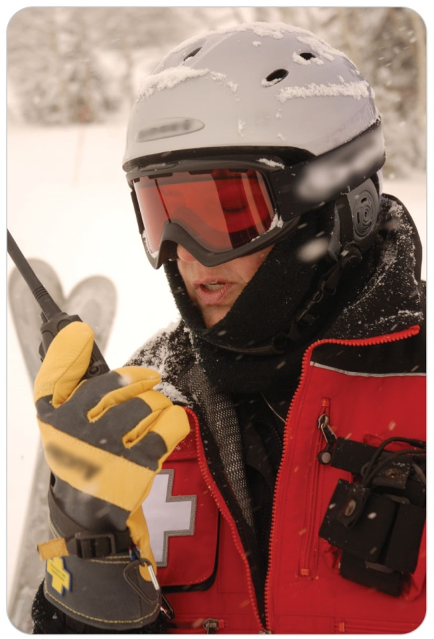
Communication Systems in Emergency Care Systems
OEC technicians communicate with each other and with other members of the emergency care system by various means, including:
Two-way radios
Landline telephones
Cell phones

Slide 27
Medical Oversight in Emergency Care Systems
2-3
A license physician assumes legal responsibility for a patient’s care throughout an emergency.
This medical oversight ensures continuity of care and that the patient receives proper treatment in accordance with local care guidelines.
Two types of medical oversight:
Direct oversight
Indirect oversight
Both types of medical oversight use preestablished medical orders, known as protocols, which have been approved by the local medical authority.

Slide 28
Medical Oversight: Direct
2-3
Direct oversight:
Also known as online medical control
Involves real-time voice contact with a licensed physician who helps guide decisions concerning patient care
Conducted typically via telephone or radio
Also includes the presence of a physician at the scene
Used primarily to oversee the provision of advanced care procedures or medications
Serves as a means by which prehospital providers may consult with a physician to discuss complex cases or to obtain specific clinical, technical, or procedural information

Slide 29
Medical Oversight: Indirect
2-3
Indirect oversight
Uses standing orders (protocols) developed by a local medical authority
Prehospital providers are not required to directly contact a physician before initiating specific treatments.
This form of medical oversight is designed to expedite patient care.
Commonly used for “preauthorizing” both routine procedures, such as:
Oxygen administration
Advanced lifesaving procedures or medications

Slide 30
Emergency Care Protocols
Protocols are written instructions describing what should be done in a given situation.
They serve as guidelines that identify the assessment and treatment considerations for commonly encountered emergencies.
Developed on a local level by emergency care professionals who are familiar with the area’s medical needs, available resources, system capabilities, and local standard of care
In the case of ski/bike patrols, protocols can be developed by the local patrol’s medical director, in concert with management, and may include practices and procedures that are not included in the OEC text.
Should be reviewed annually and revised as needed

Slide 31
Quality Improvement in Emergency Care Systems
2-4
Providing the best patient care possible is a common goal among emergency care personnel.
This goal is best achieved through a quality improvement program.
Quality improvement, often abbreviated QI, is an ongoing process designed to ensure that the products and services provided meet or exceed customer expectations.
It may involve careful examination of each step in the case, from initial entry into the emergency care system through definitive care.
Changes, if needed, will ensure the future care a patient receives is delivered in accordance with local protocols and guidelines.

Slide 32
Case Study

Slide 33
CASE PRESENTATION
You find a woman lying in the snow after a skiing accident. She says she cannot move her legs. After making the scene safe, you rapidly assess her, finding no movement or feeling below the waist. You call dispatch and tell them what you have found.
What is the first thing you and dispatch should do?

Slide 34
CASE UPDATE
The dispatcher activates the emergency care system by calling 9-1-1. He explains that the patient has no movement or feeling below the waist and requests ALS and air transport since there is a probable spinal cord injury. You get additional information from the patient and keep the woman calm and warm while awaiting assistance. You are careful not to move her. Once ski patrollers arrive, they assist you in placing the patient on a long spine board. The patient is transported to an awaiting ambulance crew, who transport the patient to a helicopter zone and then a definitive care facility.
What is your next responsibility?

Slide 35
CASE OUTCOME
The patient survives the spinal cord injury. Your risk manager and medical director discuss the case for educational purposes with the patrollers involved. Care given was exceptional. After much therapy, the patient learns to walk again. She returns a year later, thanking you for getting her to definitive care.

