Slide 1
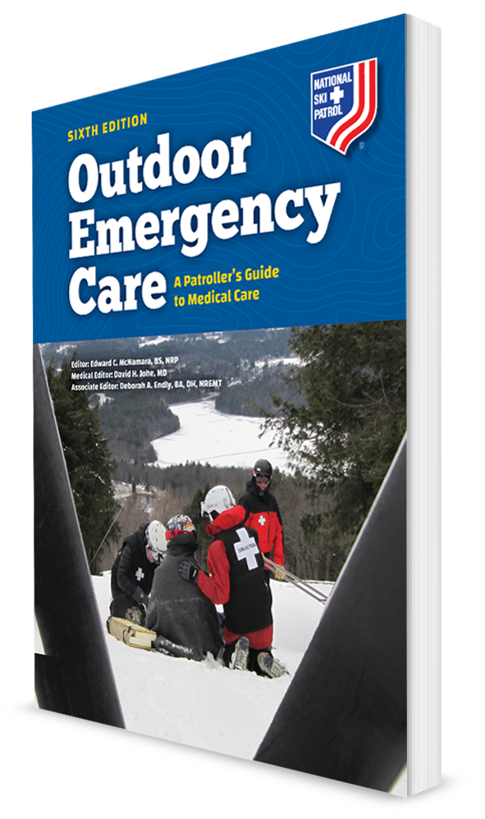
Behavioral Emergencies and Crisis Response
CHAPTER 33

Slide 2
The following presentation will utilize two symbols to identify material necessary for an OEC Technician to comprehend:
key term
Meets a Chapter Objective.
This symbol will have the corresponding Objective Number denoted within.
Identifies a Key Term.
The Key Term will be underlined for easy identification.

Slide 3
Objectives
33-1 Define the following terms:
Behavior
Behavioral emergency
33-2 Describe the main difference between a mood, adjustment, or affective disorder and a psychotic disorder.
33-3 List the signs and symptoms of the common behavioral emergencies.
33-4 Identify ways to maintain rescuer safety when responding to a behavioral emergency.

Slide 4
Objectives
33-5 Describe and demonstrate how to assess a patient with a behavioral emergency.
33-6 Describe and demonstrate the treatment of a patient with a behavioral emergency.
33-7 Define when to restrain a patient.
33-8 Describe and demonstrate how to properly restrain a patient.
33-9 Describe critical incident stress debriefing.

Slide 5
Key Terms
Agitation
Anxiety
Bipolar disorder
Crisis
Depression
Mood, adjustment, or affective disorder
Paranoia
Psychosis
Reasonable force
Schizophrenia
Stress
Suicidal gesture
Suicide

Slide 6
Chapter Overview

Slide 7
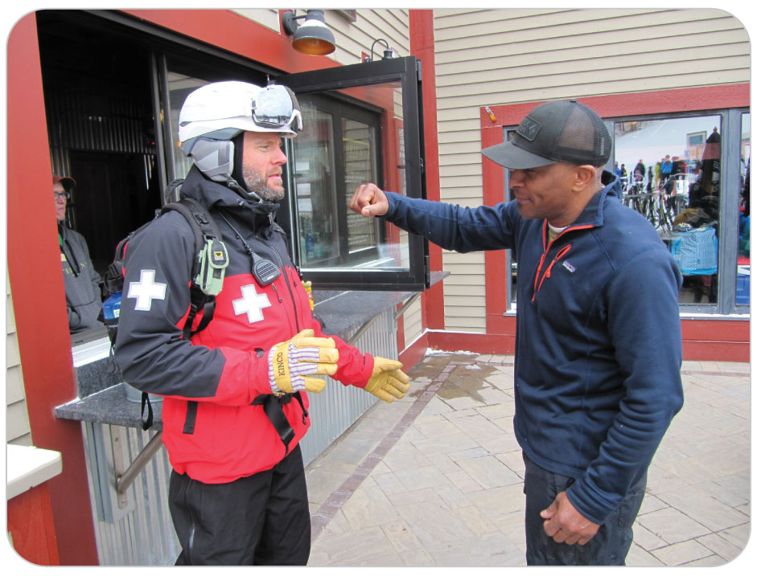
Chapter Overview
OEC Technicians may encounter people who are in crisis, behaving in an unexpected, unusual, or possibly dangerous manner.
May be caused by a variety of conditions ranging from relatively minor to immediately life threatening
Regardless of the cause, scene safety remains your first concern.
Failure to recognize abnormal behavior or an unsafe situation could result in serious injury to you, patient, or others.

Slide 8
Chapter Overview
31-1
Behavior is the way one acts or conducts oneself, especially toward others.
Environment, other relationships, and internal feelings contribute to behavior.
Some behaviors come from underlying emotions, such as laughing, crying, or yelling.
Whether one’s behavior is considered normal or abnormal is subjective and largely depends on social norms, which vary from region to region and from culture to culture.
When a person’s behavior differs from accepted norms, the person’s actions are considered abnormal.
If severe enough, the person is experiencing a behavioral emergency.

Slide 9
Chapter Overview
31-1
A behavioral emergency is a situation in which a person acts in a way that is unacceptable or intolerable to others and may pose a danger to self or others.
Others see the behavioral emergency, but the person does not realize there is problem.
Noted exception: suicidal patients who may call for help for themselves
Key concept is that the behavior must be taken into context within the situation.

Slide 10
Chapter Overview
As an OEC technician, you must carefully approach patients who exhibit abnormal behavior to evaluate them in the circumstances presented.
Underlying cause may be a:
Medical disorder
Chemical disorder
Traumatic disorder
Psychiatric disorder
Important to:
Quickly recognize the existence of a behavioral emergency
Implement effective strategies for safeguarding patient and others
Address any threats to life

Slide 11
Anatomy and Physiology

Slide 12
Stress
Stress is defined as a person’s response to strain, environmental demands, or pressures.
A perceived threat or stress-inducing factor is known as a stressor.
When the body is stressed, the “fight, flight, or stand” system triggers a series of responses.
A small amount of stress may be desirable, beneficial, and even healthy.
Too much stress could impair a person.

Slide 13
Causes of Behavioral Emergencies

Slide 14
Causes: Medical Disorders
The source of a person’s apparent behavioral emergency may be traced to an underlying medical condition.
Whenever you detect an alteration in mental status, always consider potential medical conditions first.
Brain quickly malfunctions when levels of two crucial nutrients become too low:
Oxygen causing hypoxia
Glucose leading to hypoglycemia

Slide 15
Causes: Medical Disorders
Other possible medical causes:
Epilepsy
Seizures
Cardiopulmonary disorders
Hypotension
Dehydration
Electrolyte imbalance
Medication overdose
Illegal drug overdose
Head trauma
Carbon monoxide poisoning

Slide 16
Causes: Chemicals Exposures
The use of mind-altering substances such as alcohol or drugs causes both altered mental status and bizarre behavior.
Alcohol is the most commonly abused substance in the United States.
Individuals who abuse can be depressed, agitated, or even violent.
Many wild plants, berries, and mushrooms can also produce adverse effects
A wide range of symptoms that may invoke bizarre behavior

Slide 17
Causes of Behavioral Emergencies: Trauma
Traumatic brain injuries can cause altered responsiveness and behavioral disorders.
May initially appear to be an underlying psychiatric disorder
Patients with a head injury can present with confusion, irritability, agitation, verbal outbursts, irrational behavior, and personality changes.
Brain hypoxia from hypovolemic shock may cause abnormal behavior, producing many of these same signs and symptoms.
Environmental conditions, including hypothermia and hyperthermia, are also associated with bizarre behavioral changes.

Slide 18
Causes of Behavioral Emergencies: Behavioral
31-2
31-3
A mood, adjustment, or affective disorder is characterized by abnormal behavior in a person who remains firmly in touch with reality.
Anxiety
Depression
Paranoia
Agitation
Bipolar disorder
Sharply contrasts with psychosis, or a psychotic disorder, which is characterized by abnormal behavior and altered perceptions of reality
Often have visual or auditory hallucinations
Can lead the person to engage in dangerous, suicidal, or homicidal behaviors
Generally considered more dangerous due to their increased tendency to exhibit violent behavior

Slide 19
Causes: Mood, Adjustment, or Affective Disorders
31-2
31-3
Previously called neuroses, Mood, Adjustment, and Affective disorders are now defined separately.
People with these commonly seen conditions understand what is real and not real.

Slide 20
Causes: Anxiety
31-3
Anxiety is a feeling of worry, nervousness, or unease, typically about an imminent event or something with an uncertain outcome.
Anxiety is a normal reaction that occurs when one is faced with a stressful situation.
In fact, certain amounts of anxiety can make a person more alert or careful or prompt a person to take purposeful action.

Slide 21
Causes: Anxiety
31-3
Excessive anxiety, however, can result in feelings of impending doom and an inability to function.
Over time, anxiety can lead to clinical depression and other health problems.
Acute episodes may cause panic attacks that often look like heart attacks.
In such cases, a person experiences:
Acute anxiety
Palpitations
Shortness of breath
Chest pain
A sense of impending doom

Slide 22
Causes: Depression
31-3
Depression is defined as having feelings of sadness, worthlessness, hopelessness, or despair, and can interfere with normal living.
Depression is characterized by low self-worth, guilt, loss of interest in once-pleasurable things, sleep or appetite disturbances, and poor concentration.
Most episodes of depression are brief, lasting only a few days.
Severe depression, however, can last for months or even years and can lead to self-destructive behaviors or suicide attempts.

Slide 23
Causes: Paranoia
31-3
Paranoia is a condition in which individuals believe that they are in imminent danger of being harmed (e.g., physically, emotionally, financially) by others who are plotting against them.
Condition is characterized by:
Feelings of deep suspicion
Irrational fear
Severe distrust of others
Delusions
Eccentric behavior
Individuals often believe that they are being unfairly persecuted.
Often associated with other behavioral conditions and can present by itself as a symptom of a deep-rooted psychosis such as schizophrenia

Slide 24
Causes: Agitation
31-3
Agitation is defined as excessive restlessness and increased mental or physical activity.
Can occur suddenly or develop gradually over time
Characterized by irritability, tension, heightened sensitivity, and excessive motion
Causes of agitation are numerous
Sudden development of agitation can be seen in a traumatic brain injury, hypoglycemia, and shock.
When associated with a mental disorder, agitation often precedes more aggressive behavior and is considered a warning sign for impending violence.

Slide 25
Causes: Bipolar Disorder
31-3
Bipolar disorder is a psychiatric disease that has been likened to an emotional rollercoaster.
Formerly known as manic-depressive illness
Characterized by alternating intermittent periods of euphoria, known as mania, and periods of depression
Manic phase: emotional high (e.g., increased excitability, increased energy levels or activity, elevated mood, restlessness, or impulsive behavior)
During this phase, the person can become physically violent or dangerous.
Depression phase: characterized by increased irritability, frustration, feelings of worthlessness, and thoughts of suicide.
People with bipolar disorder can become psychotic if symptoms become extreme.

Slide 26
Causes: Psychotic Disorders
31-2
31-3
Psychotic Disorders
Psychotic individuals can experience anxiety, depression, paranoia, or agitation.
Do not understand the difference between what is real and not real

Slide 27
Causes: Schizophrenia
31-3
Schizophrenia is a complex mental disorder in which a person cannot differentiate between what is real and what is not real.
Characterized by:
Impaired reasoning
Emotional instability
Paranoia
Auditory or visual hallucinations
Delusions
Violent behavior (in many cases)

Slide 28
Causes: Schizophrenia
31-3
Lifelong mental disorder that in many cases can be effectively managed with medication, provided the person continues to take it
People who have schizophrenia and discontinue their medications can pose a danger to themselves and others.
Causes of relapse include use of alcohol, marijuana, and other drugs and exposure to emotional trauma and loss.

Slide 29
Causes: Suicide
31-3
Suicide, the intentional taking of one’s life, is a problem that affects thousands of individuals each year.
Suicidal gesture:
Examples:
Superficial wounds on the body
Have taken pills and then immediately told someone
Such gestures indicate a serious situation.
Psychiatric care is urgently needed.
The patient cannot be left alone or allowed to refuse medical care.

Slide 30
Patient Assessment

Slide 31
Patient Assessment of Behavioral Emergencies
31-4
Maintaining the safety of rescuers and others is of paramount importance.
Rapidly identify potentially dangerous situations and remember that individuals experiencing a behavioral emergency can become violent.
If there is a violent person, it is not always possible to wait until someone arrives on scene.
Always follow your “gut” instinct.
If something doesn’t feel right, it probably isn’t right.
If a weapon is present, do not put yourself in danger by going near patient.
Talking to the person at a distance may defuse the situation.

Slide 32
Patient Assessment
31-4
When approaching a patient who may be having a behavioral emergency, make mental notes about the scene and look for at least two escape routes.
Whenever possible, remain near an escape route, and never let patient get between you and it.
Approach patients from a direction that enables them to see you so that you do not surprise them.
Announce that you are a patroller or an OEC technician and are there to help.
Always attempt to speak to patient at eye level.

Slide 33
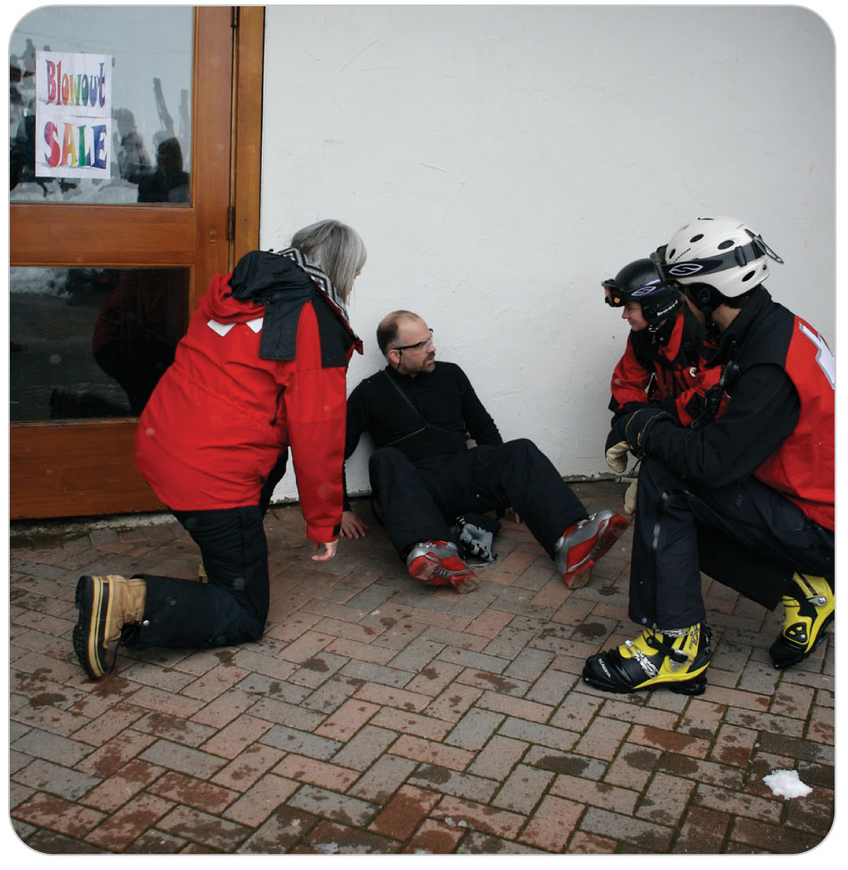
Patient Assessment
31-5
Speak in a normal but firm voice.
Avoid yelling or raising your voice even if patient does not reciprocate.
Maintain a comfortable distance from patients until they have given you permission to approach them.
Avoid sudden movements, which may startle patients and invoke an aggressive or violent response.
Assume that patients could be dangerous, and act accordingly.
If at any time the scene becomes unsafe, evacuate to a safer location and await additional assistance.

Slide 34
Patient Assessment
31-5
If you have a portable communications device, use it to quickly summon any needed help, especially the police if needed.
Some two-way radios are equipped with a distress button that, when activated, alerts others on the same frequency that you are in trouble.
Radio static and loud radio traffic can agitate an emotionally unstable individual.
A high-powered flashlight not only can illuminate the scene but also can temporarily blind a person who is acting aggressively or charging toward you.
Be prepared to quickly drop your equipment or pack and evacuate the scene if it suddenly becomes unsafe.

Slide 35
Patient Assessment
31-5
Situational stressors, such as witnessing the death or injury of a loved one, can cause a person to respond with fear, anger, or grief.
These responses are typical under the circumstances.
Often, as you take control of the situation, patient will begin to calm down.
It is important to keep your emotions under control while you give patients time to gain control of their emotions.
Be honest with patients, explaining what you are going to do before you do it, and continue to observe them for any changes in their behavior.

Slide 36
Patient Assessment: Primary Survey
31-5
The primary patient assessment begins with a rapid evaluation of patient’s ABCDs and checking for severe bleeding.
If patient has been speaking to you, the person’s airway, breathing, and heartbeat (circulation) are not compromised.
If there is an ABCD problem and the scene is safe, correct the problem.
The patient’s condition can change physically.

Slide 37
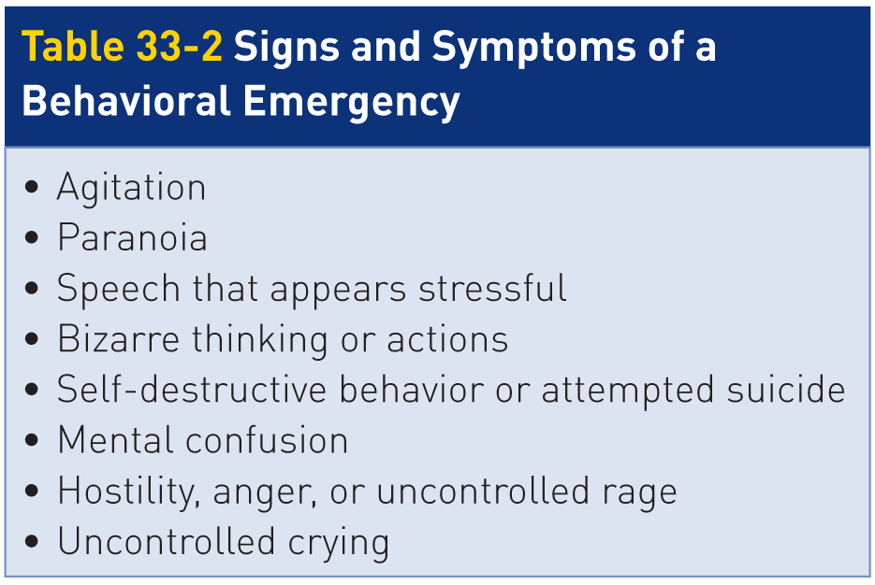
Patient Assessment
31-5
Patients with a behavior-related problem can range from withdrawn and quiet, to agitated and overly talkative, to hostile and threatening.
In some cases, patient is simply “not acting right.”
Behavior may change quickly or slowly, and some changes may not be immediately obvious.

Slide 38
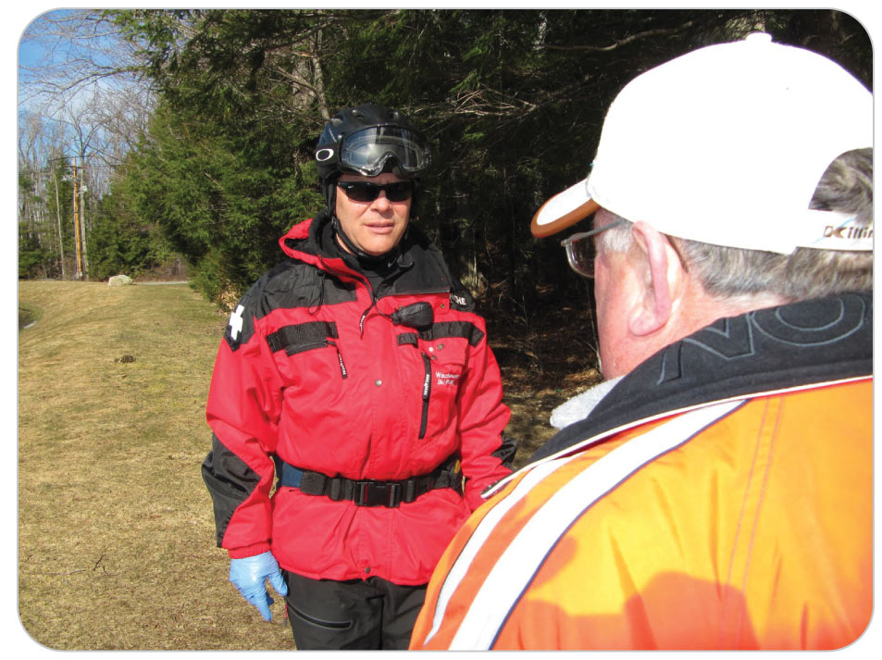
Patient Assessment
31-5
Do NOT attempt to diagnose the underlying cause of a patient’s behavior.
Instead, protect patient from harm.
Determine whether patients are in touch with reality, are suicidal, or are anxious, depressed, or dangerous.

Slide 39
Patient Assessment
31-5
When evaluating a patient who appears to be having a behavioral emergency, it is important to determine if patient is in touch with the real world.
Observe patient’s appearance and overall demeanor.
Individuals who have certain chronic mental diseases, such as schizophrenia, do not function within the normal boundaries of reality.
When in crisis, these individuals are often not oriented to the situation, place, or time and appear confused and disorganized.
They may not even know who they are.
People who have underlying mood or behavioral disorders can also exhibit bizarre behavior, but they generally function within reality.

Slide 40
Patient Assessment
31-5
As patient speaks, listen to both the words and the tone of voice.
Is patient yelling and using obscenities?
Does the person express homicidal or suicidal thoughts?
Is speech fast or slow?
Are the words slurred, pressured (i.e., the speaker can’t get them out fast enough), or threatening?
Does the person raise or lower his or her voice by an octave?
Does the person make sense?
Is patient oriented to time, situation, people, and place?
Does the person appear to be functioning within the realm of reality?

Slide 41
Patient Assessment
31-5
Maintain a safe distance until patient calms and encourage patient to talk.
Calming a patient having a behavioral emergency is essential before performing a secondary assessment.
Explain to patient, in simple terms, what you are doing before assessing them or rendering treatment.
Do not make physical contact at this point because doing so could invoke an aggressive or violent response.
Unless patient requires emergent treatment, proceed without hurrying to avoid upsetting patient.

Slide 42
Patient Assessment
31-5
If patient is yelling, it is imperative that you do not yell, argue, or raise your voice in return because doing so will only increase patient’s level of agitation.
Instead, ask questions in a calm, reassuring voice.
Acknowledge and validate that patient seems upset and repeat that you are there to help.
Continue to encourage patients to discuss what is troubling them.
Listen carefully to what they say, because verbal clues may be subtle.
Demonstrate active listening skills by acknowledging what patient said.
Be honest with patient, but avoid being judgmental, accusatory, or confrontational.
If patient is hallucinating, do not play along.

Slide 43
Patient Assessment: Secondary Survey
31-5
Begin by obtaining a complete SAMPLE history, including:
A history of prior treatment for any medical, traumatic, or mental health disorders that might cause patient’s altered mental status, such as diabetes, epilepsy, or head injury
Look for a medical alert tag.
If history of mental illness, ask patient:
Prescribed medications
If taking those medications as directed
If possible overdosed, gather:
The name of the substance
The quantity ingested
When the ingestion occurred

Slide 44
Patient Assessment: Anxiety and Depression
31-5
Anxiety
A wide range of signs and symptoms that may include fear, apprehension, agitation, crying, and hyperventilation
Depressed
Often withdrawn and relatively quiet
Exhibit apathy toward their appearance, health, or general well-being
Feelings of worthlessness, despair, or profound sadness
May reveal that they have experienced one or more life changes such as the loss of a loved one, the loss of a job, or some other personal tragedy
Other symptoms: a loss of appetite, problems sleeping, or frequent somatic complaints such as headaches or stomachaches

Slide 45
Patient Assessment: Assessing Suicide Risk
31-5
Patients who are chronically depressed frequently take medication to control their depression.
Patients who stop taking their medications or experience more severe depression may begin thinking about suicide.
Briefly assess patient’s suicide risk by noting whether patient exhibits or articulates indications that they could harm themselves.
This is especially important in interacting with individuals who are refusing medical care.
Note the presence of current wounds or old scars, especially over arterial sites such as the wrist, inside the elbow, and neck.
Do not be afraid to ask patient directly, “Are you trying to hurt yourself?”

Slide 46
Patient Assessment: Paranoid
31-5
Patients with paranoid tendencies can be difficult to assess because they are typically suspicious of anyone who attempts to help them.
Some patients may accuse you of attempting to harm them; others may openly seek your protection.
Irrational fears of paranoid patients often lead these patients to refuse a physical examination or the use of medical equipment such as a blood pressure cuff on them.
Paranoid patients who are psychotic may complain of hearing voices that feed their anxieties.

Slide 47
Patient Assessment: Psychotic Disorders
31-5
Patients who have a psychotic disorder such as schizophrenia are among the most difficult behavioral emergency patients to assess, especially if they are concurrently paranoid.
Often have auditory hallucinations of voices that instruct them to harm themselves or others or to engage in bizarre or dangerous activities
Important to ask schizophrenic patients if they have taken their medications as prescribed
Schizophrenic attacks are often precipitated by patient’s noncompliance with their medications.
Patients who appear to be psychotic do not think or act rationally, so reasoning with them can be extremely difficult, if not impossible.
Can also be depressed or anxious or have mania (periods of great excitement and overactivity)

Slide 48
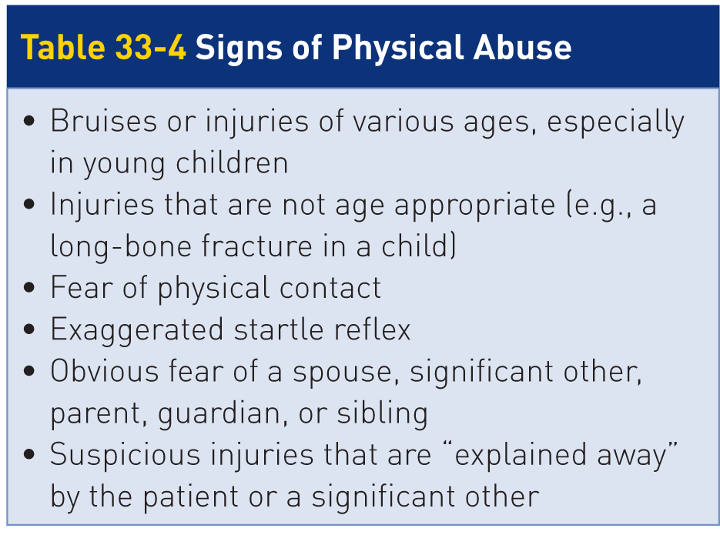
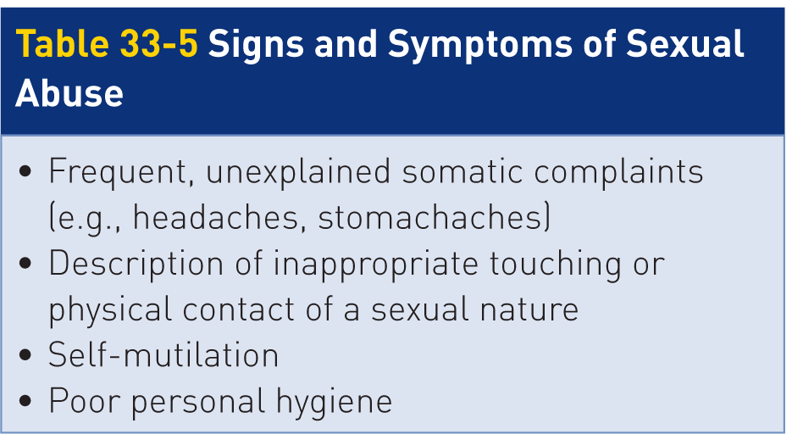
Patient Assessment: Abuse
31-5
Any patient who has been abused, whether only recently or over a long period of time, may exhibit numerous behavior-related signs and symptoms.
Abuse is a crime that, if suspected, must usually be reported to those who will be caring for patient and to law enforcement officials.
Abuse should be suspected whenever any tell-tale signs or symptoms are present.

Slide 49
Patient Assessment
31-5
Complete the secondary patient assessment as you would for any patient, using the OPQRST and DCAP-BTLS mnemonics, noting all pertinent signs or symptoms and documenting them on patient care report.
Obtain a complete set of vital signs and monitor them frequently, especially if patient has ingested any drugs or alcohol.
Continue to treat patients in a dignified, caring manner, regardless of their appearance, attitude, or behavior, and document all assessment findings on patient care report.
Be ready to protect yourself if you detect even the possibility of aggressive or violent behavior.

Slide 50
Management

Slide 51
Management of Behavioral Emergencies
31-4
31-6
Make sure the scene is safe.
As with any patient, treatment begins by correcting any potential threats to life, including any external hemorrhage resulting from self-inflicted wounds.
Until proven otherwise, assume that patient’s abnormal behavior results from an underlying medical condition.
Treatment of patients having a behavioral emergency is both preventive and supportive.
Prevention efforts center on keeping patients safe.
Away from hazards or potential weapons
Preventing them from harming themselves or others

Slide 52
Management of Behavioral Emergencies
31-4
31-6
Continue to calm and reassure the patient as you provide treatment.
Be empathetic to patient’s feelings.
Redirect patient’s attention as needed to reduce anxiety, paranoia, or suicidal thoughts.
Special patient situations warrant additional help in the form of additional patrollers, area management, and (if appropriate) security or police.
Call EMS early and, if needed, ALS for drug intervention to assist patients with severe symptoms.

Slide 53
Management: Restraint Considerations
31-6
31-7
Consider restraining patients who exhibit violent behavior or present a danger to themselves or others, following all local protocols and procedures.
Especially psychotic patients
Provide supportive care as needed and transport patient to the nearest definitive-care facility for further evaluation and ongoing treatment.
Carefully document patient encounter on patient care report, including patient’s behavior and response to treatment.
Use direct quotes as appropriate to convey patient’s feelings.

Slide 54
Management: Restraints
31-7
Physical restraint is needed when a patient poses an imminent threat of violence.
Restraint is a process that restricts a patient’s normal movement.
Goal: to prevent patient from harming self or others
Two forms of restraint:
Physical restraint, which involves directly holding on to a patient
Mechanical restraint, which involves the use of equipment such as a flexible band, strap, or cuff
Only patients who are clearly demonstrating an imminent danger to themselves or others should be restrained.
It is best to seek patient’s cooperation to avoid the need for restraint.

Slide 55
Management: Restraints
31-7
Restraints are warranted when there is no alternative but to protect the safety of patient, the rescuers, and bystanders.
Most common indication is a violent psychotic patient.
It is always best to ask for the assistance of area security or law enforcement personnel.
Have them restrain or isolate the individual.
Both for your safety and for the safety of others
When a patient is violent, it is best not to enter the scene and to wait for police.

Slide 56
Management: Restraining by Law Enforcement
31-8
Restraining a patient, if necessary, is always best done by law enforcement officials.
Law enforcement personnel can restrain anyone if they have probable cause.
Not true for medical personnel
In many states, EMS personnel have protocols to physically and chemically restrain patients.
Tenet is to use only reasonable force, the minimum amount of force required to keep patient from hurting self or others.
Be familiar with local protocols regarding the use of restraints and the procedures for restraining a combative patient.

Slide 57
Management: Keys to Restraining a Patient
31-8
Ideally, a minimum of five people is required to safely restrain a patient:
One person to hold each extremity and one person to hold patient’s head in neutral alignment
If patient must be mechanically restrained, a sixth person is needed to apply the mechanical restraints.
Patient and/or the rescuers are more likely to be injured when too few personnel are available to properly restrain a patient.
A team leader should be designated, and that leader should brief all personnel involved on their respective roles.

Slide 58
Management: Keys to Restraining a Patient
31-8
Once a plan is established, the team should move into position upon receiving a preestablished signal.
A simple show of force will often prompt a patient to submit peacefully.
The team leader should always attempt to seek patient’s cooperation and consent to treatment.

Slide 59
Management: Keys to Restraining a Patient
31-7
31-8
If patient remains noncompliant, then it becomes necessary to restrain patient.
Throughout the restraining process, continue to talk to patient, providing instructions in a firm voice.
Be polite always.
Use statements such as, “Sir, please stop fighting us,” “We are here to help you,” and “Please lie down.”
Once patient is physically restrained, use only enough force to keep patient submissive.
Any additional force may be considered excessive.

Slide 60
Management: A Restrained Patient
31-8
Patients should be placed supine on a backboard to facilitate safe transport and the monitoring of vital signs.
Exact method by which you mechanically restrain a patient should be consistent with local protocol as approved by your medical director.
In one widely accepted technique, one of patient’s arms is secured to the board above patient’s head to prevent patient from sitting up.
Patient’s other arm should be extended alongside the torso and tied to the board.

Slide 61
Management: A Restrained Patient
31-8
The legs, too, should be securely tied to the lower end of the board while remaining a neutral alignment.
Additional straps may be secured across patient’s hips and chest to further increase restraint.
Be ready to tip the board on its side should the patient vomit.
Never stick your finger in a restrained patient’s mouth.
Additionally, never restrain a patient in a prone position because death can result due to asphyxia.

Slide 62
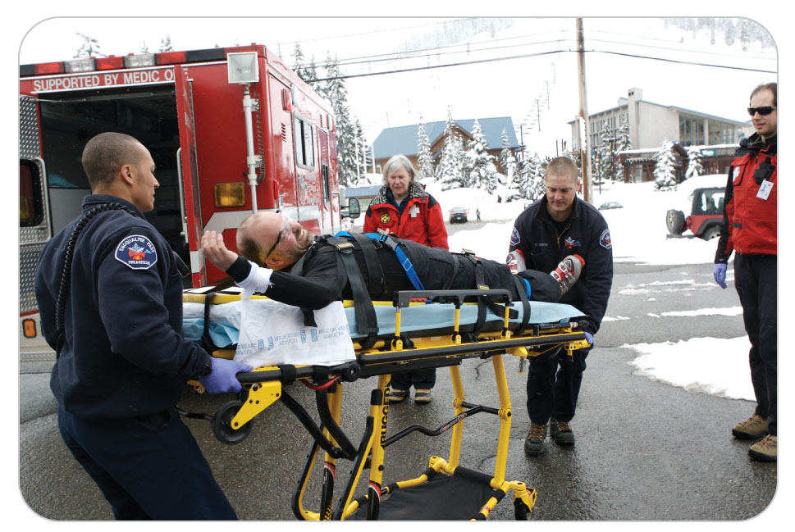
Management: Further Care for a Restrained Patient
31-8
Under most circumstances, any patient who required physical restraint to be brought under control should be mechanically restrained until examined by a physician.
Handcuffs may be used only by law enforcement personnel, who should physically accompany patient to the hospital.
Restrained patients often try to persuade medical personnel to remove the restraints.

Slide 63
Management: Documentation of a Restrained Patient
Be sure to provide thorough documentation of both patient’s behavior before, during, and after the application of restraints and your reasons for using restraints.
Documentation should also include what efforts were taken to avoid restraining patient, the restraint method(s) used, the total time patient was restrained, and all ongoing CMS exams.

Slide 64
Management: Reporting Abuse
Mandatory Reporting
You may be required to report abuse of a child, elder, or any person who is in immediate danger of being further harmed.
Check with your management and go by what your state or provincial laws mandate.

Slide 65
Management: Critical Incident Stress
31-9
As an OEC technician, you are not immune to the emotional and psychological consequences of managing ill or injured patients and witnessing death.
Consequences may be either short lived or long term.
Rescuers and others involved in extraordinary circumstances can be adversely affected by such encounters and can suffer a variety of symptoms of PTSD, including:
Difficulty concentrating
Inability to sleep
Repeatedly replaying the incident
Headache
Gastrointestinal abnormalities
Profound sadness
Depression

Slide 66
Management: Critical Incident Stress
31-9
Professional help is available to rescuers who may need assistance in working through the aftermath of a traumatic incident.
Many agencies have formal agreements with a local critical incident stress management (CISM) team created for this very purpose.
If you find yourself disturbed by an incident, seek assistance.
A critical incident stress debriefing (CISD) brings OEC technicians and a trained professional together to talk about the rescuers’ feelings.
CISD may help OEC technicians understand the signs and symptoms of stress and receive reassurance and coping techniques from a trained professional.

Slide 67
Case Study

Slide 68
CASE PRESENTATION
You receive a call to respond to a person “having an anxiety attack.” Upon your arrival, you find a visibly upset male who appears to be in his 40s sitting on a bench along one of the area’s popular trails. The man, who is wild-eyed and appears to be anxious, is yelling at a nearby female, who identifies herself as the man’s wife. Upon identifying yourself, the man yells angrily at you to “Get away or I’m going to punch you!” while repeatedly clenching and unclenching his fists.
What should you do?

Slide 69
CASE UPDATE
Your immediate concern is for your own safety and for that of others near the irate man. As other OEC technicians clear bystanders from the scene, you attempt to defuse the situation using a calm and caring tone. You assure the man that you are there to help him. Within a few minutes, he begins to settle down, and then he starts to cry.
After obtaining his permission, you carefully approach the man in a nonthreatening manner. As you begin to build trust, you learn that patient’s brother died 1 year ago today. The man and his wife were hiking up to the top of their brother’s favorite ridge, where they planned to release his ashes into the wind. Today is patient’s first time hiking in over 5 years. He is still upset and repeatedly says, “I can’t believe that he’s gone.”

Slide 70
CASE UPDATE
Patient is now breathing deep and hard and continues to cry intermittently, but he is alert and oriented to place, date, and time. During your assessment, you learn that patient has not eaten since last night, and that he never eats breakfast. Patient is not diabetic.
It is now midday. With prompting, you get patient to agree to eat an energy bar while you continue your assessment. He denies chest pain. He complains that his lips and hands are tingling and that he feels like he may “pass out.” The physical assessment is unremarkable for obvious trauma, although patient’s fingers are now tightly contorted. He begins to become agitated because he cannot open his hands. He denies that this has ever happened before or having used any mind-altering substances. He agrees to let you take his vital signs. His heart rate is 108 beats per minute, his blood pressure is 126/72 mm Hg, and his respiratory rate is 26 breaths per minute. His skin is somewhat sweaty and warm to the touch.
What should you do now?

Slide 71
CASE OUTCOME
You try to calm patient by having him breathe in a slow, controlled fashion. After several minutes, he calms down and stops crying. Shortly thereafter, the tingling subsides, so he now has full use of his hands and no longer feels faint. He drinks a bottled sports drink from his backpack. Embarrassed, he tells you that he has been very stressed since his older brother died, and he thanks you for your kindness. You and another OEC technician accompany patient and his wife to the top of the ridge, which is only a quarter mile away. From a respectful distance, you watch as the pair open an urn and throw ashes off the ridge. As the two hug each other, you smile, knowing that the healing process has begun.
This behavioral emergency was likely brought on by the combination of anxiety and grief. The techniques used to manage patient and his behavior enabled the OEC technician to determine it was not a medical emergency and deescalate what could have been a potentially difficult situation.

Slide 72
OEC Skill Activities

Slide 73
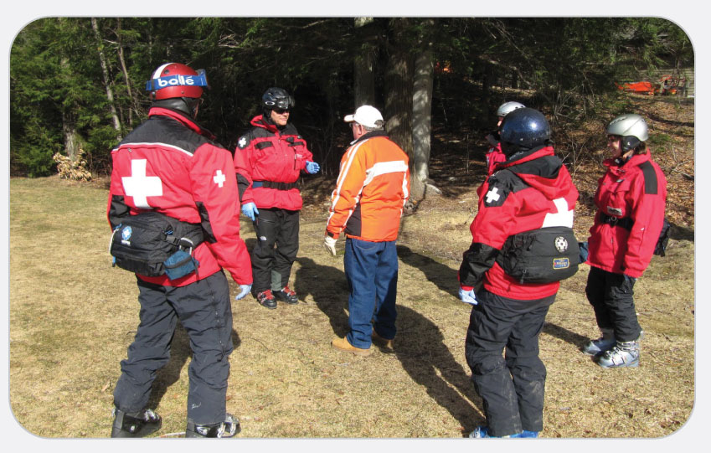
OEC Skill 33-1: Physical/Mechanical Restraint of a Patient
1. Make a plan involving all the rescuers and then have one person speak calmly with patient.

Slide 74
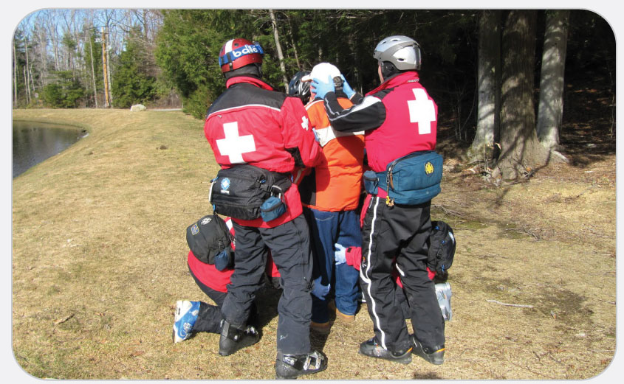
OEC Skill 33-1: Physical/Mechanical Restraint of a Patient
2. The team moves into position upon receiving a preestablished signal. Each member of the team should restrain either a single limb or the head.

Slide 75
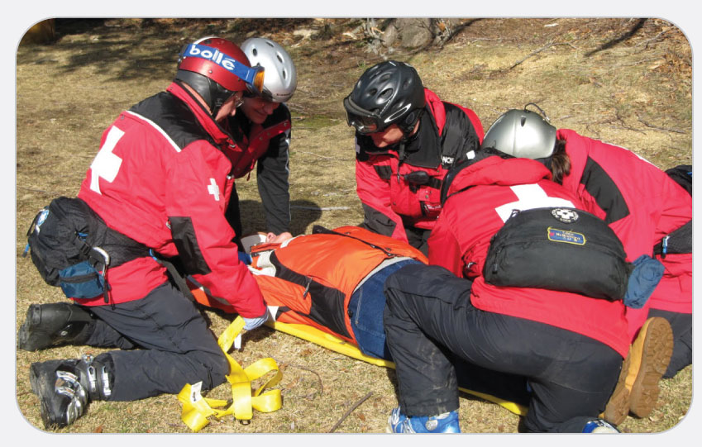
OEC Skill 33-1: Physical/Mechanical Restraint of a Patient
3. Firmly support patient as you lower the person to the ground or onto a backboard.

Slide 76
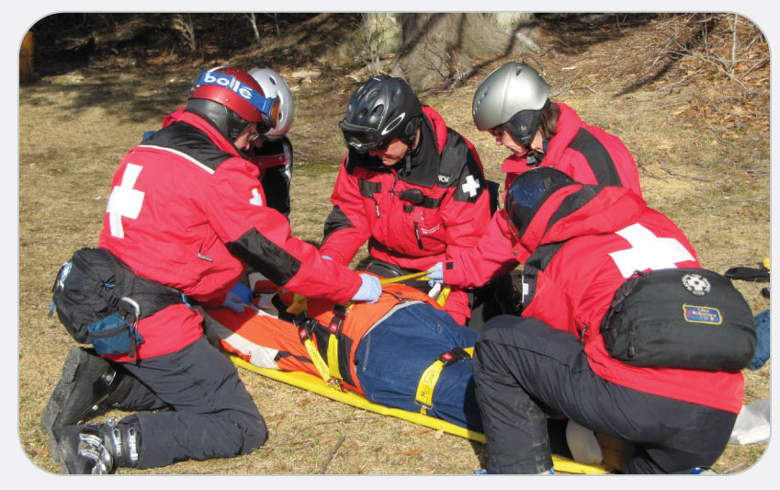
OEC Skill 33-1: Physical/Mechanical Restraint of a Patient
4. Secure patient with the right arm over the head and the left arm along the torso.

Slide 77
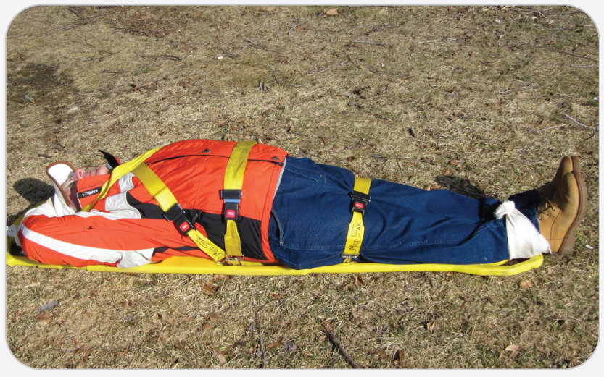
OEC Skill 33-1: Physical/Mechanical Restraint of a Patient
5. Tie patient down completely, using as many straps as needed; be prepared to tilt the board if patient should vomit.

