Slide 1
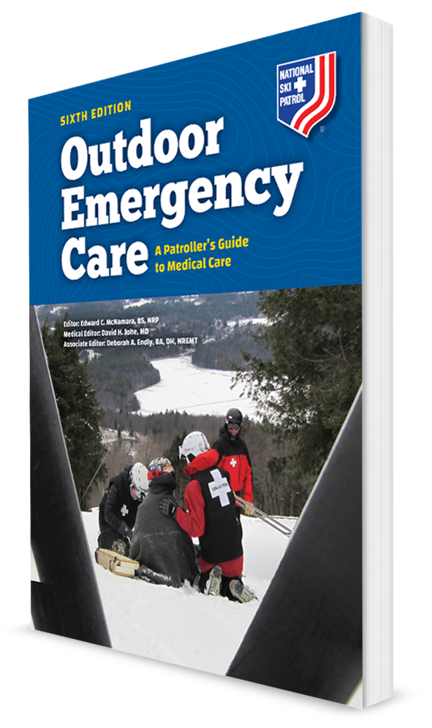
Special Operations and Ambulance Operations
CHAPTER 34

Slide 2
The following presentation will utilize two symbols to identify material necessary for an OEC Technician to comprehend:
key term
Meets a Chapter Objective.
This symbol will have the corresponding Objective Number denoted within.
Identifies a Key Term.
The Key Term will be underlined for easy identification.

Slide 3
Objectives
34-1 Define special operations.
34-2 List several activities that are classified as special operations.
34-3 Describe one disaster response agency that OEC technicians are encouraged to join.
34-4 Explain the meaning of “try before you pry.”
34-5 List the words that make up the term HAZWOPER.
34-6 Identify the purpose of the NFPA hazard identification system.
34-7 List and describe the three hazard control zones.

Slide 4
Objectives
34-8 Describe the purpose of and the mechanism of action for the contents of a nerve agent antidote kit.
34-9 Describe and demonstrate how to properly self-administer the contents of a nerve agent antidote kit.
34-10 Describe the actions you should take in the event of an active shooter.
34-11 Describe what a Recco system is.
34-12 Name three of the four functions of avalanche rescue.
34-13 Describe what the term “silence is golden” refers to in SAR response.
34-14 Describe crew resource management.

Slide 5
Key Terms
CBRNE
Cold Zone
Crew resource management (CRM)
Extrication
HAZWOPER
High-angle rescue (HAR)
Hot zone
Low-angle rescue (LAR)
Rescue
Search
Special Operations
Terrorism
Warm Zone

Slide 6
Chapter Overview

Slide 7
Chapter Overview
34-1
Despite their rigorous training, OEC technicians occasionally encounter incidents that exceed the scope of their education and expertise.
This chapter provides an overview of the special operations situations in which OEC technicians are most likely to become involved: natural and human-caused disasters, hazardous materials (hazmat) incidents, and searches.
Special Operations is defined as infrequently performed activities requiring specialized education and equipment in remote and/or difficult settings.

Slide 8
Chapter Overview
Other topics covered in this chapter are community-based emergency response groups, rope rescues, terrorism, and basic fire ground operations.
This chapter covers indications for and the self-administration of nerve agent auto-injectors.
OEC technicians are encouraged to obtain additional training to meet the needs of their respective resort areas and communities.
Being aware of the information in this chapter is required for achieving emergency first-responder status.

Slide 9
Disaster Response

Slide 10
Ambulance Operations
34-4
As a rule, experts recommend that rescuers “try before you pry”—that is, check all the vehicle’s doors before attempting a forcible entry to reach and extricate a patient.
Extrication is the process of removing a trapped person.

Slide 11
Disaster Response
34-2
Most Multiple Casualty Incidents (MCIs) can be managed using local resources or by enlisting the assistance of resources from the surrounding areas.
When an incident becomes so large that outside resources are needed, the situation is considered a disaster.
Disasters often have serious consequences.
The key to effective disaster management is preparedness.

Slide 12
Disaster Response
34-2
Disasters are typically grouped into two broad categories:
Natural disasters
Floods, tornados, hurricanes, wildland fires, and earthquakes
Human-caused disasters
Unintentional
Failure of an electrical power grid, an explosion at a power plant requiring mass evacuation of the local population, or a fire in a warehouse
Intentional
Often due to an act of terrorism and are typically classified by the substance involved
Use the mnemonic CBRNE which represents Chemical, Biological, Radiological, Nuclear, and Explosive.
Terrorism is a human-caused event that is intended to inflict fear and can involve hazardous materials.

Slide 13
Disaster Response
34-2
Organized disaster teams have specific tasks and procedures that typically require specialized training.
Trained individuals who are not part of this organized system often want to volunteer to help in the response to disasters.
The presence of unofficial disaster responders can impede the overall mission.

Slide 14
Disaster Response: National Response Framework
34-2
National Response Framework (NRF) provides guidelines for the all-hazards response to any incident within the United States.
Developed by the Department of Homeland Security
Identifies the key principles to the response
Delineates the responsibilities of all entities that may participate in the response
NRF is supported by five principles:
Engaged partnerships
A tiered response
Scalable operational capabilities
A unified command
Readiness to act

Slide 15
Disaster Response: National Disaster Medical System
34-2
National Disaster Medical System (NDMS) has three primary components:
Medical response to a disaster
Movement of patients from a disaster site to an unaffected area
Definitive medical care at participating hospitals in unaffected areas

Slide 16
Disaster Response: Disaster Medical Assistance Teams
Disaster Medical Assistance Teams (DMATs) are responsible for the medical aspects of disaster response.
DMATs are trained to deploy to disaster sites and are equipped with supplies to be self-sustainable for 72 hours.
Each team consists of physicians, nurses, paramedics, pharmacists, mental health professionals, communication specialists, logistics specialists, and administrative support personnel.
Members are employed part-time by DHHS and dedicate a portion of their professional time to disaster response.

Slide 17
Disaster Response
34-3
Although a fully deployed team typically consists of 35 members, the team may also deploy in five-member strike teams.
DMATs can set up and run a self-supporting field hospital.
May also supplement local health care resources by providing staff at first-aid stations and/or within hospitals
Given their expertise in providing emergency care in outdoor settings, OEC technicians are encouraged to join a DMAT.

Slide 18
Disaster Response: Medical Reserve Corps
34-3
On a national level, Medical Reserve Corps (MRC) are organized through the Readiness Division, Office of Emergency Management and Medical Operations, of the DHHS.
At the unit level, MRCs are community based and composed of volunteer medical professionals who have agreed to help in the event of a disaster.
MRC team members are required to complete basic disaster training and maintain a minimum set of credentials.
Many given specific goals for strengthening the national public-health infrastructure
OEC technicians are encouraged to join their local or regional MRC.

Slide 19
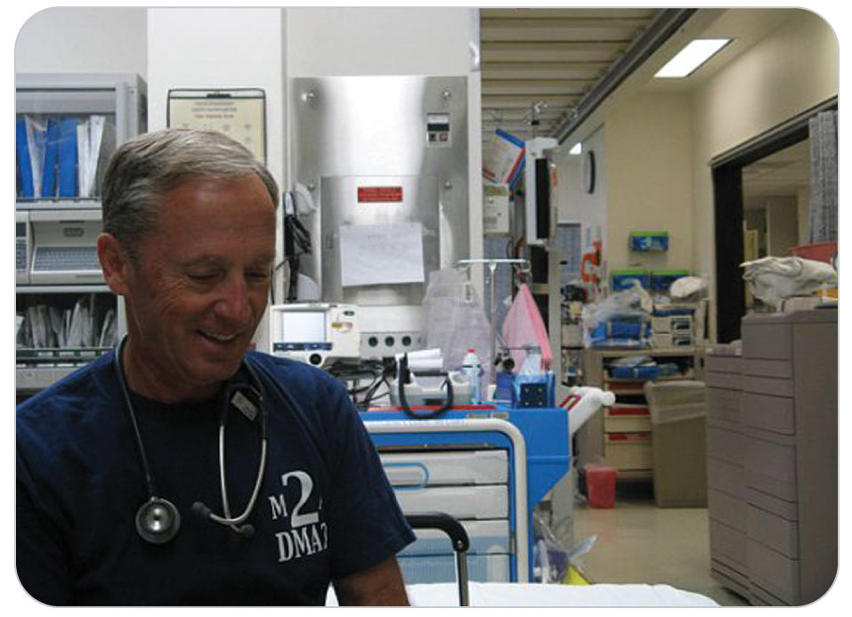
Disaster Response: Community Emergency Response Team
34-3
Each local community needs citizens trained in basic disaster response, and these needs extend well beyond medical care.
Communities affected by disasters need assistance with evacuation, search and rescue, fire suppression, communications, and other forms of basic assistance.
CERT is designed specifically for this purpose.

Slide 20
Disaster Response: CERT
34-3
Composed of local volunteers
Members receive basic training in emergency response, search and rescue, and other topics specifically related to disaster management.
Federal CERT program and the NSP have been working together for several years to encourage patrollers to join their local CERT teams.
The NSP encourages participation in local MRC or CERT.

Slide 21
Hazardous Materials Response

Slide 22
Hazardous Materials Response
34-2
A hazardous material is any substance that, because of its quantity, concentration, or physical or chemical characteristics, is capable of harming people, property, or the environment.
Can be solids, gas, or liquids
Control of hazardous materials under the authority of the US Department of Transportation

Slide 23
Hazardous Materials Response
34-6
Uses an international hazard classification system to distinguish the following nine classes of hazardous materials:
Class 1: Explosives
Class 2: Gases
Class 3: Flammable liquids (and combustible liquids in the United States)
Class 4: Flammable solids, spontaneously combustible materials, and dangerous-when-wet materials/water reactive substances
Class 5: Oxidizers and organic peroxides
Class 6: Toxic substances and infectious substances
Class 7: Radioactive substances
Class 8: Corrosive substances
Class 9: Miscellaneous hazardous materials/ products, substances, or organisms

Slide 24
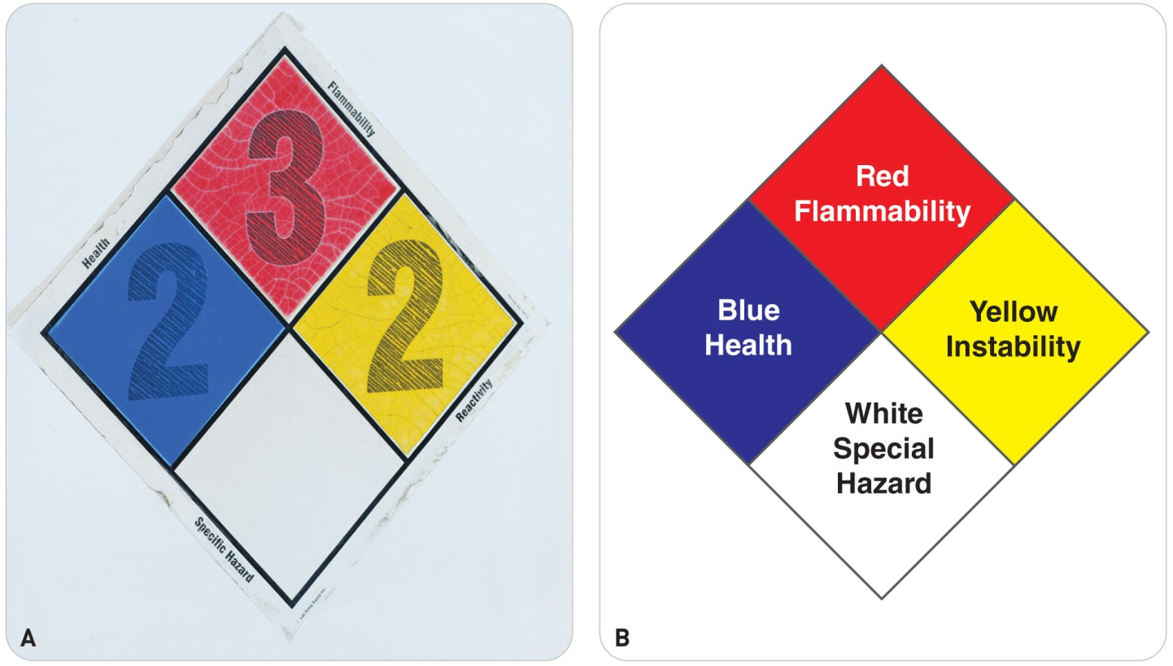
Hazardous Materials Response
34-6
Each hazardous material that is in transit must be identified by a specific placard.
Required by the DOT and the National Fire Protection Association (NFPA)
NFPA safety diamond
Diamond-shaped placard
Contains four smaller, color-coded diamond-shaped fields
Each of which identifies the known hazards for a given material:
Flammability (red)
Health hazard (blue)
Chemical reactivity (yellow)
Special precautions (white)

Slide 25
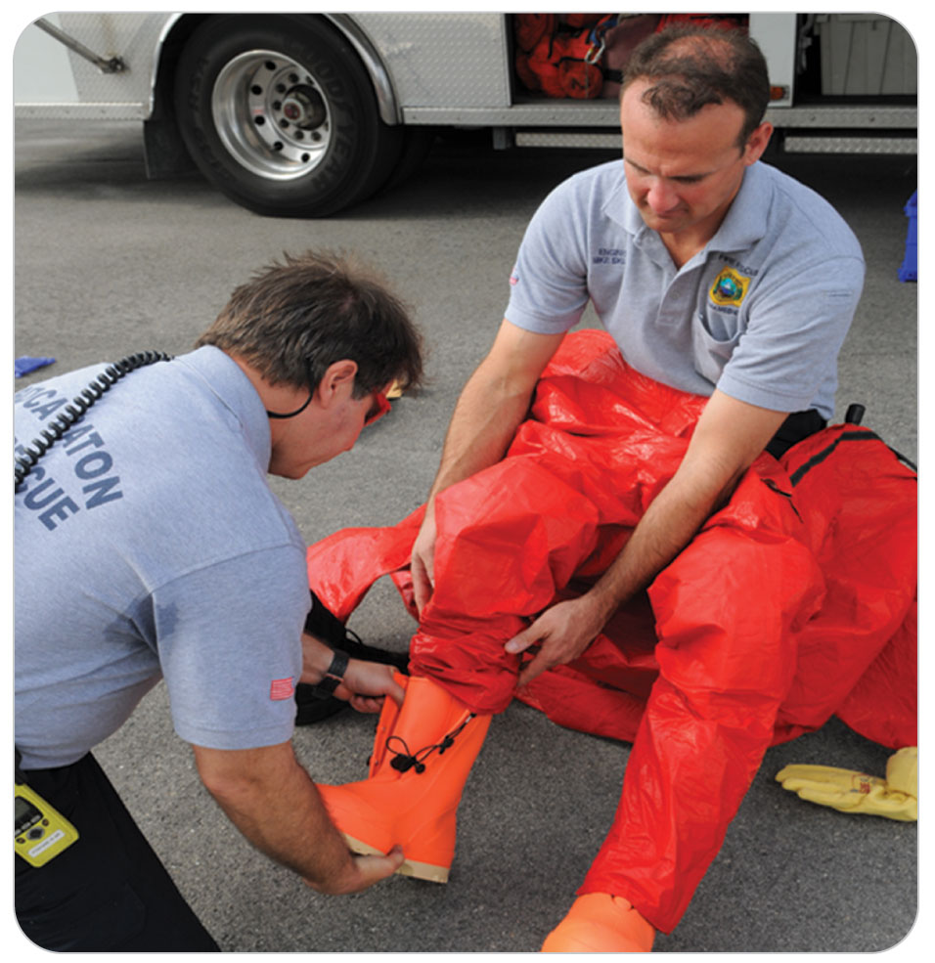
Hazardous Materials Response
34-2
Hazmat incidents are managed using the Incident Command System.
Hazmat safety officer:
Reports directly to an incident commander
Ensures the safety of personnel responding to the incident.
The Hazmat ICS operations branch includes a hazmat entry team, with backup decontamination personnel, and medical sector personnel.

Slide 26
Hazardous Materials Response
34-2
Most hazmat incidents in the United States are unintentional.
An intentional hazmat incident is considered an act of terrorism.
Management of a hazmat terrorist event also utilizes the ICS structure.
Also fall under the jurisdiction of the federal government as all terrorist events are considered criminal acts

Slide 27
Hazardous Materials Response: HAZWOPER
34-5
The response to and decontamination of a hazmat site are conducted in accordance with Occupational Safety and Health Administration standards.
Standards are referred to as HAZWOPER.
HAZardous Waste Operations and Emergency Response
Federal government mandates HAZWOPER training for any worker in an environment in which uncontrolled hazardous materials may be encountered.

Slide 28
Hazardous Materials Response: HAZWOPER Training
Typical training covers:
The types of hazardous materials present and their associated risks
Recognition of hazardous materials
Procedures relating to hazmat response, PPE, and containment and decontamination
Training requirements generally include classroom and practical training, formal certification, and annual refresher training.

Slide 29
Hazardous Materials Response: Management
34-7
Initial management of a hazmat incident:
Prevent members of the public from contacting the hazardous material by establishing an isolation perimeter to prevent their entry.
Isolation Perimeter:
Boundary may be established by placing traffic cones at street intersections or by stringing barrier tape around buildings.
Emergency responders may need to enforce the boundary with their physical presence.

Slide 30
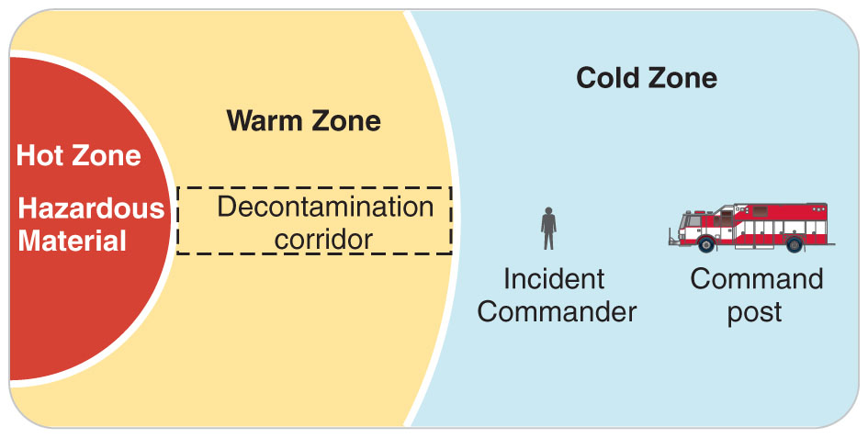
Hazardous Materials Response: Hazard-Control Zones
34-7
The next step is to establish three hazard-control zones, which establish the working areas of the incident.
Hot Zone:
Zone surrounding the incident
The most dangerous and the most contaminated
Only personnel with training in decontamination techniques are permitted to enter this zone.
Designated for personnel with specialized training and equipment

Slide 31
Hazardous Materials Response: Hazard-Control Zones
34-7
Warm Zone
Surrounds the hot zone
A transition zone in which decontamination occurs
Cold Zone
Outer zone
Part of the incident area that contains support personnel and equipment
Considered safe to operate in this zone without specialized protective equipment
Once a patient has been removed from the hot zone and has been decontaminated in the warm zone, medical treatment can begin in the cold zone.

Slide 32
Hazardous Materials Response: Nerve Agent
34-8
At times, a member of the incident response team will require treatment due to exposure to a hazardous material.
Potential hazard is organophosphate (nerve agent) poisoning.
Organophosphates cause excessive pulmonary secretions that can lead to respiratory failure.
Signs and symptoms of organophosphate poisoning can be remembered using the acronym DUMBELS or SLUDGEM.
Treatment for poisoning is by ALS providers.
Treatment for exposure in mass-casualty settings is self-administration of a nerve agent antidote kit.
Two common kits are the Mark I kit and the DuoDote kit.

Slide 33
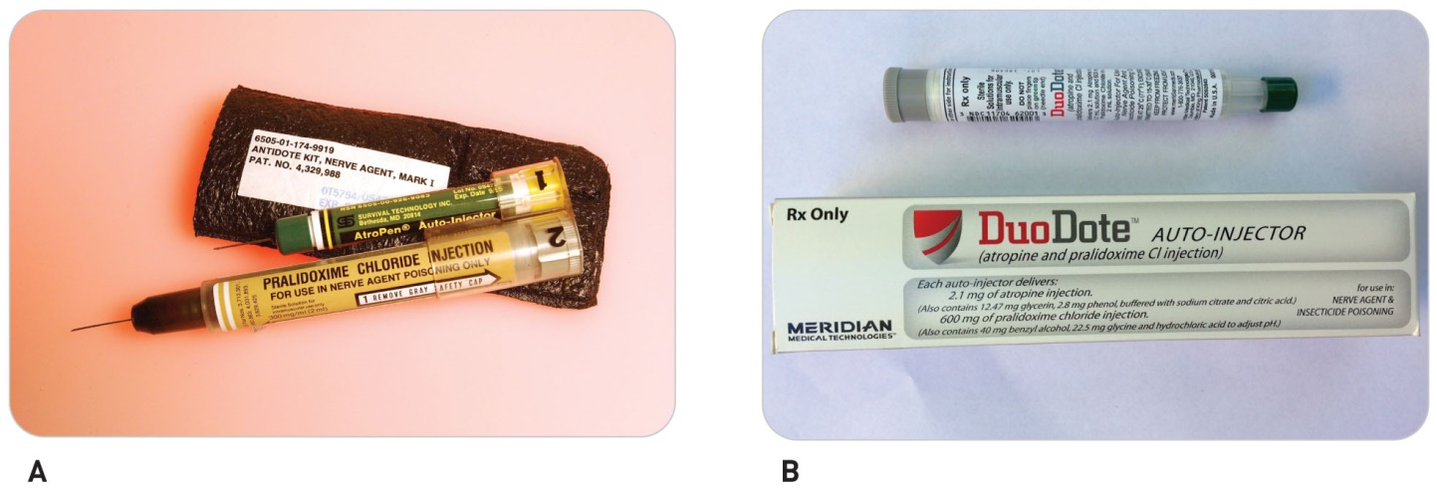
Hazardous Materials Response: Treatment of a Nerve Agent
34-8
If you have been exposed to a chemical nerve agent, you may need to self-administer a nerve agent antidote.
Administration of the antidote kit can be lifesaving.
Each kit contains two medications: atropine and pralidoxime chloride (2-PAM Cl).
Mark I kit is two auto-injectors.
DuoDote kit is a single auto-injector.

Slide 34
Hazardous Materials Response: Mechanism of Action
34-8
Mechanism of Action of Nerve Agents
Nervous system controls bodily functions by secreting various chemical transmitters, which act as “instructions” to nerves, muscles, and glands.
Neurologic instructions are of two types: those that stimulate activity by muscles and glands and those that signal inactivity in those structures.
The presence of a nerve agent interferes with the normal instructions of chemical transmitters in a way that overstimulates the nerve endings, so muscles and certain glands overreact.

Slide 35
Hazardous Materials Response: Mechanism of Action
34-8
Results are:
Excessive salivation
Tearing
Airway secretions
Respiratory distress
Depressed mental status
Initial treatment for a nerve agent exposure consists of a two-part antidote:
Atropine (to dry up secretions)
2-pam Cl (to reverse the action of the nerve agent)

Slide 36
Hazardous Materials Response: Dosing Nerve Agent
34-9
Recommended Dosing Schedules for Exposure to a Nerve Agent
If you have been exposed to a nerve agent and have mild symptoms, self-administer one kit containing both drugs.
If excessive salivation and mental status changes become present, self-administer two atropine auto-injectors and one 2-PAM Cl injector.

Slide 37
Hazardous Materials Response
34-9
In assisting with a patient who has been exposed:
Start by ensuring that you have on the correct PPE.
Then remove secretions (using suction if necessary).
Maintain the patient’s airway.
Need for PPE is necessary even if the patient has been removed to a safe zone.
It protects you from off-gassing from the nerve agent.
Off-gassing is the release of airborne particulates or chemicals.
If severe signs and symptoms are present, the EMS providers will administer:
Three atropine auto-injectors
Three 2-PAM Cl injectors in rapid succession

Slide 38
Hazardous Materials Response
34-9
Medications are administered in a similar manner as used for an EpiPen.
Follow the directions on the nerve agent antidote kit.
When assisting with another patient, support ventilations with a bag-valve mask, if needed.
Repeat dosages will be administered by EMS as needed.
If signs and symptoms resolve, then only continued monitoring is necessary.

Slide 39
Hazardous Materials Response
34-9
Premeasured doses of auto-injectors should be safe in most adults.
Pralidoxime chloride (2-PAM Cl) is most effective, especially for severe exposures, if administered immediately after poisoning and following atropine.
When the nerve agent has been ingested, exposure may continue for some time due to slow absorption from the lower bowel.
Fatal relapses have been reported after initial improvement.
In such cases, continued medical monitoring and transport are mandatory.
If dermal exposure has occurred, decontamination is critical and should be done using standard decontamination procedures.
Monitoring should be directed to the observation of the same signs and symptoms seen with all exposures to nerve agents.

Slide 40
Terrorism

Slide 41
Terrorism
Individuals today with extreme religious beliefs, severe mental illness, a grudge, or other antisocial behavior can inflict tragedy in public locations.
Most are not associated with terrorist groups directly but have antisocial personalities and decide to “become infamous” by killing people.
“Lone wolf” terrorists

Slide 42
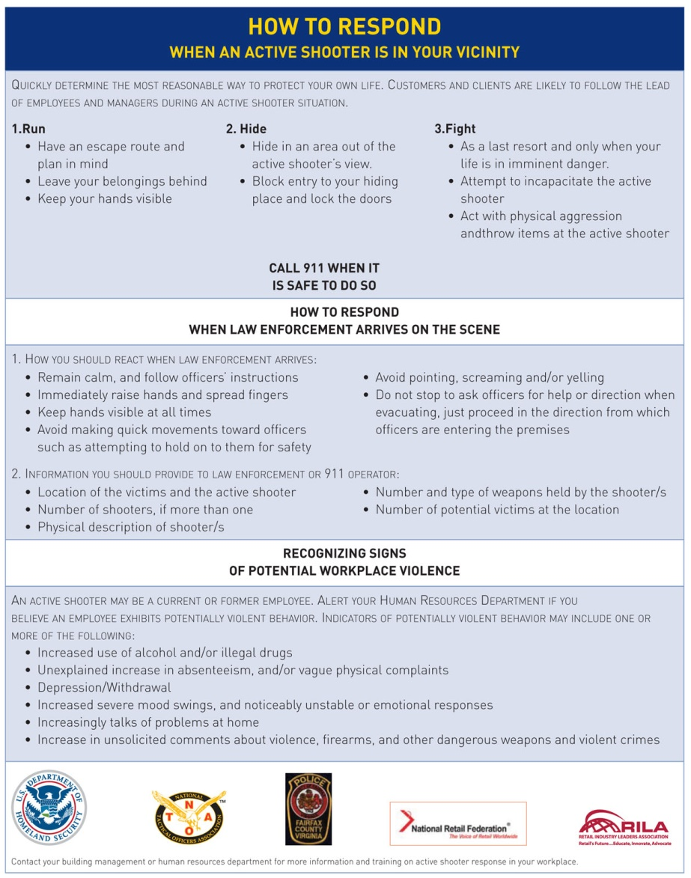
Terrorism: Scene Safety
34-10
First make the scene safe for as many people as possible and yourself.
Notifying law enforcement is an early necessity.
Do not approach an active violence scene until law enforcement says it is safe.
Your first inclination is to rush in and help the injured.
Becoming a victim yourself is never good.

Slide 43
Terrorism: Scene Safety
34-10
Run, Hide, Fight program during active shooter situations
Advocated by the Federal Bureau of Investigation and US Department of Homeland Security
Run. Evacuate if possible.
Hide. Hide silently in the safest place possible.
Fight. Take action to disrupt or incapacitate the shooter.
*Modified from the Ready.gov website.
Immediately after an incident:
Wait for local law enforcement officers to assist you out of the building, if inside.
When law enforcement arrives, you must display empty hands with open palms.

Slide 44
Terrorism: Additional Information
34-10
Understand that gunfire may sound artificial.
Assume that any popping sound is gunfire.
If there are two or more persons in the same place when a violent incident begins, you should spread out in the room to avoid offering the aggressor an easy target.
Be mindful that violent attacks can involve any type of weapon, not just a gun.
Knives, blunt objects, physical force, or explosives can be just as deadly as a gun.
The suggested actions here are applicable in any violent encounter:
Plan ahead
Visualize possible escape routes, including physically accessible routes for staff with disabilities and others with limited mobility.

Slide 45
Terrorism: Management
34-10
Once the scene is safe and the perpetrator(s) are in custody, treat the scene as a triage exercise.
There has not been a terrorist attack at a ski area as of 2020.
Management, security, the medical advisor, and the patrol may want to consider putting a plan of action in place in case one does occur, much like many school systems have done.

Slide 46
Search and Rescue

Slide 47
Search and Rescue
34-2
A search-and-rescue (SAR) operation has two interrelated components:
A search, the methodical process of actively gathering information about and then physically looking for one or more individuals in distress or imminent danger
A rescue, the process of extracting such individuals from distress or danger
Efforts can quickly shift from one component to the other.

Slide 48
Search and Rescue
34-2
Among the many SAR disciplines are:
Combat
Mountain
Urban
Ground
Air
Sea operations
Each SAR discipline has distinctly different missions, roles, training and staffing requirements, equipment needs, and operational procedures.

Slide 49
Search and Rescue
34-3
SAR work is dangerous.
Difficult terrain, inclement weather, extremes of temperature, time of day, size of the area to be searched, and the total number of people missing.
Additionally, natural or human-caused hazards

Slide 50
Search and Rescue
34-3
Many ski areas have developed a protocol manual that specifically identifies the steps to be taken when searching for a lost person.
Because of their backcountry expertise, OEC technicians are often asked to join a SAR team or to assist a team during a mission.
SAR efforts often require assistance from multiple local emergency management and response agencies.
Creates a need for cross-jurisdictional coordination
Common procedures and systems becomes critical.
SAR teams operate under NIMS and use the ICS system.

Slide 51
Search and Rescue: SAR Basic Tasks
34-3
SAR operations can be broken down to five basic tasks:
Mobilization
Team assembles and responds to the site of the incident.
Each member has a specific role.
Team leaders are typically cross-trained in multiple roles.
Intelligence gathering
Containment
Search
Rescue

Slide 52
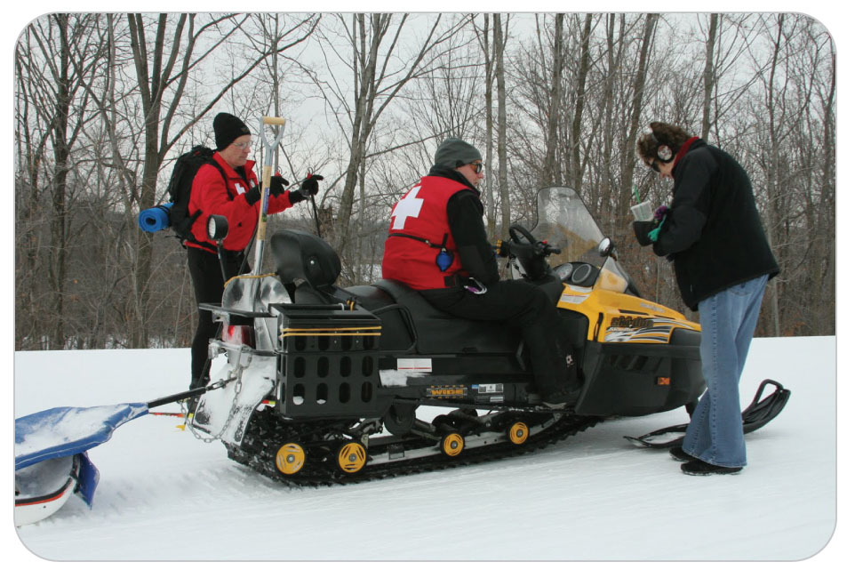
Search and Rescue: SAR Training
34-3
SAR training can be acquired through:
NSP Mountain Travel and Rescue
NSP Avalanche courses
Local SAR teams, which are usually operated by a local law enforcement agency
Every patroller/OEC technician should acquire through additional training.

Slide 53
Search and Rescue: Avalanche Rescue
34-3
Burial in an avalanche is a true medical emergency.
Small avalanches can be just as deadly as large ones.
They have claimed lives during every month of the year and in every kind of weather.
Not confined to remote, high alpine terrain
Can occur on any steep, snow-covered slope, even rooftops
Rescue operations must be initiated as soon as possible, preferably by a companion who was not caught in the avalanche.
Companion rescue efforts alone are not often successful without the additional resources provided by organized rescue operations.
There is minimal likelihood of survival when victims are buried for more than 35 minutes with an obstructed airway and in cardiac arrest upon extrication.

Slide 54
Search and Rescue: Avalanche Rescue
34-11
Avalanche rescue operations within the United States are conducted using the ICS.
Technology greatly enhances operational effectiveness.
Wireless communications, which enable rescuers to quickly learn of incidents
Helicopters, which enable rescuers to reach the scene within minutes
Avalanche transceivers and the Recco system have also improved rescue efforts by dramatically reducing search time.
Recco is a highly effective avalanche rescue system that enables rescues to quickly locate an avalanche victim using harmonic radar.
Use of rescue dog teams has also shortened search times.

Slide 55
Search and Rescue: Avalanche Rescue Basic Functions
34-12
An organized avalanche rescue consists of four basic functions:
The immediate search
Get rescuers to the site as quickly as possible to find and uncover the victim(s).
Medical care
Provide emergency care for the victims.
Transport/evacuation
Get the victims out of the field and to advanced medical care, if needed.
Support (logistics)
Care for the rescuers in the field (provide food, shelter, rest, and replacements).
These functions are not sequential and may be performed simultaneously, depending on need and the availability of resources.

Slide 56
Search and Rescue: Avalanche Rescue Sequence of Events
34-12
Although many variables affect avalanche incidents and the resulting response, most rescue operations follow a similar sequence of events.
Incident is reported.
Team is alerted and responds.
Victim(s) is/are located/extricated.
Medical care is provided.
Victim(s) is/are evacuated.
Operation is given logistical support.

Slide 57
Search and Rescue: Avalanche Rescue
34-12
As with any incident, rescuer safety is the top priority.
High probability for similar conditions along the route and on the slopes adjacent to the incident site
Upon arrival, the immediate search team leader assesses overall site safety.
Highly educated and experienced in managing avalanche-related incidents
If there is a significant residual avalanche hazard at the site, the hazard must be mitigated before the team proceeds.
During prolonged operations, team leaders must ensure that rescuers are properly cared for and supported.

Slide 58
Search and Rescue: Avalanche Rescue Management
34-12
Buried avalanche victims often have life-threatening conditions associated with:
Asphyxia
Trauma
Hypothermia
Cardiac problems can occur also, either immediately or subsequently because of asphyxia, shock, or hypothermia.
Assess and manage these injuries in the usual fashion.
Helicopter equipped with ALS providers and equipment should be dispatched and landed close to the incident site.
If multiple patients are buried or injured, standard triage methods are employed.

Slide 59
Search and Rescue: Rope Rescue
A rope rescue is any technical rescue operation involving static ropes, anchors, belaying devices, and other equipment that provides a mechanical advantage.
Ski patrol recognizes two types of rope rescue: high-angle rescue and low-angle rescue.
High-angle rescue (HAR) is any rescue work performed by ascending or descending a slope of approximately 45 degrees or steeper.
Low-angle rescue (LAR) is any rescue work performed by ascending or descending a slope that is less than approximately 45 degrees.

Slide 60
Search and Rescue: Rope Rescue
One of the first decisions that rescuers must make in a LAR is whether to lower or raise the patient out of the incident zone, the area in which the patient is located.
Primary concerns:
The safety of the rescuers and the patient
Simplicity of the rescue system should also be considered.
Generally, if it is a viable option, it is easier to lower a patient to a safe zone while letting gravity do some of the work.
If incident zone does not allow for the patient to be easily lowered to a safe zone, additional rescuers and equipment may be required to pull the patient up to a safe zone.

Slide 61
Search and Rescue: Rope Rescue
Rope rescues, which fall under the Operations section, should be performed using the ICS.
Two teams:
A technical rope team that is responsible for providing safe access to the patient and for extricating the patient and rescuers
A medical care team
It may be necessary to initiate medical treatment for a patient before a completed rope system is in place.
Providing rapid medical treatment requires that members of the medical team can safely access the patient.
Safe access may be accomplished by rappelling down to the patient using a separate rope, and then tying off to a tree or some other natural anchor near the patient.

Slide 62
Search and Rescue: Confined Space
34-13
A confined space rescue is a type of rescue involving an enclosed area that has limited or restricted means of entry or exit.
May be natural or human-made
May be created in the rubble following a building collapse
Many confined space rescues may be facilitated not only by equipment, but also by a specially trained search dog.
The exceptional sense of smell and trainability of dogs makes them ideally suited for finding objects or people.

Slide 63
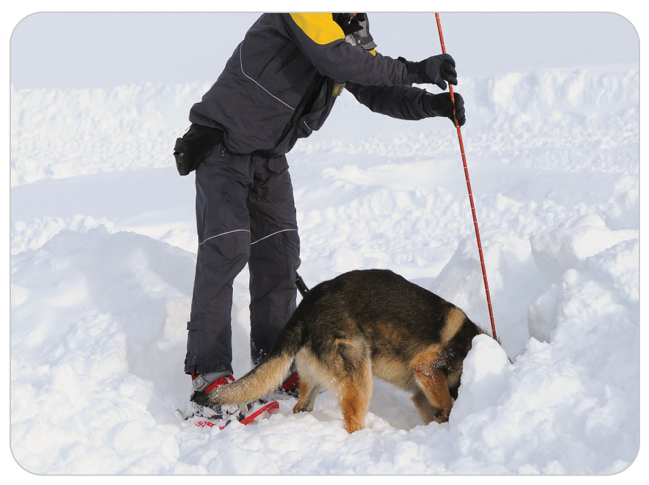
Search and Rescue: SAR Rescue Dogs
34-13
Search dogs can be trained to “alert” when they detect the odor of almost anything.
A well-trained avalanche dog can be a great asset in a search operation, especially if buried victims lack avalanche transceivers.
Dogs can easily search an area much faster than is possible using a probe line.

Slide 64
Search and Rescue: SAR Rescue Dogs
34-13
Many patrols at ski resorts in avalanche country have dogs on duty.
Many alpine SAR groups also have dog teams with handlers on call so that they can be deployed into the field quickly.
If an area or a rescue agency does not have a dog team on staff, its alerting and rescue plan should identify available local dog resources and the procedures for mobilizing them.
Several avalanche dog training organizations and certification standards are in place within the United States.
Because these organizations have slightly different training methods, the ways search dogs behave in the field can vary.
An initiative to establish international standards for the training and certification of avalanche rescue dogs is currently underway.

Slide 65
Search and Rescue: SAR Rescue Dogs
34-13
Dogs follow a cone-shaped scent trail in the air to the victim or to some other source of the scent.
To be detected, the scent of a person buried in an avalanche must first reach the surface of the snow.
This time depends on both:
The depth of burial
The scent’s rate of diffusion through the snow
Colder snow temperatures speed the diffusion rate.
Greater snow density slows the diffusion rate.
These rates can vary from less than 1 min/meter in dry powder snow to 15 min/meter in wet packed snow.

Slide 66
Search and Rescue: SAR Rescue Dogs
34-13
A scent does not always travel in a straight line up through the snow.
It follows the path of least resistance.
May move horizontally between blocks of snow or rocks
May be channeled by running water or trees to emerge a significant distance from the actual burial location
A dog will “alert” wherever this scent emerges from the snow, which is not necessarily directly over the victim.
Steady winds of low to moderate velocity provide ideal conditions for dogs.
Strong, gusty winds make searching more difficult.
Dogs are best positioned downwind of the search area before the search begins.

Slide 67
Search and Rescue: SAR Rescue Dogs
34-13
Dog Capabilities
A dog’s sense of smell is so sensitive it can not only discriminate among individuals, but also between individuals and articles of their clothing, and between a live victim and a dead body.
Advantageous for dogs to “alert” on the victim’s clothing and equipment, in addition to the victim’s scent, to provide clues that can reduce the size of the search area.
Air temperature does not seem to affect the sensitivity of a dog’s sense of smell, so dogs are a huge asset in alpine avalanche rescue operations.

Slide 68
Search and Rescue: SAR Rescue Dogs
34-13
Simplifying the Search
Dogs must in effect ignore every other scent but that of the buried victim to earn a reward for their search.
Reduce as many competing scents by keeping bystanders and nonessential personnel out of the search zone.
Stage equipment and food away from the area.

Slide 69
Search and Rescue: SAR Rescue Dogs
34-13
Search Dog Etiquette
The only person giving commands to a dog should be the dog’s handler, who often uses hand signals to communicate with the dog.
“Silence is golden.”
If the dog comes over to investigate you, it is only doing so to rule out your scent.
Ignore it and stay focused on your job.
Never approach, touch, or feed a rescue dog without its handler’s permission.

Slide 70
Search and Rescue: SAR Rescue Dogs
34-13
Dog Alerts
A dog “alerts” when it locates the source of a human scent coming off the surface of the snow.
It communicates by barking, sometimes by digging, sometimes by both.
It’s up to the handler to decide whether the dog’s behavior constitutes an alert.
When a dog alerts, immediately spot probe the area.
Shoveling before attaining a probe strike may waste precious time and should be avoided unless the probe pole is shorter than the depth of the debris.

Slide 71
Search and Rescue: SAR Rescue Dogs
34-13
The handler should call the dog off as soon as a probe strike is made so that rescuers can dig out the victim using appropriate shoveling techniques.
This course of action protects the dog and allows rescuers to safely excavate, extricate the patient, and provide emergency medical care.

Slide 72
Search and Rescue: Incidents Involving Structures
Incidents Involving Structures
In situations involving people trapped in buildings, urban search dogs certified by FEMA may be superior to dogs trained specifically for alpine avalanche SAR.
FEMA-trained dogs are familiarized with scents found in buildings and are trained to alert to live humans only, rather than to dead bodies, clothing, or other items.
These dogs are trained to explore cavities.
They work without wearing harnesses.
Less likely to be caught on wreckage debris in tight spaces

Slide 73
Fire Ground Operations

Slide 74
Fire Ground Operations
34-2
Fire ground operations
Examples: fire operations at a structure fire, brush fire, or hazmat incident
Most fire departments adopt NFPA standards as part of their standard operating procedures.
Technicians may be requested to provide medical support at the scene of a fire, most often to triage, treat, and transport patients, including injured firefighters.
May be asked to assist with firefighter rehabilitation, a process that involves monitoring the medical condition of firefighters following a work period and identifying those who are medically fit to return to duty
Firefighter rehabilitation should occur at any fire or prolonged rescue scene in which on-scene activities potentially exceed a safe level of physical or mental endurance.

Slide 75
Fire Ground Operations
34-2
Fire ground operations focus on the following key tasks: (listed from highest priority to lowest priority)
Size-up
Identifying building size and type of construction and whether flames are visible
Accountability
Identifying the locations of people within the scene
Rescue/life safety
Helping people
Confinement
Keeping the fire contained and from damaging other structures
Control
Extinguishing the fire
Ventilation
Making an opening in the structure to allow flames, smoke, and toxic vapors to exhaust
Property conservation

Slide 76
Fire Ground Operations
34-2
If you arrive at the scene of a fire before they do, report the fire, including the following information:
Exact location
The type of structure involved
Residence (including general size, such as large or small)
Apartments (includes multi-unit dwellings)
Commercial (such as warehouses, stores, or office building)
High rise (four floors or taller)

Slide 77
Fire Ground Operations
34-2
Provide basic information about the current fire conditions using the following common terms:
Fire showing (flames are visible)
Smoke showing (smoke is visible)
Nothing showing (neither flames nor smoke is visible)

Slide 78
Fire Ground Operations
34-2
While you await the arrival of firefighters, attempt to gather information from witnesses or people evacuating the building.
Among the questions to ask are the following:
Is everyone out of the building? How do you know?
How many people are still inside the building? How do you know?
Where in the building are the people located? How do you know?
Exactly where in the building is the fire located? How do you know?
Provide this information to the first fire officer to arrive on scene because it can save precious time and might save lives.

Slide 79
Fire Ground Operations
34-2
Firefighting is strenuous, even life-threatening work.
According to the NFPA, tens of thousands of firefighters are injured each year, and approximately 100 firefighters are killed in the line of duty.
When firefighters are injured, they will be evacuated as quickly as possible.
Firefighters wear PPE, including a self-contained breathing apparatus (SCBA).
To effectively treat an injured firefighter, you will likely need to remove this equipment.

Slide 80
Fire Ground Operations
34-14
Crew Resource Management (CRM)
Program that began in the early 1970s to attempt to decrease the number of airline crashes
There are many components to the program, but most can be applied to ALL emergency scenes.

Slide 81
Fire Ground Operations
34-14
CRM looks at four human factors referred to as the SHEL model:
S = Software refers to the basics of standard operating guidelines that are followed during emergency response.
H = Hardware is the equipment used during emergency response.
E = Environment includes weather, noise, terrain, and temperature.
L = Liveware refers to the people involved in the emergency response at all levels.
CRM utilizes the principles of open communication and the ability of anyone at any skill level to communicate a concern to the incident commander.
In order for CRM to work, everyone must be diligent in their awareness and be open with communications of any deviations from safe practice.

Slide 82
Case Study

Slide 83
CASE PRESENTATION
A call comes in to respond to a four-wheeler accident just off a mountain bike racecourse. One of the racers was injured. Upon your arrival, you find a four-wheeler in a ditch, with a teenage girl strapped to a stretcher on the back of the vehicle. The driver had hit a large rock and was thrown clear and is complaining of shoulder pain. Quite angry and yelling, the 16-year-old racer who has a splint on her lower leg is bleeding from a small cut on the top of her head caused by a branch of a tree near the trail. A small crowd has assembled.
What should you do?

Slide 84
CASE UPDATE
You immediately assess the situation and make sure the scene is safe by instructing bystanders to continue to have the race stopped 100 feet up the trail. You make sure the four-wheeler is turned off. There is no gasoline leaking from the vehicle. The injured teen is still yelling, so you calm her down. You control the bleeding on her head. Following your initial assessment, you call on the radio for help, management, and additional EMS transport, and ask a responsible bystander to keep the crowd back. The driver of the vehicle is up walking and comes over apologizing, still holding his shoulder. Another OEC technician arrives, and you instruct him to take care of the driver. The other OEC technician sits the driver down, assesses him, and applies a sling and swathe. Other race officials arrive to help.
What should you do now?

Slide 85
CASE OUTCOME
With the help of the race officials, you carefully unstrap the stretcher from the vehicle, leaving the teenage girl in the stretcher with the splint on her lower leg and moving her away from the vehicle. You conduct a full patient assessment of the girl and fortunately find she has only sustained a small laceration of the scalp, in addition to the lower leg injury. A third OEC technician arrives, and you instruct him to find the girl’s parents. Management arrives. The girl’s parents are found in the stands and come to the scene. You explain to them what happened. While the mother accompanies her daughter to the hospital via ambulance, you return to the aid room and complete your paperwork. The next day, the mother calls the patrol room to tell you her daughter broke her leg, is in a cast, and is now home. She received four stitches in her head. The driver fractured his clavicle but is otherwise okay. Management thanks you for your quick action in managing a difficult situation.

