Slide 1

Incident Command and Triage
CHAPTER 4

Slide 2

The following presentation will utilize two symbols to identify material necessary for an OEC Technician to comprehend:
key term
Meets a Chapter Objective.
This symbol will have the corresponding Objective Number denoted within.
Identifies a Key Term.
The Key Term will be underlined for easy identification.

Slide 3
Objectives
OBJ
  4-1 Define incident command system.
  4-2 Describe the primary responsibilities of each of the five functional areas of the incident command system.
  4-3 Describe the mnemonic ID-ME.
  4-4 Describe and demonstrate how to use the SALT triage system.
  4-5 Describe and demonstrate how to use the START triage system.
  4-6 Describe the mnemonic 30–2-Can Do.

Slide 4
Key Terms
30–2-Can Do
Chain of command
Facility
Incident
Incident commander (IC)
Incident command system (ICS)
Multiagency coordination system (MACS)
Multiple-casualty incident (MCI)
National Incident Management System (NIMS)
Personnel accountability system
Resource management
SALT triage system
Section chiefs
Span of control
START triage system
Strike team
Task force
Triage

Slide 5
Chapter Overview

Slide 6
Chapter Overview
Emergencies can happen at any time, in any place, and under a variety of circumstances.
Each emergency is unique and presents rescue personnel with countless challenges.
OEC technicians must be prepared to respond to and manage a wide variety of situations.

Slide 7
National Incident Management System
4-1
4-2
Patrollers can use the federally mandated National Incident Management System (NIMS).
  A standardized framework for responding to, and managing, emergencies or situations involving multiple jurisdictions
NIMS was established in 2003 by President George W. Bush.
  In response to the terrorist attacks of September 11, 2001

Slide 8
National Incident Management System
4-1
4-2
NIMS is a national “all-hazards” model for incident management.
Provides “a consistent nationwide approach for federal, state, tribal, and local governments to work effectively and efficiently together to prepare for, prevent, respond to, and recover from domestic incidents, regardless of cause, size, or complexity” (US Department of Homeland Security, n.d.).

Slide 9
National Incident Management System
An incident is defined as “anything out of ordinary day-to-day activities that necessitate a response.”
  Includes medical emergencies, search-and-rescue missions, natural disasters, fires, terrorist, and weapons of mass destruction, etc.

Slide 10
National Incident Management System
NIMS is designed to improve overall incident management interoperability, integration, and coordination.
  Federally mandated
  Extends to ski/bike patrols and OEC technicians
  May be called upon to:
    Take the lead in managing an incident involving external public safety organizations
    Assist other public safety agencies during an incident

Slide 11
National Incident Management System: Terminology
Chain of command
  A rank structure for management
Span of control
  The total number of individuals or resources supervised by a single person
Personnel accountability system
  A system that readily identifies both the locations and the functions of all members operative at an incident scene
Resource management
  Includes mutual-aid agreements, the use of special federal, state, local and tribal teams, and resource mobilization protocols
Multiagency coordination system (MACS)
  A process for managing an incident in which multiple agencies that have different command structures and communication capabilities are participating

Slide 12
Incident Command System
4-1
4-2
The Incident Command System (ICS) provides a method for managing any incident, regardless of its cause, size, scope, or complexity.
  Developed in the 1970s
    Method for managing California wildfires
  Evolved into an all-hazards management plan
  Improves efficiency, reduces confusion, and provides a safer work environment for rescue personnel
  Provides considerable flexibility in that it can grow or shrink to accommodate the needs of each incident

Slide 13
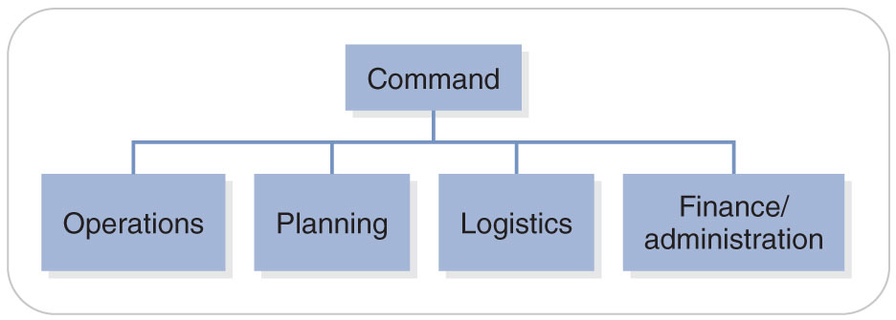
Incident Command System
4-2
The ICS structure consists of five functional areas, each of which has specific responsibilities.
The areas are interdependent and, depending on the size of the incident, may either be combined and managed by a single person or expanded and managed individually.
The functional areas are as follows:
  Incident command
  Operations section
  Planning section
  Logistics section
  Finance/administration section

Slide 14
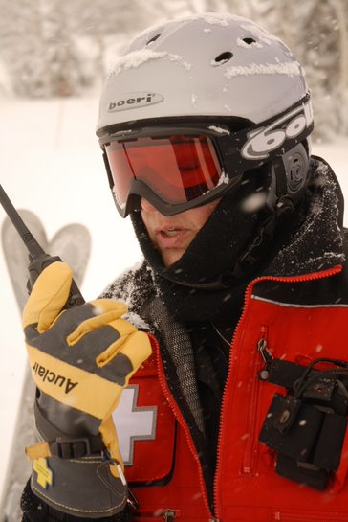
Incident Command System
4-2
Incident command is the first to be established at any incident and is managed by an incident commander (IC).
  Identification of the IC is essential.
  The person provides overall leadership and direction for managing the incident.
  Typically, the most senior person among the initial responders arriving at the scene

Slide 15
Incident Command System
4-2
The IC establishes an incident command post, or ICP, the base of operations.
The IC’s several key responsibilities include the following tasks:
  Assume command of the incident.
  Establish an ICP.
  Provide overall incident management.
  Determine incident objectives and strategies.
  Determine/develop the organizational structure needed to manage the incident.

Slide 16
Incident Command System
4-2
Operations
Second to be established at an incident
Responsible for executing the strategies
  Managed by an operations section chief:
    Participating in the planning process
    Reducing immediate hazard(s)
    Saving lives and property
    Establishing situational control
    Restoring the scene to normalcy

Slide 17
Incident Command System
4-2
Operations (cont’d)
When needed, resources may be formed into strike teams or task forces to perform specific operational tasks.
  A strike team is a group of resources of the same size or type that is managed by a strike team leader.
  A task force is a combination of different resources with common communications that is managed by a task force leader.

Slide 18
Incident Command System
4-2
Planning Section
Determine incident resource needs.
Gather and analyze incident-related data.
Create probability projections.
Prepare contingencies and alternative strategies.
Assist in the preparation of incident documents and maps.
Maintain incident records (except financial records).

Slide 19
Incident Command System
4-2
Logistics Section
Provides support for all the functional areas and has the following responsibilities:
  Acquire resources (e.g., personnel, equipment, services).
  Order/obtain supplies (e.g., food, water).
  Manage internal communications equipment.
  Maintain equipment.
  Develop a transportation system or supply line (to support operational needs).
Must ensure all incident facilities meet specified needs.
  A facility is any primary work area in or around the incident in which incident-related activities are planned, organized, directed, or conducted.

Slide 20
Incident Command System
4-2
Finance/Administration Section
Authorize expenditures.
Negotiate contracts with vendors.
Maintain reimbursement records.
Maintain injury, death, and damage documentation.
Track costs associated with mutual-aid agreements.

Slide 21
Triage

Slide 22
Triage
OEC technicians occasionally encounter incidents involving more than one patient, or even large numbers of patients.
  A multiple-casualty incident (MCI) is an incident involving two or more patients in which the number of patients exceeds the capability of immediately available resources.
  Rescuers must quickly assess the patients to determine the severity of their conditions and to rapidly identify specific resources that will be needed.

Slide 23
Triage
Triage is a process of prioritizing patients for treatment and transportation based on specific criteria, depending on the triage method that is being followed.
  Using this systematic approach, rescuers can assess large numbers of patients in a relatively short period of time.
  “Do the most good for the most people”

Slide 24
Triage
4-3
There are four common triage categories in ID-ME (pronounced “I.D. Me”):
I Immediate (red)
D Delayed (yellow)
M Minimal (green)
E Expectant (black/gray)

Slide 25
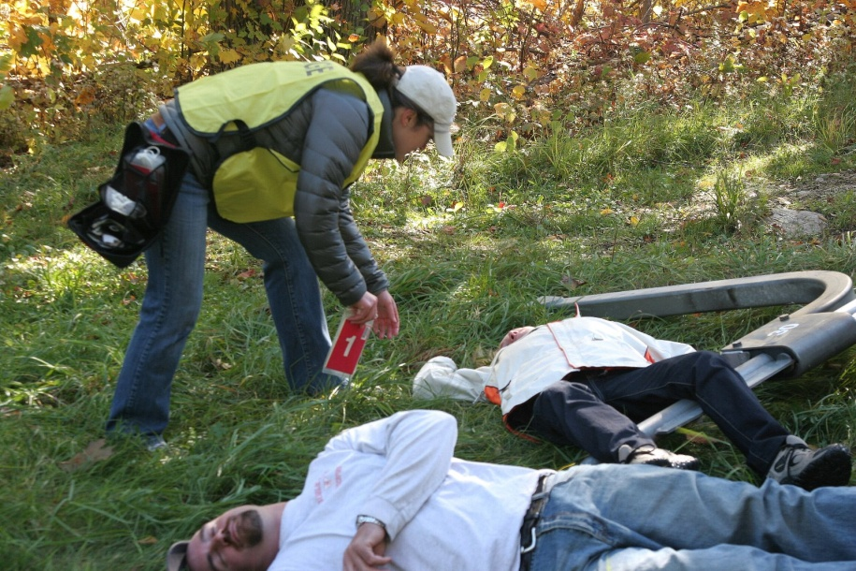
Triage: Triage Methods
4-4
There are many different types of triage systems used by EMS agencies and military personnel around the world.
  SALT and START are most common.
    The systems taught in OEC
  SMART
    Comprehensive MCI systems
    Full range of ICS and triage resources, including triage tags, triage personnel vests, and the START triage protocol, in one comprehensive package
    Some states require all emergency care systems to use a single system.

Slide 26
Triage: SALT
4-4
SALT Triage System
Highly recommended by EMS agencies in the United States
SALT is an acronym for the four-step process for triaging and tagging patients:
  Sort
  Assess
  Lifesaving interventions
  Treatment and/or Transport
Developed as an all-hazards method of triaging all patients
  Regardless of age or special needs

Slide 27
Triage: SALT
Step 1: Sort
  All individuals who can walk should move immediately to a designated location.
    Will be further triaged and treated later
  Those left should be asked to make some purposeful movement, such as “wave a hand or move a leg.”
    Indicates they are able to follow a command
  Those who do not move are considered to have a severe or life-threatening injury.
    Will triage first because they may need immediate lifesaving treatment

Slide 28
Triage: SALT
Step 2: Assess
  Assessing each patient
  Determine who needs immediate lifesaving interventions.
    Those who were unable to walk or wave

Slide 29
Triage: SALT
Step 3: Perform Lifesaving Interventions
  The lifesaving interventions would include:
    Control major bleeding by using a tourniquet.
    Open the airway by using an oropharyngeal airway or by positioning.
      No advanced airways are used in this stage.
      If the patient is a child, two rescue breaths may be given.
    Chest decompression may be conducted if the triage officer is trained in advanced life support and has the equipment on hand.
    Autoinjector antidotes may be given if the triage officer has them on hand.
      Take less than a minute to apply
      Do not require the triage officer to remain with the patient

Slide 30
Triage: SALT
Step 4: Provide Treatment and/or Transport
  After lifesaving interventions, patients are assigned to a triage category.
  The SALT triage categories vary slightly from the ID-ME mnemonic.
  SALT presents five categories:
    Immediate (red)
    Expectant (gray)
    Delayed (yellow)
    Minimal (green)
    Dead (black)

Slide 31
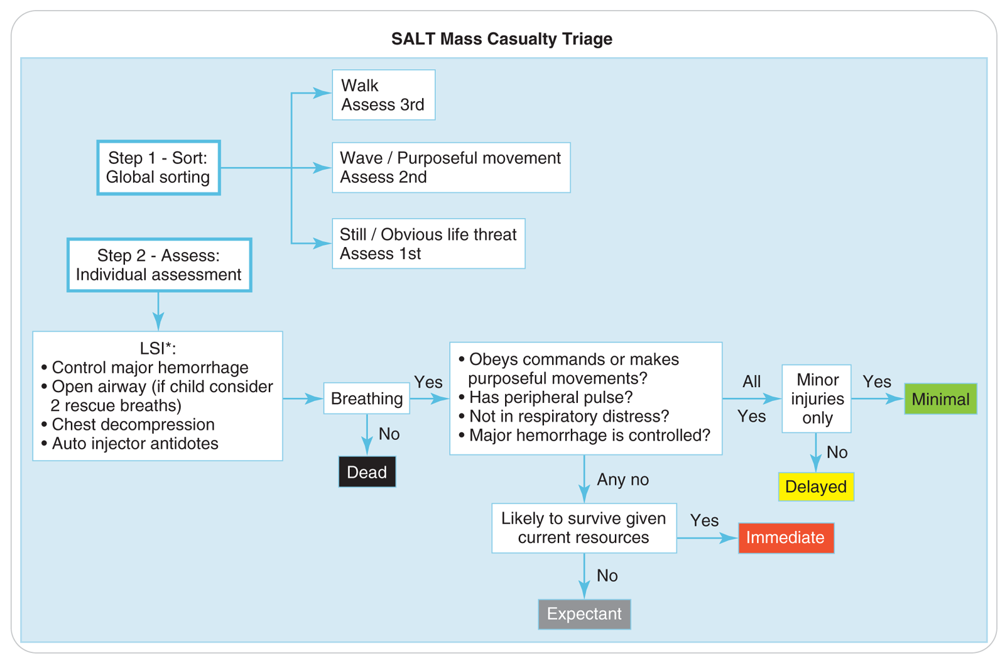
Triage: SALT

Slide 32
Triage: SALT
Red
  No peripheral pulse
  Inability to obey commands
  Respiratory distress
  Uncontrolled major hemorrhaging
Gray
  Injuries that are likely to be fatal based on resources currently available
  Brain matter showing, burns over 90% of body, or other immediate life-threatening injuries that cannot be resolved

Slide 33
Triage: SALT
Yellow
  Fractures, burns, or dislocations
  Patients who do not fit in other categories
Green
  Minor injuries, including lacerations and abrasions
  Most of these patients will be in the walking wounded area.
Black
  Dead

Slide 34
Triage: START
4-4
START Triage System
In use in many states and is currently used by the US military
Stands for Simple Triage And Rapid Treatment.
Focuses on four specific factors:
  Ability to walk (ambulate)
  Respirations
  Pulse
  Mental status

Slide 35
Triage: START
First rapidly shout “If you can hear my voice and are able to walk . . .” and request that these people move to a specific location.
  Where they are to wait until they can be assessed by other rescuers
  Allows patients with less-serious injuries to be quickly separated from those with more-serious medical problems.
  “Walking wounded” are tentatively triaged as minimal (green).
    Will be reassessed later when more resources become available

Slide 36
Triage: START
Once the walking wounded have been removed from the area, the remaining patients can generally be triaged into one of the four common triage categories:
  Each patient should take less than 30 seconds.
  Centers on assessing the patient’s “RPMs”
    Respirations
    Perfusion
    Mental status

Slide 37
Triage: START
Respirations:
Is the patient breathing?
  NOT breathing: perform one Lifesaving Intervention:
    Attempt to open the airway, using no equipment or medical aids.
    Obvious foreign bodies or debris should be removed.
The patient is then triaged based on the following findings:
  No respirations: expectant or deceased (dead) (black/gray)
  Respirations greater than 30/min: immediate (red)
  Respirations less than 30/min: go to the next assessment criterion: perfusion

Slide 38
Triage: START
Perfusion:
Assessing the radial pulse or capillary refill
  No radial pulse or capillary refill takes longer than 2 seconds: immediate (red)
  Radial pulse present and skin is pink and warm, or capillary refill occurs in less than 2 seconds: go to the next assessment criterion: mental status

Slide 39
Triage: START
Mental Status:
Can the patient follow simple commands?
  Unable to follow simple commands or unresponsive: immediate (red)
  Able to follow simple commands: delayed (yellow)

Slide 40
Triage: START
4-4
“30-2-Can Do”
  An easy way to remember START
  30 respirations per minute, capillary refill of 2 seconds, and ability to follow simple commands (can do).
This approach may not be suitable in all environments.
  Capillary refill is often delayed in a cold climate.
  Presence (or lack) of a radial pulse is a better guide for determining the patient’s perfusion status.

Slide 41
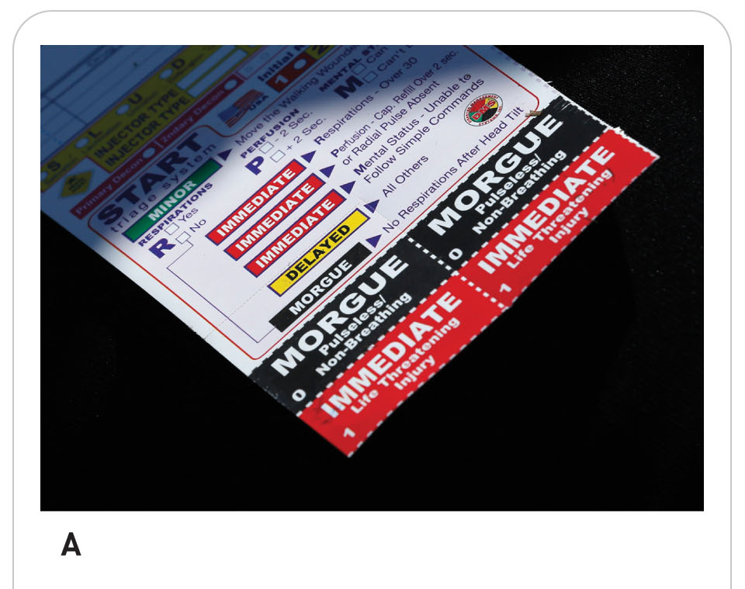
Triage
Triage should be considered a dynamic process.
May need to be performed more than once
  Incidents involving large numbers of patients
    A person’s condition can improve or deteriorate over time.
  As additional resources or more-highly trained personnel arrive
  As patients are transported to definitive care facilities
An increase in available resources may allow living patients previously categorized as expectant (grey) to be reevaluated.

Slide 42
Case Study

Slide 43
CASE PRESENTATION
You and three other patrollers are eating lunch in the mid-mountain cafeteria when you are dispatched to respond to “a skier who has fallen from a lift and may be hurt.” As you walk out of the lodge, you see a large group of people standing at the top of the slope. You observe that many individuals are hastily removing their skis and then running over to the edge. As you ski over to their location, you quickly see the source of their concern. Looking downhill, the scene before you is pure chaos. All the way down the lift line, people are frantically clinging to lift chairs. Several appear to have fallen from the lift, some as far as 40 feet. Small groups of bystanders have gathered around some of the patients and appear to be rendering aid. People are frantically waving both upslope and downslope, trying to get help. You hear muffled yells for help and screaming in the distance.
What is the first thing you and the other patrollers should do?

Slide 44
CASE UPDATE
You contact patrol dispatch to declare a major MCI, give a brief situation report, and call for additional resources. You also identify yourself as the IC. As IC, you start to determine the nature and extent of the incident by sending your fellow patrollers downhill to assess the situation. At the same time, you establish an ICP in the lift operator’s booth, which gives you a sweeping view of the scene. Given the number of patients you can see, you decide that an operations section should be created, and you inform dispatch that you need additional resources, both from the ski area and from the local emergency care system.
A patroller calls you on the radio and tells you there are “at least 30 patients on the ground and at least 120 trapped on the lifts.” With this information, you begin to formulate your IAP.

Slide 45
CASE UPDATE
A few minutes later, the patrol director enters the ICP and assumes the role of IC. You give her a quick verbal report of the situation and what you have done so far. The transfer of incident command to the patrol director is announced over the radio so that everyone is aware of the change. She then designates you as the operations section chief and directs you to go to the scene to lead the rescue efforts. Upon your arrival, a patroller informs you that the lift has collapsed and that “there are patients all the way down to the bottom!” Before you can catch your breath, a person approaches you and identifies himself as a doctor. He tells you that he is one of several emergency physicians who have come to help.
What should you do now?

Slide 46
CASE OUTCOME
You soon have several patrollers and ski resort staff members on scene. To maintain a proper span of control, you inform the IC that you are creating two operations branches: a rescue and evacuation branch and a medical branch. You assign a director to each. The rescue branch is tasked with evacuating stranded skiers from the lift, and the medical branch is tasked with assessing, treating, and transporting the patients. The medical branch is expanded into three divisions: triage, treatment, and transportation. A supervisor is assigned to manage each division. Physicians are assigned to the triage and treatment divisions to help care for the patients.

Slide 47
CASE OUTCOME
Primary triage reveals the following distribution of patients: 11 immediate (red), 18 delayed (yellow), 21 minimal (green), 0 expectant (black/gray). As more resources arrive, they are assigned to one of the two branches.
This incident took more than 4 hours to manage, during which time the operations section evacuated 220 people from the lift and treated or transported more than 100 patients, including 50 who had fallen from the lift.

