Slide 1
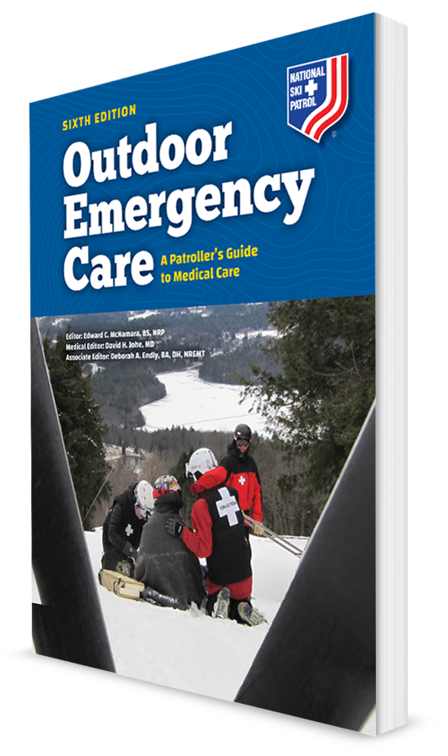
Anatomy and Physiology
CHAPTER 6

Slide 2
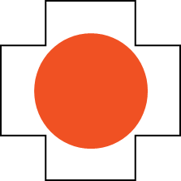
The following presentation will utilize two symbols to identify material necessary for an OEC Technician to comprehend:
key term
Meets a Chapter Objective.
This symbol will have the corresponding Objective Number denoted within.
Identifies a Key Term.
The Key Term will be underlined for easy identification.

Slide 3
Objectives
OBJ
6-1 Identify and properly use each anatomic term for body direction, movement, and position.
6-2 Identify the location and function of each of the body’s organs.
6-3 Describe the anatomy (structure) and physiology (functioning) of each body system.
6-4 Explain how blood flows through the heart.
6-5 Explain how tissue in the body gets oxygen and nourishment.
6-6 Name and describe the location of the major bones in the body.
6-7 Define and explain the three types of muscles.

Slide 4
Key Terms
Abduction
Adduction
Artery
Blood pressure
Body system
Brain
Capillaries
Cardiovascular system
Cells
Central nervous system
Diaphragm
Digestive system
Endocrine system
Extension
Flexion
Human anatomy
Human physiology
Immune response

Slide 5
Key Terms
Immunity
Integumentary system
Ligaments
Lymphatic system
Muscular system
Nervous system
Neuron
Organs
Peripheral nervous system
Reproductive system
Respiratory system
Skeletal system
Tendon
Tissue
Urinary system
Vein

Slide 6
Course Overview

Slide 7
Chapter Overview
The human body is complex, containing body systems that work together to keep it functioning properly.
These systems:
Circulate nutrients and oxygen to body tissues
Control movement
Provide structure
Allow complex thought
Provide reproduction
Perform many other functions to maintain life

Slide 8
Chapter Overview
To assess and manage a patient, you must have a basic understanding of anatomy (structure) and physiology (function).
Each of the body systems interacts with other systems to function properly.
Injury or illness to one system will cause problems in other systems.
Understanding the anatomy and physiology of the body systems, and how they interact with each other, will help you recognize and understand injuries and illnesses.
It’s important to learn the body’s systems and anatomic terminology so that you can communicate with other prehospital providers.

Slide 9
Anatomy and Physiology

Slide 10
Anatomy and Physiology
Human anatomy is the study of the structure of the body.
Includes:
Gross Anatomy: focuses on the structures that can be seen with the unaided eye
Microscopic Anatomy: focuses on structures that can be seen only under a microscope
Human physiology is the study of mechanical, physical, bioelectric, and biochemical functions of humans.

Slide 11
Anatomy and Physiology
The human body has many organs that are included in the body’s systems.
The human body is made of billions of different cells, the basic units of all living tissue.
Cells form tissue, a collection of cells acting together to perform a specific body function.
Organs are the structures containing similar tissues that act together to perform specific body functions.
A body system is a group of organs and other structures that work together to perform specific functions.

Slide 12
Terms for Body Planes and Directions

Slide 13
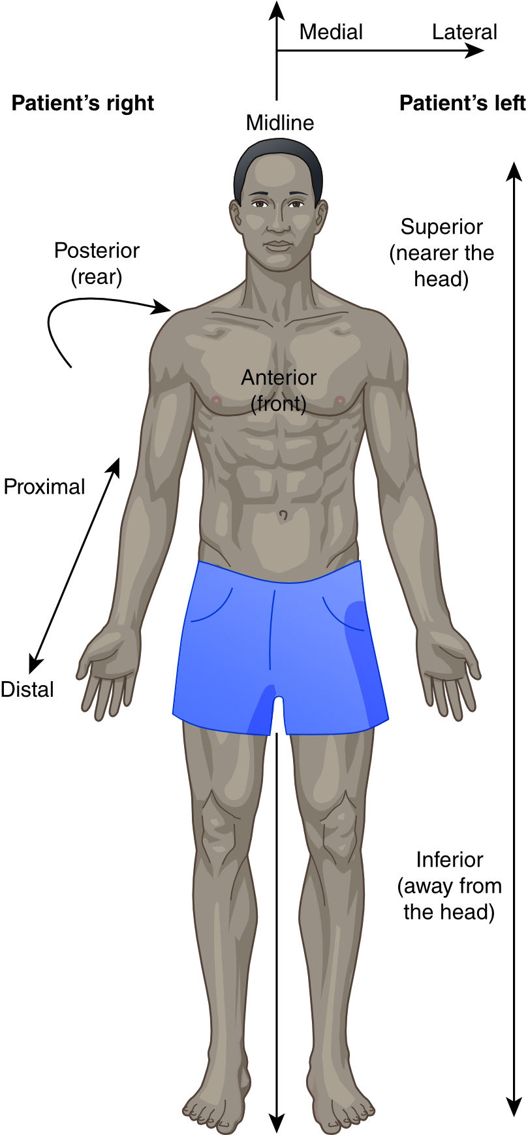
Terms for Body Planes and Directions
6-1
Anterior/Posterior
Anterior: front of the body
Posterior: back of the body
Superior/inferior
Superior: nearer the patient’s head
Inferior: nearer the patient’s feet
Medial/lateral
Based on the body’s midline
Medial: closer to the midline
Lateral: away from the midline

Slide 14
Terms for Body Planes and Directions
6-1
Proximal/Distal
Proximal: close to the trunk
Distal: away from the trunk (nearer to the extremities)
Superficial/deep
Superficial: near the surface of the body
Deep: away from the surface
Internal/external
Internal: inside
External: outside

Slide 15
Terms for Movement

Slide 16
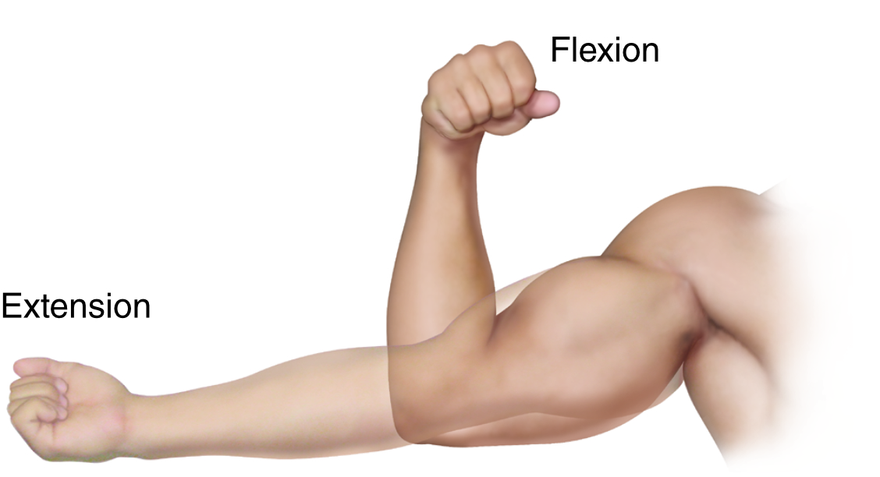
Terms for Movements
6-1
Flexion
Bending or flexing movement, such as bending at the knee or making a fist
Extension
The opposite of flexion
A straightening movement, such as making the arm straight at the elbow
The prefix hyper describes movement beyond the normal range of movement.

Slide 17
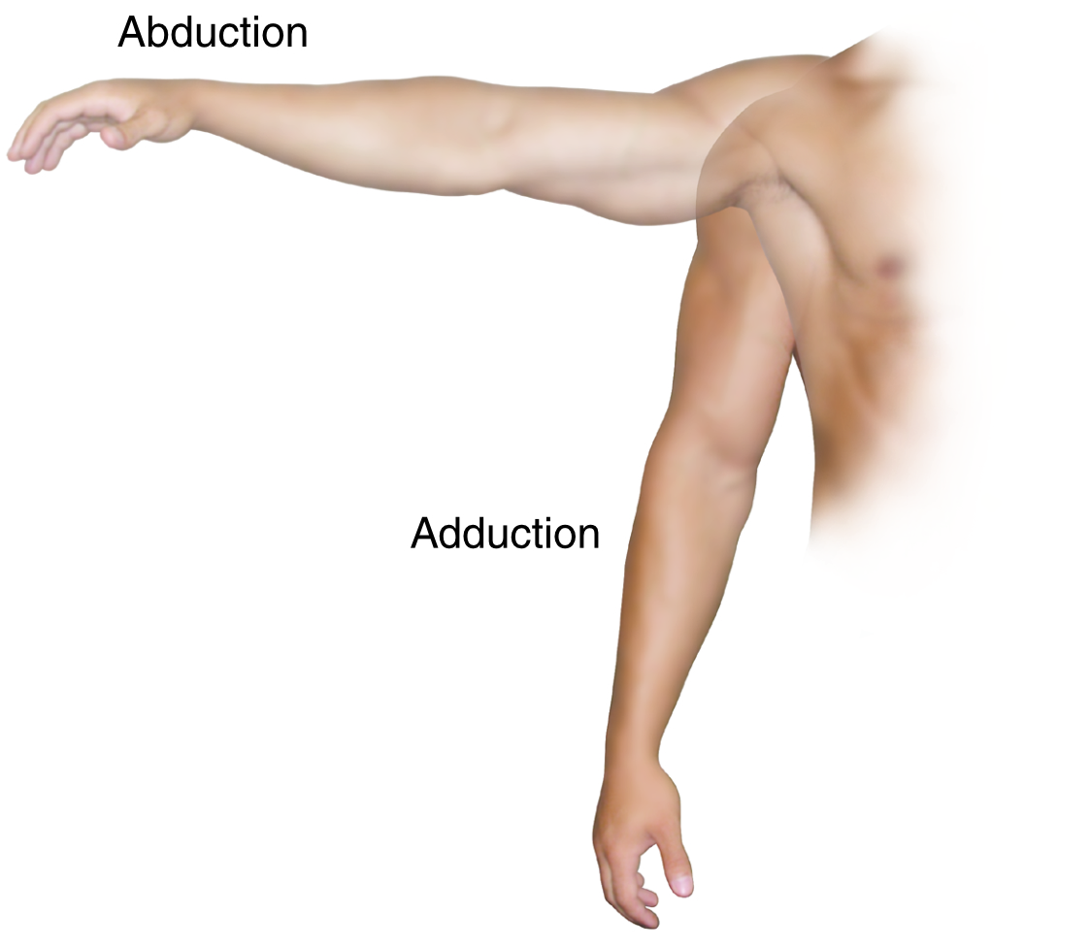
Terms of Movement
6-1
Abduction
Taking an extremity away from the midline of the body
Example: moving the arm out to the side
The prefix ab- means away from.
Adduction
The opposite of abduction
Moving an extremity toward the midline of the body
Example: moving legs that are spread apart together so that they touch each other
Prefix ad- means toward.

Slide 18
Terms of Position

Slide 19
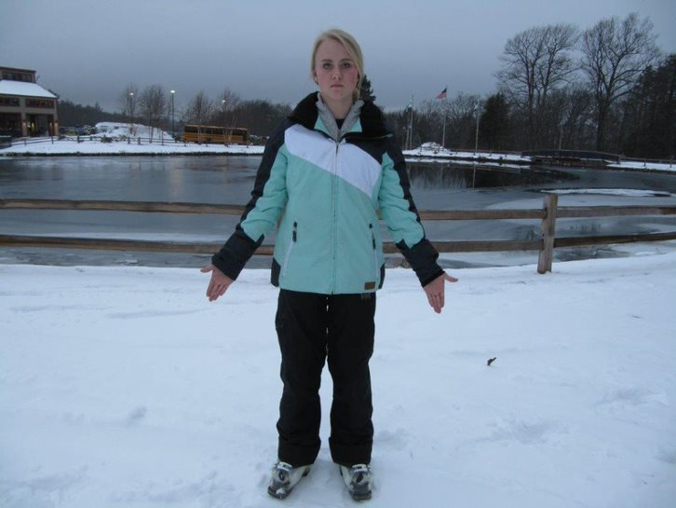
Terms of Position
6-1
Normal anatomic position
Standing with body erect
Arms down at the sides
Palms facing forward
Basis for all medical terms that refer to the body

Slide 20
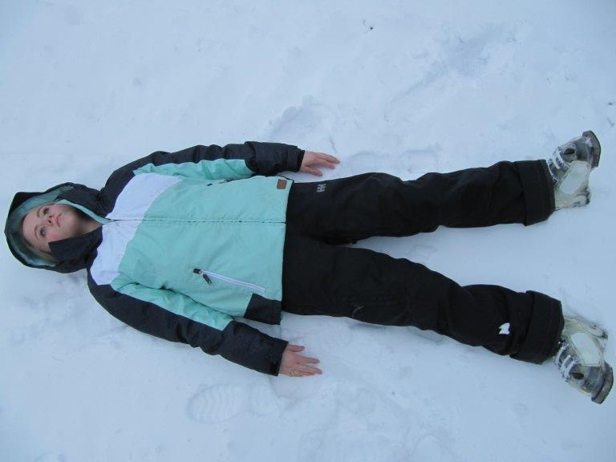
Terms of Position
6-1
Supine position
Patient lying flat on the back
Face-up

Slide 21
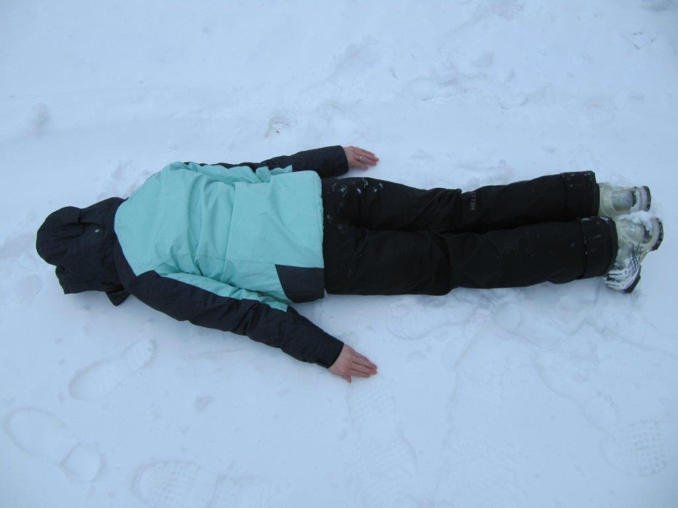
Terms of Position
6-1
Prone position
Lying on the abdomen (stomach)
Face to one side or the other

Slide 22
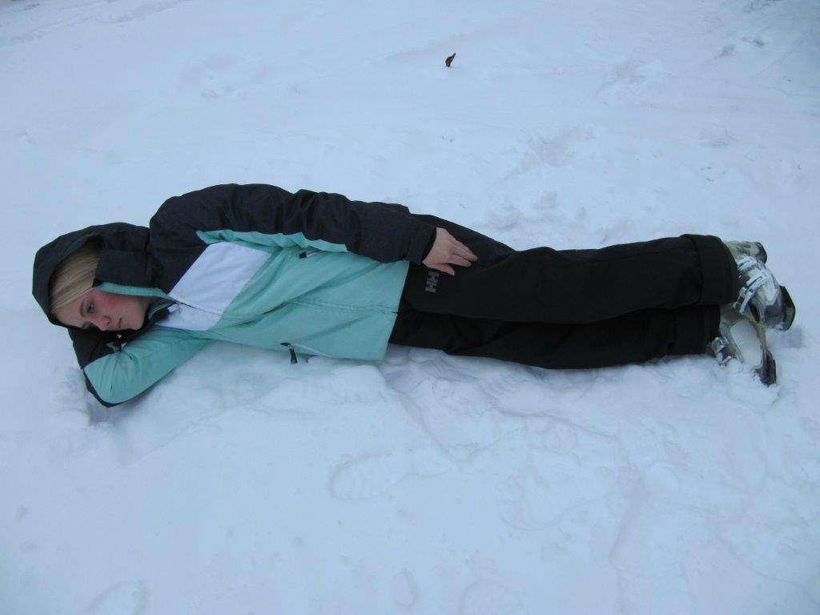
Terms of Position
6-1
Right or left lateral recumbent position
Also referred to as the recovery position
Lying on the right side or the left side
Used for people not fully responsive, without spinal injury, who may vomit

Slide 23
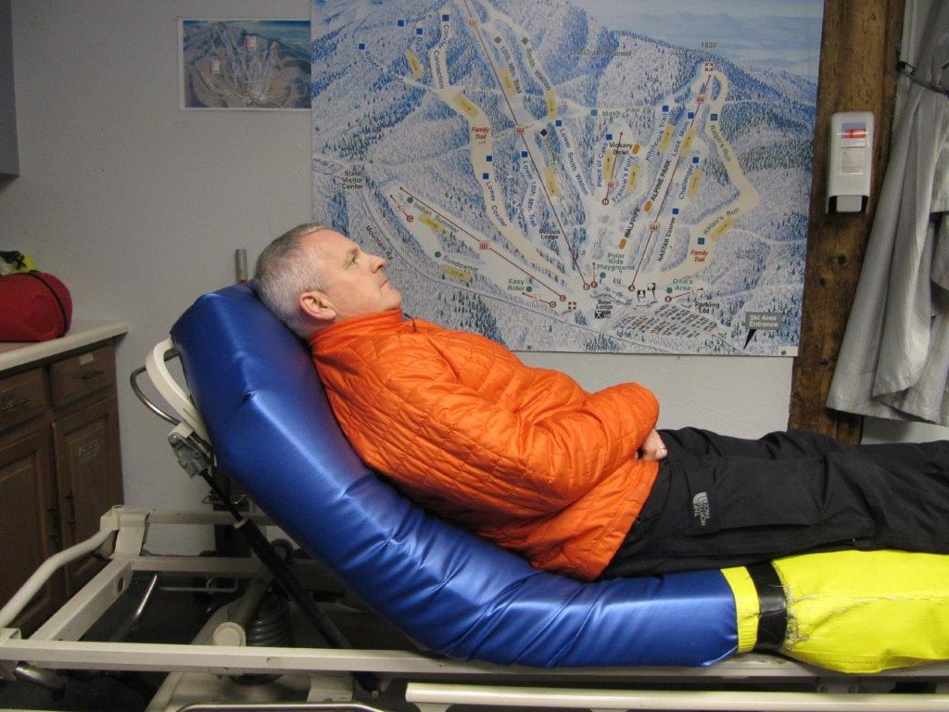
Terms of Position
6-1
Semi-Fowler position
Sitting with the upper body elevated, starting at the waist, to a 45-degree angle
Commonly used for patients who are awake and are not suspected of having a severe injury or illness

Slide 24
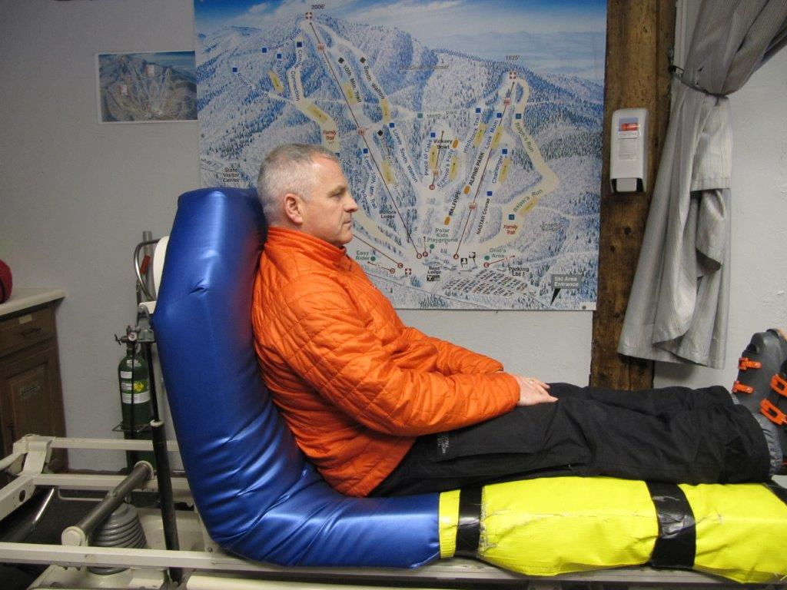
Terms of Position
6-1
High-Fowler position
Sitting fully upright with the knees straight or slightly bent
Typically for patients with severe breathing problems

Slide 25
Body Systems: Respiratory System

Slide 26
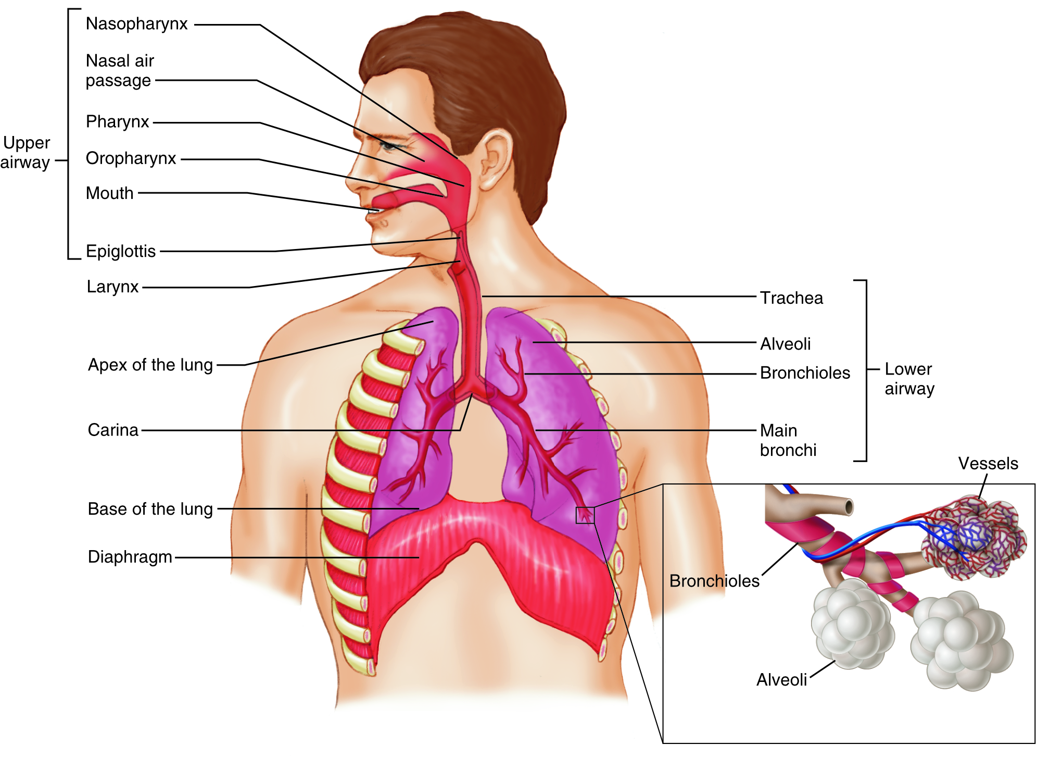
The Respiratory System
6-2
6-3
The respiratory system consists of organs responsible for a respiration:
Move air into (inhalation) and out of (exhalation) the body
Delivering oxygen to and removing carbon dioxide from the blood
Helps balance the body’s internal ph
The amount of acid in the blood

Slide 27
Respiratory System: Epiglottis
6-3
The respiratory system is divided into the upper and lower airways by the epiglottis.
The epiglottis is a leaf-shaped flapper valve that folds down over the top of the trachea (windpipe).
Prevents food or liquid from entering the trachea during swallowing.
If it does not close properly, the food may “go down the wrong pipe,” causing the person to start coughing.
If an unresponsive person vomits, the epiglottis may not be closed, allowing stomach contents into the lungs. resulting in significant damage to lung tissue.

Slide 28
Respiratory System: Upper Airway
6-2
6-3
Upper Airway includes the:
Nose
Mouth
Tongue and jaw
Pharynx (throat)
Larynx (vocal cords)
Epiglottis

Slide 29
Respiratory System: Upper Airway
6-2
6-3
During inspiration:
Air enters the body through the nose and mouth.
It is warmed and moistened.
Large particles are filtered by hairs within the nose.
Air travels through or by each structure into the lower airway.

Slide 30
Respiratory System: Lower Airway
6-2
6-3
Lower Airway consists of the:
Trachea
Bronchi
Lungs, which contain the bronchioles and alveoli

Slide 31
Respiratory System: Lower Airway
6-2
6-3
Air passes through the larynx and travels down the trachea through the tubes within the lungs.
Trachea contains rings of cartilage and can be felt in the anterior neck.
Air moving down the trachea passes into the right and left bronchi to enter each lung.
Hollow tubes carrying air, called bronchi, continue to divide into smaller and smaller passages, called bronchioles, like the branches of a tree.
Bronchioles have muscular walls that can constrict decreasing airflow.
Causes include: cold air, chemical irritants, or other factors

Slide 32
Respiratory System: Lower Airway
6-2
6-3
At the ends of each bronchiole are small air collection sacs called alveoli.
Each alveolus is surrounded by tiny blood-containing, thin-walled tubes, known as capillaries.
Alveoli allow carbon dioxide and oxygen exchange between the inhaled air in the sacs and the blood in these capillary tubes.
Thousands of alveoli are responsible for gas exchange.
Capillaries then feed bigger blood vessels, taking oxygen-rich blood through the heart and then to the body.

Slide 33
Respiratory System: Physiology
6-2
6-3
Ventilation, the act of breathing
Mechanical process of moving air into and out of the lungs
Brings in oxygen from the environment
Sends out a waste product, carbon dioxide
The flow of air into the lungs is caused primarily by contraction of the diaphragm.
Large, thick, flat muscle that separates the chest and abdomen

Slide 34
Respiratory System: Physiology
6-2
6-3
Contraction of the diaphragm results in the expansion of the lungs.
Creates negative pressure within the thoracic cavity
Draws air into the lungs
Air then flows out of the lungs in a passive process.
A combination of relaxation of the diaphragm and recoil of the chest wall, decreasing the lung size

Slide 35
Respiratory System: Physiology
6-2
6-3
Accessory muscles between the ribs and in the neck
Expand the chest directly, aiding inspiration, especially during labored or rapid breathing
The diaphragm is controlled automatically from nerves that come out of the spinal cord in the neck.
If the spinal cord is injured above where these “phrenic” nerves come out of the cervical spine (C3 to C5), the person stops breathing.

Slide 36
Respiratory System: Physiology
6-2
6-3
Minute ventilation:
Also known as minute volume
The amount of air pulled into and removed from the lungs in one minute
Based on the volume of each breath and the breathing rate
Deeper breaths and a faster rate of breathing increase the minute volume.
Affecting the amount of oxygen that goes into the lungs

Slide 37
Respiratory System: Physiology
6-2
6-3
Breathing is controlled by the level of carbon dioxide, as carbonic acid, in the blood.
Not dependent on the amount of oxygen in the blood
If carbon dioxide levels increase, the respiration rate increases automatically.
An increased volume of air is moved each minute until the excess carbon dioxide is eliminated.
Increases in carbon dioxide are caused by:
Increased production of carbon dioxide by the body
Decreased minute ventilation causing carbon dioxide to build up in the lungs and blood

Slide 38
Respiratory System: Physiology
6-2
6-3
Increased respiratory rate, in most individuals, is due to excess carbon dioxide.
Not the lack of oxygen
Those with significant lung disease have blood with a chronically high carbon dioxide level.
The drive to breathe is not based on carbon dioxide levels.

Slide 39
Respiratory System: Physiology
6-2
6-3
Resistance to airflow:
Resistance INCREASES when the diameter of the airways DECREASES.
If the tube becomes smaller, less air can move through it.
Causes:
Upper airway
Swelling or injury
Lower airway
Constriction of the small muscles in the walls of the bronchioles from irritants, cold air, or asthma
Inflammation from infection
Plugged with mucus
Compressed

Slide 40
Respiratory System: Physiology
6-2
6-3
Increased resistance causes:
Less air with each breath
More work to move the same volume of air
In most cases, the body increases the work to maintain same volume of air.
Does so by breathing faster

Slide 41
6-2
6-3
Body Systems: Cardiovascular System

Slide 42
Cardiovascular System
6-2
6-3
The Cardiovascular system
Also known as the circulatory system
Consists of the:
Heart
Blood vessels
Blood
Responsible for:
Delivering oxygen, nutrients, and fluids to the body’s cells
Taking carbon dioxide to the lungs
Taking other waste products to the kidneys for excretion
Carrying hormones to target organs

Slide 43
The Cardiovascular System: The Heart
6-2
6-3
The heart is a highly efficient muscular organ that pumps blood throughout the body.
About the size of a closed fist
Located in the chest cavity
Between the two lungs
Posterior to the sternum
Slightly to the left of the midline

Slide 44
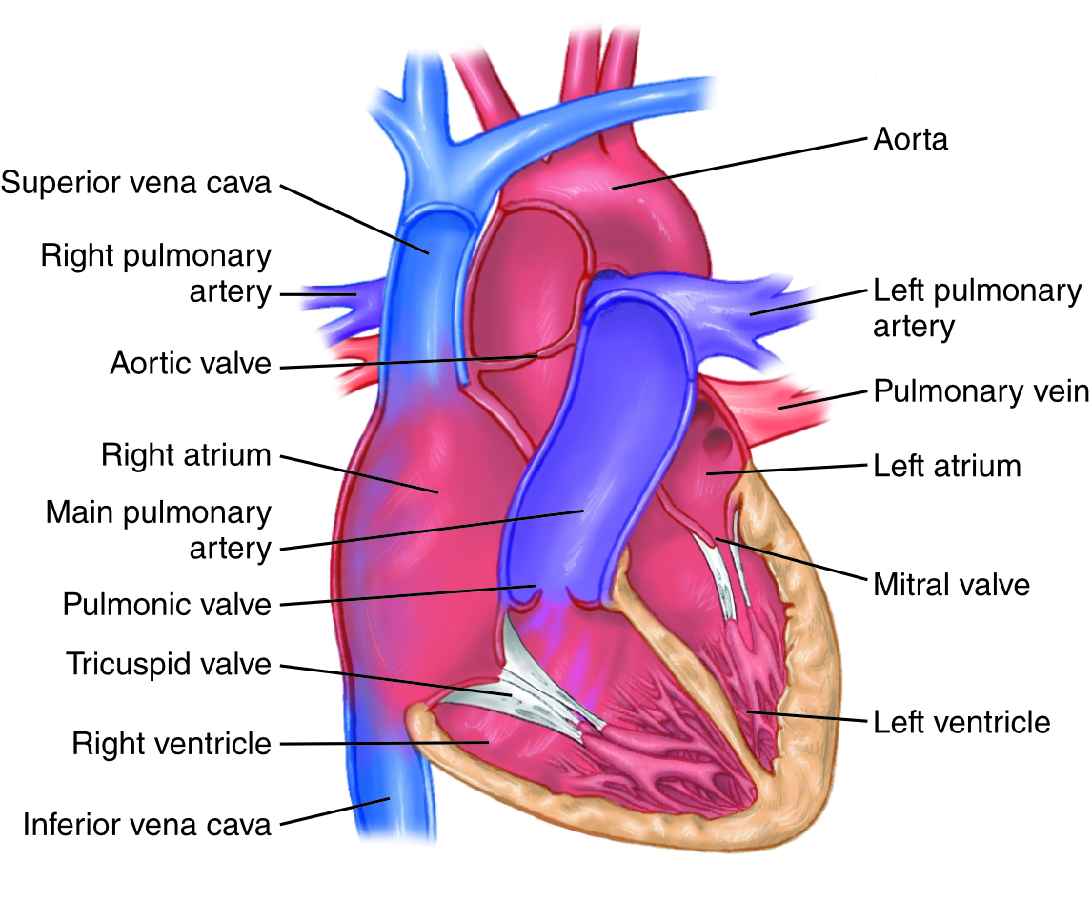
The Cardiovascular System: The Heart
6-2
6-3
The heart is divided into four compartments, called chambers.
Upper chambers are called atria.
Lower chambers are called ventricles.
The two chambers on the right side are separated from the two chambers on the left side by a wall.

Slide 45
The Cardiovascular System: The Heart
6-2
6-3
There are four valves in the heart, two on each side.
These valves allow blood to flow only in one direction when the heart muscle squeezes and moves the blood.

Slide 46
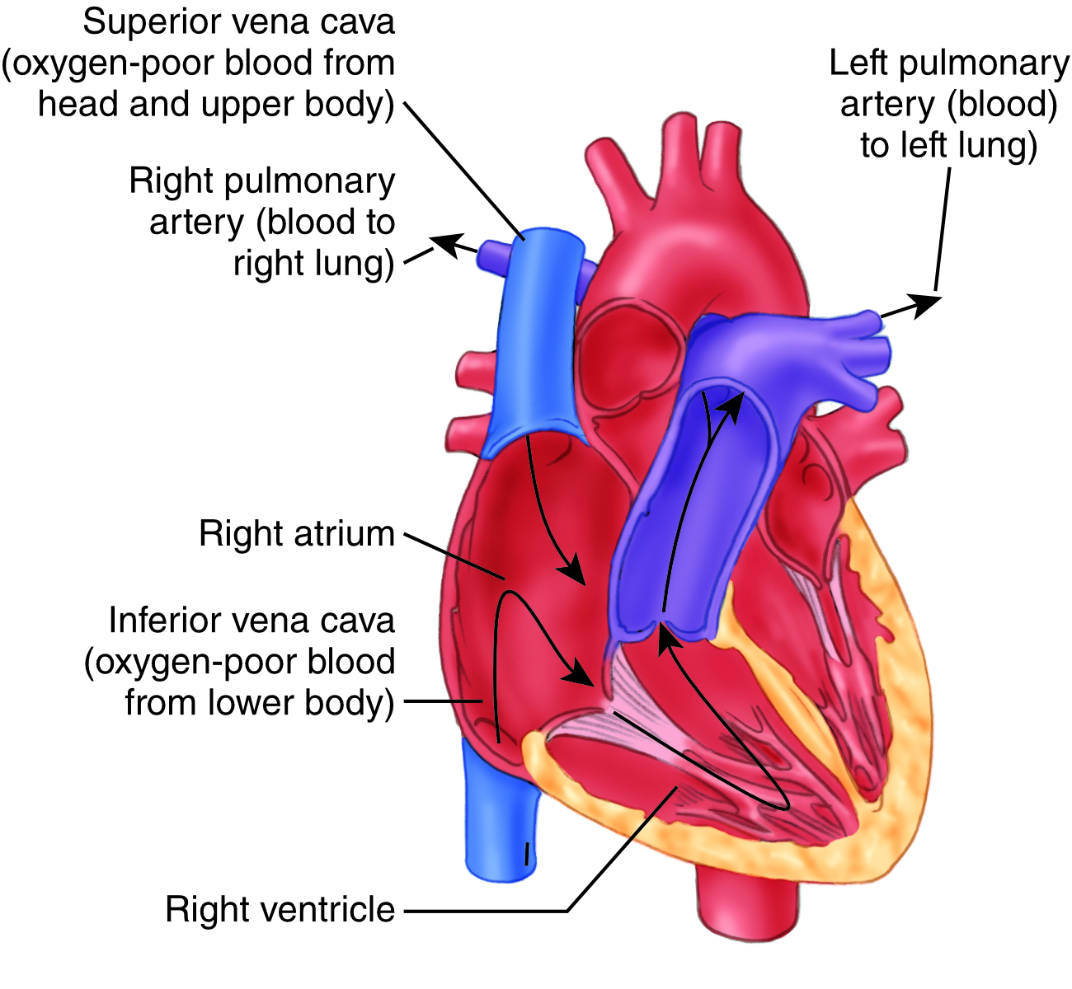
The Cardiovascular System: The Heart
6-2
6-3
The heart functions as two pumps: right and left.
The right side pumps blood to the lungs.

Slide 47
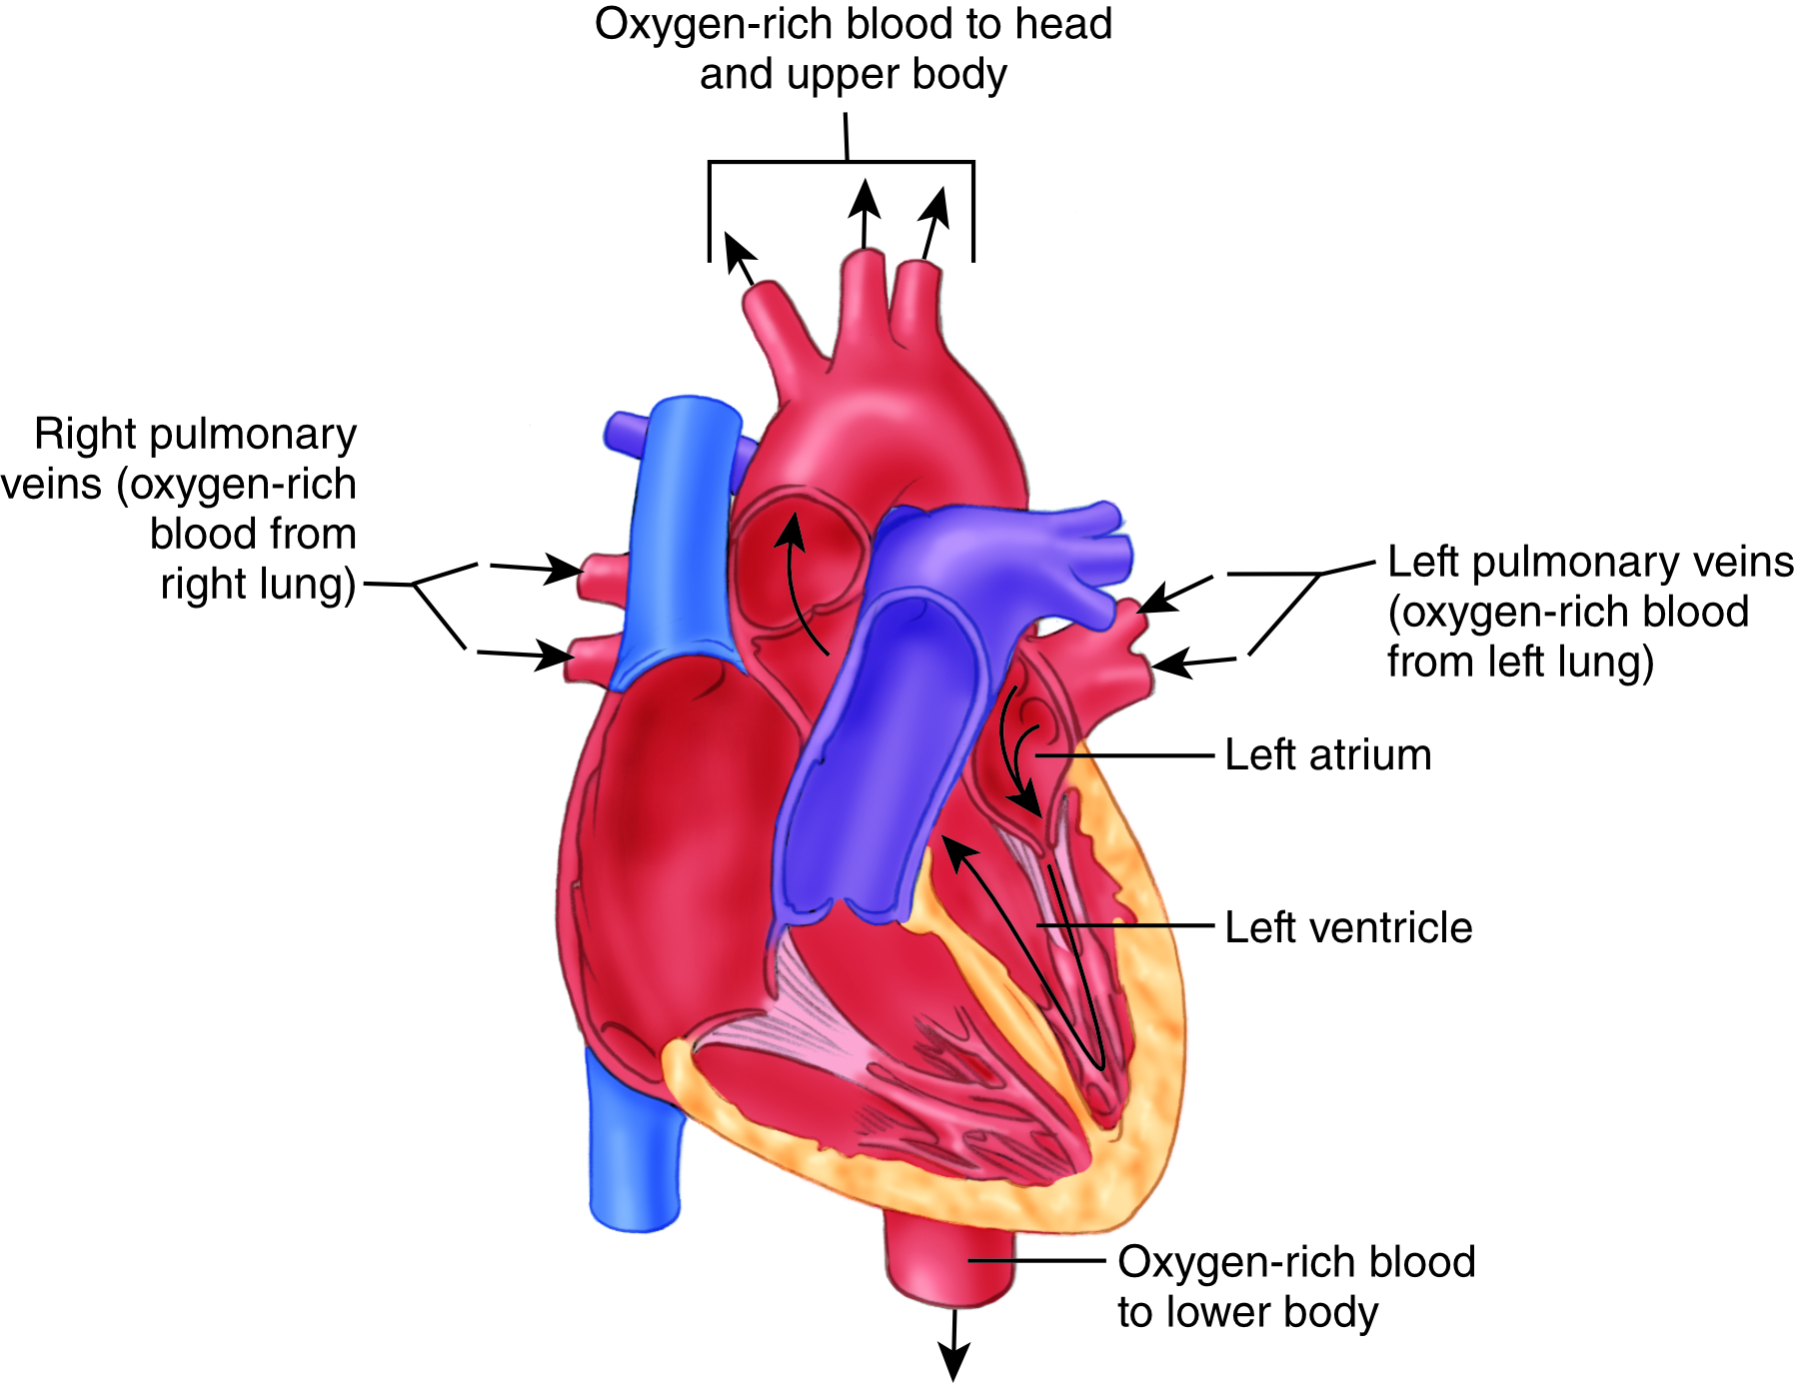
The Cardiovascular System: The Heart
6-2
6-3
The left side pumps blood to the rest of the body and the heart.
To the body: through the aorta
Big artery on top of the heart
To the heart: through coronary arteries
Arise from the first part of the aorta

Slide 48
The Cardiovascular System: The Heart
6-2
6-3
Coordination of pumping is regulated through a specialized electrical network of cells that “pace” the heart.
“Pacemaker” cells create an electric current.
Conducted through the heart and causes the heart’s muscle to contract in a coordinated way
All muscle cells in the heart can generate their own electric current.
Normal conditions:
Dominant pacemaker cells provide the electric impulse for coordinated contractions.
Electric impulse begins in the muscle of the right atrium and spreads through both atria, causing contraction of both atria.

Slide 49
The Cardiovascular System: The Heart
6-2
6-3
The impulse then spreads to cells in the right and left ventricles.
Leading to a coordinated contraction of both ventricles
This coordination results in oxygenated blood being pumped out of the heart.
The right side supplies blood to the lungs.
The lungs oxygenate it.
The left side supplies oxygenated blood to the rest of the body.

Slide 50
The Cardiovascular System: The Heart
6-2
6-3
The heart’s pacemaker cells fire at a basic rate.
Can be changed when needed by input from autonomic nerves
In a diseased heart:
If one group of pacemaker cells fails, the next one in the chain can take over.
This results in a slower heart rate and often less-coordinated contractions.
Abnormalities in the heart’s electrical system can lead to an abnormal heartbeat or rhythm, called an arrhythmia.

Slide 51
The Cardiovascular System: The Blood Vessels
6-2
6-3
The Blood Vessels:
Arteries and arterioles carry blood away from the heart to the lungs and body.
Veins and venules bring blood back to the heart.
Capillaries connect the arteries to the veins.

Slide 52
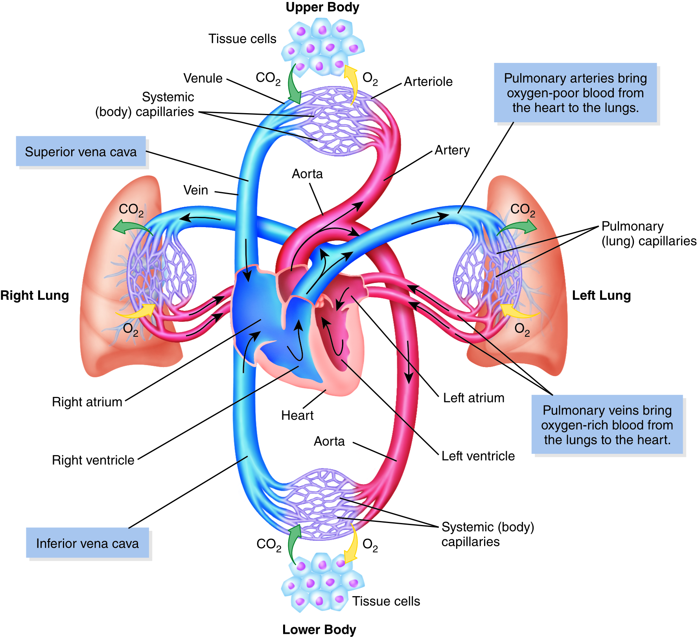
The Cardiovascular System: Pulmonary Arteries
6-5
Arteries contain oxygen-rich blood.
The exception is pulmonary arteries.
These come out of the right side of the heart and go to the lungs.
Contains the oxygen-depleted blood that has gone through the body

Slide 53
The Cardiovascular System: The Blood Vessels
6-5
Capillaries connect the arterial side of the vascular system to the venous side.
Very small tubes near all of the body’s cells
Provide nutrients, oxygen, and other substances to the cells
Capillaries exchange these needed substances for waste materials.
Including carbon dioxide
Through the capillaries, the waste products enter the bloodstream and are carried to the kidneys and lungs to be excreted.

Slide 54
The Cardiovascular System: Pulmonary Veins
6-5
The venous system carries blood from the tissues back to the heart.
Venous blood still has some oxygen in it but less than arterial blood.
Because oxygen has been given to the body’s tissues
The exception is the pulmonary veins.
Carries oxygenated blood from the lungs to the heart

Slide 55
The Cardiovascular System: The Blood Vessels
6-5
On the venous side, venules on the other side of the capillaries are the smallest tubes that carry the blood back to the heart.
These venules merge into larger veins, which merge into still larger veins as they get nearer to the heart.
Superior and inferior venae cavae, the largest veins, act as reservoirs, supplying oxygen-depleted blood to the heart.
Blood goes through a closed circular system.

Slide 56
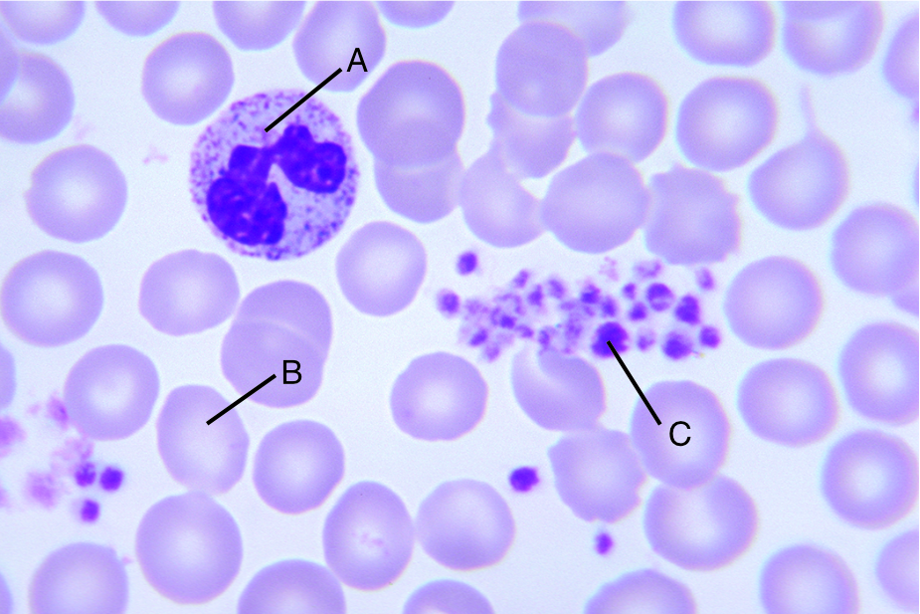
The Cardiovascular System: The Blood
6-2
6-3
There are four main components of blood:
White blood cells
Red blood cells
Platelets
Plasma, the straw-colored liquid in which they are suspended

Slide 57
The Cardiovascular System: Red Blood Cells
6-2
6-3
The function of the red blood cells is:
To carry oxygen to the body’s cells
Assist in removing carbon dioxide from them
Oxygen is carried primarily by hemoglobin in the red blood cells.
The iron in the hemoglobin of red blood cells gives blood its red color.
A small amount of oxygen dissolved in the plasma
Carbon dioxide is dissolved primarily in the plasma as carbonic acid.
With a small amount carried by the red blood cells

Slide 58
The Cardiovascular System: White Blood Cells
6-2
6-3
White blood cells are part of the body’s immune system.
Help the body defend itself against infection
Several types of white blood cells, each providing defense against different microorganisms

Slide 59
The Cardiovascular System: Platelets and Plasma
6-2
6-3
Platelets
Forms blood clots to stop bleeding
Plasma
Carries the blood cells and nutrients to the tissues
Carries waste products away from the organs
Transports other important chemicals such as hormones

Slide 60
The Cardiovascular System: Circulation
6-4
Blood makes a complete circuit throughout the body:
The heart’s right atrium receives blood from the vena cava.
The right atrium pumps it through a one-way valve into the right ventricle.
The right ventricle in turn pumps the blood through another one-way valve into the pulmonary arteries.
The pulmonary arteries then go to the lungs for oxygenation of blood.
In the lungs, oxygen is obtained, and carbon dioxide is released.

Slide 61
The Cardiovascular System: Circulation
6-4
Blood flows through pulmonary veins from the lungs back to the left atrium of the heart.
The left atrium receives this oxygen-rich blood and delivers it through a valve to the left ventricle.
Oxygen-rich blood is then pumped through another one-way valve into the aorta, the major artery that leaves the left side of the heart, and then on to the arteries.
Arteries travel throughout the body, carrying blood with increased oxygen to the tissues.
Arteries branch into increasingly smaller vessels, called arterioles.

Slide 62
The Cardiovascular System: Circulation
6-4
Narrow arterial vessels carry blood into the smallest blood vessels, the capillaries.
Once in the capillaries, nutrients enter the blood through the thin capillary walls to the cells, while waste from the cells pass into the capillaries.
Nutrients come from:
The digestive system
The lungs (oxygen)
Blood then travels through veins of increasing sizes during its return to the heart.

Slide 63
The Cardiovascular System: Venous Pressure
6-4
When the blood reaches the capillaries, there is not enough pressure to get the blood back to the heart through the veins.
Movement in some organs and the tightening of muscles in the arms and legs squeeze the veins and thus send blood back to the heart.
Veins have small one-way valves in their tubes, allowing blood to go only toward the heart.

Slide 64
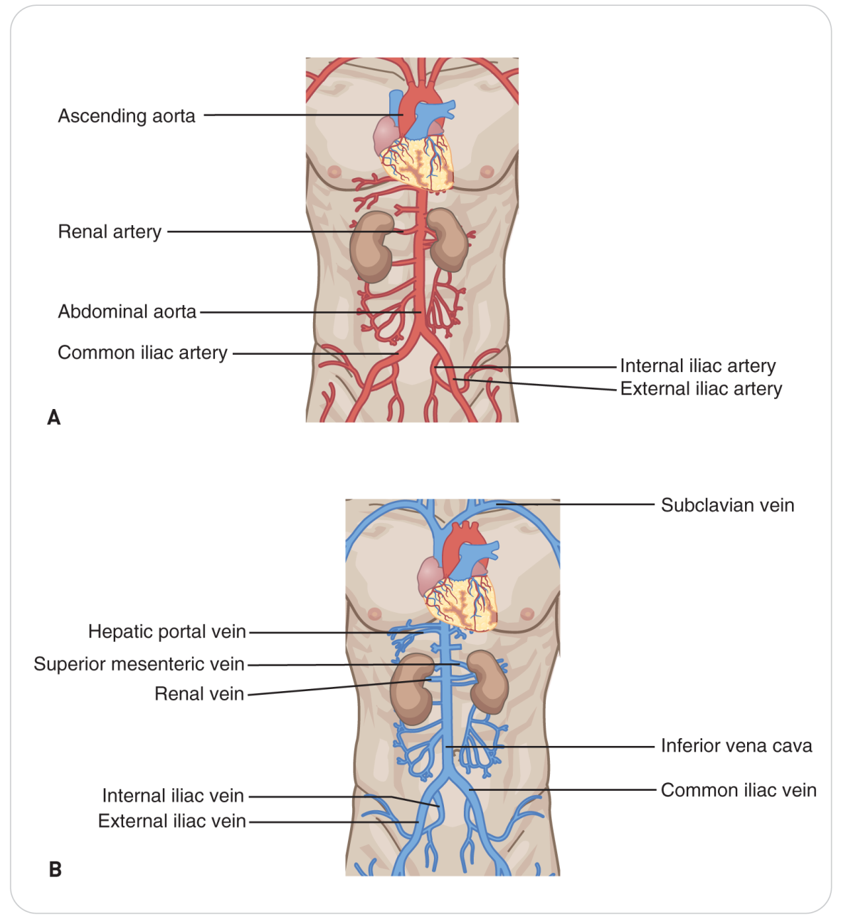
The Cardiovascular System: Venous Pressure
6-4
Large artery and vein that enter each kidney off the lower aorta and vena cava
Vessels carry blood into and out of each kidney, where waste is filtered into the urine.
Blood is cleaned after filtering through the kidneys.

Slide 65
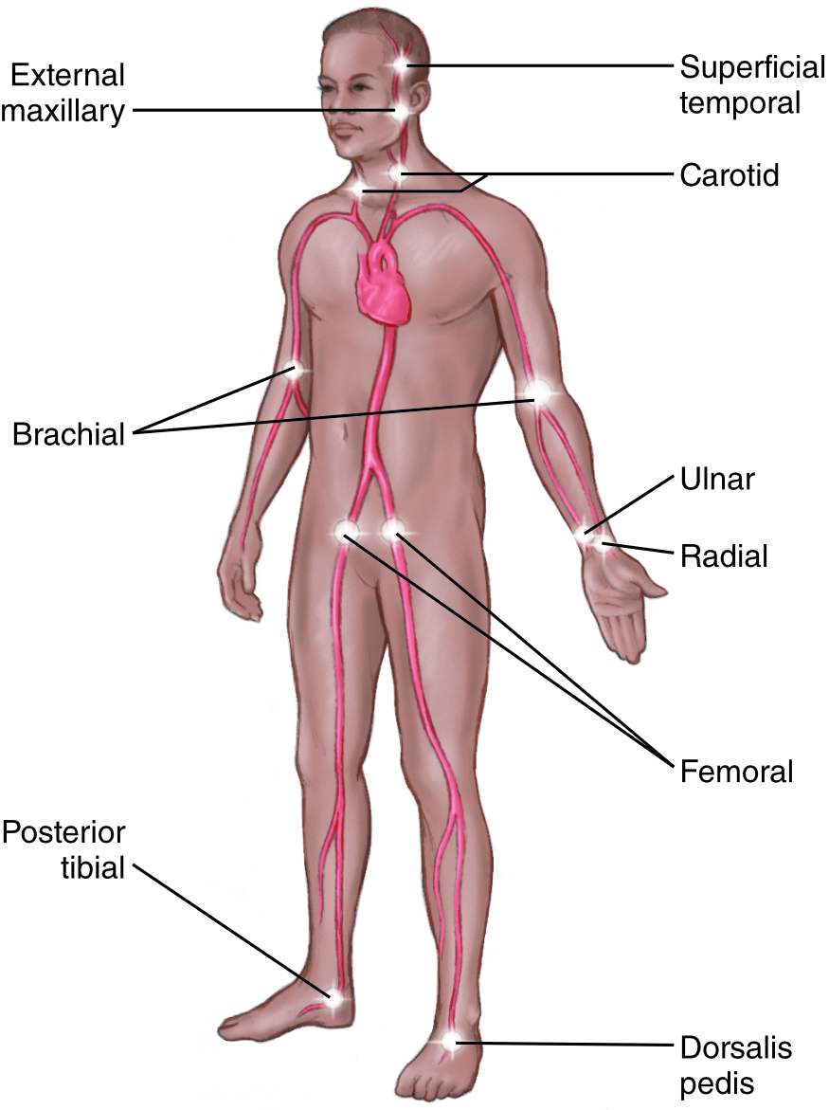
The Cardiovascular System: Pulse
Pulse
As the heart pumps blood from the left ventricle to the body, a wave of pressure, called blood pressure, can be felt by palpating arterial pulse points.
Five main arteries close to the skin, where a pulse may be taken:
Carotid
Brachial
Radial
Dorsalis pedis
Femoral

Slide 66
The Cardiovascular System: Blood Pressure
Blood Pressure
Blood pressure consists of two measures:
Systolic pressure
When the left ventricle maximally squeezes blood into the aorta
Diastolic pressure
When the left ventricle is at rest
Represents the lowest pressure maintained in the arteries
Measured in millimeters of mercury (mm Hg)
Blood pressure is expressed as “systolic pressure over diastolic pressure.”
For example, 120 over 80, written as 120/80 mm Hg

Slide 67
Body Systems: Nervous System

Slide 68
The Nervous System
6-2
6-3
The nervous system is the most complex of all the body systems.
The brain:
The computer of the nervous system
Is responsible for the control of all the body systems
Coordinates the function of sensation, controls muscles, keeps body organs functioning automatically, and integrates consciousness, memory, emotions, and the use of language

Slide 69
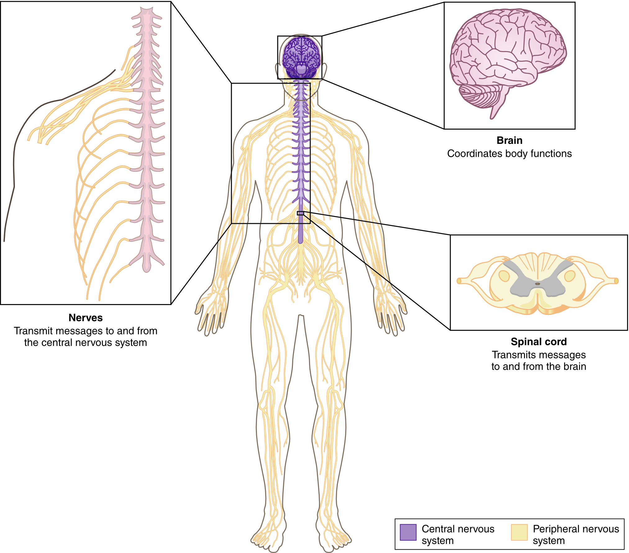
The Nervous System
Divided into two main anatomic parts:
The central nervous system (CNS)
Brain
Spinal cord
The peripheral nervous system (PNS)
Connect the spinal cord to the body

Slide 70
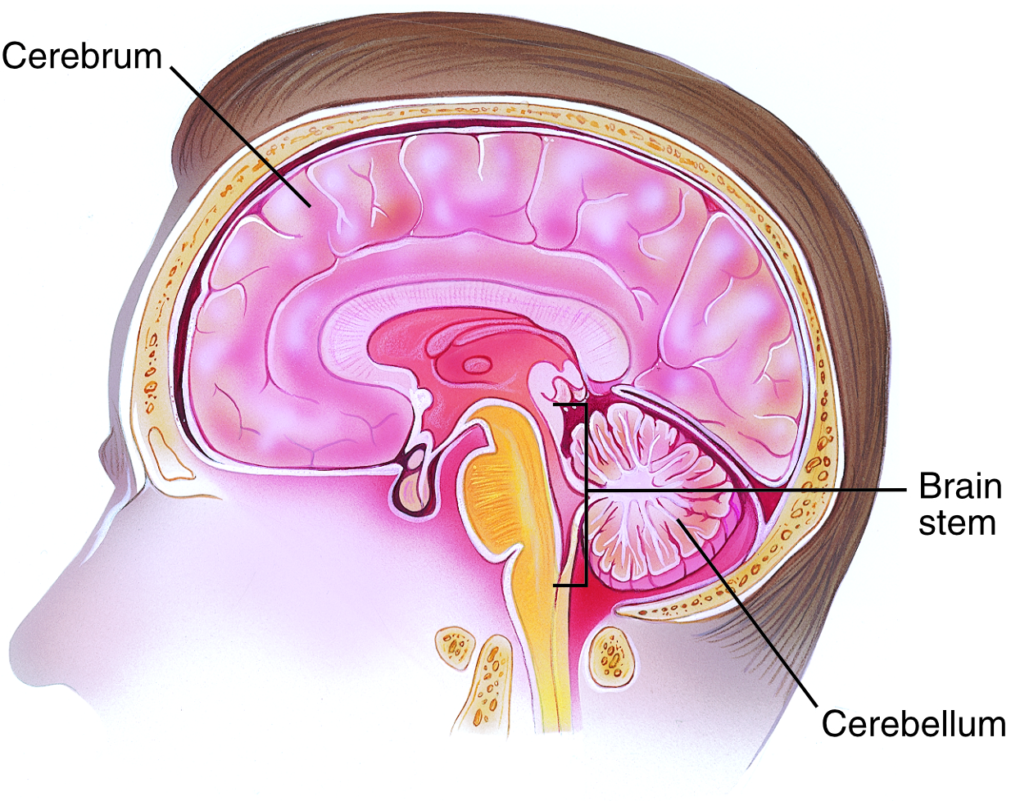
The Nervous System: The Brain
The brain can be divided into three major portions:
The cerebrum
The cerebellum
The brainstem

Slide 71
The Nervous System: Cerebrum
The cerebrum is the largest part of the brain.
Approximately 75% of the brain
Responsible for higher functions such as:
Sense perception
Voluntary movement
Speech
Thought
Memory

Slide 72
The Nervous System: Cerebrum
Divided in the middle into left and right halves
Called cerebral hemispheres
The right side of the brain controls the left side of the body.
Left side of the brain controls the right side of the body.

Slide 73
The Nervous System: Cerebellum
The cerebellum is in the middle of the brain.
Below the posterior aspect of the cerebrum and above the brainstem
It controls balance and coordination.

Slide 74
The Nervous System: Brainstem
The brainstem is below the cerebellum.
The pons and the medulla oblongata are parts of the brainstem.
Controls the most fundamental life-support functions of the body, such as heart rate and breathing
Gives rise to 12 specialized “cranial” nerves that support important functions, such as smell, sight, facial movement, and hearing
The spinal cord comes out of the bottom of the brainstem.

Slide 75
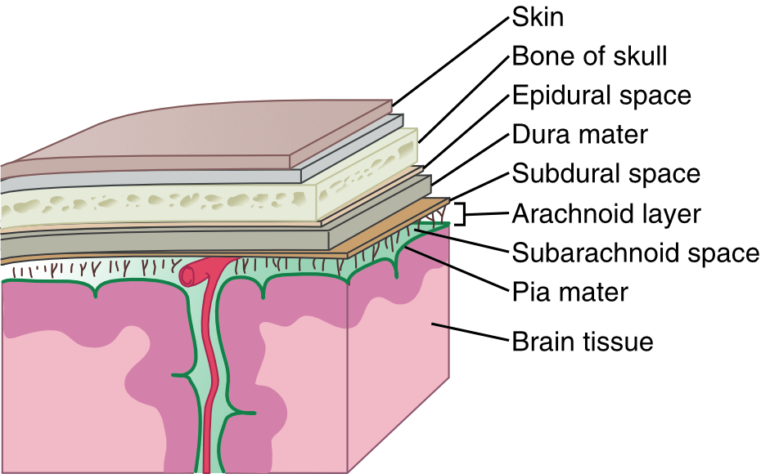
The Nervous System: Meninges
The brain and spinal cord are covered by three protective layers.
Collectively known as the meninges
Circulating within these layers is cerebrospinal fluid.
Cerebrospinal fluid (CSF) is a clear fluid.
Produced inside the brain
Circulates throughout the central nervous system in a network of canals within the meninges

Slide 76
The Nervous System: Cerebrospinal Fluid
The brain is suspended in the cerebrospinal fluid.
Protecting the brain from striking the inside of the skull
The flow of CSF:
Carries metabolic wastes away from the nervous system tissues
Helps regulate chemical concentrations and pH around the brain

Slide 77
The Nervous System: Spinal Cord
The Spinal Cord
A large rope-like bundle of nerve fibers
Comes out of the brain through a large hole in the skull called the foramen magnum
Travels inside the bones of the spine to the lower back
Protected by CSF and the three layers of the meninges
Also protected by the vertebral bodies

Slide 78
The Nervous System: Spinal Cord
Cauda Equina:
The distal portion of the spinal cord
In the lower back, at the level of the first lumbar vertebra, the nerve fibers fan out in a structure known as the cauda equina.
Latin for “horse’s tail”

Slide 79
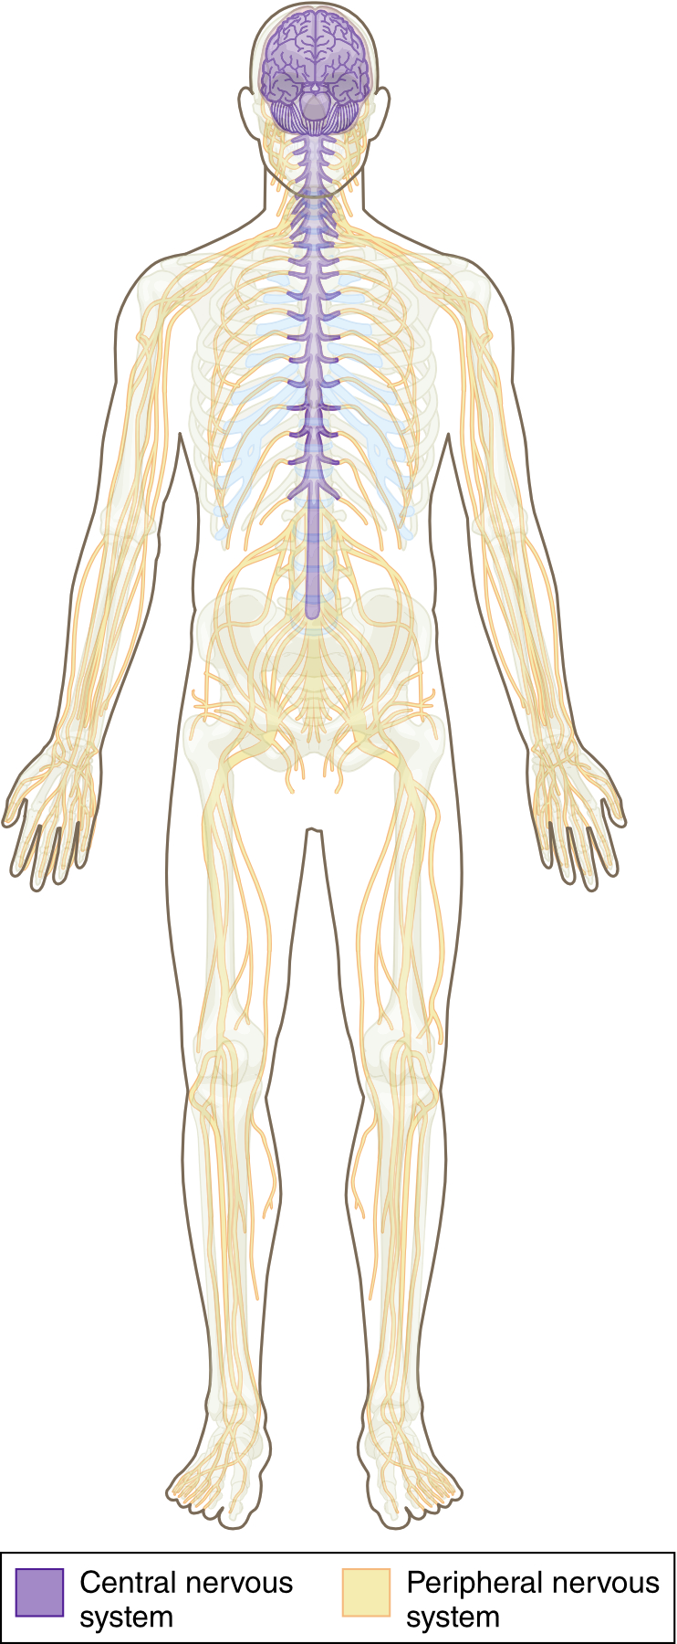
The Nervous System: Peripheral Nervous System
The peripheral nervous system is located outside the brain and spinal cord.
These nerves attach to the spinal cord.
The neuron
The fundamental functional unit of the nervous system
The cell that conducts information

Slide 80
The Nervous System: Peripheral Nervous System
The nervous system functions as a well-trained and highly efficient command center.
Information is transmitted from nerve endings in the body to the brain through the spinal cord.
Such as sensation, temperature, and position of the body
Motor instructions from the brain by way of the spinal cord travel through the peripheral nerves to the muscles.

Slide 81
The Nervous System: Two Functional Systems
The nervous system also can be divided into two functional systems:
The voluntary system
Controls movement of the muscles
Transmits sensations from the sensory organs to the brain and spinal cord
The autonomic (automatic) systems
Involuntary
Controls the involuntary actions of the organs and glands

Slide 82
The Nervous System: Autonomic Nervous System
Information from the body’s internal organs is transmitted by the autonomic nervous system to the CNS.
CNS processes it and generates a response.
The response is then transmitted from the brain, through nerves in the spinal cord, to target organs.
The body reacts accordingly.

Slide 83
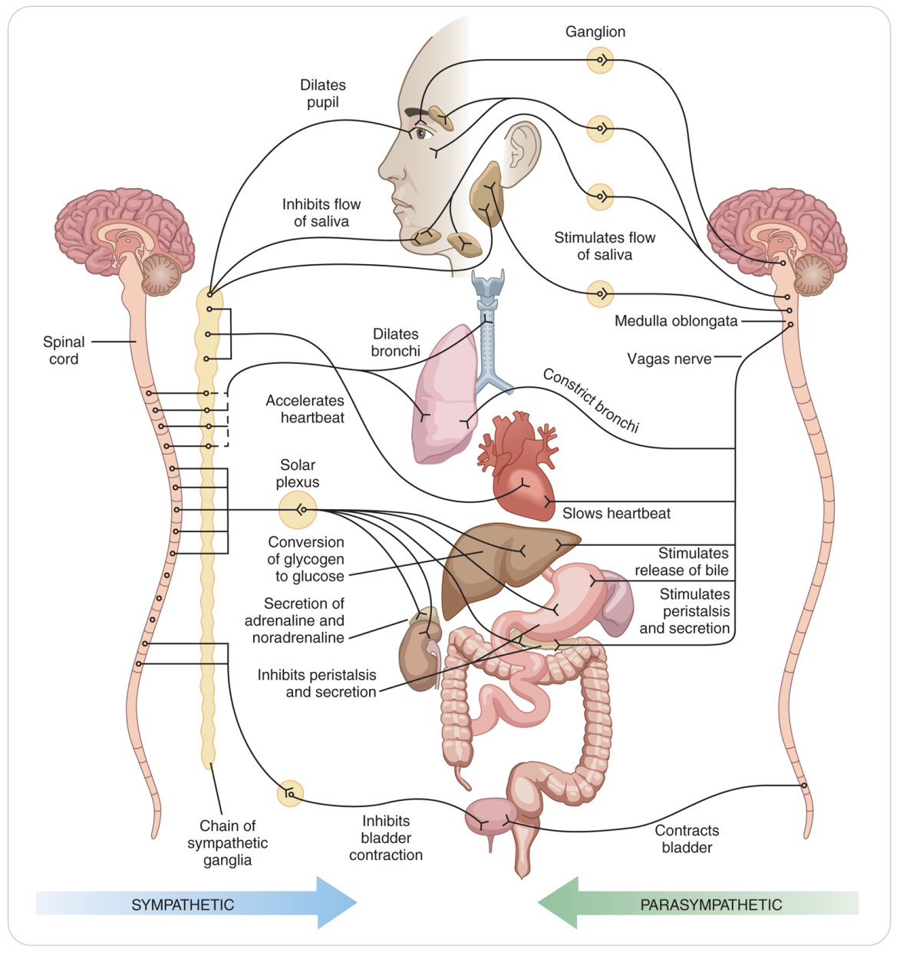
The Nervous System: Autonomic Nervous Systems
Can be divided into two subsystems:
The sympathetic division
Controls the body’s response to stressors such as pain, fear, and a sudden loss of blood
These actions are sometimes referred to as the fight-or-flight response.
The parasympathetic division

Slide 84
The Nervous System: Fight, Flight, or Freeze Response
A stress response is stimulated by one or more of the body’s five senses: sight, smell, hearing, taste, or touch.
Stress responses are controlled by the nervous system.
When stressed, the body exhibits numerous physical signs and symptoms, such as:
Nausea
Diarrhea
Dry mouth
Sweaty palms
Increased heart rate
Rapid breathing
Dilated pupils

Slide 85
The Nervous System: Fight, Flight, or Freeze Response
The fight-or-flight response
Sometimes called the “fight, flight, or freeze” response
A function of the involuntary, autonomic nervous system
Other functions include breathing, heart rate, and digestion.
A release of chemicals such as epinephrine (adrenaline) during stress causes elevated heart rate and blood pressure, pupil dilation, increased respiratory rate and airway capacity, and increased blood flow to the muscles of the arms and legs.
Extra blood flow to muscles provides the additional oxygen and nutrients needed for rapid skeletal movement.

Slide 86
Body Systems: Digestive System

Slide 87
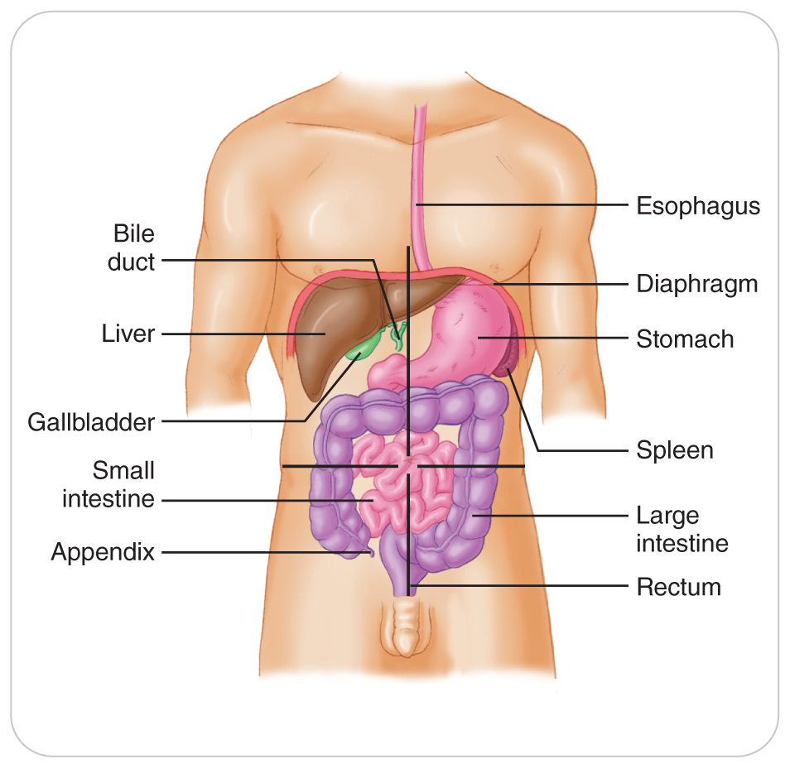
Digestive System
6-2
6-3
Digestive System
Also known as the gastrointestinal system
Consists of the organs that work together to process food and absorb water
Composed of the alimentary tract (food passageway) and several accessory organs that contribute to the digestive process
The organs of the digestive system:
Break down food
Absorb nutrients
Eliminate indigestible food components and some wastes

Slide 88
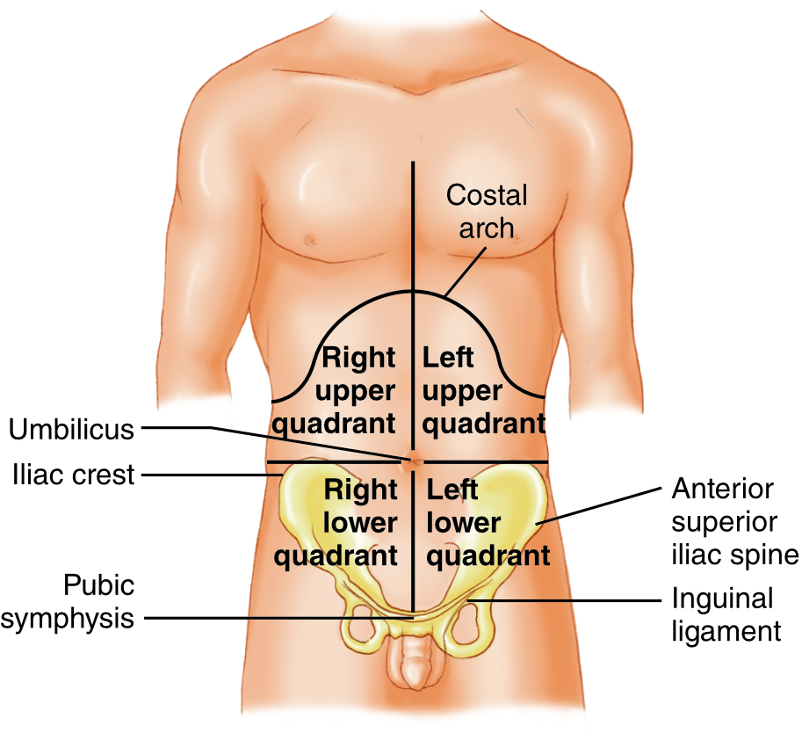
Digestive System: Four Quadrants
6-2
6-3
The most common method of describing portions of the abdomen is by quadrants.
Four equal areas formed by two imaginary lines that intersect at the umbilicus

Slide 89
Digestive System: Digestion
Digestion occurs both mechanically and chemically.
Mechanical digestion
The physical breaking down of food that begins with chewing, swallowing, and moving the food through the digestive tract
Chemical digestion
The process whereby chemicals break foods down into components the body can absorb, such as fatty acids and amino acids
Some of these chemicals come from accessory organs: the pancreas and gallbladder.

Slide 90
Digestive System: Digestion
Food enters the digestive system through the mouth.
In the mouth, it is chewed and mixed with saliva, which breaks down starch into sugar.
Particles of food then pass down the esophagus, the passageway to the stomach.
In the stomach, hydrochloric acid is released and breaks food into smaller pieces.
Food travels from the stomach into the small intestine.
The small intestine consists of three parts: the duodenum, jejunum, and ileum.
Each of these parts functions differently in nutrient absorption.

Slide 91
Digestive System: Digestion
Two organs then aid in the digestive process in the small intestine:
The pancreas secretes pancreatic juices, or enzymes, that aid in the digestion of fats, starches, and proteins.
The liver, the largest organ in the abdomen, aids in the digestion of fats by making bile.
The gallbladder stores and releases bile into the upper small intestine.
Liver is also responsible for breaking down many toxic substances absorbed through the intestines.

Slide 92
Digestive System: Digestion
Following the digestion of food into a liquid, tiny nutrients are absorbed through the small intestine’s wall into a group of venous blood vessels in the intestines.
The nutrients then go to the liver.
For absorption and processing
Then to the blood to the heart through the inferior vena cava
Then the heart pumps the nutrients to the body.

Slide 93
Digestive System: Digestion
Unused food and some wastes from the liver end up in the large intestine or colon.
Stool, also called feces, gets its characteristic brown color from the breakdown of old red blood cells (waste from the liver).
The large intestine reabsorbs water from this material, making it solid, formed stool.
Gas-forming bacteria that are normal residents in the intestines aid in the digestion of the food.
They also create noxious gases, primarily methane.
Both the stool and the gas are expelled from the anus.

Slide 94
Body Systems: Urinary System

Slide 95
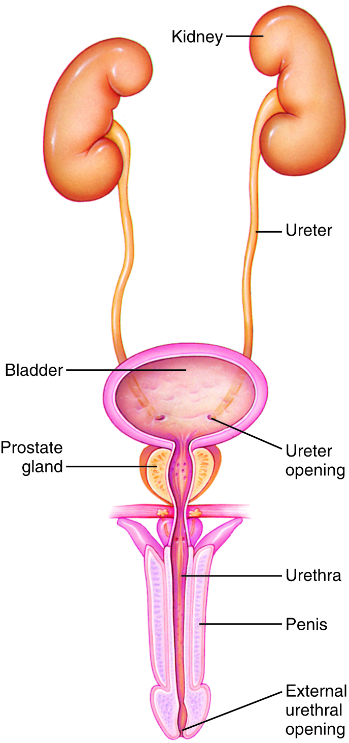
Urinary System
6-2
6-3
The urinary system consists of organs and other structures involved in the elimination of waste products.
Filtered from the blood by the kidneys and excreted in urine
These waste products include:
Normal by-products of the body’s metabolism
Toxins
The urinary system consists of the:
Kidneys
Ureters
Urinary bladder
Urethra

Slide 96
Urinary System
6-2
6-3
Kidneys: lower back outside the abdominal cavity
Urethra: the tube that carries the urine from the bladder to the point of exit from the body
Muscle at the top of the urethra controlled by the automatic nervous system controls urine continence.
The muscle can be released voluntarily when urination occurs.

Slide 97
Urinary System: Kidney Physiology
The kidneys produce urine by filtering metabolic wastes into the ureters from the blood.
They are selective: they keep nutrients in and excrete waste.
One large artery and vein attach to each kidney, allowing blood to flow through the kidneys
Water in the body is controlled by the kidneys.
Water balance in the blood is regulated by either increasing or decreasing the amount of sodium chloride (salt) that is excreted by the kidneys.
If salt is retained, water is retained.
If salt is excreted in the urine, water also is excreted.
The urinary system functions in maintaining the balance of other electrolytes and in controlling the pH of the blood.

Slide 98
Body Systems: Endocrine System

Slide 99
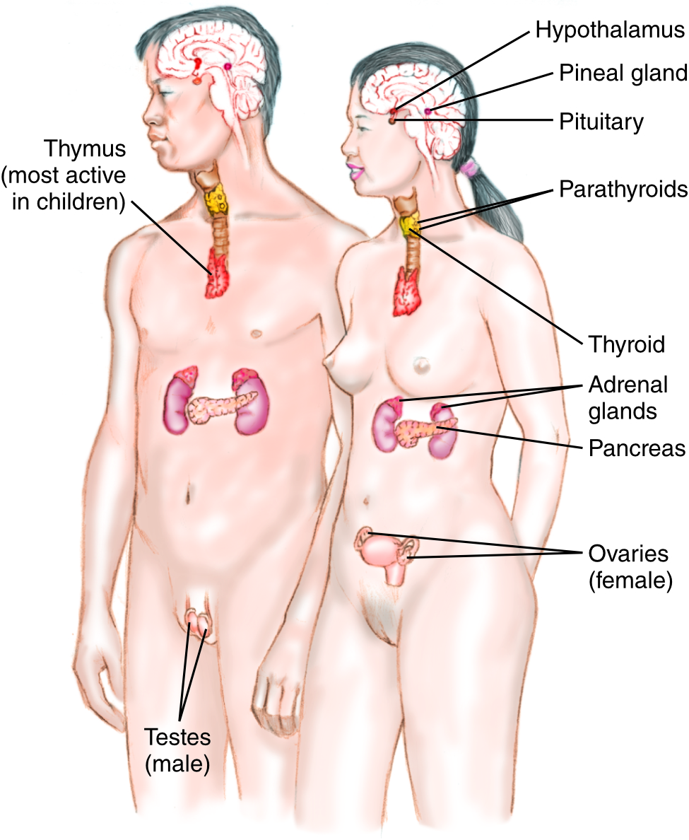
Endocrine System
6-3
The endocrine system is made up of ductless glands that secrete hormones.
Hormones are chemical substances that influence a variety of functions in distinct parts of the body.
The major endocrine glands include the:
Pituitary
Hypothalamus
Thyroid
Adrenals
Pancreas
Gonads (ovaries, testes)
Parathyroid
Pancreas
Pineal

Slide 100
Endocrine System: Pituitary Gland
6-3
Pituitary gland
Known as the “master gland”
Secretes different chemicals into the bloodstream that regulate growth in children and the activities of many other glands
Also affects kidney function
It is in the center of the brain.

Slide 101
Endocrine System: Hypothalamus
Hypothalamus
Secretes hormones that act on the pituitary gland
The hypothalamus helps control the regulation of water excretion by the kidneys.
This gland is also inside the brain.

Slide 102
Endocrine System: Thyroid
Thyroid gland
Located in the anterior neck
Regulates metabolism, growth, and development
Partially regulates nervous system activity
Inside the thyroid are the parathyroids, which regulate calcium metabolism.

Slide 103
Endocrine System: Adrenal Glands
Adrenal glands
Located on top of the kidneys
Secrete several hormones, including epinephrine (adrenalin)
Functions in the fight-or-flight response
Affects heart rate, digestive and kidney function
The contraction of smooth muscles, including those in the lungs and blood vessels
Also secrete cortisol (cortisone), which helps regulate the body’s response to stress and is necessary for life

Slide 104
Endocrine System: Pancreas
Pancreas
Located in the middle of the abdomen
Endocrine function
Secrete of hormones that regulate blood glucose
Insulin lowers blood sugar, while glucagon raises it.
Non-endocrine function
Make enzymes for digestion

Slide 105
Endocrine System: Gonads and Pineal Gland
Gonads
Ovaries in females and testes in males
Produce hormones that control reproduction and sex characteristics
They produce sperm in males and eggs in females.
Pineal gland
A tiny gland in the brain
Helps regulate daily wake/sleep patterns by secreting melatonin

Slide 106
Body Systems: Integumentary System

Slide 107
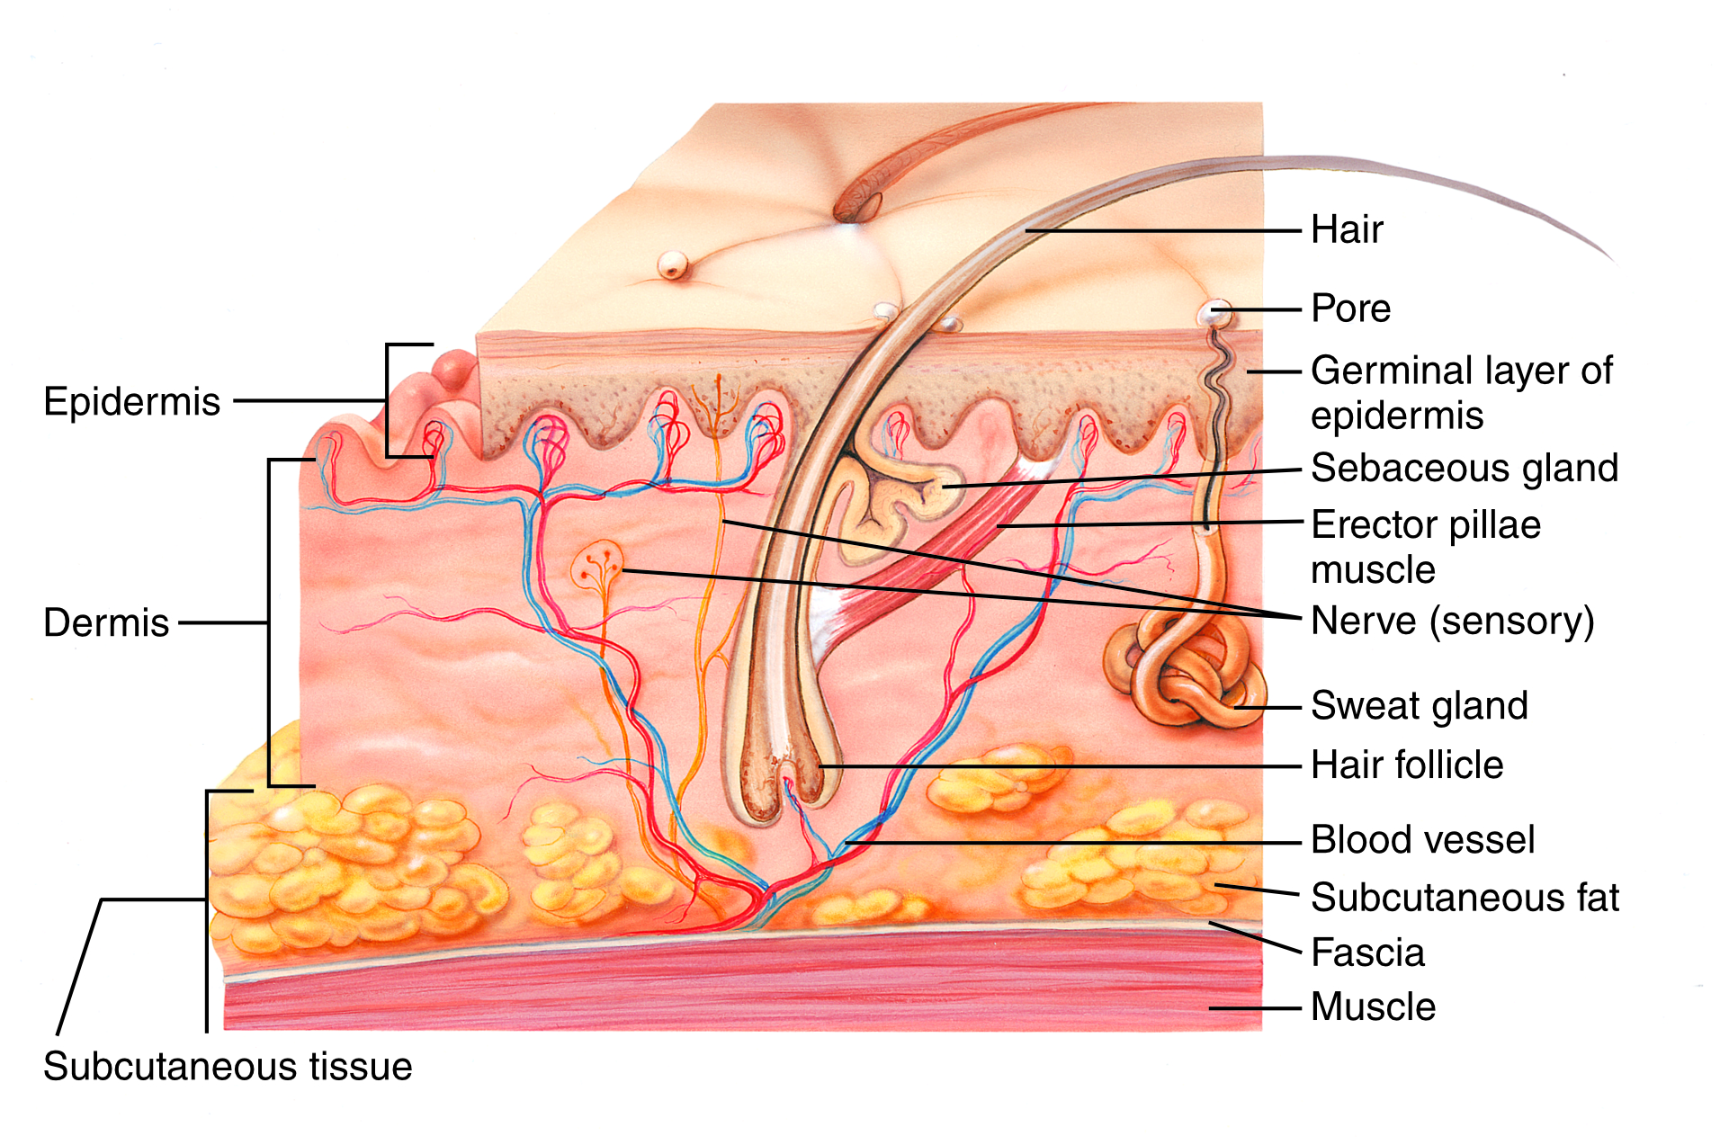
Integumentary System
6-3
The integumentary system consists of:
Skin
Hair
Nails
Sweat glands
Oil glands
Provides a protective barrier that separates our tissues, organs, and other systems from the outside world

Slide 108
Integumentary System
6-3
The skin is the body’s largest organ.
Two major layers: the epidermis and the dermis
Superficial epidermis
Contains the skin’s pigmentation
Protects us from the environment
Dermis
Contains blood vessels, nerve endings, glands, and hair
The primary source of the skin’s elasticity and strength
Under these layers is the deep subcutaneous layer, which is composed of fatty tissue.

Slide 109
Integumentary System
Major functions:
Protection of the body from injury and invasion by bacteria and other disease-producing pathogens
Regulation of body temperature and fluid balance
When blood vessels in the dermis dilate, the blood circulates close to the skin’s surface, allowing for the release of heat.
When those blood vessels constrict, less blood flows to the skin’s surface, conserving heat.
Evaporation of sweat produced by sweat glands in the skin also helps control body temperature.

Slide 110
Body Systems: Skeletal System

Slide 111
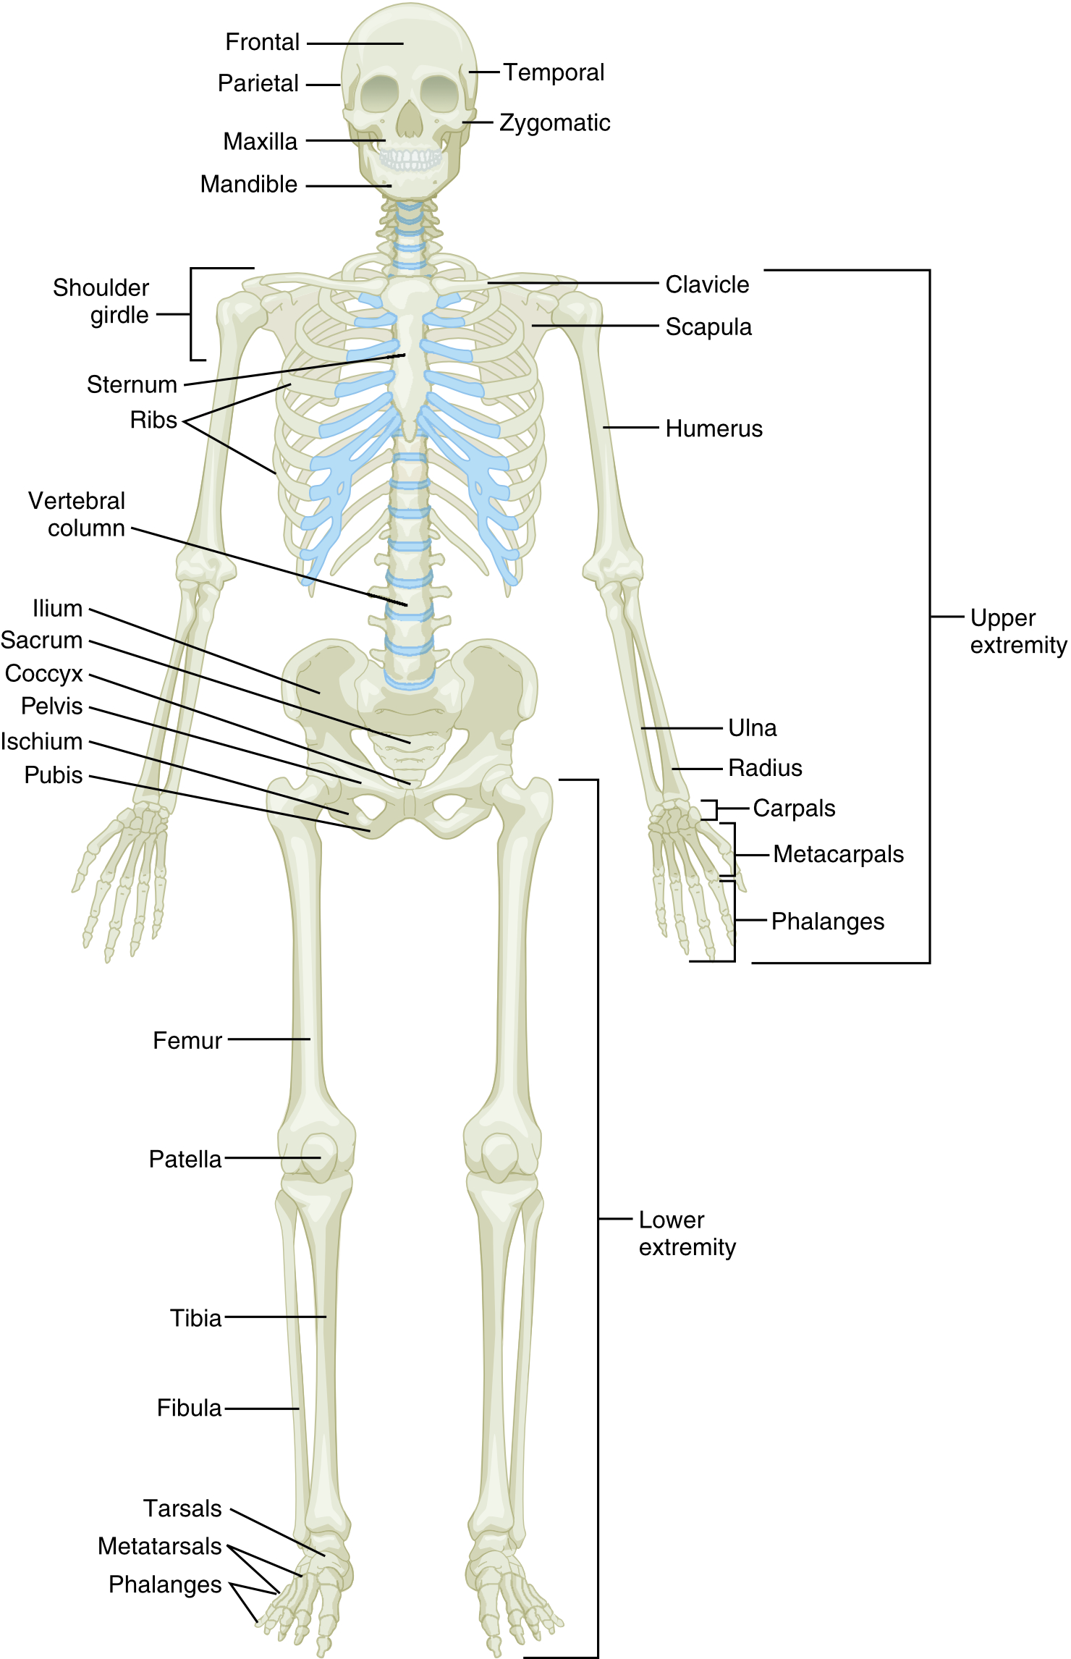
Skeletal System
6-3
6-6
The skeletal system includes bones and ligaments that support the body’s structure.
The adult skeleton has over 200 bones.
Bone is a hard, dense tissue that forms the skeleton.
Outer region of a bone is called the cortex.
Inner region contains porous tissue called marrow.

Slide 112
Skeletal System: Bones
6-3
6-6
Bones have varied sizes and shapes.
Enables them to perform specific functions
Long bones form the arms and legs.
Flat bones form the skull and pelvis.
Spinal bones have a unique shape of their own.

Slide 113
Skeletal System: Joints
Where two or more bones join, they form a joint.
Strong, tough, fibrous bands called ligaments hold the bones at a joint together.
Ligaments restrict joint movement based on their location.
Most joints allow movement.
Some (those in the skull) are immovable.
Others (those in the pelvis) allow only slight movement.

Slide 114
Skeletal System: Joints
Movable joints have a normal range of motion.
A distance they can move freely without causing injury
The most common types are:
Ball-and-socket joints
Hip and shoulder
Hinged joints
Elbow, knee, and finger joints
Different types of joints have different amounts of stability and allow different degrees of flexibility and types of movement.

Slide 115
Skeletal System: Skull
The skeleton consists of the following six sections:
Skull
Cranium:
Houses the brain
Made up of broad, flat bones that form the top, back, sides, and front of the skull
Facial Bones:
Thirteen smaller bones plus the freely movable lower jaw (the mandible) make up the face.

Slide 116
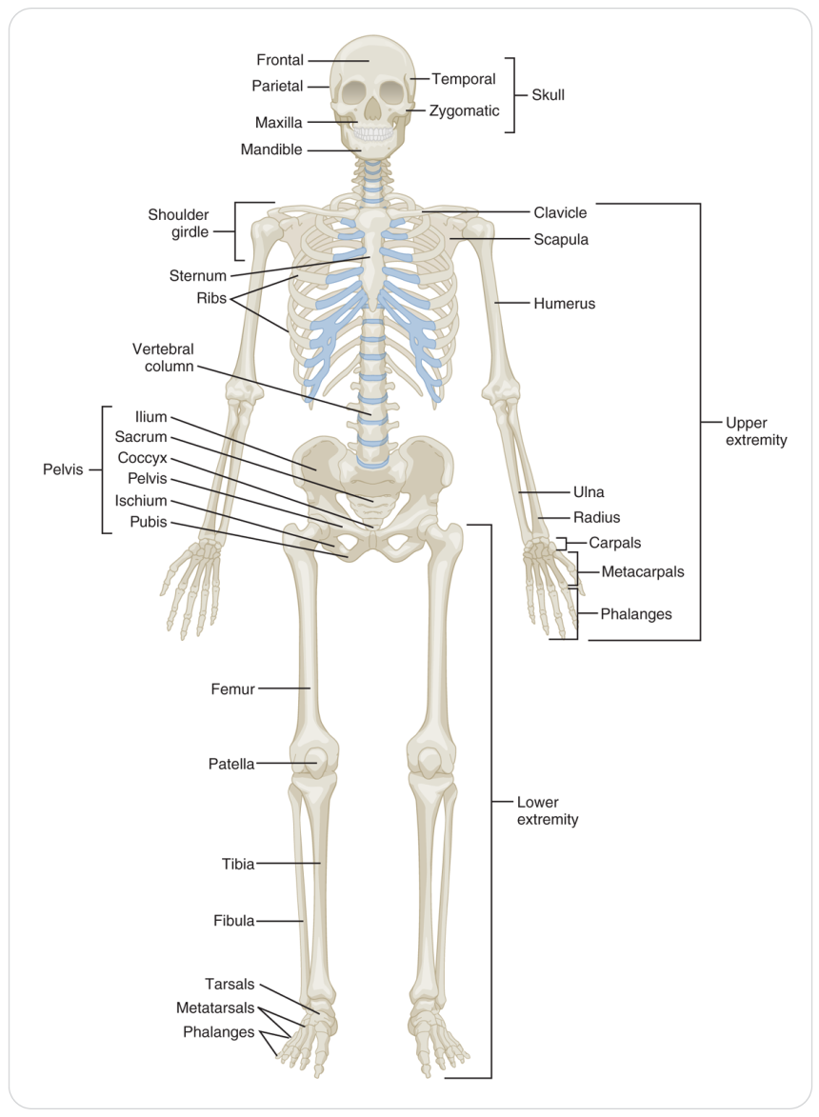
Skeletal System: Spinal Column
Spinal column
Houses and protects the spinal cord
It is the principal support system of the upright body.
The spinal column is made up of 33 small bones called vertebrae.
7 cervical vertebrae (neck)
12 thoracic vertebrae (upper back)
5 lumbar vertebrae (lower back)
5 sacral vertebrae (fused together in the lower spine)
4 fused coccygeal vertebrae (the tailbone, or coccyx)

Slide 117
Skeletal System: Thorax
Thorax
Made up of 12 pairs of ribs, the sternum, and the thoracic spine
Ten of the pairs are attached to the sternum by cartilage.
Together, these structures protect the heart and lungs.

Slide 118
Skeletal System: Pelvis
Pelvis
Made up of three sets of paired bones: the ilium, the pubis, and the ischium
Protects the pelvic organs, including the bladder and the internal reproductive organs

Slide 119
Skeletal System: Upper Extremities
Upper Extremities
Include the shoulders, upper arms, forearms, wrists, and hands
The upper arm bone is the humerus.
The two bones in the forearm are the radius (on the thumb side) and the ulna (on the pinkie side).
Attached to the trunk at the shoulder girdle
Made up of the clavicle (collarbone) and the scapula (shoulder blade)

Slide 120
Skeletal System: Lower Extremities
Lower extremities
Consist of the hips, upper and lower legs, ankles, and feet
Attached to the pelvis at the hip joints
The bone in the upper leg is the femur.
The bones in the lower leg are the tibia and fibula.
Patella (kneecap) is a small circular-shaped bone that protects the knee joint.

Slide 121
Skeletal System: Functions
The primary function of the skeleton is to provide structure to the body.
Additional functions:
A large storage site for important minerals, especially calcium, needed for many of the body’s functions
Bone marrow is the place where blood cells are made.
Red blood cells, white blood cells, and platelets are produced in the bone marrow and are released into the bloodstream through arteries that penetrate bones.
The bones of the skull, thorax, and pelvis protect internal structures from trauma.

Slide 122
Body Systems: Muscular System

Slide 123
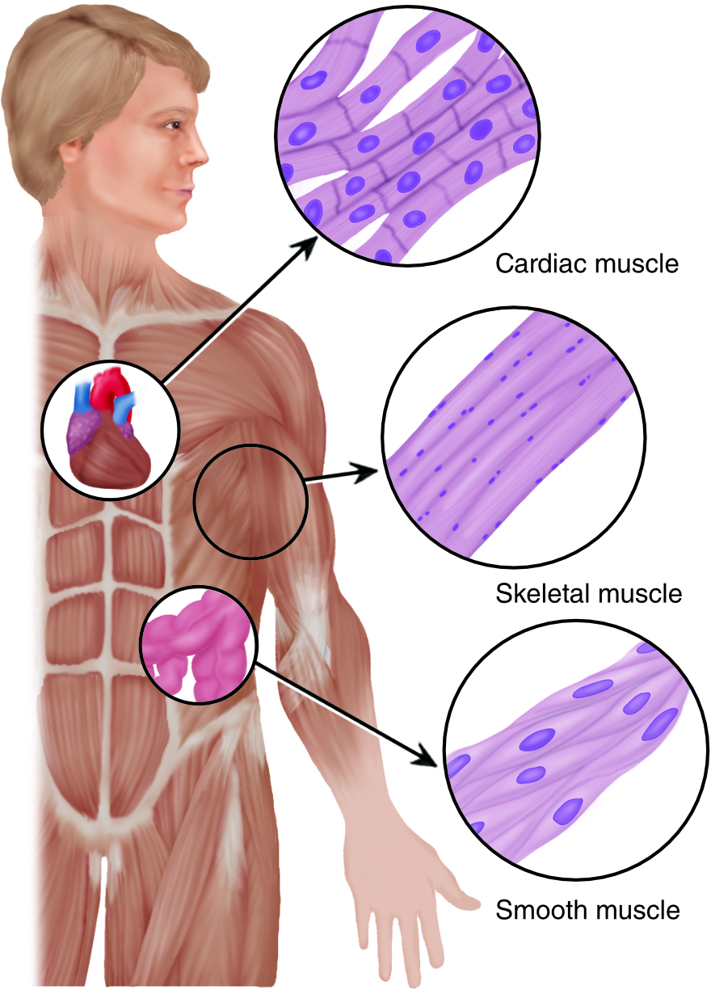
Muscular System
6-3
6-7
The Muscular System has three distinct types of muscle tissue in the body:
Skeletal
Allow the body to move
Smooth
Used for automatic body functions
Cardiac
Make heart work

Slide 124
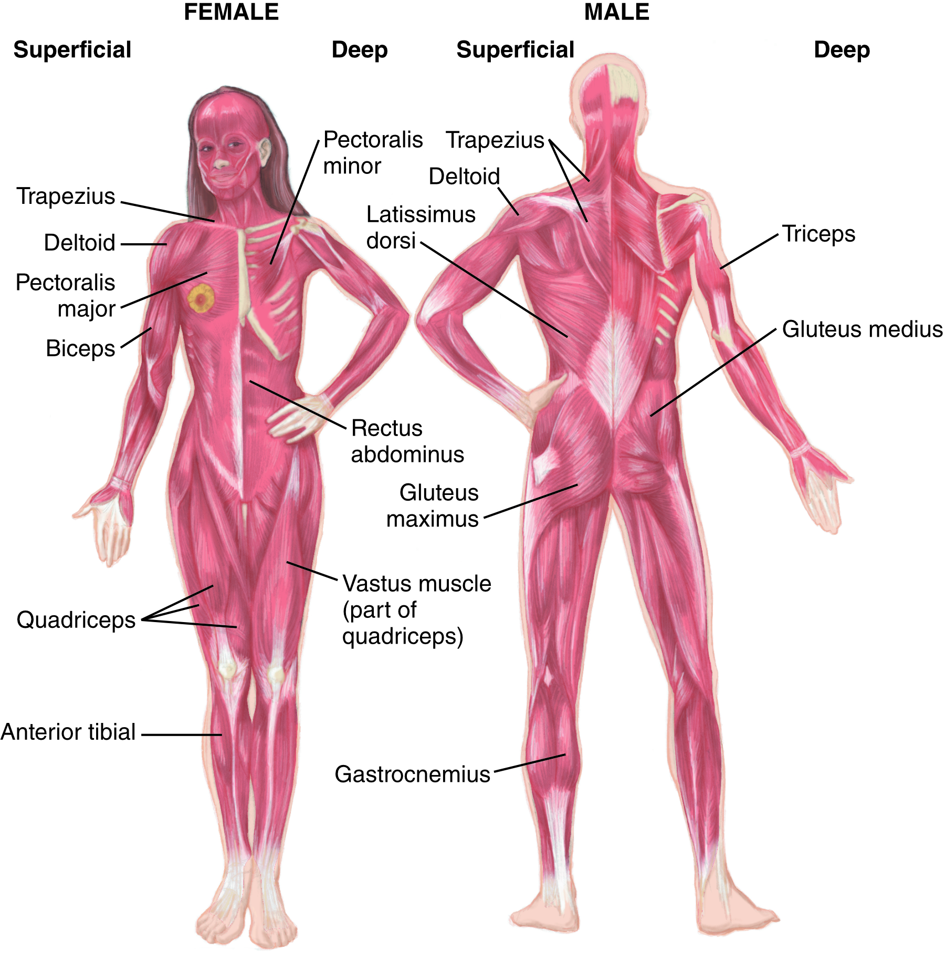
Muscular System: Skeletal Muscles
Skeletal muscles are under the control of the voluntary nervous system.
Also known as “voluntary muscles”
Give the body its shape
Make it possible to walk, smile, talk, move the eyes, and other functions

Slide 125
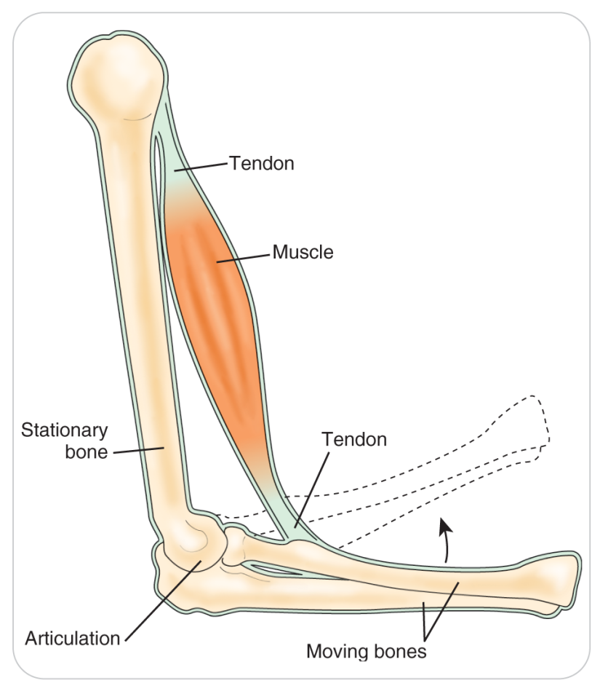
Muscular System: Muscle Fibers and Tendons
The body has over 600 skeletal muscles, most of which are attached directly to bones or to tendons.
A tendon is the extension of a muscle, composed of strong tissue, that connects the muscle to a bone.
It increases the mechanical advantage of a muscle by lengthening the lever arm across a joint.

Slide 126
Muscular System: Muscle Fibers and Tendons
Skeletal muscle cells, called fibers, are:
Usually long and threadlike
Are packed closely together in bundles
Are bound together by connective tissue

Slide 127
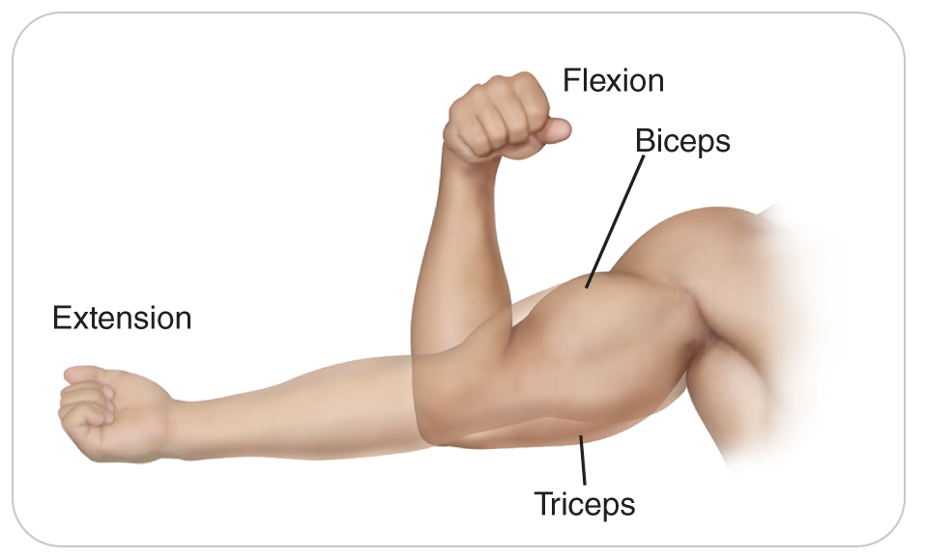
Muscular System: Contraction of Muscles
Muscle tissue attached to the skeleton can contract, becoming shorter, when stimulated by a nerve.
Contraction results in movement of a joint.
Skeletal muscles are typically paired.
One muscle produces flexion of a joint.
An opposing muscle produces extension of a joint.

Slide 128
Muscular System: Contraction of Muscles
Example:
Contraction of one set of muscles on the palm side of the forearm will produce flexion.
Allow for grasping a glass of water
Contraction of another set of muscles on the back of the forearm will produce extension.
Will release the glass

Slide 129
Muscular System: Smooth Muscles
Smooth muscles are found in the walls of tube-like organs, ducts, and blood vessels.
Also called involuntary muscles
They are “involuntarily” controlled for normal body functions.
Contraction of smooth muscle in vessels and ureters helps with movement of urine or blood.
Smooth muscle inside the wall of the intestines moves the food being digested along the gastrointestinal tract toward the anus.

Slide 130
Muscular System: Cardiac Muscle
Cardiac muscle is found only in the walls of the heart.
Shares some of the properties of both skeletal and smooth muscle
Unique property of being able to generate its own electrical impulses independent of the nervous system
Contraction of cardiac muscle causes the pumping action of the heart that moves blood through the cardiovascular system.

Slide 131
Body Systems: Reproductive System

Slide 132
Reproductive System
6-2
6-3
In both men and women, the reproductive system includes the organs for sexual reproduction.
Puberty usually begins between the ages of 10 and 14 years.
Controlled by hormones secreted by the pituitary gland
Hormones secreted by the pineal gland influence the secretion of male or female sex hormones.
Leads to the maturation of reproductive organs
Control what are called secondary sex characteristics
Facial hair in males
Breast development in females
Pubic hair in both sexes

Slide 133
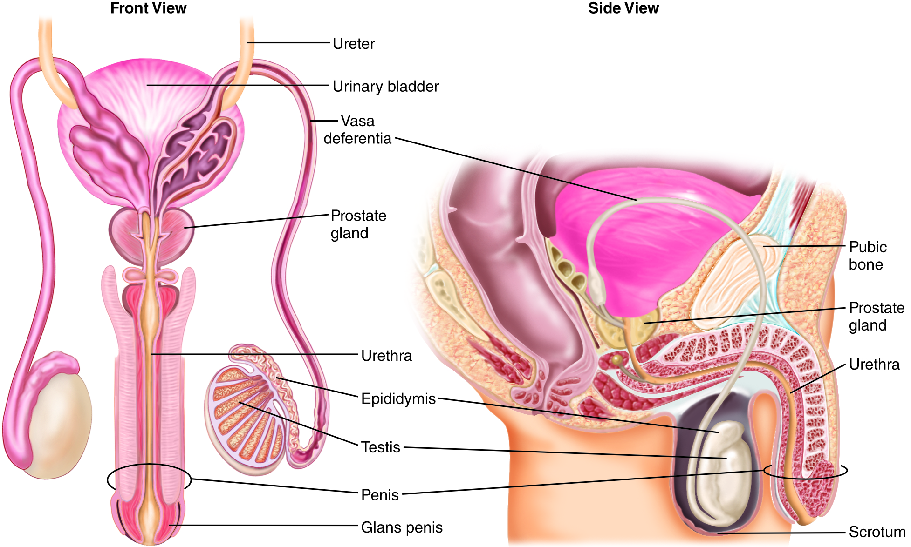
Reproductive System: Male
6-2
6-3
Many of the male reproductive structures are located outside of the pelvic cavity.
More vulnerable to injury
Two testes hang from the underside of the penis in a sac-like structure called the scrotum.

Slide 134
Reproductive System: Male
6-2
6-3
Inside the pelvic cavity are the prostate gland and the seminal vesicles.
Urethra extends from the bladder to the tip of the penis.
Penis, the prominent external phallus, is the terminal part of both the urinary and the reproductive systems in males.

Slide 135
Reproductive System: Male
The testes produce sperm and testosterone, the primary male sex hormone.
Sperm are small structures with a whip-like tail and a head that contains the genetic material needed to fertilize a woman’s egg.
Sperm contributes half the genetic material to offspring.
The prostate and seminal vesicles make and store the seminal fluid, the liquid part of the man’s ejaculate.
Sperm made in the testes combine with the seminal fluid to form semen, which is ejaculated during intercourse.
Most of the male’s urethra is part of the urinary system and transports urine from the bladder.
Last part of the urethra also is part of the reproductive system.

Slide 136
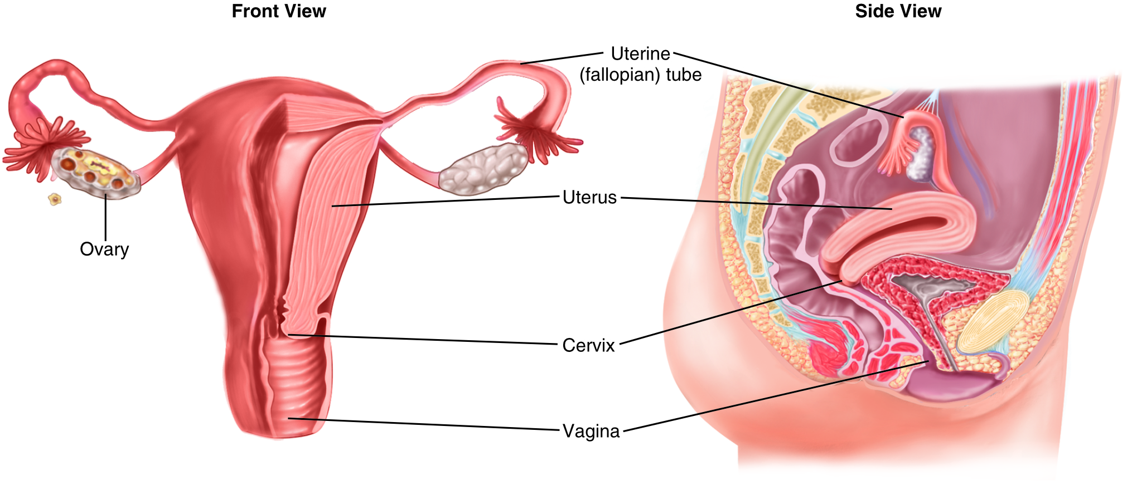
Reproductive System: Female
6-2
6-3
The female reproductive system consists of:
The ovaries
Fallopian tubes
Uterus
Cervix
Vagina
It is protected by the pelvic bones.

Slide 137
Reproductive System: Female
6-2
6-3
External structures consist of:
Labia, two vertical lips
Vulva
Clitoris
Breasts, or mammary glands, of a woman are sometimes included in this system.
Produce milk for the newborn

Slide 138
Reproductive System: Female
Endocrine glands in the body (hypothalamus and pituitary glands) release hormones that control and coordinate the development and functioning of the female reproductive system.
“Child-bearing age”
Onset of a woman’s first menstrual cycle to the time of menopause (when the woman no longer has menstrual cycles)
Average age for the onset of the menstrual cycle is 12 years.
Average age for the onset of menopause is approximately 52 years.

Slide 139
Reproductive System: Female
The menstrual cycle is approximately 28 days in length.
About midway through the cycle, typically a single egg is released from one of the ovaries.
Egg travels through the fallopian tube to the uterus.
If united with a sperm, the fertilized egg may attach to the lining of the uterus to initiate pregnancy.
If two eggs are released and both are fertilized, fraternal twins may be conceived.
The female’s ovum contributes half the genetic material to the offspring.

Slide 140
Body Systems: Lymphatic System

Slide 141
Lymphatic System
6-3
The lymphatic system:
Returns excess interstitial fluid located around cells to the bloodstream
Transports particulate materials such as molecular proteins and bacteria from the tissues
Absorbs fats and fat-soluble vitamins from the intestines
Produces lymphocytes (along with the bone marrow), which are white blood cells that are a primary weapon against microorganisms invading the body

Slide 142
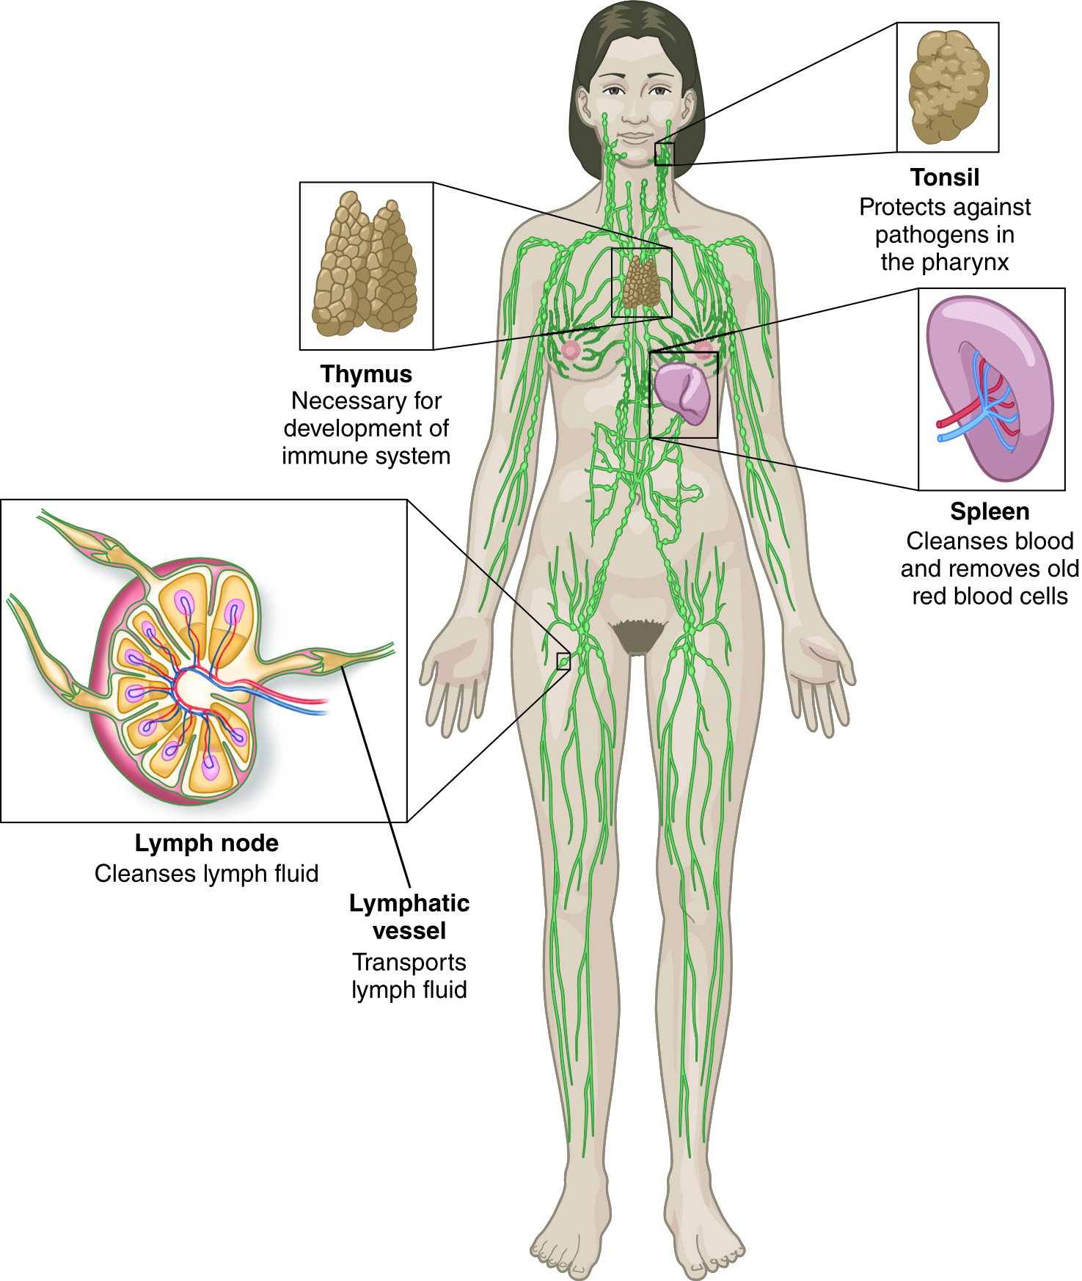
Lymphatic System
Consists of various organs, a network of vessels that carry lymphatic fluid, and numerous lymph nodes located throughout the body
Spleen:
Located in the left upper abdomen
The largest organ of the lymphatic system
Filters the blood, removing bacteria, dead tissue, and foreign matter from it, and produces white blood cells that fight infection

Slide 143
Lymphatic System
Tonsils, adenoids
Located in the throat
Help fight infection
Thymus gland
Located in the anterior neck
Help to fight infection
Lymph nodes:
In response to pathogens, become enlarged and painful from producing additional white blood cells, called lymphocytes, to fight the infection.

Slide 144
Lymphatic System: Immune Response
6-3
Lymphatic system helps with the immune response.
The immune system:
Consists of a network of specialized cells and organs that defend the body from viruses, bacteria, parasites, and other foreign invaders
Work by producing immunity, or an immune response
Immunity is defined as the state of being protected from a disease, especially an infectious disease.
Components of the immune system include the spleen, thymus, lymphatic system, bone marrow, antibodies, hormones, and leukocytes (white blood cells).

Slide 145
Lymphatic System: Immune Response
Leukocytes are the workhorses of the immune system.
Produced in the bone marrow
Transported to where they are needed via the blood and lymphatic systems to the site of invasion and engulf and destroy the invaders
Occasionally, the pathogens overwhelm the initial defense system.
Can multiply quickly, often doubling in number every 20 to 30 seconds
If the leukocytes cannot completely eradicate the pathogens, an infection or illness will result.

Slide 146
Lymphatic System: Immune Response
Can also produce protective proteins, called antibodies, in the lymph nodes and spleen that remain in the circulation
Example: Chicken Pox
If you contracted chicken pox as a child, your body created antibodies specifically against the chicken pox virus.
Antibodies remain in your body, protecting you from future attacks by the chicken pox virus for many years.

Slide 147
Case Study

Slide 148
CASE PRESENTATION
During an off-road bicycle race, two riders collided. The first patient has obvious abrasions and a deformed wrist. The second appears dazed, and his leg below the knee is crooked.
What should you do? What body systems and structures might be involved?

Slide 149
CASE UPDATE
You make sure the scene is safe and apply body substance isolation prior to evaluating both patients. After checking the ABCs (airway, breathing, and circulation), looking for serious bleeding, taking a history, and performing a physical exam on each patient, you determine that the patient with the deformed wrist has no other apparent injuries except scrapes. As you perform a full head-to-toe exam on the patient with the deformed lower leg, you find he also has pain in the left upper quadrant of his abdomen. When you gently palpate this part of his abdomen, he winces with pain. Had you not done the full-body exam, you may have missed this finding. You contact dispatch to request immediate assistance.
How would you precisely and accurately describe these injuries to dispatch?

Slide 150
CASE OUTCOME
You notify dispatch that you have two patients, one with a deformed lower leg who had decreased mental status but is now alert. He also has left upper quadrant pain near the spleen. The second patient has a deformed wrist and abrasions. Both have normal distal pulses and neurologic function in their injured extremities. Vital signs are stable. You request additional patrollers and call for an ambulance. You request advanced life support (ALS), as the one patient may have a ruptured spleen. You now begin caring for the injured patients.

Slide 151
CASE OUTCOME
Other OEC technicians soon arrive. You inform them of the injuries you have found. Working together, you and the other OEC technicians treat and package the two patients.
After transport to the aid room, the patient with the tibial injury and possible ruptured spleen goes to the hospital with ALS providers, and later you learn he had a ruptured spleen and broken tibia. The other patient goes by car to the hospital and is treated for a broken wrist.

