Slide 1
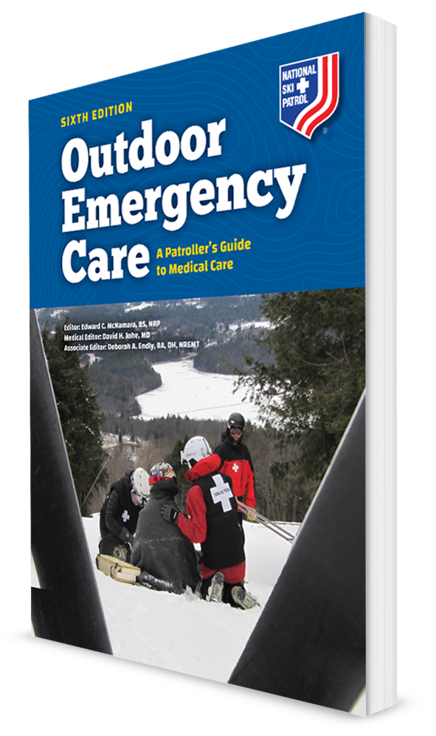
Patient Assessment
CHAPTER 7

Slide 2
The following presentation will utilize two symbols to identify material necessary for an OEC Technician to comprehend:
key term
Meets a Chapter Objective.
This symbol will have the corresponding Objective Number denoted within.
Identifies a Key Term.
The Key Term will be underlined for easy identification.

Slide 3
Objectives
7-1 Explain and demonstrate the following five parts of a patient assessment:
Scene size-up
Primary patient assessment
History taking
Secondary patient assessment
Reassessment
7-2 Describe the importance of controlling major bleeding as a first step during the primary patient assessment.
7-3 Describe the first steps you take when you encounter a patient who is responsive.

Slide 4
Objectives
7-4 Explain how the ABCDs are used in assessing a patient.
7-5 Describe the difference between a sign and a symptom.
7-6 Demonstrate how to assess the pupils.
7-7 Demonstrate how to assess eye movement.
7-8 List the normal vital signs for an infant, child, and adult.

Slide 5
Objectives
7-9 Demonstrate where you can take five pulses in five different locations on the body.
7-10 Describe and demonstrate how to assess the following vital signs:
Level of responsiveness
Pulse
Respiratory rate
Blood pressure
Oxygen saturation

Slide 6
Key Terms
Allergy
AVPU scale
Blood pressure
Breath sounds
Chief complaint
DCAP-BTLS
Decerebrate posturing
Decorticate posturing
General impression
Level of responsiveness
Mechanism of injury
Nature of illness
OPQRST
Palpate
Paresthesia
Patient assessment
PERRL
Primary patient assessment

Slide 7
Key Terms
Pulse
Pulse oximeter
SAMPLE
Scene safety
Scene size-up
Secondary patient assessment
Sign
Symptom
Vital signs

Slide 8
Chapter Overview

Slide 9
Chapter Overview
By understanding anatomy and physiology and completing a thorough patient assessment, OEC Technicians can:
Identify obvious or sometimes subtle abnormal findings
Determine the cause of a patient’s problem
Formulate an appropriate treatment plan

Slide 10
Chapter Overview
Assessment is the process to gather information about:
The scene
The events leading up to the incident
Patient’s history
Physical condition
Collected from a variety of sources, including:
Patient
Patient’s family and friends
Bystanders
The scene
Other rescuers

Slide 11
Patient Assessment

Slide 12
Patient Assessment
7-1
The overall patient assessment process consists of five parts:
Scene size-up
Primary patient assessment
History taking
Secondary patient assessment
Reassessment
Uses a systematic, standardized approach for every patient evaluation
Makes sure key medical information is not overlooked

Slide 13
Scene Size-Up

Slide 14
Scene Size-Up
7-1
Scene size-up
First step of patient assessment
Best defined as a general overview of the incident and its surroundings

Slide 15
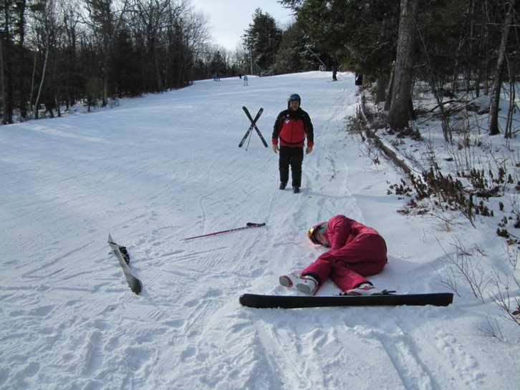
Scene Size-Up: Scene Safety
7-1
Scene Safety
If local protocol requires, report your arrival to the scene.
Notify dispatch.
If not dispatched to a known injury, they are now aware there is a possible rescue.

Slide 16
Scene Size-Up: Scene Safety
7-1
Scene size-up involves scanning the area to determine what needs to be done.
Establishes a first impression
Look for hazards that could harm the rescuer or patients.
A downed electric wire
A person with a weapon
A fire
Bikers riding toward you on an off-road path
Skiers coming down a slope
Always mitigate dangers before proceeding to help the victim.
Another person, or yourself, becoming a second victim will complicate matters.

Slide 17
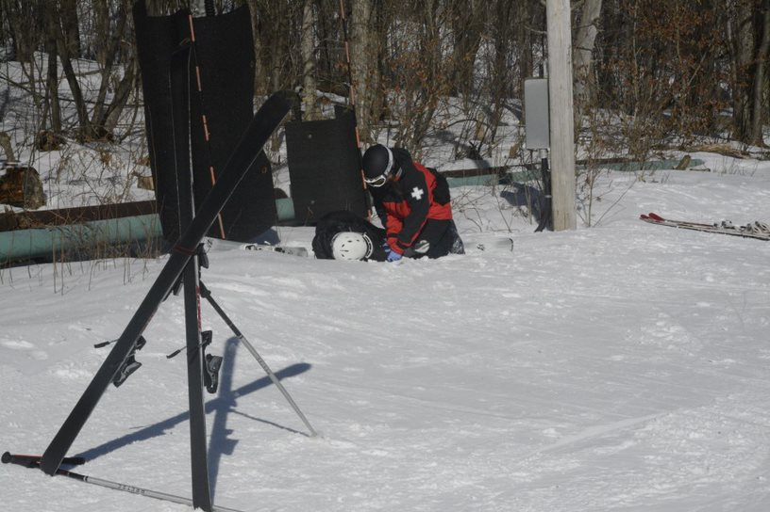
Scene Size-Up: Determine the MOI and NOI
7-1
In trauma, a force has acted on the body, causing injury.
Called the mechanism of injury (MOI)
If sick or ill from a medical condition:
Determine the nature of illness (NOI)

Slide 18
Scene Size-Up: Standard Precautions
7-1
OEC technicians must protect themselves from hazardous materials and blood borne pathogens.
Use personal protective equipment.
Apply gloves and other protective equipment before touching patient.

Slide 19
Scene Size-Up: Consider Additional Resources
7-1
The incident may require additional personnel or special equipment.
When warranted by possible MOI or NOI, call for additional resources immediately.
Even though you do not know the condition of patient(s) at this point
Requesting specialized help may take time.
Later, call for more equipment or resources as needed.

Slide 20
Primary Patient Assessment

Slide 21
Primary Patient Assessment
7-1
The second part of patient assessment sequence is the primary patient assessment.
Purpose:
To form a general impression
Identify and immediately treat life threats.

Slide 22
Primary Patient Assessment
7-2
Life threats:
Excessive bleeding
Problems with patient’s airway, breathing, circulation, and/or disability
Life threat must be corrected immediately.
Correct these problems before moving on in patient assessment process.

Slide 23
Primary Patient Assessment
7-1
As you approach patient, you already have an idea of:
The MOI or NOI
Possible hazards
Specialized personnel and equipment needed
Now form a general impression about patient’s condition.

Slide 24
Primary Patient Assessment: General Impression
7-1
Rapidly identify any life-threatening problems.
Help you determine your priority of care
Note patient’s:
Approximate age
Sex
Race
Level of distress
Overall appearance

Slide 25
Primary Patient Assessment
7-1
Unresponsive patients usually have a life-threatening problem.
Responsive:
Let the person know who you are and that you are there to help.
Ask for permission to provide care.
Show respect during your evaluation.
Do not stand over patients.
Make them feel comfortable.
Address them by name.
Reassures them you have been listening to what they say

Slide 26
Primary Patient Assessment: Control Life-Threatening Bleeding
7-2
In most cases, correcting life-threatening issues begins with the Airway, followed by Breathing, Circulation, and Disability (ABCD).
If life-threatening bleeding:
Considered a circulation issue
More appropriate to address bleeding first (Circulation), followed by a sequence of Airway, Breathing, and Disability (CABD)

Slide 27
Primary Patient Assessment: Control Life-Threatening Bleeding
7-2
As you approach patient, look for and immediately control life-threatening bleeding.
This step should occur BEFORE addressing airway or breathing concerns.
Blood loss can be very rapid.
Can quickly result in shock or even death
Death can occur in less than 5 minutes.

Slide 28
Primary Patient Assessment: Control Life-Threatening Bleeding
7-2
Signs of blood loss include:
Active bleeding from wounds
Evidence of bleeding such as blood on the clothes or near patient
Bleeding from a large:
Vein: steady blood flow
Artery: spurting flow of blood
Unconscious patient:
Do a sweep for blood.
Quickly and lightly run your gloved hands from head to toe.
Pause periodically to see if your gloves are bloody.

Slide 29
Primary Patient Assessment: Control Life-Threatening Bleeding
7-2
Techniques for controlling bleeding:
Direct pressure with your gloved hand
Soon thereafter a sterile bandage over the wound
Direct pressure stops the bleeding and helps the blood to coagulate, or clot, naturally.
Most minor bleeding can be adequately controlled by using direct pressure.

Slide 30
Primary Patient Assessment: Control Life-Threatening Bleeding
7-2
Pressure dressing:
If direct pressure is not quickly successful
Obvious arterial hemorrhage of an extremity
Tourniquet: If you are unable to control bleeding from an extremity
Pack the wound: for deep wounds with excessive bleeding where a tourniquet cannot be applied

Slide 31
Primary Patient Assessment: Level of Responsiveness
7-3
7-10
Assess Level of Responsiveness
Is the person alert and able to communicate?
The person can speak normally and no major bleeding.
The airway, breathing, and circulation are intact.
“Are you OK?”
The response “I need help” reveals that patient:
Has a pulse and airway
Is breathing
Understands you

Slide 32
Primary Patient Assessment: Level of Responsiveness
7-3
7-10
7-3
Fully responsive patients:
Always introduce yourself to patient and ask for permission to help.
Adult (alert and oriented): simply say, “Hi, I’m Paul with the ski patrol. May I help you?”
Minor: ask a parent or guardian who is present for permission to care for the child.
Unresponsive patient (or if child alone):
Implied consent

Slide 33
Primary Patient Assessment: Level of Responsiveness
7-3
Put patient at ease by talking in a calm, reassuring manner.
Avoid telling the person he or she will be “all right.”
If patient tells you he or she does not want help, respect the person’s wishes.
If concerned patient has a problem:
Stay nearby
Watch to determine that the person is OK
Patients may initially refuse care, only to later decide they need help.

Slide 34
Primary Patient Assessment: Level of Responsiveness
7-3
Introduction:
Make eye contact and try to get down to patient’s level.
Patient’s initial appearance will help you decide whether the problem is serious or minor.
Ask patient’s name and speak calmly, using the person’s name.
Consider simultaneously assessing patient’s pulse.
Radial pulse for an adult.
Brachial pulse for a child.
Assess for quality—fast or slow, strong or weak, regular or irregular.

Slide 35
Primary Patient Assessment: Level of Responsiveness
7-3
7-10
7-3
Not completely responsive:
Assess the Level of Responsiveness.
A measure of patient’s awareness and responsiveness to you and the surrounding environment
A continuum that ranges from patient being fully alert and oriented to various levels of unresponsiveness

Slide 36
Primary Patient Assessment: Level of Responsiveness
7-3
7-10
7-3
Question the patient:
Name
Physical location
Approximate time of day
Day of the week
Events leading up to the situation
When patients can answer all these questions correctly:
Awake, alert, and oriented to person, place, time, and event

Slide 37
Primary Patient Assessment: Level of Responsiveness
7-3
7-10
7-3
Inability to correctly answer any of these questions:
Suggests a potential neurologic problem
Considered abnormal
An abnormal level of responsiveness can result from brain injury, lack of oxygen, or a wide range of medical conditions.

Slide 38
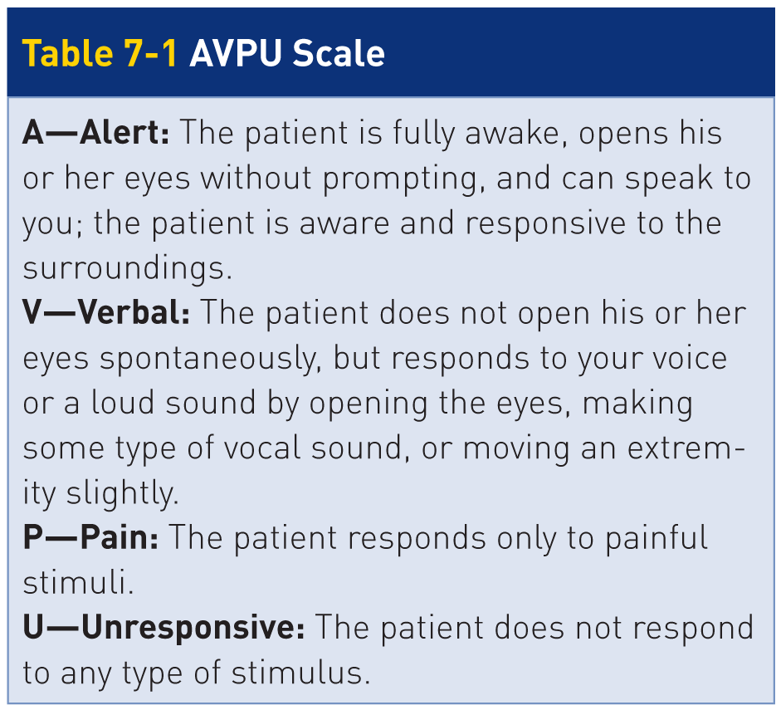
Primary Patient Assessment: AVPU
7-3
7-10
7-3
AVPU scale:
Alert, Verbal, Pain, and Unresponsive
Alternative: Glasgow Coma Scale (GCS)
More difficult to use than the AVPU scale
Takes longer to perform

Slide 39
Primary Patient Assessment: AVPU
7-3
7-10
7-3
To assess patient using the AVPU scale:
First observe whether patient appears to be awake and alert.
Scored as A on the AVPU scale
If NOT alert or has closed eyes:
Loudly talk to the person or clap your hands.
A patient who looks at you or opens his or her eyes is scored a V on the AVPU scale.

Slide 40
Primary Patient Assessment: AVPU
7-3
7-10
7-3
If does NOT respond to verbal stimuli:
Attempt to illicit a pain response in patient.
Pinch the earlobe.
Pinch the muscle between the neck and shoulder (trapezius pinch).
Press on the base of the fingernail with a hard object.
A patient who responds to pain is noted as P on the AVPU scale.
A patient who does not respond to pain is scored as U for unresponsive.
Any score less than A is considered abnormal.

Slide 41
Primary Patient Assessment: ABCD
7-4
Rapidly Assess Airway, Breathing, Circulation, and Disability.
After controlling severe bleeding:
Correct life-threatening issues begins with the airway.
Followed by breathing, circulation, and disability (ABCD)
Assess the ABCDs rapidly.
Elements are assessed almost simultaneously for any patient.

Slide 42
Primary Patient Assessment: Airway
7-4
Airway
No airway problems:
Open, “patent”
An airway problem:
Must be corrected immediately
Most common cause:
The tongue falling back either partially or completely blocking the oropharynx (throat)
Other common causes:
Vomit, bleeding, broken teeth or loose dentures, food, gum, candy, chewing tobacco, small toys, other foreign bodies, or structural damage or swelling involving the face, nose, mouth, or neck

Slide 43
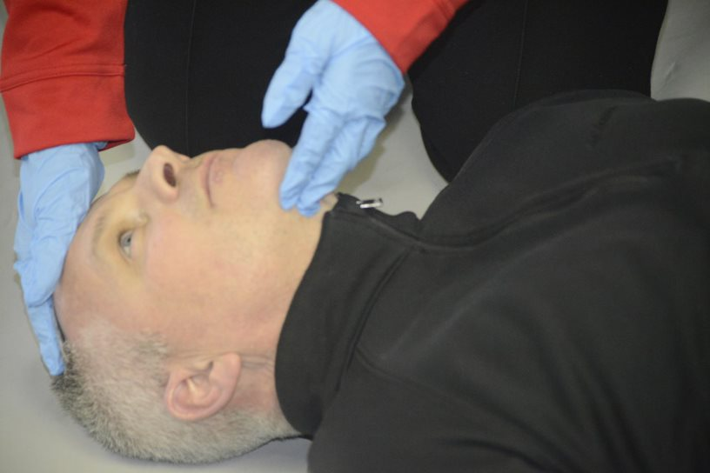
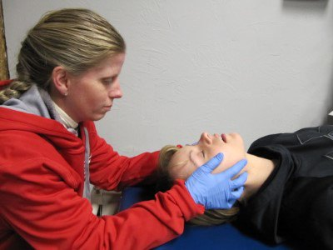
Primary Patient Assessment: Opening the Airway
7-4
The head tilt–chin lift maneuver
Used to open an airway
No concern for cervical spine injury
The jaw-thrust method
Used for a patient with a suspected cervical spine injury
Avoids aggravating a spine injury
Can also be used for someone who does not have a cervical spine injury
Always use with an unresponsive patient with a traumatic injury.

Slide 44
Primary Patient Assessment: Breathing
7-4
Breathing
If airway open:
Assess patient’s breathing.
“Look, listen, and feel”
Look: see if the chest rises and falls with each breath
Listen: place your ear near patient’s open mouth and listen for the sound of air moving in and out
Feel: air on your cheek during exhalation or place your hand on patient’s chest to feel for chest wall movements
If breathing is not present and a carotid pulse was found, begin assisting ventilations.
If oxygen is available, immediately administer it to patient.

Slide 45
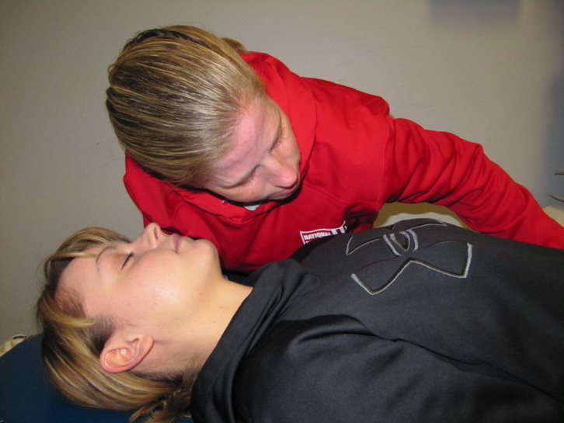
Primary Patient Assessment: Breathing
7-4
Assess the respiratory rate:
Counting the breaths for 30 seconds
Multiply by 2
Determines the number of breaths per minute
Is the respiratory rate fast or slow?
Normal respiratory rate:
Adult or adolescent is 12 to 20 breaths per minute
Infant is 20 to 60 breaths per minute

Slide 46
Primary Patient Assessment: Breathing
7-4
Are respirations:
Deep, fully expanding the chest
Shallow, barely moving the chest
Labored, indicating breathing difficulty

Slide 47
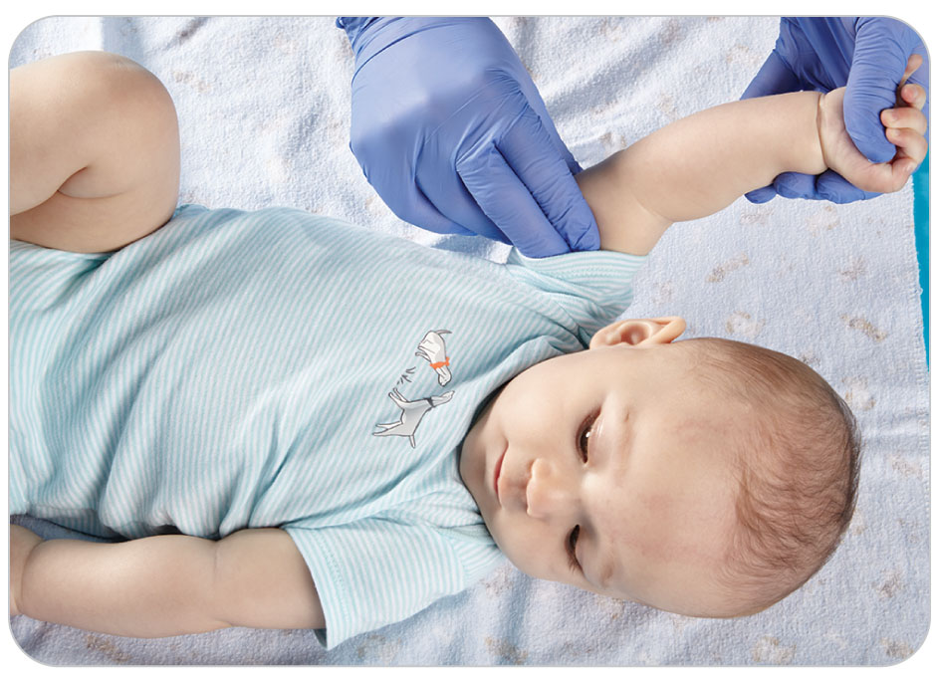
Primary Patient Assessment: Circulation
7-4
Circulation
Make sure patient has effective blood circulation by:
Feeling peripheral pulses
Assessing skin color
Evaluating capillary refill
Alert adult patients: pulse at the wrist over the radial artery
Children (under 8 years of age): the brachial pulse, above the elbow

Slide 48
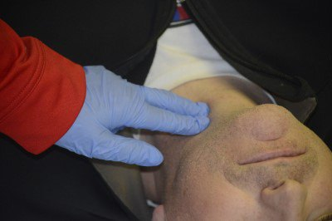
Primary Patient Assessment: CAB
7-4
For an unresponsive patient in cardiac arrest who has not sustained trauma:
Sequence of assessment and care as CAB:
Circulation
Airway
Breathing
To assess circulation (heartbeat) in an unresponsive adult, check for a pulse over the carotid artery.

Slide 49
Primary Patient Assessment: Circulation
7-4
To find carotid artery:
Place your index and long fingers together on the larynx (Adam’s apple) in the neck.
Then slide your fingers toward the ear, on the side closest to you, until they drop into a groove.
Press your fingers into this groove to feel the carotid artery pulse.
Always use your index and middle fingers to assess a pulse, not your thumb.

Slide 50
Primary Patient Assessment: Circulation
7-4
If a pulse is present but patient is not breathing:
Need to check the airway to make sure it is open
If there is still no breathing, begin rescue breaths.
If pulseless in cardiac arrest, call for:
Additional help
An automated external defibrillator
Start CPR as soon as possible.

Slide 51
Primary Patient Assessment: Circulation
7-4
If a pulse is present, determine what it feels like.
Should be strong and regular
Irregular or faint: indicates an underlying medical or traumatic disorder
Has a different time interval between beats (skips beats)
Determine the pulse rate:
Hold your index finger on the pulse.
Count the beats for 30 seconds.
Multiply this number by 2 to determine the number of beats per minute.

Slide 52
Primary Patient Assessment: Circulation
7-4
If a pulse is present, evaluate patient’s skin color.
Normal: pink or dark tone, depending on the person’s race
Pale, gray, or blue (cyanosis): circulation is compromised
Cyanosis also may be detected in the lips, mucous membranes, and earlobes.
Assess oral (inner lip) color in patients with dark skin.

Slide 53
Primary Patient Assessment: Circulation
7-4
Assess capillary refill
Press on the nail bed and then quickly release the pressure.
Normal: the nail bed will turn white when pressed and then return to its normal pink color in less than 2 seconds once the pressure is released
Abnormal: cyanotic or does not return to a pink color within 2 seconds
Should prompt you to investigate the underlying causes more thoroughly

Slide 54
Primary Patient Assessment: Circulation
7-4
Cold environment causes capillaries in the nail bed to be:
Pale
Blue
Slow to refill
Peripheral blood vessels are narrowed in response to the cold.

Slide 55
Primary Patient Assessment: Disability
7-4
Disability
Many pre-hospital responders add “D” for disability to the primary patient assessment process.
Disability means an injury to the nervous system.
Indicated by a finding such as unresponsiveness, paralysis, or neurologic compromise
Patients who can move all their extremities when asked to do so do not have a gross disability (D).

Slide 56
Primary Patient Assessment: Disability
7-4
Assess patient for any life-threatening neurologic disorders, including any problems affecting the brain or spinal cord.
Can stem from the central nervous system, the peripheral nervous system, or both
Central nervous system problems can be life threatening.
Peripheral nervous system problems affect just the nerves involved in the arm or leg.
Rarely, you may encounter damage to both systems affecting the body distally.

Slide 57
Primary Patient Assessment: Disability
7-4
You can assess for neurologic problems rapidly by asking patient, “Can you feel and move your arms and legs?”
If so:
They have understood what you said
Purposefully moved their extremities, showing the neurologic system is grossly intact
May complain of tingling or numbness in the arms or legs, a condition known as paresthesia
May complain of muscle weakness of one or more of the extremities

Slide 58
Primary Patient Assessment: Disability
7-4
In situations involving severe compromise to the central nervous system, you may observe abnormal posturing.
Two “postures” indicate neurologic problem.
Decerebrate posturing
Decorticate posturing
Both are ominous signs that something is very wrong with patient.

Slide 59
Primary Patient Assessment: Disability
7-4
Decerebrate posturing
Abnormal extension of the arms and legs
Downward pointing of the toes
Arching of the head
Due to an injury to the brain at the level of the brainstem

Slide 60
Primary Patient Assessment: Disability
7-4
Decorticate posturing
Abnormal flexing of the arms
Clenching of the fists
Extending of the legs
Due to an injury along the nerve pathway between the brain and spinal cord

Slide 61
Primary Patient Assessment
7-1
Spinal injury or head trauma patients should remain in spinal motion restriction during the exam.
Spinal motion restriction means keeping the spine in a straight line.
If patient is responsive, alert, and oriented, tell the person not to move his or her head during your examination.
In an unresponsive patient, you will be unable to obtain a medical history or valuable feedback.
Ask a relative or friend if present.
Unless a reliable witness says differently, assume a cervical spine injury until proven otherwise.

Slide 62
Primary Patient Assessment
7-1
If available, have another rescuer maintain spinal motion restriction of the neck:
If prone, prior to logrolling, examine (palpate) the midline of the spine.
If spinal motion restriction is not needed, you no longer need to protect the neck and back.
Other trauma patients may be examined in the position found.
May be placed in a sitting position only after examination of the spine reveals NO evidence of injury

Slide 63
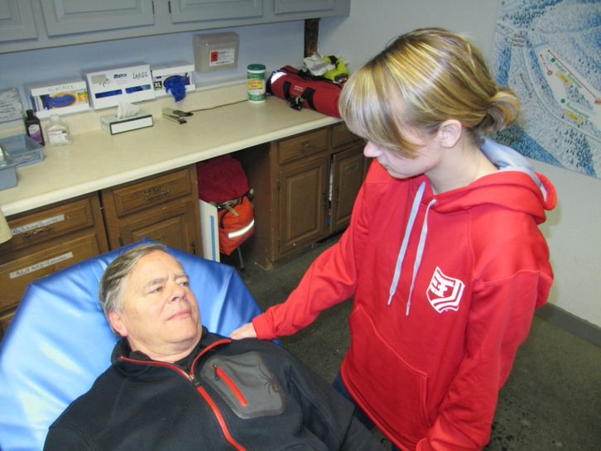
Primary Patient Assessment: Chief Complaint
7-1
Obtain Chief Complaint
In a responsive patient, ask patient what is wrong.
Chief complaint is the main reason the person needs your help.
Patient’s answer

Slide 64
History Taking

Slide 65
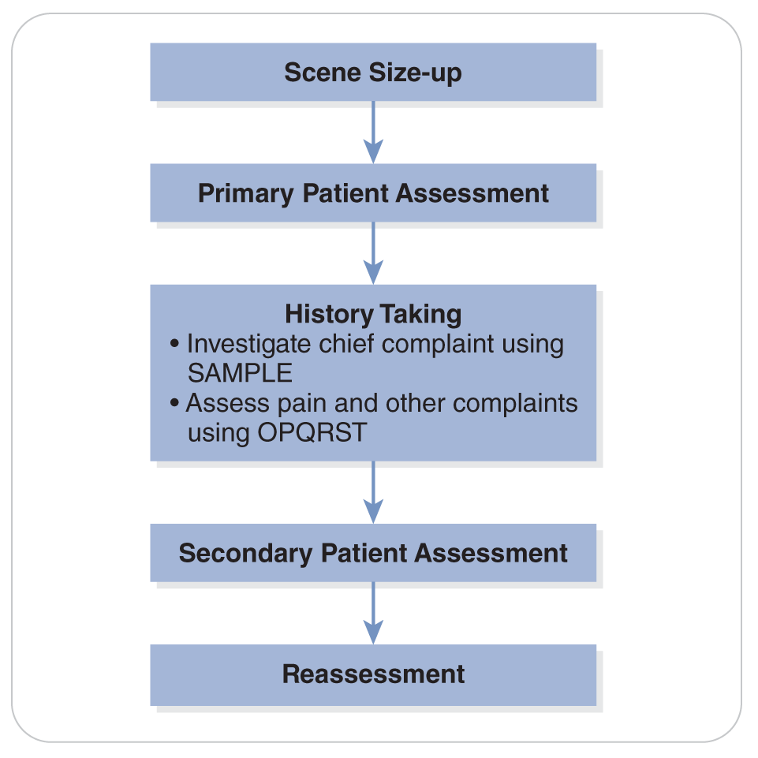
History Taking
7-1

Slide 66
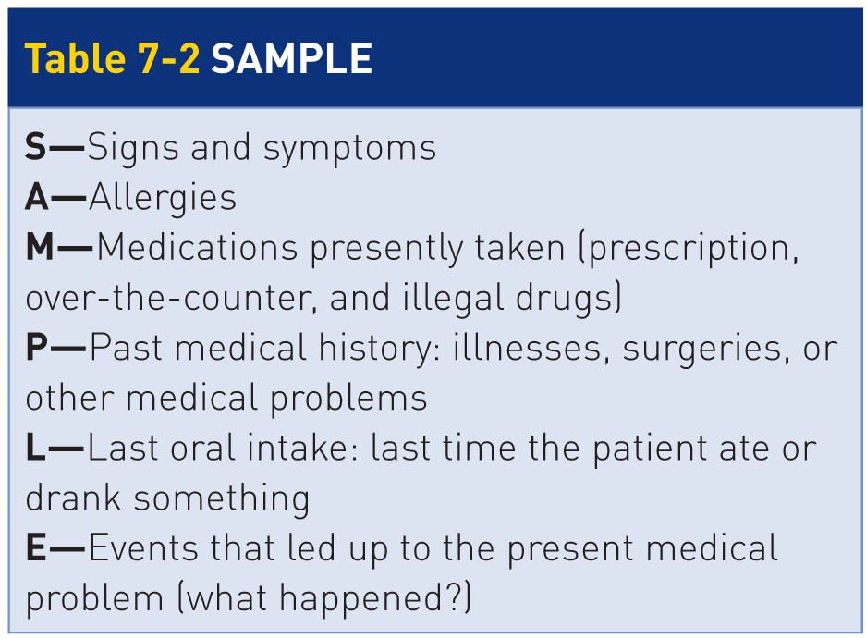
History Taking: SAMPLE
7-1
7-5
Investigate the Chief Complaint Using SAMPLE

Slide 67
History Taking: SAMPLE
7-5
S in SAMPLE
Patient’s presenting signs and symptoms are important.
A symptom, or subjective complaint, is qualitative in nature.
Typically provided by patient, patient’s family, friends, or bystanders
Are emotion-based descriptions
Examples include pain, weakness, fatigue, nausea, blurred vision, and/or impending doom.
A sign is any objective finding or evidence of disease that you can detect using your senses (see, feel, hear, smell) or that you can quantify.
Examples of signs are dilated pupils, a deformed arm, audible respiratory wheezing, a foul odor, elevated blood pressure, and low pulse oximeter reading.

Slide 68
History Taking: SAMPLE
7-1
A in SAMPLE
Ask patient if he or she has an:
Allergy
Has had an allergic reaction in the past
What occurred
This includes allergies to medications, foods, materials, insects, or animals.
It is helpful to tell medical personnel who continue care about medication allergies.

Slide 69
History Taking: SAMPLE
7-1
M in SAMPLE
Any medications?
Supposed to be taking any medications?
Taking it as prescribed?
Includes prescription medications, over-the-counter medications, herbs, vitamin supplements, homeopathic remedies, or illicit drugs or alcohol.
If you don’t know what the medication is being taken for, ask patient.
Patient will usually know.

Slide 70
History Taking: SAMPLE
7-1
P in SAMPLE
Past medical history, including any previous medical problems such as:
Heart disease
A breathing problem
Diabetes
High blood pressure
Any previous surgeries
“Do you have any significant medical problems?”
“Do you have any medical conditions for which you are seeing a physician or are supposed to be seeing a physician?”

Slide 71
History Taking: SAMPLE
7-1
L in SAMPLE
When last ate or drank something, including any alcoholic beverages
For diabetic patients, this is very important.
Blood sugar could be low if they have not eaten and have taken their diabetic medication.
Helpful should patient require surgery in the immediate future

Slide 72
History Taking: SAMPLE
7-1
E in SAMPLE
Events leading up to the medical problem, especially what patient was doing when the symptoms first occurred
Helps bring the pieces of the assessment puzzle together
Helps you to treat patient’s injuries and/or illness more effectively

Slide 73
History Taking: OPQRST
7-1
The OPQRST mnemonic can be helpful in gathering additional information about a patient’s pain.

Slide 74
History Taking: OPQRST
7-1
O in OPQRST: Onset
When symptoms began?
What was patient doing when the complaint was first noticed?
Came on suddenly or gradually?
At rest or engaged in a physical activity?
Does it feel like any previously experienced condition?
Current symptoms constant or intermittent (come and go)?

Slide 75
History Taking: OPQRST
7-1
P in OPQRST: Provocation and palliation
What might have caused the problem?
Anything makes the problem either worse (is a provocation) or better (is a palliation)?
Does rest provide any relief from the problem?
Even if only slightly or momentarily

Slide 76
History Taking: OPQRST
7-1
Q in OPQRST: Quality
Describe the nature of the symptoms.
Is the pain sharp, dull, or throbbing?
Have the symptoms changed in any way since they were first noticed?

Slide 77
History Taking: OPQRST
7-1
R in OPQRST: Radiation
Ask patient to point to where the symptoms are most intense.
To locate the source of the problem
If the problem involves a large area, ask patient to draw a circle around the site using his or her fingers.
Do the symptoms move from this area to another location?
Remain in one spot?
Ask if pressing on the site of the discomfort causes pain in another part of the body.

Slide 78
History Taking: OPQRST
7-1
S in OPQRST: Severity
Ask patient to describe the severity of the symptoms.
Rate the severity using a scale of 0 to 10.
0 being problem-free
10 being the worst pain the person has ever felt
Repeat the question.
Monitors changes in patient’s perception of the severity over time.

Slide 79
History Taking: OPQRST
7-1
T in OPQRST: Time
Ask how long patient has had the problem.
Ask if the same problem has occurred previously.

Slide 80
Secondary Patient Assessment

Slide 81
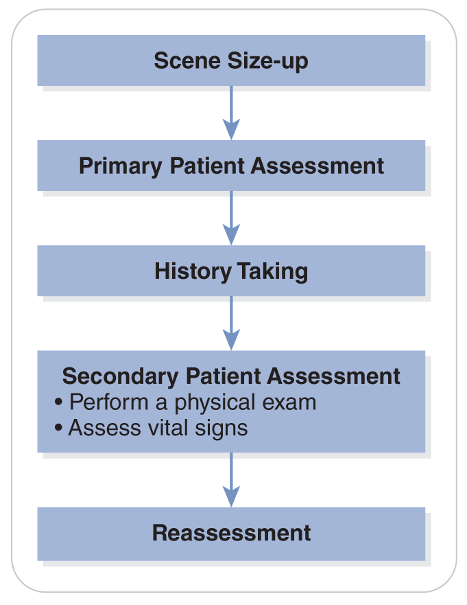
Secondary Patient Assessment
7-1
Purpose of secondary patient assessment:
To obtain more information about the specific problem
To perform a more thorough physical assessment of patient
Ensures that no medical or traumatic problem was overlooked during primary assessment

Slide 82
Secondary Patient Assessment
7-1
A secondary patient assessment could help you identify hidden injuries or a secondary problem.
A secondary patient assessment consists of:
Performing a hands-on physical exam
Assessing vital signs
Entire secondary assessment should take 2 to 5 minutes to complete.

Slide 83
Secondary Patient Assessment: Physical Exam
7-1
Perform a Physical Exam
A systematic head-to-toe, hands-on exam of patient
Ask patient for permission to perform this exam.
If patient is a competent adult and refuses, do NOT proceed.
When touching a patient, always use gloves and other appropriate personal protective equipment.

Slide 84
Secondary Patient Assessment: Physical Exam
7-1
Exam is performed to identify specific clinical findings.
Will aid in determining the source of patient’s current medical problem or traumatic injury
Note patient’s signs.
Any objective findings
Evidence of a disease that you can detect
First look at the body part, then touch or palpate it.

Slide 85
Secondary Patient Assessment: Physical Exam
7-1
You should open or remove clothes to examine each area of the body.
Then redress patient, especially during inclement or cold weather.
Use common sense when removing clothing, protecting patient’s privacy.
If necessary, you can cut the person’s clothes to get a better view of the injury.
Cut clothing only if necessary.
When treating a critical patient
When you cannot otherwise directly examine a body part that appears injured or is painful
If patient has normal responsiveness, it is best to ask permission to cut clothing.

Slide 86
Secondary Patient Assessment: Physical Exam
7-1
Position of comfort:
Short of breath: sit upright
Abdominal pain: will want to bend their knees
Exam can be done in any position, but it is easier when patient is made comfortable.

Slide 87
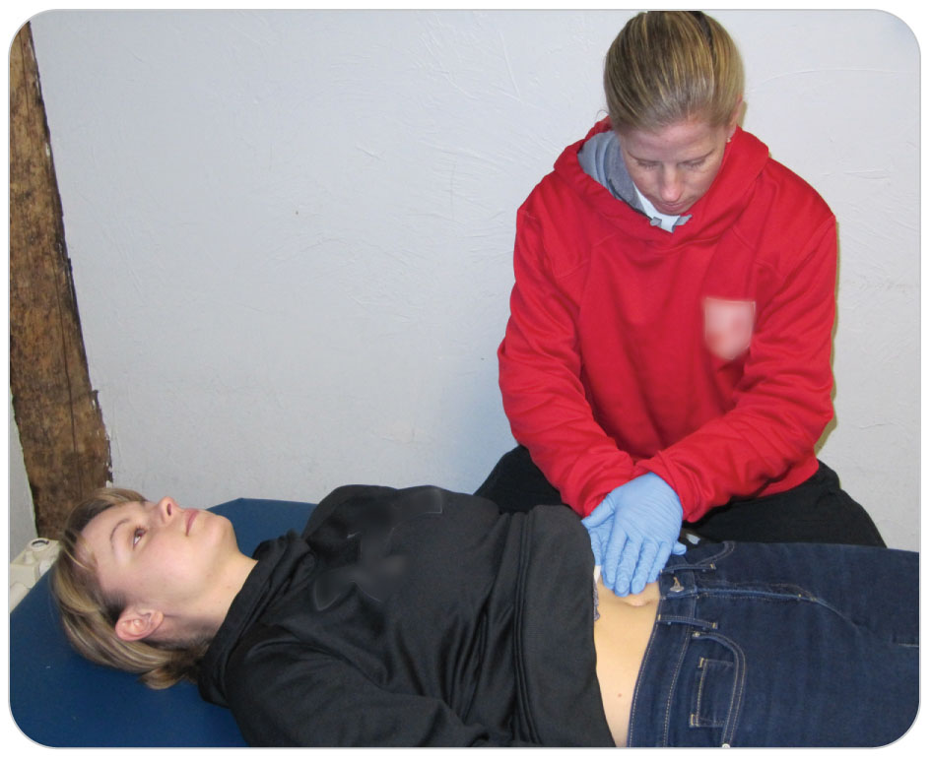
Secondary Patient Assessment: Physical Exam
7-1
Physical exam is performed in a systematic manner and should take only a few minutes to complete.
If a severe problem needing immediate attention is found, take the necessary steps to remedy that issue.
Be thorough, or potential problems might go undetected.
Most rescuers start at the head and work down during the exam.

Slide 88
Secondary Patient Assessment: Physical Exam
7-1
Do not be afraid to palpate patient.
Touching is an essential part of the exam process.
Palpate areas that are tender or swollen:
May cause patient some physical discomfort
You may want to warn patient this could hurt.
Children:
It is best to palpate possible painful areas of the body LAST.
Otherwise, they will not let you examine other body parts.
Have a child “point to where it hurts,” and palpate that body part last.

Slide 89
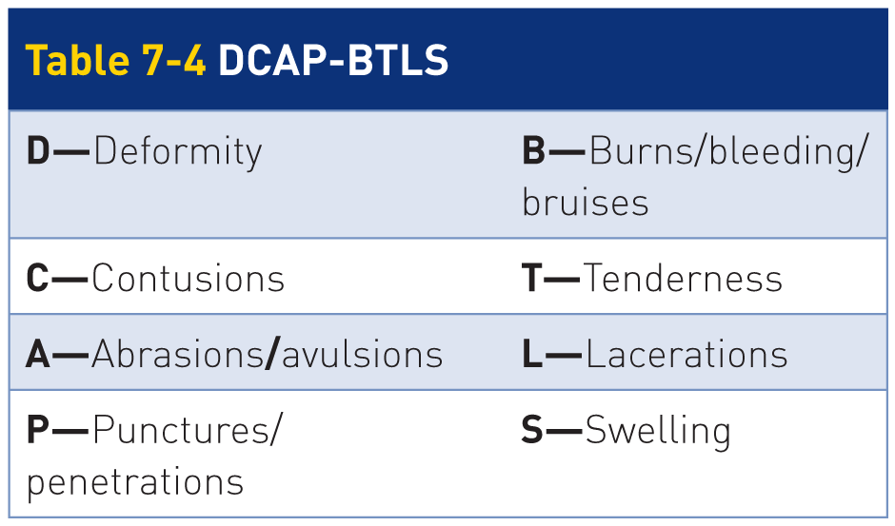
Secondary Patient Assessment: Physical Exam
7-1
The DCAP-BTLS mnemonic identifies abnormalities on examination.

Slide 90
Secondary Patient Assessment: Examine the Skin
7-1
Examine the Skin
Examine the exposed skin for color, temperature, and moisture.
Normal skin is “warm, pink, and dry.”
Skin may be bluish from cold weather.
Certain medical conditions cause sweating or flushed (hot) skin.

Slide 91
Secondary Patient Assessment: Examine the Head
7-1
Examine the Head
Begin by looking at and palpating patient’s entire head, scalp, and face.
From back to front (posterior to anterior)
Look for blood or clear fluid draining from the ears or nose.
Check the area behind the ears for discoloration (Battle sign).

Slide 92
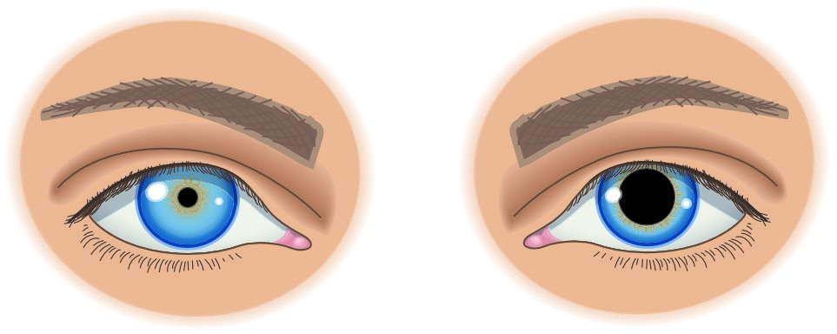
Secondary Patient Assessment: Examine the Eyes
7-6
Examine the eyes
Is the white part of the eye yellow?
Indicate possible hepatitis or liver disease
Look for symmetry.
Pupils constricted, dilated, or unequal?
Assess the pupils’ reactions to light using a small flashlight.
Do not use an LED light, which can injure the eye.
If the sunlight is too bright, assess shading each eyes during the exam.

Slide 93
Secondary Patient Assessment: Examine the Eyes
7-7
PERRL:
Pupils are the same size, are both round, and both get smaller when a light is shined into each eye.
Noted as “Pupils are Equal, Round, and Reactive to Light”
When assessing eye movement, the eyes should move in unison.
Such eye movement is called extraocular movement (EOM).
If the eyes move correctly, then extraocular movement is intact.
Noted as EOMI

Slide 94
Secondary Patient Assessment: Examine the Eyes
7-6
Note whether the light causes patient any apparent discomfort.
Look for any bleeding or fluid leaking from the eye.
If pupil appears elongated or the pupils are not symmetrical, this may indicate an injury to the:
Eye itself
Injury to the brain
Previous eye surgery

Slide 95
Secondary Patient Assessment: Examine the Face
7-1
Look at and palpate patient’s face.
Is the face symmetrical?
Is one side different from the other?
Are the muscles on one side of the face not working, making that side droop?
Does patient’s overall color appear normal, or is it pale, yellow, or slightly blue?
Check the stability of the facial bones by applying equal but gentle pressure.
First on the cheekbones
Then on the bone beneath the nose

Slide 96
Secondary Patient Assessment: Examine the Face
7-1
Check the mouth for evidence of:
Broken or loose teeth
Cuts on the inside of the cheeks
Swelling
Bleeding
Instruct patient to clench his or her teeth.
Do the teeth feel like they align normally?
Ask patient to stick out his or her tongue.
The tongue should come straight out.

Slide 97
Secondary Patient Assessment: Examine the Neck
7-1
Examine the Neck
Suspect a cervical spine injury:
Begin by limiting any motion to the neck and spine.
Do NOT suspect a cervical spine injury:
Proceed without the need for spinal motion restriction.
Looking at the neck:
Can you see any bleeding or deformity?
Look at the neck for symmetry, any deformity, swelling, lacerations, contusions, or other signs of trauma.

Slide 98
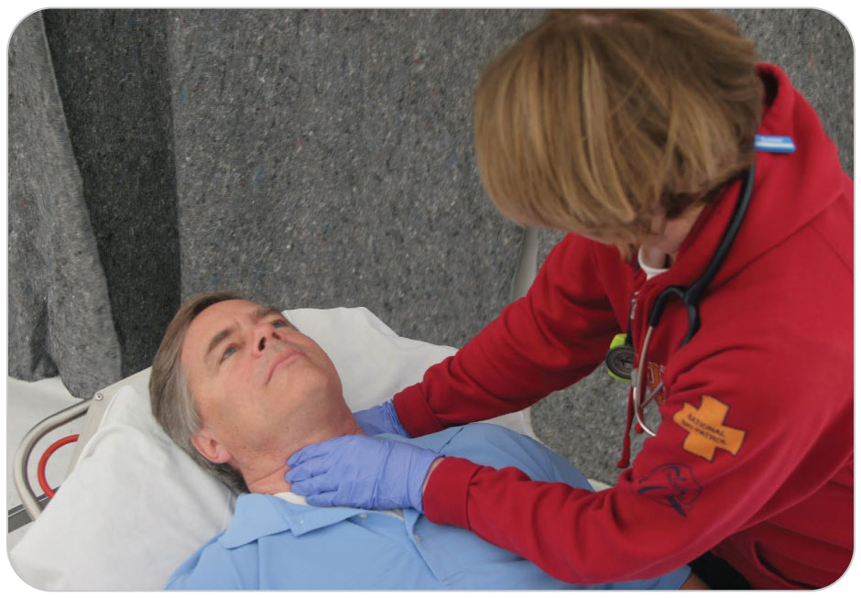
Secondary Patient Assessment: Examine the Neck
7-1
Palpate the neck:
For tenderness at the base of the skull and down the back of the neck
Palpate the midline over the spinous processes of the entire neck.
Pain over a spinous process could indicate a significant spinal injury.
Moving from the middle, palpate toward the sides.
Gently palpate the front of the neck, noting any tenderness or crackling.

Slide 99
Secondary Patient Assessment: Examine the Chest
7-1
Examine the Chest
Consider modesty, especially in a female patient.
Tell the person you will examine the chest.
Expose and look at the chest wall, both front and back.
Note the general color of the skin.
Are there any signs of trauma, such as bruising or bleeding?
Watch patient breathe in and out.
Does the chest movement appear equal on both sides?

Slide 100
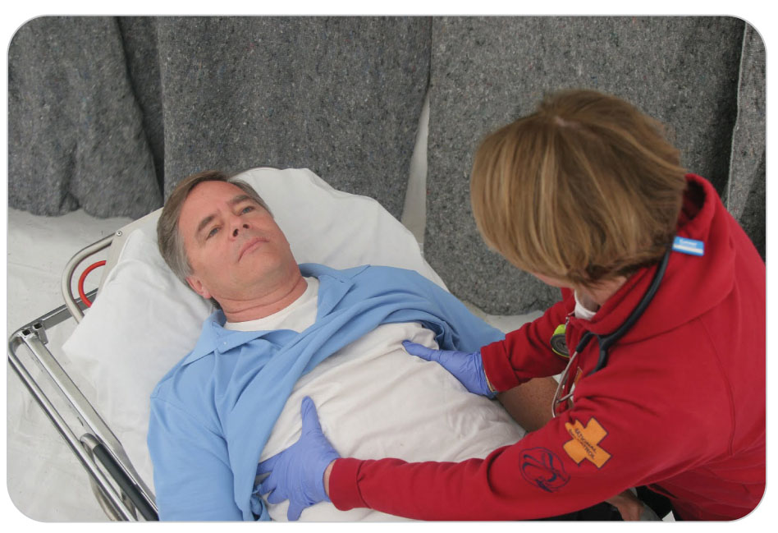
Secondary Patient Assessment: Examine the Chest
7-1
Ask patient to breathe deeply.
Does this cause patient any discomfort?
If not, place your hands on each side of patient’s chest, beneath the armpits, and squeeze firmly as patient breathes in deeply.
Does this cause any pain?
If not, place one hand on patient’s sternum and the other on patient’s spine between the shoulder blades, squeezing gently as patient breathes deeply.
Does this cause any pain?

Slide 101
Secondary Patient Assessment: Examine the Chest
7-1
If a stethoscope is available, listen to the breath sounds.
Note the presence and equality of breath sounds on both sides of the chest.
Inclement weather:
If there is no suspected chest injury, limit exam to palpation to avoid unnecessary exposure.

Slide 102
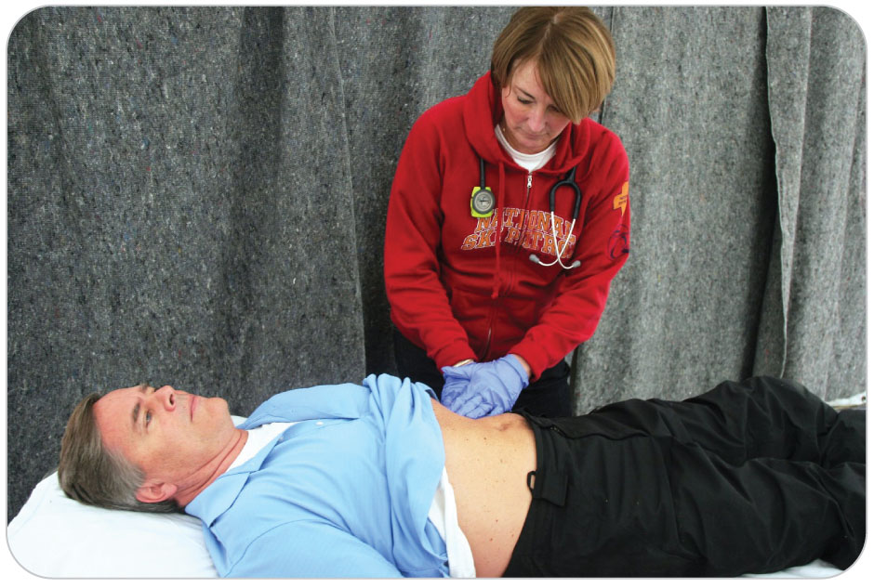
Secondary Patient Assessment: Examine the Abdomen
7-1
Examine the Abdomen
Consider modesty.
Expose and look at the abdomen.
Does it appear flat or distended?
Does it appear pale or otherwise discolored?
Ask patient where it hurts.
Palpate each of four quadrants.
Always palpating the painful quadrant last.
Palpate firmly but not too hard.
Note any tenderness, rigidity, or masses.

Slide 103
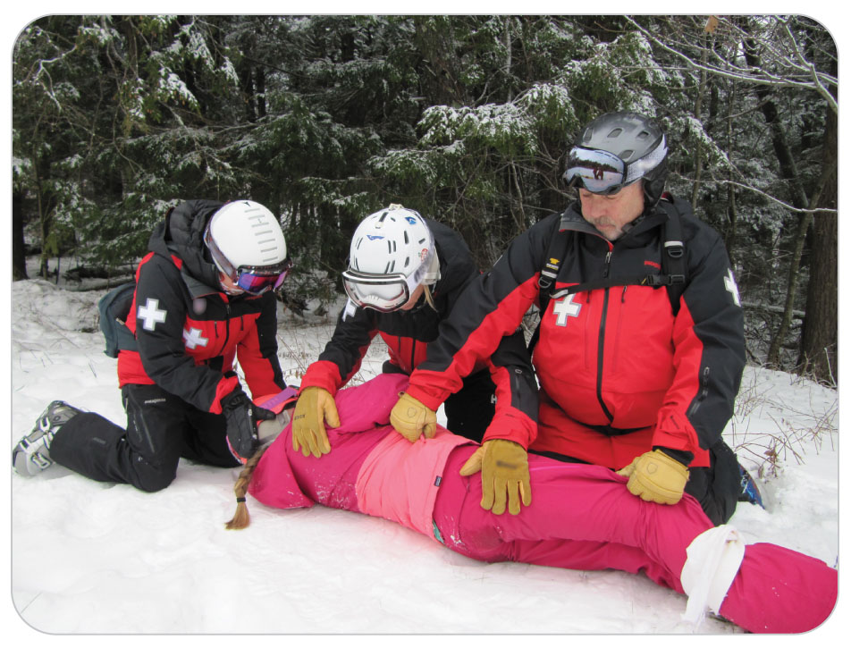
Secondary Patient Assessment: Examine the Back
7-1
Examine the Back
If examining in a lying position, logroll patient onto a side to access the back.
Keep the neck and spine in alignment if you suspect a spinal injury.
Look at patient’s back:
Note the general color of the skin
Any abnormalities?

Slide 104
Secondary Patient Assessment: Examine the Back
7-1
Palpate:
Using a flat, open hand, examine the entire back.
Palpate the entire midline length of the spine (over the spinous processes).
Using the tips of several fingers from the neck to the tailbone
Palpate each side of the back.

Slide 105
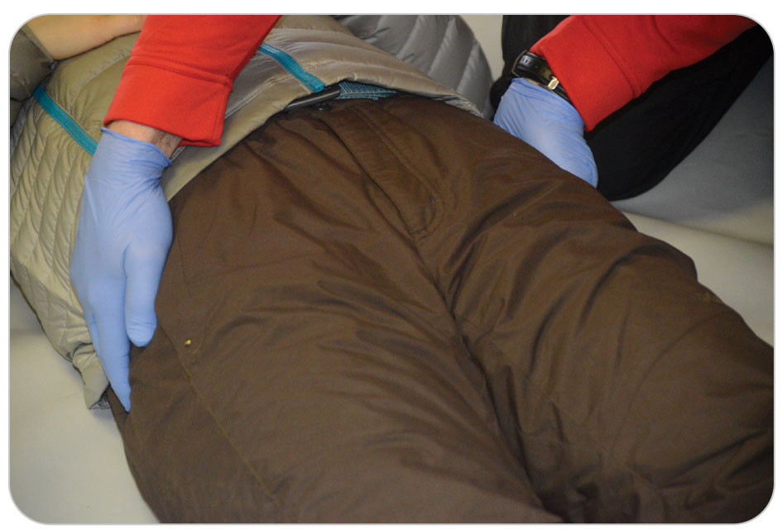
Secondary Patient Assessment: Examine the Pelvis
7-1
Examine the Pelvis
Palpate:
Place one hand on each of the iliac crests.
Each of the large pelvic bones just above the hips
Firmly but gently squeeze the bones inward (medially).
Perform test only once.
Excessive manipulation of an unstable pelvis injury could cause potentially life-threatening bleeding.
Note any instability or movement.

Slide 106
Secondary Patient Assessment: Examine the Pelvis
7-1
Inspect:
If external bleeding is apparent:
Inspect the source of bleeding
Pelvis, groin, and genital area should be visually examined ONLY if bleeding or other major injury to the area is suspected.
Preserve patient’s modesty by covering the person with a blanket or jacket.
Ideally examined by someone of the same sex

Slide 107
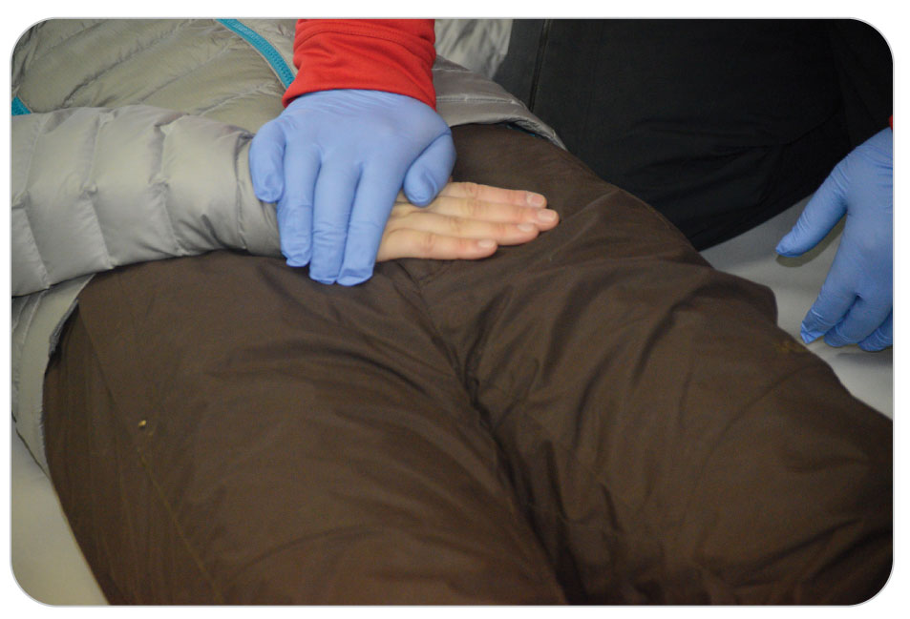
Secondary Patient Assessment: Examine the Pelvis
7-1
Suspect an injury to the anterior pelvis:
Place patient’s hand over the bones (symphysis pubis) above the genitalia.
Gently press on patient’s hand, looking for pain.
Protects patient’s modesty but allows examination of the pubic bones

Slide 108
Secondary Patient Assessment: Examine the Extremities
7-1
Examine the Extremities
Look at the arms and legs.
Do they appear normal?
Is one bent at an unnatural angle?
Is visible bleeding apparent?
Ask if patient has a wet and warm feeling under the clothes, indicating bleeding.
When assessing either the arms or the legs, do each side separately.
Ask patient to point to where it hurts.
Palpate the non-injured part of that extremity first.
Then examine the painful part.

Slide 109
Secondary Patient Assessment: Examine the Arm
7-1
To assess the entire arm:
Begin at the shoulder and move distally.
Palpate the shoulder blade and clavicle (collarbone).
Then wrap your hands around the upper arm, and with some pressure, palpate the entire arm down to the hand.

Slide 110
Secondary Patient Assessment: Examine the Arm
7-1
Note any palpable deformities or complaints of pain.
Feel the bones of the hand.
Do they feel intact?
Note the color of the skin.
Press on one of the nail beds.
Does the color immediately return?
Ask patient to make a fist.
Then to straighten out the fingers and spread them apart
Check sensation on the palm side of the thumb and fifth (pinkie) finger as well as the back of the thumb.

Slide 111
Secondary Patient Assessment: Examine the Arm
7-1
Repeat this entire exam for the other arm.
Feel for equal pulses by checking both radial pulses at the same time.
Do they feel the same?
Ask patient to grip and squeeze the middle and index fingers of both your hands simultaneously.
Is patient’s grip equal and strong on both sides?

Slide 112
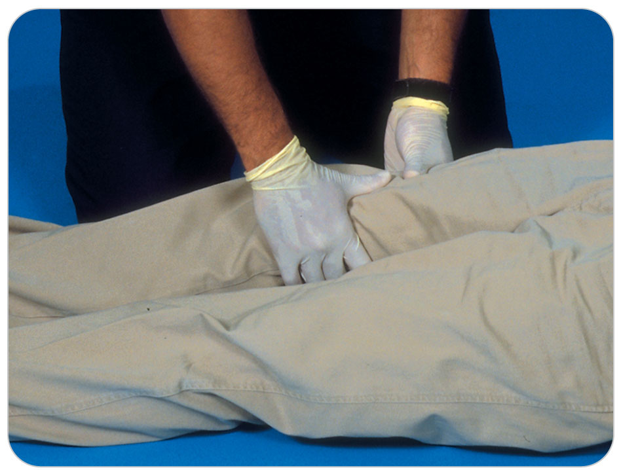
Secondary Patient Assessment: Examine the Legs
7-1
Examine the legs
Do they appear normal?
Does one or both look deformed?
Any evidence of bleeding or trauma?
Feel for deformities and other signs of injury.
Palpate the entire length of one leg with one hand on either side of the leg.
If conditions permit, inspect patient’s foot.
Note the color, overall skin temperature, and presence or absence of a pedal pulse.
Repeat the exam on the other leg.

Slide 113
Secondary Patient Assessment: Examine the Legs
7-1
Next, evaluate strength.
Place one hand against the bottom of each of patient’s feet.
Ask patient to push against your hands with each foot.
Strength should be equal on both sides of patient’s body.
Evaluate sensation.
Touch patient on both legs at the lateral and medial side of the ankle.
The sensation felt by patient should be equal.
Evaluate movement.
If outdoor weather conditions do not permit a visual exam of the foot, have patient wiggle his or her toes inside the boot.
Note whether patient can FEEL the toes wiggle.
Although not ideal, may have to take off boot once in a more controlled environment.

Slide 114
Secondary Patient Assessment: Vitals
7-8
Assess Vital Signs
An essential step of the overall assessment process
Vital signs are key objective findings used to evaluate a patient’s overall condition.
Also known as “vitals”
Used in conjunction with medical history and physical exam to evaluate how well patient is doing
By repeating the vital signs at intervals, you can see if patient is improving or getting worse.

Slide 115
Secondary Patient Assessment: Vitals
7-8
Check vitals:
Every 5 minutes for critical or unstable patients
Every 15 minutes for stable patients

Slide 116
Secondary Patient Assessment: Vitals
7-8
A complete set of vital signs is obtained both at the beginning and at the end of the secondary assessment.
Level of Responsiveness
Pulse rate
Respiratory rate
Blood pressure
Body temperature
When outdoors, you should obtain data on level of responsiveness, pulse rate, and respiratory rate.
Temperature and blood pressure may be difficult to obtain outdoors.

Slide 117
Secondary Patient Assessment: Vitals
7-8
The first set of vital signs, known as “baseline vitals”
Establishes a reference point
All other sets of vital signs will be compared against
Assess vital signs in the following order:
Level of responsiveness
Pulse rate
Respiratory rate
Blood pressure
Temperature
Additionally, oxygen saturation is now considered a vital sign by many.
Taken with a pulse oximeter

Slide 118
Secondary Patient Assessment: Pulse
7-9
7-10
Pulse
Assess the rate.
The number of times the heart beats in a minute
Assess the quality.
The strength of the heartbeat
Assess the rhythm of the pulse.
Regular or irregular

Slide 119
Secondary Patient Assessment: Pulse
7-9
7-10
The normal range of pulse rate for an adult is 60 to 100 beats per minute.
Abnormal: rate of less than 60 or greater than 100 beats per minute
May not mean there is a significant problem
Trained athletes frequently have a resting pulse rate less than 60 beats per minute.
High pulse rates can result from exercise, pain, or fear.

Slide 120
Secondary Patient Assessment: Pulse
7-9
7-10
Always use the tip of your index and middle fingers when assessing a pulse.
Not your thumb
When checking for a pulse, press gently.
If too hard, you will close off the flow of blood through the artery
Will not be able to feel the pulse
Assess pulse quality by determining whether it is:
Strong, bounding, very strong or forceful, or weak

Slide 121
Secondary Patient Assessment: Radial Pulse
7-9
7-10
Radial pulse
The radial artery is the most common site used.
Responsive patient
Feel for the radial pulse:
Place your index and middle fingers on the bony prominence of the thumb or radial side of the wrist.
Slide them toward the palm side of the wrist until they fall into a groove.

Slide 122
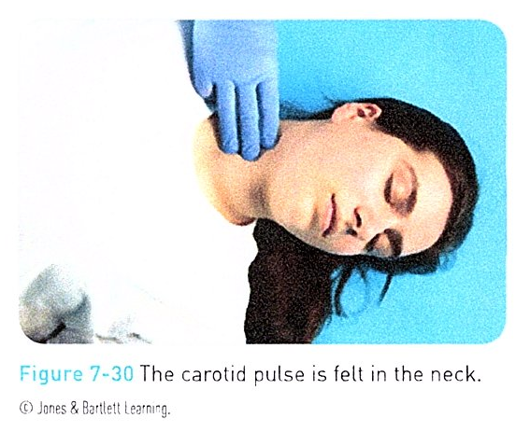
Secondary Patient Assessment: Carotid Pulse
7-9
7-10
Carotid pulse
Locate the carotid pulse:
Place index and middle fingers on the thyroid cartilage.
Also known as the Adam’s apple
Slide them laterally into the first groove.
The carotid pulse is usually the strongest arterial pulse.
Due to the proximity of this site to the heart
Frequently used for an unresponsive patient

Slide 123
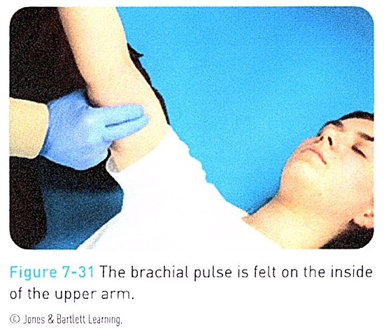
Secondary Patient Assessment: Brachial Pulse
7-9
7-10
Brachial pulse
Locate the brachial pulse:
Place your hand at the bony prominence at the ulnar side (medial side) of the elbow.
Slide your fingers into the groove at the base of the biceps muscle in the medial aspect of the elbow.
Used when assessing a child

Slide 124
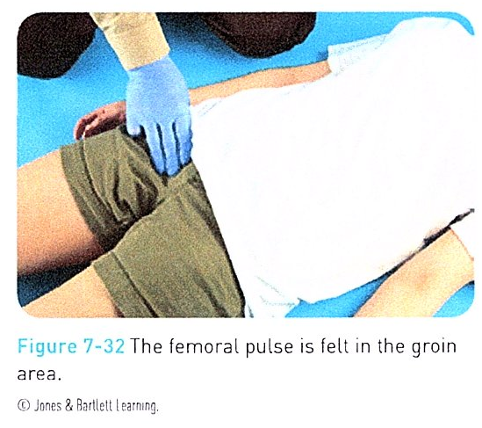
Secondary Patient Assessment: Femoral Pulse
7-9
7-10
Femoral pulse
Detect along the crease between the leg and the lower abdomen
Locate the femoral pulse:
Draw an imaginary line on patient from the middle of the groin to the hip bone, or iliac crest.
Slide your fingers along this line about one-third of the way from the groin endpoint.

Slide 125
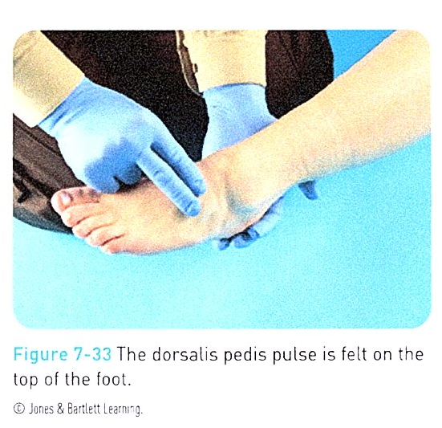
Secondary Patient Assessment: Dorsalis Pedis
7-9
7-10
Dorsalis pedis pulse
Located in the middle of the top of the foot between the ankle and the toes

Slide 126
Secondary Patient Assessment: Breathing
7-10
Breathing
Assessment of breath sounds consists of evaluating:
The rate
The quality of breaths
Rate:
An objective measure of the number of times patient takes a breath in a minute
One breath consists of one inhalation and one exhalation.
Normal respiratory rate of an adult is 12 to 20 breaths per minute.
Abnormal: less than 12 or greater than 20 breaths per minute

Slide 127
Secondary Patient Assessment: Breathing
7-10
To count the number of breaths in 1 minute:
Watch patient breathe for 30 seconds.
Count each time patient inhales.
Multiplying this number by 2 provides the respiratory rate.
Count by watching or palpating the rise and fall of patient’s chest.
Or by using your stethoscope
Assess the quality of breaths: normal, deep, or shallow.

Slide 128
Secondary Patient Assessment: Breathing
7-10
If patient is unresponsive or is wearing heavy clothing:
You may have to be more creative to count breaths.
Put a small mirror up to patient’s mouth to count the number of exhalations.
Fogs during each breath

Slide 129
Secondary Patient Assessment: Breathing
7-10
A conscious patient who knows that you are evaluating the respiratory rate will often override the automatic rate and depth by breathing more slowly and deeply.
Best to count breaths without the person’s knowledge
Place your fingers on patient’s wrist as if you were checking the pulse.
At the same time, tip your head slightly downward while moving your eyes upward to subtly watch the chest.
You may want to check the pulse first for 15 seconds and then count the number of breaths for 30 seconds with your fingers still on the wrist.
Remember not to ask patient questions while you are counting the number of breaths, as the count will not be accurate if patient is talking.

Slide 130
Secondary Patient Assessment: Breathing
7-10
Normal breathing is almost silent.
Snoring
Caused by an upper airway obstruction
A harsh, high-pitched crowing sound
Caused by a partial obstruction by a foreign body
Bubbling or gurgling
Indicates fluid in the upper airway
Wheezes or musical sounds
Indicate lower airway obstruction

Slide 131
Secondary Patient Assessment: Blood Pressure
7-10
Blood Pressure
Adequate blood pressure is needed to perfuse vital organs with blood.
A measure of the pressure of blood on the interior walls of the arteries
The unit used for blood pressure is millimeters of mercury, abbreviated mm Hg.
Old-fashioned mercury blood pressure machines are rarely seen today, as modern electronic devices or cuffs with a gauge are used.

Slide 132
Secondary Patient Assessment: Blood Pressure
7-10
A blood pressure reading consists of two values:
The systolic pressure, the pressure within the arteries just after the left ventricle maximally contracts
The diastolic pressure, the pressure within the arteries while the heart is at rest
A blood pressure that is too high or too low may indicate serious illness.
A normal blood pressure for a healthy adult is 120/80.
Read as “one hundred twenty over eighty”
The systolic pressure is 120 mm Hg.
The diastolic pressure is 80 mm Hg.

Slide 133
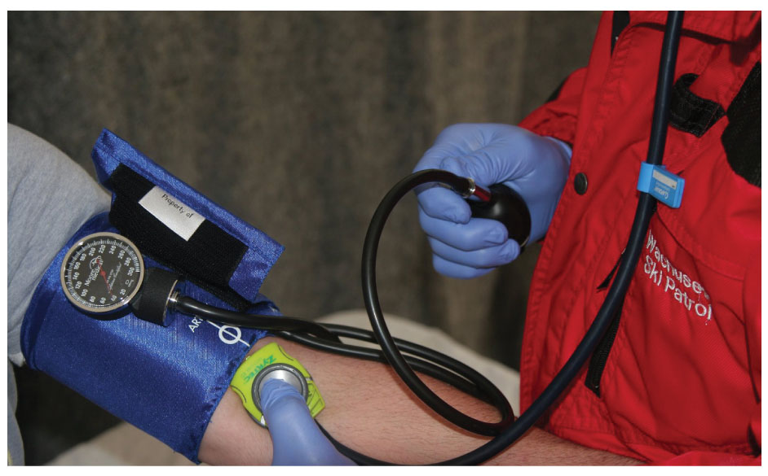
Secondary Patient Assessment: Blood Pressure
7-10
The most common place to check a blood pressure is over the brachial artery in the arm.
To listen (auscultate) need a blood pressure cuff and a stethoscope
A blood pressure cuff consists of four parts:
A flexible rubber bulb with an attached thumbscrew valve
A rubber bladder (cuff) with hoses
A sphygmomanometer (blood pressure gauge)
A nylon or cloth bladder covering

Slide 134
Secondary Patient Assessment: Blood Pressure
7-10
Do not immediately re-inflate the cuff if you:
Inadvertently deflate the blood pressure cuff too quickly
Fail to detect the systolic or diastolic pressure
Simply forget one of the two numbers
Instead, deflate the cuff completely.
Wait a few seconds before re-inflating it.
These steps will help ensure accurate readings when you repeat the procedure.

Slide 135
Secondary Patient Assessment: Blood Pressure
7-10
Rarely, you may continue to hear the pulse sound down to a reading of 0 mm Hg.
Wait a few seconds, re-inflate the cuff, and slowly release the pressure again.
This time deflate until you detect a subtle change in the sound of the pulse sound.
The number at which this change occurs is the diastolic blood pressure.

Slide 136
Secondary Patient Assessment: Blood Pressure
7-10
Once finished measuring the blood pressure:
May remove the cuff OR
May leave it on the arm deflated if you anticipate taking additional readings in a potentially unstable patient
Do not leave an inflated blood pressure cuff on the arm for more than a few minutes.
Can cut off blood flow to the distal arm and hand, which is painful

Slide 137
Secondary Patient Assessment: Blood Pressure
7-10
Palpated blood pressure:
Can obtain an approximate systolic pressure with just blood pressure cuff and fingers if:
Do not have a stethoscope
Too noisy to hear the pulse sound using the stethoscope
Not as accurate but provides a useful estimate
Verbally stated as, “patient’s blood pressure is ninety over palpation,” documented as “90/P.”

Slide 138
Secondary Patient Assessment: Blood Pressure
7-10
To obtain a palpated blood pressure, follow these steps:
Apply the blood pressure cuff above the elbow.
Find patient’s radial pulse.
Inflate the blood pressure cuff until you can no longer feel the radial pulse.
Open the thumbscrew and slowly release air from the cuff.
The pressure at which you can again feel the radial pulse is the systolic blood pressure.

Slide 139
Secondary Patient Assessment: Blood Pressure
7-10
No blood pressure cuff?
Can estimate the minimum systolic pressure by feeling the presence of an arterial pulse at various locations
Radial pulse = 80 mm Hg
Femoral pulse = 70 mm Hg
Carotid pulse = 60 mm Hg
These estimates are roughly accurate.
Should not necessarily be reassured by a strong radial pulse
With trauma or suspected acute internal blood loss, a systolic blood pressure less than 90 mm Hg can be life threatening.

Slide 140
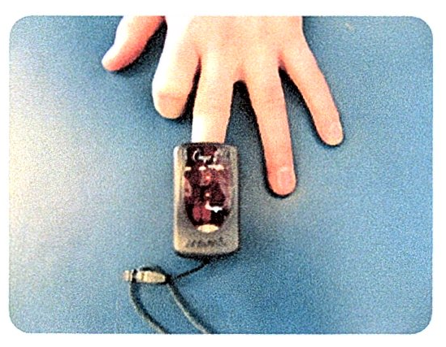
Secondary Patient Assessment: Pulse Oximetry
7-10
Oxygen Saturation Level
Oxygen saturation levels are measured using a device known as a pulse oximeter.
Measures the percentage of oxygen in the blood
Uses a probe that is attached to a:
Finger
Earlobe
Simple to use
Some less expensive pulse oximeters are not accurate.
Trust your eyes and not the device.

Slide 141
Secondary Patient Assessment: Pulse Oximetry
7-10
Abnormal:
Reading of less than 94%
May indicate serious illness or injury
Chronic smokers:
May live with a low percentage of oxygen in the blood
An oxygen saturation level much lower than 94%
Higher altitudes will lower the normal oxygen saturation reading.

Slide 142
Secondary Patient Assessment: Neurologic Assessment
7-10
Neurologic assessment
Level of responsiveness is a continuum that ranges from patient being fully alert to various levels of unresponsiveness.
Normal:
Patient awake and fully oriented
Abnormal:
Look for abnormal posturing.
Decorticate or decerebrate posturing

Slide 143
Reassessment

Slide 144
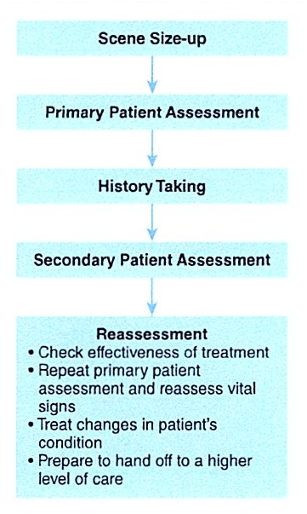
Reassessment
7-1
A patient’s condition can change over time.
During the reassessment, check the effectiveness of your treatment.
If you need to continue to care for patient, you must regularly repeat some parts of patient assessment.

Slide 145
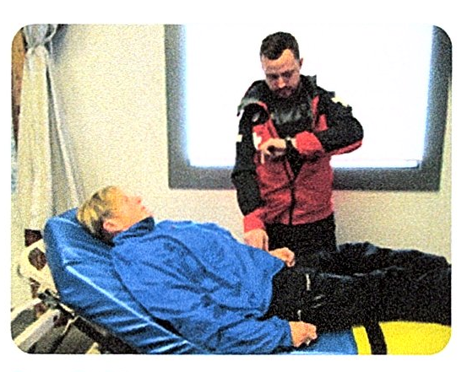
Reassessment
7-1
Check vital signs:
Every 5 minutes for critical or unstable patients
Every 15 minutes for stable patients
Continually monitor the ABCDs and repeat the vital signs regularly.
If patient is getting worse, consider what you can do to improve the situation.

Slide 146
Case Study

Slide 147
CASE PRESENTATION
You respond to a call to assist a patient who has fallen in the lodge. When you arrive on scene, you find a male in his mid-50s sitting on the floor beside a table. His wife reports that her husband was eating a burger, complained of chest pain, then fell to the floor, injuring his wrist. He did not lose responsiveness. After making sure the area is clear of hazards and quickly managing the crowd that has gathered, you begin assessing the man. He appears to be having difficulty breathing and is complaining of chest pain, saying, “I feel like an elephant is sitting on my chest.” The wife insists you look at his wrist.
What should you do?

Slide 148
CASE UPDATE
After ensuring that the scene is safe, you introduce yourself and ask permission to assess, examine, and treat patient. Patient says, “Yes,” so you perform a primary patient assessment while using spinal motion restriction because of the mechanism of injury of falling. Patient is awake and speaks to you in two- or three-word sentences. You determine that his airway is open, but you are concerned that he appears to be having trouble breathing. You check his radial pulse, which is rapid (100 beats per minute) and weak. Patient is alert and oriented to person, place, time, and event. He opens his eyes spontaneously, speaks coherently, and can follow your commands.

Slide 149
CASE UPDATE
In assessing his AVPU score, you assign him an A for alert. The patient complains of a persistent pain on the left side of his chest. The history you take reveals that the patient was eating lunch when he had chest pain and fell off his chair onto the floor. He remembers falling on his wrist and does not believe that he lost consciousness. He describes the pain in his chest as “heavy.” The pain radiates into the left arm. He also reports being short of breath. He says his wrist hurts some. He reports no allergies to any medications. He states that he takes aspirin on a daily basis because he had a heart attack 10 years ago but has been doing quite well since then. You obtain additional information using the OPQRST mnemonic.
What should you do now?

Slide 150
CASE OUTCOME
Suspecting the man has a serious medical condition, possibly having suffered a heart attack, you call for additional OEC technicians and advanced life support. You then perform a physical exam on patient. During the exam, you notice some discoloration of patient’s wrist. He has equal sensation and movement in all his extremities. Pulses in both the upper and lower extremities are equal and strong. Pulse rate and breathing are abnormally high. Other OEC technicians arrive to assist you. Working together, you package patient and send him by ambulance to a nearby hospital. You later learn that patient had a mild heart attack, which the doctors think may have caused him to become dizzy and fall. He also had a broken wrist.

Slide 151
OEC Skill Activities

Slide 152
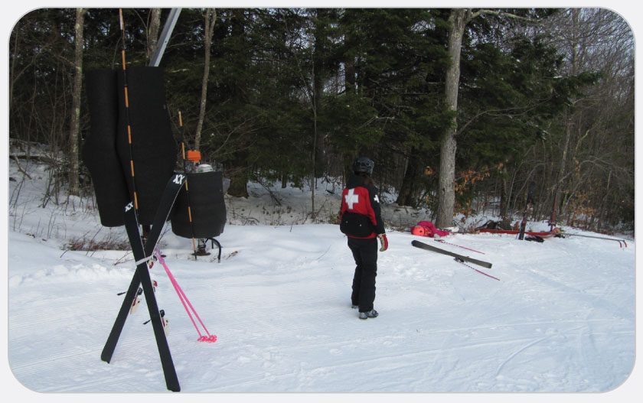
OEC Skill 7-1: Performing a Patient Assessment
1. Perform a scene size-up. The scene size-up is performed by ensuring scene safety, determining the mechanism of injury or nature of illness, taking standard precautions, determining the number of patients, and considering whether additional resources are needed. At this point, the patroller must also make an initial assessment of the need for spinal motion restriction.

Slide 153
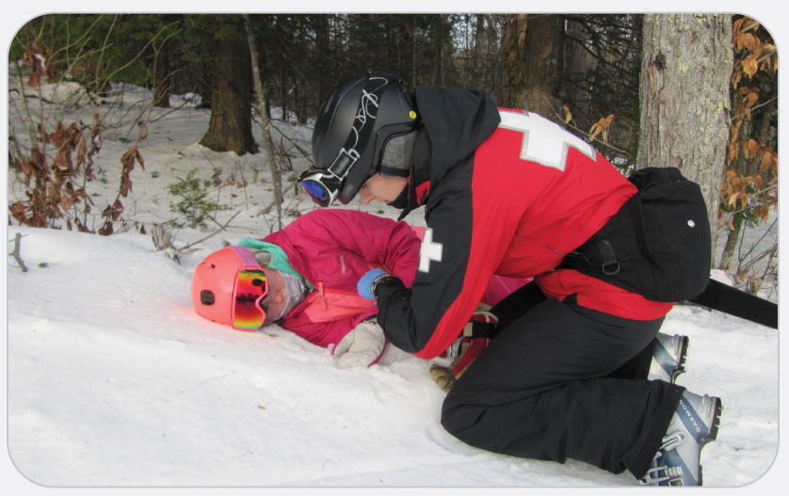
OEC Skill 7-1: Performing a Patient Assessment
2. Perform a primary patient assessment. The primary patient assessment includes forming a general impression of patient; controlling life-threatening bleeding; assessing level of responsiveness; rapidly assessing airway, breathing, circulation, and disability; obtaining the chief complaint; and updating dispatch of needs.

Slide 154
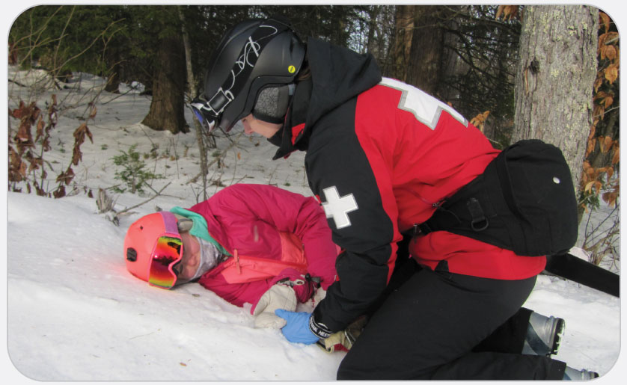
OEC Skill 7-1: Performing a Patient Assessment
3. Obtain a complete history from patient. History taking includes using SAMPLE to investigate the chief complaint and OPQRST to assess pain and other complaints.

Slide 155
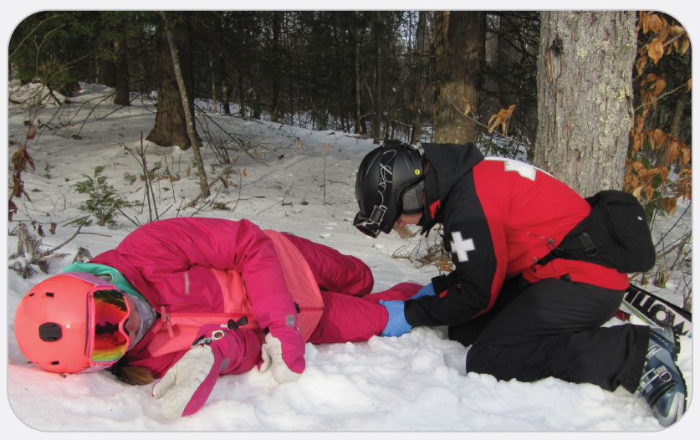
OEC Skill 7-1: Performing a Patient Assessment
4. Perform a secondary patient assessment. The secondary patient assessment includes performing a physical exam of patient and assessing vital signs.

Slide 156
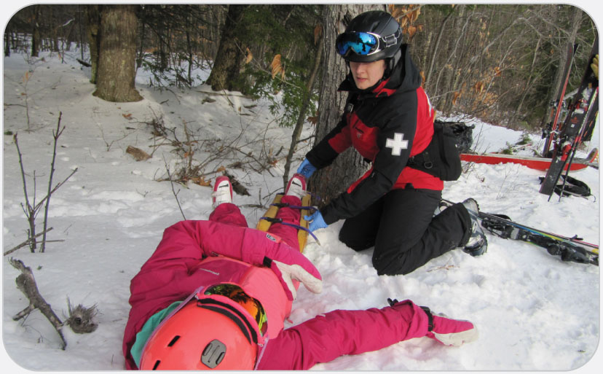
OEC Skill 7-1: Performing a Patient Assessment
5. Perform a reassessment. The reassessment includes checking the effectiveness of treatment provided, repeating the primary patient assessment and reassessing vital signs, treating changes in patient’s condition, and preparing to hand off patient to a higher level of care.

Slide 157
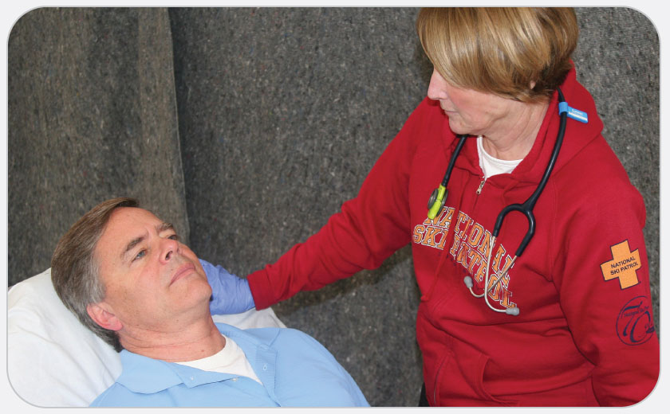
OEC Skill 7-2: Assessing Pupils
1. Tell patient to stare at your nose or the center of your forehead. Look at the pupils. Are they the same size? If not, the pupils are said to be asymmetrical. Asymmetry may be caused by an underlying medical or traumatic condition, or rarely it may be normal.

Slide 158
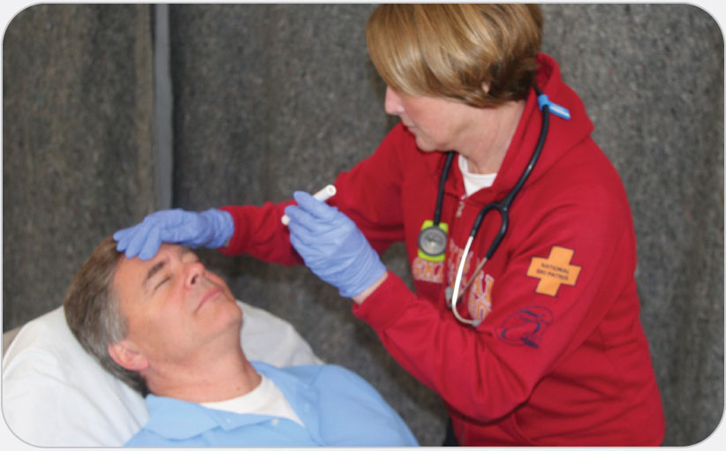
OEC Skill 7-2: Assessing Pupils
2. Moving from the lateral side of patient’s face, briefly shine the light into patient’s left pupil. Note the reaction of both pupils to the light. Both should get smaller, or constrict, when the light is shined into the left pupil. In some cases, you may need to perform this step more than once. Move the light away from the left eye. Repeat this step by shining the light into patient’s right pupil. You should get the same response with the right eye; that is, both pupils should constrict.

Slide 159
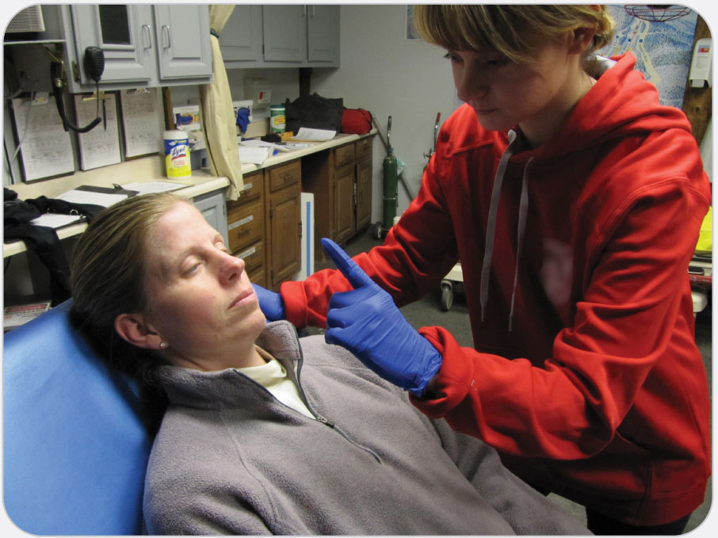
OEC Skill 7-3: Assessing Eye Movement
1. Ask patient to stare at your nose.

Slide 160
OEC Skill 7-3: Assessing Eye Movement
2. Hold up your index finger approximately 6 to 8 inches away from patient’s face. Instruct patient to follow the tip of your finger with his or her eyes without moving his or her head.

Slide 161
OEC Skill 7-3: Assessing Eye Movement
3. Slowly move your index finger from the center to the right, then back to center, then over to the left, and then back to center. Next, slowly move your finger from the center upward, then downward past center, and then back up to the center. Finally, slowly move your finger toward you a few inches and then toward patient’s nose. Throughout this step, patient’s eyes should follow your finger and move in sync with one another.

Slide 162
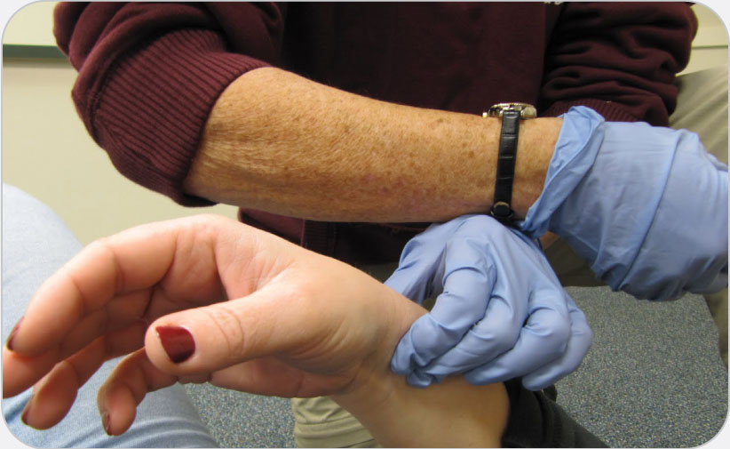
OEC Skill 7-4: Assessing Pulse
1. Locate the radial pulse on a responsive adult and assess the pulse rate and quality.

Slide 163
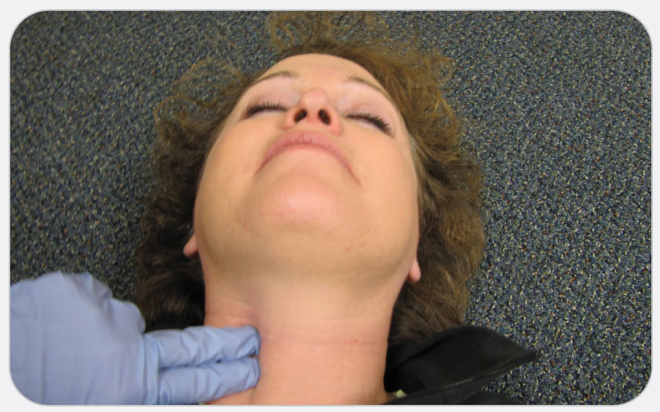
OEC Skill 7-4: Assessing Pulse
2. Locate the carotid pulse on an unresponsive adult and assess the pulse rate and quality.

Slide 164
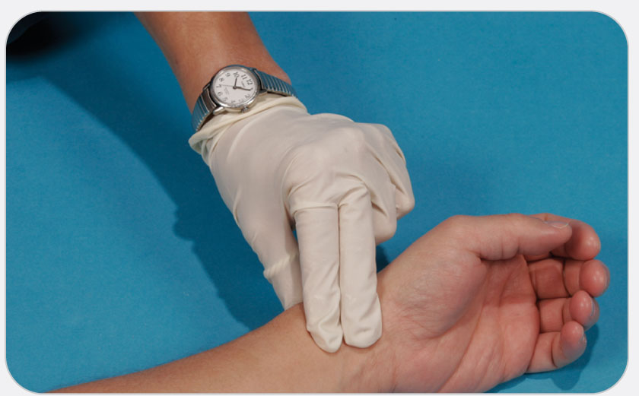
OEC Skill 7-4: Assessing Pulse
3. Locate the brachial pulse on an infant and assess the pulse rate and quality.

Slide 165
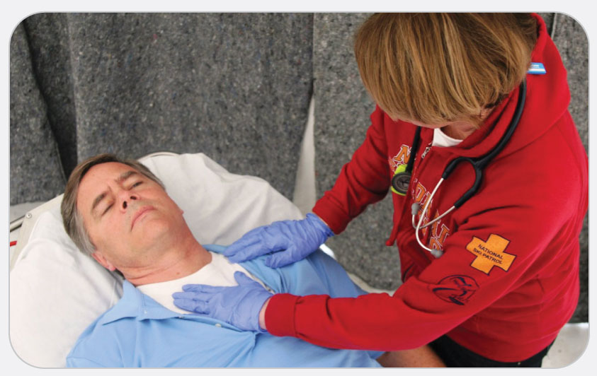
OEC Skill 7-5: Assessing Respiratory Rate
1. Look and feel for patient’s chest to rise and fall.

Slide 166
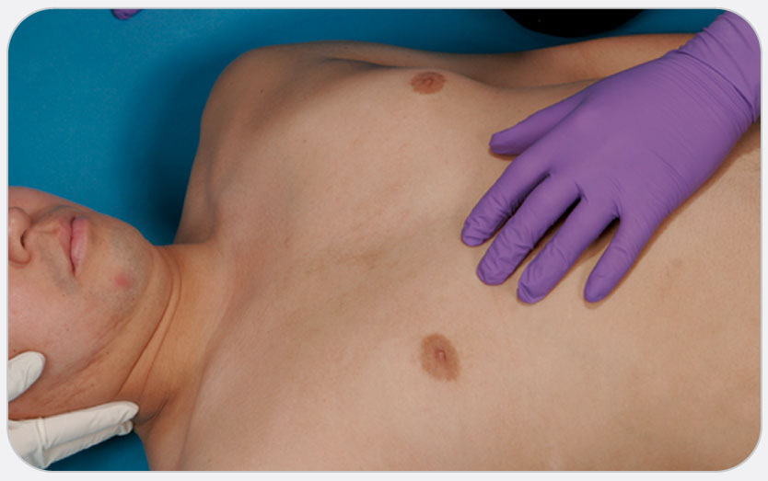
OEC Skill 7-5: Assessing Respiratory Rate
2. Assess patient’s breathing for rhythm, depth, effort, and noise to determine if patient is breathing within normal limits.

Slide 167
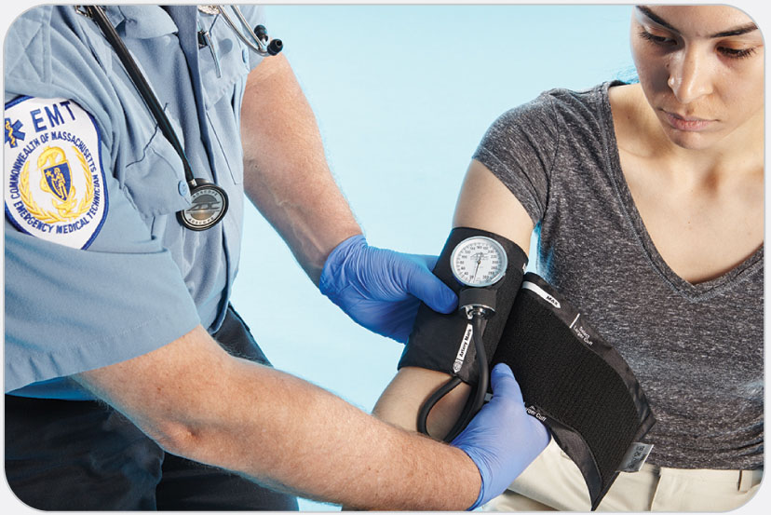
OEC Skill 7-6: Obtaining a Blood Pressure Reading
1. Ensure that you have the correct size cuff. (Size options include regular, large adult, and pediatric.) Unscrew the thumbscrew valve on the flexible bulb and deflate the bladder of the cuff. Place the cuff on patient’s upper arm with the cuff 1 to 2 inches above the crease of the elbow. The arrow on the cuff should point to the brachial artery, which is located on the medial side of the arm at the crease of the elbow. The cuff should be placed directly on patient’s skin because you will get a false reading if the cuff is placed over bulky clothing. The cuff should be snug, but not too tight.

Slide 168
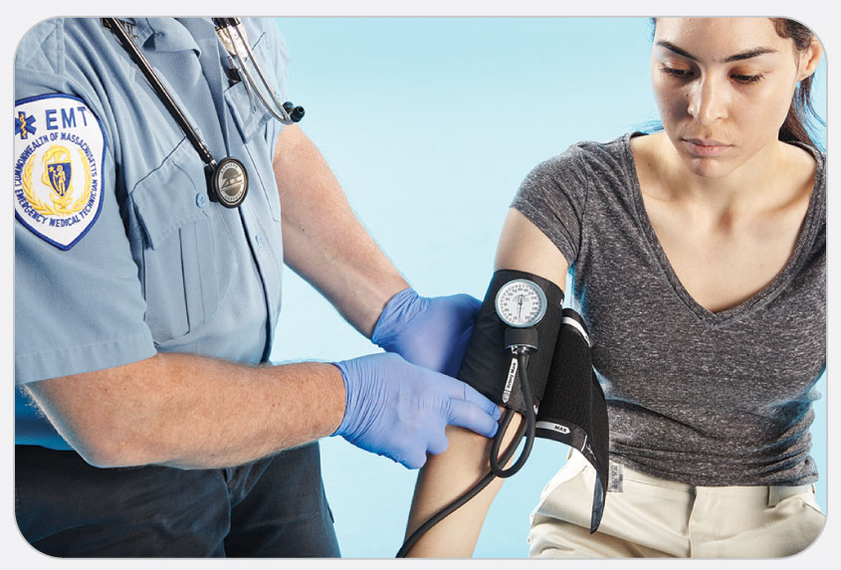
OEC Skill 7-6: Obtaining a Blood Pressure Reading
2. Place the sphygmomanometer in a location that is easy for you to read without having to hold it. (Some cuffs have a clip on the sphygmomanometer that enables you to attach it to patient’s clothing or to a loop on the cuff while you are taking the pressure reading.) Place the ear tips of the stethoscope in your ears. The tips should point forward. Palpate the pulse of the brachial artery below the cuff at the crease of the elbow and then place the diaphragm of the stethoscope over the pulse point. (You will not hear a pulse at this time.) Hold the stethoscope in place lightly on the skin as you measure the pressure.

Slide 169
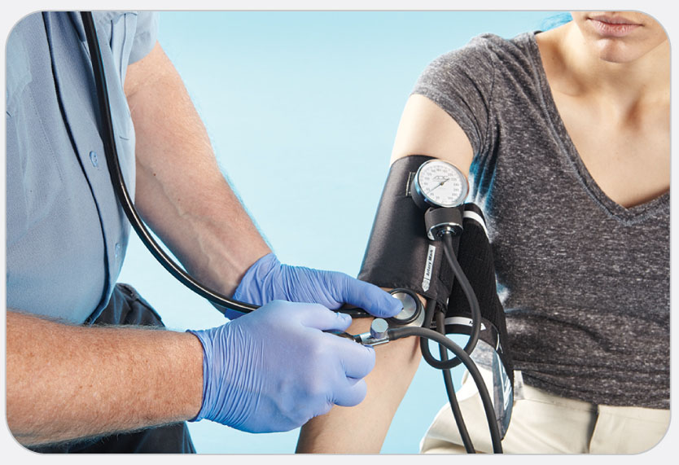
OEC Skill 7-6: Obtaining a Blood Pressure Reading
3. Using your other hand, tighten the thumbscrew valve on the sphygmomanometer and inflate the cuff by repeatedly pumping the flexible bulb. Inflate the cuff to a pressure of 160 mm Hg. If you can hear the pulse sound at this pressure, inflate the cuff to 200 mm Hg. If you still can hear the heartbeat, inflate the cuff in increments of 20 mm Hg until you can no longer hear the pulse sound.

Slide 170
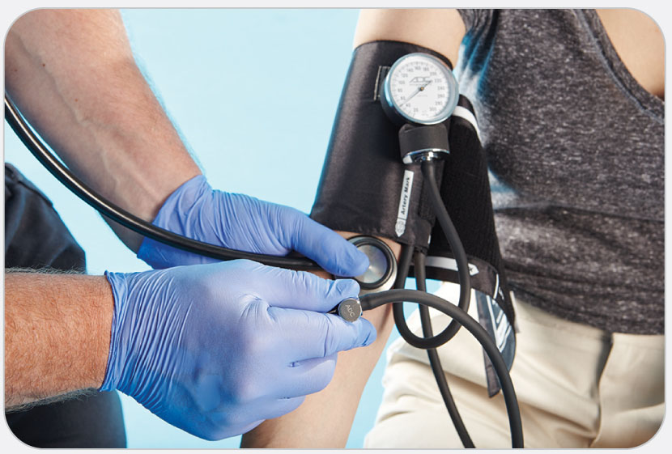
OEC Skill 7-6: Obtaining a Blood Pressure Reading
4. Gently open the thumbscrew valve and slowly release the air from the cuff. As you slowly release the air, listen for the first pulse sound (first “thump”). The reading on the dial at the time of this sound is the systolic blood pressure. Continue to slowly release the air from the cuff. The sound will become very soft and will eventually disappear. The reading on the dial when the sound disappears is the diastolic blood pressure.

